Slide 1
LOWER SIXTH ARTS
GEOGRAPHY
Lesson 5
Landforms at Destructive and Conservative Margins
Notes:
Good morning, class, and welcome to our geography lesson. I am your geography teacher, Mr Kamdem. Today we are starting Lesson 5: Landforms at Destructive and Conservative Margins.

Slide 2
CLASS INFO
Class, Chapter and Duration
Class | Lower Sixth Arts
Chapter | Module 2: Understanding and managing physical landscapes, geomorphological processes and hazards across the world in general and Cameroon in particular
Duration | 2 periods (2 × 50 minutes)
Notes:
This lesson is for Lower Sixth Arts. It belongs to Module 2: Understanding and managing physical landscapes, geomorphological processes and hazards across the world in general and Cameroon in particular. We shall need 2 periods to cover it.

Slide 3
IDENTIFICATION
Lesson Identification
Topic | The Development of the Earth's Structure
Sub-topic | Theories of Earth Structure and Resultant Landforms
Lesson | Lesson 5: Landforms at Destructive and Conservative Margins
Notions / Concepts | Convergence, subduction, Benioff zone, fold mountain, anticline, syncline, ocean trench, island arc, transform fault.
Syllabus focus | Destructive margins: fold mountains, ocean trenches, island arcs, volcanoes and earthquakes; conservative margins: transform faults and earthquakes.
Competence | Learners are able to explain the landforms and hazards of destructive and conservative margins with world examples.
Notes:
Our topic is The Development of the Earth's Structure, and the sub-topic is Theories of Earth Structure and Resultant Landforms. The key notions we shall use today are: convergence, subduction, Benioff zone, fold mountain, anticline, syncline, ocean trench, island arc, transform fault. At the end, you should be able to do this: learners are able to explain the landforms and hazards of destructive and conservative margins with world examples.

Slide 4

HOMEWORK CORRECTION
Correction of the Homework
Question (Lesson 4: Landforms at Constructive or Divergent Margins):
Name one range of fold mountains.
Notes:
Before we start the new lesson, let us correct the homework I gave you at the end of Lesson 4: Landforms at Constructive or Divergent Margins. The question was: Name one range of fold mountains. Take out your exercise books.

Slide 5
HOMEWORK CORRECTION
Correction: Possible Answer
The Himalayas, the Andes, the Alps, the Atlas or the Rockies (any one).
Notes:
Here is a good answer. The Himalayas, the Andes, the Alps, the Atlas or the Rockies (any one). Compare it with your own answer and correct your work in red.

Slide 6
LESSON PLAN
Lesson Plan
Correction of the homework
Objectives and recall
Real-life situation and action to take
Learning activities
Board summary
Evaluation, remediation and homework
Notes:
Here is the plan of our lesson today. First, we shall correct the homework. Then we shall look at the objectives and recall what you already know. After that, we shall study a situation from real life and the action to take, and do the learning activities. Finally, we shall copy the board summary, do the evaluation and the remediation, and I will give you the homework.

Slide 7
OBJECTIVES
Objectives
By the end of this lesson, you should be able to:
Explain the formation of fold mountains.
Explain the formation of ocean trenches and island arcs.
Notes:
Take your time to copy this part; we will continue together.

Slide 8
OBJECTIVES
Objectives (continued)
Explain why destructive margins have volcanoes and earthquakes.
Describe conservative margins and their earthquakes.
Notes:
By the end of this lesson, you should be able to do four things. Number 1: explain the formation of fold mountains. Number 2: explain the formation of ocean trenches and island arcs. Number 3: explain why destructive margins have volcanoes and earthquakes. Number 4: describe conservative margins and their earthquakes.

Slide 9
PREVIOUS KNOWLEDGE
Previous Knowledge
At a destructive margin, plates move towards each other.
The denser plate sinks by subduction.
At a conservative margin, plates slide past each other.
Notes:
Let us first remember what you already know. At a destructive margin, plates move towards each other. The denser plate sinks by subduction. At a conservative margin, plates slide past each other. Keep this in mind, because we shall build on it today.

Slide 10
REAL-LIFE SITUATION
Situation in Real Life
On CRTV, a reporter explains that a small tremor was felt in Buea but that Mount Cameroon is monitored.
Later, a documentary shows the huge Himalayas and the great earthquakes of Japan and California.
In Garoua the ground is always still.
Notes:
Take your time to copy this part; we will continue together.

Slide 11
REAL-LIFE SITUATION
Situation in Real Life (continued)
You ask: "What happens when plates crash into each other or slide past each other, and what landforms and dangers do they create?"
Notes:
Listen carefully to this situation from real life. On CRTV, a reporter explains that a small tremor was felt in Buea but that Mount Cameroon is monitored. Later, a documentary shows the huge Himalayas and the great earthquakes of Japan and California. In Garoua the ground is always still. You ask: "What happens when plates crash into each other or slide past each other, and what landforms and dangers do they create?" Think about it, because I am going to ask you some questions.

Slide 12
REAL-LIFE SITUATION
Situation: Question 1
What is the problem in the situation?
Notes:
Question 1: What is the problem in the situation? Think for a moment, then raise your hand to answer.

Slide 13
REAL-LIFE SITUATION
Answer
The learner does not know the landforms and hazards of destructive and conservative margins.
Notes:
Good. The learner does not know the landforms and hazards of destructive and conservative margins.

Slide 14
REAL-LIFE SITUATION
Situation: Question 2
What forms when two continental plates collide?
Notes:
Question 2: What forms when two continental plates collide? Think for a moment, then raise your hand to answer.

Slide 15
REAL-LIFE SITUATION
Answer
Fold mountains such as the Himalayas.
Notes:
Good. Fold mountains such as the Himalayas.

Slide 16
REAL-LIFE SITUATION
Situation: Question 3
Why is there no volcano on the San Andreas Fault?
Notes:
Question 3: Why is there no volcano on the San Andreas Fault? Think for a moment, then raise your hand to answer.

Slide 17
REAL-LIFE SITUATION
Possible Answer
Plates slide past each other, so no crust sinks and melts.
Notes:
Good. Plates slide past each other, so no crust sinks and melts.

Slide 18
ACTION TO TAKE
Action to Take
Locate the hazard zones of the world on a map of plate margins.
Notes:
From this situation, the action we are working towards in this lesson is the following: locate the hazard zones of the world on a map of plate margins.

Slide 19
JUSTIFICATION
Justification of the Lesson
This lesson explains the highest mountains, the deepest trenches and the most dangerous hazards on Earth.
Notes:
Why is this lesson important for you? This lesson explains the highest mountains, the deepest trenches and the most dangerous hazards on Earth.

Slide 20
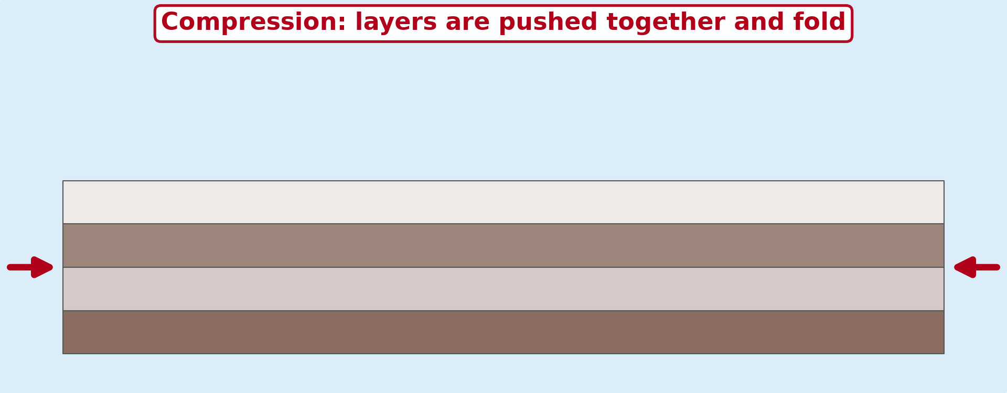
1. FOLD MOUNTAINS
Activity 1
Animation: rock layers fold.
Notes:
Activity 1. Look carefully at this animation: animation: rock layers fold. Watch the animation to the end; it will play again.

Slide 21
1. FOLD MOUNTAINS
Activity 1: Question
What is an upward fold called?
Notes:
Here is the question for Activity 1: What is an upward fold called? Take one minute to think and write your answer in your rough notebook.

Slide 22
1. FOLD MOUNTAINS
Activity 1: Answer
An anticline.
Notes:
Let us check the answer together. An anticline.

Slide 23
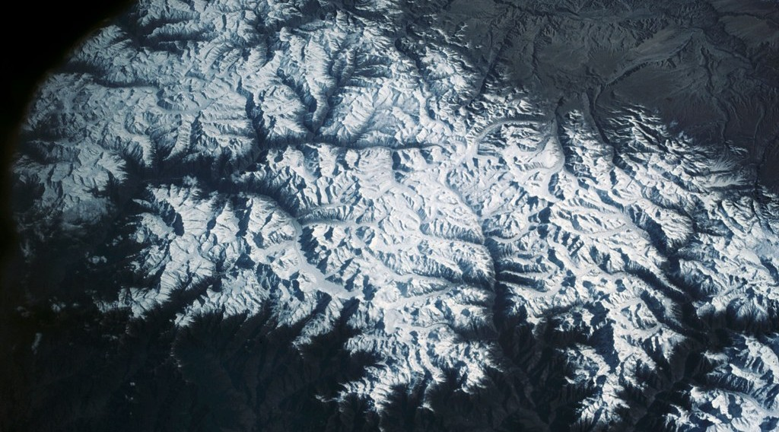
1. FOLD MOUNTAINS
Activity 2
The Himalayas.
Notes:
Activity 2. Look carefully at this picture: the Himalayas. Observe every detail before I ask the question.

Slide 24
1. FOLD MOUNTAINS
Activity 2: Question
Which plates collide to form the Himalayas?
Notes:
Here is the question for Activity 2: Which plates collide to form the Himalayas? Take one minute to think and write your answer in your rough notebook.

Slide 25
1. FOLD MOUNTAINS
Activity 2: Answer
The Indian (Indo-Australian) and Eurasian plates.
Notes:
Let us check the answer together. The Indian (Indo-Australian) and Eurasian plates.

Slide 26
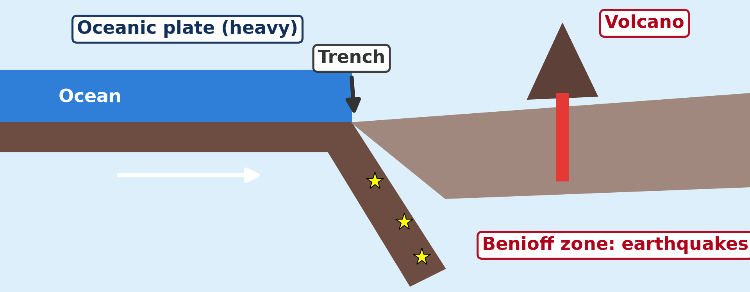
1. TRENCHES AND ARCS
Activity 3
Subduction.
Notes:
Activity 3. Look carefully at this diagram: subduction. Observe every detail before I ask the question.

Slide 27
1. TRENCHES AND ARCS
Activity 3: Question
What is the deepest trench in the world?
Notes:
Here is the question for Activity 3: What is the deepest trench in the world? Take one minute to think and write your answer in your rough notebook.

Slide 28
1. TRENCHES AND ARCS
Activity 3: Answer
The Mariana Trench (about 11,000 m).
Notes:
Let us check the answer together. The Mariana Trench (about 11,000 m).

Slide 29
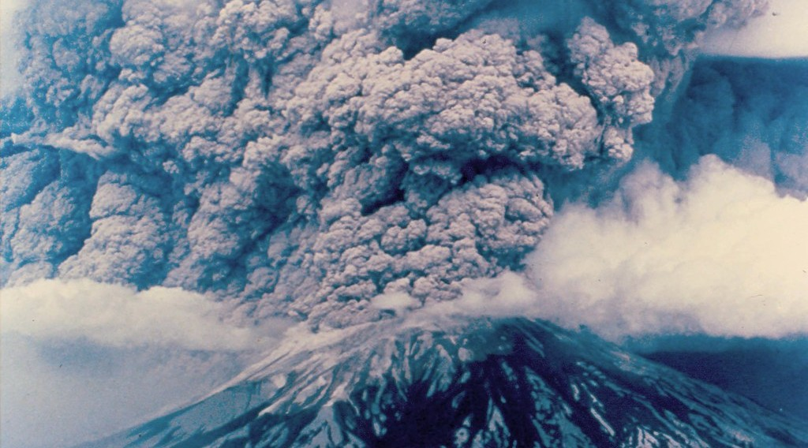
1. VOLCANOES
Activity 4
An explosive volcano.
Notes:
Activity 4. Look carefully at this picture: an explosive volcano. Observe every detail before I ask the question.

Slide 30
1. VOLCANOES
Activity 4: Question
Why are volcanoes at destructive margins explosive?
Notes:
Here is the question for Activity 4: Why are volcanoes at destructive margins explosive? Take one minute to think and write your answer in your rough notebook.

Slide 31
1. VOLCANOES
Activity 4: Answer
The sinking plate melts into thick, gas-rich magma.
Notes:
Let us check the answer together. The sinking plate melts into thick, gas-rich magma.

Slide 32

2. CONSERVATIVE MARGINS
Activity 5
The San Andreas Fault.
Notes:
Activity 5. Look carefully at this picture: the San Andreas Fault. Observe every detail before I ask the question.

Slide 33
2. CONSERVATIVE MARGINS
Activity 5: Question
What causes the strong earthquakes along this fault?
Notes:
Here is the question for Activity 5: What causes the strong earthquakes along this fault? Take one minute to think and write your answer in your rough notebook.

Slide 34
2. CONSERVATIVE MARGINS
Activity 5: Answer
Plates get stuck, stress builds up and is suddenly released.
Notes:
Let us check the answer together. Plates get stuck, stress builds up and is suddenly released.

Slide 35
BOARD SUMMARY
Board Summary
Topic: The Development of the Earth's Structure
Sub-topic: Theories of Earth Structure and Resultant Landforms
Lesson 5: Landforms at Destructive and Conservative Margins
Notes:
Now we are going to copy the board summary. Write the title and the headings neatly in your notebooks. I will give you enough time for each slide, so do not rush.

Slide 36
BOARD SUMMARY
DEFINITIONS
The key terms of this lesson are defined as follows:
Destructive (convergent) margin: It is a boundary where two plates move towards each other and crust is destroyed.
Notes:
Let us copy the definitions. The key terms of this lesson are defined as follows. On this slide we have Destructive (convergent) margin. Write each point on a new line, with the key term first, and explain it in your own words when we revise. When you finish, we go to the next slide.

Slide 37
BOARD SUMMARY
DEFINITIONS (continued)
Conservative margin: It is a boundary where two plates slide past each other without creating or destroying crust.
Benioff zone: It is the sloping zone of earthquakes along a sinking plate.
Notes:
We continue with the definitions. On this slide we have Conservative margin and Benioff zone. Write each point on a new line, with the key term first, and explain it in your own words when we revise. When you finish, we go to the next slide.

Slide 38
BOARD SUMMARY
DEFINITIONS (continued)
Anticline and syncline: An anticline is an upward fold of rock layers and a syncline is a downward fold.
Tear (transform) fault: It is a fault along which two blocks slide past each other horizontally.
Notes:
We continue with the definitions. On this slide we have Anticline and syncline and Tear (transform) fault. Write each point on a new line, with the key term first, and explain it in your own words when we revise.

Slide 39
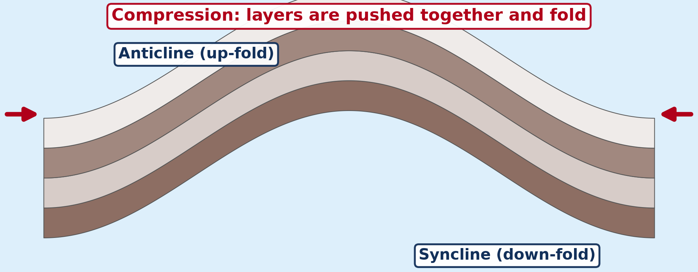
BOARD SUMMARY
1. Destructive (Convergent) Margins
A) Folding and Fold Mountains
Fold mountains are formed as follows:
Compression and folding: When two plates collide, the layers of sedimentary rock between them are squeezed and bend into folds. Upward folds are called anticlines and downward folds synclines.
Illustration: folding
Notes:
Let us copy Folding and Fold Mountains. Fold mountains are formed as follows. Copy the point on Compression and folding on the left, then draw the diagram on the right: folding. Give it a title and label it clearly.

Slide 40
BOARD SUMMARY
1. Destructive (Convergent) Margins
A) Folding and Fold Mountains
Types of folds: Gentle pressure forms simple, symmetrical folds, while stronger pressure forms asymmetrical and overturned folds. Very strong pressure lays the folds flat (recumbent folds) and can push them far forward as nappes, as in the Alps.
Notes:
We continue with Folding and Fold Mountains. Copy the point on Types of folds: write the key term first, then its explanation.

Slide 41
BOARD SUMMARY
1. Destructive (Convergent) Margins
A) Folding and Fold Mountains
Continent against continent: When two continental plates collide, neither sinks, so the crust is crumpled and thickened into very high mountains. The Himalayas rose where the Indian plate pushes into the Eurasian plate.
Illustration: the Himalayas
Notes:
Copy the point on Continent against continent on the left, then draw the diagram on the right: the Himalayas. Give it a title and label it clearly.

Slide 42
BOARD SUMMARY
1. Destructive (Convergent) Margins
A) Folding and Fold Mountains
Ocean against continent: When an oceanic plate sinks under a continental plate, the edge of the continent is folded and uplifted. The Andes rose in this way where the Nazca plate sinks under the South American plate.
Notes:
We continue with Folding and Fold Mountains. Copy the point on Ocean against continent: write the key term first, then its explanation.

Slide 43
BOARD SUMMARY
1. Destructive (Convergent) Margins
B) Trenches and the Benioff Zone
Subduction forms the following features:
Ocean trenches: Where a dense oceanic plate bends down into the mantle, a very deep, narrow trench forms on the ocean floor. The Mariana Trench in the Pacific is about 11,000 m deep, the deepest point on Earth.
Illustration: subduction
Notes:
Let us copy Trenches and the Benioff Zone. Subduction forms the following features. Copy the point on Ocean trenches on the left, then draw the diagram on the right: subduction. Give it a title and label it clearly.

Slide 44
BOARD SUMMARY
1. Destructive (Convergent) Margins
B) Trenches and the Benioff Zone
The Benioff zone: As the plate sinks, friction and breaking of rocks cause earthquakes along a sloping zone that goes down to about 700 km. This zone, called the Benioff zone, shows the path of the sinking plate.
Notes:
We continue with Trenches and the Benioff Zone. Copy the point on The Benioff zone: write the key term first, then its explanation.

Slide 45
BOARD SUMMARY
1. Destructive (Convergent) Margins
C) Island Arcs, Volcanoes and Earthquakes
Destructive margins also have the following features and activities:
Island arcs: When two oceanic plates meet, one sinks and melts, and the rising magma builds a curved chain of volcanic islands. Japan, the Philippines and the Aleutian Islands are island arcs.
Notes:
Let us copy Island Arcs, Volcanoes and Earthquakes. Destructive margins also have the following features and activities. Copy the point on Island arcs: write the key term first, then its explanation.

Slide 46
BOARD SUMMARY
1. Destructive (Convergent) Margins
C) Island Arcs, Volcanoes and Earthquakes
Explosive volcanoes: The melting of the sinking plate produces thick, sticky magma rich in silica and gas. It causes violent eruptions, as at Mount St Helens in 1980 and Mount Pinatubo in 1991.
Illustration: Mount St Helens
Notes:
Copy the point on Explosive volcanoes on the left, then draw the diagram on the right: mount St Helens. Give it a title and label it clearly.

Slide 47
BOARD SUMMARY
1. Destructive (Convergent) Margins
C) Island Arcs, Volcanoes and Earthquakes
Powerful earthquakes: Earthquakes occur at all depths: shallow near the trench, intermediate and deep along the Benioff zone. The shallow ones are the strongest on Earth, like the Chile earthquake of 1960 (magnitude 9.5).
Notes:
We continue with Island Arcs, Volcanoes and Earthquakes. Copy the point on Powerful earthquakes: write the key term first, then its explanation.

Slide 48

BOARD SUMMARY
1. Destructive (Convergent) Margins
D) Location on a Global Scale
These features and processes are located in the following zones:
The Pacific Ring of Fire: It surrounds the Pacific Ocean, from the Andes to Japan and New Zealand, and contains about 75 % of the active volcanoes of the world. About 80 % of the largest earthquakes of the world occur along it.
Illustration: the tectonic plates
Notes:
Let us copy Location on a Global Scale. These features and processes are located in the following zones. Copy the point on The Pacific Ring of Fire on the left, then draw the diagram on the right: the tectonic plates. Give it a title and label it clearly.

Slide 49
BOARD SUMMARY
1. Destructive (Convergent) Margins
D) Location on a Global Scale
The Alpine–Himalayan belt: It runs from the Atlas Mountains through the Alps, Turkey and Iran to the Himalayas. It is a zone of collision with young fold mountains and frequent earthquakes.
Notes:
We continue with Location on a Global Scale. Copy the point on The Alpine–Himalayan belt: write the key term first, then its explanation.

Slide 50
BOARD SUMMARY
2. Conservative (Neutral) Margins
Conservative margins have the following processes:
By-passing of plates: The plates slide past each other in opposite directions, or in the same direction at different speeds. Crust is neither created nor destroyed, so there are no volcanoes.
Illustration: the San Andreas Fault
Notes:
Let us copy Conservative (Neutral) Margins. Conservative margins have the following processes. Copy the point on By-passing of plates on the left, then draw the diagram on the right: the San Andreas Fault. Give it a title and label it clearly.

Slide 51
BOARD SUMMARY
2. Conservative (Neutral) Margins
Tear (transform) faulting: The movement tears the crust along a long vertical fault, and the land on each side is offset. Rivers, roads and fences that cross the fault are displaced, as along the San Andreas Fault in California.
Notes:
We continue with Conservative (Neutral) Margins. Copy the point on Tear (transform) faulting: write the key term first, then its explanation.

Slide 52
BOARD SUMMARY
2. Conservative (Neutral) Margins
Earthquakes: The plates lock together by friction, and stress builds up for many years. When the rocks suddenly slip, a strong shallow earthquake occurs, like the San Francisco earthquake of 1906.
Notes:
We continue with Conservative (Neutral) Margins. Copy the point on Earthquakes: write the key term first, then its explanation.

Slide 53
FORMATIVE EVALUATION
Evaluation 1
Why do fold mountains form at destructive margins but not at conservative margins?
Notes:
Now let us check what you have understood. Question 1: Why do fold mountains form at destructive margins but not at conservative margins? Answer in your exercise book.

Slide 54
FORMATIVE EVALUATION
Expected Answer
At destructive margins plates collide and compress rock layers; at conservative margins plates only slide past each other.
Notes:
The expected answer is: at destructive margins plates collide and compress rock layers; at conservative margins plates only slide past each other. If you got it right, well done.

Slide 55
FORMATIVE EVALUATION
Evaluation 2
Name one ocean trench and the island arc near it.
Notes:
Now let us check what you have understood. Question 2: Name one ocean trench and the island arc near it. Answer in your exercise book.

Slide 56
FORMATIVE EVALUATION
Expected Answer
The Japan Trench and Japan, or the Mariana Trench and the Mariana Islands.
Notes:
The expected answer is: the Japan Trench and Japan, or the Mariana Trench and the Mariana Islands. If you got it right, well done.

Slide 57
REMEDIATION
Remediation
Fill in the blanks:
An upward fold is an ______.
The deepest trench is the ______ Trench.
Conservative margins have earthquakes but no ______.
Notes:
For those who need more practice, fill in the blanks in your exercise book. The answers are: number 1, anticline; number 2, Mariana; number 3, volcanoes.

Slide 58
HOMEWORK
Homework
Distinguish magma from lava.
Notes:
For your homework: Distinguish magma from lava. We shall correct it at the beginning of our next lesson.

Slide 59
NEXT LESSON
Next Lesson
Our next lesson will be on:
Lesson 6: Volcanism
Notes:
Our next lesson will be on Lesson 6: Volcanism. Thank you for your attention, and see you next time.

Slide 60
BILINGUAL GAME
Bilingual Game (Jeu Bilingue)
English | Français
Fold mountain | La chaîne de montagnes plissées
Trench | La fosse océanique
Earthquake | Le séisme
Plate margin | La limite de plaque
Anticline | L'anticlinal
Syncline | Le synclinal
Notes:
Let us play the bilingual game. I say a word in English, and you give me the French word. Then we do the reverse.

Slide 61
LOGBOOK
Official Logbook (1/2)
Module / Topic | The Development of the Earth's Structure
Lesson Title | Lesson 5: Landforms at Destructive and Conservative Margins
Expected Learning Outcomes | Explain the formation of fold mountains. Explain the formation of ocean trenches and island arcs. Explain why destructive margins have volcanoes and earthquakes. Describe conservative margins and their earthquakes.
Competence | Learners are able to explain the landforms and hazards of destructive and conservative margins with world examples.
Notes:
I record this information in the official logbook of the class after the lesson.

Slide 62
LOGBOOK
Official Logbook (2/2)
Matter Taught | DEFINITIONS; Folding and Fold Mountains; Trenches and the Benioff Zone; Island Arcs, Volcanoes and Earthquakes; Location on a Global Scale; Conservative (Neutral) Margins.
Evaluation | Formative evaluation and remediation exercise.
Homework | Distinguish magma from lava.
Enrolment / Present / Absent | ____ / ____ / ____
Achievement | To be completed after the lesson.
Notes:
I complete the second page of the logbook: the matter taught, the evaluation, the homework and the attendance.

Slide 63
TEACHER'S NOTE
Teacher's Note
Timing: Homework correction, plan, objectives 8 min | Recall, situation, action 10 min | 5 activities 30 min | Board summary (copying) 30 min | Evaluation, remediation 10 min | Homework, next lesson 5 min | Logbook 7 min
Activity 1 is an animation (GIF): it plays automatically in slide-show mode.
Without the projector (Activity 1): push a pile of cloths to make folds.
Without the projector (Activity 2): locate the Himalayas.
Without the projector (Activity 3): draw a trench and an island arc.
Without the projector (Activity 4): compare with shield volcanoes.
Without the projector (Activity 5): rub two rough blocks together.
Notes:
This slide is for me, the teacher: it gives the timing of the lesson and what to do if the projector is not available.

Slide 64
REFERENCES
References
Geography Syllabus for Sixth Forms (Lower and Upper Sixth), MINESEC, 2019 — Module 2 (Geomorphology).
Teacher's course notes: Mr KAMDEM E., Geomorphology (LSA), GBHS Garoua, 2026.
Photo, Activity 2: “View of the Himalaya Mountain Range” by NASA Johnson, CC BY-NC 2.0, via nasa (https://www.flickr.com/photos/29988733@N04/10678470543)
Photo, Activity 4: “Mount St. Helens: Eruption, May 18, 1980, from East. Photo: DNR” by Washington State Department of Natural Resources, CC BY-NC-ND 2.0, via Flickr (https://www.flickr.com/photos/35433815@N08/4607166057)
Photo, Activity 5: “faultfind_48” by dsearls, CC BY-SA 2.0, via Flickr (https://www.flickr.com/photos/52614599@N00/15392616)
Diagrams and animations: drawn for this lesson (Geography Department).
Notes:
These are the references and picture credits used to prepare this lesson.

