Slide 1
LOWER SIXTH ARTS
GEOGRAPHY
Lesson 2
Structure of the Atmosphere
Notes:
Good morning, class, and welcome to our geography lesson. I am your geography teacher, Mr Kamdem. Today we are starting Lesson 2: Structure of the Atmosphere.

Slide 2
CLASS INFO
Class, Chapter and Duration
Class | Lower Sixth Arts
Chapter | Module 1: Understanding and managing atmospheric and hydrological phenomena and hazards across the world in general and Cameroon in particular
Duration | 2 periods (2 × 50 minutes)
Notes:
This lesson is for Lower Sixth Arts. It belongs to Module 1: Understanding and managing atmospheric and hydrological phenomena and hazards across the world in general and Cameroon in particular. We shall need 2 periods to cover it.

Slide 3
IDENTIFICATION
Lesson Identification
Topic | The Atmosphere as a Centre of Weather and Climate
Sub-topic | The Atmosphere
Lesson | Lesson 2: Structure of the Atmosphere
Notions / Concepts | Homosphere, heterosphere, troposphere, tropopause, stratosphere, ozone layer, mesosphere, thermosphere, CFCs, Montreal Protocol.
Syllabus focus | Structure by chemical composition (homosphere, heterosphere) and by temperature (four layers and pauses); the ozone layer, its depletion and protection.
Competence | Learners are able to describe the layers of the atmosphere and explain the importance and protection of the ozone layer.
Notes:
Our topic is The Atmosphere as a Centre of Weather and Climate, and the sub-topic is The Atmosphere. The key notions we shall use today are: homosphere, heterosphere, troposphere, tropopause, stratosphere, ozone layer, mesosphere, thermosphere, CFCs, Montreal Protocol. At the end, you should be able to do this: learners are able to describe the layers of the atmosphere and explain the importance and protection of the ozone layer.

Slide 4

HOMEWORK CORRECTION
Correction of the Homework
Question (Lesson 1: The Meaning and Composition of the Atmosphere):
Name the four layers of the atmosphere.
Notes:
Before we start the new lesson, let us correct the homework I gave you at the end of Lesson 1: The Meaning and Composition of the Atmosphere. The question was: Name the four layers of the atmosphere. Take out your exercise books.

Slide 5
HOMEWORK CORRECTION
Correction: Possible Answer
The troposphere, the stratosphere, the mesosphere and the thermosphere.
Notes:
Here is a good answer. The troposphere, the stratosphere, the mesosphere and the thermosphere. Compare it with your own answer and correct your work in red.

Slide 6
LESSON PLAN
Lesson Plan
Correction of the homework
Objectives and recall
Real-life situation and action to take
Learning activities
Board summary
Evaluation, remediation and homework
Notes:
Here is the plan of our lesson today. First, we shall correct the homework. Then we shall look at the objectives and recall what you already know. After that, we shall study a situation from real life and the action to take, and do the learning activities. Finally, we shall copy the board summary, do the evaluation and the remediation, and I will give you the homework.

Slide 7
OBJECTIVES
Objectives
By the end of this lesson, you should be able to:
Distinguish the homosphere and the heterosphere.
Describe the four thermal layers of the atmosphere.
Notes:
Take your time to copy this part; we will continue together.

Slide 8
OBJECTIVES
Objectives (continued)
Explain the importance of the ozone layer.
Explain the causes of its depletion and the measures to protect it.
Notes:
By the end of this lesson, you should be able to do four things. Number 1: distinguish the homosphere and the heterosphere. Number 2: describe the four thermal layers of the atmosphere. Number 3: explain the importance of the ozone layer. Number 4: explain the causes of its depletion and the measures to protect it.

Slide 9
PREVIOUS KNOWLEDGE
Previous Knowledge
Nitrogen and oxygen are constant gases.
Ozone absorbs ultraviolet rays.
Clouds form in the air near the Earth.
Notes:
Let us first remember what you already know. Nitrogen and oxygen are constant gases. Ozone absorbs ultraviolet rays. Clouds form in the air near the Earth. Keep this in mind, because we shall build on it today.

Slide 10
REAL-LIFE SITUATION
Situation in Real Life
You fly with Camair-Co from Garoua to Douala.
As the plane climbs, the air outside becomes very cold and you fly above the clouds.
You wonder what it is like even higher, where satellites move, and why the plane does not keep climbing.
Notes:
Take your time to copy this part; we will continue together.

Slide 11
REAL-LIFE SITUATION
Situation in Real Life (continued)
You also remember that the sun of Garoua is very strong.
You ask: "Is the atmosphere the same all the way up, and what protects us from the dangerous rays of the Sun?"
Notes:
Listen carefully to this situation from real life. You fly with Camair-Co from Garoua to Douala. As the plane climbs, the air outside becomes very cold and you fly above the clouds. You wonder what it is like even higher, where satellites move, and why the plane does not keep climbing. You also remember that the sun of Garoua is very strong. You ask: "Is the atmosphere the same all the way up, and what protects us from the dangerous rays of the Sun?" Think about it, because I am going to ask you some questions.

Slide 12
REAL-LIFE SITUATION
Situation: Question 1
What is the problem in the situation?
Notes:
Question 1: What is the problem in the situation? Think for a moment, then raise your hand to answer.

Slide 13
REAL-LIFE SITUATION
Answer
The learner does not know the structure of the atmosphere.
Notes:
Good. The learner does not know the structure of the atmosphere.

Slide 14
REAL-LIFE SITUATION
Situation: Question 2
Does it always get colder as we go up?
Notes:
Question 2: Does it always get colder as we go up? Think for a moment, then raise your hand to answer.

Slide 15
REAL-LIFE SITUATION
Answer
No: it gets colder in the troposphere, but warmer again in the stratosphere.
Notes:
Good. No: it gets colder in the troposphere, but warmer again in the stratosphere.

Slide 16
REAL-LIFE SITUATION
Situation: Question 3
What protects us from dangerous solar rays?
Notes:
Question 3: What protects us from dangerous solar rays? Think for a moment, then raise your hand to answer.

Slide 17
REAL-LIFE SITUATION
Possible Answer
The ozone layer in the stratosphere.
Notes:
Good. The ozone layer in the stratosphere.

Slide 18
ACTION TO TAKE
Action to Take
Avoid products containing CFCs and protect yourself from strong ultraviolet rays.
Notes:
From this situation, the action we are working towards in this lesson is the following: avoid products containing CFCs and protect yourself from strong ultraviolet rays.

Slide 19
JUSTIFICATION
Justification of the Lesson
This lesson helps us to understand where weather happens and why the ozone layer must be protected.
Notes:
Why is this lesson important for you? This lesson helps us to understand where weather happens and why the ozone layer must be protected.

Slide 20
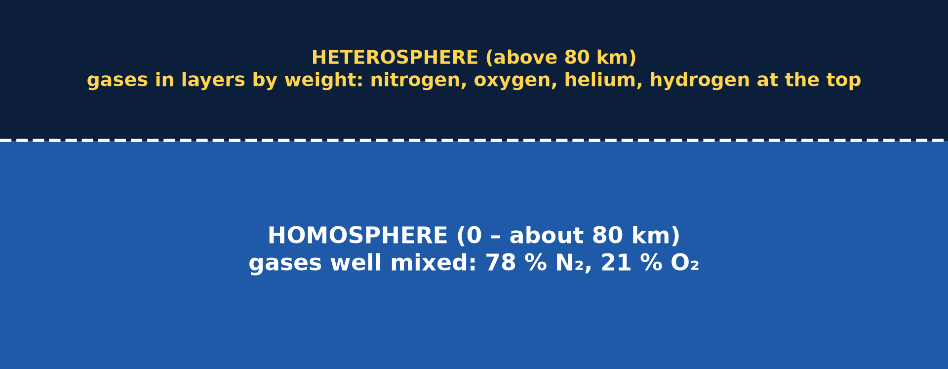
1. COMPOSITION
Activity 1
Homosphere and heterosphere.
Notes:
Activity 1. Look carefully at this picture: homosphere and heterosphere. Observe every detail before I ask the question.

Slide 21
1. COMPOSITION
Activity 1: Question
In which part of the atmosphere are gases well mixed?
Notes:
Here is the question for Activity 1: In which part of the atmosphere are gases well mixed? Take one minute to think and write your answer in your rough notebook.

Slide 22
1. COMPOSITION
Activity 1: Answer
The homosphere (up to about 80 km).
Notes:
Let us check the answer together. The homosphere (up to about 80 km).

Slide 23

2. THERMAL LAYERS
Activity 2
The layers of the atmosphere.
Notes:
Activity 2. Look carefully at this diagram: the layers of the atmosphere. Observe every detail before I ask the question.

Slide 24
2. THERMAL LAYERS
Activity 2: Question
In which layer does almost all weather happen?
Notes:
Here is the question for Activity 2: In which layer does almost all weather happen? Take one minute to think and write your answer in your rough notebook.

Slide 25
2. THERMAL LAYERS
Activity 2: Answer
The troposphere.
Notes:
Let us check the answer together. The troposphere.

Slide 26
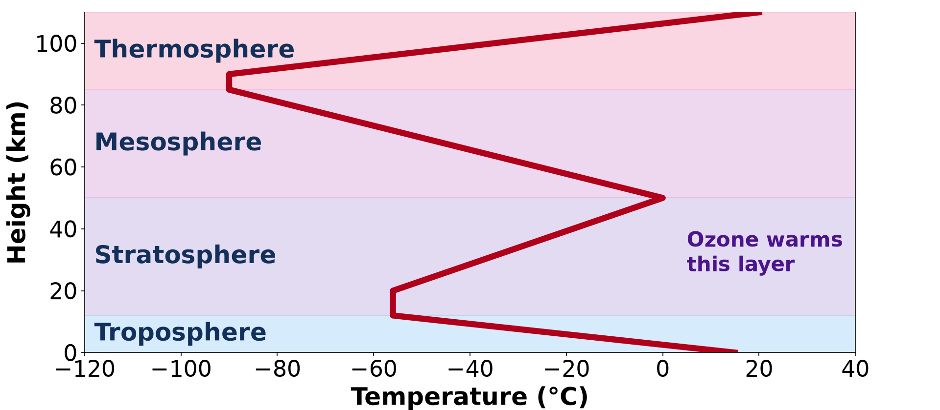
2. THERMAL LAYERS
Activity 3
Temperature and height.
Notes:
Activity 3. Look carefully at this diagram: temperature and height. Observe every detail before I ask the question.

Slide 27
2. THERMAL LAYERS
Activity 3: Question
Why does temperature rise in the stratosphere?
Notes:
Here is the question for Activity 3: Why does temperature rise in the stratosphere? Take one minute to think and write your answer in your rough notebook.

Slide 28
2. THERMAL LAYERS
Activity 3: Answer
Ozone absorbs ultraviolet rays and heats it.
Notes:
Let us check the answer together. Ozone absorbs ultraviolet rays and heats it.

Slide 29
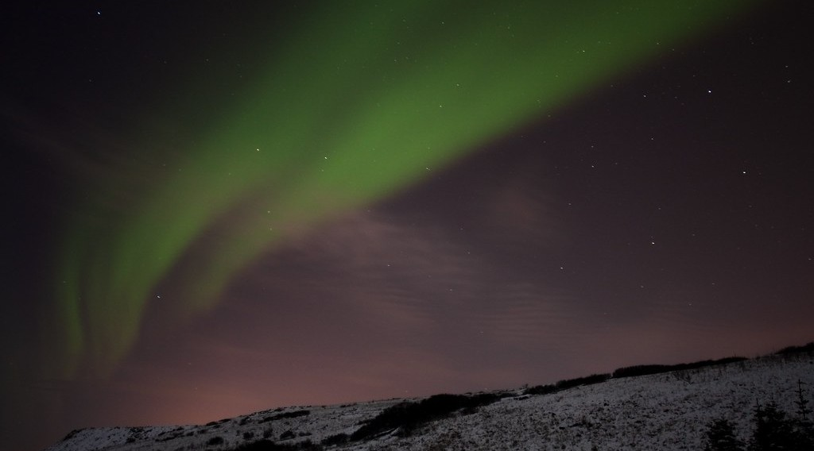
2. THERMAL LAYERS
Activity 4
An aurora.
Notes:
Activity 4. Look carefully at this picture: an aurora. Observe every detail before I ask the question.

Slide 30
2. THERMAL LAYERS
Activity 4: Question
In which layer do auroras and the space station occur?
Notes:
Here is the question for Activity 4: In which layer do auroras and the space station occur? Take one minute to think and write your answer in your rough notebook.

Slide 31
2. THERMAL LAYERS
Activity 4: Answer
The thermosphere.
Notes:
Let us check the answer together. The thermosphere.

Slide 32

3. OZONE LAYER
Activity 5
The ozone hole over Antarctica.
Notes:
Activity 5. Look carefully at this picture: the ozone hole over Antarctica. Observe every detail before I ask the question.

Slide 33
3. OZONE LAYER
Activity 5: Question
Which chemicals caused the ozone hole?
Notes:
Here is the question for Activity 5: Which chemicals caused the ozone hole? Take one minute to think and write your answer in your rough notebook.

Slide 34
3. OZONE LAYER
Activity 5: Answer
CFCs (chlorofluorocarbons) from old fridges, air conditioners and sprays.
Notes:
Let us check the answer together. CFCs (chlorofluorocarbons) from old fridges, air conditioners and sprays.

Slide 35
BOARD SUMMARY
Board Summary
Topic: The Atmosphere as a Centre of Weather and Climate
Sub-topic: The Atmosphere
Lesson 2: Structure of the Atmosphere
Notes:
Now we are going to copy the board summary. Write the title and the headings neatly in your notebooks. I will give you enough time for each slide, so do not rush.

Slide 36
BOARD SUMMARY
DEFINITIONS
The key terms of this lesson are defined as follows:
Homosphere: It is the lower atmosphere (up to about 80 km) where gases are well mixed.
Heterosphere: It is the upper atmosphere (above 80 km) where gases form layers according to their weight.
Notes:
Let us copy the definitions. The key terms of this lesson are defined as follows. On this slide we have Homosphere and Heterosphere. Write each point on a new line, with the key term first, and explain it in your own words when we revise. When you finish, we go to the next slide.

Slide 37
BOARD SUMMARY
DEFINITIONS (continued)
Isothermal layer: It is a layer of the atmosphere in which the temperature does not change with height.
Ozone layer: It is a zone of the stratosphere rich in ozone, which absorbs harmful ultraviolet rays.
Notes:
We continue with the definitions. On this slide we have Isothermal layer and Ozone layer. Write each point on a new line, with the key term first, and explain it in your own words when we revise.

Slide 38
BOARD SUMMARY
1. Chemical Characteristics: Homosphere and Heterosphere
By its chemical composition, the atmosphere is divided into the following two layers:
Homosphere (0 to about 80 km): In the homosphere, winds and turbulence mix the gases so well that their proportions stay the same, with about 78 % nitrogen and 21 % oxygen. It contains almost all the mass of the air and all living things.
Illustration: homosphere and heterosphere
Notes:
Let us copy Chemical Characteristics: Homosphere and Heterosphere. By its chemical composition, the atmosphere is divided into the following two layers. Copy the point on Homosphere (0 to about 80 km) on the left, then draw the diagram on the right: homosphere and heterosphere. Give it a title and label it clearly.

Slide 39
BOARD SUMMARY
1. Chemical Characteristics: Homosphere and Heterosphere
Heterosphere (above 80 km): In the heterosphere, the air is so thin that the gases are no longer mixed and separate according to their weight. Heavy nitrogen is found lowest, followed by oxygen, then helium, and light hydrogen at the top.
Notes:
We continue with Chemical Characteristics: Homosphere and Heterosphere. Copy the point on Heterosphere (above 80 km): write the key term first, then its explanation.

Slide 40
BOARD SUMMARY
2. Thermal Characteristics
A) The Four Layers
By temperature, the atmosphere has the following four layers:
Troposphere: The troposphere reaches about 8 km at the poles and 16 to 18 km at the Equator, and its temperature falls with height by about 6.5 °C per km. It holds about 75 % of the air and almost all the water vapour, so all clouds and weather occur in it.
Illustration: the layers of the atmosphere
Notes:
Let us copy The Four Layers. By temperature, the atmosphere has the following four layers. Copy the point on Troposphere on the left, then draw the diagram on the right: the layers of the atmosphere. Give it a title and label it clearly.

Slide 41
BOARD SUMMARY
2. Thermal Characteristics
A) The Four Layers
Stratosphere (to about 50 km): In the stratosphere, temperature rises with height because the ozone absorbs ultraviolet rays. The air is calm and dry, which is why aircraft fly in its lower part.
Illustration: temperature and height
Notes:
Copy the point on Stratosphere (to about 50 km) on the left, then draw the diagram on the right: temperature and height. Give it a title and label it clearly.

Slide 42
BOARD SUMMARY
2. Thermal Characteristics
A) The Four Layers
Mesosphere (50 to 80 km): In the mesosphere, temperature falls again with height and reaches about −90 °C, the coldest point of the atmosphere. Meteors burn up in this layer and appear as shooting stars.
Notes:
We continue with The Four Layers. Copy the point on Mesosphere (50 to 80 km): write the key term first, then its explanation.

Slide 43
BOARD SUMMARY
2. Thermal Characteristics
A) The Four Layers
Thermosphere (above 80 km): In the thermosphere, the thin gases absorb very strong solar radiation, so temperature rises above 1,000 °C. Auroras form here and satellites such as the space station orbit in this layer.
Illustration: an aurora
Notes:
Copy the point on Thermosphere (above 80 km) on the left, then draw the diagram on the right: an aurora. Give it a title and label it clearly.

Slide 44
BOARD SUMMARY
2. Thermal Characteristics
B) The Isothermal Layers
The isothermal layers of the atmosphere are the following:
Tropopause and lower stratosphere: Above the troposphere, temperature stops falling and remains at about −55 °C up to about 20 km. This isothermal layer acts as a lid that stops clouds from rising higher, which gives thunderclouds their flat anvil top.
Notes:
Let us copy The Isothermal Layers. The isothermal layers of the atmosphere are the following. Copy the point on Tropopause and lower stratosphere: write the key term first, then its explanation.

Slide 45
BOARD SUMMARY
2. Thermal Characteristics
B) The Isothermal Layers
Stratopause and mesopause: The stratopause (about 50 km) and the mesopause (about 80 km) are thin layers where temperature stays constant for a few kilometres. They mark the limits where the temperature trend changes from rising to falling, or from falling to rising.
Notes:
We continue with The Isothermal Layers. Copy the point on Stratopause and mesopause: write the key term first, then its explanation.

Slide 46
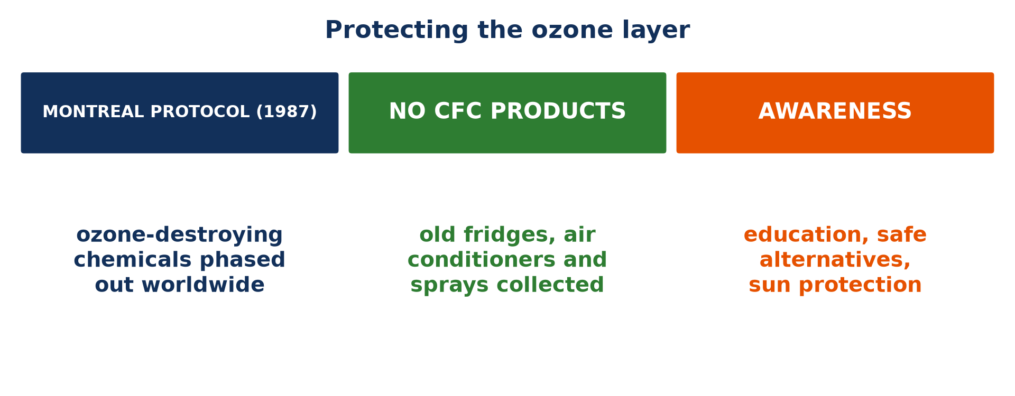
BOARD SUMMARY
3. The Ozone Layer
A) Function
The ozone layer has the following functions:
Absorption of ultraviolet rays: The ozone layer absorbs most of the harmful ultraviolet (UV-B) rays of the Sun. It thus protects people from skin cancer and eye cataracts and protects plants and sea plankton.
Illustration: the ozone layer
Notes:
Let us copy Function. The ozone layer has the following functions. Copy the point on Absorption of ultraviolet rays on the left, then draw the diagram on the right: the ozone layer. Give it a title and label it clearly.

Slide 47
BOARD SUMMARY
3. The Ozone Layer
A) Function
Heating of the stratosphere: The energy absorbed by ozone heats the stratosphere. This is why temperature rises with height in this layer.
Notes:
We continue with Function. Copy the point on Heating of the stratosphere: write the key term first, then its explanation.

Slide 48
BOARD SUMMARY
3. The Ozone Layer
B) Depletion
The ozone layer is depleted in the following ways:
Chlorofluorocarbons (CFCs): CFCs from old fridges, air conditioners and aerosol sprays rise slowly into the stratosphere. There, ultraviolet rays release chlorine, and each chlorine atom can destroy thousands of ozone molecules.
Notes:
Let us copy Depletion. The ozone layer is depleted in the following ways. Copy the point on Chlorofluorocarbons (CFCs): write the key term first, then its explanation.

Slide 49
BOARD SUMMARY
3. The Ozone Layer
B) Depletion
Other ozone-destroying gases: Halons from fire extinguishers, methyl bromide used against pests and nitrous oxide from fertilisers also destroy ozone. Their effect adds to that of CFCs.
Notes:
We continue with Depletion. Copy the point on Other ozone-destroying gases: write the key term first, then its explanation.

Slide 50
BOARD SUMMARY
3. The Ozone Layer
B) Depletion
The ozone hole: Every spring (September to November), the ozone layer over Antarctica becomes very thin because extreme cold speeds up the chemical reactions. This thinning is called the ozone hole.
Illustration: the ozone hole
Notes:
Copy the point on The ozone hole on the left, then draw the diagram on the right: the ozone hole. Give it a title and label it clearly.

Slide 51
BOARD SUMMARY
3. The Ozone Layer
C) Measures
The ozone layer is protected by the following measures:
The Montreal Protocol (1987): Under this agreement, almost all countries, including Cameroon, stopped producing and using CFCs and other ozone-destroying chemicals. As a result, the ozone layer is slowly recovering and should return to its 1980 level by about 2066 over Antarctica.
Notes:
Let us copy Measures. The ozone layer is protected by the following measures. Copy the point on The Montreal Protocol (1987): write the key term first, then its explanation.

Slide 52
BOARD SUMMARY
3. The Ozone Layer
C) Measures
Collection of old equipment: Old fridges and air conditioners must be collected so that their gases are recovered and destroyed. This prevents the CFCs they still contain from escaping into the air.
Notes:
We continue with Measures. Copy the point on Collection of old equipment: write the key term first, then its explanation.

Slide 53
BOARD SUMMARY
3. The Ozone Layer
C) Measures
Education and sun protection: People are informed so that they buy ozone-friendly products labelled "CFC-free". In strong sun, as in Garoua, wearing hats and sunglasses protects them from the ultraviolet rays that still reach the ground.
Notes:
We continue with Measures. Copy the point on Education and sun protection: write the key term first, then its explanation.

Slide 54
FORMATIVE EVALUATION
Evaluation 1
Why does temperature fall in the troposphere but rise in the stratosphere?
Notes:
Now let us check what you have understood. Question 1: Why does temperature fall in the troposphere but rise in the stratosphere? Answer in your exercise book.

Slide 55
FORMATIVE EVALUATION
Expected Answer
The troposphere is heated from the ground below; the stratosphere is heated by ozone absorbing ultraviolet rays.
Notes:
The expected answer is: the troposphere is heated from the ground below; the stratosphere is heated by ozone absorbing ultraviolet rays. If you got it right, well done.

Slide 56
FORMATIVE EVALUATION
Evaluation 2
Give two measures to protect the ozone layer.
Notes:
Now let us check what you have understood. Question 2: Give two measures to protect the ozone layer. Answer in your exercise book.

Slide 57
FORMATIVE EVALUATION
Expected Answer
Apply the Montreal Protocol, stop using CFCs, recycle old fridges, educate people (any two).
Notes:
The expected answer is: apply the Montreal Protocol, stop using CFCs, recycle old fridges, educate people (any two). If you got it right, well done.

Slide 58
REMEDIATION
Remediation
Fill in the blanks:
Weather happens in the ______.
The ozone layer lies in the ______.
The coldest layer is the ______.
Notes:
For those who need more practice, fill in the blanks in your exercise book. The answers are: number 1, troposphere; number 2, stratosphere; number 3, mesosphere.

Slide 59
HOMEWORK
Homework
Define insolation.
Notes:
For your homework: Define insolation. We shall correct it at the beginning of our next lesson.

Slide 60
NEXT LESSON
Next Lesson
Our next lesson will be on:
Lesson 3: Solar Radiation
Notes:
Our next lesson will be on Lesson 3: Solar Radiation. Thank you for your attention, and see you next time.

Slide 61
BILINGUAL GAME
Bilingual Game (Jeu Bilingue)
English | Français
Layer | La couche
Ozone | L'ozone
Temperature | La température
Troposphere | La troposphère
Stratosphere | La stratosphère
Ultraviolet rays | Les rayons ultraviolets
Notes:
Let us play the bilingual game. I say a word in English, and you give me the French word. Then we do the reverse.

Slide 62
LOGBOOK
Official Logbook (1/2)
Module / Topic | The Atmosphere as a Centre of Weather and Climate
Lesson Title | Lesson 2: Structure of the Atmosphere
Expected Learning Outcomes | Distinguish the homosphere and the heterosphere. Describe the four thermal layers of the atmosphere. Explain the importance of the ozone layer. Explain the causes of its depletion and the measures to protect it.
Competence | Learners are able to describe the layers of the atmosphere and explain the importance and protection of the ozone layer.
Notes:
I record this information in the official logbook of the class after the lesson.

Slide 63
LOGBOOK
Official Logbook (2/2)
Matter Taught | DEFINITIONS; Chemical Characteristics: Homosphere and Heterosphere; The Four Layers; The Isothermal Layers; Function; Depletion; Measures.
Evaluation | Formative evaluation and remediation exercise.
Homework | Define insolation.
Enrolment / Present / Absent | ____ / ____ / ____
Achievement | To be completed after the lesson.
Notes:
I complete the second page of the logbook: the matter taught, the evaluation, the homework and the attendance.

Slide 64
TEACHER'S NOTE
Teacher's Note
Timing: Homework correction, plan, objectives 8 min | Recall, situation, action 10 min | 5 activities 30 min | Board summary (copying) 30 min | Evaluation, remediation 10 min | Homework, next lesson 5 min | Logbook 7 min
Without the projector (Activity 1): draw the two parts on the board.
Without the projector (Activity 2): draw the four layers.
Without the projector (Activity 3): draw the zig-zag temperature line.
Without the projector (Activity 4): describe a shooting star.
Without the projector (Activity 5): explain the ozone hole.
Notes:
This slide is for me, the teacher: it gives the timing of the lesson and what to do if the projector is not available.

Slide 65
REFERENCES
References
Geography Syllabus for Sixth Forms (Lower and Upper Sixth), MINESEC, 2019 — Module 1 (Meteorology, Climatology & Hydrology).
Teacher's course notes: Mr KAMDEM E., Meteorology (LSA), GBHS Garoua, 2026.
Photo, Activity 4: “Aurora Borealis” by Haukur H., CC BY-NC-ND 2.0, via Flickr (https://www.flickr.com/photos/34699962@N04/3256810738)
Photo, Activity 5: “Sauron's Eye” by sjrankin, CC BY-NC 2.0, via Flickr (https://www.flickr.com/photos/24354425@N03/15252220086)
Diagrams and animations: drawn for this lesson (Geography Department).
Notes:
These are the references and picture credits used to prepare this lesson.

