Slide 1
LOWER SIXTH ARTS
GEOGRAPHY
Further Study 2
Weather Observation, Prediction, Modification and Mapping
Notes:
Good morning, class, and welcome to our geography lesson. I am your geography teacher, Mr Kamdem. Today we are starting Further Study 2: Weather Observation, Prediction, Modification and Mapping.

Slide 2
CLASS INFO
Class, Chapter and Duration
Class | Lower Sixth Arts
Chapter | Module 1: Understanding and managing atmospheric and hydrological phenomena and hazards across the world in general and Cameroon in particular
Duration | 2 periods (2 × 50 minutes)
Notes:
This lesson is for Lower Sixth Arts. It belongs to Module 1: Understanding and managing atmospheric and hydrological phenomena and hazards across the world in general and Cameroon in particular. We shall need 2 periods to cover it.

Slide 3
IDENTIFICATION
Lesson Identification
Topic | Climates
Sub-topic | Weather Observation
Lesson | Further Study 2: Weather Observation, Prediction, Modification and Mapping
Notions / Concepts | Weather element, weather station, Stevenson screen, rain gauge, barometer, anemometer, radiosonde, Doppler radar, weather satellite, numerical weather prediction, cloud seeding, synoptic chart, isobar, front.
Syllabus focus | Weather observation (elements and instruments); weather prediction; weather modification techniques; weather mapping with synoptic charts.
Competence | Learners are able to explain how weather is observed, forecast, modified and mapped, and read a simple synoptic chart.
Notes:
Our topic is Climates, and the sub-topic is Weather Observation. The key notions we shall use today are: weather element, weather station, Stevenson screen, rain gauge, barometer, anemometer, radiosonde, Doppler radar, weather satellite, numerical weather prediction, cloud seeding, synoptic chart, isobar, front. At the end, you should be able to do this: learners are able to explain how weather is observed, forecast, modified and mapped, and read a simple synoptic chart.

Slide 4

HOMEWORK CORRECTION
Correction of the Homework
Question (Lesson 21: Mountain Climates):
Name one instrument of a weather station.
Notes:
Before we start the new lesson, let us correct the homework I gave you at the end of Lesson 21: Mountain Climates. The question was: Name one instrument of a weather station. Take out your exercise books.

Slide 5
HOMEWORK CORRECTION
Correction: Possible Answer
A thermometer, a rain gauge, a barometer, a wind vane, an anemometer or a hygrometer (any one).
Notes:
Here is a good answer. A thermometer, a rain gauge, a barometer, a wind vane, an anemometer or a hygrometer (any one). Compare it with your own answer and correct your work in red.

Slide 6
LESSON PLAN
Lesson Plan
Correction of the homework
Objectives and recall
Real-life situation and action to take
Learning activities
Board summary
Evaluation, remediation and homework
Notes:
Here is the plan of our lesson today. First, we shall correct the homework. Then we shall look at the objectives and recall what you already know. After that, we shall study a situation from real life and the action to take, and do the learning activities. Finally, we shall copy the board summary, do the evaluation and the remediation, and I will give you the homework.

Slide 7
OBJECTIVES
Objectives
By the end of this lesson, you should be able to:
Name the weather elements and the instruments used to measure them.
Explain how weather is predicted.
Notes:
Take your time to copy this part; we will continue together.

Slide 8
OBJECTIVES
Objectives (continued)
Describe techniques of weather modification.
Read the main symbols of a synoptic chart.
Notes:
By the end of this lesson, you should be able to do four things. Number 1: name the weather elements and the instruments used to measure them. Number 2: explain how weather is predicted. Number 3: describe techniques of weather modification. Number 4: read the main symbols of a synoptic chart.

Slide 9
PREVIOUS KNOWLEDGE
Previous Knowledge
Pressure is measured with a barometer.
Anticyclones bring clear weather.
Fronts separate air masses.
Notes:
Let us first remember what you already know. Pressure is measured with a barometer. Anticyclones bring clear weather. Fronts separate air masses. Keep this in mind, because we shall build on it today.

Slide 10
REAL-LIFE SITUATION
Situation in Real Life
Before planting cotton, a farmer near Garoua listens to the weather forecast on the radio, which announces the first rains for next week.
Notes:
Take your time to copy this part; we will continue together.

Slide 11
REAL-LIFE SITUATION
Situation in Real Life (continued)
At the airport, a pilot checks satellite images before taking off, and in the newspaper you see a map full of lines and symbols.
You ask: "How do meteorologists observe the weather, how do they forecast it, and how do they draw it on maps?"
Notes:
Listen carefully to this situation from real life. Before planting cotton, a farmer near Garoua listens to the weather forecast on the radio, which announces the first rains for next week. At the airport, a pilot checks satellite images before taking off, and in the newspaper you see a map full of lines and symbols. You ask: "How do meteorologists observe the weather, how do they forecast it, and how do they draw it on maps?" Think about it, because I am going to ask you some questions.

Slide 12
REAL-LIFE SITUATION
Situation: Question 1
What is the problem in the situation?
Notes:
Question 1: What is the problem in the situation? Think for a moment, then raise your hand to answer.

Slide 13
REAL-LIFE SITUATION
Answer
The learner does not know how weather is observed, predicted and mapped.
Notes:
Good. The learner does not know how weather is observed, predicted and mapped.

Slide 14
REAL-LIFE SITUATION
Situation: Question 2
Which instrument measures rainfall?
Notes:
Question 2: Which instrument measures rainfall? Think for a moment, then raise your hand to answer.

Slide 15
REAL-LIFE SITUATION
Answer
The rain gauge.
Notes:
Good. The rain gauge.

Slide 16
REAL-LIFE SITUATION
Situation: Question 3
What is a weather map called?
Notes:
Question 3: What is a weather map called? Think for a moment, then raise your hand to answer.

Slide 17
REAL-LIFE SITUATION
Possible Answer
A synoptic chart.
Notes:
Good. A synoptic chart.

Slide 18
ACTION TO TAKE
Action to Take
Follow weather forecasts before farming, travelling or fishing.
Notes:
From this situation, the action we are working towards in this lesson is the following: follow weather forecasts before farming, travelling or fishing.

Slide 19
JUSTIFICATION
Justification of the Lesson
This lesson shows how weather information is produced and used by farmers, pilots, fishermen and the public.
Notes:
Why is this lesson important for you? This lesson shows how weather information is produced and used by farmers, pilots, fishermen and the public.

Slide 20

1. OBSERVATION
Activity 1
Instruments of a weather station.
Notes:
Activity 1. Look carefully at this diagram: instruments of a weather station. Observe every detail before I ask the question.

Slide 21
1. OBSERVATION
Activity 1: Question
Where are thermometers kept in a weather station?
Notes:
Here is the question for Activity 1: Where are thermometers kept in a weather station? Take one minute to think and write your answer in your rough notebook.

Slide 22
1. OBSERVATION
Activity 1: Answer
In a Stevenson screen.
Notes:
Let us check the answer together. In a Stevenson screen.

Slide 23
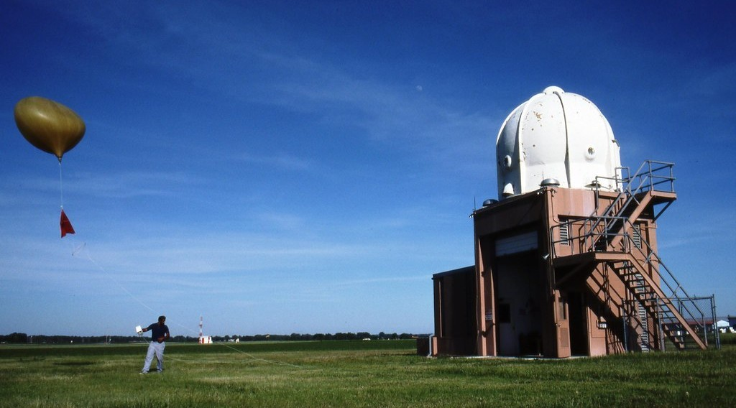
1. OBSERVATION
Activity 2
Launching a radiosonde.
Notes:
Activity 2. Look carefully at this picture: launching a radiosonde. Observe every detail before I ask the question.

Slide 24
1. OBSERVATION
Activity 2: Question
What does a radiosonde measure?
Notes:
Here is the question for Activity 2: What does a radiosonde measure? Take one minute to think and write your answer in your rough notebook.

Slide 25
1. OBSERVATION
Activity 2: Answer
Temperature, humidity and pressure at different heights.
Notes:
Let us check the answer together. Temperature, humidity and pressure at different heights.

Slide 26
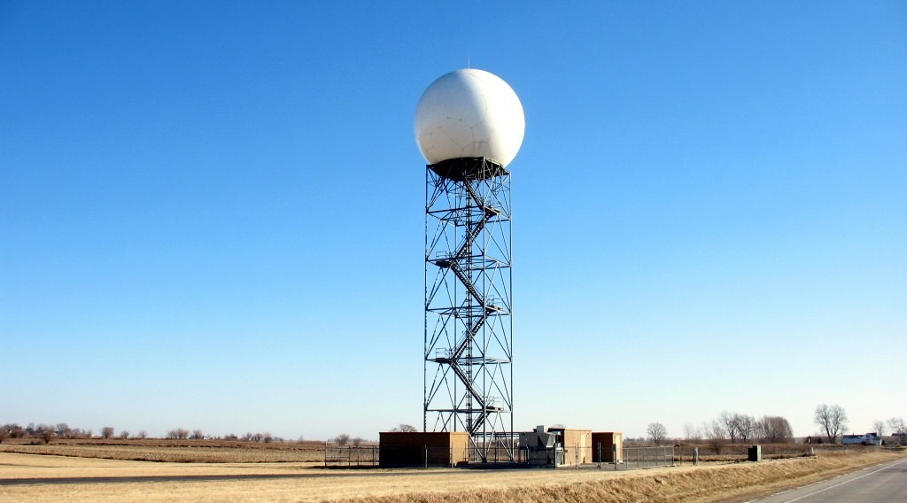
2. PREDICTION
Activity 3
A weather radar.
Notes:
Activity 3. Look carefully at this picture: a weather radar. Observe every detail before I ask the question.

Slide 27
2. PREDICTION
Activity 3: Question
What does a Doppler radar detect?
Notes:
Here is the question for Activity 3: What does a Doppler radar detect? Take one minute to think and write your answer in your rough notebook.

Slide 28
2. PREDICTION
Activity 3: Answer
The intensity and movement of rain and storms.
Notes:
Let us check the answer together. The intensity and movement of rain and storms.

Slide 29
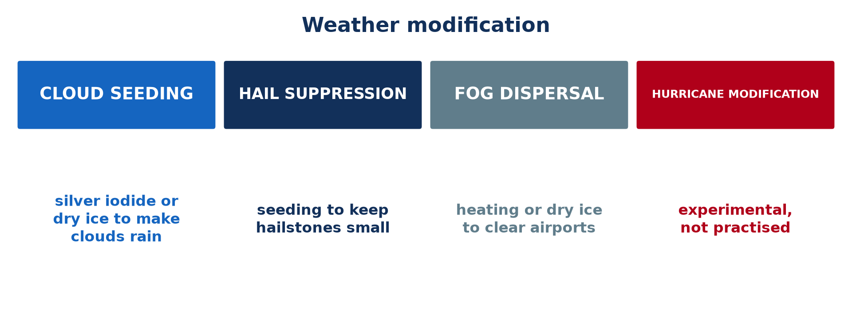
3. MODIFICATION
Activity 4
Weather modification.
Notes:
Activity 4. Look carefully at this picture: weather modification. Observe every detail before I ask the question.

Slide 30
3. MODIFICATION
Activity 4: Question
What is cloud seeding?
Notes:
Here is the question for Activity 4: What is cloud seeding? Take one minute to think and write your answer in your rough notebook.

Slide 31
3. MODIFICATION
Activity 4: Answer
Adding silver iodide or dry ice to clouds to make them rain.
Notes:
Let us check the answer together. Adding silver iodide or dry ice to clouds to make them rain.

Slide 32
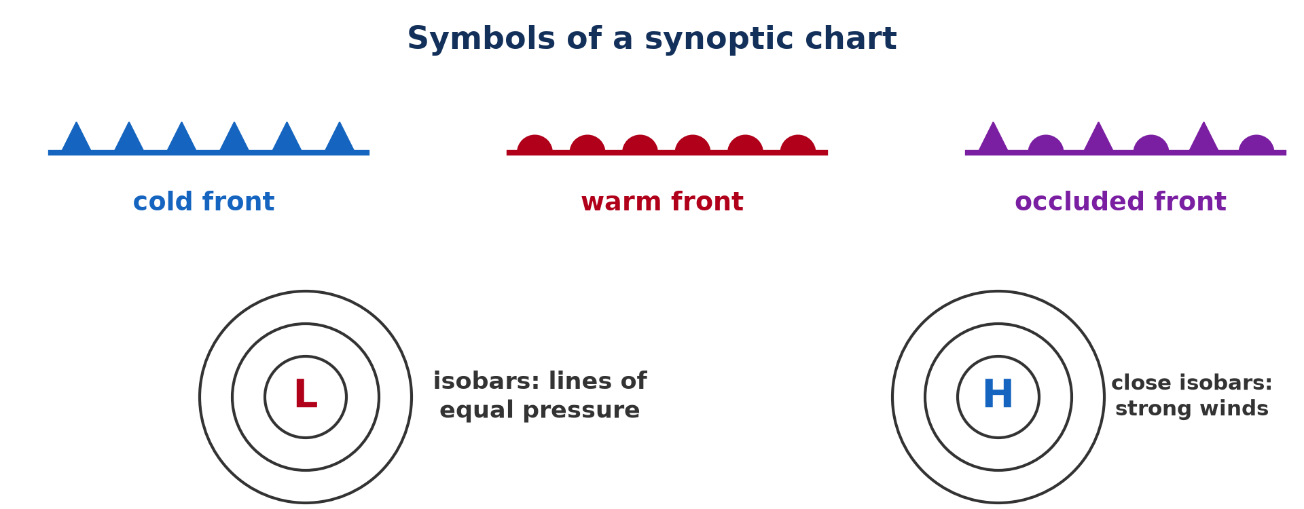
4. MAPPING
Activity 5
Symbols of a synoptic chart.
Notes:
Activity 5. Look carefully at this picture: symbols of a synoptic chart. Observe every detail before I ask the question.

Slide 33
4. MAPPING
Activity 5: Question
What do closely spaced isobars indicate?
Notes:
Here is the question for Activity 5: What do closely spaced isobars indicate? Take one minute to think and write your answer in your rough notebook.

Slide 34
4. MAPPING
Activity 5: Answer
Strong winds.
Notes:
Let us check the answer together. Strong winds.

Slide 35
BOARD SUMMARY
Board Summary
Topic: Climates
Sub-topic: Weather Observation
Further Study 2: Weather Observation, Prediction, Modification and Mapping
Notes:
Now we are going to copy the board summary. Write the title and the headings neatly in your notebooks. I will give you enough time for each slide, so do not rush.

Slide 36
BOARD SUMMARY
DEFINITIONS
The key terms of this lesson are defined as follows:
Weather observation: It is the measurement and recording of the elements of the weather.
Weather forecasting: It is the prediction of future weather from observations and models.
Notes:
Let us copy the definitions. The key terms of this lesson are defined as follows. On this slide we have Weather observation and Weather forecasting. Write each point on a new line, with the key term first, and explain it in your own words when we revise. When you finish, we go to the next slide.

Slide 37
BOARD SUMMARY
DEFINITIONS (continued)
Weather modification: It is the deliberate action of people to change the weather.
Synoptic chart: It is a weather map summarising the weather over a large area at a given time.
Isobar: It is a line joining places of equal atmospheric pressure.
Notes:
We continue with the definitions. On this slide we have Weather modification, Synoptic chart and Isobar. Write each point on a new line, with the key term first, and explain it in your own words when we revise.

Slide 38
BOARD SUMMARY
1. Weather Observation
A) Elements Observed at a Weather Station
The main elements of weather are observed as follows:
Temperature: Temperature is measured in °C with thermometers kept in a white, ventilated Stevenson screen, 1.25 m above the ground and out of direct sunlight. Maximum and minimum thermometers give the highest and lowest temperatures of each day.
Illustration: weather instruments
Notes:
Let us copy Elements Observed at a Weather Station. The main elements of weather are observed as follows. Copy the point on Temperature on the left, then draw the diagram on the right: weather instruments. Give it a title and label it clearly.

Slide 39

BOARD SUMMARY
1. Weather Observation
A) Elements Observed at a Weather Station
Rainfall (precipitation): Rainfall is measured in millimetres with a rain gauge placed in an open area away from trees and buildings. The water collected is measured every morning at the same time.
Illustration: a rain gauge
Notes:
Copy the point on Rainfall (precipitation) on the left, then draw the diagram on the right: a rain gauge. Give it a title and label it clearly.

Slide 40
BOARD SUMMARY
1. Weather Observation
A) Elements Observed at a Weather Station
Cloud cover: Cloud cover is estimated by looking at the sky and dividing it into eighths, called oktas. A sky with no clouds is 0 okta and a completely covered sky is 8 oktas.
Notes:
We continue with Elements Observed at a Weather Station. Copy the point on Cloud cover: write the key term first, then its explanation.

Slide 41
BOARD SUMMARY
1. Weather Observation
B) Upper-Air and Remote Observation
The upper air and large areas are observed with the following instruments:
Radiosonde: A radiosonde is a small box of instruments carried up to about 30 km by a balloon filled with hydrogen or helium. It sends the temperature, humidity and pressure of the upper air by radio, and tracking it gives the wind.
Illustration: a radiosonde
Notes:
Let us copy Upper-Air and Remote Observation. The upper air and large areas are observed with the following instruments. Copy the point on Radiosonde on the left, then draw the diagram on the right: a radiosonde. Give it a title and label it clearly.

Slide 42
BOARD SUMMARY
1. Weather Observation
B) Upper-Air and Remote Observation
Doppler radar: A Doppler radar sends out radio waves that are reflected by raindrops and hailstones. It shows where it is raining, how heavily, and in which direction and how fast the storm is moving.
Illustration: a weather radar
Notes:
Copy the point on Doppler radar on the left, then draw the diagram on the right: a weather radar. Give it a title and label it clearly.

Slide 43
BOARD SUMMARY
1. Weather Observation
B) Upper-Air and Remote Observation
Weather satellites: Geostationary satellites, such as Meteosat over Africa, stay above the same place and send images every 15 minutes. Polar-orbiting satellites pass over the whole Earth and measure temperature and moisture at different heights.
Notes:
We continue with Upper-Air and Remote Observation. Copy the point on Weather satellites: write the key term first, then its explanation.

Slide 44
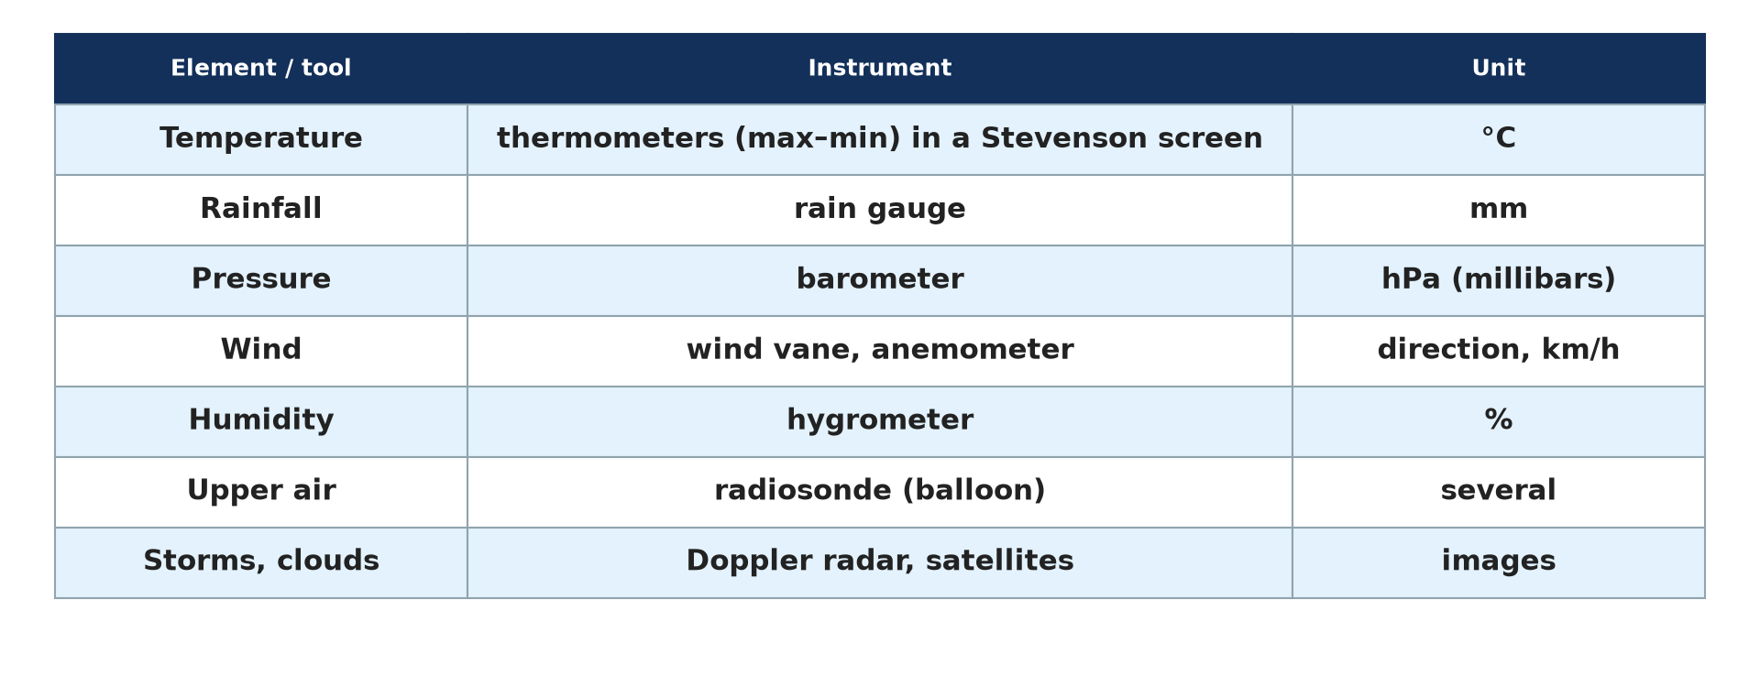
BOARD SUMMARY
2. Weather Prediction
Weather is predicted in the following steps:
Collection of data: Thousands of stations, ships, balloons, radars and satellites send their observations to world weather centres several times a day. The data are exchanged between countries through the World Meteorological Organization.
Illustration: weather observations
Notes:
Let us copy Weather Prediction. Weather is predicted in the following steps. Copy the point on Collection of data on the left, then draw the diagram on the right: weather observations. Give it a title and label it clearly.

Slide 45
BOARD SUMMARY
2. Weather Prediction
Numerical models: Powerful computers solve the equations of the atmosphere to calculate the future weather. Forecasts are fairly reliable for about five to seven days.
Notes:
We continue with Weather Prediction. Copy the point on Numerical models: write the key term first, then its explanation.

Slide 46
BOARD SUMMARY
2. Weather Prediction
Forecasts for users: Meteorologists interpret the models and inform the public, farmers, pilots and fishermen. In Cameroon, this is done by the National Meteorological Service, whose forecasts help farmers to plan sowing.
Notes:
We continue with Weather Prediction. Copy the point on Forecasts for users: write the key term first, then its explanation.

Slide 47
BOARD SUMMARY
3. Weather Modification
People try to modify the weather by the following techniques:
Cloud seeding: Aircraft or rockets spread silver iodide or dry ice into clouds, which act as nuclei on which ice crystals and drops grow. This can increase rain or snow by about 10 %, and it is used in dry countries such as the United Arab Emirates.
Illustration: weather modification
Notes:
Let us copy Weather Modification. People try to modify the weather by the following techniques. Copy the point on Cloud seeding on the left, then draw the diagram on the right: weather modification. Give it a title and label it clearly.

Slide 48
BOARD SUMMARY
3. Weather Modification
Hail suppression: Seeding a storm cloud with many nuclei makes many small hailstones instead of a few large ones. The small stones melt before reaching the ground, which protects crops and vineyards.
Notes:
We continue with Weather Modification. Copy the point on Hail suppression: write the key term first, then its explanation.

Slide 49
BOARD SUMMARY
3. Weather Modification
Fog dispersal: At airports, fog is cleared by seeding supercooled fog with dry ice or by heating the air with burners. This allows aircraft to land and take off safely.
Notes:
We continue with Weather Modification. Copy the point on Fog dispersal: write the key term first, then its explanation.

Slide 50
BOARD SUMMARY
3. Weather Modification
Hurricane modification: Scientists tried to weaken hurricanes by seeding the clouds around their eye in the Stormfury project (1962 to 1983). The results were not clear, and this technique remains experimental because of the risks.
Notes:
We continue with Weather Modification. Copy the point on Hurricane modification: write the key term first, then its explanation.

Slide 51
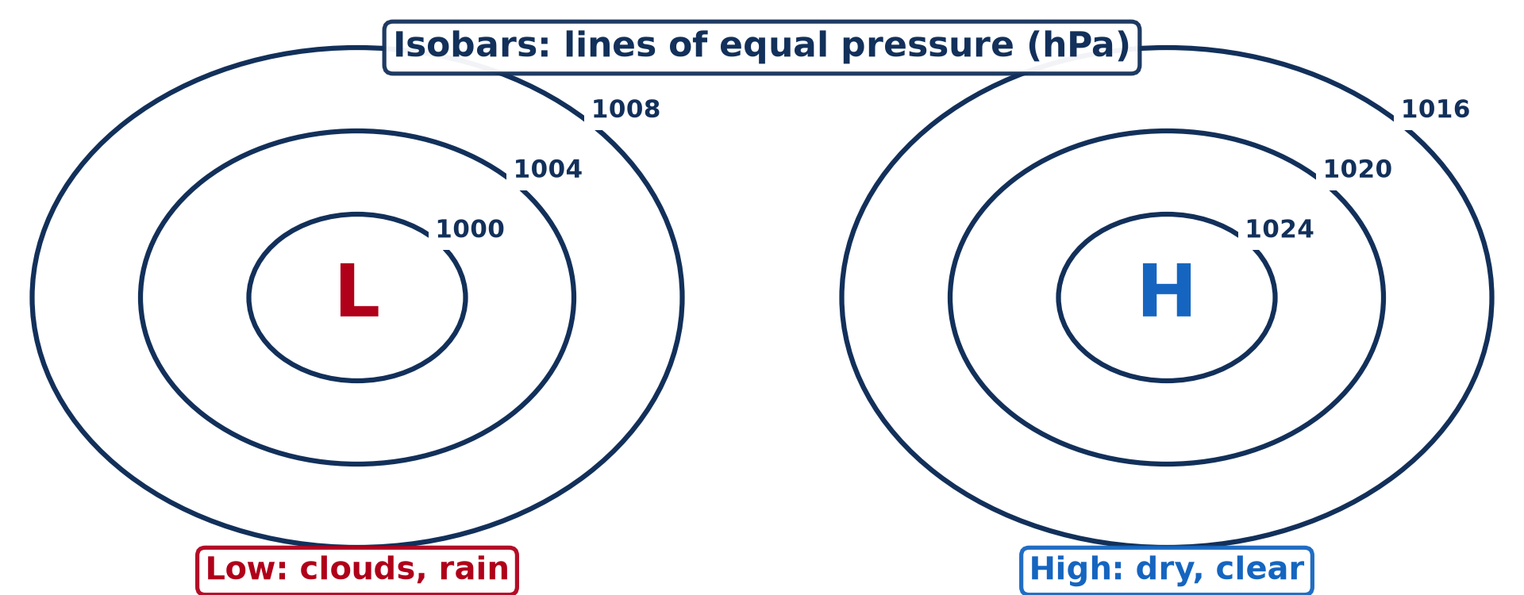
BOARD SUMMARY
4. Weather Mapping: the Synoptic Chart
A synoptic chart shows the weather with the following elements:
Isobars: Isobars join places with the same pressure, usually drawn every 4 hPa. Close isobars show a steep pressure gradient and strong winds, while widely spaced isobars show light winds.
Illustration: a synoptic chart
Notes:
Let us copy Weather Mapping: the Synoptic Chart. A synoptic chart shows the weather with the following elements. Copy the point on Isobars on the left, then draw the diagram on the right: a synoptic chart. Give it a title and label it clearly.

Slide 52
BOARD SUMMARY
4. Weather Mapping: the Synoptic Chart
Pressure systems: The letter H marks the centre of an anticyclone, with clear and stable weather. The letter L marks a depression, with clouds, rain and strong winds.
Notes:
We continue with Weather Mapping: the Synoptic Chart. Copy the point on Pressure systems: write the key term first, then its explanation.

Slide 53
BOARD SUMMARY
4. Weather Mapping: the Synoptic Chart
Fronts: A cold front is a blue line with triangles and brings cooler air and heavy showers. A warm front is a red line with semicircles and brings steady rain, and an occluded front is a purple line with both symbols.
Illustration: the symbols of fronts
Notes:
Copy the point on Fronts on the left, then draw the diagram on the right: the symbols of fronts. Give it a title and label it clearly.

Slide 54
BOARD SUMMARY
4. Weather Mapping: the Synoptic Chart
Station models and uses: Small symbols at each station show its temperature, wind, cloud cover and weather. By comparing charts drawn every few hours, forecasters follow the movement of weather systems for aviation, shipping and agriculture.
Notes:
We continue with Weather Mapping: the Synoptic Chart. Copy the point on Station models and uses: write the key term first, then its explanation.

Slide 55
FORMATIVE EVALUATION
Evaluation 1
Explain how a radiosonde works.
Notes:
Now let us check what you have understood. Question 1: Explain how a radiosonde works. Answer in your exercise book.

Slide 56
FORMATIVE EVALUATION
Expected Answer
A balloon carries instruments into the upper air; they measure temperature, humidity and pressure and send the data by radio.
Notes:
The expected answer is: a balloon carries instruments into the upper air; they measure temperature, humidity and pressure and send the data by radio. If you got it right, well done.

Slide 57
FORMATIVE EVALUATION
Evaluation 2
What is a synoptic chart and how is it used?
Notes:
Now let us check what you have understood. Question 2: What is a synoptic chart and how is it used? Answer in your exercise book.

Slide 58
FORMATIVE EVALUATION
Expected Answer
A weather map summarising conditions over a large area at one time; it is used to analyse and forecast the weather.
Notes:
The expected answer is: a weather map summarising conditions over a large area at one time; it is used to analyse and forecast the weather. If you got it right, well done.

Slide 59
REMEDIATION
Remediation
Fill in the blanks:
Rainfall is measured with a rain ______.
Lines of equal pressure are ______.
Silver iodide is used for cloud ______.
Notes:
For those who need more practice, fill in the blanks in your exercise book. The answers are: number 1, gauge; number 2, isobars; number 3, seeding.

Slide 60
HOMEWORK
Homework
Define hydrology.
Notes:
For your homework: Define hydrology. We shall correct it at the beginning of our next lesson.

Slide 61
NEXT LESSON
Next Lesson
Our next lesson will be on:
Lesson 22: Introduction to Hydrology
Notes:
Our next lesson will be on Lesson 22: Introduction to Hydrology. Thank you for your attention, and see you next time.

Slide 62
BILINGUAL GAME
Bilingual Game (Jeu Bilingue)
English | Français
Weather forecast | La prévision météorologique
Rain gauge | Le pluviomètre
Barometer | Le baromètre
Weather map | La carte météorologique
Isobar | L'isobare
Cloud seeding | L'ensemencement des nuages
Notes:
Let us play the bilingual game. I say a word in English, and you give me the French word. Then we do the reverse.

Slide 63
LOGBOOK
Official Logbook (1/2)
Module / Topic | Climates
Lesson Title | Further Study 2: Weather Observation, Prediction, Modification and Mapping
Expected Learning Outcomes | Name the weather elements and the instruments used to measure them. Explain how weather is predicted. Describe techniques of weather modification. Read the main symbols of a synoptic chart.
Competence | Learners are able to explain how weather is observed, forecast, modified and mapped, and read a simple synoptic chart.
Notes:
I record this information in the official logbook of the class after the lesson.

Slide 64
LOGBOOK
Official Logbook (2/2)
Matter Taught | DEFINITIONS; Elements Observed at a Weather Station; Upper-Air and Remote Observation; Weather Prediction; Weather Modification; Weather Mapping: the Synoptic Chart.
Evaluation | Formative evaluation and remediation exercise.
Homework | Define hydrology.
Enrolment / Present / Absent | ____ / ____ / ____
Achievement | To be completed after the lesson.
Notes:
I complete the second page of the logbook: the matter taught, the evaluation, the homework and the attendance.

Slide 65
TEACHER'S NOTE
Teacher's Note
Timing: Homework correction, plan, objectives 8 min | Recall, situation, action 10 min | 5 activities 30 min | Board summary (copying) 30 min | Evaluation, remediation 10 min | Homework, next lesson 5 min | Logbook 7 min
Without the projector (Activity 1): visit or describe a weather station.
Without the projector (Activity 2): describe a weather balloon.
Without the projector (Activity 3): listen to a radio forecast.
Without the projector (Activity 4): list the techniques.
Without the projector (Activity 5): draw isobars around an L and an H.
Notes:
This slide is for me, the teacher: it gives the timing of the lesson and what to do if the projector is not available.

Slide 66
REFERENCES
References
Geography Syllabus for Sixth Forms (Lower and Upper Sixth), MINESEC, 2019 — Module 1 (Meteorology, Climatology & Hydrology).
Teacher's course notes: Mr KAMDEM E., Meteorology (LSA), GBHS Garoua, 2026.
Photo, Activity 2: “wea01144” by NOAA Photo Library, CC BY 2.0, via Flickr (https://www.flickr.com/photos/51647007@N08/5083800180)
Photo, Activity 3: “ILX - Central Illinois Doppler Radar - NOAA” by HAM guy, CC BY 2.0, via Flickr (https://www.flickr.com/photos/10728157@N00/363045232)
Photo, board summary (Rainfall (precipitation)): “Sarasota - Rain Gauge (in 23rd Year)” by roger4336, CC BY-SA 2.0, via Flickr (https://www.flickr.com/photos/24736216@N07/8370429863)
Diagrams and animations: drawn for this lesson (Geography Department).
Notes:
These are the references and picture credits used to prepare this lesson.

