Slide 1
FORM 4
GEOGRAPHY
Lesson 1
Concept of the Soil
Notes:
Good morning, class, and welcome to our geography lesson. I am your geography teacher, Mr Kamdem. Today we are starting Lesson 1: Concept of the Soil.

Slide 2
CLASS INFO
Class, Chapter and Duration
Class | Form 4
Chapter | Module I: Ecological Systems and their Resources
Duration | 2 periods (2 × 50 minutes)
Notes:
This lesson is for Form 4. It belongs to Module I: Ecological Systems and their Resources. We shall need 2 periods to cover it.

Slide 3
IDENTIFICATION
Lesson Identification
Topic | Conservation of World's Biomes and Resources
Sub-topic | The Soil
Lesson | Lesson 1: Concept of the Soil
Notions / Concepts | Soil, mineral matter, organic matter, soil texture, structure, depth, fertility.
Syllabus focus | Definition; components; the soil system (diagram only); soil characteristics.
Competence | Learners are able to define the soil, name its components and describe its characteristics.
Notes:
Our topic is Conservation of World's Biomes and Resources, and the sub-topic is The Soil. The key notions we shall use today are: soil, mineral matter, organic matter, soil texture, structure, depth, fertility. At the end, you should be able to do this: learners are able to define the soil, name its components and describe its characteristics.

Slide 4

LESSON PLAN
Lesson Plan
Objectives and recall
Real-life situation and action to take
Learning activities
Board summary
Evaluation, remediation and homework
Notes:
Here is the plan of our lesson today. First, we shall look at the objectives and recall what you already know. After that, we shall study a situation from real life and the action to take, and do the learning activities. Finally, we shall copy the board summary, do the evaluation and the remediation, and I will give you the homework.

Slide 5
OBJECTIVES
Objectives
By the end of this lesson, you should be able to:
Define the soil.
Identify the components of the soil.
Describe the soil system and the characteristics of soils.
Notes:
By the end of this lesson, you should be able to do three things. Number 1: define the soil. Number 2: identify the components of the soil. Number 3: describe the soil system and the characteristics of soils.

Slide 6
PREVIOUS KNOWLEDGE
Previous Knowledge
Plants grow in the soil.
Rocks break down by weathering.
Dead leaves rot on the ground.
Notes:
Let us first remember what you already know. Plants grow in the soil. Rocks break down by weathering. Dead leaves rot on the ground. Keep this in mind, because we shall build on it today.

Slide 7
REAL-LIFE SITUATION
Situation in Real Life
Two farmers near Garoua plant maize. The first farm has dark, soft soil and gives a good harvest. The second has sandy, pale soil and gives a poor harvest. The farmers ask why soils are different.
Notes:
Listen carefully to this situation from real life. Two farmers near Garoua plant maize. The first farm has dark, soft soil and gives a good harvest. The second has sandy, pale soil and gives a poor harvest. The farmers ask why soils are different. Think about it, because I am going to ask you some questions.

Slide 8
REAL-LIFE SITUATION
Situation: Question 1
What is the problem in the situation?
Notes:
Question 1: What is the problem in the situation? Think for a moment, then raise your hand to answer.

Slide 9
REAL-LIFE SITUATION
Answer
The farmers do not know why their soils are different.
Notes:
Good. The farmers do not know why their soils are different.

Slide 10
REAL-LIFE SITUATION
Situation: Question 2
Which soil gives a good harvest?
Notes:
Question 2: Which soil gives a good harvest? Think for a moment, then raise your hand to answer.

Slide 11
REAL-LIFE SITUATION
Answer
The dark, soft soil.
Notes:
Good. The dark, soft soil.

Slide 12
REAL-LIFE SITUATION
Situation: Question 3
What makes a soil dark?
Notes:
Question 3: What makes a soil dark? Think for a moment, then raise your hand to answer.

Slide 13
REAL-LIFE SITUATION
Possible Answer
Humus (organic matter).
Notes:
Good. Humus (organic matter).

Slide 14
ACTION TO TAKE
Action to Take
Add manure and keep plant cover to keep your soil fertile.
Notes:
From this situation, the action we are working towards in this lesson is the following: add manure and keep plant cover to keep your soil fertile.

Slide 15
JUSTIFICATION
Justification of the Lesson
This lesson helps us to know the soil, which feeds plants, animals and people.
Notes:
Why is this lesson important for you? This lesson helps us to know the soil, which feeds plants, animals and people.

Slide 16

1. MEANING
Activity 1
A soil pit.
Notes:
Activity 1. Look carefully at this picture: a soil pit. Observe every detail before I ask the question.

Slide 17
1. MEANING
Activity 1: Question
What is soil?
Notes:
Here is the question for Activity 1: What is soil? Take one minute to think and write your answer in your rough notebook.

Slide 18
1. MEANING
Activity 1: Answer
The loose top layer of the Earth's surface in which plants grow.
Notes:
Let us check the answer together. The loose top layer of the Earth's surface in which plants grow.

Slide 19
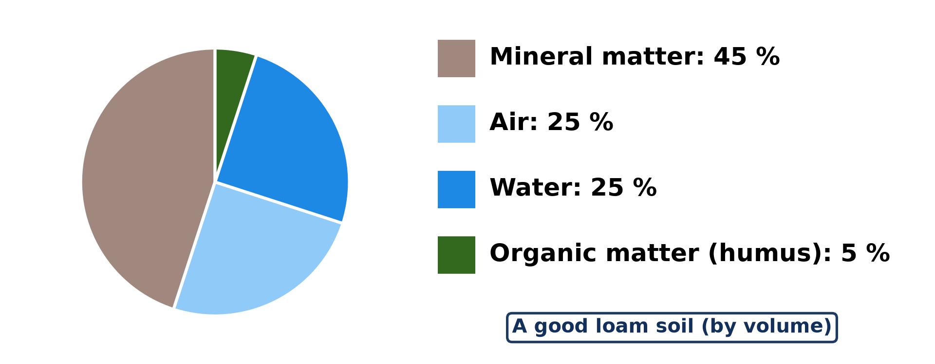
2. COMPONENTS
Activity 2
The components of a good soil.
Notes:
Activity 2. Look carefully at this diagram: the components of a good soil. Observe every detail before I ask the question.

Slide 20
2. COMPONENTS
Activity 2: Question
Name the four components of the soil.
Notes:
Here is the question for Activity 2: Name the four components of the soil. Take one minute to think and write your answer in your rough notebook.

Slide 21
2. COMPONENTS
Activity 2: Answer
Mineral matter, organic matter (humus), water and air.
Notes:
Let us check the answer together. Mineral matter, organic matter (humus), water and air.

Slide 22
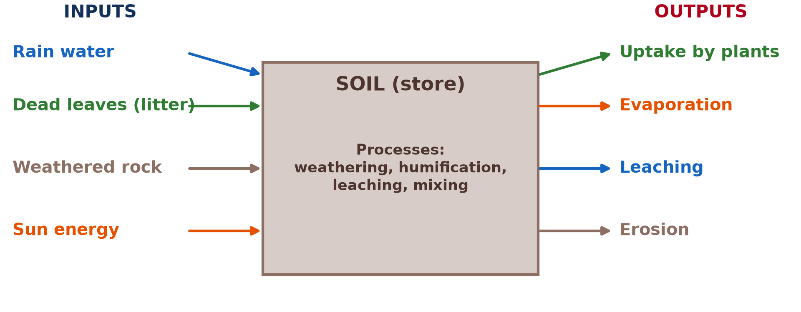
3. THE SOIL SYSTEM
Activity 3
The soil as a system.
Notes:
Activity 3. Look carefully at this diagram: the soil as a system. Observe every detail before I ask the question.

Slide 23
3. THE SOIL SYSTEM
Activity 3: Question
Give two inputs and two outputs of the soil system.
Notes:
Here is the question for Activity 3: Give two inputs and two outputs of the soil system. Take one minute to think and write your answer in your rough notebook.

Slide 24
3. THE SOIL SYSTEM
Activity 3: Answer
Inputs: rain water and dead leaves. Outputs: uptake by plants and erosion.
Notes:
Let us check the answer together. Inputs: rain water and dead leaves. Outputs: uptake by plants and erosion.

Slide 25
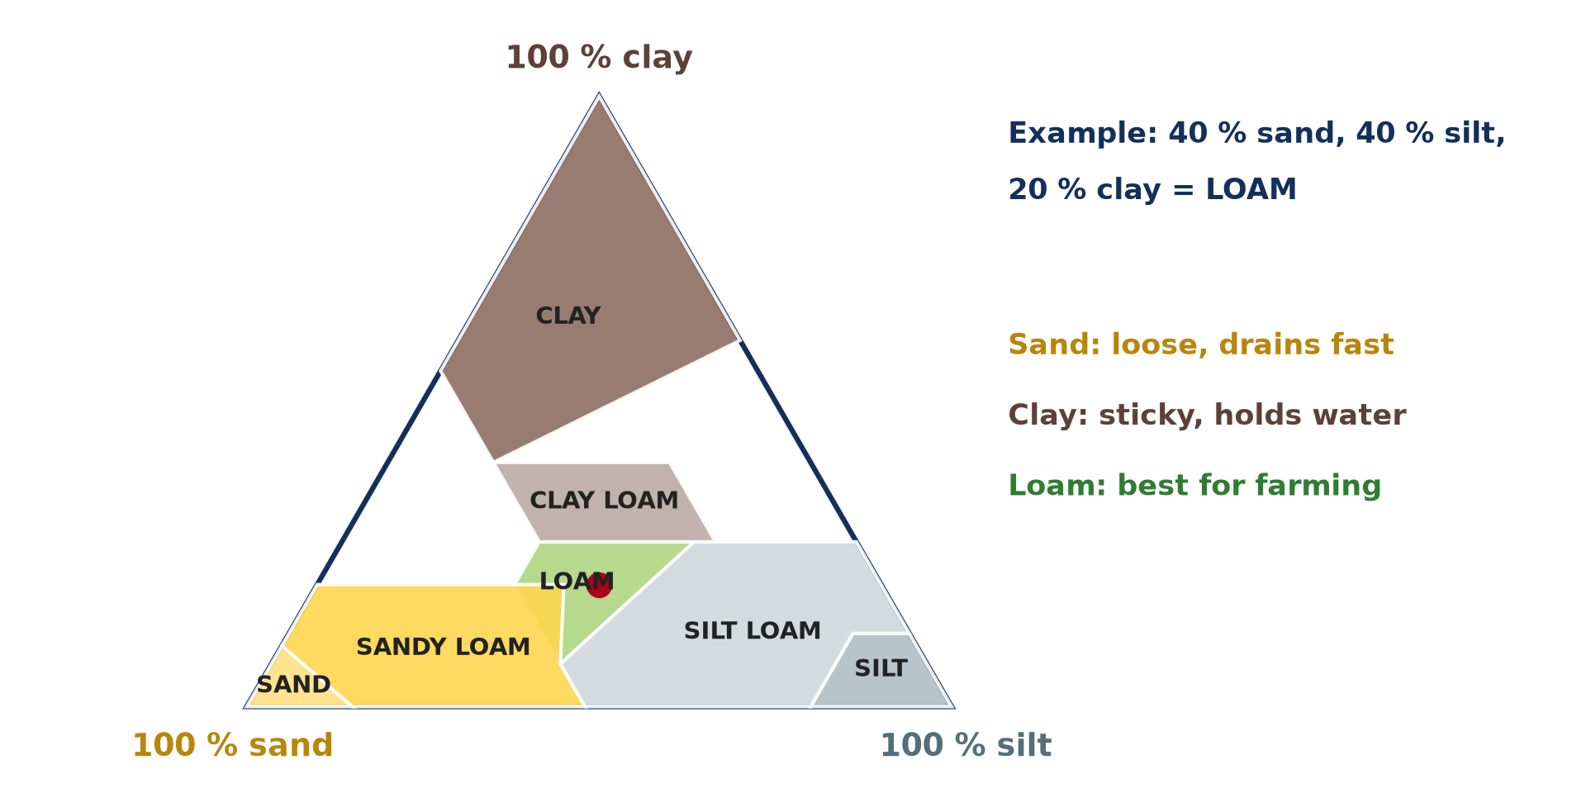
4. CHARACTERISTICS
Activity 4
Soil texture.
Notes:
Activity 4. Look carefully at this diagram: soil texture. Observe every detail before I ask the question.

Slide 26
4. CHARACTERISTICS
Activity 4: Question
What is soil texture?
Notes:
Here is the question for Activity 4: What is soil texture? Take one minute to think and write your answer in your rough notebook.

Slide 27
4. CHARACTERISTICS
Activity 4: Answer
The size of the soil particles: sand, silt and clay.
Notes:
Let us check the answer together. The size of the soil particles: sand, silt and clay.

Slide 28

4. CHARACTERISTICS
Activity 5
A fertile dark soil.
Notes:
Activity 5. Look carefully at this picture: a fertile dark soil. Observe every detail before I ask the question.

Slide 29
4. CHARACTERISTICS
Activity 5: Question
What makes a soil fertile?
Notes:
Here is the question for Activity 5: What makes a soil fertile? Take one minute to think and write your answer in your rough notebook.

Slide 30
4. CHARACTERISTICS
Activity 5: Answer
Humus, plant food (minerals), water and good depth.
Notes:
Let us check the answer together. Humus, plant food (minerals), water and good depth.

Slide 31
BOARD SUMMARY
Board Summary
Topic: Conservation of World's Biomes and Resources
Sub-topic: The Soil
Lesson 1: Concept of the Soil
Notes:
Now we are going to copy the board summary. Write the title and the headings neatly in your notebooks. I will give you enough time for each slide, so do not rush.

Slide 32
BOARD SUMMARY
1. Meaning of the Soil
The soil is defined as follows:
Soil: It is the loose top layer of the Earth's surface in which plants grow.
Notes:
Let us copy Meaning of the Soil. The soil is defined as follows. On this slide we have Soil. Write each point on a new line, with the key term first, and explain it in your own words when we revise.

Slide 33
BOARD SUMMARY
2. Components of the Soil
The soil is made up of the following components:
Mineral matter: It is made of small pieces of weathered rock and forms about 45 % of the soil.
Organic matter: It is humus from dead plants and animals and forms about 5 % of the soil.
Notes:
Let us copy Components of the Soil. The soil is made up of the following components. On this slide we have Mineral matter and Organic matter. Write each point on a new line, with the key term first, and explain it in your own words when we revise. When you finish, we go to the next slide.

Slide 34
BOARD SUMMARY
2. Components of the Soil (continued)
Water and air: They fill the spaces between the particles and form about half of the soil.
Notes:
We continue with Components of the Soil. On this slide we have Water and air. Write each point on a new line, with the key term first, and explain it in your own words when we revise.

Slide 35
BOARD SUMMARY
2. Components of the Soil
Illustration: the components of the soil
Notes:
Now draw this illustration in your notebook: the components of the soil. Give it a title and label it clearly.

Slide 36
BOARD SUMMARY
3. The Soil System
The soil works as a system:
Inputs: Rain, dead leaves, weathered rock and sun energy enter the soil.
Outputs: Plant uptake, evaporation, leaching and erosion leave the soil.
Notes:
Let us copy The Soil System. The soil works as a system. On this slide we have Inputs and Outputs. Write each point on a new line, with the key term first, and explain it in your own words when we revise.

Slide 37
BOARD SUMMARY
3. The Soil System
Illustration: the soil system
Notes:
Now draw this illustration in your notebook: the soil system. Give it a title and label it clearly.

Slide 38
BOARD SUMMARY
4. Soil Characteristics
Soils have the following characteristics:
Texture: It is the size of the particles: sand, silt or clay.
Structure: It is the way the particles are grouped together.
Notes:
Let us copy Soil Characteristics. Soils have the following characteristics. On this slide we have Texture and Structure. Write each point on a new line, with the key term first, and explain it in your own words when we revise. When you finish, we go to the next slide.

Slide 39
BOARD SUMMARY
4. Soil Characteristics (continued)
Depth and fertility: A deep soil rich in humus and minerals is fertile.
Notes:
We continue with Soil Characteristics. On this slide we have Depth and fertility. Write each point on a new line, with the key term first, and explain it in your own words when we revise.

Slide 40
FORMATIVE EVALUATION
Evaluation 1
Name the four components of the soil.
Notes:
Now let us check what you have understood. Question 1: Name the four components of the soil. Answer in your exercise book.

Slide 41
FORMATIVE EVALUATION
Expected Answer
Mineral matter, organic matter, water and air.
Notes:
The expected answer is: mineral matter, organic matter, water and air. If you got it right, well done.

Slide 42
FORMATIVE EVALUATION
Evaluation 2
What is soil texture?
Notes:
Now let us check what you have understood. Question 2: What is soil texture? Answer in your exercise book.

Slide 43
FORMATIVE EVALUATION
Expected Answer
The size of the soil particles.
Notes:
The expected answer is: the size of the soil particles. If you got it right, well done.

Slide 44
REMEDIATION
Remediation
Fill in the blanks:
Dead plants and animals give ______.
Sand, silt and clay describe soil ______.
A soil able to feed plants well is ______.
Notes:
For those who need more practice, fill in the blanks in your exercise book. The answers are: number 1, humus; number 2, texture; number 3, fertile.

Slide 45
HOMEWORK
Homework
Collect two soil samples from different places and compare their colour and texture.
Notes:
For your homework: Collect two soil samples from different places and compare their colour and texture. We shall correct it at the beginning of our next lesson.

Slide 46
NEXT LESSON
Next Lesson
Our next lesson will be on:
Lesson 2: The Soil Profile
Notes:
Our next lesson will be on Lesson 2: The Soil Profile. Thank you for your attention, and see you next time.

Slide 47
BILINGUAL GAME
Bilingual Game (Jeu Bilingue)
English | Français
Soil | Le sol
Humus | L'humus
Texture | La texture
Clay | L'argile
Sand | Le sable
Fertility | La fertilité
Notes:
Let us play the bilingual game. I say a word in English, and you give me the French word. Then we do the reverse.

Slide 48
LOGBOOK
Official Logbook (1/2)
Module / Topic | Conservation of World's Biomes and Resources
Lesson Title | Lesson 1: Concept of the Soil
Expected Learning Outcomes | Define the soil. Identify the components of the soil. Describe the soil system and the characteristics of soils.
Competence | Learners are able to define the soil, name its components and describe its characteristics.
Notes:
I record this information in the official logbook of the class after the lesson.

Slide 49
LOGBOOK
Official Logbook (2/2)
Matter Taught | Meaning of the Soil; Components of the Soil; The Soil System; Soil Characteristics.
Evaluation | Formative evaluation and remediation exercise.
Homework | Collect two soil samples from different places and compare their colour and texture.
Enrolment / Present / Absent | ____ / ____ / ____
Achievement | To be completed after the lesson.
Notes:
I complete the second page of the logbook: the matter taught, the evaluation, the homework and the attendance.

Slide 50
TEACHER'S NOTE
Teacher's Note
Timing: Homework correction, plan, objectives 8 min | Recall, situation, action 10 min | 5 activities 30 min | Board summary (copying) 30 min | Evaluation, remediation 10 min | Homework, next lesson 5 min | Logbook 7 min
Without the projector (Activity 1): show a handful of soil.
Without the projector (Activity 2): put soil in a jar of water and shake it.
Without the projector (Activity 3): draw the soil system.
Without the projector (Activity 4): rub soil between the fingers.
Without the projector (Activity 5): compare two soil samples.
Notes:
This slide is for me, the teacher: it gives the timing of the lesson and what to do if the projector is not available.

Slide 51
REFERENCES
References
Geography Syllabus, Forms I–V, MINESEC (2023) — Form 4, Module I: Ecological Systems and their Resources.
Photo, Activity 1: “Humic Dystrudept (fine-loamy, isotic, frigid)” by SoilScience.info, CC BY 2.0, via Flickr (https://www.flickr.com/photos/22503286@N06/5140645742)
Photo, Activity 5: “My date palm. Cool, huh?” by Hair Squared, CC BY-SA 2.0, via Flickr (https://www.flickr.com/photos/73119211@N00/3804244479)
Diagrams and animations: drawn for this lesson (Geography Department).
Notes:
These are the references and picture credits used to prepare this lesson.

