Slide 1
FORM 4
GEOGRAPHY
Lesson 6
The Functioning of Ecosystems
Notes:
Good morning, class, and welcome to our geography lesson. I am your geography teacher, Mr Kamdem. Today we are starting Lesson 6: The Functioning of Ecosystems.

Slide 2
CLASS INFO
Class, Chapter and Duration
Class | Form 4
Chapter | Module I: Ecological Systems and their Resources
Duration | 2 periods (2 × 50 minutes)
Notes:
This lesson is for Form 4. It belongs to Module I: Ecological Systems and their Resources. We shall need 2 periods to cover it.

Slide 3
IDENTIFICATION
Lesson Identification
Topic | Conservation of World's Biomes and Resources
Sub-topic | The Ecosystem
Lesson | Lesson 6: The Functioning of Ecosystems
Notions / Concepts | Energy, food chain, food web, trophic level.
Syllabus focus | Energy flow; trophic levels.
Competence | Learners are able to explain how energy flows through an ecosystem.
Notes:
Our topic is Conservation of World's Biomes and Resources, and the sub-topic is The Ecosystem. The key notions we shall use today are: energy, food chain, food web, trophic level. At the end, you should be able to do this: learners are able to explain how energy flows through an ecosystem.

Slide 4

HOMEWORK CORRECTION
Correction of the Homework
Question (Lesson 5: The Ecosystem):
Choose an ecosystem near your home and list three biotic and three abiotic components.
Notes:
Before we start the new lesson, let us correct the homework I gave you at the end of Lesson 5: The Ecosystem. The question was: Choose an ecosystem near your home and list three biotic and three abiotic components. Take out your exercise books.

Slide 5
HOMEWORK CORRECTION
Correction: Possible Answer
Example (a school garden): biotic – grass, ants, birds; abiotic – soil, water, sunlight.
Notes:
Here is a good answer. Example (a school garden): biotic – grass, ants, birds; abiotic – soil, water, sunlight. Compare it with your own answer and correct your work in red.

Slide 6
LESSON PLAN
Lesson Plan
Correction of the homework
Objectives and recall
Real-life situation and action to take
Learning activities
Board summary
Evaluation, remediation and homework
Notes:
Here is the plan of our lesson today. First, we shall correct the homework. Then we shall look at the objectives and recall what you already know. After that, we shall study a situation from real life and the action to take, and do the learning activities. Finally, we shall copy the board summary, do the evaluation and the remediation, and I will give you the homework.

Slide 7
OBJECTIVES
Objectives
By the end of this lesson, you should be able to:
Explain energy flow in an ecosystem.
Build a food chain and a food web.
Identify trophic levels.
Notes:
By the end of this lesson, you should be able to do three things. Number 1: explain energy flow in an ecosystem. Number 2: build a food chain and a food web. Number 3: identify trophic levels.

Slide 8
PREVIOUS KNOWLEDGE
Previous Knowledge
Plants make food from sunlight.
Animals eat plants or other animals.
Decomposers break down dead matter.
Notes:
Let us first remember what you already know. Plants make food from sunlight. Animals eat plants or other animals. Decomposers break down dead matter. Keep this in mind, because we shall build on it today.

Slide 9
REAL-LIFE SITUATION
Situation in Real Life
In Bénoué National Park, grass feeds antelopes and antelopes are eaten by lions. When poachers killed many antelopes, the lions began to attack cattle in nearby villages.
Notes:
Listen carefully to this situation from real life. In Bénoué National Park, grass feeds antelopes and antelopes are eaten by lions. When poachers killed many antelopes, the lions began to attack cattle in nearby villages. Think about it, because I am going to ask you some questions.

Slide 10
REAL-LIFE SITUATION
Situation: Question 1
What is the problem in the situation?
Notes:
Question 1: What is the problem in the situation? Think for a moment, then raise your hand to answer.

Slide 11
REAL-LIFE SITUATION
Answer
Poaching broke the food chain.
Notes:
Good. Poaching broke the food chain.

Slide 12
REAL-LIFE SITUATION
Situation: Question 2
What do antelopes eat?
Notes:
Question 2: What do antelopes eat? Think for a moment, then raise your hand to answer.

Slide 13
REAL-LIFE SITUATION
Answer
Grass.
Notes:
Good. Grass.

Slide 14
REAL-LIFE SITUATION
Situation: Question 3
Why did lions attack cattle?
Notes:
Question 3: Why did lions attack cattle? Think for a moment, then raise your hand to answer.

Slide 15
REAL-LIFE SITUATION
Possible Answer
They had fewer antelopes to eat.
Notes:
Good. They had fewer antelopes to eat.

Slide 16
ACTION TO TAKE
Action to Take
Protect wild animals and report poachers.
Notes:
From this situation, the action we are working towards in this lesson is the following: protect wild animals and report poachers.

Slide 17
JUSTIFICATION
Justification of the Lesson
This lesson helps us to understand how living things are linked by food.
Notes:
Why is this lesson important for you? This lesson helps us to understand how living things are linked by food.

Slide 18
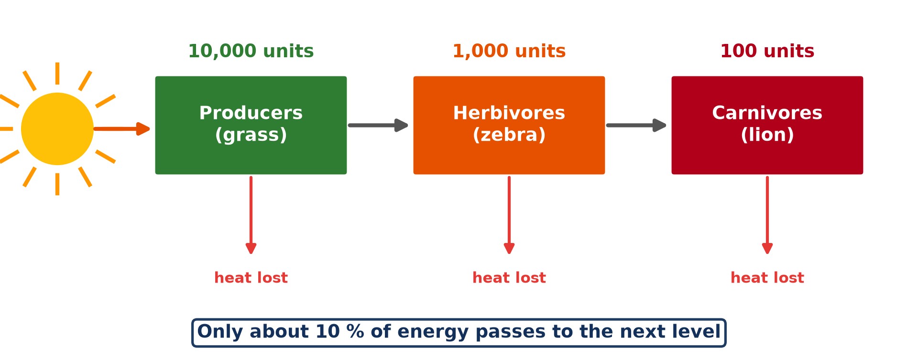
1. ENERGY FLOW
Activity 1
Energy flow from the Sun.
Notes:
Activity 1. Look carefully at this diagram: energy flow from the Sun. Observe every detail before I ask the question.

Slide 19
1. ENERGY FLOW
Activity 1: Question
Where does the energy of an ecosystem come from?
Notes:
Here is the question for Activity 1: Where does the energy of an ecosystem come from? Take one minute to think and write your answer in your rough notebook.

Slide 20
1. ENERGY FLOW
Activity 1: Answer
From the Sun, captured by green plants.
Notes:
Let us check the answer together. From the Sun, captured by green plants.

Slide 21

2. FOOD CHAIN
Activity 2
Zebras grazing.
Notes:
Activity 2. Look carefully at this picture: zebras grazing. Observe every detail before I ask the question.

Slide 22
2. FOOD CHAIN
Activity 2: Question
Build a food chain with grass, zebra and lion.
Notes:
Here is the question for Activity 2: Build a food chain with grass, zebra and lion. Take one minute to think and write your answer in your rough notebook.

Slide 23
2. FOOD CHAIN
Activity 2: Answer
Grass → zebra → lion.
Notes:
Let us check the answer together. Grass → zebra → lion.

Slide 24
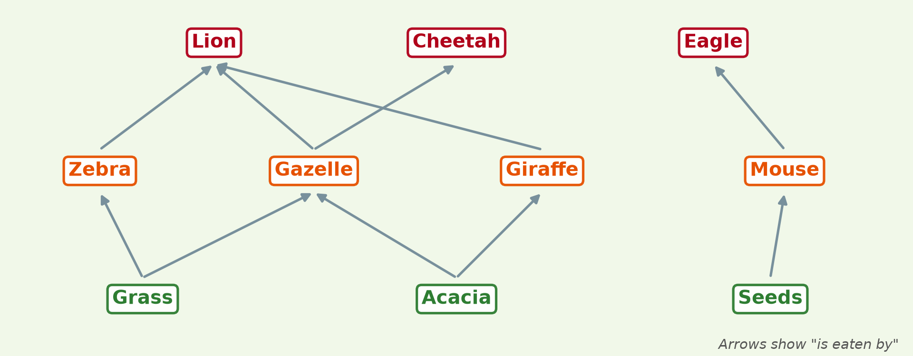
2. FOOD WEB
Activity 3
A food web of the savanna.
Notes:
Activity 3. Look carefully at this diagram: a food web of the savanna. Observe every detail before I ask the question.

Slide 25
2. FOOD WEB
Activity 3: Question
What is a food web?
Notes:
Here is the question for Activity 3: What is a food web? Take one minute to think and write your answer in your rough notebook.

Slide 26
2. FOOD WEB
Activity 3: Answer
Many food chains linked together.
Notes:
Let us check the answer together. Many food chains linked together.

Slide 27
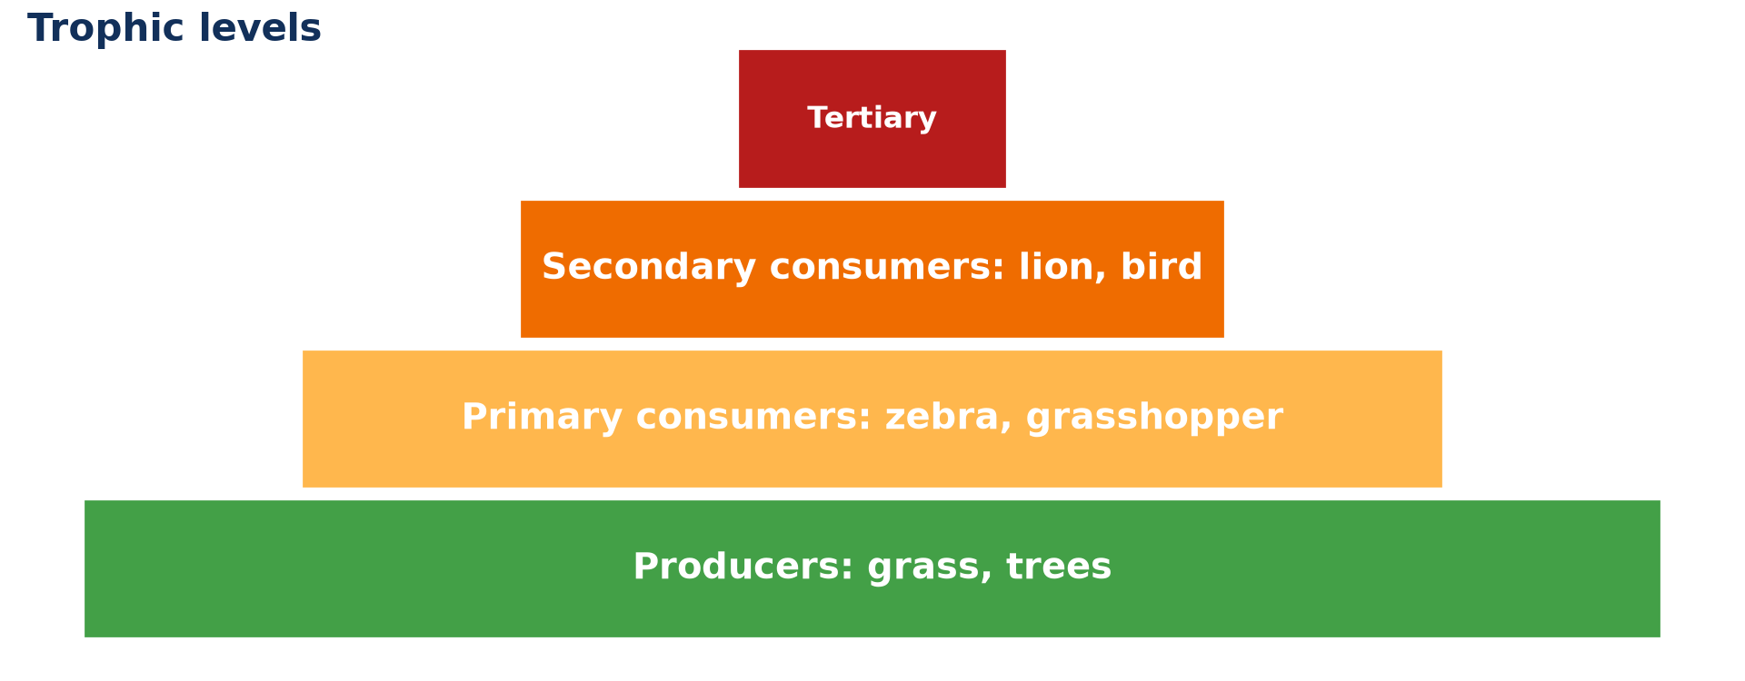
3. TROPHIC LEVELS
Activity 4
Trophic levels.
Notes:
Activity 4. Look carefully at this diagram: trophic levels. Observe every detail before I ask the question.

Slide 28
3. TROPHIC LEVELS
Activity 4: Question
Name the trophic levels from the bottom.
Notes:
Here is the question for Activity 4: Name the trophic levels from the bottom. Take one minute to think and write your answer in your rough notebook.

Slide 29
3. TROPHIC LEVELS
Activity 4: Answer
Producers, primary consumers, secondary consumers, tertiary consumers.
Notes:
Let us check the answer together. Producers, primary consumers, secondary consumers, tertiary consumers.

Slide 30
3. ENERGY LOSS
Activity 5
Energy passed at each level.
Notes:
Activity 5. Look carefully at this diagram: energy passed at each level. Observe every detail before I ask the question.

Slide 31
3. ENERGY LOSS
Activity 5: Question
Why are there fewer lions than zebras?
Notes:
Here is the question for Activity 5: Why are there fewer lions than zebras? Take one minute to think and write your answer in your rough notebook.

Slide 32
3. ENERGY LOSS
Activity 5: Answer
Only about 10 % of energy passes to the next level; the rest is lost as heat.
Notes:
Let us check the answer together. Only about 10 % of energy passes to the next level; the rest is lost as heat.

Slide 33
BOARD SUMMARY
Board Summary
Topic: Conservation of World's Biomes and Resources
Sub-topic: The Ecosystem
Lesson 6: The Functioning of Ecosystems
Notes:
Now we are going to copy the board summary. Write the title and the headings neatly in your notebooks. I will give you enough time for each slide, so do not rush.

Slide 34
BOARD SUMMARY
DEFINITIONS
The key terms of this lesson are defined as follows:
Food chain: It is the order in which living things eat one another.
Trophic level: It is the position of a living thing in a food chain.
Notes:
Let us copy the definitions. The key terms of this lesson are defined as follows. On this slide we have Food chain and Trophic level. Write each point on a new line, with the key term first, and explain it in your own words when we revise.

Slide 35
BOARD SUMMARY
1. Energy Flow
Energy flows through an ecosystem as follows:
Source: Energy comes from the Sun and is captured by green plants.
Transfer: Energy passes from plants to herbivores and then to carnivores.
Notes:
Let us copy Energy Flow. Energy flows through an ecosystem as follows. On this slide we have Source and Transfer. Write each point on a new line, with the key term first, and explain it in your own words when we revise. When you finish, we go to the next slide.

Slide 36
BOARD SUMMARY
1. Energy Flow (continued)
Loss: Only about 10 % of energy passes to the next level, and the rest is lost as heat.
Notes:
We continue with Energy Flow. On this slide we have Loss. Write each point on a new line, with the key term first, and explain it in your own words when we revise.

Slide 37
BOARD SUMMARY
1. Energy Flow
Illustration: energy flow
Notes:
Now draw this illustration in your notebook: energy flow. Give it a title and label it clearly.

Slide 38
BOARD SUMMARY
2. Food Chains, Food Webs and Trophic Levels
Living things are linked by food as follows:
Food chain: An example is grass → zebra → lion.
Food web: It is many food chains linked together.
Notes:
Let us copy Food Chains, Food Webs and Trophic Levels. Living things are linked by food as follows. On this slide we have Food chain and Food web. Write each point on a new line, with the key term first, and explain it in your own words when we revise. When you finish, we go to the next slide.

Slide 39
BOARD SUMMARY
2. Food Chains, Food Webs and Trophic Levels (continued)
Trophic levels: They are producers, primary consumers, secondary consumers and tertiary consumers.
Notes:
We continue with Food Chains, Food Webs and Trophic Levels. On this slide we have Trophic levels. Write each point on a new line, with the key term first, and explain it in your own words when we revise.

Slide 40
BOARD SUMMARY
2. Food Chains, Food Webs and Trophic Levels
Illustration: trophic levels
Notes:
Now draw this illustration in your notebook: trophic levels. Give it a title and label it clearly.

Slide 41
FORMATIVE EVALUATION
Evaluation 1
Build a food chain of three links.
Notes:
Now let us check what you have understood. Question 1: Build a food chain of three links. Answer in your exercise book.

Slide 42
FORMATIVE EVALUATION
Expected Answer
Grass → antelope → lion.
Notes:
The expected answer is: grass → antelope → lion. If you got it right, well done.

Slide 43
FORMATIVE EVALUATION
Evaluation 2
Why does energy decrease along a food chain?
Notes:
Now let us check what you have understood. Question 2: Why does energy decrease along a food chain? Answer in your exercise book.

Slide 44
FORMATIVE EVALUATION
Expected Answer
Most energy is lost as heat at each level.
Notes:
The expected answer is: most energy is lost as heat at each level. If you got it right, well done.

Slide 45
REMEDIATION
Remediation
Fill in the blanks:
The source of energy in ecosystems is the ______.
Many linked food chains form a food ______.
Herbivores are ______ consumers.
Notes:
For those who need more practice, fill in the blanks in your exercise book. The answers are: number 1, Sun; number 2, web; number 3, primary.

Slide 46
HOMEWORK
Homework
Build two food chains found in your area.
Notes:
For your homework: Build two food chains found in your area. We shall correct it at the beginning of our next lesson.

Slide 47
NEXT LESSON
Next Lesson
Our next lesson will be on:
Lesson 7: The Tropical Rainforest Biome
Notes:
Our next lesson will be on Lesson 7: The Tropical Rainforest Biome. Thank you for your attention, and see you next time.

Slide 48
BILINGUAL GAME
Bilingual Game (Jeu Bilingue)
English | Français
Food chain | La chaîne alimentaire
Energy | L'énergie
Herbivore | L'herbivore
Carnivore | Le carnivore
Level | Le niveau
Predator | Le prédateur
Notes:
Let us play the bilingual game. I say a word in English, and you give me the French word. Then we do the reverse.

Slide 49
LOGBOOK
Official Logbook (1/2)
Module / Topic | Conservation of World's Biomes and Resources
Lesson Title | Lesson 6: The Functioning of Ecosystems
Expected Learning Outcomes | Explain energy flow in an ecosystem. Build a food chain and a food web. Identify trophic levels.
Competence | Learners are able to explain how energy flows through an ecosystem.
Notes:
I record this information in the official logbook of the class after the lesson.

Slide 50
LOGBOOK
Official Logbook (2/2)
Matter Taught | DEFINITIONS; Energy Flow; Food Chains, Food Webs and Trophic Levels.
Evaluation | Formative evaluation and remediation exercise.
Homework | Build two food chains found in your area.
Enrolment / Present / Absent | ____ / ____ / ____
Achievement | To be completed after the lesson.
Notes:
I complete the second page of the logbook: the matter taught, the evaluation, the homework and the attendance.

Slide 51
TEACHER'S NOTE
Teacher's Note
Timing: Homework correction, plan, objectives 8 min | Recall, situation, action 10 min | 5 activities 30 min | Board summary (copying) 30 min | Evaluation, remediation 10 min | Homework, next lesson 5 min | Logbook 7 min
Without the projector (Activity 1): draw the Sun and a plant.
Without the projector (Activity 2): write the chain with arrows.
Without the projector (Activity 3): draw a web on the board.
Without the projector (Activity 4): draw a pyramid.
Without the projector (Activity 5): use numbers 1,000 → 100 → 10.
Notes:
This slide is for me, the teacher: it gives the timing of the lesson and what to do if the projector is not available.

Slide 52
REFERENCES
References
Geography Syllabus, Forms I–V, MINESEC (2023) — Form 4, Module I: Ecological Systems and their Resources.
Photo, Activity 2: “Zebra” by mape_s, CC BY 2.0, via Flickr (https://www.flickr.com/photos/50931380@N00/333863114)
Diagrams and animations: drawn for this lesson (Geography Department).
Notes:
These are the references and picture credits used to prepare this lesson.

