Slide 1
FORM 4
GEOGRAPHY
Lesson 9
The Tropical Monsoon Biome
Notes:
Good morning, class, and welcome to our geography lesson. I am your geography teacher, Mr Kamdem. Today we are starting Lesson 9: The Tropical Monsoon Biome.

Slide 2
CLASS INFO
Class, Chapter and Duration
Class | Form 4
Chapter | Module I: Ecological Systems and their Resources
Duration | 2 periods (2 × 50 minutes)
Notes:
This lesson is for Form 4. It belongs to Module I: Ecological Systems and their Resources. We shall need 2 periods to cover it.

Slide 3
IDENTIFICATION
Lesson Identification
Topic | Conservation of World's Biomes and Resources
Sub-topic | Tropical Biomes and their Significance
Lesson | Lesson 9: The Tropical Monsoon Biome
Notions / Concepts | Monsoon, deciduous forest, lumbering, wet rice.
Syllabus focus | Location; characteristics (climate, vegetation, soils, animal life); human activities.
Competence | Learners are able to describe the tropical monsoon biome and its human activities.
Notes:
Our topic is Conservation of World's Biomes and Resources, and the sub-topic is Tropical Biomes and their Significance. The key notions we shall use today are: monsoon, deciduous forest, lumbering, wet rice. At the end, you should be able to do this: learners are able to describe the tropical monsoon biome and its human activities.

Slide 4

HOMEWORK CORRECTION
Correction of the Homework
Question (Lesson 8: The Tropical Wet and Dry (Savanna) Biome):
List five activities of people in the savanna around your home.
Notes:
Before we start the new lesson, let us correct the homework I gave you at the end of Lesson 8: The Tropical Wet and Dry (Savanna) Biome. The question was: List five activities of people in the savanna around your home. Take out your exercise books.

Slide 5
HOMEWORK CORRECTION
Correction: Possible Answer
Farming sorghum and cotton, rearing cattle, making crafts (mats, pottery), trading in markets, fishing in the Benue.
Notes:
Here is a good answer. Farming sorghum and cotton, rearing cattle, making crafts (mats, pottery), trading in markets, fishing in the Benue. Compare it with your own answer and correct your work in red.

Slide 6
LESSON PLAN
Lesson Plan
Correction of the homework
Objectives and recall
Real-life situation and action to take
Learning activities
Board summary
Evaluation, remediation and homework
Notes:
Here is the plan of our lesson today. First, we shall correct the homework. Then we shall look at the objectives and recall what you already know. After that, we shall study a situation from real life and the action to take, and do the learning activities. Finally, we shall copy the board summary, do the evaluation and the remediation, and I will give you the homework.

Slide 7
OBJECTIVES
Objectives
By the end of this lesson, you should be able to:
Locate the monsoon biome.
Describe its climate, vegetation, soils and animal life.
Describe its human activities.
Notes:
By the end of this lesson, you should be able to do three things. Number 1: locate the monsoon biome. Number 2: describe its climate, vegetation, soils and animal life. Number 3: describe its human activities.

Slide 8
PREVIOUS KNOWLEDGE
Previous Knowledge
Winds blow from high to low pressure.
Cameroon has a south-west monsoon.
Rice needs a lot of water.
Notes:
Let us first remember what you already know. Winds blow from high to low pressure. Cameroon has a south-west monsoon. Rice needs a lot of water. Keep this in mind, because we shall build on it today.

Slide 9
REAL-LIFE SITUATION
Situation in Real Life
In India, farmers wait for the summer monsoon wind from the sea. When it comes, heavy rains fall and they plant rice in flooded fields. When it is late, there is famine.
Notes:
Listen carefully to this situation from real life. In India, farmers wait for the summer monsoon wind from the sea. When it comes, heavy rains fall and they plant rice in flooded fields. When it is late, there is famine. Think about it, because I am going to ask you some questions.

Slide 10
REAL-LIFE SITUATION
Situation: Question 1
What is the problem in the situation?
Notes:
Question 1: What is the problem in the situation? Think for a moment, then raise your hand to answer.

Slide 11
REAL-LIFE SITUATION
Answer
Farmers depend on the monsoon rains.
Notes:
Good. Farmers depend on the monsoon rains.

Slide 12
REAL-LIFE SITUATION
Situation: Question 2
Where does the summer monsoon come from?
Notes:
Question 2: Where does the summer monsoon come from? Think for a moment, then raise your hand to answer.

Slide 13
REAL-LIFE SITUATION
Answer
From the sea.
Notes:
Good. From the sea.

Slide 14
REAL-LIFE SITUATION
Situation: Question 3
What happens when the monsoon is late?
Notes:
Question 3: What happens when the monsoon is late? Think for a moment, then raise your hand to answer.

Slide 15
REAL-LIFE SITUATION
Possible Answer
Harvests fail and there is famine.
Notes:
Good. Harvests fail and there is famine.

Slide 16
ACTION TO TAKE
Action to Take
Compare the monsoon with the rainy season of Cameroon.
Notes:
From this situation, the action we are working towards in this lesson is the following: compare the monsoon with the rainy season of Cameroon.

Slide 17
JUSTIFICATION
Justification of the Lesson
This lesson helps us to understand the monsoon biome, where many people live.
Notes:
Why is this lesson important for you? This lesson helps us to understand the monsoon biome, where many people live.

Slide 18

1. LOCATION
Activity 1
Biomes of the world.
Notes:
Activity 1. Look carefully at this diagram: biomes of the world. Observe every detail before I ask the question.

Slide 19
1. LOCATION
Activity 1: Question
Where is the monsoon biome found?
Notes:
Here is the question for Activity 1: Where is the monsoon biome found? Take one minute to think and write your answer in your rough notebook.

Slide 20
1. LOCATION
Activity 1: Answer
In South and South-East Asia (India, Bangladesh, Myanmar) and northern Australia.
Notes:
Let us check the answer together. In South and South-East Asia (India, Bangladesh, Myanmar) and northern Australia.

Slide 21
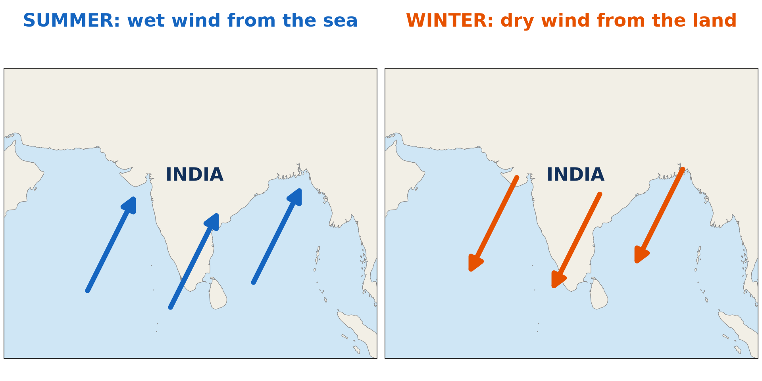
2. CLIMATE
Activity 2
Summer and winter monsoons.
Notes:
Activity 2. Look carefully at this diagram: summer and winter monsoons. Observe every detail before I ask the question.

Slide 22
2. CLIMATE
Activity 2: Question
Describe the two monsoon winds.
Notes:
Here is the question for Activity 2: Describe the two monsoon winds. Take one minute to think and write your answer in your rough notebook.

Slide 23
2. CLIMATE
Activity 2: Answer
In summer, a wet wind blows from the sea and brings rain; in winter, a dry wind blows from the land.
Notes:
Let us check the answer together. In summer, a wet wind blows from the sea and brings rain; in winter, a dry wind blows from the land.

Slide 24
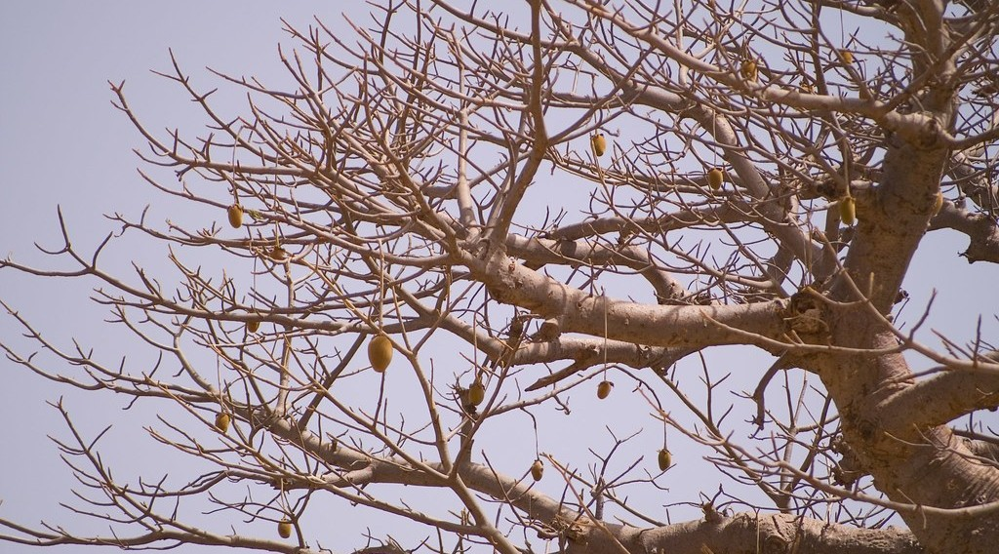
2. VEGETATION
Activity 3
Trees without leaves in the dry season.
Notes:
Activity 3. Look carefully at this picture: trees without leaves in the dry season. Observe every detail before I ask the question.

Slide 25
2. VEGETATION
Activity 3: Question
Why do monsoon forest trees lose their leaves?
Notes:
Here is the question for Activity 3: Why do monsoon forest trees lose their leaves? Take one minute to think and write your answer in your rough notebook.

Slide 26
2. VEGETATION
Activity 3: Answer
To save water during the dry season: they are deciduous.
Notes:
Let us check the answer together. To save water during the dry season: they are deciduous.

Slide 27
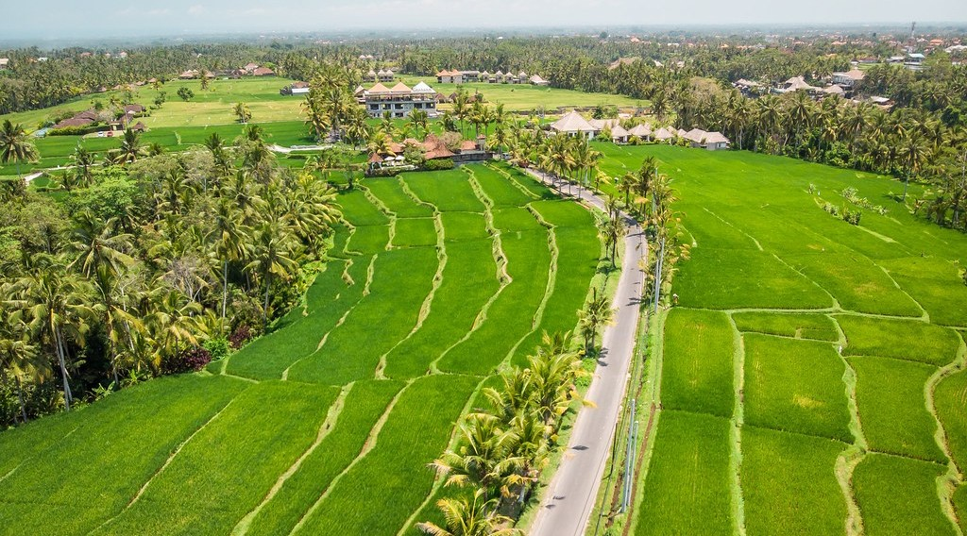
3. HUMAN ACTIVITIES
Activity 4
Rice fields in Asia.
Notes:
Activity 4. Look carefully at this picture: rice fields in Asia. Observe every detail before I ask the question.

Slide 28
3. HUMAN ACTIVITIES
Activity 4: Question
Which crop is grown in flooded fields in the monsoon lands?
Notes:
Here is the question for Activity 4: Which crop is grown in flooded fields in the monsoon lands? Take one minute to think and write your answer in your rough notebook.

Slide 29
3. HUMAN ACTIVITIES
Activity 4: Answer
Wet rice (paddy).
Notes:
Let us check the answer together. Wet rice (paddy).

Slide 30

3. HUMAN ACTIVITIES
Activity 5
A sawmill.
Notes:
Activity 5. Look carefully at this picture: a sawmill. Observe every detail before I ask the question.

Slide 31
3. HUMAN ACTIVITIES
Activity 5: Question
Which valuable tree of the monsoon forest is cut for timber?
Notes:
Here is the question for Activity 5: Which valuable tree of the monsoon forest is cut for timber? Take one minute to think and write your answer in your rough notebook.

Slide 32
3. HUMAN ACTIVITIES
Activity 5: Answer
Teak (also sal).
Notes:
Let us check the answer together. Teak (also sal).

Slide 33
BOARD SUMMARY
Board Summary
Topic: Conservation of World's Biomes and Resources
Sub-topic: Tropical Biomes and their Significance
Lesson 9: The Tropical Monsoon Biome
Notes:
Now we are going to copy the board summary. Write the title and the headings neatly in your notebooks. I will give you enough time for each slide, so do not rush.

Slide 34
BOARD SUMMARY
1. Location
The monsoon biome is located as follows:
Location: It is found in South and South-East Asia, such as India and Bangladesh, and in northern Australia.
Notes:
Let us copy Location. The monsoon biome is located as follows. On this slide we have Location. Write each point on a new line, with the key term first, and explain it in your own words when we revise.

Slide 35
BOARD SUMMARY
2. Characteristics
The monsoon biome has the following characteristics:
Climate: A wet summer monsoon from the sea brings heavy rain, and a dry winter monsoon blows from the land.
Notes:
Let us copy Characteristics. The monsoon biome has the following characteristics. On this slide we have Climate. Write each point on a new line, with the key term first, and explain it in your own words when we revise. When you finish, we go to the next slide.

Slide 36
BOARD SUMMARY
2. Characteristics (continued)
Vegetation: It is a deciduous forest whose trees, such as teak, lose their leaves in the dry season.
Soils: The soils are red and alluvial soils, fertile in river valleys.
Animal life: Tigers, elephants, monkeys and many birds live there.
Notes:
We continue with Characteristics. On this slide we have Vegetation, Soils and Animal life. Write each point on a new line, with the key term first, and explain it in your own words when we revise.

Slide 37
BOARD SUMMARY
2. Characteristics
Illustration: summer and winter monsoons
Notes:
Now draw this illustration in your notebook: summer and winter monsoons. Give it a title and label it clearly.

Slide 38
BOARD SUMMARY
3. Human Activities
People carry out the following activities:
Wet rice farming: Farmers grow rice in flooded fields during the monsoon.
Lumbering: Teak and sal are cut for timber.
Other activities: People grow tea and jute and rear cattle and buffaloes.
Notes:
Let us copy Human Activities. People carry out the following activities. On this slide we have Wet rice farming, Lumbering and Other activities. Write each point on a new line, with the key term first, and explain it in your own words when we revise.

Slide 39
FORMATIVE EVALUATION
Evaluation 1
What is a monsoon?
Notes:
Now let us check what you have understood. Question 1: What is a monsoon? Answer in your exercise book.

Slide 40
FORMATIVE EVALUATION
Expected Answer
A seasonal wind that changes direction between summer and winter.
Notes:
The expected answer is: a seasonal wind that changes direction between summer and winter. If you got it right, well done.

Slide 41
FORMATIVE EVALUATION
Evaluation 2
Give two human activities.
Notes:
Now let us check what you have understood. Question 2: Give two human activities. Answer in your exercise book.

Slide 42
FORMATIVE EVALUATION
Expected Answer
Wet rice farming and lumbering.
Notes:
The expected answer is: wet rice farming and lumbering. If you got it right, well done.

Slide 43
REMEDIATION
Remediation
Fill in the blanks:
The wet summer wind comes from the ______.
Trees that lose their leaves are ______.
The main crop of monsoon lands is ______.
Notes:
For those who need more practice, fill in the blanks in your exercise book. The answers are: number 1, sea; number 2, deciduous; number 3, rice.

Slide 44
HOMEWORK
Homework
Compare the monsoon of India with the rainy season of Garoua: give one similarity and one difference.
Notes:
For your homework: Compare the monsoon of India with the rainy season of Garoua: give one similarity and one difference. We shall correct it at the beginning of our next lesson.

Slide 45
NEXT LESSON
Next Lesson
Our next lesson will be on:
Lesson 10: The Tropical Hot Desert Biome
Notes:
Our next lesson will be on Lesson 10: The Tropical Hot Desert Biome. Thank you for your attention, and see you next time.

Slide 46
BILINGUAL GAME
Bilingual Game (Jeu Bilingue)
English | Français
Monsoon | La mousson
Rice | Le riz
Teak | Le teck
Deciduous | Caduc
Flood | L'inondation
Tiger | Le tigre
Notes:
Let us play the bilingual game. I say a word in English, and you give me the French word. Then we do the reverse.

Slide 47
LOGBOOK
Official Logbook (1/2)
Module / Topic | Conservation of World's Biomes and Resources
Lesson Title | Lesson 9: The Tropical Monsoon Biome
Expected Learning Outcomes | Locate the monsoon biome. Describe its climate, vegetation, soils and animal life. Describe its human activities.
Competence | Learners are able to describe the tropical monsoon biome and its human activities.
Notes:
I record this information in the official logbook of the class after the lesson.

Slide 48
LOGBOOK
Official Logbook (2/2)
Matter Taught | Location; Characteristics; Human Activities.
Evaluation | Formative evaluation and remediation exercise.
Homework | Compare the monsoon of India with the rainy season of Garoua: give one similarity and one difference.
Enrolment / Present / Absent | ____ / ____ / ____
Achievement | To be completed after the lesson.
Notes:
I complete the second page of the logbook: the matter taught, the evaluation, the homework and the attendance.

Slide 49
TEACHER'S NOTE
Teacher's Note
Timing: Homework correction, plan, objectives 8 min | Recall, situation, action 10 min | 5 activities 30 min | Board summary (copying) 30 min | Evaluation, remediation 10 min | Homework, next lesson 5 min | Logbook 7 min
Without the projector (Activity 1): use the atlas.
Without the projector (Activity 2): draw arrows on a map of India.
Without the projector (Activity 3): compare with savanna trees.
Without the projector (Activity 4): describe rice fields of Yagoua.
Without the projector (Activity 5): name furniture woods.
Notes:
This slide is for me, the teacher: it gives the timing of the lesson and what to do if the projector is not available.

Slide 50
REFERENCES
References
Geography Syllabus, Forms I–V, MINESEC (2023) — Form 4, Module I: Ecological Systems and their Resources.
Photo, Activity 3: “'Pain de singe' (monkey's bread) in a baobab, Senegal” by Milamber's portfolio, CC BY-NC-ND 2.0, via Flickr (https://www.flickr.com/photos/90956808@N00/420120264)
Photo, Activity 4: “Drone view of rice plantation on bali island with path to walk around ” by Artem Beliaikin, CC0 1.0, via Flickr (https://www.flickr.com/photos/157635012@N07/46229046541)
Photo, Activity 5: “CBCF Project, Yogyakarta” by CIFOR, CC BY-NC-ND 2.0, via Flickr (https://www.flickr.com/photos/45423546@N07/35977173724)
Diagrams and animations: drawn for this lesson (Geography Department).
Notes:
These are the references and picture credits used to prepare this lesson.

