Slide 1
FORM 4
GEOGRAPHY
Practical Work 6
Map Copying, Reduction and Enlargement
Notes:
Good morning, class, and welcome to our geography lesson. I am your geography teacher, Mr Kamdem. Today we are starting Practical Work 6: Map Copying, Reduction and Enlargement.

Slide 2
CLASS INFO
Class, Chapter and Duration
Class | Form 4
Chapter | Module I: Ecological Systems and their Resources
Duration | 2 periods (2 × 50 minutes)
Notes:
This lesson is for Form 4. It belongs to Module I: Ecological Systems and their Resources. We shall need 2 periods to cover it.

Slide 3
IDENTIFICATION
Lesson Identification
Topic | Initiation to Map Analysis
Sub-topic | Map Reading
Lesson | Practical Work 6: Map Copying, Reduction and Enlargement
Notions / Concepts | Map copying, reduction, enlargement, grid method.
Syllabus focus | Map copying; reduction and enlargement of maps.
Competence | Learners are able to copy, reduce and enlarge maps using the grid method.
Notes:
Our topic is Initiation to Map Analysis, and the sub-topic is Map Reading. The key notions we shall use today are: map copying, reduction, enlargement, grid method. At the end, you should be able to do this: learners are able to copy, reduce and enlarge maps using the grid method.

Slide 4

HOMEWORK CORRECTION
Correction of the Homework
Question (Practical Work 5: Scales and Map Measurements):
On a 1:50,000 map extract, measure the length of a river and the area of a forest.
Notes:
Before we start the new lesson, let us correct the homework I gave you at the end of Practical Work 5: Scales and Map Measurements. The question was: On a 1:50,000 map extract, measure the length of a river and the area of a forest. Take out your exercise books.

Slide 5
HOMEWORK CORRECTION
Correction: Possible Answer
Answers depend on the map. Correct method: river length = thread length in cm × 0.5 km; forest area = full squares + half the part squares, in km².
Notes:
Here is a good answer. Answers depend on the map. Correct method: river length = thread length in cm × 0.5 km; forest area = full squares + half the part squares, in km². Compare it with your own answer and correct your work in red.

Slide 6
LESSON PLAN
Lesson Plan
Correction of the homework
Objectives and recall
Real-life situation and action to take
Learning activities
Board summary
Evaluation, remediation and homework
Notes:
Here is the plan of our lesson today. First, we shall correct the homework. Then we shall look at the objectives and recall what you already know. After that, we shall study a situation from real life and the action to take, and do the learning activities. Finally, we shall copy the board summary, do the evaluation and the remediation, and I will give you the homework.

Slide 7
OBJECTIVES
Objectives
By the end of this lesson, you should be able to:
Explain the grid method of map copying.
Reduce a map.
Enlarge a map.
Notes:
By the end of this lesson, you should be able to do three things. Number 1: explain the grid method of map copying. Number 2: reduce a map. Number 3: enlarge a map.

Slide 8
PREVIOUS KNOWLEDGE
Previous Knowledge
Maps have grid lines.
A scale shows the size of a map.
A sketch map is a simple drawing.
Notes:
Let us first remember what you already know. Maps have grid lines. A scale shows the size of a map. A sketch map is a simple drawing. Keep this in mind, because we shall build on it today.

Slide 9
REAL-LIFE SITUATION
Situation in Real Life
For an exhibition, the class must draw a big map of Cameroon on a wall from a small map in the atlas, and a small map of the region in their notebooks.
Notes:
Listen carefully to this situation from real life. For an exhibition, the class must draw a big map of Cameroon on a wall from a small map in the atlas, and a small map of the region in their notebooks. Think about it, because I am going to ask you some questions.

Slide 10
REAL-LIFE SITUATION
Situation: Question 1
What is the problem in the situation?
Notes:
Question 1: What is the problem in the situation? Think for a moment, then raise your hand to answer.

Slide 11
REAL-LIFE SITUATION
Answer
The class must enlarge and reduce maps.
Notes:
Good. The class must enlarge and reduce maps.

Slide 12
REAL-LIFE SITUATION
Situation: Question 2
Which map must be enlarged?
Notes:
Question 2: Which map must be enlarged? Think for a moment, then raise your hand to answer.

Slide 13
REAL-LIFE SITUATION
Answer
The atlas map of Cameroon for the wall.
Notes:
Good. The atlas map of Cameroon for the wall.

Slide 14
REAL-LIFE SITUATION
Situation: Question 3
Which method helps?
Notes:
Question 3: Which method helps? Think for a moment, then raise your hand to answer.

Slide 15
REAL-LIFE SITUATION
Possible Answer
The grid (square) method.
Notes:
Good. The grid (square) method.

Slide 16
ACTION TO TAKE
Action to Take
Draw light grids with a pencil and copy square by square.
Notes:
From this situation, the action we are working towards in this lesson is the following: draw light grids with a pencil and copy square by square.

Slide 17
JUSTIFICATION
Justification of the Lesson
This practical work helps us to draw accurate maps of any size.
Notes:
Why is this lesson important for you? This practical work helps us to draw accurate maps of any size.

Slide 18
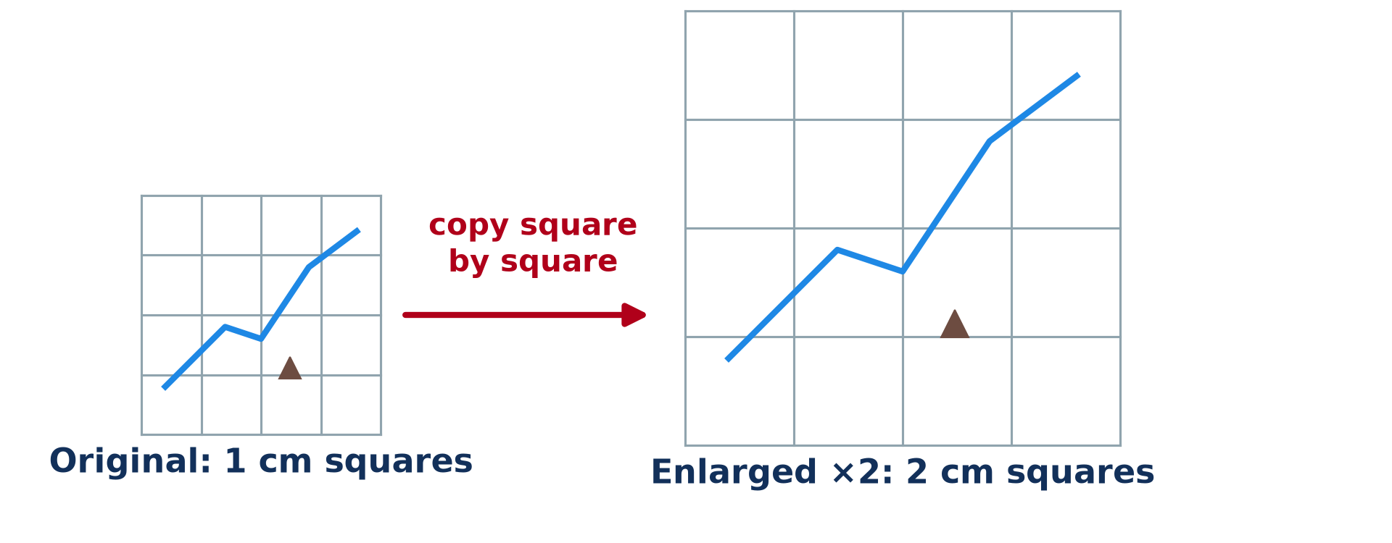
1. MAP COPYING
Activity 1
The grid method.
Notes:
Activity 1. Look carefully at this diagram: the grid method. Observe every detail before I ask the question.

Slide 19
1. MAP COPYING
Activity 1: Question
Describe the grid method of copying a map.
Notes:
Here is the question for Activity 1: Describe the grid method of copying a map. Take one minute to think and write your answer in your rough notebook.

Slide 20
1. MAP COPYING
Activity 1: Answer
Draw a grid on the original and the same number of squares on the new paper, then copy each square.
Notes:
Let us check the answer together. Draw a grid on the original and the same number of squares on the new paper, then copy each square.

Slide 21
2. ENLARGEMENT
Activity 2
Enlarging a map two times.
Notes:
Activity 2. Look carefully at this diagram: enlarging a map two times. Observe every detail before I ask the question.

Slide 22
2. ENLARGEMENT
Activity 2: Question
To enlarge a map two times, what size must the new squares be?
Notes:
Here is the question for Activity 2: To enlarge a map two times, what size must the new squares be? Take one minute to think and write your answer in your rough notebook.

Slide 23
2. ENLARGEMENT
Activity 2: Answer
Twice as long: 1 cm squares become 2 cm squares.
Notes:
Let us check the answer together. Twice as long: 1 cm squares become 2 cm squares.

Slide 24
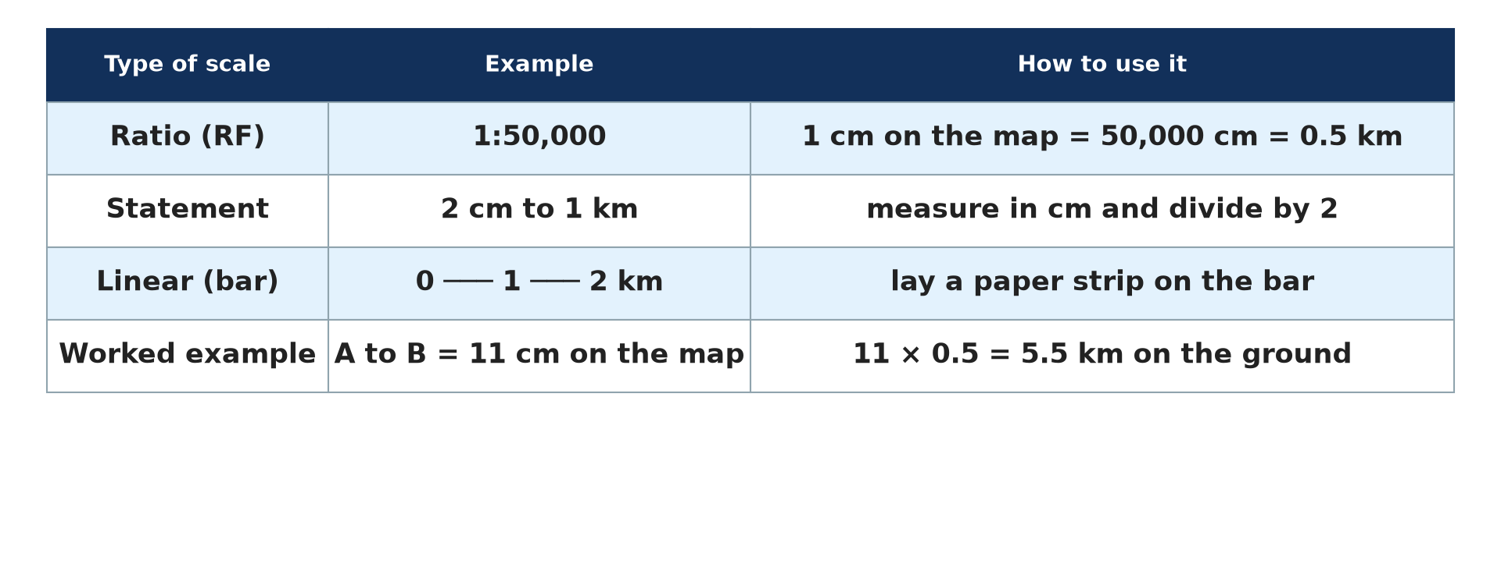
2. EFFECT ON SCALE
Activity 3
Scales.
Notes:
Activity 3. Look carefully at this diagram: scales. Observe every detail before I ask the question.

Slide 25
2. EFFECT ON SCALE
Activity 3: Question
What happens to the scale when a 1:100,000 map is enlarged two times?
Notes:
Here is the question for Activity 3: What happens to the scale when a 1:100,000 map is enlarged two times? Take one minute to think and write your answer in your rough notebook.

Slide 26
2. EFFECT ON SCALE
Activity 3: Answer
It becomes 1:50,000.
Notes:
Let us check the answer together. It becomes 1:50,000.

Slide 27

3. REDUCTION
Activity 4
A map of Cameroon with a grid.
Notes:
Activity 4. Look carefully at this diagram: a map of Cameroon with a grid. Observe every detail before I ask the question.

Slide 28
3. REDUCTION
Activity 4: Question
To reduce a map by half, what size must the new squares be?
Notes:
Here is the question for Activity 4: To reduce a map by half, what size must the new squares be? Take one minute to think and write your answer in your rough notebook.

Slide 29
3. REDUCTION
Activity 4: Answer
Half as long: 2 cm squares become 1 cm squares.
Notes:
Let us check the answer together. Half as long: 2 cm squares become 1 cm squares.

Slide 30

3. EFFECT ON SCALE
Activity 5
Elements of a map.
Notes:
Activity 5. Look carefully at this diagram: elements of a map. Observe every detail before I ask the question.

Slide 31
3. EFFECT ON SCALE
Activity 5: Question
What must be added to a copied map?
Notes:
Here is the question for Activity 5: What must be added to a copied map? Take one minute to think and write your answer in your rough notebook.

Slide 32
3. EFFECT ON SCALE
Activity 5: Answer
A title, a key, a new scale and a north arrow.
Notes:
Let us check the answer together. A title, a key, a new scale and a north arrow.

Slide 33
BOARD SUMMARY
Board Summary
Topic: Initiation to Map Analysis
Sub-topic: Map Reading
Practical Work 6: Map Copying, Reduction and Enlargement
Notes:
Now we are going to copy the board summary. Write the title and the headings neatly in your notebooks. I will give you enough time for each slide, so do not rush.

Slide 34
BOARD SUMMARY
DEFINITIONS
The key terms of this lesson are defined as follows:
Enlargement: It is drawing a map bigger than the original.
Reduction: It is drawing a map smaller than the original.
Notes:
Let us copy the definitions. The key terms of this lesson are defined as follows. On this slide we have Enlargement and Reduction. Write each point on a new line, with the key term first, and explain it in your own words when we revise.

Slide 35
BOARD SUMMARY
1. The Grid Method
Maps are copied with the grid method as follows:
Step 1: We draw a grid of equal squares over the original map.
Step 2: We draw the same number of squares on the new paper, bigger or smaller as needed.
Notes:
Let us copy The Grid Method. Maps are copied with the grid method as follows. On this slide we have Step 1 and Step 2. Write each point on a new line, with the key term first, and explain it in your own words when we revise. When you finish, we go to the next slide.

Slide 36
BOARD SUMMARY
1. The Grid Method (continued)
Step 3: We copy the features square by square and add the title, key, scale and north arrow.
Notes:
We continue with The Grid Method. On this slide we have Step 3. Write each point on a new line, with the key term first, and explain it in your own words when we revise.

Slide 37
BOARD SUMMARY
1. The Grid Method
Illustration: enlarging a map
Notes:
Now draw this illustration in your notebook: enlarging a map. Give it a title and label it clearly.

Slide 38
BOARD SUMMARY
2. Reduction and Enlargement
The scale changes as follows:
Enlargement: Enlarging two times doubles the square side and changes 1:100,000 to 1:50,000.
Reduction: Reducing by half halves the square side and changes 1:50,000 to 1:100,000.
Notes:
Let us copy Reduction and Enlargement. The scale changes as follows. On this slide we have Enlargement and Reduction. Write each point on a new line, with the key term first, and explain it in your own words when we revise.

Slide 39
FORMATIVE EVALUATION
Evaluation 1
Describe the grid method.
Notes:
Now let us check what you have understood. Question 1: Describe the grid method. Answer in your exercise book.

Slide 40
FORMATIVE EVALUATION
Expected Answer
Draw equal grids on both papers and copy square by square.
Notes:
The expected answer is: draw equal grids on both papers and copy square by square. If you got it right, well done.

Slide 41
FORMATIVE EVALUATION
Evaluation 2
A 1:50,000 map is reduced by half. Give the new scale.
Notes:
Now let us check what you have understood. Question 2: A 1:50,000 map is reduced by half. Give the new scale. Answer in your exercise book.

Slide 42
FORMATIVE EVALUATION
Expected Answer
1:100,000.
Notes:
The expected answer is: 1:100,000. If you got it right, well done.

Slide 43
REMEDIATION
Remediation
Fill in the blanks:
Making a map bigger is ______.
Making a map smaller is ______.
Maps are copied square by square with the ______ method.
Notes:
For those who need more practice, fill in the blanks in your exercise book. The answers are: number 1, enlargement; number 2, reduction; number 3, grid.

Slide 44
HOMEWORK
Homework
Enlarge the map of your region two times using the grid method.
Notes:
For your homework: Enlarge the map of your region two times using the grid method. We shall correct it at the beginning of our next lesson.

Slide 45
NEXT LESSON
Next Lesson
Our next lesson will be on:
Practical Work 7: Interpreting Relief Forms from Maps
Notes:
Our next lesson will be on Practical Work 7: Interpreting Relief Forms from Maps. Thank you for your attention, and see you next time.

Slide 46
BILINGUAL GAME
Bilingual Game (Jeu Bilingue)
English | Français
Copy | La copie
Enlargement | L'agrandissement
Reduction | La réduction
Grid | Le quadrillage
Pencil | Le crayon
Drawing | Le dessin
Notes:
Let us play the bilingual game. I say a word in English, and you give me the French word. Then we do the reverse.

Slide 47
LOGBOOK
Official Logbook (1/2)
Module / Topic | Initiation to Map Analysis
Lesson Title | Practical Work 6: Map Copying, Reduction and Enlargement
Expected Learning Outcomes | Explain the grid method of map copying. Reduce a map. Enlarge a map.
Competence | Learners are able to copy, reduce and enlarge maps using the grid method.
Notes:
I record this information in the official logbook of the class after the lesson.

Slide 48
LOGBOOK
Official Logbook (2/2)
Matter Taught | DEFINITIONS; The Grid Method; Reduction and Enlargement.
Evaluation | Formative evaluation and remediation exercise.
Homework | Enlarge the map of your region two times using the grid method.
Enrolment / Present / Absent | ____ / ____ / ____
Achievement | To be completed after the lesson.
Notes:
I complete the second page of the logbook: the matter taught, the evaluation, the homework and the attendance.

Slide 49
TEACHER'S NOTE
Teacher's Note
Timing: Homework correction, plan, objectives 8 min | Recall, situation, action 10 min | 5 activities 30 min | Board summary (copying) 30 min | Evaluation, remediation 10 min | Homework, next lesson 5 min | Logbook 7 min
Without the projector (Activity 1): draw two grids.
Without the projector (Activity 2): practise on paper.
Without the projector (Activity 3): work it out.
Without the projector (Activity 4): practise on paper.
Without the projector (Activity 5): check a copied map.
Notes:
This slide is for me, the teacher: it gives the timing of the lesson and what to do if the projector is not available.

Slide 50
REFERENCES
References
Geography Syllabus, Forms I–V, MINESEC (2023) — Form 4, Module I: Ecological Systems and their Resources.
Diagrams and animations: drawn for this lesson (Geography Department).
Notes:
These are the references and picture credits used to prepare this lesson.

