Slide 1
FORM 4
GEOGRAPHY
Practical Work 7
Interpreting Relief Forms from Maps
Notes:
Good morning, class, and welcome to our geography lesson. I am your geography teacher, Mr Kamdem. Today we are starting Practical Work 7: Interpreting Relief Forms from Maps.

Slide 2
CLASS INFO
Class, Chapter and Duration
Class | Form 4
Chapter | Module I: Ecological Systems and their Resources
Duration | 2 periods (2 × 50 minutes)
Notes:
This lesson is for Form 4. It belongs to Module I: Ecological Systems and their Resources. We shall need 2 periods to cover it.

Slide 3
IDENTIFICATION
Lesson Identification
Topic | Initiation to Map Analysis
Sub-topic | Map Interpretation
Lesson | Practical Work 7: Interpreting Relief Forms from Maps
Notions / Concepts | Contour, contour interval, spot height, spur, valley, hill, plateau, escarpment.
Syllabus focus | Ways of representing relief on maps; principles of contours; identification of landforms from contours.
Competence | Learners are able to identify landforms from contour patterns.
Notes:
Our topic is Initiation to Map Analysis, and the sub-topic is Map Interpretation. The key notions we shall use today are: contour, contour interval, spot height, spur, valley, hill, plateau, escarpment. At the end, you should be able to do this: learners are able to identify landforms from contour patterns.

Slide 4

HOMEWORK CORRECTION
Correction of the Homework
Question (Practical Work 6: Map Copying, Reduction and Enlargement):
Enlarge the map of your region two times using the grid method.
Notes:
Before we start the new lesson, let us correct the homework I gave you at the end of Practical Work 6: Map Copying, Reduction and Enlargement. The question was: Enlarge the map of your region two times using the grid method. Take out your exercise books.

Slide 5
HOMEWORK CORRECTION
Correction: Possible Answer
The enlarged map has squares twice as long as the original, the same features in each square, a new scale, a title, a key and a north arrow.
Notes:
Here is a good answer. The enlarged map has squares twice as long as the original, the same features in each square, a new scale, a title, a key and a north arrow. Compare it with your own answer and correct your work in red.

Slide 6
LESSON PLAN
Lesson Plan
Correction of the homework
Objectives and recall
Real-life situation and action to take
Learning activities
Board summary
Evaluation, remediation and homework
Notes:
Here is the plan of our lesson today. First, we shall correct the homework. Then we shall look at the objectives and recall what you already know. After that, we shall study a situation from real life and the action to take, and do the learning activities. Finally, we shall copy the board summary, do the evaluation and the remediation, and I will give you the homework.

Slide 7
OBJECTIVES
Objectives
By the end of this lesson, you should be able to:
Name the ways of representing relief on maps.
State the principles of contours.
Identify landforms from contours.
Notes:
By the end of this lesson, you should be able to do three things. Number 1: name the ways of representing relief on maps. Number 2: state the principles of contours. Number 3: identify landforms from contours.

Slide 8
PREVIOUS KNOWLEDGE
Previous Knowledge
Contours are brown lines.
Relief is high and low land.
Maps show heights.
Notes:
Let us first remember what you already know. Contours are brown lines. Relief is high and low land. Maps show heights. Keep this in mind, because we shall build on it today.

Slide 9
REAL-LIFE SITUATION
Situation in Real Life
On a topographic map, Aïssatou sees brown lines very close together in one place and far apart in another. The teacher says these lines show the shape of the land.
Notes:
Listen carefully to this situation from real life. On a topographic map, Aïssatou sees brown lines very close together in one place and far apart in another. The teacher says these lines show the shape of the land. Think about it, because I am going to ask you some questions.

Slide 10
REAL-LIFE SITUATION
Situation: Question 1
What is the problem in the situation?
Notes:
Question 1: What is the problem in the situation? Think for a moment, then raise your hand to answer.

Slide 11
REAL-LIFE SITUATION
Answer
Aïssatou must read relief from contours.
Notes:
Good. Aïssatou must read relief from contours.

Slide 12
REAL-LIFE SITUATION
Situation: Question 2
What are the brown lines?
Notes:
Question 2: What are the brown lines? Think for a moment, then raise your hand to answer.

Slide 13
REAL-LIFE SITUATION
Answer
Contours.
Notes:
Good. Contours.

Slide 14
REAL-LIFE SITUATION
Situation: Question 3
What do close contours show?
Notes:
Question 3: What do close contours show? Think for a moment, then raise your hand to answer.

Slide 15
REAL-LIFE SITUATION
Possible Answer
A steep slope.
Notes:
Good. A steep slope.

Slide 16
ACTION TO TAKE
Action to Take
Always read the contour heights before naming a landform.
Notes:
From this situation, the action we are working towards in this lesson is the following: always read the contour heights before naming a landform.

Slide 17
JUSTIFICATION
Justification of the Lesson
This practical work helps us to read the shape of the land on maps.
Notes:
Why is this lesson important for you? This practical work helps us to read the shape of the land on maps.

Slide 18
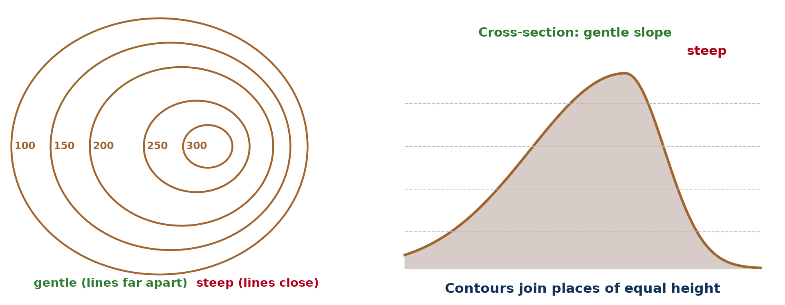
1. WAYS OF REPRESENTING RELIEF
Activity 1
Contours and slopes.
Notes:
Activity 1. Look carefully at this diagram: contours and slopes. Observe every detail before I ask the question.

Slide 19
1. WAYS OF REPRESENTING RELIEF
Activity 1: Question
Name three ways of showing relief on maps.
Notes:
Here is the question for Activity 1: Name three ways of showing relief on maps. Take one minute to think and write your answer in your rough notebook.

Slide 20
1. WAYS OF REPRESENTING RELIEF
Activity 1: Answer
Contours, spot heights and layer colouring (also hachures, trigonometric stations).
Notes:
Let us check the answer together. Contours, spot heights and layer colouring (also hachures, trigonometric stations).

Slide 21
2. PRINCIPLES OF CONTOURS
Activity 2
Principles of contours.
Notes:
Activity 2. Look carefully at this diagram: principles of contours. Observe every detail before I ask the question.

Slide 22
2. PRINCIPLES OF CONTOURS
Activity 2: Question
Give two principles of contours.
Notes:
Here is the question for Activity 2: Give two principles of contours. Take one minute to think and write your answer in your rough notebook.

Slide 23
2. PRINCIPLES OF CONTOURS
Activity 2: Answer
Contours join places of equal height and never cross; close contours show steep slopes.
Notes:
Let us check the answer together. Contours join places of equal height and never cross; close contours show steep slopes.

Slide 24
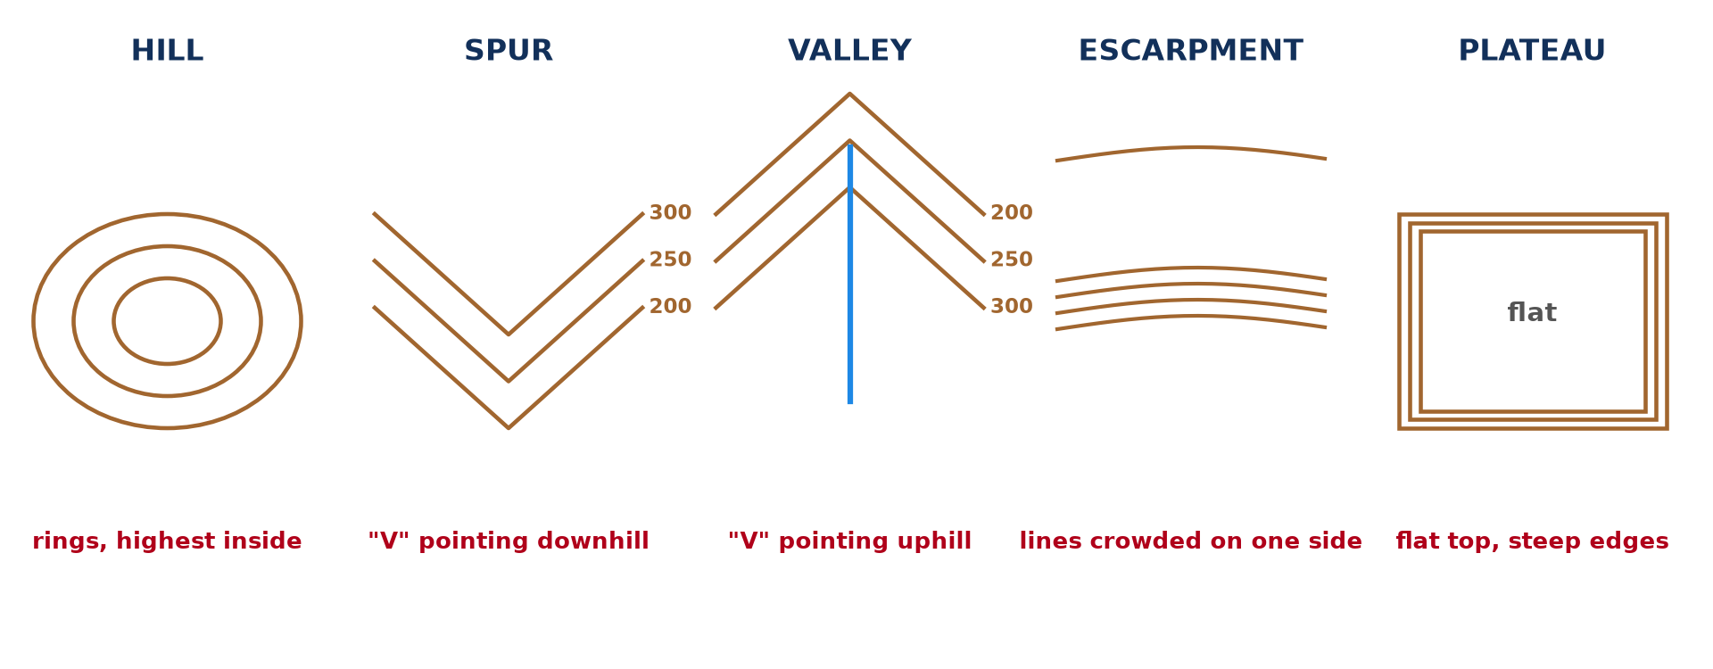
3. LANDFORMS
Activity 3
Landforms from contours.
Notes:
Activity 3. Look carefully at this diagram: landforms from contours. Observe every detail before I ask the question.

Slide 25
3. LANDFORMS
Activity 3: Question
How do we tell a spur from a valley?
Notes:
Here is the question for Activity 3: How do we tell a spur from a valley? Take one minute to think and write your answer in your rough notebook.

Slide 26
3. LANDFORMS
Activity 3: Answer
A spur's contours form V-shapes pointing downhill; a valley's point uphill, often with a river.
Notes:
Let us check the answer together. A spur's contours form V-shapes pointing downhill; a valley's point uphill, often with a river.

Slide 27
3. LANDFORMS
Activity 4
Hill and plateau.
Notes:
Activity 4. Look carefully at this diagram: hill and plateau. Observe every detail before I ask the question.

Slide 28
3. LANDFORMS
Activity 4: Question
How do a hill and a plateau appear on a map?
Notes:
Here is the question for Activity 4: How do a hill and a plateau appear on a map? Take one minute to think and write your answer in your rough notebook.

Slide 29
3. LANDFORMS
Activity 4: Answer
A hill: closed contours rising to a top. A plateau: a high flat area with close contours around its edges.
Notes:
Let us check the answer together. A hill: closed contours rising to a top. A plateau: a high flat area with close contours around its edges.

Slide 30

3. EXERCISE
Activity 5
A relief extract (invented).
Notes:
Activity 5. Look carefully at this diagram: a relief extract (invented). Observe every detail before I ask the question.

Slide 31
3. EXERCISE
Activity 5: Question
Identify two landforms on this extract.
Notes:
Here is the question for Activity 5: Identify two landforms on this extract. Take one minute to think and write your answer in your rough notebook.

Slide 32
3. EXERCISE
Activity 5: Answer
A hill in the south-east and a valley with a river (also a highland in the north-west).
Notes:
Let us check the answer together. A hill in the south-east and a valley with a river (also a highland in the north-west).

Slide 33
BOARD SUMMARY
Board Summary
Topic: Initiation to Map Analysis
Sub-topic: Map Interpretation
Practical Work 7: Interpreting Relief Forms from Maps
Notes:
Now we are going to copy the board summary. Write the title and the headings neatly in your notebooks. I will give you enough time for each slide, so do not rush.

Slide 34
BOARD SUMMARY
DEFINITIONS
The key terms of this lesson are defined as follows:
Contour: It is a line joining places of the same height above sea level.
Contour interval: It is the difference in height between two neighbouring contours.
Notes:
Let us copy the definitions. The key terms of this lesson are defined as follows. On this slide we have Contour and Contour interval. Write each point on a new line, with the key term first, and explain it in your own words when we revise.

Slide 35
BOARD SUMMARY
1. Ways of Representing Relief
Relief is shown on maps in the following ways:
Contours: Brown lines join places of the same height.
Spot heights and trigonometric stations: They give the exact height of points.
Notes:
Let us copy Ways of Representing Relief. Relief is shown on maps in the following ways. On this slide we have Contours and Spot heights and trigonometric stations. Write each point on a new line, with the key term first, and explain it in your own words when we revise. When you finish, we go to the next slide.

Slide 36
BOARD SUMMARY
1. Ways of Representing Relief (continued)
Layer colouring: Colours show different heights, from green to brown.
Notes:
We continue with Ways of Representing Relief. On this slide we have Layer colouring. Write each point on a new line, with the key term first, and explain it in your own words when we revise.

Slide 37
BOARD SUMMARY
2. Principles of Contours
Contours follow these principles:
Equal height: Contours never cross and are drawn at a fixed interval.
Slopes: Close contours show steep slopes and wide contours show gentle slopes.
Notes:
Let us copy Principles of Contours. Contours follow these principles. On this slide we have Equal height and Slopes. Write each point on a new line, with the key term first, and explain it in your own words when we revise.

Slide 38
BOARD SUMMARY
3. Identification of Landforms
Landforms are identified from contours as follows:
Hill: Closed contours rise to a summit.
Spur and valley: V-shapes point downhill on a spur and uphill in a valley.
Notes:
Let us copy Identification of Landforms. Landforms are identified from contours as follows. On this slide we have Hill and Spur and valley. Write each point on a new line, with the key term first, and explain it in your own words when we revise. When you finish, we go to the next slide.

Slide 39
BOARD SUMMARY
3. Identification of Landforms (continued)
Plateau and escarpment: A plateau is high and flat; an escarpment has close contours on one side.
Notes:
We continue with Identification of Landforms. On this slide we have Plateau and escarpment. Write each point on a new line, with the key term first, and explain it in your own words when we revise.

Slide 40
BOARD SUMMARY
3. Identification of Landforms
Illustration: landforms from contours
Notes:
Now draw this illustration in your notebook: landforms from contours. Give it a title and label it clearly.

Slide 41
FORMATIVE EVALUATION
Evaluation 1
What do close contours show?
Notes:
Now let us check what you have understood. Question 1: What do close contours show? Answer in your exercise book.

Slide 42
FORMATIVE EVALUATION
Expected Answer
A steep slope.
Notes:
The expected answer is: a steep slope. If you got it right, well done.

Slide 43
FORMATIVE EVALUATION
Evaluation 2
How does a valley appear on a map?
Notes:
Now let us check what you have understood. Question 2: How does a valley appear on a map? Answer in your exercise book.

Slide 44
FORMATIVE EVALUATION
Expected Answer
V-shaped contours pointing uphill, often with a river.
Notes:
The expected answer is: v-shaped contours pointing uphill, often with a river. If you got it right, well done.

Slide 45
REMEDIATION
Remediation
Fill in the blanks:
A line joining places of equal height is a ______.
Wide contours show a ______ slope.
The exact height of a point is a spot ______.
Notes:
For those who need more practice, fill in the blanks in your exercise book. The answers are: number 1, contour; number 2, gentle; number 3, height.

Slide 46
HOMEWORK
Homework
Draw the contour patterns of a hill, a valley and a spur.
Notes:
For your homework: Draw the contour patterns of a hill, a valley and a spur. We shall correct it at the beginning of our next lesson.

Slide 47
NEXT LESSON
Next Lesson
Our next lesson will be on:
Practical Work 8: Description of Relief and Sketching of Relief Areas from Maps
Notes:
Our next lesson will be on Practical Work 8: Description of Relief and Sketching of Relief Areas from Maps. Thank you for your attention, and see you next time.

Slide 48
BILINGUAL GAME
Bilingual Game (Jeu Bilingue)
English | Français
Contour | La courbe de niveau
Slope | La pente
Hill | La colline
Valley | La vallée
Spur | L'éperon
Height | L'altitude
Notes:
Let us play the bilingual game. I say a word in English, and you give me the French word. Then we do the reverse.

Slide 49
LOGBOOK
Official Logbook (1/2)
Module / Topic | Initiation to Map Analysis
Lesson Title | Practical Work 7: Interpreting Relief Forms from Maps
Expected Learning Outcomes | Name the ways of representing relief on maps. State the principles of contours. Identify landforms from contours.
Competence | Learners are able to identify landforms from contour patterns.
Notes:
I record this information in the official logbook of the class after the lesson.

Slide 50
LOGBOOK
Official Logbook (2/2)
Matter Taught | DEFINITIONS; Ways of Representing Relief; Principles of Contours; Identification of Landforms.
Evaluation | Formative evaluation and remediation exercise.
Homework | Draw the contour patterns of a hill, a valley and a spur.
Enrolment / Present / Absent | ____ / ____ / ____
Achievement | To be completed after the lesson.
Notes:
I complete the second page of the logbook: the matter taught, the evaluation, the homework and the attendance.

Slide 51
TEACHER'S NOTE
Teacher's Note
Timing: Homework correction, plan, objectives 8 min | Recall, situation, action 10 min | 5 activities 30 min | Board summary (copying) 30 min | Evaluation, remediation 10 min | Homework, next lesson 5 min | Logbook 7 min
Without the projector (Activity 1): draw each method.
Without the projector (Activity 2): draw close and wide contours.
Without the projector (Activity 3): draw both.
Without the projector (Activity 4): draw both.
Without the projector (Activity 5): use a map.
Notes:
This slide is for me, the teacher: it gives the timing of the lesson and what to do if the projector is not available.

Slide 52
REFERENCES
References
Geography Syllabus, Forms I–V, MINESEC (2023) — Form 4, Module I: Ecological Systems and their Resources.
Diagrams and animations: drawn for this lesson (Geography Department).
Notes:
These are the references and picture credits used to prepare this lesson.

