Slide 1
FORM 4
GEOGRAPHY
Lesson 21
Rostow's Model of Economic Growth
Notes:
Good morning, class, and welcome to our geography lesson. I am your geography teacher, Mr Kamdem. Today we are starting Lesson 21: Rostow's Model of Economic Growth.

Slide 2
CLASS INFO
Class, Chapter and Duration
Class | Form 4
Chapter | Module II: Development and the Management of Primary Resources
Duration | 2 periods (2 × 50 minutes)
Notes:
This lesson is for Form 4. It belongs to Module II: Development and the Management of Primary Resources. We shall need 2 periods to cover it.

Slide 3
IDENTIFICATION
Lesson Identification
Topic | The Process of Development
Sub-topic | Challenges of Development and Fight against Underdevelopment
Lesson | Lesson 21: Rostow's Model of Economic Growth
Notions / Concepts | Traditional society, preconditions for take-off, take-off, drive to maturity, age of mass consumption.
Syllabus focus | Illustration of the model; characteristics of main stages; examples of countries at each stage.
Competence | Learners are able to describe the stages of Rostow's model and place countries on it.
Notes:
Our topic is The Process of Development, and the sub-topic is Challenges of Development and Fight against Underdevelopment. The key notions we shall use today are: traditional society, preconditions for take-off, take-off, drive to maturity, age of mass consumption. At the end, you should be able to do this: learners are able to describe the stages of Rostow's model and place countries on it.

Slide 4

HOMEWORK CORRECTION
Correction of the Homework
Question (Lesson 20: Classification of Countries in Terms of Development Levels):
Find the country of origin of five manufactured goods at home and classify the countries.
Notes:
Before we start the new lesson, let us correct the homework I gave you at the end of Lesson 20: Classification of Countries in Terms of Development Levels. The question was: Find the country of origin of five manufactured goods at home and classify the countries. Take out your exercise books.

Slide 5
HOMEWORK CORRECTION
Correction: Possible Answer
Examples: phone (China – NIC), television (South Korea – NIC), car (Japan – AIC), medicine (France – AIC), shoes (China – NIC).
Notes:
Here is a good answer. Examples: phone (China – NIC), television (South Korea – NIC), car (Japan – AIC), medicine (France – AIC), shoes (China – NIC). Compare it with your own answer and correct your work in red.

Slide 6
LESSON PLAN
Lesson Plan
Correction of the homework
Objectives and recall
Real-life situation and action to take
Learning activities
Board summary
Evaluation, remediation and homework
Notes:
Here is the plan of our lesson today. First, we shall correct the homework. Then we shall look at the objectives and recall what you already know. After that, we shall study a situation from real life and the action to take, and do the learning activities. Finally, we shall copy the board summary, do the evaluation and the remediation, and I will give you the homework.

Slide 7
OBJECTIVES
Objectives
By the end of this lesson, you should be able to:
Illustrate Rostow's model.
Describe the characteristics of each stage.
Give examples of countries at each stage.
Notes:
By the end of this lesson, you should be able to do three things. Number 1: illustrate Rostow's model. Number 2: describe the characteristics of each stage. Number 3: give examples of countries at each stage.

Slide 8
PREVIOUS KNOWLEDGE
Previous Knowledge
Countries have different levels of development.
NICs industrialised quickly.
AICs are rich.
Notes:
Let us first remember what you already know. Countries have different levels of development. NICs industrialised quickly. AICs are rich. Keep this in mind, because we shall build on it today.

Slide 9
REAL-LIFE SITUATION
Situation in Real Life
The economist W.W. Rostow said that all countries pass through five stages to become developed, like a plane taxiing, taking off and flying. The class wonders where Cameroon is.
Notes:
Listen carefully to this situation from real life. The economist W.W. Rostow said that all countries pass through five stages to become developed, like a plane taxiing, taking off and flying. The class wonders where Cameroon is. Think about it, because I am going to ask you some questions.

Slide 10
REAL-LIFE SITUATION
Situation: Question 1
What is the problem in the situation?
Notes:
Question 1: What is the problem in the situation? Think for a moment, then raise your hand to answer.

Slide 11
REAL-LIFE SITUATION
Answer
We want to know the stages of economic growth.
Notes:
Good. We want to know the stages of economic growth.

Slide 12
REAL-LIFE SITUATION
Situation: Question 2
How many stages did Rostow describe?
Notes:
Question 2: How many stages did Rostow describe? Think for a moment, then raise your hand to answer.

Slide 13
REAL-LIFE SITUATION
Answer
Five.
Notes:
Good. Five.

Slide 14
REAL-LIFE SITUATION
Situation: Question 3
What is the model compared to?
Notes:
Question 3: What is the model compared to? Think for a moment, then raise your hand to answer.

Slide 15
REAL-LIFE SITUATION
Possible Answer
An aeroplane taking off.
Notes:
Good. An aeroplane taking off.

Slide 16
ACTION TO TAKE
Action to Take
Discuss what Cameroon needs to reach take-off.
Notes:
From this situation, the action we are working towards in this lesson is the following: discuss what Cameroon needs to reach take-off.

Slide 17
JUSTIFICATION
Justification of the Lesson
This lesson helps us to understand the stages of economic growth.
Notes:
Why is this lesson important for you? This lesson helps us to understand the stages of economic growth.

Slide 18
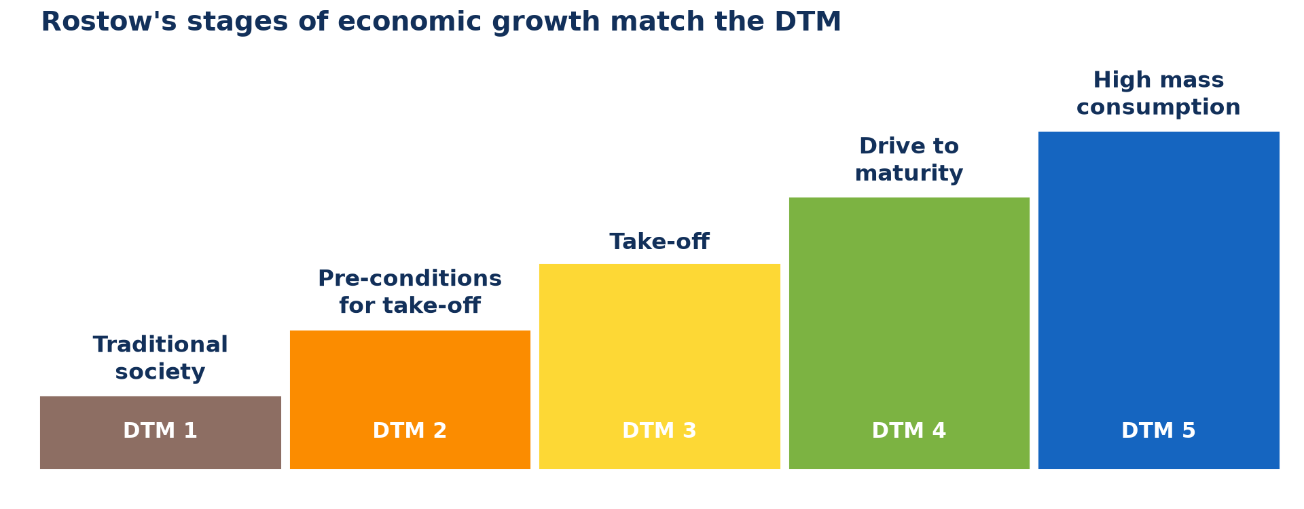
1. THE MODEL
Activity 1
Rostow's five stages.
Notes:
Activity 1. Look carefully at this diagram: rostow's five stages. Observe every detail before I ask the question.

Slide 19
1. THE MODEL
Activity 1: Question
Name the five stages of Rostow's model.
Notes:
Here is the question for Activity 1: Name the five stages of Rostow's model. Take one minute to think and write your answer in your rough notebook.

Slide 20
1. THE MODEL
Activity 1: Answer
Traditional society, preconditions for take-off, take-off, drive to maturity, age of high mass consumption.
Notes:
Let us check the answer together. Traditional society, preconditions for take-off, take-off, drive to maturity, age of high mass consumption.

Slide 21

2. TRADITIONAL SOCIETY
Activity 2
Traditional farming.
Notes:
Activity 2. Look carefully at this picture: traditional farming. Observe every detail before I ask the question.

Slide 22
2. TRADITIONAL SOCIETY
Activity 2: Question
Describe the traditional society stage.
Notes:
Here is the question for Activity 2: Describe the traditional society stage. Take one minute to think and write your answer in your rough notebook.

Slide 23
2. TRADITIONAL SOCIETY
Activity 2: Answer
Most people are subsistence farmers with simple tools and little trade.
Notes:
Let us check the answer together. Most people are subsistence farmers with simple tools and little trade.

Slide 24

2. PRECONDITIONS AND TAKE-OFF
Activity 3
A textile factory.
Notes:
Activity 3. Look carefully at this picture: a textile factory. Observe every detail before I ask the question.

Slide 25
2. PRECONDITIONS AND TAKE-OFF
Activity 3: Question
What happens at take-off?
Notes:
Here is the question for Activity 3: What happens at take-off? Take one minute to think and write your answer in your rough notebook.

Slide 26
2. PRECONDITIONS AND TAKE-OFF
Activity 3: Answer
Industries grow quickly, investment rises and towns grow.
Notes:
Let us check the answer together. Industries grow quickly, investment rises and towns grow.

Slide 27
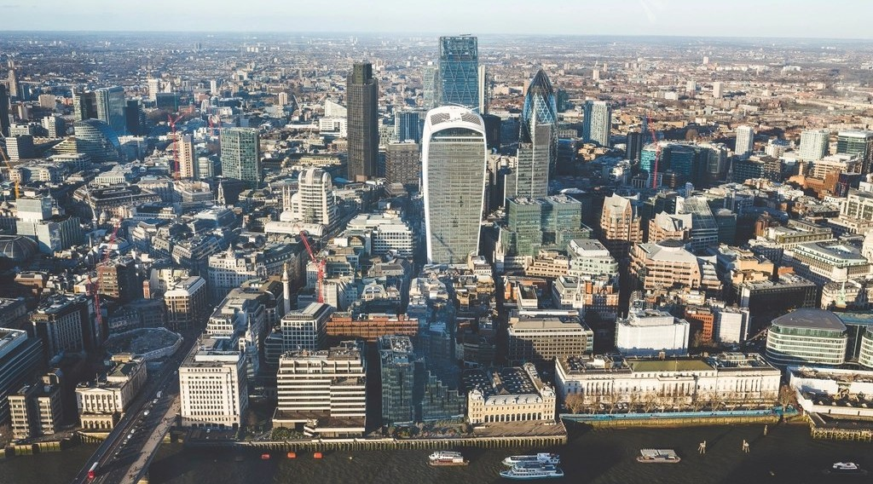
2. MATURITY AND MASS CONSUMPTION
Activity 4
A rich city.
Notes:
Activity 4. Look carefully at this picture: a rich city. Observe every detail before I ask the question.

Slide 28
2. MATURITY AND MASS CONSUMPTION
Activity 4: Question
Describe the age of high mass consumption.
Notes:
Here is the question for Activity 4: Describe the age of high mass consumption. Take one minute to think and write your answer in your rough notebook.

Slide 29
2. MATURITY AND MASS CONSUMPTION
Activity 4: Answer
People have high incomes and buy many consumer goods; services dominate.
Notes:
Let us check the answer together. People have high incomes and buy many consumer goods; services dominate.

Slide 30
3. EXAMPLES
Activity 5
Countries at each stage.
Notes:
Activity 5. Look carefully at this diagram: countries at each stage. Observe every detail before I ask the question.

Slide 31
3. EXAMPLES
Activity 5: Question
Give one country at take-off and one at mass consumption.
Notes:
Here is the question for Activity 5: Give one country at take-off and one at mass consumption. Take one minute to think and write your answer in your rough notebook.

Slide 32
3. EXAMPLES
Activity 5: Answer
Take-off: India or Vietnam (Cameroon is at the preconditions stage). Mass consumption: the USA.
Notes:
Let us check the answer together. Take-off: India or Vietnam (Cameroon is at the preconditions stage). Mass consumption: the USA.

Slide 33
BOARD SUMMARY
Board Summary
Topic: The Process of Development
Sub-topic: Challenges of Development and Fight against Underdevelopment
Lesson 21: Rostow's Model of Economic Growth
Notes:
Now we are going to copy the board summary. Write the title and the headings neatly in your notebooks. I will give you enough time for each slide, so do not rush.

Slide 34
BOARD SUMMARY
1. Rostow's Model
Rostow (1960) described five stages of economic growth:
Traditional society: People are subsistence farmers with simple technology.
Preconditions for take-off: Roads, schools and commercial farming develop.
Notes:
Let us copy Rostow's Model. Rostow (1960) described five stages of economic growth. On this slide we have Traditional society and Preconditions for take-off. Write each point on a new line, with the key term first, and explain it in your own words when we revise. When you finish, we go to the next slide.

Slide 35
BOARD SUMMARY
1. Rostow's Model (continued)
Take-off: Industries grow rapidly and investment increases.
Drive to maturity: Industries become varied and technology spreads.
Age of high mass consumption: Incomes are high and people buy many consumer goods.
Notes:
We continue with Rostow's Model. On this slide we have Take-off, Drive to maturity and Age of high mass consumption. Write each point on a new line, with the key term first, and explain it in your own words when we revise.

Slide 36
BOARD SUMMARY
1. Rostow's Model
Illustration: Rostow's model
Notes:
Now draw this illustration in your notebook: rostow's model. Give it a title and label it clearly.

Slide 37
BOARD SUMMARY
2. Examples of Countries
Countries can be placed on the model as follows:
Early stages: Many LICs such as Chad are between traditional society and preconditions.
Notes:
Let us copy Examples of Countries. Countries can be placed on the model as follows. On this slide we have Early stages. Write each point on a new line, with the key term first, and explain it in your own words when we revise. When you finish, we go to the next slide.

Slide 38
BOARD SUMMARY
2. Examples of Countries (continued)
Take-off and maturity: NICs such as China and India are at take-off or drive to maturity.
Mass consumption: AICs such as the USA, Japan and France have reached this stage.
Notes:
We continue with Examples of Countries. On this slide we have Take-off and maturity and Mass consumption. Write each point on a new line, with the key term first, and explain it in your own words when we revise.

Slide 39
FORMATIVE EVALUATION
Evaluation 1
Name the five stages of Rostow's model.
Notes:
Now let us check what you have understood. Question 1: Name the five stages of Rostow's model. Answer in your exercise book.

Slide 40
FORMATIVE EVALUATION
Expected Answer
Traditional society, preconditions, take-off, drive to maturity, mass consumption.
Notes:
The expected answer is: traditional society, preconditions, take-off, drive to maturity, mass consumption. If you got it right, well done.

Slide 41
FORMATIVE EVALUATION
Evaluation 2
At which stage are industries growing fastest?
Notes:
Now let us check what you have understood. Question 2: At which stage are industries growing fastest? Answer in your exercise book.

Slide 42
FORMATIVE EVALUATION
Expected Answer
Take-off.
Notes:
The expected answer is: take-off. If you got it right, well done.

Slide 43
REMEDIATION
Remediation
Fill in the blanks:
The first stage of Rostow's model is ______ society.
Rapid industrial growth happens at ______.
The USA is at the age of high mass ______.
Notes:
For those who need more practice, fill in the blanks in your exercise book. The answers are: number 1, traditional; number 2, take-off; number 3, consumption.

Slide 44
HOMEWORK
Homework
At which stage of Rostow's model is Cameroon? Give two reasons.
Notes:
For your homework: At which stage of Rostow's model is Cameroon? Give two reasons. We shall correct it at the beginning of our next lesson.

Slide 45
NEXT LESSON
Next Lesson
Our next lesson will be on:
Lesson 22: Challenges of Development
Notes:
Our next lesson will be on Lesson 22: Challenges of Development. Thank you for your attention, and see you next time.

Slide 46
BILINGUAL GAME
Bilingual Game (Jeu Bilingue)
English | Français
Stage | L'étape
Growth | La croissance
Take-off | Le décollage
Maturity | La maturité
Consumption | La consommation
Model | Le modèle
Notes:
Let us play the bilingual game. I say a word in English, and you give me the French word. Then we do the reverse.

Slide 47
LOGBOOK
Official Logbook (1/2)
Module / Topic | The Process of Development
Lesson Title | Lesson 21: Rostow's Model of Economic Growth
Expected Learning Outcomes | Illustrate Rostow's model. Describe the characteristics of each stage. Give examples of countries at each stage.
Competence | Learners are able to describe the stages of Rostow's model and place countries on it.
Notes:
I record this information in the official logbook of the class after the lesson.

Slide 48
LOGBOOK
Official Logbook (2/2)
Matter Taught | Rostow's Model; Examples of Countries.
Evaluation | Formative evaluation and remediation exercise.
Homework | At which stage of Rostow's model is Cameroon? Give two reasons.
Enrolment / Present / Absent | ____ / ____ / ____
Achievement | To be completed after the lesson.
Notes:
I complete the second page of the logbook: the matter taught, the evaluation, the homework and the attendance.

Slide 49
TEACHER'S NOTE
Teacher's Note
Timing: Homework correction, plan, objectives 8 min | Recall, situation, action 10 min | 5 activities 30 min | Board summary (copying) 30 min | Evaluation, remediation 10 min | Homework, next lesson 5 min | Logbook 7 min
Without the projector (Activity 1): draw steps on the board.
Without the projector (Activity 2): describe old village life.
Without the projector (Activity 3): discuss industries of Cameroon.
Without the projector (Activity 4): list consumer goods.
Without the projector (Activity 5): place countries on the steps.
Notes:
This slide is for me, the teacher: it gives the timing of the lesson and what to do if the projector is not available.

Slide 50
REFERENCES
References
Geography Syllabus, Forms I–V, MINESEC (2023) — Form 4, Module II: Development and the Management of Primary Resources.
Photo, Activity 2: “Acacia Tree” by D-Stanley, CC BY 2.0, via Flickr (https://www.flickr.com/photos/79721788@N00/11527335486)
Photo, Activity 3: “Lowell Massachusetts - Boott Cotton Mills Museum Weave Room” by Onasill ~ Bill- 81M views, CC BY-NC-SA 2.0, via Flickr (https://www.flickr.com/photos/7156765@N05/43677799854)
Photo, Activity 4: “Aerial View City Skyline Skyscraper” by unknown, CC0 1.0, via rawpixel (https://www.rawpixel.com/image/5967710/aerial-view-city-skyline-skyscraper)
Diagrams and animations: drawn for this lesson (Geography Department).
Notes:
These are the references and picture credits used to prepare this lesson.

