Slide 1
FORM 4
GEOGRAPHY
Lesson 26
Agriculture
Notes:
Good morning, class, and welcome to our geography lesson. I am your geography teacher, Mr Kamdem. Today we are starting Lesson 26: Agriculture.

Slide 2
CLASS INFO
Class, Chapter and Duration
Class | Form 4
Chapter | Module II: Development and the Management of Primary Resources
Duration | 2 periods (2 × 50 minutes)
Notes:
This lesson is for Form 4. It belongs to Module II: Development and the Management of Primary Resources. We shall need 2 periods to cover it.

Slide 3
IDENTIFICATION
Lesson Identification
Topic | Managing Resources for Development through Economic Activities
Sub-topic | Agriculture as an Economic Activity of the Primary Sector
Lesson | Lesson 26: Agriculture
Notions / Concepts | Agriculture, inputs, processes, outputs.
Syllabus focus | Meaning; agriculture as a system (flow diagram only).
Competence | Learners are able to explain agriculture as a system of inputs, processes and outputs.
Notes:
Our topic is Managing Resources for Development through Economic Activities, and the sub-topic is Agriculture as an Economic Activity of the Primary Sector. The key notions we shall use today are: agriculture, inputs, processes, outputs. At the end, you should be able to do this: learners are able to explain agriculture as a system of inputs, processes and outputs.

Slide 4

HOMEWORK CORRECTION
Correction of the Homework
Question (Lesson 25: Economic Activities):
List the jobs of five people you know and classify them into sectors.
Notes:
Before we start the new lesson, let us correct the homework I gave you at the end of Lesson 25: Economic Activities. The question was: List the jobs of five people you know and classify them into sectors. Take out your exercise books.

Slide 5
HOMEWORK CORRECTION
Correction: Possible Answer
Examples: farmer (primary), mechanic (secondary or tertiary), trader (tertiary), teacher (tertiary), computer programmer (quaternary).
Notes:
Here is a good answer. Examples: farmer (primary), mechanic (secondary or tertiary), trader (tertiary), teacher (tertiary), computer programmer (quaternary). Compare it with your own answer and correct your work in red.

Slide 6
LESSON PLAN
Lesson Plan
Correction of the homework
Objectives and recall
Real-life situation and action to take
Learning activities
Board summary
Evaluation, remediation and homework
Notes:
Here is the plan of our lesson today. First, we shall correct the homework. Then we shall look at the objectives and recall what you already know. After that, we shall study a situation from real life and the action to take, and do the learning activities. Finally, we shall copy the board summary, do the evaluation and the remediation, and I will give you the homework.

Slide 7
OBJECTIVES
Objectives
By the end of this lesson, you should be able to:
Define agriculture.
Identify the inputs, processes and outputs of a farm.
Draw the farm system.
Notes:
By the end of this lesson, you should be able to do three things. Number 1: define agriculture. Number 2: identify the inputs, processes and outputs of a farm. Number 3: draw the farm system.

Slide 8
PREVIOUS KNOWLEDGE
Previous Knowledge
Farming is a primary activity.
Farmers need land, seeds and work.
Farms produce crops and animals.
Notes:
Let us first remember what you already know. Farming is a primary activity. Farmers need land, seeds and work. Farms produce crops and animals. Keep this in mind, because we shall build on it today.

Slide 9
REAL-LIFE SITUATION
Situation in Real Life
A farmer near Garoua uses land, seeds, fertiliser and his family's labour. He ploughs, sows, weeds and harvests. He sells some cotton and keeps maize for the family.
Notes:
Listen carefully to this situation from real life. A farmer near Garoua uses land, seeds, fertiliser and his family's labour. He ploughs, sows, weeds and harvests. He sells some cotton and keeps maize for the family. Think about it, because I am going to ask you some questions.

Slide 10
REAL-LIFE SITUATION
Situation: Question 1
What is the problem in the situation?
Notes:
Question 1: What is the problem in the situation? Think for a moment, then raise your hand to answer.

Slide 11
REAL-LIFE SITUATION
Answer
We want to see the farm as a system.
Notes:
Good. We want to see the farm as a system.

Slide 12
REAL-LIFE SITUATION
Situation: Question 2
Name two inputs.
Notes:
Question 2: Name two inputs. Think for a moment, then raise your hand to answer.

Slide 13
REAL-LIFE SITUATION
Answer
Seeds and fertiliser (also land, labour).
Notes:
Good. Seeds and fertiliser (also land, labour).

Slide 14
REAL-LIFE SITUATION
Situation: Question 3
Name two outputs.
Notes:
Question 3: Name two outputs. Think for a moment, then raise your hand to answer.

Slide 15
REAL-LIFE SITUATION
Possible Answer
Cotton and maize.
Notes:
Good. Cotton and maize.

Slide 16
ACTION TO TAKE
Action to Take
Plan inputs carefully to get good outputs.
Notes:
From this situation, the action we are working towards in this lesson is the following: plan inputs carefully to get good outputs.

Slide 17
JUSTIFICATION
Justification of the Lesson
This lesson helps us to understand how a farm works.
Notes:
Why is this lesson important for you? This lesson helps us to understand how a farm works.

Slide 18
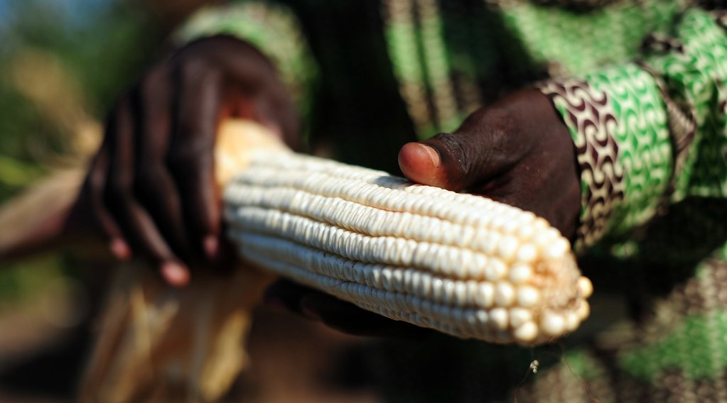
1. MEANING
Activity 1
Maize.
Notes:
Activity 1. Look carefully at this picture: maize. Observe every detail before I ask the question.

Slide 19
1. MEANING
Activity 1: Question
What is agriculture?
Notes:
Here is the question for Activity 1: What is agriculture? Take one minute to think and write your answer in your rough notebook.

Slide 20
1. MEANING
Activity 1: Answer
The growing of crops and the rearing of animals.
Notes:
Let us check the answer together. The growing of crops and the rearing of animals.

Slide 21
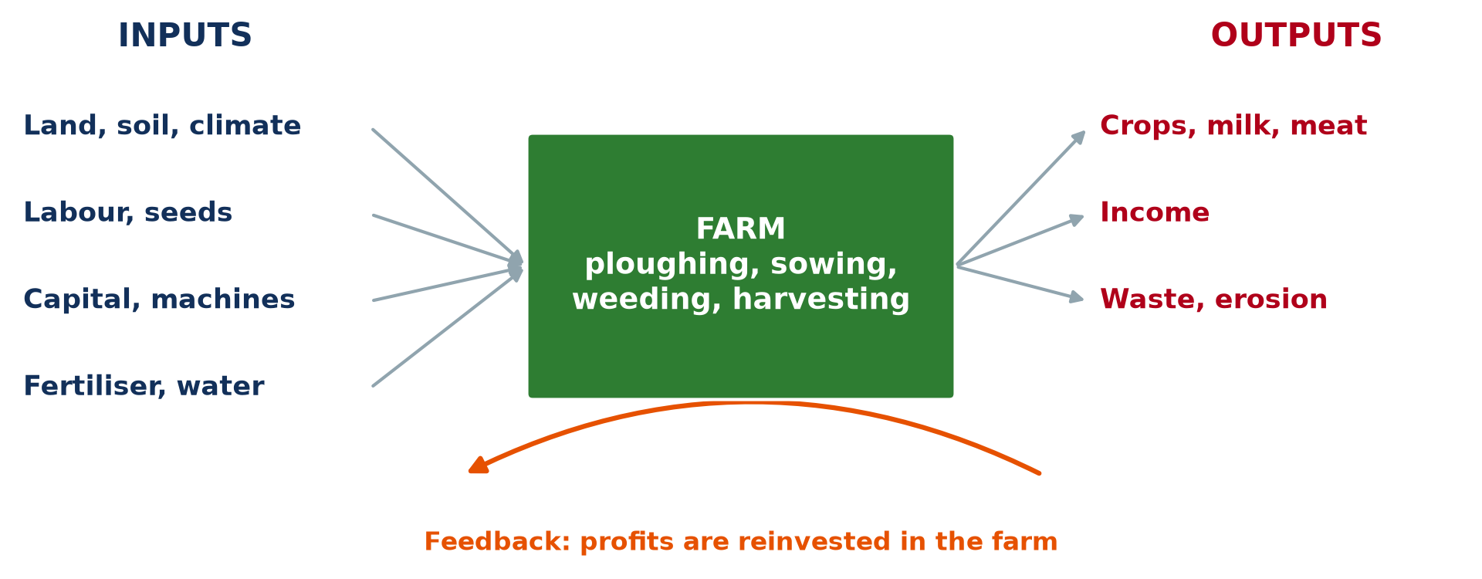
2. INPUTS
Activity 2
The farm as a system.
Notes:
Activity 2. Look carefully at this diagram: the farm as a system. Observe every detail before I ask the question.

Slide 22
2. INPUTS
Activity 2: Question
Name four inputs of a farm.
Notes:
Here is the question for Activity 2: Name four inputs of a farm. Take one minute to think and write your answer in your rough notebook.

Slide 23
2. INPUTS
Activity 2: Answer
Land, labour, seeds and fertiliser (also capital, machines, water).
Notes:
Let us check the answer together. Land, labour, seeds and fertiliser (also capital, machines, water).

Slide 24

2. PROCESSES
Activity 3
A farmer sowing.
Notes:
Activity 3. Look carefully at this picture: a farmer sowing. Observe every detail before I ask the question.

Slide 25
2. PROCESSES
Activity 3: Question
Name four farm processes.
Notes:
Here is the question for Activity 3: Name four farm processes. Take one minute to think and write your answer in your rough notebook.

Slide 26
2. PROCESSES
Activity 3: Answer
Ploughing, sowing, weeding and harvesting.
Notes:
Let us check the answer together. Ploughing, sowing, weeding and harvesting.

Slide 27
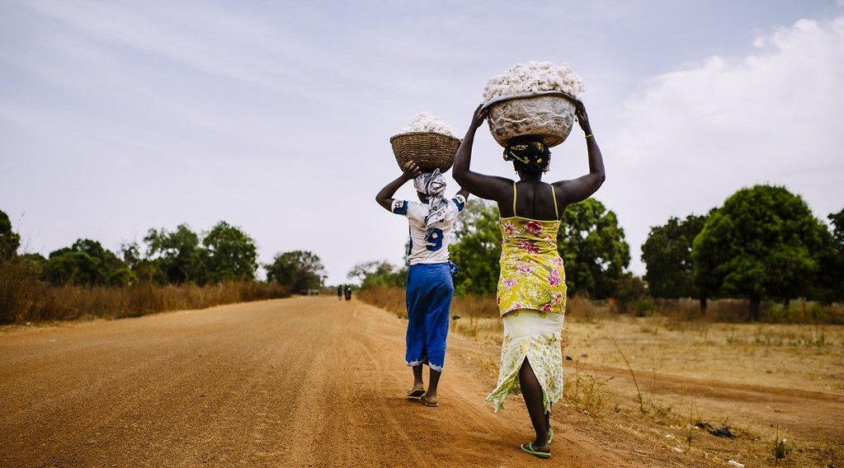
2. OUTPUTS
Activity 4
Carrying harvested cotton.
Notes:
Activity 4. Look carefully at this picture: carrying harvested cotton. Observe every detail before I ask the question.

Slide 28
2. OUTPUTS
Activity 4: Question
Name three outputs of a farm.
Notes:
Here is the question for Activity 4: Name three outputs of a farm. Take one minute to think and write your answer in your rough notebook.

Slide 29
2. OUTPUTS
Activity 4: Answer
Crops, animal products and income (also waste).
Notes:
Let us check the answer together. Crops, animal products and income (also waste).

Slide 30
2. FEEDBACK
Activity 5
Feedback in the farm system.
Notes:
Activity 5. Look carefully at this diagram: feedback in the farm system. Observe every detail before I ask the question.

Slide 31
2. FEEDBACK
Activity 5: Question
What is feedback in the farm system?
Notes:
Here is the question for Activity 5: What is feedback in the farm system? Take one minute to think and write your answer in your rough notebook.

Slide 32
2. FEEDBACK
Activity 5: Answer
Profits or seeds from the harvest are reinvested in the farm.
Notes:
Let us check the answer together. Profits or seeds from the harvest are reinvested in the farm.

Slide 33
BOARD SUMMARY
Board Summary
Topic: Managing Resources for Development through Economic Activities
Sub-topic: Agriculture as an Economic Activity of the Primary Sector
Lesson 26: Agriculture
Notes:
Now we are going to copy the board summary. Write the title and the headings neatly in your notebooks. I will give you enough time for each slide, so do not rush.

Slide 34
BOARD SUMMARY
DEFINITIONS
The key terms of this lesson are defined as follows:
Agriculture: It is the growing of crops and the rearing of animals.
Notes:
Let us copy the definitions. The key terms of this lesson are defined as follows. On this slide we have Agriculture. Write each point on a new line, with the key term first, and explain it in your own words when we revise.

Slide 35
BOARD SUMMARY
1. Agriculture as a System
A farm works as a system with the following parts:
Inputs: They are land, labour, seeds, fertiliser, water and capital.
Processes: They are ploughing, sowing, weeding, spraying and harvesting.
Notes:
Let us copy Agriculture as a System. A farm works as a system with the following parts. On this slide we have Inputs and Processes. Write each point on a new line, with the key term first, and explain it in your own words when we revise. When you finish, we go to the next slide.

Slide 36
BOARD SUMMARY
1. Agriculture as a System (continued)
Outputs: They are crops, milk, meat, income and sometimes waste.
Feedback: Part of the profit or harvest is reinvested in the farm.
Notes:
We continue with Agriculture as a System. On this slide we have Outputs and Feedback. Write each point on a new line, with the key term first, and explain it in your own words when we revise.

Slide 37
BOARD SUMMARY
1. Agriculture as a System
Illustration: the farm as a system
Notes:
Now draw this illustration in your notebook: the farm as a system. Give it a title and label it clearly.

Slide 38
FORMATIVE EVALUATION
Evaluation 1
Define agriculture.
Notes:
Now let us check what you have understood. Question 1: Define agriculture. Answer in your exercise book.

Slide 39
FORMATIVE EVALUATION
Expected Answer
The growing of crops and rearing of animals.
Notes:
The expected answer is: the growing of crops and rearing of animals. If you got it right, well done.

Slide 40
FORMATIVE EVALUATION
Evaluation 2
Give two inputs, two processes and two outputs.
Notes:
Now let us check what you have understood. Question 2: Give two inputs, two processes and two outputs. Answer in your exercise book.

Slide 41
FORMATIVE EVALUATION
Expected Answer
Inputs: seeds, labour. Processes: sowing, harvesting. Outputs: crops, income.
Notes:
The expected answer is: inputs: seeds, labour. Processes: sowing, harvesting. Outputs: crops, income. If you got it right, well done.

Slide 42
REMEDIATION
Remediation
Fill in the blanks:
Seeds and fertiliser are ______.
Sowing and weeding are ______.
Crops and income are ______.
Notes:
For those who need more practice, fill in the blanks in your exercise book. The answers are: number 1, inputs; number 2, processes; number 3, outputs.

Slide 43
HOMEWORK
Homework
Draw the system of a farm you know with its inputs, processes and outputs.
Notes:
For your homework: Draw the system of a farm you know with its inputs, processes and outputs. We shall correct it at the beginning of our next lesson.

Slide 44
NEXT LESSON
Next Lesson
Our next lesson will be on:
Lesson 27: Agricultural Systems
Notes:
Our next lesson will be on Lesson 27: Agricultural Systems. Thank you for your attention, and see you next time.

Slide 45
BILINGUAL GAME
Bilingual Game (Jeu Bilingue)
English | Français
Agriculture | L'agriculture
Input | L'intrant
Output | Le produit
Harvest | La récolte
Seed | La semence
Labour | La main-d'œuvre
Notes:
Let us play the bilingual game. I say a word in English, and you give me the French word. Then we do the reverse.

Slide 46
LOGBOOK
Official Logbook (1/2)
Module / Topic | Managing Resources for Development through Economic Activities
Lesson Title | Lesson 26: Agriculture
Expected Learning Outcomes | Define agriculture. Identify the inputs, processes and outputs of a farm. Draw the farm system.
Competence | Learners are able to explain agriculture as a system of inputs, processes and outputs.
Notes:
I record this information in the official logbook of the class after the lesson.

Slide 47
LOGBOOK
Official Logbook (2/2)
Matter Taught | DEFINITIONS; Agriculture as a System.
Evaluation | Formative evaluation and remediation exercise.
Homework | Draw the system of a farm you know with its inputs, processes and outputs.
Enrolment / Present / Absent | ____ / ____ / ____
Achievement | To be completed after the lesson.
Notes:
I complete the second page of the logbook: the matter taught, the evaluation, the homework and the attendance.

Slide 48
TEACHER'S NOTE
Teacher's Note
Timing: Homework correction, plan, objectives 8 min | Recall, situation, action 10 min | 5 activities 30 min | Board summary (copying) 30 min | Evaluation, remediation 10 min | Homework, next lesson 5 min | Logbook 7 min
Without the projector (Activity 1): list crops and animals.
Without the projector (Activity 2): draw the inputs.
Without the projector (Activity 3): describe the farming calendar.
Without the projector (Activity 4): list products.
Without the projector (Activity 5): draw an arrow back to inputs.
Notes:
This slide is for me, the teacher: it gives the timing of the lesson and what to do if the projector is not available.

Slide 49
REFERENCES
References
Geography Syllabus, Forms I–V, MINESEC (2023) — Form 4, Module II: Development and the Management of Primary Resources.
Photo, Activity 1: “Ghana 15” by CIAT International Center for Tropical Agriculture, CC BY-NC-SA 2.0, via Flickr (https://www.flickr.com/photos/38476503@N08/5207540264)
Photo, Activity 3: “Farmer” by CIFOR, CC BY-NC-ND 2.0, via Flickr (https://www.flickr.com/photos/45423546@N07/35708569412)
Photo, Activity 4: “Women carrying cotton” by CIFOR, CC BY-NC-ND 2.0, via Flickr (https://www.flickr.com/photos/45423546@N07/35706852432)
Diagrams and animations: drawn for this lesson (Geography Department).
Notes:
These are the references and picture credits used to prepare this lesson.

