Slide 1
FORM 4
GEOGRAPHY
Lesson 31
Sustainable Agriculture
Notes:
Good morning, class, and welcome to our geography lesson. I am your geography teacher, Mr Kamdem. Today we are starting Lesson 31: Sustainable Agriculture.

Slide 2
CLASS INFO
Class, Chapter and Duration
Class | Form 4
Chapter | Module II: Development and the Management of Primary Resources
Duration | 2 periods (2 × 50 minutes)
Notes:
This lesson is for Form 4. It belongs to Module II: Development and the Management of Primary Resources. We shall need 2 periods to cover it.

Slide 3
IDENTIFICATION
Lesson Identification
Topic | Managing Resources for Development through Economic Activities
Sub-topic | Agriculture as an Economic Activity of the Primary Sector
Lesson | Lesson 31: Sustainable Agriculture
Notions / Concepts | Sustainable agriculture, crop rotation, agro-forestry, cover cropping, controlled grazing.
Syllabus focus | Meaning and aims; sustainable agricultural practices; importance.
Competence | Learners are able to propose sustainable agricultural practices.
Notes:
Our topic is Managing Resources for Development through Economic Activities, and the sub-topic is Agriculture as an Economic Activity of the Primary Sector. The key notions we shall use today are: sustainable agriculture, crop rotation, agro-forestry, cover cropping, controlled grazing. At the end, you should be able to do this: learners are able to propose sustainable agricultural practices.

Slide 4

HOMEWORK CORRECTION
Correction of the Homework
Question (Lesson 30: The Impact of Agriculture):
Write one positive and one negative impact of farming in your area.
Notes:
Before we start the new lesson, let us correct the homework I gave you at the end of Lesson 30: The Impact of Agriculture. The question was: Write one positive and one negative impact of farming in your area. Take out your exercise books.

Slide 5
HOMEWORK CORRECTION
Correction: Possible Answer
Positive: farming gives food and income to families. Negative: bush fires and clearing cause soil erosion.
Notes:
Here is a good answer. Positive: farming gives food and income to families. Negative: bush fires and clearing cause soil erosion. Compare it with your own answer and correct your work in red.

Slide 6
LESSON PLAN
Lesson Plan
Correction of the homework
Objectives and recall
Real-life situation and action to take
Learning activities
Board summary
Evaluation, remediation and homework
Notes:
Here is the plan of our lesson today. First, we shall correct the homework. Then we shall look at the objectives and recall what you already know. After that, we shall study a situation from real life and the action to take, and do the learning activities. Finally, we shall copy the board summary, do the evaluation and the remediation, and I will give you the homework.

Slide 7
OBJECTIVES
Objectives
By the end of this lesson, you should be able to:
Define sustainable agriculture and its aims.
Describe sustainable agricultural practices.
Notes:
Take your time to copy this part; we will continue together.

Slide 8
OBJECTIVES
Objectives (continued)
Explain its importance.
Notes:
By the end of this lesson, you should be able to do three things. Number 1: define sustainable agriculture and its aims. Number 2: describe sustainable agricultural practices. Number 3: explain its importance.

Slide 9
PREVIOUS KNOWLEDGE
Previous Knowledge
Agriculture can damage the environment.
Soil can be conserved.
Development must be sustainable.
Notes:
Let us first remember what you already know. Agriculture can damage the environment. Soil can be conserved. Development must be sustainable. Keep this in mind, because we shall build on it today.

Slide 10
REAL-LIFE SITUATION
Situation in Real Life
A farmer near Guider plants trees among his crops, changes crops each year and uses manure from his cattle instead of chemicals. His soil stays fertile year after year.
Notes:
Listen carefully to this situation from real life. A farmer near Guider plants trees among his crops, changes crops each year and uses manure from his cattle instead of chemicals. His soil stays fertile year after year. Think about it, because I am going to ask you some questions.

Slide 11
REAL-LIFE SITUATION
Situation: Question 1
What is the problem in the situation?
Notes:
Question 1: What is the problem in the situation? Think for a moment, then raise your hand to answer.

Slide 12
REAL-LIFE SITUATION
Answer
The farmer wants to farm without damaging the soil.
Notes:
Good. The farmer wants to farm without damaging the soil.

Slide 13
REAL-LIFE SITUATION
Situation: Question 2
Name two practices he uses.
Notes:
Question 2: Name two practices he uses. Think for a moment, then raise your hand to answer.

Slide 14
REAL-LIFE SITUATION
Answer
Crop rotation and manure (also trees among crops).
Notes:
Good. Crop rotation and manure (also trees among crops).

Slide 15
REAL-LIFE SITUATION
Situation: Question 3
What is the result?
Notes:
Question 3: What is the result? Think for a moment, then raise your hand to answer.

Slide 16
REAL-LIFE SITUATION
Possible Answer
His soil stays fertile.
Notes:
Good. His soil stays fertile.

Slide 17
ACTION TO TAKE
Action to Take
Use manure, crop rotation and trees on farms.
Notes:
From this situation, the action we are working towards in this lesson is the following: use manure, crop rotation and trees on farms.

Slide 18
JUSTIFICATION
Justification of the Lesson
This lesson helps us to farm without destroying the land.
Notes:
Why is this lesson important for you? This lesson helps us to farm without destroying the land.

Slide 19
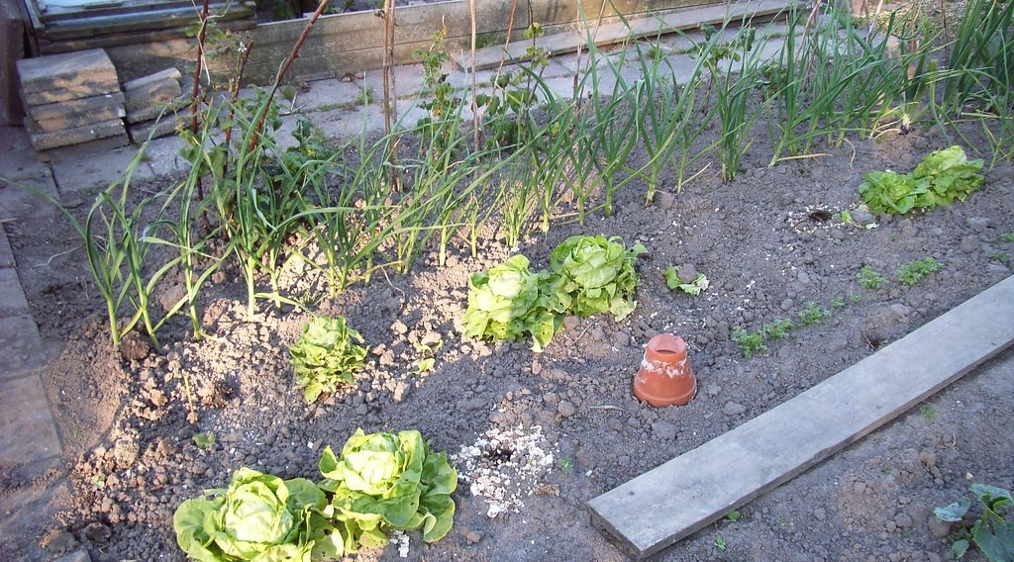
1. MEANING
Activity 1
An organic garden.
Notes:
Activity 1. Look carefully at this picture: an organic garden. Observe every detail before I ask the question.

Slide 20
1. MEANING
Activity 1: Question
What is sustainable agriculture?
Notes:
Here is the question for Activity 1: What is sustainable agriculture? Take one minute to think and write your answer in your rough notebook.

Slide 21
1. MEANING
Activity 1: Answer
Farming that produces food today while protecting soils, water and biodiversity for the future.
Notes:
Let us check the answer together. Farming that produces food today while protecting soils, water and biodiversity for the future.

Slide 22

2. CROP ROTATION
Activity 2
A mixed farm.
Notes:
Activity 2. Look carefully at this picture: a mixed farm. Observe every detail before I ask the question.

Slide 23
2. CROP ROTATION
Activity 2: Question
What is crop rotation and why is it useful?
Notes:
Here is the question for Activity 2: What is crop rotation and why is it useful? Take one minute to think and write your answer in your rough notebook.

Slide 24
2. CROP ROTATION
Activity 2: Answer
Changing crops on the same land each year; it keeps the soil fertile and reduces pests.
Notes:
Let us check the answer together. Changing crops on the same land each year; it keeps the soil fertile and reduces pests.

Slide 25

2. AGRO-FORESTRY
Activity 3
Trees in farmland.
Notes:
Activity 3. Look carefully at this picture: trees in farmland. Observe every detail before I ask the question.

Slide 26
2. AGRO-FORESTRY
Activity 3: Question
What is agro-forestry?
Notes:
Here is the question for Activity 3: What is agro-forestry? Take one minute to think and write your answer in your rough notebook.

Slide 27
2. AGRO-FORESTRY
Activity 3: Answer
Growing trees together with crops or animals.
Notes:
Let us check the answer together. Growing trees together with crops or animals.

Slide 28

2. COVER CROPS AND GRAZING
Activity 4
Terraces.
Notes:
Activity 4. Look carefully at this picture: terraces. Observe every detail before I ask the question.

Slide 29
2. COVER CROPS AND GRAZING
Activity 4: Question
How do cover crops and controlled grazing help?
Notes:
Here is the question for Activity 4: How do cover crops and controlled grazing help? Take one minute to think and write your answer in your rough notebook.

Slide 30
2. COVER CROPS AND GRAZING
Activity 4: Answer
Cover crops protect the soil; controlled grazing prevents overgrazing.
Notes:
Let us check the answer together. Cover crops protect the soil; controlled grazing prevents overgrazing.

Slide 31
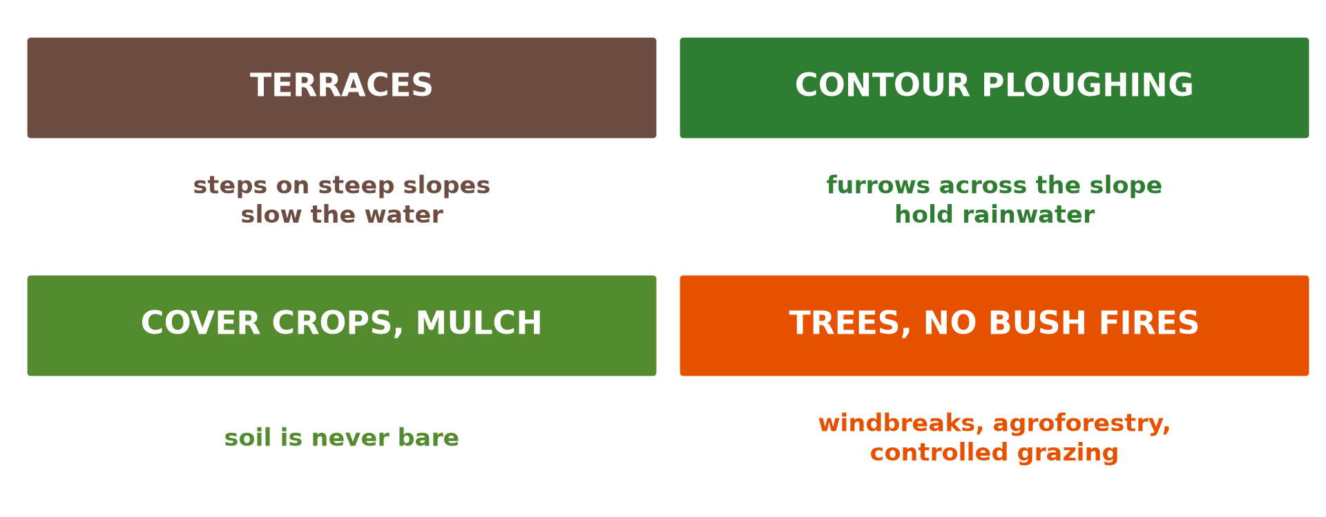
3. IMPORTANCE
Activity 5
Soil conservation.
Notes:
Activity 5. Look carefully at this diagram: soil conservation. Observe every detail before I ask the question.

Slide 32
3. IMPORTANCE
Activity 5: Question
Give two reasons why sustainable agriculture is important.
Notes:
Here is the question for Activity 5: Give two reasons why sustainable agriculture is important. Take one minute to think and write your answer in your rough notebook.

Slide 33
3. IMPORTANCE
Activity 5: Answer
It keeps the soil fertile for future generations and reduces pollution.
Notes:
Let us check the answer together. It keeps the soil fertile for future generations and reduces pollution.

Slide 34
BOARD SUMMARY
Board Summary
Topic: Managing Resources for Development through Economic Activities
Sub-topic: Agriculture as an Economic Activity of the Primary Sector
Lesson 31: Sustainable Agriculture
Notes:
Now we are going to copy the board summary. Write the title and the headings neatly in your notebooks. I will give you enough time for each slide, so do not rush.

Slide 35
BOARD SUMMARY
DEFINITIONS
The key terms of this lesson are defined as follows:
Sustainable agriculture: It is farming that meets present needs while protecting the environment for the future.
Notes:
Let us copy the definitions. The key terms of this lesson are defined as follows. On this slide we have Sustainable agriculture. Write each point on a new line, with the key term first, and explain it in your own words when we revise.

Slide 36
BOARD SUMMARY
1. Aims
Sustainable agriculture has the following aims:
Food security: It produces enough food for everyone.
Environment: It protects soils, water, forests and biodiversity.
Notes:
Let us copy Aims. Sustainable agriculture has the following aims. On this slide we have Food security and Environment. Write each point on a new line, with the key term first, and explain it in your own words when we revise. When you finish, we go to the next slide.

Slide 37
BOARD SUMMARY
1. Aims (continued)
Income: It gives farmers a fair and lasting income.
Notes:
We continue with Aims. On this slide we have Income. Write each point on a new line, with the key term first, and explain it in your own words when we revise.

Slide 38
BOARD SUMMARY
2. Sustainable Agricultural Practices
Farmers use the following practices:
Crop rotation: Changing crops each year keeps the soil fertile.
Agro-forestry: Trees grown with crops protect and enrich the soil.
Notes:
Let us copy Sustainable Agricultural Practices. Farmers use the following practices. On this slide we have Crop rotation and Agro-forestry. Write each point on a new line, with the key term first, and explain it in your own words when we revise. When you finish, we go to the next slide.

Slide 39
BOARD SUMMARY
2. Sustainable Agricultural Practices (continued)
Cover cropping and mulching: Plants and dead leaves cover the soil against erosion.
Controlled grazing and manure: Limiting animals and using manure protect and feed the soil.
Notes:
We continue with Sustainable Agricultural Practices. On this slide we have Cover cropping and mulching and Controlled grazing and manure. Write each point on a new line, with the key term first, and explain it in your own words when we revise.

Slide 40
BOARD SUMMARY
2. Sustainable Agricultural Practices
Illustration: sustainable practices
Notes:
Now draw this illustration in your notebook: sustainable practices. Give it a title and label it clearly.

Slide 41
FORMATIVE EVALUATION
Evaluation 1
Define sustainable agriculture.
Notes:
Now let us check what you have understood. Question 1: Define sustainable agriculture. Answer in your exercise book.

Slide 42
FORMATIVE EVALUATION
Expected Answer
Farming that protects the environment for the future.
Notes:
The expected answer is: farming that protects the environment for the future. If you got it right, well done.

Slide 43
FORMATIVE EVALUATION
Evaluation 2
Give three sustainable practices.
Notes:
Now let us check what you have understood. Question 2: Give three sustainable practices. Answer in your exercise book.

Slide 44
FORMATIVE EVALUATION
Expected Answer
Crop rotation, agro-forestry and cover cropping.
Notes:
The expected answer is: crop rotation, agro-forestry and cover cropping. If you got it right, well done.

Slide 45
REMEDIATION
Remediation
Fill in the blanks:
Changing crops each year is crop ______.
Growing trees with crops is ______.
Using animal waste to feed the soil is using ______.
Notes:
For those who need more practice, fill in the blanks in your exercise book. The answers are: number 1, rotation; number 2, agro-forestry; number 3, manure.

Slide 46
HOMEWORK
Homework
Propose a crop rotation plan for three years on a farm in your area.
Notes:
For your homework: Propose a crop rotation plan for three years on a farm in your area. We shall correct it at the beginning of our next lesson.

Slide 47
NEXT LESSON
Next Lesson
Our next lesson will be on:
Lesson 32: Climate-Smart Agriculture
Notes:
Our next lesson will be on Lesson 32: Climate-Smart Agriculture. Thank you for your attention, and see you next time.

Slide 48
BILINGUAL GAME
Bilingual Game (Jeu Bilingue)
English | Français
Sustainable | Durable
Rotation | L'assolement
Agro-forestry | L'agroforesterie
Manure | Le fumier
Cover crop | La culture de couverture
Grazing | Le pâturage
Notes:
Let us play the bilingual game. I say a word in English, and you give me the French word. Then we do the reverse.

Slide 49
LOGBOOK
Official Logbook (1/2)
Module / Topic | Managing Resources for Development through Economic Activities
Lesson Title | Lesson 31: Sustainable Agriculture
Expected Learning Outcomes | Define sustainable agriculture and its aims. Describe sustainable agricultural practices. Explain its importance.
Competence | Learners are able to propose sustainable agricultural practices.
Notes:
I record this information in the official logbook of the class after the lesson.

Slide 50
LOGBOOK
Official Logbook (2/2)
Matter Taught | DEFINITIONS; Aims; Sustainable Agricultural Practices.
Evaluation | Formative evaluation and remediation exercise.
Homework | Propose a crop rotation plan for three years on a farm in your area.
Enrolment / Present / Absent | ____ / ____ / ____
Achievement | To be completed after the lesson.
Notes:
I complete the second page of the logbook: the matter taught, the evaluation, the homework and the attendance.

Slide 51
TEACHER'S NOTE
Teacher's Note
Timing: Homework correction, plan, objectives 8 min | Recall, situation, action 10 min | 5 activities 30 min | Board summary (copying) 30 min | Evaluation, remediation 10 min | Homework, next lesson 5 min | Logbook 7 min
Without the projector (Activity 1): discuss.
Without the projector (Activity 2): plan a rotation.
Without the projector (Activity 3): name useful farm trees.
Without the projector (Activity 4): discuss.
Without the projector (Activity 5): list reasons.
Notes:
This slide is for me, the teacher: it gives the timing of the lesson and what to do if the projector is not available.

Slide 52
REFERENCES
References
Geography Syllabus, Forms I–V, MINESEC (2023) — Form 4, Module II: Development and the Management of Primary Resources.
Photo, Activity 1: “Allotment garden” by tacowitte, CC BY 2.0, via Flickr (https://www.flickr.com/photos/31817492@N00/1509608412)
Photo, Activity 2: “Timid” by tricky (rick harrison), CC BY-NC-SA 2.0, via Flickr (https://www.flickr.com/photos/81851211@N00/205287304)
Photo, Activity 3: “Female shea tree (Vitellaria paradoxa) in full flower” by Joel Abroad, CC BY-NC-SA 2.0, via Flickr (https://www.flickr.com/photos/40295335@N00/5603751456)
Photo, Activity 4: “Terraced Hillside” by AdamCohn, CC BY-NC-ND 2.0, via Flickr (https://www.flickr.com/photos/96142515@N00/6311042523)
Diagrams and animations: drawn for this lesson (Geography Department).
Notes:
These are the references and picture credits used to prepare this lesson.

