Slide 1
FORM 4
GEOGRAPHY
Lesson 42
The Management of Fish Resources in Cameroon
Notes:
Good morning, class, and welcome to our geography lesson. I am your geography teacher, Mr Kamdem. Today we are starting Lesson 42: The Management of Fish Resources in Cameroon.

Slide 2
CLASS INFO
Class, Chapter and Duration
Class | Form 4
Chapter | Module II: Development and the Management of Primary Resources
Duration | 2 periods (2 × 50 minutes)
Notes:
This lesson is for Form 4. It belongs to Module II: Development and the Management of Primary Resources. We shall need 2 periods to cover it.

Slide 3
IDENTIFICATION
Lesson Identification
Topic | Management of Primary Resources
Sub-topic | The Economic Development Potentials of Cameroon in the Primary Sector: Fishing
Lesson | Lesson 42: The Management of Fish Resources in Cameroon
Notions / Concepts | Inland fishing, artisanal fishing, industrial fishing.
Syllabus focus | Distribution; methods of exploitation; importance to the economy; problems facing exploitation; recent efforts to conserve the resource.
Competence | Learners are able to describe fishing in Cameroon, its problems and conservation.
Notes:
Our topic is Management of Primary Resources, and the sub-topic is The Economic Development Potentials of Cameroon in the Primary Sector: Fishing. The key notions we shall use today are: inland fishing, artisanal fishing, industrial fishing. At the end, you should be able to do this: learners are able to describe fishing in Cameroon, its problems and conservation.

Slide 4

HOMEWORK CORRECTION
Correction of the Homework
Question (Lesson 41: Fish Resources and their Management):
List three places in Cameroon where people fish.
Notes:
Before we start the new lesson, let us correct the homework I gave you at the end of Lesson 41: Fish Resources and their Management. The question was: List three places in Cameroon where people fish. Take out your exercise books.

Slide 5
HOMEWORK CORRECTION
Correction: Possible Answer
The Lagdo lake, the River Benue and the coast of Kribi and Limbe (also Lake Chad, the Wouri estuary).
Notes:
Here is a good answer. The Lagdo lake, the River Benue and the coast of Kribi and Limbe (also Lake Chad, the Wouri estuary). Compare it with your own answer and correct your work in red.

Slide 6
LESSON PLAN
Lesson Plan
Correction of the homework
Objectives and recall
Real-life situation and action to take
Learning activities
Board summary
Evaluation, remediation and homework
Notes:
Here is the plan of our lesson today. First, we shall correct the homework. Then we shall look at the objectives and recall what you already know. After that, we shall study a situation from real life and the action to take, and do the learning activities. Finally, we shall copy the board summary, do the evaluation and the remediation, and I will give you the homework.

Slide 7
OBJECTIVES
Objectives
By the end of this lesson, you should be able to:
Describe the distribution of fishing in Cameroon.
Describe the methods of exploitation.
Notes:
Take your time to copy this part; we will continue together.

Slide 8
OBJECTIVES
Objectives (continued)
Explain the problems and efforts to conserve fish.
Notes:
By the end of this lesson, you should be able to do three things. Number 1: describe the distribution of fishing in Cameroon. Number 2: describe the methods of exploitation. Number 3: explain the problems and efforts to conserve fish.

Slide 9
PREVIOUS KNOWLEDGE
Previous Knowledge
Cameroon has a coast and big rivers and lakes.
Fish is an important food.
Overfishing reduces fish.
Notes:
Let us first remember what you already know. Cameroon has a coast and big rivers and lakes. Fish is an important food. Overfishing reduces fish. Keep this in mind, because we shall build on it today.

Slide 10
REAL-LIFE SITUATION
Situation in Real Life
At Lagdo, fishermen in canoes catch fish with nets and dry them to sell in Garoua. Near Kribi, industrial trawlers fish at sea.
Notes:
Listen carefully to this situation from real life. At Lagdo, fishermen in canoes catch fish with nets and dry them to sell in Garoua. Near Kribi, industrial trawlers fish at sea. Think about it, because I am going to ask you some questions.

Slide 11
REAL-LIFE SITUATION
Situation: Question 1
What is the problem in the situation?
Notes:
Question 1: What is the problem in the situation? Think for a moment, then raise your hand to answer.

Slide 12
REAL-LIFE SITUATION
Answer
We want to understand fishing in Cameroon.
Notes:
Good. We want to understand fishing in Cameroon.

Slide 13
REAL-LIFE SITUATION
Situation: Question 2
How do Lagdo fishermen fish?
Notes:
Question 2: How do Lagdo fishermen fish? Think for a moment, then raise your hand to answer.

Slide 14
REAL-LIFE SITUATION
Answer
In canoes with nets.
Notes:
Good. In canoes with nets.

Slide 15
REAL-LIFE SITUATION
Situation: Question 3
Where does industrial fishing take place?
Notes:
Question 3: Where does industrial fishing take place? Think for a moment, then raise your hand to answer.

Slide 16
REAL-LIFE SITUATION
Possible Answer
At sea near Kribi.
Notes:
Good. At sea near Kribi.

Slide 17
ACTION TO TAKE
Action to Take
Denounce illegal fishing methods such as poison and small nets.
Notes:
From this situation, the action we are working towards in this lesson is the following: denounce illegal fishing methods such as poison and small nets.

Slide 18
JUSTIFICATION
Justification of the Lesson
This lesson helps us to know and protect the fish resources of Cameroon.
Notes:
Why is this lesson important for you? This lesson helps us to know and protect the fish resources of Cameroon.

Slide 19

1. DISTRIBUTION
Activity 1
A dam lake.
Notes:
Activity 1. Look carefully at this picture: a dam lake. Observe every detail before I ask the question.

Slide 20
1. DISTRIBUTION
Activity 1: Question
Name three fishing areas of Cameroon.
Notes:
Here is the question for Activity 1: Name three fishing areas of Cameroon. Take one minute to think and write your answer in your rough notebook.

Slide 21
1. DISTRIBUTION
Activity 1: Answer
The coast (Kribi, Limbe, Douala), Lake Lagdo and Lake Chad (also the Benue, Sanaga).
Notes:
Let us check the answer together. The coast (Kribi, Limbe, Douala), Lake Lagdo and Lake Chad (also the Benue, Sanaga).

Slide 22

2. ARTISANAL FISHING
Activity 2
Artisanal fishing.
Notes:
Activity 2. Look carefully at this picture: artisanal fishing. Observe every detail before I ask the question.

Slide 23
2. ARTISANAL FISHING
Activity 2: Question
Describe artisanal fishing.
Notes:
Here is the question for Activity 2: Describe artisanal fishing. Take one minute to think and write your answer in your rough notebook.

Slide 24
2. ARTISANAL FISHING
Activity 2: Answer
Small-scale fishing with canoes, nets and lines.
Notes:
Let us check the answer together. Small-scale fishing with canoes, nets and lines.

Slide 25
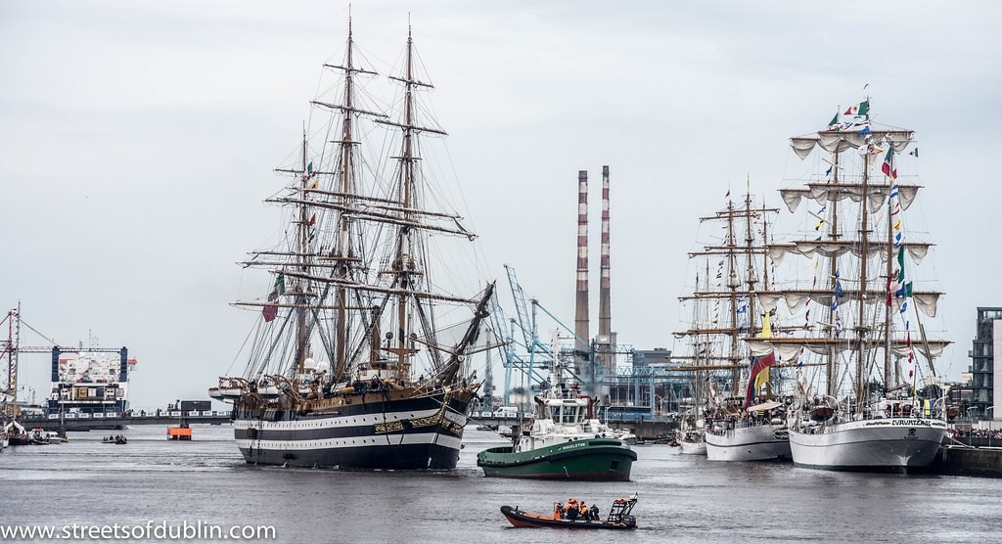
2. INDUSTRIAL FISHING
Activity 3
Ships in a port.
Notes:
Activity 3. Look carefully at this picture: ships in a port. Observe every detail before I ask the question.

Slide 26
2. INDUSTRIAL FISHING
Activity 3: Question
Describe industrial fishing.
Notes:
Here is the question for Activity 3: Describe industrial fishing. Take one minute to think and write your answer in your rough notebook.

Slide 27
2. INDUSTRIAL FISHING
Activity 3: Answer
Large-scale fishing at sea with trawlers and refrigeration.
Notes:
Let us check the answer together. Large-scale fishing at sea with trawlers and refrigeration.

Slide 28

3. IMPORTANCE AND PROBLEMS
Activity 4
A fish market.
Notes:
Activity 4. Look carefully at this picture: a fish market. Observe every detail before I ask the question.

Slide 29
3. IMPORTANCE AND PROBLEMS
Activity 4: Question
Give two problems of fishing in Cameroon.
Notes:
Here is the question for Activity 4: Give two problems of fishing in Cameroon. Take one minute to think and write your answer in your rough notebook.

Slide 30
3. IMPORTANCE AND PROBLEMS
Activity 4: Answer
Poor preservation and overfishing (also foreign trawlers, pollution, poor equipment).
Notes:
Let us check the answer together. Poor preservation and overfishing (also foreign trawlers, pollution, poor equipment).

Slide 31

4. EFFORTS
Activity 5
A fish pond.
Notes:
Activity 5. Look carefully at this picture: a fish pond. Observe every detail before I ask the question.

Slide 32
4. EFFORTS
Activity 5: Question
Give two efforts to conserve fish in Cameroon.
Notes:
Here is the question for Activity 5: Give two efforts to conserve fish in Cameroon. Take one minute to think and write your answer in your rough notebook.

Slide 33
4. EFFORTS
Activity 5: Answer
Promoting fish farming and controlling fishing licences and net sizes.
Notes:
Let us check the answer together. Promoting fish farming and controlling fishing licences and net sizes.

Slide 34
BOARD SUMMARY
Board Summary
Topic: Management of Primary Resources
Sub-topic: The Economic Development Potentials of Cameroon in the Primary Sector: Fishing
Lesson 42: The Management of Fish Resources in Cameroon
Notes:
Now we are going to copy the board summary. Write the title and the headings neatly in your notebooks. I will give you enough time for each slide, so do not rush.

Slide 35
BOARD SUMMARY
1. Distribution and Methods
Fishing in Cameroon is organised as follows:
Distribution: Fishing takes place on the coast (Kribi, Limbe, Douala), on rivers and on lakes such as Lagdo and Chad.
Artisanal fishing: Fishermen use canoes, nets and lines.
Notes:
Let us copy Distribution and Methods. Fishing in Cameroon is organised as follows. On this slide we have Distribution and Artisanal fishing. Write each point on a new line, with the key term first, and explain it in your own words when we revise. When you finish, we go to the next slide.

Slide 36
BOARD SUMMARY
1. Distribution and Methods (continued)
Industrial fishing: Trawlers with refrigeration fish at sea.
Notes:
We continue with Distribution and Methods. On this slide we have Industrial fishing. Write each point on a new line, with the key term first, and explain it in your own words when we revise.

Slide 37
BOARD SUMMARY
2. Importance and Problems
Fishing is important but faces problems:
Importance: It provides protein, jobs and income.
Problems: Poor equipment, poor preservation, overfishing, illegal methods and pollution.
Notes:
Let us copy Importance and Problems. Fishing is important but faces problems. On this slide we have Importance and Problems. Write each point on a new line, with the key term first, and explain it in your own words when we revise.

Slide 38
BOARD SUMMARY
3. Recent Efforts to Conserve the Resource
The following efforts protect fish:
Regulation: Fishing licences, closed seasons and control of net sizes are enforced.
Fish farming: The state promotes pisciculture in ponds.
Notes:
Let us copy Recent Efforts to Conserve the Resource. The following efforts protect fish. On this slide we have Regulation and Fish farming. Write each point on a new line, with the key term first, and explain it in your own words when we revise.

Slide 39
FORMATIVE EVALUATION
Evaluation 1
Distinguish artisanal and industrial fishing.
Notes:
Now let us check what you have understood. Question 1: Distinguish artisanal and industrial fishing. Answer in your exercise book.

Slide 40
FORMATIVE EVALUATION
Expected Answer
Artisanal: canoes and nets. Industrial: trawlers at sea.
Notes:
The expected answer is: artisanal: canoes and nets. Industrial: trawlers at sea. If you got it right, well done.

Slide 41
FORMATIVE EVALUATION
Evaluation 2
Give two efforts to conserve fish.
Notes:
Now let us check what you have understood. Question 2: Give two efforts to conserve fish. Answer in your exercise book.

Slide 42
FORMATIVE EVALUATION
Expected Answer
Fishing licences and fish farming.
Notes:
The expected answer is: fishing licences and fish farming. If you got it right, well done.

Slide 43
REMEDIATION
Remediation
Fill in the blanks:
Small-scale fishing is ______ fishing.
A large fishing boat is a ______.
Fish from Lagdo is often ______ to preserve it.
Notes:
For those who need more practice, fill in the blanks in your exercise book. The answers are: number 1, artisanal; number 2, trawler; number 3, dried (or smoked).

Slide 44
HOMEWORK
Homework
Visit a fish market and write the types of fish sold and where they come from.
Notes:
For your homework: Visit a fish market and write the types of fish sold and where they come from. We shall correct it at the beginning of our next lesson.

Slide 45
NEXT LESSON
Next Lesson
Our next lesson will be on:
Lesson 43: Mineral Resources and their Management
Notes:
Our next lesson will be on Lesson 43: Mineral Resources and their Management. Thank you for your attention, and see you next time.

Slide 46
BILINGUAL GAME
Bilingual Game (Jeu Bilingue)
English | Français
Canoe | La pirogue
Net | Le filet
Smoked fish | Le poisson fumé
Pond | L'étang
Licence | Le permis
Coast | La côte
Notes:
Let us play the bilingual game. I say a word in English, and you give me the French word. Then we do the reverse.

Slide 47
LOGBOOK
Official Logbook (1/2)
Module / Topic | Management of Primary Resources
Lesson Title | Lesson 42: The Management of Fish Resources in Cameroon
Expected Learning Outcomes | Describe the distribution of fishing in Cameroon. Describe the methods of exploitation. Explain the problems and efforts to conserve fish.
Competence | Learners are able to describe fishing in Cameroon, its problems and conservation.
Notes:
I record this information in the official logbook of the class after the lesson.

Slide 48
LOGBOOK
Official Logbook (2/2)
Matter Taught | Distribution and Methods; Importance and Problems; Recent Efforts to Conserve the Resource.
Evaluation | Formative evaluation and remediation exercise.
Homework | Visit a fish market and write the types of fish sold and where they come from.
Enrolment / Present / Absent | ____ / ____ / ____
Achievement | To be completed after the lesson.
Notes:
I complete the second page of the logbook: the matter taught, the evaluation, the homework and the attendance.

Slide 49
TEACHER'S NOTE
Teacher's Note
Timing: Homework correction, plan, objectives 8 min | Recall, situation, action 10 min | 5 activities 30 min | Board summary (copying) 30 min | Evaluation, remediation 10 min | Homework, next lesson 5 min | Logbook 7 min
Without the projector (Activity 1): use the map.
Without the projector (Activity 2): describe local fishing.
Without the projector (Activity 3): compare the two.
Without the projector (Activity 4): discuss.
Without the projector (Activity 5): discuss fish farming.
Notes:
This slide is for me, the teacher: it gives the timing of the lesson and what to do if the projector is not available.

Slide 50
REFERENCES
References
Geography Syllabus, Forms I–V, MINESEC (2023) — Form 4, Module II: Development and the Management of Primary Resources.
Photo, Activity 1: “South Holston Lake, (Virginia-Tennessee border, USA)” by James St. John, CC BY 2.0, via Flickr (https://www.flickr.com/photos/47445767@N05/39221734762)
Photo, Activity 2: “Fishermen, Lake Tana” by A.Davey, CC BY 2.0, via Flickr (https://www.flickr.com/photos/40595948@N00/2260748777)
Photo, Activity 3: “The Amerigo Vespucci Arrives In Dublin (Tall Ships Race Dublin - 2012)” by infomatique, CC BY-SA 2.0, via Flickr (https://www.flickr.com/photos/80824546@N00/7846937046)
Photo, Activity 4: “Kenyan food, farming and landscapes” by CGIAR Climate, CC BY-NC-SA 2.0, via Flickr (https://www.flickr.com/photos/55227776@N04/14310899853)
Photo, Activity 5: “Gooderstone Water Gardens - pond - water lilies” by ell brown, CC BY 2.0, via Flickr (https://www.flickr.com/photos/39415781@N06/5993988041)
Diagrams and animations: drawn for this lesson (Geography Department).
Notes:
These are the references and picture credits used to prepare this lesson.

