Slide 1
FORM 4
GEOGRAPHY
Lesson 45
Energy Resources
Notes:
Good morning, class, and welcome to our geography lesson. I am your geography teacher, Mr Kamdem. Today we are starting Lesson 45: Energy Resources.

Slide 2
CLASS INFO
Class, Chapter and Duration
Class | Form 4
Chapter | Module II: Development and the Management of Primary Resources
Duration | 2 periods (2 × 50 minutes)
Notes:
This lesson is for Form 4. It belongs to Module II: Development and the Management of Primary Resources. We shall need 2 periods to cover it.

Slide 3
IDENTIFICATION
Lesson Identification
Topic | Management of Primary Resources
Sub-topic | Major Sources of Power
Lesson | Lesson 45: Energy Resources
Notions / Concepts | Energy, coal, HEP, petroleum, natural gas, biogas, wind, nuclear, solar.
Syllabus focus | Meaning of energy; sources (traditional and modern); problems associated with energy sources; energy conservation methods.
Competence | Learners are able to classify energy sources and propose energy conservation methods.
Notes:
Our topic is Management of Primary Resources, and the sub-topic is Major Sources of Power. The key notions we shall use today are: energy, coal, HEP, petroleum, natural gas, biogas, wind, nuclear, solar. At the end, you should be able to do this: learners are able to classify energy sources and propose energy conservation methods.

Slide 4

HOMEWORK CORRECTION
Correction of the Homework
Question (Lesson 44: The Management of Mineral Resources in Cameroon):
Give two advantages and two dangers of artisanal gold mining.
Notes:
Before we start the new lesson, let us correct the homework I gave you at the end of Lesson 44: The Management of Mineral Resources in Cameroon. The question was: Give two advantages and two dangers of artisanal gold mining. Take out your exercise books.

Slide 5
HOMEWORK CORRECTION
Correction: Possible Answer
Advantages: income for families and jobs for young people. Dangers: accidents in pits and pollution of rivers by mercury (also child labour, deforestation).
Notes:
Here is a good answer. Advantages: income for families and jobs for young people. Dangers: accidents in pits and pollution of rivers by mercury (also child labour, deforestation). Compare it with your own answer and correct your work in red.

Slide 6
LESSON PLAN
Lesson Plan
Correction of the homework
Objectives and recall
Real-life situation and action to take
Learning activities
Board summary
Evaluation, remediation and homework
Notes:
Here is the plan of our lesson today. First, we shall correct the homework. Then we shall look at the objectives and recall what you already know. After that, we shall study a situation from real life and the action to take, and do the learning activities. Finally, we shall copy the board summary, do the evaluation and the remediation, and I will give you the homework.

Slide 7
OBJECTIVES
Objectives
By the end of this lesson, you should be able to:
Define energy and classify its sources.
Explain the problems associated with energy sources.
Describe energy conservation methods.
Notes:
By the end of this lesson, you should be able to do three things. Number 1: define energy and classify its sources. Number 2: explain the problems associated with energy sources. Number 3: describe energy conservation methods.

Slide 8
PREVIOUS KNOWLEDGE
Previous Knowledge
We cook with wood, gas or charcoal.
Dams produce electricity.
Burning fuels pollutes the air.
Notes:
Let us first remember what you already know. We cook with wood, gas or charcoal. Dams produce electricity. Burning fuels pollutes the air. Keep this in mind, because we shall build on it today.

Slide 9
REAL-LIFE SITUATION
Situation in Real Life
In Garoua, some families cook with firewood, others with gas; some have electricity from the Lagdo dam and others use solar lamps. Power cuts are frequent.
Notes:
Listen carefully to this situation from real life. In Garoua, some families cook with firewood, others with gas; some have electricity from the Lagdo dam and others use solar lamps. Power cuts are frequent. Think about it, because I am going to ask you some questions.

Slide 10
REAL-LIFE SITUATION
Situation: Question 1
What is the problem in the situation?
Notes:
Question 1: What is the problem in the situation? Think for a moment, then raise your hand to answer.

Slide 11
REAL-LIFE SITUATION
Answer
Families use different energy sources and face power cuts.
Notes:
Good. Families use different energy sources and face power cuts.

Slide 12
REAL-LIFE SITUATION
Situation: Question 2
Name two traditional sources.
Notes:
Question 2: Name two traditional sources. Think for a moment, then raise your hand to answer.

Slide 13
REAL-LIFE SITUATION
Answer
Firewood and charcoal.
Notes:
Good. Firewood and charcoal.

Slide 14
REAL-LIFE SITUATION
Situation: Question 3
Name two modern sources.
Notes:
Question 3: Name two modern sources. Think for a moment, then raise your hand to answer.

Slide 15
REAL-LIFE SITUATION
Possible Answer
Electricity (HEP) and solar energy (also gas).
Notes:
Good. Electricity (HEP) and solar energy (also gas).

Slide 16
ACTION TO TAKE
Action to Take
Switch off lights and appliances when not in use.
Notes:
From this situation, the action we are working towards in this lesson is the following: switch off lights and appliances when not in use.

Slide 17
JUSTIFICATION
Justification of the Lesson
This lesson helps us to know energy sources and save energy.
Notes:
Why is this lesson important for you? This lesson helps us to know energy sources and save energy.

Slide 18
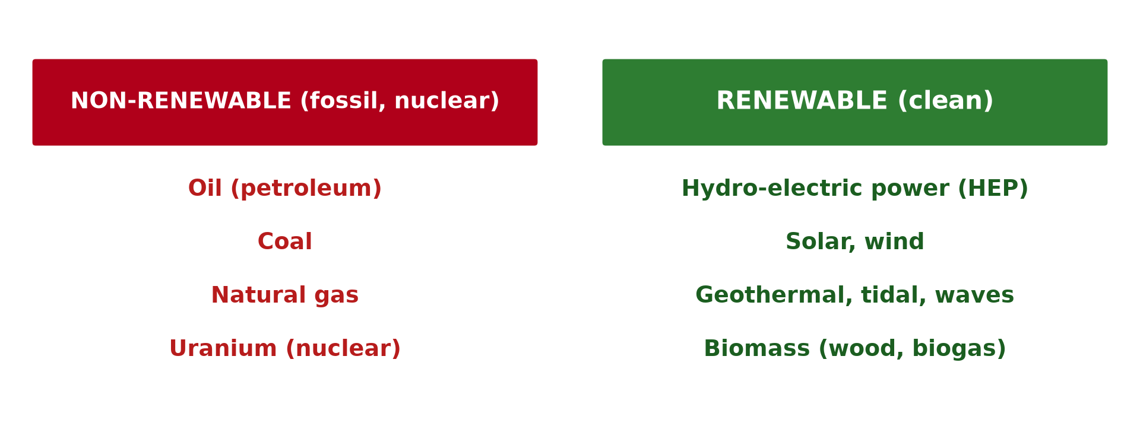
1. MEANING
Activity 1
Classification of energy.
Notes:
Activity 1. Look carefully at this diagram: classification of energy. Observe every detail before I ask the question.

Slide 19
1. MEANING
Activity 1: Question
What is energy?
Notes:
Here is the question for Activity 1: What is energy? Take one minute to think and write your answer in your rough notebook.

Slide 20
1. MEANING
Activity 1: Answer
The power used to do work: to cook, light, move and run machines.
Notes:
Let us check the answer together. The power used to do work: to cook, light, move and run machines.

Slide 21

2. TRADITIONAL SOURCES
Activity 2
Charcoal.
Notes:
Activity 2. Look carefully at this picture: charcoal. Observe every detail before I ask the question.

Slide 22
2. TRADITIONAL SOURCES
Activity 2: Question
Name three traditional sources of energy.
Notes:
Here is the question for Activity 2: Name three traditional sources of energy. Take one minute to think and write your answer in your rough notebook.

Slide 23
2. TRADITIONAL SOURCES
Activity 2: Answer
Firewood, charcoal and animal power (also human power).
Notes:
Let us check the answer together. Firewood, charcoal and animal power (also human power).

Slide 24
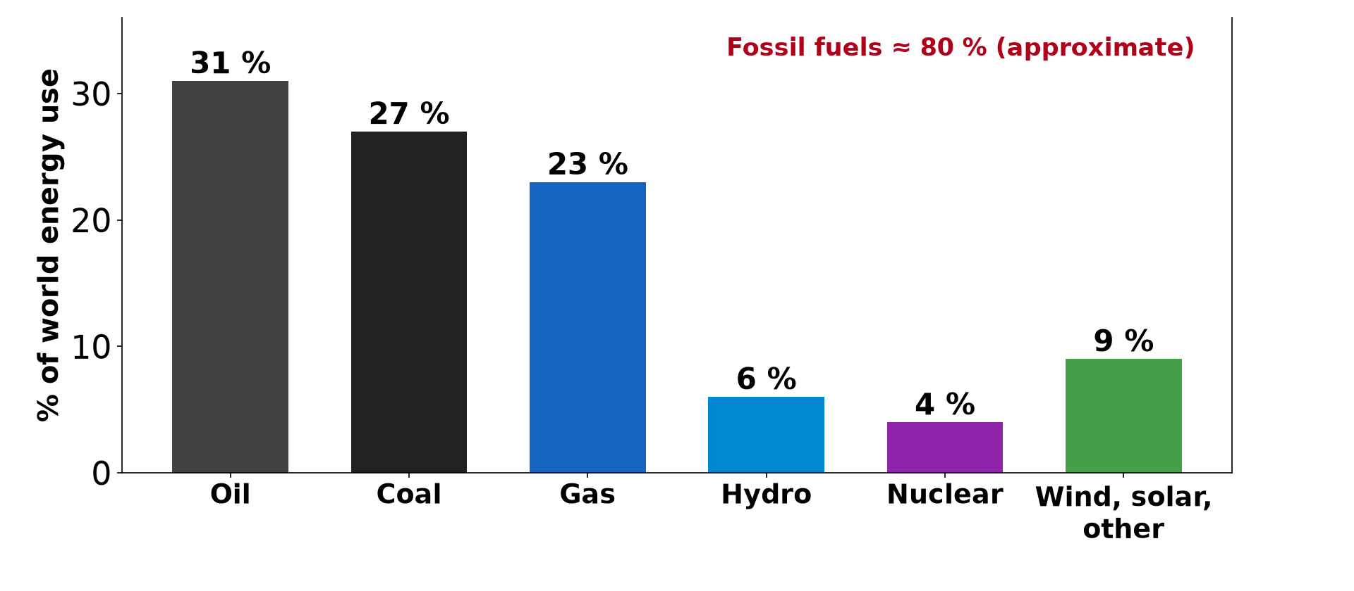
2. MODERN SOURCES
Activity 3
World energy use.
Notes:
Activity 3. Look carefully at this diagram: world energy use. Observe every detail before I ask the question.

Slide 25
2. MODERN SOURCES
Activity 3: Question
Name four modern sources and classify them as renewable or not.
Notes:
Here is the question for Activity 3: Name four modern sources and classify them as renewable or not. Take one minute to think and write your answer in your rough notebook.

Slide 26
2. MODERN SOURCES
Activity 3: Answer
Oil and coal (non-renewable); HEP and solar (renewable) (also gas, nuclear, wind, biogas).
Notes:
Let us check the answer together. Oil and coal (non-renewable); HEP and solar (renewable) (also gas, nuclear, wind, biogas).

Slide 27

3. PROBLEMS
Activity 4
Smoke from a factory.
Notes:
Activity 4. Look carefully at this picture: smoke from a factory. Observe every detail before I ask the question.

Slide 28
3. PROBLEMS
Activity 4: Question
Give two problems associated with energy sources.
Notes:
Here is the question for Activity 4: Give two problems associated with energy sources. Take one minute to think and write your answer in your rough notebook.

Slide 29
3. PROBLEMS
Activity 4: Answer
Fossil fuels pollute and will run out; firewood causes deforestation (also high costs, power cuts).
Notes:
Let us check the answer together. Fossil fuels pollute and will run out; firewood causes deforestation (also high costs, power cuts).

Slide 30

4. CONSERVATION
Activity 5
Solar panels.
Notes:
Activity 5. Look carefully at this picture: solar panels. Observe every detail before I ask the question.

Slide 31
4. CONSERVATION
Activity 5: Question
Give three energy conservation methods.
Notes:
Here is the question for Activity 5: Give three energy conservation methods. Take one minute to think and write your answer in your rough notebook.

Slide 32
4. CONSERVATION
Activity 5: Answer
Switching off lights, using energy-saving bulbs and using renewable energy (also improved stoves).
Notes:
Let us check the answer together. Switching off lights, using energy-saving bulbs and using renewable energy (also improved stoves).

Slide 33
BOARD SUMMARY
Board Summary
Topic: Management of Primary Resources
Sub-topic: Major Sources of Power
Lesson 45: Energy Resources
Notes:
Now we are going to copy the board summary. Write the title and the headings neatly in your notebooks. I will give you enough time for each slide, so do not rush.

Slide 34
BOARD SUMMARY
DEFINITIONS
The key terms of this lesson are defined as follows:
Energy: It is the power used to do work, such as cooking, lighting and running machines.
Notes:
Let us copy the definitions. The key terms of this lesson are defined as follows. On this slide we have Energy. Write each point on a new line, with the key term first, and explain it in your own words when we revise.

Slide 35
BOARD SUMMARY
1. Sources of Energy
Energy comes from the following sources:
Traditional sources: Firewood, charcoal, animal and human power are used mainly in villages.
Non-renewable modern sources: Coal, petroleum, natural gas and nuclear fuel will run out.
Notes:
Let us copy Sources of Energy. Energy comes from the following sources. On this slide we have Traditional sources and Non-renewable modern sources. Write each point on a new line, with the key term first, and explain it in your own words when we revise. When you finish, we go to the next slide.

Slide 36
BOARD SUMMARY
1. Sources of Energy (continued)
Renewable modern sources: HEP, solar, wind and biogas are renewed naturally.
Notes:
We continue with Sources of Energy. On this slide we have Renewable modern sources. Write each point on a new line, with the key term first, and explain it in your own words when we revise.

Slide 37
BOARD SUMMARY
1. Sources of Energy
Illustration: classification of energy
Notes:
Now draw this illustration in your notebook: classification of energy. Give it a title and label it clearly.

Slide 38
BOARD SUMMARY
2. Problems Associated with Energy Sources
Energy sources have the following problems:
Fossil fuels: They pollute the air, cause climate change and will run out.
Firewood: Its use causes deforestation.
Access: Many people lack electricity and suffer power cuts.
Notes:
Let us copy Problems Associated with Energy Sources. Energy sources have the following problems. On this slide we have Fossil fuels, Firewood and Access. Write each point on a new line, with the key term first, and explain it in your own words when we revise.

Slide 39
BOARD SUMMARY
3. Energy Conservation Methods
Energy can be saved in the following ways:
Saving habits: Switch off lights and appliances and use energy-saving bulbs.
Efficient equipment: Improved stoves and efficient machines use less energy.
Notes:
Let us copy Energy Conservation Methods. Energy can be saved in the following ways. On this slide we have Saving habits and Efficient equipment. Write each point on a new line, with the key term first, and explain it in your own words when we revise. When you finish, we go to the next slide.

Slide 40
BOARD SUMMARY
3. Energy Conservation Methods (continued)
Renewable energy: Solar, wind and biogas reduce the use of fossil fuels.
Notes:
We continue with Energy Conservation Methods. On this slide we have Renewable energy. Write each point on a new line, with the key term first, and explain it in your own words when we revise.

Slide 41
FORMATIVE EVALUATION
Evaluation 1
Name two renewable and two non-renewable sources.
Notes:
Now let us check what you have understood. Question 1: Name two renewable and two non-renewable sources. Answer in your exercise book.

Slide 42
FORMATIVE EVALUATION
Expected Answer
Solar and HEP; oil and coal.
Notes:
The expected answer is: solar and HEP; oil and coal. If you got it right, well done.

Slide 43
FORMATIVE EVALUATION
Evaluation 2
Give two energy conservation methods.
Notes:
Now let us check what you have understood. Question 2: Give two energy conservation methods. Answer in your exercise book.

Slide 44
FORMATIVE EVALUATION
Expected Answer
Switching off lights and using improved stoves.
Notes:
The expected answer is: switching off lights and using improved stoves. If you got it right, well done.

Slide 45
REMEDIATION
Remediation
Fill in the blanks:
Electricity from dams is ______.
Gas from animal waste is ______.
Oil and coal are ______ fuels.
Notes:
For those who need more practice, fill in the blanks in your exercise book. The answers are: number 1, HEP; number 2, biogas; number 3, fossil.

Slide 46
HOMEWORK
Homework
List the energy sources used in your home and suggest two ways to save energy.
Notes:
For your homework: List the energy sources used in your home and suggest two ways to save energy. We shall correct it at the beginning of our next lesson.

Slide 47
NEXT LESSON
Next Lesson
Our next lesson will be on:
Lesson 46: The Energy Resources of Cameroon
Notes:
Our next lesson will be on Lesson 46: The Energy Resources of Cameroon. Thank you for your attention, and see you next time.

Slide 48
BILINGUAL GAME
Bilingual Game (Jeu Bilingue)
English | Français
Energy | L'énergie
Electricity | L'électricité
Solar | Solaire
Wind | L'éolien
Coal | Le charbon
Power cut | La coupure de courant
Notes:
Let us play the bilingual game. I say a word in English, and you give me the French word. Then we do the reverse.

Slide 49
LOGBOOK
Official Logbook (1/2)
Module / Topic | Management of Primary Resources
Lesson Title | Lesson 45: Energy Resources
Expected Learning Outcomes | Define energy and classify its sources. Explain the problems associated with energy sources. Describe energy conservation methods.
Competence | Learners are able to classify energy sources and propose energy conservation methods.
Notes:
I record this information in the official logbook of the class after the lesson.

Slide 50
LOGBOOK
Official Logbook (2/2)
Matter Taught | DEFINITIONS; Sources of Energy; Problems Associated with Energy Sources; Energy Conservation Methods.
Evaluation | Formative evaluation and remediation exercise.
Homework | List the energy sources used in your home and suggest two ways to save energy.
Enrolment / Present / Absent | ____ / ____ / ____
Achievement | To be completed after the lesson.
Notes:
I complete the second page of the logbook: the matter taught, the evaluation, the homework and the attendance.

Slide 51
TEACHER'S NOTE
Teacher's Note
Timing: Homework correction, plan, objectives 8 min | Recall, situation, action 10 min | 5 activities 30 min | Board summary (copying) 30 min | Evaluation, remediation 10 min | Homework, next lesson 5 min | Logbook 7 min
Without the projector (Activity 1): list uses of energy.
Without the projector (Activity 2): list sources at home.
Without the projector (Activity 3): classify on the board.
Without the projector (Activity 4): discuss.
Without the projector (Activity 5): list actions.
Notes:
This slide is for me, the teacher: it gives the timing of the lesson and what to do if the projector is not available.

Slide 52
REFERENCES
References
Geography Syllabus, Forms I–V, MINESEC (2023) — Form 4, Module II: Development and the Management of Primary Resources.
Photo, Activity 2: “Charcoal, made from tree branches” by World Bank Photo Collection, CC BY-NC-ND 2.0, via Flickr (https://www.flickr.com/photos/10816734@N03/25644159775)
Photo, Activity 4: “image replaced (thanks Anne :) )” by why 137, CC BY 2.0, via Flickr (https://www.flickr.com/photos/78752351@N03/8464430910)
Photo, Activity 5: “Noor Ouarzazate III Solar Plant” by Richard Allaway, CC BY 2.0, via Flickr (https://www.flickr.com/photos/16287002@N00/52769922684)
Diagrams and animations: drawn for this lesson (Geography Department).
Notes:
These are the references and picture credits used to prepare this lesson.

