Slide 1

DIVINE GRACE COLLEGE OF ARTS, SCIENCE AND TECHNOLOGY
(DGCAST) — GAROUA | GEOGRAPHY DEPARTMENT
LOWER SIXTH ARTS — GEOMORPHOLOGY — LESSON 8
Earthquakes and Man
Mr KAMDEM EMMANUEL
Geography Teacher — PLEG
Academic Year 2026 / 2027
Notes:
Good morning, class. Today we study Lesson 8: Earthquakes and Man.

Slide 2
GEOGRAPHY — LOWER SIXTH ARTS
CLASS INFO
Class, Chapter & Duration
Class | Lower Sixth Arts
Chapter | Module 2: Understanding and managing physical landscapes, geomorphological processes and hazards across the world in general and Cameroon in particular
Duration | 2 periods (2 × 50 minutes)
2026 / 2027
DGCAST GAROUA — GEOGRAPHY DEPARTMENT
Mr KAMDEM E. | 2

Slide 3
GEOGRAPHY — LOWER SIXTH ARTS
IDENTIFICATION
Lesson Identification
Topic | Crustal Processes and their Effect on the Land Surface and Man
Sub-topic | Seismic Activity (Earthquakes)
Lesson | Lesson 8: Earthquakes and Man
Notions / Concepts | Earthquake, focus, epicentre, seismic waves, tsunami, isostatic recovery.
Syllabus focus | Meaning and nature; distribution; causes; effects; mitigation.
Competence | Learners are able to explain earthquakes and propose ways to reduce their damage.
2026 / 2027
DGCAST GAROUA — GEOGRAPHY DEPARTMENT
Mr KAMDEM E. | 3

Slide 4
GEOGRAPHY — LOWER SIXTH ARTS
OBJECTIVES
Learning Objectives
By the end of the lesson, the learner should be able to:
Define an earthquake, the focus and the epicentre.
Explain the causes and distribution of earthquakes.
Describe their effects and measures of mitigation.
2026 / 2027
DGCAST GAROUA — GEOGRAPHY DEPARTMENT
Mr KAMDEM E. | 4

Slide 5
GEOGRAPHY — LOWER SIXTH ARTS
RECALL
Recall
Most earthquakes occur at plate margins.
Volcanoes can cause earthquakes.
2026 / 2027
DGCAST GAROUA — GEOGRAPHY DEPARTMENT
Mr KAMDEM E. | 5

Slide 6
GEOGRAPHY — LOWER SIXTH ARTS
REAL-LIFE SITUATION
Real-Life Situation
In September 2023, an earthquake in the Atlas Mountains of Morocco destroyed villages of stone and mud houses. Nearly 3,000 people died.
2026 / 2027
DGCAST GAROUA — GEOGRAPHY DEPARTMENT
Mr KAMDEM E. | 6
Notes:
Read the situation slowly, twice.

Slide 7
GEOGRAPHY — LOWER SIXTH ARTS
REAL-LIFE SITUATION
Situation — Question 1
What is the problem in the situation?
2026 / 2027
DGCAST GAROUA — GEOGRAPHY DEPARTMENT
Mr KAMDEM E. | 7

Slide 8
GEOGRAPHY — LOWER SIXTH ARTS
REAL-LIFE SITUATION
Answer
An earthquake killed many people.
2026 / 2027
DGCAST GAROUA — GEOGRAPHY DEPARTMENT
Mr KAMDEM E. | 8

Slide 9
GEOGRAPHY — LOWER SIXTH ARTS
REAL-LIFE SITUATION
Situation — Question 2
Why did so many die?
2026 / 2027
DGCAST GAROUA — GEOGRAPHY DEPARTMENT
Mr KAMDEM E. | 9

Slide 10
GEOGRAPHY — LOWER SIXTH ARTS
REAL-LIFE SITUATION
Answer
Their houses collapsed on them.
2026 / 2027
DGCAST GAROUA — GEOGRAPHY DEPARTMENT
Mr KAMDEM E. | 10

Slide 11
GEOGRAPHY — LOWER SIXTH ARTS
REAL-LIFE SITUATION
Situation — Question 3
How can such deaths be reduced?
2026 / 2027
DGCAST GAROUA — GEOGRAPHY DEPARTMENT
Mr KAMDEM E. | 11

Slide 12
GEOGRAPHY — LOWER SIXTH ARTS
REAL-LIFE SITUATION
Possible Answer
By building stronger houses and preparing people.
2026 / 2027
DGCAST GAROUA — GEOGRAPHY DEPARTMENT
Mr KAMDEM E. | 12

Slide 13
GEOGRAPHY — LOWER SIXTH ARTS
JUSTIFICATION
Justification of the Lesson
This lesson helps us to understand earthquakes and to protect people from them.
2026 / 2027
DGCAST GAROUA — GEOGRAPHY DEPARTMENT
Mr KAMDEM E. | 13

Slide 14
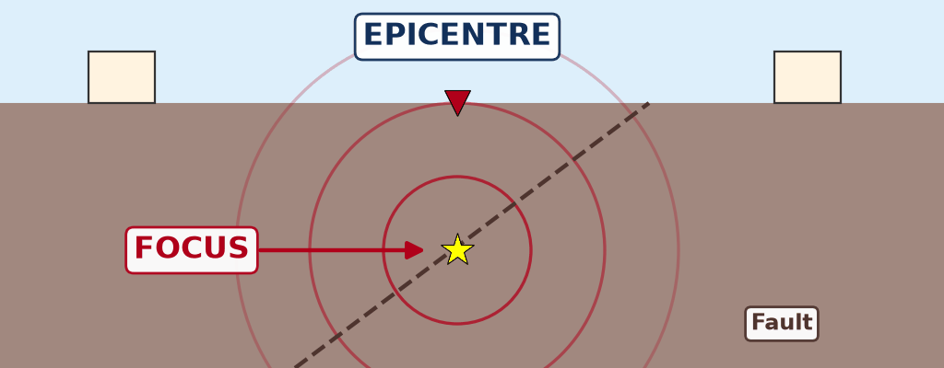
GEOGRAPHY — LOWER SIXTH ARTS
I. MEANING
Activity 1
Animation: seismic waves from the focus.
2026 / 2027
DGCAST GAROUA — GEOGRAPHY DEPARTMENT
Mr KAMDEM E. | 14
Notes:
Without the projector: drop a stone in water: waves spread in circles.

Slide 15
GEOGRAPHY — LOWER SIXTH ARTS
I. MEANING
Activity 1: Question
What is the focus? What is the epicentre?
2026 / 2027
DGCAST GAROUA — GEOGRAPHY DEPARTMENT
Mr KAMDEM E. | 15

Slide 16
GEOGRAPHY — LOWER SIXTH ARTS
I. MEANING
Answer
The focus is the starting point underground; the epicentre is the point on the surface above it.
2026 / 2027
DGCAST GAROUA — GEOGRAPHY DEPARTMENT
Mr KAMDEM E. | 16

Slide 17
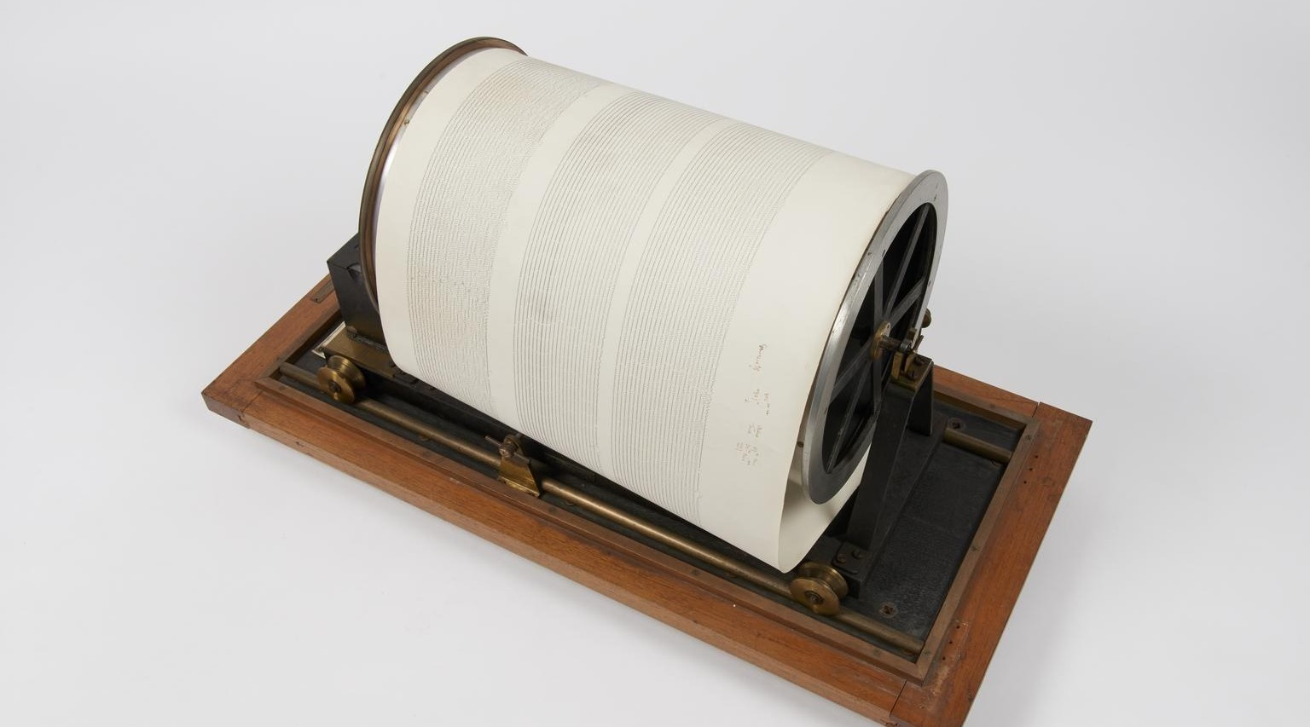
GEOGRAPHY — LOWER SIXTH ARTS
II. MEASUREMENT
Activity 2
A seismograph drum.
2026 / 2027
DGCAST GAROUA — GEOGRAPHY DEPARTMENT
Mr KAMDEM E. | 17
Notes:
Without the projector: draw a zigzag line on the board.

Slide 18
GEOGRAPHY — LOWER SIXTH ARTS
II. MEASUREMENT
Activity 2: Question
Which instrument records earthquakes? Which scale measures their energy?
2026 / 2027
DGCAST GAROUA — GEOGRAPHY DEPARTMENT
Mr KAMDEM E. | 18

Slide 19
GEOGRAPHY — LOWER SIXTH ARTS
II. MEASUREMENT
Answer
The seismograph; the Richter (magnitude) scale.
2026 / 2027
DGCAST GAROUA — GEOGRAPHY DEPARTMENT
Mr KAMDEM E. | 19

Slide 20

GEOGRAPHY — LOWER SIXTH ARTS
III. CAUSES AND DISTRIBUTION
Activity 3
Plate margins of the world.
2026 / 2027
DGCAST GAROUA — GEOGRAPHY DEPARTMENT
Mr KAMDEM E. | 20
Notes:
Without the projector: show the Pacific Ring of Fire.

Slide 21
GEOGRAPHY — LOWER SIXTH ARTS
III. CAUSES AND DISTRIBUTION
Activity 3: Question
Where do most earthquakes happen? Name one area of Cameroon where they are felt.
2026 / 2027
DGCAST GAROUA — GEOGRAPHY DEPARTMENT
Mr KAMDEM E. | 21

Slide 22
GEOGRAPHY — LOWER SIXTH ARTS
III. CAUSES AND DISTRIBUTION
Answer
At plate margins; in Cameroon, around Mount Cameroon and the volcanic line.
2026 / 2027
DGCAST GAROUA — GEOGRAPHY DEPARTMENT
Mr KAMDEM E. | 22

Slide 23

GEOGRAPHY — LOWER SIXTH ARTS
IV. EFFECTS
Activity 4
Buildings destroyed by an earthquake.
2026 / 2027
DGCAST GAROUA — GEOGRAPHY DEPARTMENT
Mr KAMDEM E. | 23
Notes:
Without the projector: describe the Morocco earthquake of 2023.

Slide 24
GEOGRAPHY — LOWER SIXTH ARTS
IV. EFFECTS
Activity 4: Question
Give two effects of an earthquake on people.
2026 / 2027
DGCAST GAROUA — GEOGRAPHY DEPARTMENT
Mr KAMDEM E. | 24

Slide 25
GEOGRAPHY — LOWER SIXTH ARTS
IV. EFFECTS
Answer
Houses collapse and people die; roads and water pipes are cut.
2026 / 2027
DGCAST GAROUA — GEOGRAPHY DEPARTMENT
Mr KAMDEM E. | 25

Slide 26
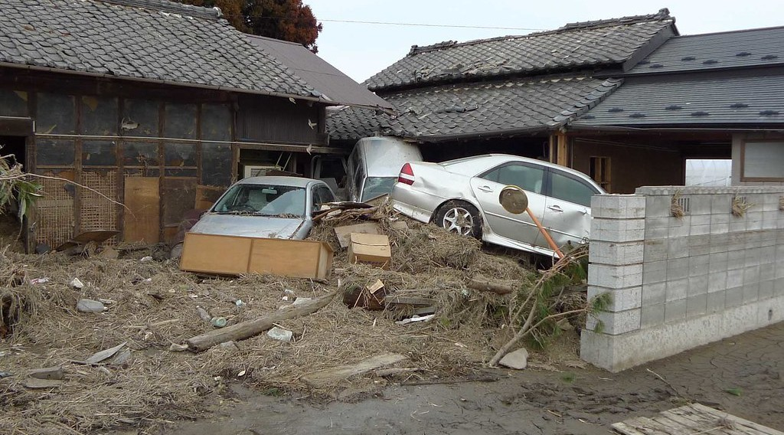
GEOGRAPHY — LOWER SIXTH ARTS
IV. EFFECTS
Activity 5
Damage caused by a tsunami.
2026 / 2027
DGCAST GAROUA — GEOGRAPHY DEPARTMENT
Mr KAMDEM E. | 26
Notes:
Without the projector: mention the tsunamis of 2004 (Indian Ocean) and 2011 (Japan).

Slide 27
GEOGRAPHY — LOWER SIXTH ARTS
IV. EFFECTS
Activity 5: Question
An earthquake under the sea can cause a giant wave. What is it called?
2026 / 2027
DGCAST GAROUA — GEOGRAPHY DEPARTMENT
Mr KAMDEM E. | 27

Slide 28
GEOGRAPHY — LOWER SIXTH ARTS
IV. EFFECTS
Answer
A tsunami.
2026 / 2027
DGCAST GAROUA — GEOGRAPHY DEPARTMENT
Mr KAMDEM E. | 28

Slide 29
GEOGRAPHY — LOWER SIXTH ARTS
BOARD SUMMARY
Earthquakes and Man
Topic: Crustal Processes and their Effect on the Land Surface and Man
Sub-topic: Seismic Activity (Earthquakes)
Lesson 8: Earthquakes and Man
2026 / 2027
DGCAST GAROUA — GEOGRAPHY DEPARTMENT
Mr KAMDEM E. | 29
Notes:
Learners copy the board summary now. Give them enough time for each slide.

Slide 30
GEOGRAPHY — LOWER SIXTH ARTS
BOARD SUMMARY
I. Definitions (1/2)
Earthquake: It is a sudden shaking of the ground caused by the release of energy in the crust.
Focus: It is the point underground where the earthquake starts.
Epicentre: It is the point on the surface directly above the focus.
2026 / 2027
DGCAST GAROUA — GEOGRAPHY DEPARTMENT
Mr KAMDEM E. | 30

Slide 31
GEOGRAPHY — LOWER SIXTH ARTS
BOARD SUMMARY
I. Definitions (2/2)
Tsunami: It is a giant sea wave caused by an earthquake under the sea.
2026 / 2027
DGCAST GAROUA — GEOGRAPHY DEPARTMENT
Mr KAMDEM E. | 31

Slide 32
GEOGRAPHY — LOWER SIXTH ARTS
BOARD SUMMARY
II. Nature and Distribution (1/3)
A. Seismic waves: Energy spreads from the focus as P, S and surface waves. The seismograph records them.
B. Measurement: The Richter scale measures the energy (magnitude). The Mercalli scale measures the damage (intensity).
2026 / 2027
DGCAST GAROUA — GEOGRAPHY DEPARTMENT
Mr KAMDEM E. | 32

Slide 33
GEOGRAPHY — LOWER SIXTH ARTS
BOARD SUMMARY
II. Nature and Distribution (2/3)
C. Distribution: Most earthquakes occur at plate margins, such as the Pacific Ring of Fire. In Cameroon, small earthquakes occur along the Cameroon Volcanic Line.
2026 / 2027
DGCAST GAROUA — GEOGRAPHY DEPARTMENT
Mr KAMDEM E. | 33

Slide 34
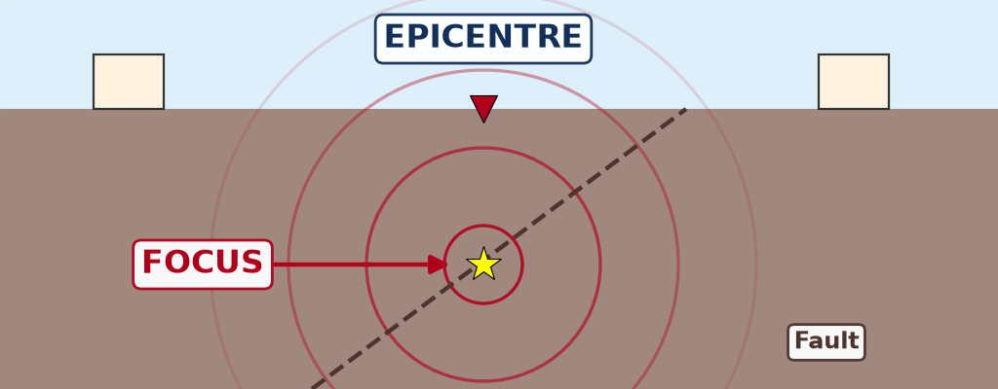
GEOGRAPHY — LOWER SIXTH ARTS
BOARD SUMMARY
II. Nature and Distribution (3/3)
Copy the focus and the epicentre.
2026 / 2027
DGCAST GAROUA — GEOGRAPHY DEPARTMENT
Mr KAMDEM E. | 34

Slide 35
GEOGRAPHY — LOWER SIXTH ARTS
BOARD SUMMARY
III. Causes, Effects and Mitigation (1/2)
A. Causes: Plate movements along faults are the main cause. Volcanic eruptions and isostatic recovery also cause earthquakes.
B. Effects: Buildings collapse, landslides and tsunamis occur, and fires break out. Many people die or lose their homes.
2026 / 2027
DGCAST GAROUA — GEOGRAPHY DEPARTMENT
Mr KAMDEM E. | 35

Slide 36
GEOGRAPHY — LOWER SIXTH ARTS
BOARD SUMMARY
III. Causes, Effects and Mitigation (2/2)
C. Mitigation: Countries build earthquake-resistant buildings and teach safety drills. Warning systems and land-use planning also reduce damage.
2026 / 2027
DGCAST GAROUA — GEOGRAPHY DEPARTMENT
Mr KAMDEM E. | 36

Slide 37
GEOGRAPHY — LOWER SIXTH ARTS
FORMATIVE EVALUATION
Formative Evaluation 1
What is the epicentre?
2026 / 2027
DGCAST GAROUA — GEOGRAPHY DEPARTMENT
Mr KAMDEM E. | 37

Slide 38
GEOGRAPHY — LOWER SIXTH ARTS
FORMATIVE EVALUATION
Expected Answer
The point on the surface directly above the focus.
2026 / 2027
DGCAST GAROUA — GEOGRAPHY DEPARTMENT
Mr KAMDEM E. | 38

Slide 39
GEOGRAPHY — LOWER SIXTH ARTS
FORMATIVE EVALUATION
Formative Evaluation 2
Give two ways to reduce earthquake damage.
2026 / 2027
DGCAST GAROUA — GEOGRAPHY DEPARTMENT
Mr KAMDEM E. | 39

Slide 40
GEOGRAPHY — LOWER SIXTH ARTS
FORMATIVE EVALUATION
Expected Answer
Earthquake-resistant buildings; safety drills and warnings.
2026 / 2027
DGCAST GAROUA — GEOGRAPHY DEPARTMENT
Mr KAMDEM E. | 40

Slide 41
GEOGRAPHY — LOWER SIXTH ARTS
REMEDIATION
Remediation
Fill in the blanks:
The point where an earthquake starts is the ______.
A giant wave caused by an earthquake is a ______.
Earthquakes are recorded by a ______.
2026 / 2027
DGCAST GAROUA — GEOGRAPHY DEPARTMENT
Mr KAMDEM E. | 41
Notes:
Answers: 1. focus 2. tsunami 3. seismograph

Slide 42
GEOGRAPHY — LOWER SIXTH ARTS
HOMEWORK
Homework
Look at an old wall or a big rock near your home. Describe how it is breaking.
This prepares Lesson 9: Denudation and Weathering.
2026 / 2027
DGCAST GAROUA — GEOGRAPHY DEPARTMENT
Mr KAMDEM E. | 42
Notes:
This homework prepares the next lesson.

Slide 43
GEOGRAPHY — LOWER SIXTH ARTS
BILINGUAL GAME
Bilingual Game (Jeu Bilingue)
English | Français
Earthquake | Le séisme
Epicentre | L'épicentre
Focus | Le foyer
Seismic wave | L'onde sismique
Tsunami | Le tsunami
Magnitude | La magnitude
2026 / 2027
DGCAST GAROUA — GEOGRAPHY DEPARTMENT
Mr KAMDEM E. | 43
Notes:
Say the English word; learners give the French word, then the reverse.

Slide 44
GEOGRAPHY — LOWER SIXTH ARTS
LOGBOOK
Official Logbook (1/2)
Module / Topic | Crustal Processes and their Effect on the Land Surface and Man
Lesson Title | Lesson 8: Earthquakes and Man
Expected Learning Outcomes | Define an earthquake, the focus and the epicentre. Explain the causes and distribution of earthquakes. Describe their effects and measures of mitigation.
Competence | Learners are able to explain earthquakes and propose ways to reduce their damage.
2026 / 2027
DGCAST GAROUA — GEOGRAPHY DEPARTMENT
Mr KAMDEM E. | 44

Slide 45
GEOGRAPHY — LOWER SIXTH ARTS
LOGBOOK
Official Logbook (2/2)
Matter Taught | I. Definitions: Earthquake, Focus, Epicentre, Tsunami; II. Nature and Distribution: Seismic waves, Measurement, Distribution; III. Causes, Effects and Mitigation: Causes, Effects, Mitigation.
Evaluation | Formative evaluation (3 questions) and remediation exercise.
Homework | Look at an old wall or a big rock near your home. Describe how it is breaking.
Enrolment / Present / Absent | ____ / ____ / ____
Achievement | To be completed by the teacher after the lesson.
2026 / 2027
DGCAST GAROUA — GEOGRAPHY DEPARTMENT
Mr KAMDEM E. | 45

Slide 46
GEOGRAPHY — LOWER SIXTH ARTS
TEACHER'S NOTE
Teacher's Note
Timing: Set-up, recall 8 min | Situation 8 min | 5 activities 30 min | Board summary (copying) 30 min | Evaluation, remediation 10 min | Homework, logbook 9 min | Spare 5 min
Activity 1 is an animation (GIF): it plays automatically in slide-show mode.
2026 / 2027
DGCAST GAROUA — GEOGRAPHY DEPARTMENT
Mr KAMDEM E. | 46

Slide 47
GEOGRAPHY — LOWER SIXTH ARTS
REFERENCES
References
National Geography Syllabus, Sixth Forms (Lower & Upper Sixth), MINESEC/IGE/IP-SS, August 2019 — Module 2 (Geomorphology).
Photo, Activity 2: “Recording drum from Golitsyn seismograph” by Galitzin, Boris; Masing, Hugo, CC BY-NC-SA 4.0, via sciencemuseum (https://collection.sciencemuseumgroup.org.uk/objects/co8647018/recording-drum-from-golitsyn-seismograph)
Photo, Activity 4: “Collapsed buildings in earthquake-hit Chautara, Nepal” by DFID - UK Department for International Development, CC BY 2.0, via Flickr (https://www.flickr.com/photos/14214150@N02/16693413433)
Photo, Activity 5: “Tsunami damage” by robertodevido, CC BY-NC-ND 2.0, via Flickr (https://www.flickr.com/photos/63082042@N00/5531541425)
Diagrams and animations: drawn for this lesson (DGCAST Geography Department).
2026 / 2027
DGCAST GAROUA — GEOGRAPHY DEPARTMENT
Mr KAMDEM E. | 47

