Slide 1

DIVINE GRACE COLLEGE OF ARTS, SCIENCE AND TECHNOLOGY
(DGCAST) — GAROUA | GEOGRAPHY DEPARTMENT
LOWER SIXTH ARTS — GEOMORPHOLOGY — LESSON 9
Denudation and Weathering
Mr KAMDEM EMMANUEL
Geography Teacher — PLEG
Academic Year 2026 / 2027
Notes:
Good morning, class. Today we study Lesson 9: Denudation and Weathering.

Slide 2
GEOGRAPHY — LOWER SIXTH ARTS
CLASS INFO
Class, Chapter & Duration
Class | Lower Sixth Arts
Chapter | Module 2: Understanding and managing physical landscapes, geomorphological processes and hazards across the world in general and Cameroon in particular
Duration | 2 periods (2 × 50 minutes)
2026 / 2027
DGCAST GAROUA — GEOGRAPHY DEPARTMENT
Mr KAMDEM E. | 2

Slide 3
GEOGRAPHY — LOWER SIXTH ARTS
IDENTIFICATION
Lesson Identification
Topic | Denudational Processes on Slopes
Sub-topic | Weathering
Lesson | Lesson 9: Denudation and Weathering
Notions / Concepts | Denudation, weathering, slope, degradation, aggradation.
Syllabus focus | Meaning and classification of denudation; slopes and the slope system; weathering types and agents.
Competence | Learners are able to identify the processes that wear down slopes and the types of weathering.
2026 / 2027
DGCAST GAROUA — GEOGRAPHY DEPARTMENT
Mr KAMDEM E. | 3

Slide 4
GEOGRAPHY — LOWER SIXTH ARTS
OBJECTIVES
Learning Objectives
By the end of the lesson, the learner should be able to:
Define denudation and weathering.
Describe slopes and the slope system.
Explain the types of weathering and their processes.
2026 / 2027
DGCAST GAROUA — GEOGRAPHY DEPARTMENT
Mr KAMDEM E. | 4

Slide 5
GEOGRAPHY — LOWER SIXTH ARTS
RECALL
Recall
External forces wear down the relief.
Rocks break down over time.
2026 / 2027
DGCAST GAROUA — GEOGRAPHY DEPARTMENT
Mr KAMDEM E. | 5

Slide 6
GEOGRAPHY — LOWER SIXTH ARTS
REAL-LIFE SITUATION
Real-Life Situation
Near Garoua, Yaya sees that a big granite rock is peeling in thin layers, while an old metal gate in town has turned red and crumbles.
2026 / 2027
DGCAST GAROUA — GEOGRAPHY DEPARTMENT
Mr KAMDEM E. | 6
Notes:
Read the situation slowly, twice.

Slide 7
GEOGRAPHY — LOWER SIXTH ARTS
REAL-LIFE SITUATION
Situation — Question 1
What is the problem in the situation?
2026 / 2027
DGCAST GAROUA — GEOGRAPHY DEPARTMENT
Mr KAMDEM E. | 7

Slide 8
GEOGRAPHY — LOWER SIXTH ARTS
REAL-LIFE SITUATION
Answer
Yaya does not know why the rock and the gate are breaking.
2026 / 2027
DGCAST GAROUA — GEOGRAPHY DEPARTMENT
Mr KAMDEM E. | 8

Slide 9
GEOGRAPHY — LOWER SIXTH ARTS
REAL-LIFE SITUATION
Situation — Question 2
What is breaking the rock?
2026 / 2027
DGCAST GAROUA — GEOGRAPHY DEPARTMENT
Mr KAMDEM E. | 9

Slide 10
GEOGRAPHY — LOWER SIXTH ARTS
REAL-LIFE SITUATION
Answer
Heating and cooling (physical weathering).
2026 / 2027
DGCAST GAROUA — GEOGRAPHY DEPARTMENT
Mr KAMDEM E. | 10

Slide 11
GEOGRAPHY — LOWER SIXTH ARTS
REAL-LIFE SITUATION
Situation — Question 3
What is breaking the gate?
2026 / 2027
DGCAST GAROUA — GEOGRAPHY DEPARTMENT
Mr KAMDEM E. | 11

Slide 12
GEOGRAPHY — LOWER SIXTH ARTS
REAL-LIFE SITUATION
Possible Answer
Water and air (chemical change, like oxidation).
2026 / 2027
DGCAST GAROUA — GEOGRAPHY DEPARTMENT
Mr KAMDEM E. | 12

Slide 13
GEOGRAPHY — LOWER SIXTH ARTS
JUSTIFICATION
Justification of the Lesson
This lesson helps us to understand how slopes and rocks are slowly worn down.
2026 / 2027
DGCAST GAROUA — GEOGRAPHY DEPARTMENT
Mr KAMDEM E. | 13

Slide 14

GEOGRAPHY — LOWER SIXTH ARTS
I. DENUDATION
Activity 1
Animation: the processes of denudation.
2026 / 2027
DGCAST GAROUA — GEOGRAPHY DEPARTMENT
Mr KAMDEM E. | 14
Notes:
Without the projector: write the four words with arrows.

Slide 15
GEOGRAPHY — LOWER SIXTH ARTS
I. DENUDATION
Activity 1: Question
Name the four processes of denudation in order.
2026 / 2027
DGCAST GAROUA — GEOGRAPHY DEPARTMENT
Mr KAMDEM E. | 15

Slide 16
GEOGRAPHY — LOWER SIXTH ARTS
I. DENUDATION
Answer
Weathering, erosion, transport and deposition.
2026 / 2027
DGCAST GAROUA — GEOGRAPHY DEPARTMENT
Mr KAMDEM E. | 16

Slide 17
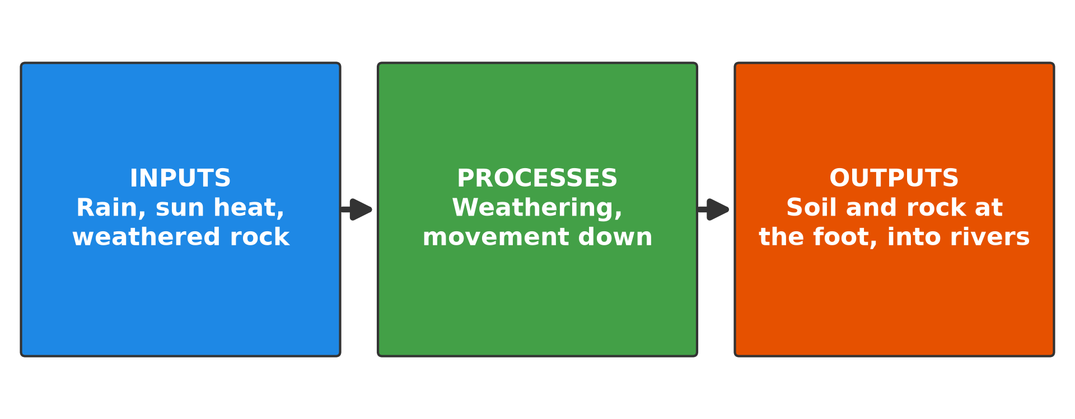
GEOGRAPHY — LOWER SIXTH ARTS
II. SLOPES
Activity 2
The slope as a system.
2026 / 2027
DGCAST GAROUA — GEOGRAPHY DEPARTMENT
Mr KAMDEM E. | 17
Notes:
Without the projector: draw a slope with arrows.

Slide 18
GEOGRAPHY — LOWER SIXTH ARTS
II. SLOPES
Activity 2: Question
What are the inputs and outputs of a slope system?
2026 / 2027
DGCAST GAROUA — GEOGRAPHY DEPARTMENT
Mr KAMDEM E. | 18

Slide 19
GEOGRAPHY — LOWER SIXTH ARTS
II. SLOPES
Answer
Inputs: rain, sun heat, weathered rock. Outputs: soil and rock that reach the foot and the rivers.
2026 / 2027
DGCAST GAROUA — GEOGRAPHY DEPARTMENT
Mr KAMDEM E. | 19

Slide 20
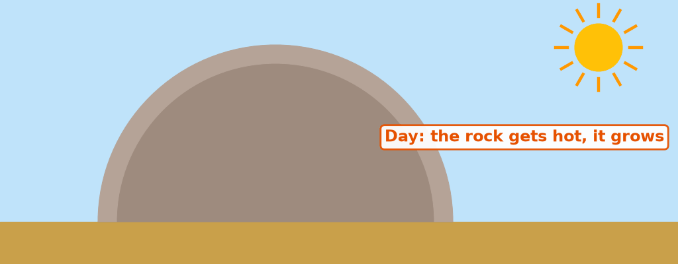
GEOGRAPHY — LOWER SIXTH ARTS
III. PHYSICAL WEATHERING
Activity 3
Animation: heating by day, cooling at night.
2026 / 2027
DGCAST GAROUA — GEOGRAPHY DEPARTMENT
Mr KAMDEM E. | 20
Notes:
Without the projector: use the example of the granite rock.

Slide 21
GEOGRAPHY — LOWER SIXTH ARTS
III. PHYSICAL WEATHERING
Activity 3: Question
Why does granite peel off in hot dry areas?
2026 / 2027
DGCAST GAROUA — GEOGRAPHY DEPARTMENT
Mr KAMDEM E. | 21

Slide 22
GEOGRAPHY — LOWER SIXTH ARTS
III. PHYSICAL WEATHERING
Answer
It expands by day and contracts at night until the outer layer breaks (exfoliation).
2026 / 2027
DGCAST GAROUA — GEOGRAPHY DEPARTMENT
Mr KAMDEM E. | 22

Slide 23

GEOGRAPHY — LOWER SIXTH ARTS
IV. CHEMICAL WEATHERING
Activity 4
Rusty metal.
2026 / 2027
DGCAST GAROUA — GEOGRAPHY DEPARTMENT
Mr KAMDEM E. | 23
Notes:
Without the projector: show a rusty nail.

Slide 24
GEOGRAPHY — LOWER SIXTH ARTS
IV. CHEMICAL WEATHERING
Activity 4: Question
Water and oxygen attack iron. What is this process called in rocks?
2026 / 2027
DGCAST GAROUA — GEOGRAPHY DEPARTMENT
Mr KAMDEM E. | 24

Slide 25
GEOGRAPHY — LOWER SIXTH ARTS
IV. CHEMICAL WEATHERING
Answer
Oxidation (a type of chemical weathering).
2026 / 2027
DGCAST GAROUA — GEOGRAPHY DEPARTMENT
Mr KAMDEM E. | 25

Slide 26

GEOGRAPHY — LOWER SIXTH ARTS
V. BIOLOGICAL WEATHERING
Activity 5
Roots breaking rocks.
2026 / 2027
DGCAST GAROUA — GEOGRAPHY DEPARTMENT
Mr KAMDEM E. | 26
Notes:
Without the projector: show a road cracked by roots.

Slide 27
GEOGRAPHY — LOWER SIXTH ARTS
V. BIOLOGICAL WEATHERING
Activity 5: Question
How do plants weather rocks?
2026 / 2027
DGCAST GAROUA — GEOGRAPHY DEPARTMENT
Mr KAMDEM E. | 27

Slide 28
GEOGRAPHY — LOWER SIXTH ARTS
V. BIOLOGICAL WEATHERING
Answer
Roots widen cracks and plants release acids.
2026 / 2027
DGCAST GAROUA — GEOGRAPHY DEPARTMENT
Mr KAMDEM E. | 28

Slide 29
GEOGRAPHY — LOWER SIXTH ARTS
BOARD SUMMARY
Denudation and Weathering
Topic: Denudational Processes on Slopes
Sub-topic: Weathering
Lesson 9: Denudation and Weathering
2026 / 2027
DGCAST GAROUA — GEOGRAPHY DEPARTMENT
Mr KAMDEM E. | 29
Notes:
Learners copy the board summary now. Give them enough time for each slide.

Slide 30
GEOGRAPHY — LOWER SIXTH ARTS
BOARD SUMMARY
I. Definitions (1/2)
Denudation: It is the wearing down of the land by weathering, mass movement and erosion.
Weathering: It is the breakdown of rocks in their place by weather and living things.
Degradation: It is the lowering of the land by removal of material.
2026 / 2027
DGCAST GAROUA — GEOGRAPHY DEPARTMENT
Mr KAMDEM E. | 30

Slide 31
GEOGRAPHY — LOWER SIXTH ARTS
BOARD SUMMARY
I. Definitions (2/2)
Aggradation: It is the building up of the land by deposition.
2026 / 2027
DGCAST GAROUA — GEOGRAPHY DEPARTMENT
Mr KAMDEM E. | 31

Slide 32
GEOGRAPHY — LOWER SIXTH ARTS
BOARD SUMMARY
II. Slopes (1/2)
A. Meaning and types: A slope is an inclined surface of the land. Slopes can be convex, concave, straight or free faces (cliffs).
B. The slope system: Inputs are rain, heat and weathered rock. Material moves downslope and leaves at the foot into rivers.
2026 / 2027
DGCAST GAROUA — GEOGRAPHY DEPARTMENT
Mr KAMDEM E. | 32

Slide 33
GEOGRAPHY — LOWER SIXTH ARTS
BOARD SUMMARY
II. Slopes (2/2)
Copy the slope system.
2026 / 2027
DGCAST GAROUA — GEOGRAPHY DEPARTMENT
Mr KAMDEM E. | 33

Slide 34
GEOGRAPHY — LOWER SIXTH ARTS
BOARD SUMMARY
III. Types of Weathering (1/2)
A. Physical (mechanical): Rocks break into pieces without changing their minerals. Processes include exfoliation, frost action and salt crystallisation.
B. Chemical: Water, oxygen and acids change the minerals of rocks. Processes include oxidation, hydrolysis, carbonation and solution.
2026 / 2027
DGCAST GAROUA — GEOGRAPHY DEPARTMENT
Mr KAMDEM E. | 34

Slide 35
GEOGRAPHY — LOWER SIXTH ARTS
BOARD SUMMARY
III. Types of Weathering (2/2)
C. Biological: Plants and animals break rocks. Roots widen cracks and burrowing animals expose rocks.
2026 / 2027
DGCAST GAROUA — GEOGRAPHY DEPARTMENT
Mr KAMDEM E. | 35

Slide 36
GEOGRAPHY — LOWER SIXTH ARTS
FORMATIVE EVALUATION
Formative Evaluation 1
Distinguish weathering and erosion.
2026 / 2027
DGCAST GAROUA — GEOGRAPHY DEPARTMENT
Mr KAMDEM E. | 36

Slide 37
GEOGRAPHY — LOWER SIXTH ARTS
FORMATIVE EVALUATION
Expected Answer
Weathering breaks rocks in place; erosion removes and carries material.
2026 / 2027
DGCAST GAROUA — GEOGRAPHY DEPARTMENT
Mr KAMDEM E. | 37

Slide 38
GEOGRAPHY — LOWER SIXTH ARTS
FORMATIVE EVALUATION
Formative Evaluation 2
Give one process of each type of weathering.
2026 / 2027
DGCAST GAROUA — GEOGRAPHY DEPARTMENT
Mr KAMDEM E. | 38

Slide 39
GEOGRAPHY — LOWER SIXTH ARTS
FORMATIVE EVALUATION
Expected Answer
Exfoliation (physical), oxidation (chemical), root action (biological).
2026 / 2027
DGCAST GAROUA — GEOGRAPHY DEPARTMENT
Mr KAMDEM E. | 39

Slide 40
GEOGRAPHY — LOWER SIXTH ARTS
REMEDIATION
Remediation
Fill in the blanks:
The wearing down of the land is ______.
Building up of the land by deposition is ______.
Peeling of rock by heating and cooling is ______.
2026 / 2027
DGCAST GAROUA — GEOGRAPHY DEPARTMENT
Mr KAMDEM E. | 40
Notes:
Answers: 1. denudation 2. aggradation 3. exfoliation

Slide 41
GEOGRAPHY — LOWER SIXTH ARTS
HOMEWORK
Homework
Compare rocks in the dry North and in the wet South of Cameroon. Where are they more deeply weathered? Why?
This prepares Lesson 10: Intensity and Types of Weathering.
2026 / 2027
DGCAST GAROUA — GEOGRAPHY DEPARTMENT
Mr KAMDEM E. | 41
Notes:
This homework prepares the next lesson.

Slide 42
GEOGRAPHY — LOWER SIXTH ARTS
BILINGUAL GAME
Bilingual Game (Jeu Bilingue)
English | Français
Weathering | L'altération / la météorisation
Denudation | L'érosion (dénudation)
Slope | Le versant
Exfoliation | La desquamation
Oxidation | L'oxydation
Deposition | Le dépôt
2026 / 2027
DGCAST GAROUA — GEOGRAPHY DEPARTMENT
Mr KAMDEM E. | 42
Notes:
Say the English word; learners give the French word, then the reverse.

Slide 43
GEOGRAPHY — LOWER SIXTH ARTS
LOGBOOK
Official Logbook (1/2)
Module / Topic | Denudational Processes on Slopes
Lesson Title | Lesson 9: Denudation and Weathering
Expected Learning Outcomes | Define denudation and weathering. Describe slopes and the slope system. Explain the types of weathering and their processes.
Competence | Learners are able to identify the processes that wear down slopes and the types of weathering.
2026 / 2027
DGCAST GAROUA — GEOGRAPHY DEPARTMENT
Mr KAMDEM E. | 43

Slide 44
GEOGRAPHY — LOWER SIXTH ARTS
LOGBOOK
Official Logbook (2/2)
Matter Taught | I. Definitions: Denudation, Weathering, Degradation, Aggradation; II. Slopes: Meaning and types, The slope system; III. Types of Weathering: Physical (mechanical), Chemical, Biological.
Evaluation | Formative evaluation (3 questions) and remediation exercise.
Homework | Compare rocks in the dry North and in the wet South of Cameroon. Where are they more deeply weathered? Why?
Enrolment / Present / Absent | ____ / ____ / ____
Achievement | To be completed by the teacher after the lesson.
2026 / 2027
DGCAST GAROUA — GEOGRAPHY DEPARTMENT
Mr KAMDEM E. | 44

Slide 45
GEOGRAPHY — LOWER SIXTH ARTS
TEACHER'S NOTE
Teacher's Note
Timing: Set-up, recall 8 min | Situation 8 min | 5 activities 30 min | Board summary (copying) 30 min | Evaluation, remediation 10 min | Homework, logbook 9 min | Spare 5 min
Activities 1 and 3 are animations (GIF): it plays automatically in slide-show mode.
2026 / 2027
DGCAST GAROUA — GEOGRAPHY DEPARTMENT
Mr KAMDEM E. | 45

Slide 46
GEOGRAPHY — LOWER SIXTH ARTS
REFERENCES
References
National Geography Syllabus, Sixth Forms (Lower & Upper Sixth), MINESEC/IGE/IP-SS, August 2019 — Module 2 (Geomorphology).
Photo, Activity 4: “Lock down!” by ViNo Gv, CC BY 2.0, via Flickr (https://www.flickr.com/photos/38217093@N03/20143584561)
Photo, Activity 5: “Stones 'n' Roots” by erix!, CC BY 2.0, via Flickr (https://www.flickr.com/photos/68387408@N00/55692423)
Diagrams and animations: drawn for this lesson (DGCAST Geography Department).
2026 / 2027
DGCAST GAROUA — GEOGRAPHY DEPARTMENT
Mr KAMDEM E. | 46

