Slide 1

DIVINE GRACE COLLEGE OF ARTS, SCIENCE AND TECHNOLOGY
(DGCAST) — GAROUA | GEOGRAPHY DEPARTMENT
LOWER SIXTH ARTS — GEOMORPHOLOGY — LESSON 14
Erosional Processes and the Fluvial System
Mr KAMDEM EMMANUEL
Geography Teacher — PLEG
Academic Year 2026 / 2027
Notes:
Good morning, class. Today we study Lesson 14: Erosional Processes and the Fluvial System.

Slide 2
GEOGRAPHY — LOWER SIXTH ARTS
CLASS INFO
Class, Chapter & Duration
Class | Lower Sixth Arts
Chapter | Module 2: Understanding and managing physical landscapes, geomorphological processes and hazards across the world in general and Cameroon in particular
Duration | 2 periods (2 × 50 minutes)
2026 / 2027
DGCAST GAROUA — GEOGRAPHY DEPARTMENT
Mr KAMDEM E. | 2

Slide 3
GEOGRAPHY — LOWER SIXTH ARTS
IDENTIFICATION
Lesson Identification
Topic | Denudational Processes on Slopes
Sub-topic | Erosion and Depositional Processes and Landforms
Lesson | Lesson 14: Erosional Processes and the Fluvial System
Notions / Concepts | Erosion, transportation, deposition, competence, capacity, Hjulström.
Syllabus focus | Processes of erosion and transport; types of load; the Hjulström graph; the river as a system.
Competence | Learners are able to explain how rivers erode, carry and deposit material.
2026 / 2027
DGCAST GAROUA — GEOGRAPHY DEPARTMENT
Mr KAMDEM E. | 3

Slide 4
GEOGRAPHY — LOWER SIXTH ARTS
OBJECTIVES
Learning Objectives
By the end of the lesson, the learner should be able to:
Explain the processes of river erosion.
Describe how rivers carry their load.
Interpret the Hjulström graph and describe the river as a system.
2026 / 2027
DGCAST GAROUA — GEOGRAPHY DEPARTMENT
Mr KAMDEM E. | 4

Slide 5
GEOGRAPHY — LOWER SIXTH ARTS
RECALL
Recall
Denudation includes erosion, transport and deposition.
Running water is the main agent of erosion.
2026 / 2027
DGCAST GAROUA — GEOGRAPHY DEPARTMENT
Mr KAMDEM E. | 5

Slide 6
GEOGRAPHY — LOWER SIXTH ARTS
REAL-LIFE SITUATION
Real-Life Situation
In August, the Benue at Garoua is brown and fast and carries mud, sand and branches. In March, the water is clear and slow, and sandbanks appear.
2026 / 2027
DGCAST GAROUA — GEOGRAPHY DEPARTMENT
Mr KAMDEM E. | 6
Notes:
Read the situation slowly, twice.

Slide 7
GEOGRAPHY — LOWER SIXTH ARTS
REAL-LIFE SITUATION
Situation — Question 1
What is the problem in the situation?
2026 / 2027
DGCAST GAROUA — GEOGRAPHY DEPARTMENT
Mr KAMDEM E. | 7

Slide 8
GEOGRAPHY — LOWER SIXTH ARTS
REAL-LIFE SITUATION
Answer
We want to know why the river carries more in August.
2026 / 2027
DGCAST GAROUA — GEOGRAPHY DEPARTMENT
Mr KAMDEM E. | 8

Slide 9
GEOGRAPHY — LOWER SIXTH ARTS
REAL-LIFE SITUATION
Situation — Question 2
What does the river carry?
2026 / 2027
DGCAST GAROUA — GEOGRAPHY DEPARTMENT
Mr KAMDEM E. | 9

Slide 10
GEOGRAPHY — LOWER SIXTH ARTS
REAL-LIFE SITUATION
Answer
Mud, sand and branches (its load).
2026 / 2027
DGCAST GAROUA — GEOGRAPHY DEPARTMENT
Mr KAMDEM E. | 10

Slide 11
GEOGRAPHY — LOWER SIXTH ARTS
REAL-LIFE SITUATION
Situation — Question 3
Why are there sandbanks in March?
2026 / 2027
DGCAST GAROUA — GEOGRAPHY DEPARTMENT
Mr KAMDEM E. | 11

Slide 12
GEOGRAPHY — LOWER SIXTH ARTS
REAL-LIFE SITUATION
Possible Answer
The slow water drops its load.
2026 / 2027
DGCAST GAROUA — GEOGRAPHY DEPARTMENT
Mr KAMDEM E. | 12

Slide 13
GEOGRAPHY — LOWER SIXTH ARTS
JUSTIFICATION
Justification of the Lesson
This lesson helps us to understand the work of rivers.
2026 / 2027
DGCAST GAROUA — GEOGRAPHY DEPARTMENT
Mr KAMDEM E. | 13

Slide 14
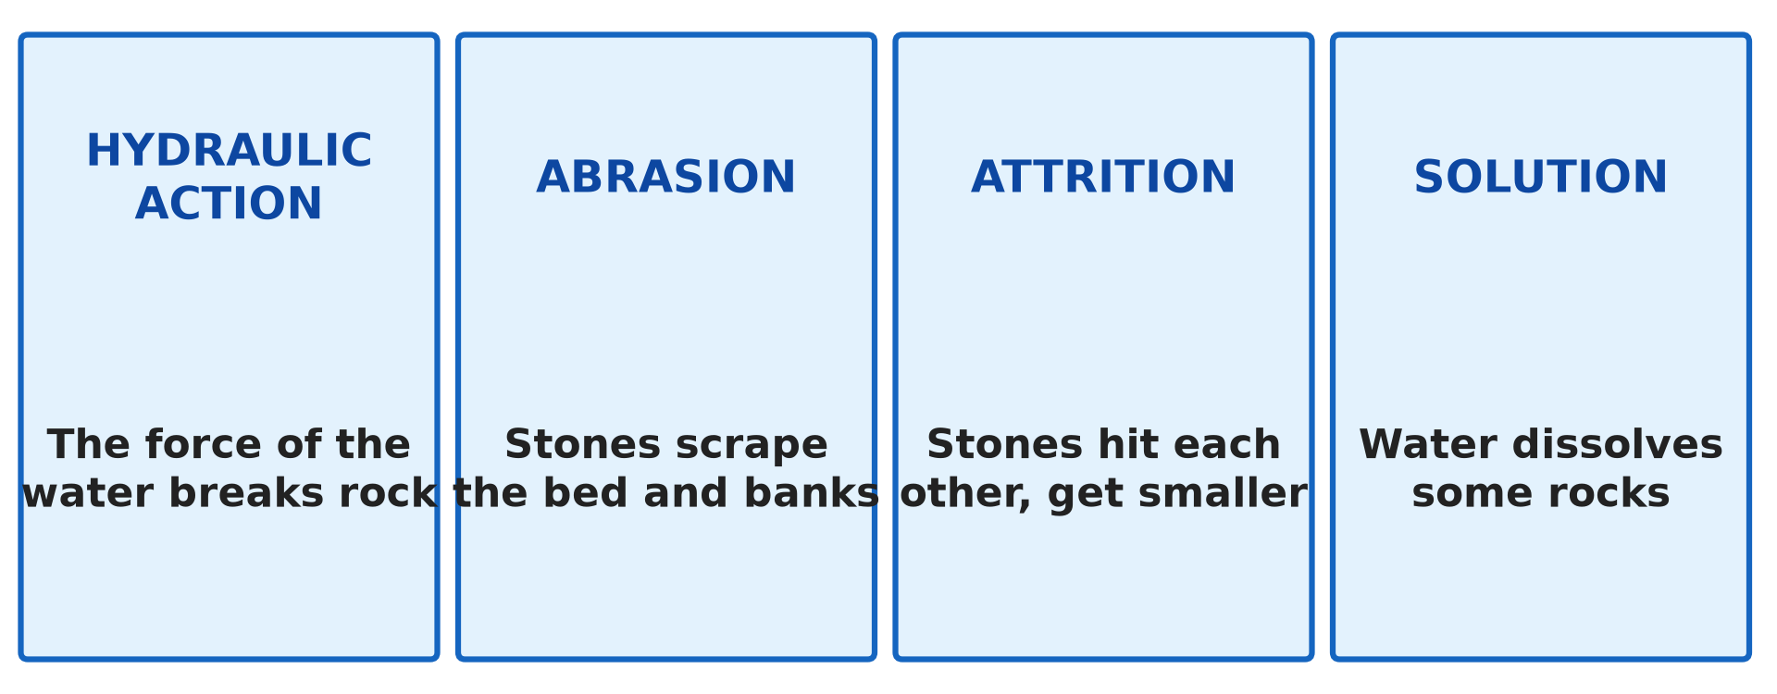
GEOGRAPHY — LOWER SIXTH ARTS
I. EROSION
Activity 1
The four processes of river erosion.
2026 / 2027
DGCAST GAROUA — GEOGRAPHY DEPARTMENT
Mr KAMDEM E. | 14
Notes:
Without the projector: write the four processes with one example each.

Slide 15
GEOGRAPHY — LOWER SIXTH ARTS
I. EROSION
Activity 1: Question
Name the four processes of river erosion.
2026 / 2027
DGCAST GAROUA — GEOGRAPHY DEPARTMENT
Mr KAMDEM E. | 15

Slide 16
GEOGRAPHY — LOWER SIXTH ARTS
I. EROSION
Answer
Hydraulic action, abrasion, attrition and solution.
2026 / 2027
DGCAST GAROUA — GEOGRAPHY DEPARTMENT
Mr KAMDEM E. | 16

Slide 17
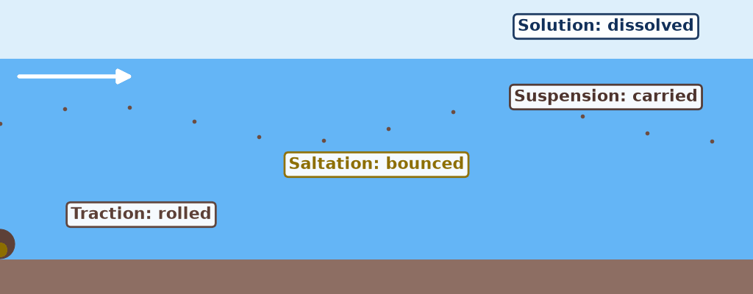
GEOGRAPHY — LOWER SIXTH ARTS
II. TRANSPORT
Activity 2
Animation: how a river carries its load.
2026 / 2027
DGCAST GAROUA — GEOGRAPHY DEPARTMENT
Mr KAMDEM E. | 17
Notes:
Without the projector: shake sand and water in a bottle.

Slide 18
GEOGRAPHY — LOWER SIXTH ARTS
II. TRANSPORT
Activity 2: Question
Name the four ways a river carries its load.
2026 / 2027
DGCAST GAROUA — GEOGRAPHY DEPARTMENT
Mr KAMDEM E. | 18

Slide 19
GEOGRAPHY — LOWER SIXTH ARTS
II. TRANSPORT
Answer
Traction, saltation, suspension and solution.
2026 / 2027
DGCAST GAROUA — GEOGRAPHY DEPARTMENT
Mr KAMDEM E. | 19

Slide 20
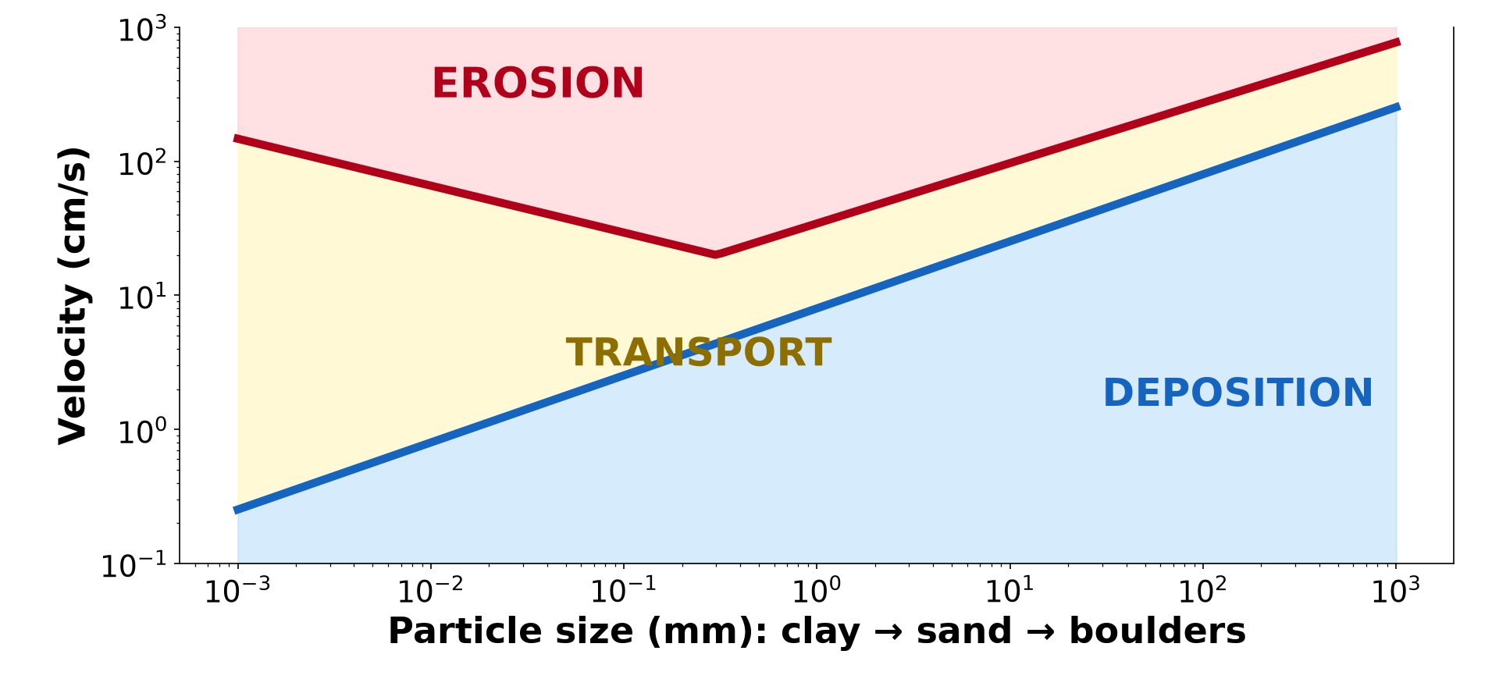
GEOGRAPHY — LOWER SIXTH ARTS
III. HJULSTRÖM GRAPH
Activity 3
The Hjulström graph.
2026 / 2027
DGCAST GAROUA — GEOGRAPHY DEPARTMENT
Mr KAMDEM E. | 20
Notes:
Without the projector: compare dry clay and loose sand.

Slide 21
GEOGRAPHY — LOWER SIXTH ARTS
III. HJULSTRÖM GRAPH
Activity 3: Question
Why is clay difficult to erode although it is very small?
2026 / 2027
DGCAST GAROUA — GEOGRAPHY DEPARTMENT
Mr KAMDEM E. | 21

Slide 22
GEOGRAPHY — LOWER SIXTH ARTS
III. HJULSTRÖM GRAPH
Answer
Clay particles stick together, so a high velocity is needed.
2026 / 2027
DGCAST GAROUA — GEOGRAPHY DEPARTMENT
Mr KAMDEM E. | 22

Slide 23

GEOGRAPHY — LOWER SIXTH ARTS
IV. DEPOSITION
Activity 4
A muddy river seen from space.
2026 / 2027
DGCAST GAROUA — GEOGRAPHY DEPARTMENT
Mr KAMDEM E. | 23
Notes:
Without the projector: describe sandbanks of the Benue in the dry season.

Slide 24
GEOGRAPHY — LOWER SIXTH ARTS
IV. DEPOSITION
Activity 4: Question
When does a river deposit its load?
2026 / 2027
DGCAST GAROUA — GEOGRAPHY DEPARTMENT
Mr KAMDEM E. | 24

Slide 25
GEOGRAPHY — LOWER SIXTH ARTS
IV. DEPOSITION
Answer
When its speed or volume falls, for example on flat land or at the sea.
2026 / 2027
DGCAST GAROUA — GEOGRAPHY DEPARTMENT
Mr KAMDEM E. | 25

Slide 26

GEOGRAPHY — LOWER SIXTH ARTS
V. THE RIVER AS A SYSTEM
Activity 5
The drainage basin as a system.
2026 / 2027
DGCAST GAROUA — GEOGRAPHY DEPARTMENT
Mr KAMDEM E. | 26
Notes:
Without the projector: draw three boxes with arrows.

Slide 27
GEOGRAPHY — LOWER SIXTH ARTS
V. THE RIVER AS A SYSTEM
Activity 5: Question
What are the inputs and outputs of a river system?
2026 / 2027
DGCAST GAROUA — GEOGRAPHY DEPARTMENT
Mr KAMDEM E. | 27

Slide 28
GEOGRAPHY — LOWER SIXTH ARTS
V. THE RIVER AS A SYSTEM
Answer
Inputs: rain, load from slopes. Outputs: water and sediment to the sea, evaporation.
2026 / 2027
DGCAST GAROUA — GEOGRAPHY DEPARTMENT
Mr KAMDEM E. | 28

Slide 29
GEOGRAPHY — LOWER SIXTH ARTS
BOARD SUMMARY
Erosional Processes and the Fluvial System
Topic: Denudational Processes on Slopes
Sub-topic: Erosion and Depositional Processes and Landforms
Lesson 14: Erosional Processes and the Fluvial System
2026 / 2027
DGCAST GAROUA — GEOGRAPHY DEPARTMENT
Mr KAMDEM E. | 29
Notes:
Learners copy the board summary now. Give them enough time for each slide.

Slide 30
GEOGRAPHY — LOWER SIXTH ARTS
BOARD SUMMARY
I. Definitions
Erosion: It is the wearing away and removal of rock and soil.
Competence: It is the largest particle a river can carry.
Capacity: It is the total load a river can carry.
2026 / 2027
DGCAST GAROUA — GEOGRAPHY DEPARTMENT
Mr KAMDEM E. | 30

Slide 31
GEOGRAPHY — LOWER SIXTH ARTS
BOARD SUMMARY
II. Erosion and Transport (1/3)
A. Erosion processes: Hydraulic action, abrasion, attrition and solution wear the bed and banks. Vertical erosion deepens and lateral erosion widens the valley.
B. Transport: Large stones roll by traction and sand bounces by saltation. Fine clay is carried in suspension and minerals in solution.
2026 / 2027
DGCAST GAROUA — GEOGRAPHY DEPARTMENT
Mr KAMDEM E. | 31

Slide 32
GEOGRAPHY — LOWER SIXTH ARTS
BOARD SUMMARY
II. Erosion and Transport (2/3)
C. The Hjulström graph: It shows the velocities for erosion, transport and deposition. Sand is the easiest to erode; clay needs high speed because it is cohesive.
2026 / 2027
DGCAST GAROUA — GEOGRAPHY DEPARTMENT
Mr KAMDEM E. | 32

Slide 33
GEOGRAPHY — LOWER SIXTH ARTS
BOARD SUMMARY
II. Erosion and Transport (3/3)
Copy the Hjulström graph.
2026 / 2027
DGCAST GAROUA — GEOGRAPHY DEPARTMENT
Mr KAMDEM E. | 33

Slide 34
GEOGRAPHY — LOWER SIXTH ARTS
BOARD SUMMARY
III. Deposition and the River System (1/2)
A. Deposition: A river drops its load when it loses speed or volume. Coarse material is dropped first and fine material last.
B. The river as a system: Inputs are rain and load from slopes. Outputs are water and sediment to the sea, and evaporation.
2026 / 2027
DGCAST GAROUA — GEOGRAPHY DEPARTMENT
Mr KAMDEM E. | 34

Slide 35
GEOGRAPHY — LOWER SIXTH ARTS
BOARD SUMMARY
III. Deposition and the River System (2/2)
C. Functions: Rivers erode, transport and deposit material. They shape valleys, floodplains and deltas.
2026 / 2027
DGCAST GAROUA — GEOGRAPHY DEPARTMENT
Mr KAMDEM E. | 35

Slide 36
GEOGRAPHY — LOWER SIXTH ARTS
FORMATIVE EVALUATION
Formative Evaluation 1
Distinguish competence and capacity.
2026 / 2027
DGCAST GAROUA — GEOGRAPHY DEPARTMENT
Mr KAMDEM E. | 36

Slide 37
GEOGRAPHY — LOWER SIXTH ARTS
FORMATIVE EVALUATION
Expected Answer
Competence is the largest particle carried; capacity is the total load.
2026 / 2027
DGCAST GAROUA — GEOGRAPHY DEPARTMENT
Mr KAMDEM E. | 37

Slide 38
GEOGRAPHY — LOWER SIXTH ARTS
FORMATIVE EVALUATION
Formative Evaluation 2
Name the four types of transport.
2026 / 2027
DGCAST GAROUA — GEOGRAPHY DEPARTMENT
Mr KAMDEM E. | 38

Slide 39
GEOGRAPHY — LOWER SIXTH ARTS
FORMATIVE EVALUATION
Expected Answer
Traction, saltation, suspension, solution.
2026 / 2027
DGCAST GAROUA — GEOGRAPHY DEPARTMENT
Mr KAMDEM E. | 39

Slide 40
GEOGRAPHY — LOWER SIXTH ARTS
REMEDIATION
Remediation
Fill in the blanks:
Stones rolled on the bed move by ______.
Sand bouncing on the bed moves by ______.
The total load a river can carry is its ______.
2026 / 2027
DGCAST GAROUA — GEOGRAPHY DEPARTMENT
Mr KAMDEM E. | 40
Notes:
Answers: 1. traction 2. saltation 3. capacity

Slide 41
GEOGRAPHY — LOWER SIXTH ARTS
HOMEWORK
Homework
Draw the long profile of a river and mark the upper, middle and lower courses.
This prepares Lesson 15: River Action on its Long Profile.
2026 / 2027
DGCAST GAROUA — GEOGRAPHY DEPARTMENT
Mr KAMDEM E. | 41
Notes:
This homework prepares the next lesson.

Slide 42
GEOGRAPHY — LOWER SIXTH ARTS
BILINGUAL GAME
Bilingual Game (Jeu Bilingue)
English | Français
Erosion | L'érosion
Load | La charge
Suspension | La suspension
Saltation | La saltation
Deposition | Le dépôt
Drainage basin | Le bassin versant
2026 / 2027
DGCAST GAROUA — GEOGRAPHY DEPARTMENT
Mr KAMDEM E. | 42
Notes:
Say the English word; learners give the French word, then the reverse.

Slide 43
GEOGRAPHY — LOWER SIXTH ARTS
LOGBOOK
Official Logbook (1/2)
Module / Topic | Denudational Processes on Slopes
Lesson Title | Lesson 14: Erosional Processes and the Fluvial System
Expected Learning Outcomes | Explain the processes of river erosion. Describe how rivers carry their load. Interpret the Hjulström graph and describe the river as a system.
Competence | Learners are able to explain how rivers erode, carry and deposit material.
2026 / 2027
DGCAST GAROUA — GEOGRAPHY DEPARTMENT
Mr KAMDEM E. | 43

Slide 44
GEOGRAPHY — LOWER SIXTH ARTS
LOGBOOK
Official Logbook (2/2)
Matter Taught | I. Definitions: Erosion, Competence, Capacity; II. Erosion and Transport: Erosion processes, Transport, The Hjulström graph; III. Deposition and the River System: Deposition, The river as a system, Functions.
Evaluation | Formative evaluation (3 questions) and remediation exercise.
Homework | Draw the long profile of a river and mark the upper, middle and lower courses.
Enrolment / Present / Absent | ____ / ____ / ____
Achievement | To be completed by the teacher after the lesson.
2026 / 2027
DGCAST GAROUA — GEOGRAPHY DEPARTMENT
Mr KAMDEM E. | 44

Slide 45
GEOGRAPHY — LOWER SIXTH ARTS
TEACHER'S NOTE
Teacher's Note
Timing: Set-up, recall 8 min | Situation 8 min | 5 activities 30 min | Board summary (copying) 30 min | Evaluation, remediation 10 min | Homework, logbook 9 min | Spare 5 min
Activity 2 is an animation (GIF): it plays automatically in slide-show mode.
2026 / 2027
DGCAST GAROUA — GEOGRAPHY DEPARTMENT
Mr KAMDEM E. | 45

Slide 46
GEOGRAPHY — LOWER SIXTH ARTS
REFERENCES
References
National Geography Syllabus, Sixth Forms (Lower & Upper Sixth), MINESEC/IGE/IP-SS, August 2019 — Module 2 (Geomorphology).
Photo, Activity 4: “Parana River Floodplain, Northern Argentina (NASA, International Space” by NASA's Marshall Space Flight Center, CC BY-NC 2.0, via nasa (https://www.flickr.com/photos/28634332@N05/5684050889)
Diagrams and animations: drawn for this lesson (DGCAST Geography Department).
2026 / 2027
DGCAST GAROUA — GEOGRAPHY DEPARTMENT
Mr KAMDEM E. | 46

