Slide 1

DIVINE GRACE COLLEGE OF ARTS, SCIENCE AND TECHNOLOGY
(DGCAST) — GAROUA | GEOGRAPHY DEPARTMENT
LOWER SIXTH ARTS — GEOMORPHOLOGY — LESSON 15
River Action on its Long Profile
Mr KAMDEM EMMANUEL
Geography Teacher — PLEG
Academic Year 2026 / 2027
Notes:
Good morning, class. Today we study Lesson 15: River Action on its Long Profile.

Slide 2
GEOGRAPHY — LOWER SIXTH ARTS
CLASS INFO
Class, Chapter & Duration
Class | Lower Sixth Arts
Chapter | Module 2: Understanding and managing physical landscapes, geomorphological processes and hazards across the world in general and Cameroon in particular
Duration | 2 periods (2 × 50 minutes)
2026 / 2027
DGCAST GAROUA — GEOGRAPHY DEPARTMENT
Mr KAMDEM E. | 2

Slide 3
GEOGRAPHY — LOWER SIXTH ARTS
IDENTIFICATION
Lesson Identification
Topic | Denudational Processes on Slopes
Sub-topic | Erosion and Depositional Processes and Landforms
Lesson | Lesson 15: River Action on its Long Profile
Notions / Concepts | Long profile, V-shaped valley, waterfall, meander, ox-bow lake, floodplain, delta.
Syllabus focus | Upper, middle and lower courses: characteristics and features.
Competence | Learners are able to describe and explain the landforms of each course of a river.
2026 / 2027
DGCAST GAROUA — GEOGRAPHY DEPARTMENT
Mr KAMDEM E. | 3

Slide 4
GEOGRAPHY — LOWER SIXTH ARTS
OBJECTIVES
Learning Objectives
By the end of the lesson, the learner should be able to:
Describe the long profile of a river.
Explain the features of the upper and middle courses.
Explain the features of the lower course.
2026 / 2027
DGCAST GAROUA — GEOGRAPHY DEPARTMENT
Mr KAMDEM E. | 4

Slide 5
GEOGRAPHY — LOWER SIXTH ARTS
RECALL
Recall
Rivers erode, transport and deposit.
The long profile goes from the source to the mouth.
2026 / 2027
DGCAST GAROUA — GEOGRAPHY DEPARTMENT
Mr KAMDEM E. | 5

Slide 6
GEOGRAPHY — LOWER SIXTH ARTS
REAL-LIFE SITUATION
Real-Life Situation
The Vina River falls over a cliff near Ngaoundéré. Further north, the Benue at Garoua is wide and winding, with sandbanks, and in Nigeria the Niger forms a huge delta.
2026 / 2027
DGCAST GAROUA — GEOGRAPHY DEPARTMENT
Mr KAMDEM E. | 6
Notes:
Read the situation slowly, twice.

Slide 7
GEOGRAPHY — LOWER SIXTH ARTS
REAL-LIFE SITUATION
Situation — Question 1
What is the problem in the situation?
2026 / 2027
DGCAST GAROUA — GEOGRAPHY DEPARTMENT
Mr KAMDEM E. | 7

Slide 8
GEOGRAPHY — LOWER SIXTH ARTS
REAL-LIFE SITUATION
Answer
We want to explain why rivers change from source to mouth.
2026 / 2027
DGCAST GAROUA — GEOGRAPHY DEPARTMENT
Mr KAMDEM E. | 8

Slide 9
GEOGRAPHY — LOWER SIXTH ARTS
REAL-LIFE SITUATION
Situation — Question 2
Describe the Vina near Ngaoundéré.
2026 / 2027
DGCAST GAROUA — GEOGRAPHY DEPARTMENT
Mr KAMDEM E. | 9

Slide 10
GEOGRAPHY — LOWER SIXTH ARTS
REAL-LIFE SITUATION
Answer
Fast, with a waterfall and steep sides.
2026 / 2027
DGCAST GAROUA — GEOGRAPHY DEPARTMENT
Mr KAMDEM E. | 10

Slide 11
GEOGRAPHY — LOWER SIXTH ARTS
REAL-LIFE SITUATION
Situation — Question 3
Where does the Niger end?
2026 / 2027
DGCAST GAROUA — GEOGRAPHY DEPARTMENT
Mr KAMDEM E. | 11

Slide 12
GEOGRAPHY — LOWER SIXTH ARTS
REAL-LIFE SITUATION
Possible Answer
In a delta at the sea.
2026 / 2027
DGCAST GAROUA — GEOGRAPHY DEPARTMENT
Mr KAMDEM E. | 12

Slide 13
GEOGRAPHY — LOWER SIXTH ARTS
JUSTIFICATION
Justification of the Lesson
This lesson helps us to recognise river landforms and understand how they form.
2026 / 2027
DGCAST GAROUA — GEOGRAPHY DEPARTMENT
Mr KAMDEM E. | 13

Slide 14

GEOGRAPHY — LOWER SIXTH ARTS
I. THE LONG PROFILE
Activity 1
The long profile of a river.
2026 / 2027
DGCAST GAROUA — GEOGRAPHY DEPARTMENT
Mr KAMDEM E. | 14
Notes:
Without the projector: draw a concave curve.

Slide 15
GEOGRAPHY — LOWER SIXTH ARTS
I. THE LONG PROFILE
Activity 1: Question
Describe the slope of the river from source to mouth.
2026 / 2027
DGCAST GAROUA — GEOGRAPHY DEPARTMENT
Mr KAMDEM E. | 15

Slide 16
GEOGRAPHY — LOWER SIXTH ARTS
I. THE LONG PROFILE
Answer
Steep in the upper course, gentle in the middle, almost flat in the lower course.
2026 / 2027
DGCAST GAROUA — GEOGRAPHY DEPARTMENT
Mr KAMDEM E. | 16

Slide 17
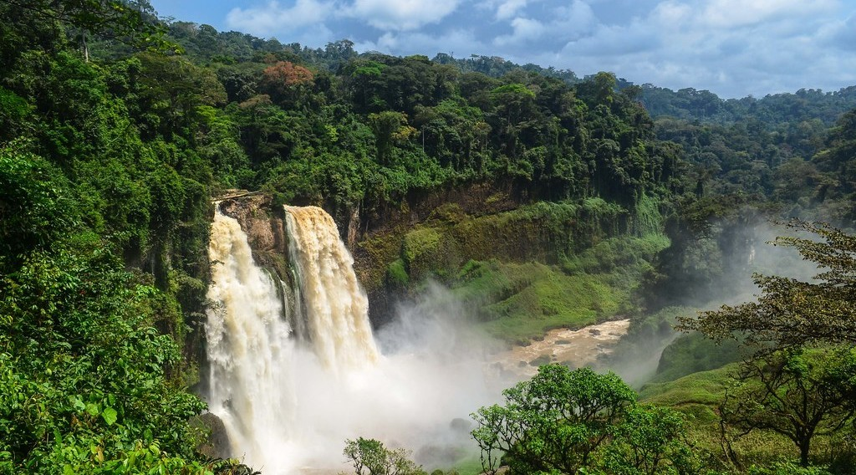
GEOGRAPHY — LOWER SIXTH ARTS
II. UPPER COURSE
Activity 2
The Ekom-Nkam waterfall, Cameroon.
2026 / 2027
DGCAST GAROUA — GEOGRAPHY DEPARTMENT
Mr KAMDEM E. | 17
Notes:
Without the projector: draw hard rock over soft rock.

Slide 18
GEOGRAPHY — LOWER SIXTH ARTS
II. UPPER COURSE
Activity 2: Question
How is a waterfall formed?
2026 / 2027
DGCAST GAROUA — GEOGRAPHY DEPARTMENT
Mr KAMDEM E. | 18

Slide 19
GEOGRAPHY — LOWER SIXTH ARTS
II. UPPER COURSE
Answer
Hard rock lies over soft rock; the soft rock is eroded faster.
2026 / 2027
DGCAST GAROUA — GEOGRAPHY DEPARTMENT
Mr KAMDEM E. | 19

Slide 20
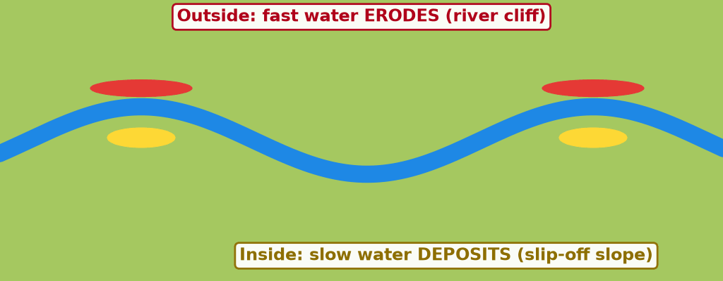
GEOGRAPHY — LOWER SIXTH ARTS
III. MIDDLE COURSE
Activity 3
Animation: a meander grows.
2026 / 2027
DGCAST GAROUA — GEOGRAPHY DEPARTMENT
Mr KAMDEM E. | 20
Notes:
Without the projector: draw a bend with a river cliff and a slip-off slope.

Slide 21
GEOGRAPHY — LOWER SIXTH ARTS
III. MIDDLE COURSE
Activity 3: Question
Where does the river erode and deposit in a meander?
2026 / 2027
DGCAST GAROUA — GEOGRAPHY DEPARTMENT
Mr KAMDEM E. | 21

Slide 22
GEOGRAPHY — LOWER SIXTH ARTS
III. MIDDLE COURSE
Answer
It erodes the outside of the bend and deposits on the inside.
2026 / 2027
DGCAST GAROUA — GEOGRAPHY DEPARTMENT
Mr KAMDEM E. | 22

Slide 23
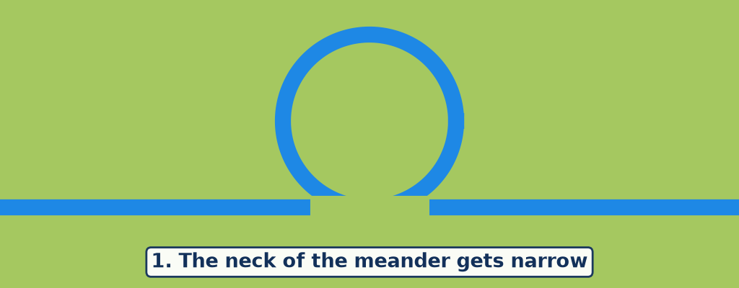
GEOGRAPHY — LOWER SIXTH ARTS
IV. LOWER COURSE
Activity 4
Animation: an ox-bow lake forms.
2026 / 2027
DGCAST GAROUA — GEOGRAPHY DEPARTMENT
Mr KAMDEM E. | 23
Notes:
Without the projector: draw the three stages.

Slide 24
GEOGRAPHY — LOWER SIXTH ARTS
IV. LOWER COURSE
Activity 4: Question
How does an ox-bow lake form?
2026 / 2027
DGCAST GAROUA — GEOGRAPHY DEPARTMENT
Mr KAMDEM E. | 24

Slide 25
GEOGRAPHY — LOWER SIXTH ARTS
IV. LOWER COURSE
Answer
The river cuts through the neck of a meander and leaves the old bend.
2026 / 2027
DGCAST GAROUA — GEOGRAPHY DEPARTMENT
Mr KAMDEM E. | 25

Slide 26
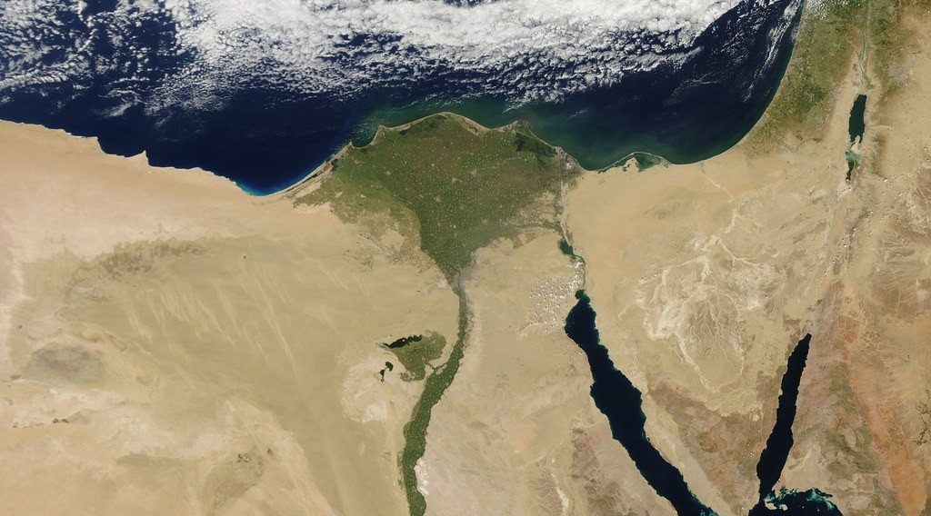
GEOGRAPHY — LOWER SIXTH ARTS
IV. LOWER COURSE
Activity 5
The Nile Delta seen from space.
2026 / 2027
DGCAST GAROUA — GEOGRAPHY DEPARTMENT
Mr KAMDEM E. | 26
Notes:
Without the projector: draw a triangle at a river mouth.

Slide 27
GEOGRAPHY — LOWER SIXTH ARTS
IV. LOWER COURSE
Activity 5: Question
Why does a delta form at the mouth of a river?
2026 / 2027
DGCAST GAROUA — GEOGRAPHY DEPARTMENT
Mr KAMDEM E. | 27

Slide 28
GEOGRAPHY — LOWER SIXTH ARTS
IV. LOWER COURSE
Answer
The river slows down at the sea and deposits its load faster than waves remove it.
2026 / 2027
DGCAST GAROUA — GEOGRAPHY DEPARTMENT
Mr KAMDEM E. | 28

Slide 29
GEOGRAPHY — LOWER SIXTH ARTS
BOARD SUMMARY
River Action on its Long Profile
Topic: Denudational Processes on Slopes
Sub-topic: Erosion and Depositional Processes and Landforms
Lesson 15: River Action on its Long Profile
2026 / 2027
DGCAST GAROUA — GEOGRAPHY DEPARTMENT
Mr KAMDEM E. | 29
Notes:
Learners copy the board summary now. Give them enough time for each slide.

Slide 30
GEOGRAPHY — LOWER SIXTH ARTS
BOARD SUMMARY
I. Definitions
Long profile: It is the slope of a river from its source to its mouth.
Meander: It is a large bend in a river.
Delta: It is a flat area of deposits at the mouth of a river.
2026 / 2027
DGCAST GAROUA — GEOGRAPHY DEPARTMENT
Mr KAMDEM E. | 30

Slide 31
GEOGRAPHY — LOWER SIXTH ARTS
BOARD SUMMARY
II. Upper and Middle Courses (1/3)
A. Upper course: The gradient is steep and vertical erosion dominates. Features are V-shaped valleys, interlocking spurs, waterfalls, gorges and potholes.
B. Waterfalls: They form where hard rock lies over soft rock. The fall retreats upstream and leaves a gorge.
2026 / 2027
DGCAST GAROUA — GEOGRAPHY DEPARTMENT
Mr KAMDEM E. | 31

Slide 32
GEOGRAPHY — LOWER SIXTH ARTS
BOARD SUMMARY
II. Upper and Middle Courses (2/3)
C. Middle course: The gradient is gentle and lateral erosion widens the valley. Meanders form with river cliffs outside and slip-off slopes inside.
2026 / 2027
DGCAST GAROUA — GEOGRAPHY DEPARTMENT
Mr KAMDEM E. | 32

Slide 33
GEOGRAPHY — LOWER SIXTH ARTS
BOARD SUMMARY
II. Upper and Middle Courses (3/3)
Copy the long profile.
2026 / 2027
DGCAST GAROUA — GEOGRAPHY DEPARTMENT
Mr KAMDEM E. | 33

Slide 34
GEOGRAPHY — LOWER SIXTH ARTS
BOARD SUMMARY
III. Lower Course (1/2)
A. Characteristics: The gradient is almost flat and the channel is wide and deep. Deposition dominates.
B. Floodplains and levees: Floods spread alluvium over a wide floodplain. Coarse material builds levees along the banks.
2026 / 2027
DGCAST GAROUA — GEOGRAPHY DEPARTMENT
Mr KAMDEM E. | 34

Slide 35
GEOGRAPHY — LOWER SIXTH ARTS
BOARD SUMMARY
III. Lower Course (2/2)
C. Ox-bow lakes and braids: A river cuts through a meander neck and leaves an ox-bow lake. Sandbanks divide the channel into braids.
D. Deltas: Deposits at the mouth form deltas. Examples: the Niger and the Nile deltas.
2026 / 2027
DGCAST GAROUA — GEOGRAPHY DEPARTMENT
Mr KAMDEM E. | 35

Slide 36
GEOGRAPHY — LOWER SIXTH ARTS
FORMATIVE EVALUATION
Formative Evaluation 1
Explain the formation of a waterfall.
2026 / 2027
DGCAST GAROUA — GEOGRAPHY DEPARTMENT
Mr KAMDEM E. | 36

Slide 37
GEOGRAPHY — LOWER SIXTH ARTS
FORMATIVE EVALUATION
Expected Answer
Soft rock under hard rock is eroded faster, so the hard rock forms a step.
2026 / 2027
DGCAST GAROUA — GEOGRAPHY DEPARTMENT
Mr KAMDEM E. | 37

Slide 38
GEOGRAPHY — LOWER SIXTH ARTS
FORMATIVE EVALUATION
Formative Evaluation 2
Give two features of the lower course.
2026 / 2027
DGCAST GAROUA — GEOGRAPHY DEPARTMENT
Mr KAMDEM E. | 38

Slide 39
GEOGRAPHY — LOWER SIXTH ARTS
FORMATIVE EVALUATION
Expected Answer
Floodplain and delta (also levees, ox-bow lakes).
2026 / 2027
DGCAST GAROUA — GEOGRAPHY DEPARTMENT
Mr KAMDEM E. | 39

Slide 40
GEOGRAPHY — LOWER SIXTH ARTS
REMEDIATION
Remediation
Fill in the blanks:
A large bend in a river is a ______.
An old meander cut off is an ______ lake.
Deposits at the mouth form a ______.
2026 / 2027
DGCAST GAROUA — GEOGRAPHY DEPARTMENT
Mr KAMDEM E. | 40
Notes:
Answers: 1. meander 2. ox-bow 3. delta

Slide 41
GEOGRAPHY — LOWER SIXTH ARTS
HOMEWORK
Homework
Describe the coast at Kribi or Limbe from a picture: beach, rocks or cliffs.
This prepares Lesson 16: Coastal Processes and Features.
2026 / 2027
DGCAST GAROUA — GEOGRAPHY DEPARTMENT
Mr KAMDEM E. | 41
Notes:
This homework prepares the next lesson.

Slide 42
GEOGRAPHY — LOWER SIXTH ARTS
BILINGUAL GAME
Bilingual Game (Jeu Bilingue)
English | Français
Long profile | Le profil en long
Waterfall | La chute d'eau
Meander | Le méandre
Ox-bow lake | Le bras mort
Floodplain | La plaine d'inondation
Delta | Le delta
2026 / 2027
DGCAST GAROUA — GEOGRAPHY DEPARTMENT
Mr KAMDEM E. | 42
Notes:
Say the English word; learners give the French word, then the reverse.

Slide 43
GEOGRAPHY — LOWER SIXTH ARTS
LOGBOOK
Official Logbook (1/2)
Module / Topic | Denudational Processes on Slopes
Lesson Title | Lesson 15: River Action on its Long Profile
Expected Learning Outcomes | Describe the long profile of a river. Explain the features of the upper and middle courses. Explain the features of the lower course.
Competence | Learners are able to describe and explain the landforms of each course of a river.
2026 / 2027
DGCAST GAROUA — GEOGRAPHY DEPARTMENT
Mr KAMDEM E. | 43

Slide 44
GEOGRAPHY — LOWER SIXTH ARTS
LOGBOOK
Official Logbook (2/2)
Matter Taught | I. Definitions: Long profile, Meander, Delta; II. Upper and Middle Courses: Upper course, Waterfalls, Middle course; III. Lower Course: Characteristics, Floodplains and levees, Ox-bow lakes and braids, Deltas.
Evaluation | Formative evaluation (3 questions) and remediation exercise.
Homework | Describe the coast at Kribi or Limbe from a picture: beach, rocks or cliffs.
Enrolment / Present / Absent | ____ / ____ / ____
Achievement | To be completed by the teacher after the lesson.
2026 / 2027
DGCAST GAROUA — GEOGRAPHY DEPARTMENT
Mr KAMDEM E. | 44

Slide 45
GEOGRAPHY — LOWER SIXTH ARTS
TEACHER'S NOTE
Teacher's Note
Timing: Set-up, recall 8 min | Situation 8 min | 5 activities 30 min | Board summary (copying) 30 min | Evaluation, remediation 10 min | Homework, logbook 9 min | Spare 5 min
Activities 3 and 4 are animations (GIF): it plays automatically in slide-show mode.
2026 / 2027
DGCAST GAROUA — GEOGRAPHY DEPARTMENT
Mr KAMDEM E. | 45

Slide 46
GEOGRAPHY — LOWER SIXTH ARTS
REFERENCES
References
National Geography Syllabus, Sixth Forms (Lower & Upper Sixth), MINESEC/IGE/IP-SS, August 2019 — Module 2 (Geomorphology).
Photo, Activity 2: “Ekom-Nkam waterfall” by jbdodane, CC BY-NC 2.0, via Flickr (https://www.flickr.com/photos/27998473@N02/11291226526)
Photo, Activity 5: “Egypt” by NASA Goddard Photo and Video, CC BY 2.0, via nasa (https://www.flickr.com/photos/24662369@N07/5635018418)
Diagrams and animations: drawn for this lesson (DGCAST Geography Department).
2026 / 2027
DGCAST GAROUA — GEOGRAPHY DEPARTMENT
Mr KAMDEM E. | 46

