Slide 1

DIVINE GRACE COLLEGE OF ARTS, SCIENCE AND TECHNOLOGY
(DGCAST) — GAROUA | GEOGRAPHY DEPARTMENT
LOWER SIXTH ARTS — GEOMORPHOLOGY — LESSON 16
Coastal Processes and Features
Mr KAMDEM EMMANUEL
Geography Teacher — PLEG
Academic Year 2026 / 2027
Notes:
Good morning, class. Today we study Lesson 16: Coastal Processes and Features.

Slide 2
GEOGRAPHY — LOWER SIXTH ARTS
CLASS INFO
Class, Chapter & Duration
Class | Lower Sixth Arts
Chapter | Module 2: Understanding and managing physical landscapes, geomorphological processes and hazards across the world in general and Cameroon in particular
Duration | 2 periods (2 × 50 minutes)
2026 / 2027
DGCAST GAROUA — GEOGRAPHY DEPARTMENT
Mr KAMDEM E. | 2

Slide 3
GEOGRAPHY — LOWER SIXTH ARTS
IDENTIFICATION
Lesson Identification
Topic | Denudational Processes on Slopes
Sub-topic | Erosion and Depositional Processes and Landforms
Lesson | Lesson 16: Coastal Processes and Features
Notions / Concepts | Coastal system, wave refraction, swash, backwash, longshore drift, storm surge.
Syllabus focus | The coastal system and its factors; waves and refraction; erosion, transport and deposition; threats to coasts.
Competence | Learners are able to explain coastal landforms and the threats to coasts.
2026 / 2027
DGCAST GAROUA — GEOGRAPHY DEPARTMENT
Mr KAMDEM E. | 3

Slide 4
GEOGRAPHY — LOWER SIXTH ARTS
OBJECTIVES
Learning Objectives
By the end of the lesson, the learner should be able to:
Describe the coastal system and waves.
Explain the formation of erosional features.
Explain depositional features and threats to coasts.
2026 / 2027
DGCAST GAROUA — GEOGRAPHY DEPARTMENT
Mr KAMDEM E. | 4

Slide 5
GEOGRAPHY — LOWER SIXTH ARTS
RECALL
Recall
Waves are caused by the wind.
Constructive waves build beaches; destructive waves erode them.
2026 / 2027
DGCAST GAROUA — GEOGRAPHY DEPARTMENT
Mr KAMDEM E. | 5

Slide 6
GEOGRAPHY — LOWER SIXTH ARTS
REAL-LIFE SITUATION
Real-Life Situation
At Limbe, waves attack black volcanic rocks. At Kribi, the beach is wide and sandy. In Douala, people fear that the sea level will rise.
2026 / 2027
DGCAST GAROUA — GEOGRAPHY DEPARTMENT
Mr KAMDEM E. | 6
Notes:
Read the situation slowly, twice.

Slide 7
GEOGRAPHY — LOWER SIXTH ARTS
REAL-LIFE SITUATION
Situation — Question 1
What is the problem in the situation?
2026 / 2027
DGCAST GAROUA — GEOGRAPHY DEPARTMENT
Mr KAMDEM E. | 7

Slide 8
GEOGRAPHY — LOWER SIXTH ARTS
REAL-LIFE SITUATION
Answer
The coasts are different and some are threatened.
2026 / 2027
DGCAST GAROUA — GEOGRAPHY DEPARTMENT
Mr KAMDEM E. | 8

Slide 9
GEOGRAPHY — LOWER SIXTH ARTS
REAL-LIFE SITUATION
Situation — Question 2
Why is the coast at Limbe rocky?
2026 / 2027
DGCAST GAROUA — GEOGRAPHY DEPARTMENT
Mr KAMDEM E. | 9

Slide 10
GEOGRAPHY — LOWER SIXTH ARTS
REAL-LIFE SITUATION
Answer
Waves erode hard volcanic rock and leave cliffs.
2026 / 2027
DGCAST GAROUA — GEOGRAPHY DEPARTMENT
Mr KAMDEM E. | 10

Slide 11
GEOGRAPHY — LOWER SIXTH ARTS
REAL-LIFE SITUATION
Situation — Question 3
Why is Douala threatened?
2026 / 2027
DGCAST GAROUA — GEOGRAPHY DEPARTMENT
Mr KAMDEM E. | 11

Slide 12
GEOGRAPHY — LOWER SIXTH ARTS
REAL-LIFE SITUATION
Possible Answer
It is low and the sea level is rising.
2026 / 2027
DGCAST GAROUA — GEOGRAPHY DEPARTMENT
Mr KAMDEM E. | 12

Slide 13
GEOGRAPHY — LOWER SIXTH ARTS
JUSTIFICATION
Justification of the Lesson
This lesson helps us to understand coastal landforms and protect coastal areas.
2026 / 2027
DGCAST GAROUA — GEOGRAPHY DEPARTMENT
Mr KAMDEM E. | 13

Slide 14
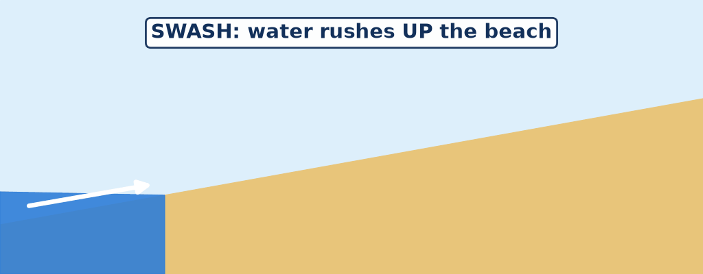
GEOGRAPHY — LOWER SIXTH ARTS
I. WAVES
Activity 1
Animation: swash and backwash.
2026 / 2027
DGCAST GAROUA — GEOGRAPHY DEPARTMENT
Mr KAMDEM E. | 14
Notes:
Without the projector: draw a beach with arrows up and down.

Slide 15
GEOGRAPHY — LOWER SIXTH ARTS
I. WAVES
Activity 1: Question
What are the swash and the backwash?
2026 / 2027
DGCAST GAROUA — GEOGRAPHY DEPARTMENT
Mr KAMDEM E. | 15

Slide 16
GEOGRAPHY — LOWER SIXTH ARTS
I. WAVES
Answer
The swash goes up the beach; the backwash goes back to the sea.
2026 / 2027
DGCAST GAROUA — GEOGRAPHY DEPARTMENT
Mr KAMDEM E. | 16

Slide 17
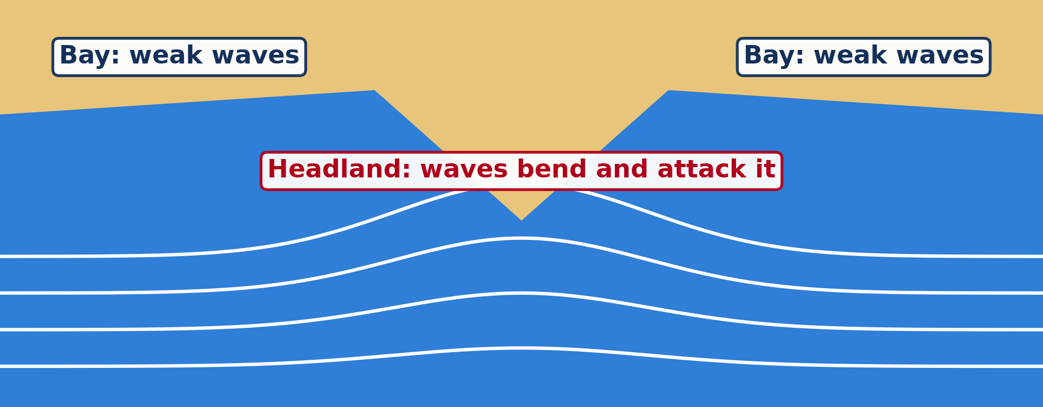
GEOGRAPHY — LOWER SIXTH ARTS
I. WAVES
Activity 2
Wave refraction at a headland.
2026 / 2027
DGCAST GAROUA — GEOGRAPHY DEPARTMENT
Mr KAMDEM E. | 17
Notes:
Without the projector: draw a headland with bending waves.

Slide 18
GEOGRAPHY — LOWER SIXTH ARTS
I. WAVES
Activity 2: Question
Why is wave energy concentrated on headlands?
2026 / 2027
DGCAST GAROUA — GEOGRAPHY DEPARTMENT
Mr KAMDEM E. | 18

Slide 19
GEOGRAPHY — LOWER SIXTH ARTS
I. WAVES
Answer
Waves bend (refract) around headlands and attack them from three sides.
2026 / 2027
DGCAST GAROUA — GEOGRAPHY DEPARTMENT
Mr KAMDEM E. | 19

Slide 20
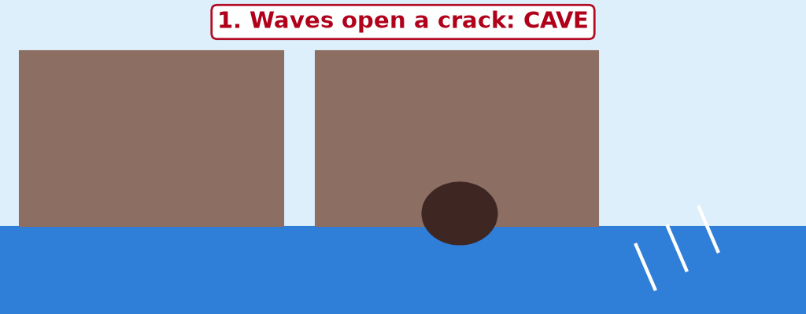
GEOGRAPHY — LOWER SIXTH ARTS
II. EROSION
Activity 3
Animation: a headland is worn away.
2026 / 2027
DGCAST GAROUA — GEOGRAPHY DEPARTMENT
Mr KAMDEM E. | 20
Notes:
Without the projector: draw the four stages.

Slide 21
GEOGRAPHY — LOWER SIXTH ARTS
II. EROSION
Activity 3: Question
Put in order: stack, cave, stump, arch.
2026 / 2027
DGCAST GAROUA — GEOGRAPHY DEPARTMENT
Mr KAMDEM E. | 21

Slide 22
GEOGRAPHY — LOWER SIXTH ARTS
II. EROSION
Answer
Cave, arch, stack, stump.
2026 / 2027
DGCAST GAROUA — GEOGRAPHY DEPARTMENT
Mr KAMDEM E. | 22

Slide 23
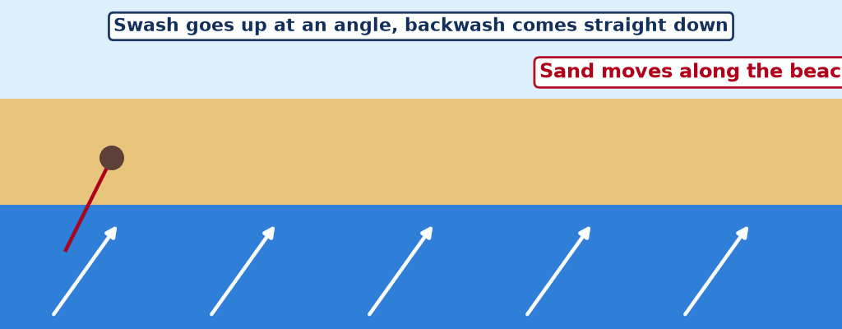
GEOGRAPHY — LOWER SIXTH ARTS
III. DEPOSITION
Activity 4
Animation: longshore drift.
2026 / 2027
DGCAST GAROUA — GEOGRAPHY DEPARTMENT
Mr KAMDEM E. | 23
Notes:
Without the projector: draw the zigzag movement of sand.

Slide 24
GEOGRAPHY — LOWER SIXTH ARTS
III. DEPOSITION
Activity 4: Question
How does longshore drift form a spit?
2026 / 2027
DGCAST GAROUA — GEOGRAPHY DEPARTMENT
Mr KAMDEM E. | 24

Slide 25
GEOGRAPHY — LOWER SIXTH ARTS
III. DEPOSITION
Answer
Sand is carried along the coast and extends out where the coast changes direction.
2026 / 2027
DGCAST GAROUA — GEOGRAPHY DEPARTMENT
Mr KAMDEM E. | 25

Slide 26

GEOGRAPHY — LOWER SIXTH ARTS
IV. THREATS
Activity 5
Old sea defences broken by waves (England).
2026 / 2027
DGCAST GAROUA — GEOGRAPHY DEPARTMENT
Mr KAMDEM E. | 26
Notes:
Without the projector: describe threats to Douala and Kribi.

Slide 27
GEOGRAPHY — LOWER SIXTH ARTS
IV. THREATS
Activity 5: Question
Give two threats to coasts.
2026 / 2027
DGCAST GAROUA — GEOGRAPHY DEPARTMENT
Mr KAMDEM E. | 27

Slide 28
GEOGRAPHY — LOWER SIXTH ARTS
IV. THREATS
Answer
Coastal erosion, storm surges, sea-level rise and pollution.
2026 / 2027
DGCAST GAROUA — GEOGRAPHY DEPARTMENT
Mr KAMDEM E. | 28

Slide 29
GEOGRAPHY — LOWER SIXTH ARTS
BOARD SUMMARY
Coastal Processes and Features
Topic: Denudational Processes on Slopes
Sub-topic: Erosion and Depositional Processes and Landforms
Lesson 16: Coastal Processes and Features
2026 / 2027
DGCAST GAROUA — GEOGRAPHY DEPARTMENT
Mr KAMDEM E. | 29
Notes:
Learners copy the board summary now. Give them enough time for each slide.

Slide 30
GEOGRAPHY — LOWER SIXTH ARTS
BOARD SUMMARY
I. Definitions (1/2)
Coast: It is the zone where land meets the sea.
Wave refraction: It is the bending of waves as they approach an irregular coast.
Longshore drift: It is the movement of sand along the coast by waves.
2026 / 2027
DGCAST GAROUA — GEOGRAPHY DEPARTMENT
Mr KAMDEM E. | 30

Slide 31
GEOGRAPHY — LOWER SIXTH ARTS
BOARD SUMMARY
I. Definitions (2/2)
Storm surge: It is a sudden rise of the sea during a storm.
2026 / 2027
DGCAST GAROUA — GEOGRAPHY DEPARTMENT
Mr KAMDEM E. | 31

Slide 32
GEOGRAPHY — LOWER SIXTH ARTS
BOARD SUMMARY
II. The Coastal System and Waves (1/2)
A. Factors: Waves, tides, currents, rock type and sea level shape coasts. People also change coasts with ports and walls.
B. Waves and energy: Wave energy depends on wind speed, duration and fetch. Constructive waves build beaches and destructive waves erode them.
2026 / 2027
DGCAST GAROUA — GEOGRAPHY DEPARTMENT
Mr KAMDEM E. | 32

Slide 33
GEOGRAPHY — LOWER SIXTH ARTS
BOARD SUMMARY
II. The Coastal System and Waves (2/2)
C. Refraction: Waves bend around headlands and concentrate their energy there. Bays receive weaker waves and collect sand.
2026 / 2027
DGCAST GAROUA — GEOGRAPHY DEPARTMENT
Mr KAMDEM E. | 33

Slide 34
GEOGRAPHY — LOWER SIXTH ARTS
BOARD SUMMARY
III. Features (1/3)
A. Erosional features: Waves erode by hydraulic action, abrasion, attrition and solution. They form cliffs, wave-cut platforms, caves, arches, stacks and stumps.
B. Depositional features: Waves deposit sand as beaches, spits, bars and tombolos. Longshore drift moves the sand.
2026 / 2027
DGCAST GAROUA — GEOGRAPHY DEPARTMENT
Mr KAMDEM E. | 34

Slide 35
GEOGRAPHY — LOWER SIXTH ARTS
BOARD SUMMARY
III. Features (2/3)
C. Threats: Coasts suffer from erosion, storm surges, tsunamis and sea-level rise. Douala and Limbe need sea walls, groynes and mangrove protection.
2026 / 2027
DGCAST GAROUA — GEOGRAPHY DEPARTMENT
Mr KAMDEM E. | 35

Slide 36
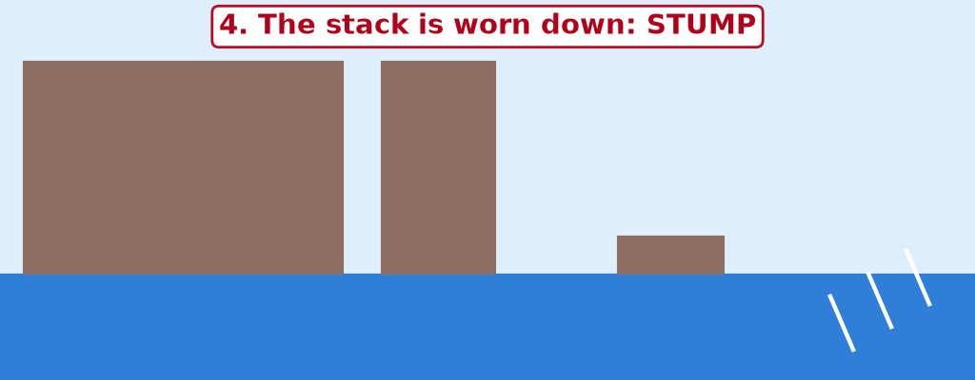
GEOGRAPHY — LOWER SIXTH ARTS
BOARD SUMMARY
III. Features (3/3)
Copy the cave, arch, stack and stump.
2026 / 2027
DGCAST GAROUA — GEOGRAPHY DEPARTMENT
Mr KAMDEM E. | 36

Slide 37
GEOGRAPHY — LOWER SIXTH ARTS
FORMATIVE EVALUATION
Formative Evaluation 1
Explain wave refraction.
2026 / 2027
DGCAST GAROUA — GEOGRAPHY DEPARTMENT
Mr KAMDEM E. | 37

Slide 38
GEOGRAPHY — LOWER SIXTH ARTS
FORMATIVE EVALUATION
Expected Answer
Waves bend around headlands and concentrate their energy on them.
2026 / 2027
DGCAST GAROUA — GEOGRAPHY DEPARTMENT
Mr KAMDEM E. | 38

Slide 39
GEOGRAPHY — LOWER SIXTH ARTS
FORMATIVE EVALUATION
Formative Evaluation 2
Give two depositional features.
2026 / 2027
DGCAST GAROUA — GEOGRAPHY DEPARTMENT
Mr KAMDEM E. | 39

Slide 40
GEOGRAPHY — LOWER SIXTH ARTS
FORMATIVE EVALUATION
Expected Answer
Spit and tombolo (also beach, bar).
2026 / 2027
DGCAST GAROUA — GEOGRAPHY DEPARTMENT
Mr KAMDEM E. | 40

Slide 41
GEOGRAPHY — LOWER SIXTH ARTS
REMEDIATION
Remediation
Fill in the blanks:
Water going up the beach is the ______.
Movement of sand along the coast is longshore ______.
A cave that goes through a headland becomes an ______.
2026 / 2027
DGCAST GAROUA — GEOGRAPHY DEPARTMENT
Mr KAMDEM E. | 41
Notes:
Answers: 1. swash 2. drift 3. arch

Slide 42
GEOGRAPHY — LOWER SIXTH ARTS
HOMEWORK
Homework
On a map of Cameroon, find Mount Cameroon, the Adamawa Plateau and the Chad Plain.
This prepares Further Study 3: The Relief of Cameroon.
2026 / 2027
DGCAST GAROUA — GEOGRAPHY DEPARTMENT
Mr KAMDEM E. | 42
Notes:
This homework prepares the next lesson.

Slide 43
GEOGRAPHY — LOWER SIXTH ARTS
BILINGUAL GAME
Bilingual Game (Jeu Bilingue)
English | Français
Coast | La côte
Wave | La vague
Cliff | La falaise
Spit | La flèche littorale
Longshore drift | La dérive littorale
Storm surge | La surcote (onde de tempête)
2026 / 2027
DGCAST GAROUA — GEOGRAPHY DEPARTMENT
Mr KAMDEM E. | 43
Notes:
Say the English word; learners give the French word, then the reverse.

Slide 44
GEOGRAPHY — LOWER SIXTH ARTS
LOGBOOK
Official Logbook (1/2)
Module / Topic | Denudational Processes on Slopes
Lesson Title | Lesson 16: Coastal Processes and Features
Expected Learning Outcomes | Describe the coastal system and waves. Explain the formation of erosional features. Explain depositional features and threats to coasts.
Competence | Learners are able to explain coastal landforms and the threats to coasts.
2026 / 2027
DGCAST GAROUA — GEOGRAPHY DEPARTMENT
Mr KAMDEM E. | 44

Slide 45
GEOGRAPHY — LOWER SIXTH ARTS
LOGBOOK
Official Logbook (2/2)
Matter Taught | I. Definitions: Coast, Wave refraction, Longshore drift, Storm surge; II. The Coastal System and Waves: Factors, Waves and energy, Refraction; III. Features: Erosional features, Depositional features, Threats.
Evaluation | Formative evaluation (3 questions) and remediation exercise.
Homework | On a map of Cameroon, find Mount Cameroon, the Adamawa Plateau and the Chad Plain.
Enrolment / Present / Absent | ____ / ____ / ____
Achievement | To be completed by the teacher after the lesson.
2026 / 2027
DGCAST GAROUA — GEOGRAPHY DEPARTMENT
Mr KAMDEM E. | 45

Slide 46
GEOGRAPHY — LOWER SIXTH ARTS
TEACHER'S NOTE
Teacher's Note
Timing: Set-up, recall 8 min | Situation 8 min | 5 activities 30 min | Board summary (copying) 30 min | Evaluation, remediation 10 min | Homework, logbook 9 min | Spare 5 min
Activities 1 and 3 and 4 are animations (GIF): it plays automatically in slide-show mode.
2026 / 2027
DGCAST GAROUA — GEOGRAPHY DEPARTMENT
Mr KAMDEM E. | 46

Slide 47
GEOGRAPHY — LOWER SIXTH ARTS
REFERENCES
References
National Geography Syllabus, Sixth Forms (Lower & Upper Sixth), MINESEC/IGE/IP-SS, August 2019 — Module 2 (Geomorphology).
Photo, Activity 5: “Coastal defences no longer being maintained - Why? Spurn Head, Yorkshi” by Richard Allaway, CC BY 2.0, via Flickr (https://www.flickr.com/photos/16287002@N00/6605676971)
Diagrams and animations: drawn for this lesson (DGCAST Geography Department).
2026 / 2027
DGCAST GAROUA — GEOGRAPHY DEPARTMENT
Mr KAMDEM E. | 47

