Slide 1
FORM 1
GEOGRAPHY
Guided Work 1
Degradation of the Natural Environment of the School
Notes:
Good morning, class, and welcome to our geography lesson. I am your geography teacher, Mr Kamdem. Today we are starting Guided Work 1: Degradation of the Natural Environment of the School.

Slide 2
CLASS INFO
Class, Chapter and Duration
Class | Form 1
Chapter | Module 2: Preservation of the Environment
Duration | 2 periods (2 × 50 minutes)
Notes:
This lesson is for Form 1. It belongs to Module 2: Preservation of the Environment. We shall need 2 periods to cover it.

Slide 3
IDENTIFICATION
Lesson Identification
Topic | Let's Preserve our Environment
Sub-topic | Natural Regions (Bio-climatic Zones) and their Degradation
Lesson | Guided Work 1: Degradation of the Natural Environment of the School
Notions / Concepts | Human aggression, degradation, observation, field visit, solution.
Syllabus focus | Theoretical basis (in class): recall the different types of human aggression on natural regions. Practical exercise (outdoor activity): visit the school surroundings; observe, identify, describe and explain the aggressions; identify and propose solutions.
Competence | Learners are able to observe and describe the degradation of their school environment and propose solutions.
Notes:
Our topic is Let's Preserve our Environment, and the sub-topic is Natural Regions (Bio-climatic Zones) and their Degradation. The key notions we shall use today are: human aggression, degradation, observation, field visit, solution. At the end, you should be able to do this: learners are able to observe and describe the degradation of their school environment and propose solutions.

Slide 4

HOMEWORK CORRECTION
Correction of the Homework
Question (Lesson 6: Forms of Degradation of the Natural Regions of Cameroon):
Observe your school surroundings and write two examples of damage to the environment.
Notes:
Before we start the new lesson, let us correct the homework I gave you at the end of Lesson 6: Forms of Degradation of the Natural Regions of Cameroon. The question was: Observe your school surroundings and write two examples of damage to the environment. Take out your exercise books.

Slide 5
HOMEWORK CORRECTION
Correction: Possible Answer
Examples: trees cut for firewood, bare soil with small gullies, plastic bags and rubbish thrown around, burnt grass.
Notes:
Here is a good answer. Examples: trees cut for firewood, bare soil with small gullies, plastic bags and rubbish thrown around, burnt grass. Compare it with your own answer and correct your work in red.

Slide 6
LESSON PLAN
Lesson Plan
Correction of the homework
Objectives and recall
Real-life situation and action to take
Learning activities
Board summary
Evaluation, remediation and homework
Notes:
Here is the plan of our lesson today. First, we shall correct the homework. Then we shall look at the objectives and recall what you already know. After that, we shall study a situation from real life and the action to take, and do the learning activities. Finally, we shall copy the board summary, do the evaluation and the remediation, and I will give you the homework.

Slide 7
OBJECTIVES
Objectives
By the end of this lesson, you should be able to:
Recall the types of human aggression on natural regions.
Observe and describe the degradation around the school.
Notes:
Take your time to copy this part; we will continue together.

Slide 8
OBJECTIVES
Objectives (continued)
Propose practical solutions.
Notes:
By the end of this lesson, you should be able to do three things. Number 1: recall the types of human aggression on natural regions. Number 2: observe and describe the degradation around the school. Number 3: propose practical solutions.

Slide 9
PREVIOUS KNOWLEDGE
Previous Knowledge
Deforestation, bush fires, erosion and pollution damage the environment.
People cause most of these problems.
Trees and good waste management protect the environment.
Notes:
Let us first remember what you already know. Deforestation, bush fires, erosion and pollution damage the environment. People cause most of these problems. Trees and good waste management protect the environment. Keep this in mind, because we shall build on it today.

Slide 10
REAL-LIFE SITUATION
Situation in Real Life
The principal of DGCAST notices rubbish, bare soil and cut trees around the school. He asks Form 1: "Which places of our school are damaged, what caused the damage, and what can we do to repair it?"
Notes:
Listen carefully to this situation from real life. The principal of DGCAST notices rubbish, bare soil and cut trees around the school. He asks Form 1: "Which places of our school are damaged, what caused the damage, and what can we do to repair it?" Think about it, because I am going to ask you some questions.

Slide 11
REAL-LIFE SITUATION
Situation: Question 1
What is the problem in the situation?
Notes:
Question 1: What is the problem in the situation? Think for a moment, then raise your hand to answer.

Slide 12
REAL-LIFE SITUATION
Answer
The school environment is damaged, and the class must find the causes and the solutions.
Notes:
Good. The school environment is damaged, and the class must find the causes and the solutions.

Slide 13
REAL-LIFE SITUATION
Situation: Question 2
What must the class do first?
Notes:
Question 2: What must the class do first? Think for a moment, then raise your hand to answer.

Slide 14
REAL-LIFE SITUATION
Answer
Walk around the school and observe.
Notes:
Good. Walk around the school and observe.

Slide 15
REAL-LIFE SITUATION
Situation: Question 3
What must they give at the end?
Notes:
Question 3: What must they give at the end? Think for a moment, then raise your hand to answer.

Slide 16
REAL-LIFE SITUATION
Possible Answer
Solutions to protect the school environment.
Notes:
Good. Solutions to protect the school environment.

Slide 17
ACTION TO TAKE
Action to Take
Keep the school clean and green: plant trees, protect the grass and use the dustbins.
Notes:
From this situation, the action we are working towards in this lesson is the following: keep the school clean and green: plant trees, protect the grass and use the dustbins.

Slide 18
JUSTIFICATION
Justification of the Lesson
This guided work helps us to observe our own environment and act to protect it.
Notes:
Why is this lesson important for you? This guided work helps us to observe our own environment and act to protect it.

Slide 19

1. THEORETICAL BASIS
Activity 1
Cut trees.
Notes:
Activity 1. Look carefully at this picture: cut trees. Observe every detail before I ask the question.

Slide 20
1. THEORETICAL BASIS
Activity 1: Question
What is the damage shown in this picture?
Notes:
Here is the question for Activity 1: What is the damage shown in this picture? Take one minute to think and write your answer in your rough notebook.

Slide 21
1. THEORETICAL BASIS
Activity 1: Answer
Trees have been cut and burnt: it is deforestation.
Notes:
Let us check the answer together. Trees have been cut and burnt: it is deforestation.

Slide 22
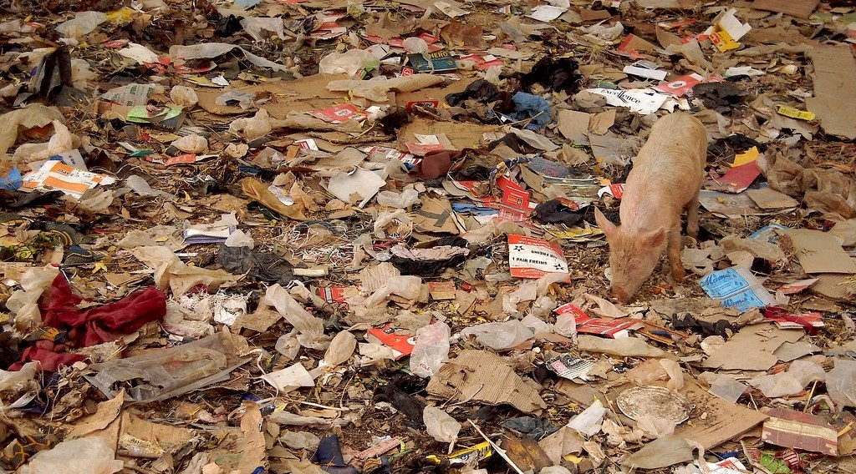
2. OBSERVATION
Activity 2
Rubbish on the ground.
Notes:
Activity 2. Look carefully at this picture: rubbish on the ground. Observe every detail before I ask the question.

Slide 23
2. OBSERVATION
Activity 2: Question
What should you write in your notebook for each damaged place?
Notes:
Here is the question for Activity 2: What should you write in your notebook for each damaged place? Take one minute to think and write your answer in your rough notebook.

Slide 24
2. OBSERVATION
Activity 2: Answer
Where it is, what the damage is, what caused it and a possible solution.
Notes:
Let us check the answer together. Where it is, what the damage is, what caused it and a possible solution.

Slide 25

2. OBSERVATION
Activity 3
Bare soil and a gully.
Notes:
Activity 3. Look carefully at this picture: bare soil and a gully. Observe every detail before I ask the question.

Slide 26
2. OBSERVATION
Activity 3: Question
Where around a school do we often find soil erosion?
Notes:
Here is the question for Activity 3: Where around a school do we often find soil erosion? Take one minute to think and write your answer in your rough notebook.

Slide 27
2. OBSERVATION
Activity 3: Answer
On paths and bare slopes where people walk and the rain runs.
Notes:
Let us check the answer together. On paths and bare slopes where people walk and the rain runs.

Slide 28

3. EXPLANATION
Activity 4
Burnt grass.
Notes:
Activity 4. Look carefully at this picture: burnt grass. Observe every detail before I ask the question.

Slide 29
3. EXPLANATION
Activity 4: Question
Why is the grass burnt around some schools?
Notes:
Here is the question for Activity 4: Why is the grass burnt around some schools? Take one minute to think and write your answer in your rough notebook.

Slide 30
3. EXPLANATION
Activity 4: Answer
People burn rubbish or grass to clear the place.
Notes:
Let us check the answer together. People burn rubbish or grass to clear the place.

Slide 31

4. SOLUTIONS
Activity 5
Planting a young tree.
Notes:
Activity 5. Look carefully at this picture: planting a young tree. Observe every detail before I ask the question.

Slide 32
4. SOLUTIONS
Activity 5: Question
What can our class do to protect the school environment?
Notes:
Here is the question for Activity 5: What can our class do to protect the school environment? Take one minute to think and write your answer in your rough notebook.

Slide 33
4. SOLUTIONS
Activity 5: Answer
Plant trees and grass, use dustbins and walk on the paths.
Notes:
Let us check the answer together. Plant trees and grass, use dustbins and walk on the paths.

Slide 34
BOARD SUMMARY
Board Summary
Topic: Let's Preserve our Environment
Sub-topic: Natural Regions (Bio-climatic Zones) and their Degradation
Guided Work 1: Degradation of the Natural Environment of the School
Notes:
Now we are going to copy the board summary. Write the title and the headings neatly in your notebooks. I will give you enough time for each slide, so do not rush.

Slide 35
BOARD SUMMARY
DEFINITIONS
The key terms of this lesson are defined as follows:
Human aggression: It is any human action that damages the natural environment.
Notes:
Let us copy the definitions. The key terms of this lesson are defined as follows. On this slide we have Human aggression. Write each point on a new line, with the key term first, and explain it in your own words when we revise.

Slide 36
BOARD SUMMARY
1. Types of Human Aggression on the Environment
People damage the natural environment in the following ways:
Deforestation: Trees are cut for wood, building or space.
Illustration: cut trees
Notes:
Let us copy Types of Human Aggression on the Environment. People damage the natural environment in the following ways. Copy the point on Deforestation on the left, then draw the diagram on the right: cut trees. Give it a title and label it clearly.

Slide 37
BOARD SUMMARY
1. Types of Human Aggression on the Environment
Bush fires: Grass and rubbish are burnt and leave the soil bare.
Illustration: burnt grass
Notes:
Copy the point on Bush fires on the left, then draw the diagram on the right: burnt grass. Give it a title and label it clearly.

Slide 38
BOARD SUMMARY
1. Types of Human Aggression on the Environment
Pollution: Rubbish, plastics and smoke make the environment dirty.
Illustration: rubbish
Notes:
Copy the point on Pollution on the left, then draw the diagram on the right: rubbish. Give it a title and label it clearly.

Slide 39
BOARD SUMMARY
1. Types of Human Aggression on the Environment
Soil degradation: Bare soil is trampled and washed away by rain.
Illustration: a gully
Notes:
Copy the point on Soil degradation on the left, then draw the diagram on the right: a gully. Give it a title and label it clearly.

Slide 40
BOARD SUMMARY
2. Method of the Field Visit
The field visit is carried out in the following steps:
Step 1: We walk around the school in groups with a notebook.
Step 2: We observe and identify each damaged place.
Notes:
Let us copy Method of the Field Visit. The field visit is carried out in the following steps. On this slide we have Step 1 and Step 2. Write each point on a new line, with the key term first, and explain it in your own words when we revise. When you finish, we go to the next slide.

Slide 41
BOARD SUMMARY
2. Method of the Field Visit (continued)
Step 3: We describe the damage and explain its cause.
Step 4: We propose a practical solution for each problem.
Notes:
We continue with Method of the Field Visit. On this slide we have Step 3 and Step 4. Write each point on a new line, with the key term first, and explain it in your own words when we revise.

Slide 42
BOARD SUMMARY
3. Solutions for the School
The school environment can be protected by the following actions:
Planting: We plant trees and grass on bare areas.
Illustration: planting a tree
Notes:
Let us copy Solutions for the School. The school environment can be protected by the following actions. Copy the point on Planting on the left, then draw the diagram on the right: planting a tree. Give it a title and label it clearly.

Slide 43
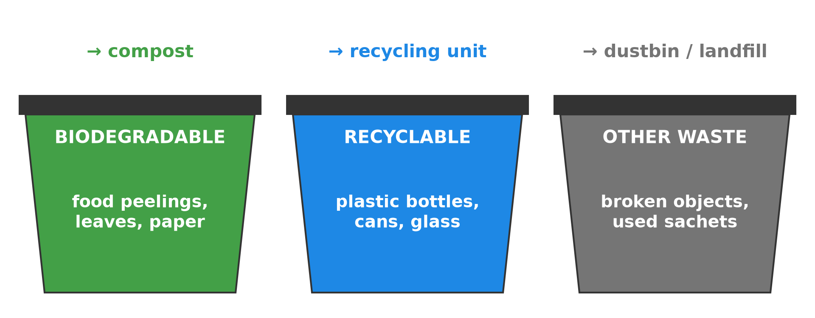
BOARD SUMMARY
3. Solutions for the School
Waste management: We put dustbins and sort the waste.
Illustration: sorting waste
Notes:
Copy the point on Waste management on the left, then draw the diagram on the right: sorting waste. Give it a title and label it clearly.

Slide 44
BOARD SUMMARY
3. Solutions for the School
Protecting the soil: We use paths and make small barriers against running water.
Good behaviour: We stop burning rubbish and grass and remind others to keep the school clean.
Notes:
We continue with Solutions for the School. On this slide we have Protecting the soil and Good behaviour. Write each point on a new line, with the key term first, and explain it in your own words when we revise.

Slide 45
FORMATIVE EVALUATION
Evaluation 1
Name two forms of degradation observed around the school.
Notes:
Now let us check what you have understood. Question 1: Name two forms of degradation observed around the school. Answer in your exercise book.

Slide 46
FORMATIVE EVALUATION
Expected Answer
Rubbish on the ground and bare, eroded soil (also cut trees).
Notes:
The expected answer is: rubbish on the ground and bare, eroded soil (also cut trees). If you got it right, well done.

Slide 47
FORMATIVE EVALUATION
Evaluation 2
Propose two solutions.
Notes:
Now let us check what you have understood. Question 2: Propose two solutions. Answer in your exercise book.

Slide 48
FORMATIVE EVALUATION
Expected Answer
Plant trees and put dustbins.
Notes:
The expected answer is: plant trees and put dustbins. If you got it right, well done.

Slide 49
REMEDIATION
Remediation
Fill in the blanks:
Cutting trees is ______.
Rubbish on the ground is a form of ______.
Planting trees protects the ______.
Notes:
For those who need more practice, fill in the blanks in your exercise book. The answers are: number 1, deforestation; number 2, pollution; number 3, soil.

Slide 50
HOMEWORK
Homework
Write a short report (five lines) on the damage you observed around the school and your solutions.
Notes:
For your homework: Write a short report (five lines) on the damage you observed around the school and your solutions. We shall correct it at the beginning of our next lesson.

Slide 51
NEXT LESSON
Next Lesson
Our next lesson will be on:
Practical Work 5: Solid Waste Management
Notes:
Our next lesson will be on Practical Work 5: Solid Waste Management. Thank you for your attention, and see you next time.

Slide 52
BILINGUAL GAME
Bilingual Game (Jeu Bilingue)
English | Français
Observation | L'observation
Damage | Le dommage
Report | Le rapport
Dustbin | La poubelle
Tree | L'arbre
Solution | La solution
Notes:
Let us play the bilingual game. I say a word in English, and you give me the French word. Then we do the reverse.

Slide 53
LOGBOOK
Official Logbook (1/2)
Module / Topic | Let's Preserve our Environment
Lesson Title | Guided Work 1: Degradation of the Natural Environment of the School
Expected Learning Outcomes | Recall the types of human aggression on natural regions. Observe and describe the degradation around the school. Propose practical solutions.
Competence | Learners are able to observe and describe the degradation of their school environment and propose solutions.
Notes:
I record this information in the official logbook of the class after the lesson.

Slide 54
LOGBOOK
Official Logbook (2/2)
Matter Taught | DEFINITIONS; Types of Human Aggression on the Environment; Method of the Field Visit; Solutions for the School.
Evaluation | Formative evaluation and remediation exercise.
Homework | Write a short report (five lines) on the damage you observed around the school and your solutions.
Enrolment / Present / Absent | ____ / ____ / ____
Achievement | To be completed after the lesson.
Notes:
I complete the second page of the logbook: the matter taught, the evaluation, the homework and the attendance.

Slide 55
TEACHER'S NOTE
Teacher's Note
Timing: Homework correction, plan, objectives 8 min | Recall, situation, action 10 min | 5 activities 30 min | Board summary (copying) 30 min | Evaluation, remediation 10 min | Homework, next lesson 5 min | Logbook 7 min
Without the projector (Activity 1): list the types of damage on the board.
Without the projector (Activity 2): prepare a table with four columns.
Without the projector (Activity 3): look at the playground.
Without the projector (Activity 4): discuss in groups.
Without the projector (Activity 5): write a class action plan.
Notes:
This slide is for me, the teacher: it gives the timing of the lesson and what to do if the projector is not available.

Slide 56
REFERENCES
References
Geography Syllabus, Forms I–V, MINESEC (2023) — Form 1, Module 2: Preservation of the Environment.
Photo, Activity 1: “Slash and burn agriculture in the Amazon” by Matt-Zimmerman, CC BY 2.0, via Flickr (https://www.flickr.com/photos/16725630@N00/1524189000)
Photo, Activity 2: “Do the evolution” by Marco Bellucci, CC BY 2.0, via Flickr (https://www.flickr.com/photos/50451886@N00/3382099741)
Photo, Activity 3: “Soil erosion in the central Mexican Highlands” by CIMMYT, CC BY-NC-SA 2.0, via Flickr (https://www.flickr.com/photos/44760652@N05/6244930288)
Photo, Activity 4: “20111216-NRCS-LSC-0355” by USDAgov, CC BY 2.0, via Flickr (https://www.flickr.com/photos/41284017@N08/6551564351)
Photo, Activity 5: “Haitian Students Breathe New Life into Depleted Pine Forest” by United Nations Photo, CC BY-NC-ND 2.0, via Flickr (https://www.flickr.com/photos/35483578@N03/5860275159)
Diagrams and animations: drawn for this lesson (Geography Department).
Notes:
These are the references and picture credits used to prepare this lesson.

