Slide 1
FORM 1
GEOGRAPHY
Lesson 11
The Internal Structure of the Earth
Notes:
Good morning, class, and welcome to our geography lesson. I am your geography teacher, Mr Kamdem. Today we are starting Lesson 11: The Internal Structure of the Earth.

Slide 2
CLASS INFO
Class, Chapter and Duration
Class | Form 1
Chapter | Module 3: Protection from the Wrath of Nature
Duration | 2 periods (2 × 50 minutes)
Notes:
This lesson is for Form 1. It belongs to Module 3: Protection from the Wrath of Nature. We shall need 2 periods to cover it.

Slide 3
IDENTIFICATION
Lesson Identification
Topic | Protection against the Wrath of Nature
Sub-topic | Movements of the Earth's Crust
Lesson | Lesson 11: The Internal Structure of the Earth
Notions / Concepts | Lithosphere, plate motion, tectonic movements.
Syllabus focus | The crust; the mantle; the core (identification and illustration only).
Competence | Learners are able to identify and draw the layers of the Earth.
Notes:
Our topic is Protection against the Wrath of Nature, and the sub-topic is Movements of the Earth's Crust. The key notions we shall use today are: lithosphere, plate motion, tectonic movements. At the end, you should be able to do this: learners are able to identify and draw the layers of the Earth.

Slide 4

HOMEWORK CORRECTION
Correction of the Homework
Question (Lesson 10: Climate Change and its Consequences):
Propose three actions your family can take against climate change.
Notes:
Before we start the new lesson, let us correct the homework I gave you at the end of Lesson 10: Climate Change and its Consequences. The question was: Propose three actions your family can take against climate change. Take out your exercise books.

Slide 5
HOMEWORK CORRECTION
Correction: Possible Answer
Plant trees around the house; switch off lights and use solar lamps; stop burning rubbish and use improved stoves that need less wood.
Notes:
Here is a good answer. Plant trees around the house; switch off lights and use solar lamps; stop burning rubbish and use improved stoves that need less wood. Compare it with your own answer and correct your work in red.

Slide 6
LESSON PLAN
Lesson Plan
Correction of the homework
Objectives and recall
Real-life situation and action to take
Learning activities
Board summary
Evaluation, remediation and homework
Notes:
Here is the plan of our lesson today. First, we shall correct the homework. Then we shall look at the objectives and recall what you already know. After that, we shall study a situation from real life and the action to take, and do the learning activities. Finally, we shall copy the board summary, do the evaluation and the remediation, and I will give you the homework.

Slide 7
OBJECTIVES
Objectives
By the end of this lesson, you should be able to:
Identify the three main layers of the Earth.
Describe each layer briefly.
Draw the internal structure of the Earth.
Notes:
By the end of this lesson, you should be able to do three things. Number 1: identify the three main layers of the Earth. Number 2: describe each layer briefly. Number 3: draw the internal structure of the Earth.

Slide 8
PREVIOUS KNOWLEDGE
Previous Knowledge
The Earth is round like a ball.
Volcanoes bring hot rock from inside the Earth.
An egg has a shell, a white and a yolk.
Notes:
Let us first remember what you already know. The Earth is round like a ball. Volcanoes bring hot rock from inside the Earth. An egg has a shell, a white and a yolk. Keep this in mind, because we shall build on it today.

Slide 9
REAL-LIFE SITUATION
Situation in Real Life
Moussa cuts a boiled egg in two. He sees a thin shell, the white and a yellow yolk in the centre. His teacher says that the Earth also has layers like the egg. Moussa asks: "What are the layers inside the Earth?"
Notes:
Listen carefully to this situation from real life. Moussa cuts a boiled egg in two. He sees a thin shell, the white and a yellow yolk in the centre. His teacher says that the Earth also has layers like the egg. Moussa asks: "What are the layers inside the Earth?" Think about it, because I am going to ask you some questions.

Slide 10
REAL-LIFE SITUATION
Situation: Question 1
What is the problem in the situation?
Notes:
Question 1: What is the problem in the situation? Think for a moment, then raise your hand to answer.

Slide 11
REAL-LIFE SITUATION
Answer
Moussa does not know the layers inside the Earth.
Notes:
Good. Moussa does not know the layers inside the Earth.

Slide 12
REAL-LIFE SITUATION
Situation: Question 2
Which part of the egg is like the crust?
Notes:
Question 2: Which part of the egg is like the crust? Think for a moment, then raise your hand to answer.

Slide 13
REAL-LIFE SITUATION
Answer
The shell.
Notes:
Good. The shell.

Slide 14
REAL-LIFE SITUATION
Situation: Question 3
Which part is like the core?
Notes:
Question 3: Which part is like the core? Think for a moment, then raise your hand to answer.

Slide 15
REAL-LIFE SITUATION
Possible Answer
The yolk.
Notes:
Good. The yolk.

Slide 16
ACTION TO TAKE
Action to Take
Use simple models such as an egg or an onion to explain the layers of the Earth.
Notes:
From this situation, the action we are working towards in this lesson is the following: use simple models such as an egg or an onion to explain the layers of the Earth.

Slide 17
JUSTIFICATION
Justification of the Lesson
This lesson helps us to know what is inside our planet.
Notes:
Why is this lesson important for you? This lesson helps us to know what is inside our planet.

Slide 18

1. THE CRUST
Activity 1
Rocks and soil.
Notes:
Activity 1. Look carefully at this picture: rocks and soil. Observe every detail before I ask the question.

Slide 19
1. THE CRUST
Activity 1: Question
On which layer of the Earth do we live?
Notes:
Here is the question for Activity 1: On which layer of the Earth do we live? Take one minute to think and write your answer in your rough notebook.

Slide 20
1. THE CRUST
Activity 1: Answer
On the crust, the thin and solid outer layer.
Notes:
Let us check the answer together. On the crust, the thin and solid outer layer.

Slide 21

2. THE MANTLE
Activity 2
Lava coming out of a volcano.
Notes:
Activity 2. Look carefully at this picture: lava coming out of a volcano. Observe every detail before I ask the question.

Slide 22
2. THE MANTLE
Activity 2: Question
Where does the hot lava of volcanoes come from?
Notes:
Here is the question for Activity 2: Where does the hot lava of volcanoes come from? Take one minute to think and write your answer in your rough notebook.

Slide 23
2. THE MANTLE
Activity 2: Answer
From the very hot mantle under the crust.
Notes:
Let us check the answer together. From the very hot mantle under the crust.

Slide 24
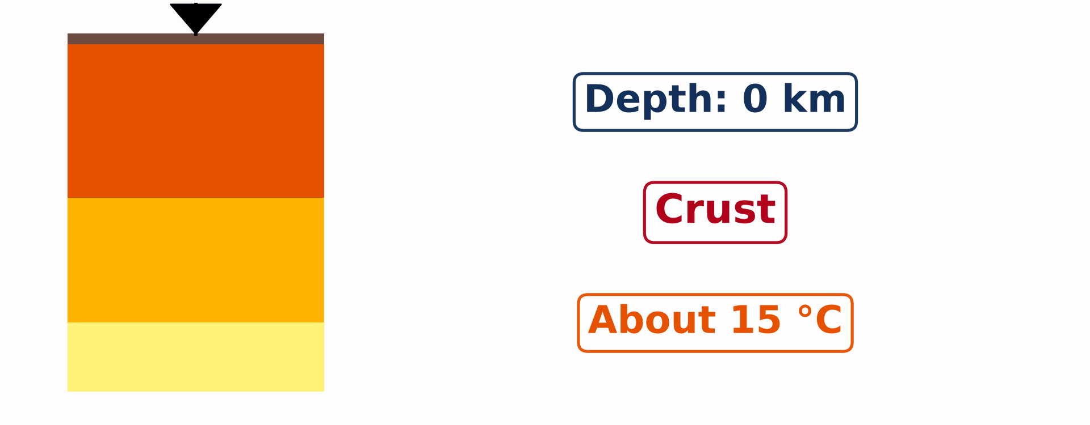
3. THE CORE
Activity 3
Animation: a journey to the centre of the Earth.
Notes:
Activity 3. Look carefully at this animation: animation: a journey to the centre of the Earth. Watch the animation to the end; it will play again.

Slide 25
3. THE CORE
Activity 3: Question
What do we find at the centre of the Earth?
Notes:
Here is the question for Activity 3: What do we find at the centre of the Earth? Take one minute to think and write your answer in your rough notebook.

Slide 26
3. THE CORE
Activity 3: Answer
The core, made mainly of very hot iron and nickel.
Notes:
Let us check the answer together. The core, made mainly of very hot iron and nickel.

Slide 27

4. ILLUSTRATION
Activity 4
A cut through the Earth.
Notes:
Activity 4. Look carefully at this diagram: a cut through the Earth. Observe every detail before I ask the question.

Slide 28
4. ILLUSTRATION
Activity 4: Question
How many main layers can you see in this cut through the Earth?
Notes:
Here is the question for Activity 4: How many main layers can you see in this cut through the Earth? Take one minute to think and write your answer in your rough notebook.

Slide 29
4. ILLUSTRATION
Activity 4: Answer
Three: the crust, the mantle and the core.
Notes:
Let us check the answer together. Three: the crust, the mantle and the core.

Slide 30
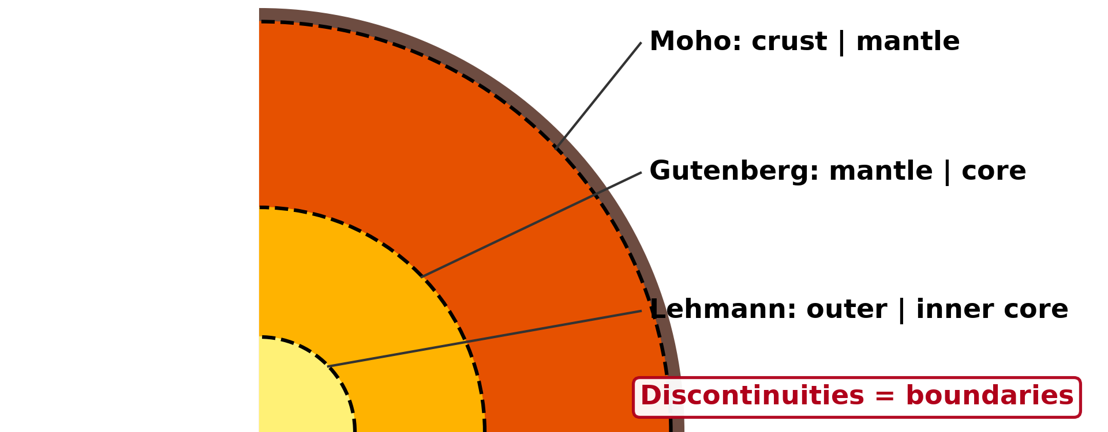
4. ILLUSTRATION
Activity 5
The thickness of the layers.
Notes:
Activity 5. Look carefully at this diagram: the thickness of the layers. Observe every detail before I ask the question.

Slide 31
4. ILLUSTRATION
Activity 5: Question
Which layer is the thinnest?
Notes:
Here is the question for Activity 5: Which layer is the thinnest? Take one minute to think and write your answer in your rough notebook.

Slide 32
4. ILLUSTRATION
Activity 5: Answer
The crust.
Notes:
Let us check the answer together. The crust.

Slide 33
BOARD SUMMARY
Board Summary
Topic: Protection against the Wrath of Nature
Sub-topic: Movements of the Earth's Crust
Lesson 11: The Internal Structure of the Earth
Notes:
Now we are going to copy the board summary. Write the title and the headings neatly in your notebooks. I will give you enough time for each slide, so do not rush.

Slide 34
BOARD SUMMARY
DEFINITIONS
The key terms of this lesson are defined as follows:
Internal structure of the Earth: It is the arrangement of the layers inside the Earth.
Lithosphere: It is the crust and the top part of the mantle, which form the rigid plates.
Notes:
Let us copy the definitions. The key terms of this lesson are defined as follows. On this slide we have Internal structure of the Earth and Lithosphere. Write each point on a new line, with the key term first, and explain it in your own words when we revise.

Slide 35
BOARD SUMMARY
1. The Crust
The first layer of the Earth is the crust:
Crust: It is the thin, solid, rocky layer on which we live. It is about 5 to 70 km thick.
Illustration: the layers of the Earth
Notes:
Let us copy The Crust. The first layer of the Earth is the crust. Copy the point on Crust on the left, then draw the diagram on the right: the layers of the Earth. Give it a title and label it clearly.

Slide 36
BOARD SUMMARY
1. The Crust
Continental crust: It forms the continents and is thicker.
Oceanic crust: It lies under the oceans and is thinner.
Notes:
We continue with The Crust. On this slide we have Continental crust and Oceanic crust. Write each point on a new line, with the key term first, and explain it in your own words when we revise.

Slide 37
BOARD SUMMARY
2. The Mantle
The second layer of the Earth is the mantle:
Mantle: It is a thick layer of very hot rock, about 2,900 km thick. The rock of its upper part moves very slowly.
Illustration: the thickness of the layers
Notes:
Let us copy The Mantle. The second layer of the Earth is the mantle. Copy the point on Mantle on the left, then draw the diagram on the right: the thickness of the layers. Give it a title and label it clearly.

Slide 38
BOARD SUMMARY
3. The Core
The centre of the Earth is the core:
Outer core: It is a layer of hot liquid iron and nickel.
Notes:
Let us copy The Core. The centre of the Earth is the core. On this slide we have Outer core. Write each point on a new line, with the key term first, and explain it in your own words when we revise.

Slide 39
BOARD SUMMARY
3. The Core
Inner core: It is the solid, very hot centre of the Earth.
Illustration: the internal structure of the Earth
Notes:
Copy the point on Inner core on the left, then draw the diagram on the right: the internal structure of the Earth. Give it a title and label it clearly.

Slide 40
FORMATIVE EVALUATION
Evaluation 1
Name the three main layers of the Earth.
Notes:
Now let us check what you have understood. Question 1: Name the three main layers of the Earth. Answer in your exercise book.

Slide 41
FORMATIVE EVALUATION
Expected Answer
Crust, mantle and core.
Notes:
The expected answer is: crust, mantle and core. If you got it right, well done.

Slide 42
FORMATIVE EVALUATION
Evaluation 2
Which layer do we live on?
Notes:
Now let us check what you have understood. Question 2: Which layer do we live on? Answer in your exercise book.

Slide 43
FORMATIVE EVALUATION
Expected Answer
The crust.
Notes:
The expected answer is: the crust. If you got it right, well done.

Slide 44
REMEDIATION
Remediation
Fill in the blanks:
The outer layer of the Earth is the ______.
The layer under the crust is the ______.
The centre of the Earth is the ______.
Notes:
For those who need more practice, fill in the blanks in your exercise book. The answers are: number 1, crust; number 2, mantle; number 3, core.

Slide 45
HOMEWORK
Homework
Draw and label the internal structure of the Earth.
Notes:
For your homework: Draw and label the internal structure of the Earth. We shall correct it at the beginning of our next lesson.

Slide 46
NEXT LESSON
Next Lesson
Our next lesson will be on:
Lesson 12: Plate Movements
Notes:
Our next lesson will be on Lesson 12: Plate Movements. Thank you for your attention, and see you next time.

Slide 47
BILINGUAL GAME
Bilingual Game (Jeu Bilingue)
English | Français
Crust | L'écorce terrestre
Mantle | Le manteau
Core | Le noyau
Layer | La couche
Rock | La roche
Iron | Le fer
Notes:
Let us play the bilingual game. I say a word in English, and you give me the French word. Then we do the reverse.

Slide 48
LOGBOOK
Official Logbook (1/2)
Module / Topic | Protection against the Wrath of Nature
Lesson Title | Lesson 11: The Internal Structure of the Earth
Expected Learning Outcomes | Identify the three main layers of the Earth. Describe each layer briefly. Draw the internal structure of the Earth.
Competence | Learners are able to identify and draw the layers of the Earth.
Notes:
I record this information in the official logbook of the class after the lesson.

Slide 49
LOGBOOK
Official Logbook (2/2)
Matter Taught | DEFINITIONS; The Crust; The Mantle; The Core.
Evaluation | Formative evaluation and remediation exercise.
Homework | Draw and label the internal structure of the Earth.
Enrolment / Present / Absent | ____ / ____ / ____
Achievement | To be completed after the lesson.
Notes:
I complete the second page of the logbook: the matter taught, the evaluation, the homework and the attendance.

Slide 50
TEACHER'S NOTE
Teacher's Note
Timing: Homework correction, plan, objectives 8 min | Recall, situation, action 10 min | 5 activities 30 min | Board summary (copying) 30 min | Evaluation, remediation 10 min | Homework, next lesson 5 min | Logbook 7 min
Activity 3 is an animation (GIF): it plays automatically in slide-show mode.
Without the projector (Activity 1): show a stone.
Without the projector (Activity 2): describe Mount Cameroon erupting.
Without the projector (Activity 3): compare with the yolk of an egg.
Without the projector (Activity 4): draw three circles.
Without the projector (Activity 5): draw a cross-section of the Earth.
Notes:
This slide is for me, the teacher: it gives the timing of the lesson and what to do if the projector is not available.

Slide 51
REFERENCES
References
Geography Syllabus, Forms I–V, MINESEC (2023) — Form 1, Module 3: Protection from the Wrath of Nature.
Photo, Activity 1: “Laterite soil bricks in Richard Rebello's farm” by India Water Portal, CC BY-NC-SA 2.0, via Flickr (https://www.flickr.com/photos/21623815@N03/10720461943)
Photo, Activity 2: “Happy Anniversary Hawaii” by U.S. Geological Survey, CC0 1.0, via Flickr (https://www.flickr.com/photos/27784370@N05/14802198589)
Diagrams and animations: drawn for this lesson (Geography Department).
Notes:
These are the references and picture credits used to prepare this lesson.

