Slide 1
FORM 1
GEOGRAPHY
Further Study 2
What to Do in Case of an Earthquake or a Volcanic Eruption
Notes:
Good morning, class, and welcome to our geography lesson. I am your geography teacher, Mr Kamdem. Today we are starting Further Study 2: What to Do in Case of an Earthquake or a Volcanic Eruption.

Slide 2
CLASS INFO
Class, Chapter and Duration
Class | Form 1
Chapter | Module 3: Protection from the Wrath of Nature
Duration | 2 periods (2 × 50 minutes)
Notes:
This lesson is for Form 1. It belongs to Module 3: Protection from the Wrath of Nature. We shall need 2 periods to cover it.

Slide 3
IDENTIFICATION
Lesson Identification
Topic | Protection against the Wrath of Nature
Sub-topic | Movements of the Earth's Crust
Lesson | Further Study 2: What to Do in Case of an Earthquake or a Volcanic Eruption
Notions / Concepts | Safety, evacuation, first aid, adaptation, mitigation, warning.
Syllabus focus | What to do in case of an earthquake or a volcanic eruption, and what adaptation and mitigation measures to take.
Competence | Learners are able to react safely during an earthquake or volcanic eruption and help others.
Notes:
Our topic is Protection against the Wrath of Nature, and the sub-topic is Movements of the Earth's Crust. The key notions we shall use today are: safety, evacuation, first aid, adaptation, mitigation, warning. At the end, you should be able to do this: learners are able to react safely during an earthquake or volcanic eruption and help others.

Slide 4

HOMEWORK CORRECTION
Correction of the Homework
Question (Lesson 13: Consequences of the Instability of the Earth's Crust):
Find out what happened at Lake Nyos in 1986 and write three sentences about it.
Notes:
Before we start the new lesson, let us correct the homework I gave you at the end of Lesson 13: Consequences of the Instability of the Earth's Crust. The question was: Find out what happened at Lake Nyos in 1986 and write three sentences about it. Take out your exercise books.

Slide 5
HOMEWORK CORRECTION
Correction: Possible Answer
On 21 August 1986, a cloud of carbon dioxide gas came out of Lake Nyos. It flowed down the valleys and killed about 1,700 people and many animals. Today pipes remove the gas from the lake.
Notes:
Here is a good answer. On 21 August 1986, a cloud of carbon dioxide gas came out of Lake Nyos. It flowed down the valleys and killed about 1,700 people and many animals. Today pipes remove the gas from the lake. Compare it with your own answer and correct your work in red.

Slide 6
LESSON PLAN
Lesson Plan
Correction of the homework
Objectives and recall
Real-life situation and action to take
Learning activities
Board summary
Evaluation, remediation and homework
Notes:
Here is the plan of our lesson today. First, we shall correct the homework. Then we shall look at the objectives and recall what you already know. After that, we shall study a situation from real life and the action to take, and do the learning activities. Finally, we shall copy the board summary, do the evaluation and the remediation, and I will give you the homework.

Slide 7
OBJECTIVES
Objectives
By the end of this lesson, you should be able to:
Give the safety rules during an earthquake.
Give the safety rules during a volcanic eruption.
Notes:
Take your time to copy this part; we will continue together.

Slide 8
OBJECTIVES
Objectives (continued)
Describe adaptation and mitigation measures.
Notes:
By the end of this lesson, you should be able to do three things. Number 1: give the safety rules during an earthquake. Number 2: give the safety rules during a volcanic eruption. Number 3: describe adaptation and mitigation measures.

Slide 9
PREVIOUS KNOWLEDGE
Previous Knowledge
Earthquakes shake the ground.
Volcanoes give lava, ash and gases.
Mount Cameroon is an active volcano.
Notes:
Let us first remember what you already know. Earthquakes shake the ground. Volcanoes give lava, ash and gases. Mount Cameroon is an active volcano. Keep this in mind, because we shall build on it today.

Slide 10
REAL-LIFE SITUATION
Situation in Real Life
The radio announces that Mount Cameroon may erupt soon. The people of Buea are worried: some want to stay, and others want to leave immediately. A mother asks: "What must my family do to stay safe?"
Notes:
Listen carefully to this situation from real life. The radio announces that Mount Cameroon may erupt soon. The people of Buea are worried: some want to stay, and others want to leave immediately. A mother asks: "What must my family do to stay safe?" Think about it, because I am going to ask you some questions.

Slide 11
REAL-LIFE SITUATION
Situation: Question 1
What is the problem in the situation?
Notes:
Question 1: What is the problem in the situation? Think for a moment, then raise your hand to answer.

Slide 12
REAL-LIFE SITUATION
Answer
The people of Buea do not know what to do before and during an eruption.
Notes:
Good. The people of Buea do not know what to do before and during an eruption.

Slide 13
REAL-LIFE SITUATION
Situation: Question 2
What should they listen to?
Notes:
Question 2: What should they listen to? Think for a moment, then raise your hand to answer.

Slide 14
REAL-LIFE SITUATION
Answer
The warnings of the authorities.
Notes:
Good. The warnings of the authorities.

Slide 15
REAL-LIFE SITUATION
Situation: Question 3
Where should they go?
Notes:
Question 3: Where should they go? Think for a moment, then raise your hand to answer.

Slide 16
REAL-LIFE SITUATION
Possible Answer
To safe places far from the lava paths.
Notes:
Good. To safe places far from the lava paths.

Slide 17
ACTION TO TAKE
Action to Take
Know the safe places and the first aid rules; help the weak during an emergency.
Notes:
From this situation, the action we are working towards in this lesson is the following: know the safe places and the first aid rules; help the weak during an emergency.

Slide 18
JUSTIFICATION
Justification of the Lesson
This further study helps us to protect our lives during natural disasters.
Notes:
Why is this lesson important for you? This further study helps us to protect our lives during natural disasters.

Slide 19

1. DURING AN EARTHQUAKE
Activity 1
Damage after an earthquake.
Notes:
Activity 1. Look carefully at this picture: damage after an earthquake. Observe every detail before I ask the question.

Slide 20
1. DURING AN EARTHQUAKE
Activity 1: Question
Where should you hide inside a building when the ground shakes?
Notes:
Here is the question for Activity 1: Where should you hide inside a building when the ground shakes? Take one minute to think and write your answer in your rough notebook.

Slide 21
1. DURING AN EARTHQUAKE
Activity 1: Answer
Under a strong table, covering your head, away from windows.
Notes:
Let us check the answer together. Under a strong table, covering your head, away from windows.

Slide 22
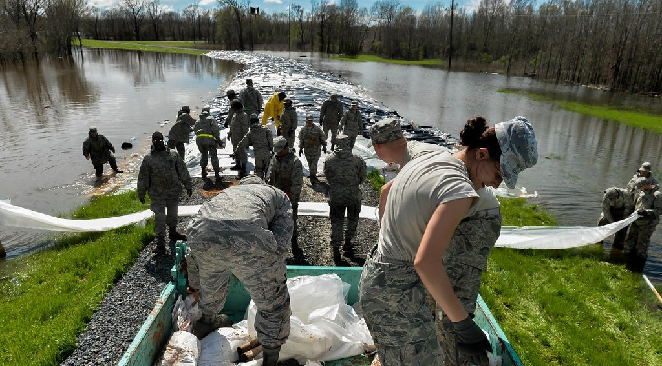
1. AFTER AN EARTHQUAKE
Activity 2
Rescue workers.
Notes:
Activity 2. Look carefully at this picture: rescue workers. Observe every detail before I ask the question.

Slide 23
1. AFTER AN EARTHQUAKE
Activity 2: Question
What should you do after the shaking stops?
Notes:
Here is the question for Activity 2: What should you do after the shaking stops? Take one minute to think and write your answer in your rough notebook.

Slide 24
1. AFTER AN EARTHQUAKE
Activity 2: Answer
Go out carefully to an open space, help the injured and call the rescue services.
Notes:
Let us check the answer together. Go out carefully to an open space, help the injured and call the rescue services.

Slide 25

2. DURING A VOLCANIC ERUPTION
Activity 3
A volcanic eruption.
Notes:
Activity 3. Look carefully at this picture: a volcanic eruption. Observe every detail before I ask the question.

Slide 26
2. DURING A VOLCANIC ERUPTION
Activity 3: Question
Why must people leave the valleys during an eruption?
Notes:
Here is the question for Activity 3: Why must people leave the valleys during an eruption? Take one minute to think and write your answer in your rough notebook.

Slide 27
2. DURING A VOLCANIC ERUPTION
Activity 3: Answer
Lava and heavy gases flow down the valleys.
Notes:
Let us check the answer together. Lava and heavy gases flow down the valleys.

Slide 28
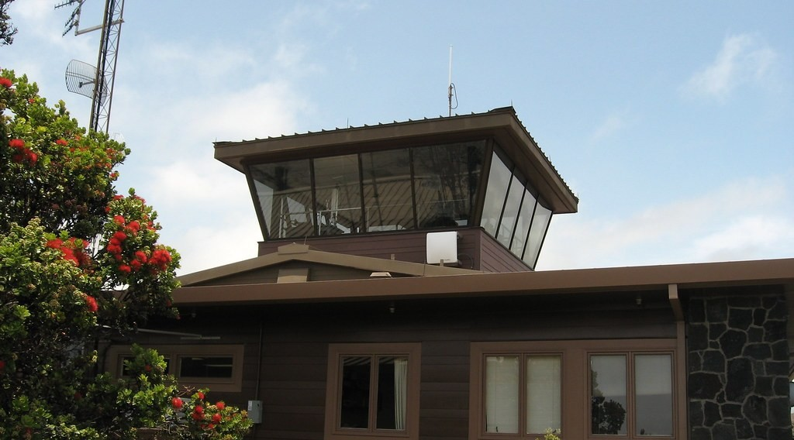
3. MITIGATION
Activity 4
Scientists at work on a volcano.
Notes:
Activity 4. Look carefully at this picture: scientists at work on a volcano. Observe every detail before I ask the question.

Slide 29
3. MITIGATION
Activity 4: Question
How can scientists reduce the danger of volcanoes?
Notes:
Here is the question for Activity 4: How can scientists reduce the danger of volcanoes? Take one minute to think and write your answer in your rough notebook.

Slide 30
3. MITIGATION
Activity 4: Answer
By watching volcanoes with instruments to predict eruptions and warn people.
Notes:
Let us check the answer together. By watching volcanoes with instruments to predict eruptions and warn people.

Slide 31

3. ADAPTATION
Activity 5
Lake Nyos.
Notes:
Activity 5. Look carefully at this picture: lake Nyos. Observe every detail before I ask the question.

Slide 32
3. ADAPTATION
Activity 5: Question
What was done at Lake Nyos to prevent another disaster?
Notes:
Here is the question for Activity 5: What was done at Lake Nyos to prevent another disaster? Take one minute to think and write your answer in your rough notebook.

Slide 33
3. ADAPTATION
Activity 5: Answer
Pipes were placed to remove the dangerous gas from the lake.
Notes:
Let us check the answer together. Pipes were placed to remove the dangerous gas from the lake.

Slide 34
BOARD SUMMARY
Board Summary
Topic: Protection against the Wrath of Nature
Sub-topic: Movements of the Earth's Crust
Further Study 2: What to Do in Case of an Earthquake or a Volcanic Eruption
Notes:
Now we are going to copy the board summary. Write the title and the headings neatly in your notebooks. I will give you enough time for each slide, so do not rush.

Slide 35
BOARD SUMMARY
DEFINITIONS
The key terms of this lesson are defined as follows:
Evacuation: It is leaving a dangerous place quickly and in an organised way.
First aid: It is the first help given to an injured person before the doctor arrives.
Notes:
Let us copy the definitions. The key terms of this lesson are defined as follows. On this slide we have Evacuation and First aid. Write each point on a new line, with the key term first, and explain it in your own words when we revise.

Slide 36
BOARD SUMMARY
1. What to Do in Case of an Earthquake
In case of an earthquake, we follow these rules:
Inside: We drop, cover our head under a strong table and hold on, away from windows.
Illustration: damage after an earthquake
Notes:
Let us copy What to Do in Case of an Earthquake. In case of an earthquake, we follow these rules. Copy the point on Inside on the left, then draw the diagram on the right: damage after an earthquake. Give it a title and label it clearly.

Slide 37
BOARD SUMMARY
1. What to Do in Case of an Earthquake
Outside: We move to an open space away from buildings, trees and electric wires.
Notes:
We continue with What to Do in Case of an Earthquake. On this slide we have Outside. Write each point on a new line, with the key term first, and explain it in your own words when we revise.

Slide 38
BOARD SUMMARY
1. What to Do in Case of an Earthquake
After: We go out carefully, help the injured, give first aid and call the rescue services.
Illustration: rescue workers
Notes:
Copy the point on After on the left, then draw the diagram on the right: rescue workers. Give it a title and label it clearly.

Slide 39
BOARD SUMMARY
1. What to Do in Case of an Earthquake
Tsunami warning: On the coast, we move quickly to high ground.
Notes:
We continue with What to Do in Case of an Earthquake. On this slide we have Tsunami warning. Write each point on a new line, with the key term first, and explain it in your own words when we revise.

Slide 40
BOARD SUMMARY
2. What to Do in Case of a Volcanic Eruption
In case of a volcanic eruption, we follow these rules:
Warnings: We listen to the radio and obey the authorities.
Notes:
Let us copy What to Do in Case of a Volcanic Eruption. In case of a volcanic eruption, we follow these rules. On this slide we have Warnings. Write each point on a new line, with the key term first, and explain it in your own words when we revise.

Slide 41
BOARD SUMMARY
2. What to Do in Case of a Volcanic Eruption
Evacuation: We leave quickly, away from lava paths and low valleys.
Illustration: a volcanic eruption
Notes:
Copy the point on Evacuation on the left, then draw the diagram on the right: a volcanic eruption. Give it a title and label it clearly.

Slide 42
BOARD SUMMARY
2. What to Do in Case of a Volcanic Eruption
Protection: We cover the nose and mouth against ash and gases.
Emergency bag: We take water, food, a torch, a first-aid kit and our documents.
Notes:
We continue with What to Do in Case of a Volcanic Eruption. On this slide we have Protection and Emergency bag. Write each point on a new line, with the key term first, and explain it in your own words when we revise.

Slide 43
BOARD SUMMARY
3. Adaptation and Mitigation Measures
The following measures reduce the dangers:
Monitoring: Scientists watch volcanoes and earthquakes to warn people in time.
Illustration: volcano monitoring
Notes:
Let us copy Adaptation and Mitigation Measures. The following measures reduce the dangers. Copy the point on Monitoring on the left, then draw the diagram on the right: volcano monitoring. Give it a title and label it clearly.

Slide 44
BOARD SUMMARY
3. Adaptation and Mitigation Measures
Strong buildings: Buildings made to resist shaking save lives.
Land-use planning: People do not build in valleys where lava and gases flow.
Notes:
We continue with Adaptation and Mitigation Measures. On this slide we have Strong buildings and Land-use planning. Write each point on a new line, with the key term first, and explain it in your own words when we revise.

Slide 45
BOARD SUMMARY
3. Adaptation and Mitigation Measures
Degassing: Pipes remove the gas from Lake Nyos and Lake Monoun.
Illustration: Lake Nyos
Notes:
Copy the point on Degassing on the left, then draw the diagram on the right: lake Nyos. Give it a title and label it clearly.

Slide 46
BOARD SUMMARY
3. Adaptation and Mitigation Measures
Education: People learn safety drills and first aid, as the Red Cross teaches.
Notes:
We continue with Adaptation and Mitigation Measures. On this slide we have Education. Write each point on a new line, with the key term first, and explain it in your own words when we revise.

Slide 47
FORMATIVE EVALUATION
Evaluation 1
Give two rules during an earthquake.
Notes:
Now let us check what you have understood. Question 1: Give two rules during an earthquake. Answer in your exercise book.

Slide 48
FORMATIVE EVALUATION
Expected Answer
Drop, cover and hold on; stay away from windows.
Notes:
The expected answer is: drop, cover and hold on; stay away from windows. If you got it right, well done.

Slide 49
FORMATIVE EVALUATION
Evaluation 2
Give two rules during a volcanic eruption.
Notes:
Now let us check what you have understood. Question 2: Give two rules during a volcanic eruption. Answer in your exercise book.

Slide 50
FORMATIVE EVALUATION
Expected Answer
Obey warnings and leave the area away from lava paths.
Notes:
The expected answer is: obey warnings and leave the area away from lava paths. If you got it right, well done.

Slide 51
REMEDIATION
Remediation
Fill in the blanks:
During an earthquake, we drop, cover and ______ on.
Leaving a dangerous area is ______.
Scientists watch volcanoes to give ______.
Notes:
For those who need more practice, fill in the blanks in your exercise book. The answers are: number 1, hold; number 2, evacuation; number 3, warnings.

Slide 52
HOMEWORK
Homework
Prepare a list of five items to take in an emergency bag.
Notes:
For your homework: Prepare a list of five items to take in an emergency bag. We shall correct it at the beginning of our next lesson.

Slide 53
BILINGUAL GAME
Bilingual Game (Jeu Bilingue)
English | Français
Safety | La sécurité
Evacuation | L'évacuation
First aid | Les premiers secours
Warning | L'alerte
Rescue | Le sauvetage
Injured | Le blessé
Notes:
Let us play the bilingual game. I say a word in English, and you give me the French word. Then we do the reverse.

Slide 54
LOGBOOK
Official Logbook (1/2)
Module / Topic | Protection against the Wrath of Nature
Lesson Title | Further Study 2: What to Do in Case of an Earthquake or a Volcanic Eruption
Expected Learning Outcomes | Give the safety rules during an earthquake. Give the safety rules during a volcanic eruption. Describe adaptation and mitigation measures.
Competence | Learners are able to react safely during an earthquake or volcanic eruption and help others.
Notes:
I record this information in the official logbook of the class after the lesson.

Slide 55
LOGBOOK
Official Logbook (2/2)
Matter Taught | DEFINITIONS; What to Do in Case of an Earthquake; What to Do in Case of a Volcanic Eruption; Adaptation and Mitigation Measures.
Evaluation | Formative evaluation and remediation exercise.
Homework | Prepare a list of five items to take in an emergency bag.
Enrolment / Present / Absent | ____ / ____ / ____
Achievement | To be completed after the lesson.
Notes:
I complete the second page of the logbook: the matter taught, the evaluation, the homework and the attendance.

Slide 56
TEACHER'S NOTE
Teacher's Note
Timing: Homework correction, plan, objectives 8 min | Recall, situation, action 10 min | 5 activities 30 min | Board summary (copying) 30 min | Evaluation, remediation 10 min | Homework, next lesson 5 min | Logbook 7 min
Without the projector (Activity 1): practise "drop, cover, hold on".
Without the projector (Activity 2): role-play a rescue.
Without the projector (Activity 3): list items to take when leaving.
Without the projector (Activity 4): explain monitoring.
Without the projector (Activity 5): describe the degassing pipes.
Notes:
This slide is for me, the teacher: it gives the timing of the lesson and what to do if the projector is not available.

Slide 57
REFERENCES
References
Geography Syllabus, Forms I–V, MINESEC (2023) — Form 1, Module 3: Protection from the Wrath of Nature.
Photo, Activity 1: “Collapsed buildings in earthquake-hit Chautara, Nepal” by DFID - UK Department for International Development, CC BY 2.0, via Flickr (https://www.flickr.com/photos/14214150@N02/16693413433)
Photo, Activity 2: “160310-F-VO743-004” by Official U.S. Air Force, CC BY-NC 2.0, via Flickr (https://www.flickr.com/photos/39513508@N06/25854674326)
Photo, Activity 3: “Happy Anniversary Hawaii” by U.S. Geological Survey, CC0 1.0, via Flickr (https://www.flickr.com/photos/27784370@N05/14802198589)
Photo, Activity 4: “Hawaiian Volcano Observatory, Hawaiʻi Volcanoes National Park, Hawaii” by Ken Lund, CC BY-SA 2.0, via Flickr (https://www.flickr.com/photos/75683070@N00/4528702285)
Photo, Activity 5: “Lake Nyos, Cameroon” by jbdodane, CC BY-NC 2.0, via Flickr (https://www.flickr.com/photos/27998473@N02/11584073056)
Diagrams and animations: drawn for this lesson (Geography Department).
Notes:
These are the references and picture credits used to prepare this lesson.

