Slide 1
FORM 2
GEOGRAPHY
Lesson 2
The Uneven Distribution of the World's Population
Notes:
Good morning, class, and welcome to our geography lesson. I am your geography teacher, Mr Kamdem. Today we are starting Lesson 2: The Uneven Distribution of the World's Population.

Slide 2
CLASS INFO
Class, Chapter and Duration
Class | Form 2
Chapter | Module 1: Man in his Environment
Duration | 2 periods (2 × 50 minutes)
Notes:
This lesson is for Form 2. It belongs to Module 1: Man in his Environment. We shall need 2 periods to cover it.

Slide 3
IDENTIFICATION
Lesson Identification
Topic | Man in his Environment
Sub-topic | The World's Population
Lesson | Lesson 2: The Uneven Distribution of the World's Population
Notions / Concepts | Population density, population distribution.
Syllabus focus | Concept of population density; spatial distribution; factors of uneven distribution.
Competence | Learners are able to identify densely and sparsely populated areas and explain the reasons.
Notes:
Our topic is Man in his Environment, and the sub-topic is The World's Population. The key notions we shall use today are: population density, population distribution. At the end, you should be able to do this: learners are able to identify densely and sparsely populated areas and explain the reasons.

Slide 4

HOMEWORK CORRECTION
Correction of the Homework
Question (Practical Work 1: Calculation of the Demographic Indices of Cameroon):
A village of 5,000 people has 200 births and 50 deaths. Calculate the three indices.
Notes:
Before we start the new lesson, let us correct the homework I gave you at the end of Practical Work 1: Calculation of the Demographic Indices of Cameroon. The question was: A village of 5,000 people has 200 births and 50 deaths. Calculate the three indices. Take out your exercise books.

Slide 5
HOMEWORK CORRECTION
Correction: Possible Answer
Birth rate = (200 ÷ 5,000) × 1,000 = 40 ‰. Death rate = (50 ÷ 5,000) × 1,000 = 10 ‰. Natural growth rate = (40 − 10) ÷ 10 = 3 %.
Notes:
Here is a good answer. Birth rate = (200 ÷ 5,000) × 1,000 = 40 ‰. Death rate = (50 ÷ 5,000) × 1,000 = 10 ‰. Natural growth rate = (40 − 10) ÷ 10 = 3 %. Compare it with your own answer and correct your work in red.

Slide 6
LESSON PLAN
Lesson Plan
Correction of the homework
Objectives and recall
Real-life situation and action to take
Learning activities
Board summary
Evaluation, remediation and homework
Notes:
Here is the plan of our lesson today. First, we shall correct the homework. Then we shall look at the objectives and recall what you already know. After that, we shall study a situation from real life and the action to take, and do the learning activities. Finally, we shall copy the board summary, do the evaluation and the remediation, and I will give you the homework.

Slide 7
OBJECTIVES
Objectives
By the end of this lesson, you should be able to:
Define and calculate population density.
Describe the spatial distribution of the world population.
Notes:
Take your time to copy this part; we will continue together.

Slide 8
OBJECTIVES
Objectives (continued)
Explain the factors of uneven distribution.
Notes:
By the end of this lesson, you should be able to do three things. Number 1: define and calculate population density. Number 2: describe the spatial distribution of the world population. Number 3: explain the factors of uneven distribution.

Slide 9
PREVIOUS KNOWLEDGE
Previous Knowledge
The world has more than 8 billion people.
Some places are crowded, others are empty.
Deserts are very dry.
Notes:
Let us first remember what you already know. The world has more than 8 billion people. Some places are crowded, others are empty. Deserts are very dry. Keep this in mind, because we shall build on it today.

Slide 10
REAL-LIFE SITUATION
Situation in Real Life
On a world map of population, Ali sees many dots in Asia and Europe, but very few in the Sahara and the Amazon forest. He asks his teacher: "Why do people not live everywhere on the Earth?"
Notes:
Listen carefully to this situation from real life. On a world map of population, Ali sees many dots in Asia and Europe, but very few in the Sahara and the Amazon forest. He asks his teacher: "Why do people not live everywhere on the Earth?" Think about it, because I am going to ask you some questions.

Slide 11
REAL-LIFE SITUATION
Situation: Question 1
What is the problem in the situation?
Notes:
Question 1: What is the problem in the situation? Think for a moment, then raise your hand to answer.

Slide 12
REAL-LIFE SITUATION
Answer
Ali does not know why people are not spread evenly over the Earth.
Notes:
Good. Ali does not know why people are not spread evenly over the Earth.

Slide 13
REAL-LIFE SITUATION
Situation: Question 2
Name two crowded areas.
Notes:
Question 2: Name two crowded areas. Think for a moment, then raise your hand to answer.

Slide 14
REAL-LIFE SITUATION
Answer
East Asia and South Asia (also Europe).
Notes:
Good. East Asia and South Asia (also Europe).

Slide 15
REAL-LIFE SITUATION
Situation: Question 3
Name two nearly empty areas.
Notes:
Question 3: Name two nearly empty areas. Think for a moment, then raise your hand to answer.

Slide 16
REAL-LIFE SITUATION
Possible Answer
The Sahara and the Amazon forest.
Notes:
Good. The Sahara and the Amazon forest.

Slide 17
ACTION TO TAKE
Action to Take
Read population maps and compare the density of different areas.
Notes:
From this situation, the action we are working towards in this lesson is the following: read population maps and compare the density of different areas.

Slide 18
JUSTIFICATION
Justification of the Lesson
This lesson helps us to understand why people live in some places and not in others.
Notes:
Why is this lesson important for you? This lesson helps us to understand why people live in some places and not in others.

Slide 19
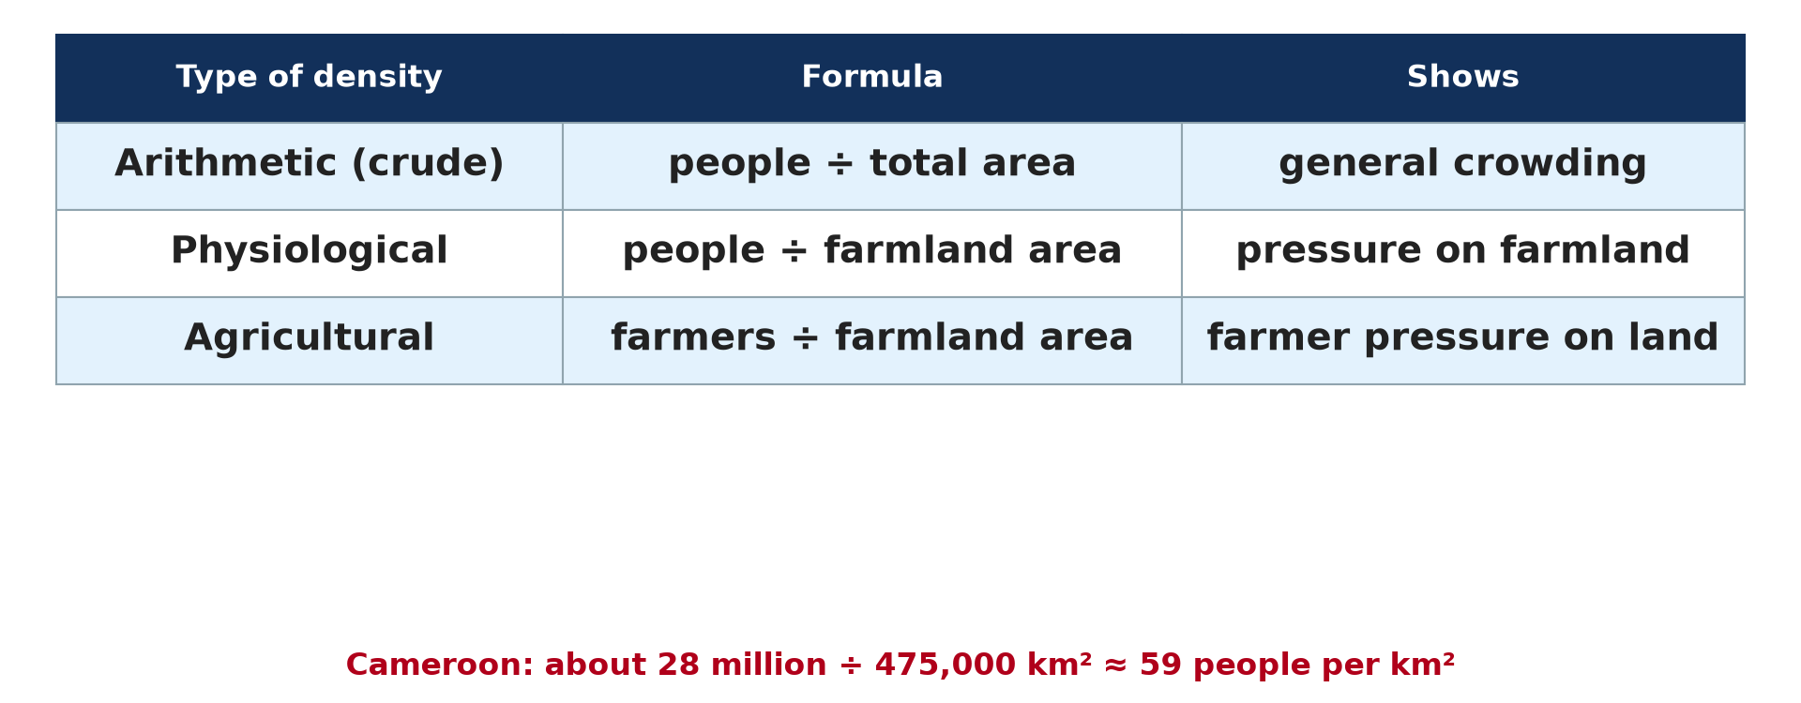
1. POPULATION DENSITY
Activity 1
People and area.
Notes:
Activity 1. Look carefully at this diagram: people and area. Observe every detail before I ask the question.

Slide 20
1. POPULATION DENSITY
Activity 1: Question
How can we measure how crowded a place is?
Notes:
Here is the question for Activity 1: How can we measure how crowded a place is? Take one minute to think and write your answer in your rough notebook.

Slide 21
1. POPULATION DENSITY
Activity 1: Answer
By dividing the population by the area: this is the population density, in people per km².
Notes:
Let us check the answer together. By dividing the population by the area: this is the population density, in people per km².

Slide 22
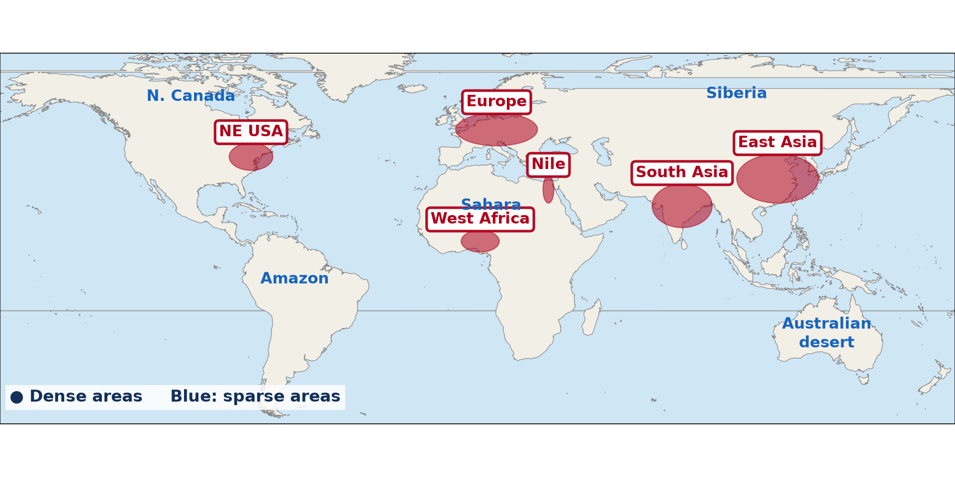
2. SPATIAL DISTRIBUTION
Activity 2
Where people live in the world.
Notes:
Activity 2. Look carefully at this diagram: where people live in the world. Observe every detail before I ask the question.

Slide 23
2. SPATIAL DISTRIBUTION
Activity 2: Question
Name three crowded areas of the world.
Notes:
Here is the question for Activity 2: Name three crowded areas of the world. Take one minute to think and write your answer in your rough notebook.

Slide 24
2. SPATIAL DISTRIBUTION
Activity 2: Answer
East Asia, South Asia and Europe (also West Africa and the north-east of the USA).
Notes:
Let us check the answer together. East Asia, South Asia and Europe (also West Africa and the north-east of the USA).

Slide 25

2. SPATIAL DISTRIBUTION
Activity 3
A sandy desert.
Notes:
Activity 3. Look carefully at this picture: a sandy desert. Observe every detail before I ask the question.

Slide 26
2. SPATIAL DISTRIBUTION
Activity 3: Question
Why do very few people live here?
Notes:
Here is the question for Activity 3: Why do very few people live here? Take one minute to think and write your answer in your rough notebook.

Slide 27
2. SPATIAL DISTRIBUTION
Activity 3: Answer
It is too dry and too hot for farming.
Notes:
Let us check the answer together. It is too dry and too hot for farming.

Slide 28

3. FACTORS
Activity 4
Rice fields on a plain.
Notes:
Activity 4. Look carefully at this picture: rice fields on a plain. Observe every detail before I ask the question.

Slide 29
3. FACTORS
Activity 4: Question
Why do many people live on fertile plains?
Notes:
Here is the question for Activity 4: Why do many people live on fertile plains? Take one minute to think and write your answer in your rough notebook.

Slide 30
3. FACTORS
Activity 4: Answer
The soil is good for farming, and there is water.
Notes:
Let us check the answer together. The soil is good for farming, and there is water.

Slide 31

3. FACTORS
Activity 5
Douala.
Notes:
Activity 5. Look carefully at this picture: douala. Observe every detail before I ask the question.

Slide 32
3. FACTORS
Activity 5: Question
Why do many people move to towns like Douala?
Notes:
Here is the question for Activity 5: Why do many people move to towns like Douala? Take one minute to think and write your answer in your rough notebook.

Slide 33
3. FACTORS
Activity 5: Answer
To find jobs in industries and the port, and services such as schools and hospitals.
Notes:
Let us check the answer together. To find jobs in industries and the port, and services such as schools and hospitals.

Slide 34
BOARD SUMMARY
Board Summary
Topic: Man in his Environment
Sub-topic: The World's Population
Lesson 2: The Uneven Distribution of the World's Population
Notes:
Now we are going to copy the board summary. Write the title and the headings neatly in your notebooks. I will give you enough time for each slide, so do not rush.

Slide 35
BOARD SUMMARY
DEFINITIONS
The key terms of this lesson are defined as follows:
Population density: It is the average number of people per km², calculated as population ÷ area.
Population distribution: It is the way people are spread over an area.
Notes:
Let us copy the definitions. The key terms of this lesson are defined as follows. On this slide we have Population density and Population distribution. Write each point on a new line, with the key term first, and explain it in your own words when we revise.

Slide 36
BOARD SUMMARY
1. Concept of Population Density
Population density is understood as follows:
Formula: Density = population ÷ area, in people per km².
Illustration: population density
Notes:
Let us copy Concept of Population Density. Population density is understood as follows. Copy the point on Formula on the left, then draw the diagram on the right: population density. Give it a title and label it clearly.

Slide 37
BOARD SUMMARY
1. Concept of Population Density
Example: Cameroon has about 28,000,000 people on 475,000 km², so its density is about 59 people per km².
Levels: Areas can have a high, moderate or low density.
Notes:
We continue with Concept of Population Density. On this slide we have Example and Levels. Write each point on a new line, with the key term first, and explain it in your own words when we revise.

Slide 38
BOARD SUMMARY
2. Spatial Distribution
The world population is distributed as follows:
Densely populated areas: East Asia, South Asia, Western Europe, West Africa and the north-east of the USA are crowded.
Illustration: dense and sparse areas of the world
Notes:
Let us copy Spatial Distribution. The world population is distributed as follows. Copy the point on Densely populated areas on the left, then draw the diagram on the right: dense and sparse areas of the world. Give it a title and label it clearly.

Slide 39
BOARD SUMMARY
2. Spatial Distribution
Sparsely populated areas: Hot deserts, polar lands, high mountains and thick forests have very few people.
Illustration: a desert
Notes:
Copy the point on Sparsely populated areas on the left, then draw the diagram on the right: a desert. Give it a title and label it clearly.

Slide 40
BOARD SUMMARY
3. Factors of Uneven Distribution
The distribution depends on the following factors:
Climate: A mild climate with enough rain attracts people, while very hot, cold or dry places repel them.
Notes:
Let us copy Factors of Uneven Distribution. The distribution depends on the following factors. On this slide we have Climate. Write each point on a new line, with the key term first, and explain it in your own words when we revise.

Slide 41
BOARD SUMMARY
3. Factors of Uneven Distribution
Relief and soils: Flat land and fertile soils attract people.
Illustration: a fertile plain
Notes:
Copy the point on Relief and soils on the left, then draw the diagram on the right: a fertile plain. Give it a title and label it clearly.

Slide 42
BOARD SUMMARY
3. Factors of Uneven Distribution
Water: People settle near rivers, lakes and coasts.
Notes:
We continue with Factors of Uneven Distribution. On this slide we have Water. Write each point on a new line, with the key term first, and explain it in your own words when we revise.

Slide 43
BOARD SUMMARY
3. Factors of Uneven Distribution
Economic factors: Jobs, industries, ports and mines attract people.
Illustration: Douala, a port and industrial town
Notes:
Copy the point on Economic factors on the left, then draw the diagram on the right: douala, a port and industrial town. Give it a title and label it clearly.

Slide 44
BOARD SUMMARY
3. Factors of Uneven Distribution
Social and political factors: Services, security and good government attract people.
Notes:
We continue with Factors of Uneven Distribution. On this slide we have Social and political factors. Write each point on a new line, with the key term first, and explain it in your own words when we revise.

Slide 45
FORMATIVE EVALUATION
Evaluation 1
A region has 300,000 people and 1,000 km². Find its density.
Notes:
Now let us check what you have understood. Question 1: A region has 300,000 people and 1,000 km². Find its density. Answer in your exercise book.

Slide 46
FORMATIVE EVALUATION
Expected Answer
300,000 ÷ 1,000 = 300 people per km².
Notes:
The expected answer is: 300,000 ÷ 1,000 = 300 people per km². If you got it right, well done.

Slide 47
FORMATIVE EVALUATION
Evaluation 2
Give two reasons why deserts are sparsely populated.
Notes:
Now let us check what you have understood. Question 2: Give two reasons why deserts are sparsely populated. Answer in your exercise book.

Slide 48
FORMATIVE EVALUATION
Expected Answer
Lack of water and very hot temperatures.
Notes:
The expected answer is: lack of water and very hot temperatures. If you got it right, well done.

Slide 49
REMEDIATION
Remediation
Fill in the blanks:
Population ÷ area gives population ______.
The Sahara is a ______ populated area.
Fertile soils ______ people.
Notes:
For those who need more practice, fill in the blanks in your exercise book. The answers are: number 1, density; number 2, sparsely; number 3, attract.

Slide 50
HOMEWORK
Homework
Find the population and the area of your region and calculate its density.
Notes:
For your homework: Find the population and the area of your region and calculate its density. We shall correct it at the beginning of our next lesson.

Slide 51
NEXT LESSON
Next Lesson
Our next lesson will be on:
Practical Work 2: Population Densities in Cameroon
Notes:
Our next lesson will be on Practical Work 2: Population Densities in Cameroon. Thank you for your attention, and see you next time.

Slide 52
BILINGUAL GAME
Bilingual Game (Jeu Bilingue)
English | Français
Density | La densité
Distribution | La répartition
Dense | Dense
Sparse | Clairsemé
Area | La superficie
Desert | Le désert
Notes:
Let us play the bilingual game. I say a word in English, and you give me the French word. Then we do the reverse.

Slide 53
LOGBOOK
Official Logbook (1/2)
Module / Topic | Man in his Environment
Lesson Title | Lesson 2: The Uneven Distribution of the World's Population
Expected Learning Outcomes | Define and calculate population density. Describe the spatial distribution of the world population. Explain the factors of uneven distribution.
Competence | Learners are able to identify densely and sparsely populated areas and explain the reasons.
Notes:
I record this information in the official logbook of the class after the lesson.

Slide 54
LOGBOOK
Official Logbook (2/2)
Matter Taught | DEFINITIONS; Concept of Population Density; Spatial Distribution; Factors of Uneven Distribution.
Evaluation | Formative evaluation and remediation exercise.
Homework | Find the population and the area of your region and calculate its density.
Enrolment / Present / Absent | ____ / ____ / ____
Achievement | To be completed after the lesson.
Notes:
I complete the second page of the logbook: the matter taught, the evaluation, the homework and the attendance.

Slide 55
TEACHER'S NOTE
Teacher's Note
Timing: Homework correction, plan, objectives 8 min | Recall, situation, action 10 min | 5 activities 30 min | Board summary (copying) 30 min | Evaluation, remediation 10 min | Homework, next lesson 5 min | Logbook 7 min
Without the projector (Activity 1): write the formula.
Without the projector (Activity 2): use the atlas.
Without the projector (Activity 3): describe the Sahara.
Without the projector (Activity 4): name fertile areas of Cameroon.
Without the projector (Activity 5): ask why people move to Douala.
Notes:
This slide is for me, the teacher: it gives the timing of the lesson and what to do if the projector is not available.

Slide 56
REFERENCES
References
Geography Syllabus, Forms I–V, MINESEC (2023) — Form 2, Module 1: Man in his Environment.
Photo, Activity 3: “Desert trekking in Merzouga” by Antonio Cinotti , CC BY-NC-ND 2.0, via Flickr (https://www.flickr.com/photos/46378751@N02/15331399979)
Photo, Activity 4: “Irrigated rice fields in Sefula, Zambia. Photo by Kate Longley, 2013.” by WorldFish, CC BY-NC-ND 2.0, via Flickr (https://www.flickr.com/photos/61545321@N06/8608804590)
Photo, Activity 5: “Douala” by christing-O-, CC BY 2.0, via Flickr (https://www.flickr.com/photos/76187282@N00/7227535754)
Diagrams and animations: drawn for this lesson (Geography Department).
Notes:
These are the references and picture credits used to prepare this lesson.

