Slide 1
FORM 2
GEOGRAPHY
Practical Work 2
Population Densities in Cameroon
Notes:
Good morning, class, and welcome to our geography lesson. I am your geography teacher, Mr Kamdem. Today we are starting Practical Work 2: Population Densities in Cameroon.

Slide 2
CLASS INFO
Class, Chapter and Duration
Class | Form 2
Chapter | Module 1: Man in his Environment
Duration | 2 periods (2 × 50 minutes)
Notes:
This lesson is for Form 2. It belongs to Module 1: Man in his Environment. We shall need 2 periods to cover it.

Slide 3
IDENTIFICATION
Lesson Identification
Topic | Man in his Environment
Sub-topic | The World's Population
Lesson | Practical Work 2: Population Densities in Cameroon
Notions / Concepts | Population density; dense, moderate and low density.
Syllabus focus | Theoretical basis: recall of the notion of population density. Practical exercise: calculation of the density for different regions of Cameroon. Contextualisation: identify, from a map of population distribution in Cameroon, areas of dense, moderate and low population densities.
Competence | Learners are able to calculate and map the population densities of the regions of Cameroon.
Notes:
Our topic is Man in his Environment, and the sub-topic is The World's Population. The key notions we shall use today are: population density; dense, moderate and low density. At the end, you should be able to do this: learners are able to calculate and map the population densities of the regions of Cameroon.

Slide 4

HOMEWORK CORRECTION
Correction of the Homework
Question (Lesson 2: The Uneven Distribution of the World's Population):
Find the population and the area of your region and calculate its density.
Notes:
Before we start the new lesson, let us correct the homework I gave you at the end of Lesson 2: The Uneven Distribution of the World's Population. The question was: Find the population and the area of your region and calculate its density. Take out your exercise books.

Slide 5
HOMEWORK CORRECTION
Correction: Possible Answer
Example for the North Region: about 2,800,000 people ÷ 66,000 km² ≈ 42 people per km².
Notes:
Here is a good answer. Example for the North Region: about 2,800,000 people ÷ 66,000 km² ≈ 42 people per km². Compare it with your own answer and correct your work in red.

Slide 6
LESSON PLAN
Lesson Plan
Correction of the homework
Objectives and recall
Real-life situation and action to take
Learning activities
Board summary
Evaluation, remediation and homework
Notes:
Here is the plan of our lesson today. First, we shall correct the homework. Then we shall look at the objectives and recall what you already know. After that, we shall study a situation from real life and the action to take, and do the learning activities. Finally, we shall copy the board summary, do the evaluation and the remediation, and I will give you the homework.

Slide 7
OBJECTIVES
Objectives
By the end of this lesson, you should be able to:
Recall the notion of population density.
Calculate the density of the regions of Cameroon.
Notes:
Take your time to copy this part; we will continue together.

Slide 8
OBJECTIVES
Objectives (continued)
Identify areas of dense, moderate and low density on a map.
Notes:
By the end of this lesson, you should be able to do three things. Number 1: recall the notion of population density. Number 2: calculate the density of the regions of Cameroon. Number 3: identify areas of dense, moderate and low density on a map.

Slide 9
PREVIOUS KNOWLEDGE
Previous Knowledge
Density = population ÷ area.
Cameroon has ten regions.
The West is crowded and the East is almost empty.
Notes:
Let us first remember what you already know. Density = population ÷ area. Cameroon has ten regions. The West is crowded and the East is almost empty. Keep this in mind, because we shall build on it today.

Slide 10
REAL-LIFE SITUATION
Situation in Real Life
The Ministry wants to build new schools where many people live. It gives the class the population and the area of the regions of Cameroon and asks: "Which regions are the most crowded, and which are almost empty?"
Notes:
Listen carefully to this situation from real life. The Ministry wants to build new schools where many people live. It gives the class the population and the area of the regions of Cameroon and asks: "Which regions are the most crowded, and which are almost empty?" Think about it, because I am going to ask you some questions.

Slide 11
REAL-LIFE SITUATION
Situation: Question 1
What is the problem in the situation?
Notes:
Question 1: What is the problem in the situation? Think for a moment, then raise your hand to answer.

Slide 12
REAL-LIFE SITUATION
Answer
The class must find the most crowded and the emptiest regions.
Notes:
Good. The class must find the most crowded and the emptiest regions.

Slide 13
REAL-LIFE SITUATION
Situation: Question 2
Which index shows crowding?
Notes:
Question 2: Which index shows crowding? Think for a moment, then raise your hand to answer.

Slide 14
REAL-LIFE SITUATION
Answer
Population density.
Notes:
Good. Population density.

Slide 15
REAL-LIFE SITUATION
Situation: Question 3
What data do we need?
Notes:
Question 3: What data do we need? Think for a moment, then raise your hand to answer.

Slide 16
REAL-LIFE SITUATION
Possible Answer
The population and the area of each region.
Notes:
Good. The population and the area of each region.

Slide 17
ACTION TO TAKE
Action to Take
Use numbers and maps to compare places.
Notes:
From this situation, the action we are working towards in this lesson is the following: use numbers and maps to compare places.

Slide 18
JUSTIFICATION
Justification of the Lesson
This practical work helps us to compare the regions of Cameroon.
Notes:
Why is this lesson important for you? This practical work helps us to compare the regions of Cameroon.

Slide 19
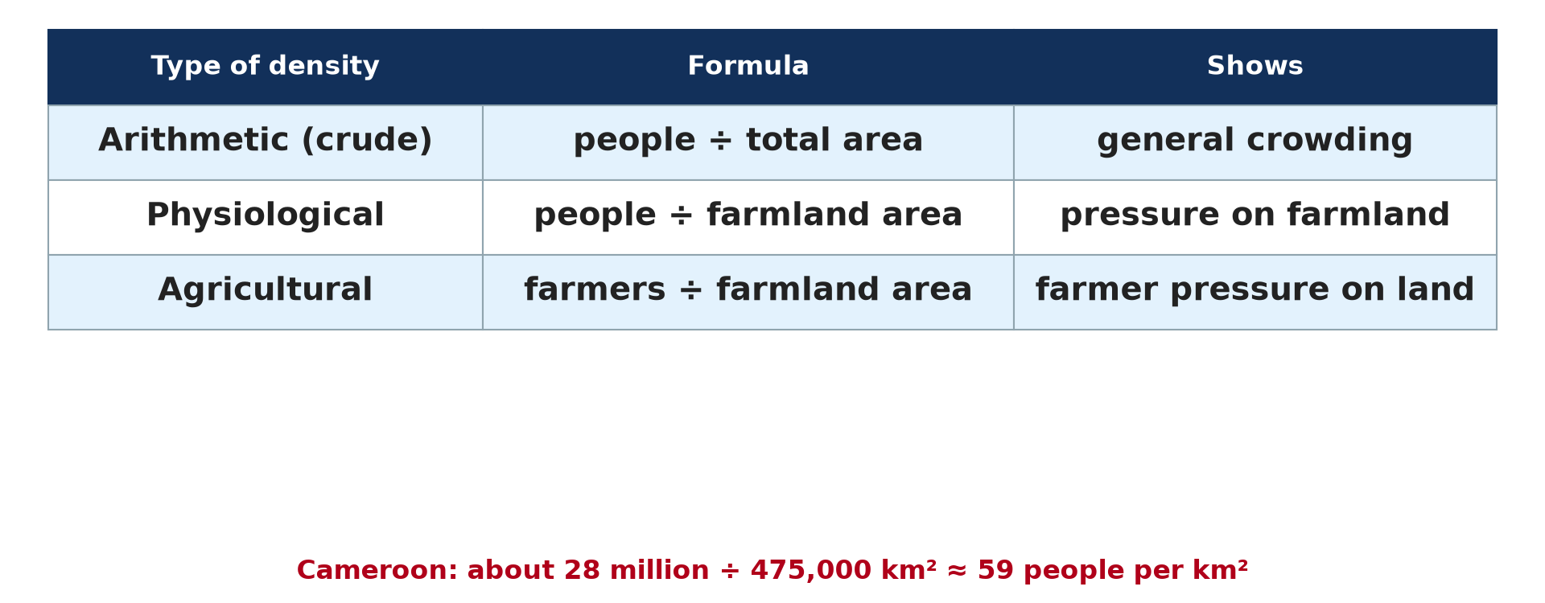
1. RECALL
Activity 1
The formula of density.
Notes:
Activity 1. Look carefully at this diagram: the formula of density. Observe every detail before I ask the question.

Slide 20
1. RECALL
Activity 1: Question
What is the formula of population density?
Notes:
Here is the question for Activity 1: What is the formula of population density? Take one minute to think and write your answer in your rough notebook.

Slide 21
1. RECALL
Activity 1: Answer
Population ÷ area, in people per km².
Notes:
Let us check the answer together. Population ÷ area, in people per km².

Slide 22
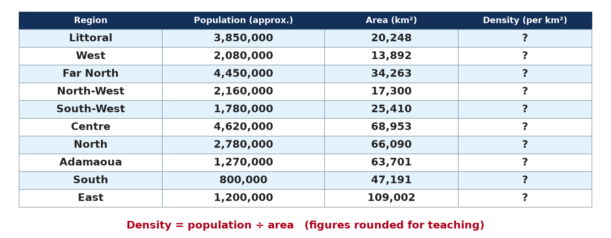
2. CALCULATION
Activity 2
Population and area of the regions (approximate).
Notes:
Activity 2. Look carefully at this diagram: population and area of the regions (approximate). Observe every detail before I ask the question.

Slide 23
2. CALCULATION
Activity 2: Question
Calculate the density of the Littoral.
Notes:
Here is the question for Activity 2: Calculate the density of the Littoral. Take one minute to think and write your answer in your rough notebook.

Slide 24
2. CALCULATION
Activity 2: Answer
3,850,000 ÷ 20,248 ≈ 190 people per km².
Notes:
Let us check the answer together. 3,850,000 ÷ 20,248 ≈ 190 people per km².

Slide 25
2. CALCULATION
Activity 3
Population and area of the regions (approximate).
Notes:
Activity 3. Look carefully at this diagram: population and area of the regions (approximate). Observe every detail before I ask the question.

Slide 26
2. CALCULATION
Activity 3: Question
Calculate the density of the East.
Notes:
Here is the question for Activity 3: Calculate the density of the East. Take one minute to think and write your answer in your rough notebook.

Slide 27
2. CALCULATION
Activity 3: Answer
1,200,000 ÷ 109,002 ≈ 11 people per km².
Notes:
Let us check the answer together. 1,200,000 ÷ 109,002 ≈ 11 people per km².

Slide 28

3. MAPPING
Activity 4
Density of the regions of Cameroon.
Notes:
Activity 4. Look carefully at this diagram: density of the regions of Cameroon. Observe every detail before I ask the question.

Slide 29
3. MAPPING
Activity 4: Question
Which regions have the darkest colour on this map?
Notes:
Here is the question for Activity 4: Which regions have the darkest colour on this map? Take one minute to think and write your answer in your rough notebook.

Slide 30
3. MAPPING
Activity 4: Answer
The Littoral, the West, the Far North and the North-West: they are the most densely populated.
Notes:
Let us check the answer together. The Littoral, the West, the Far North and the North-West: they are the most densely populated.

Slide 31

3. EXPLANATION
Activity 5
A village in the West Region.
Notes:
Activity 5. Look carefully at this picture: a village in the West Region. Observe every detail before I ask the question.

Slide 32
3. EXPLANATION
Activity 5: Question
Why is the West densely populated?
Notes:
Here is the question for Activity 5: Why is the West densely populated? Take one minute to think and write your answer in your rough notebook.

Slide 33
3. EXPLANATION
Activity 5: Answer
It has fertile volcanic soils, a cool climate and good roads.
Notes:
Let us check the answer together. It has fertile volcanic soils, a cool climate and good roads.

Slide 34
BOARD SUMMARY
Board Summary
Topic: Man in his Environment
Sub-topic: The World's Population
Practical Work 2: Population Densities in Cameroon
Notes:
Now we are going to copy the board summary. Write the title and the headings neatly in your notebooks. I will give you enough time for each slide, so do not rush.

Slide 35
BOARD SUMMARY
DEFINITIONS
The key terms of this lesson are defined as follows:
Population density: It is the number of people per km², calculated as population ÷ area.
Notes:
Let us copy the definitions. The key terms of this lesson are defined as follows. On this slide we have Population density. Write each point on a new line, with the key term first, and explain it in your own words when we revise.

Slide 36
BOARD SUMMARY
1. Calculation of Densities
The densities of the regions of Cameroon are calculated as follows (approximate):
Littoral: 3,850,000 ÷ 20,248 km² ≈ 190 people per km².
Illustration: population and area of the regions
Notes:
Let us copy Calculation of Densities. The densities of the regions of Cameroon are calculated as follows (approximate). Copy the point on Littoral on the left, then draw the diagram on the right: population and area of the regions. Give it a title and label it clearly.

Slide 37
BOARD SUMMARY
1. Calculation of Densities
West: 2,080,000 ÷ 13,892 km² ≈ 150 people per km².
North: 2,780,000 ÷ 66,090 km² ≈ 42 people per km².
East: 1,200,000 ÷ 109,002 km² ≈ 11 people per km².
Notes:
We continue with Calculation of Densities. On this slide we have West, North and East. Write each point on a new line, with the key term first, and explain it in your own words when we revise.

Slide 38
BOARD SUMMARY
2. Areas of Dense, Moderate and Low Density
The map of Cameroon shows the following areas:
High density (over 100 per km²): The Littoral, the West, the North-West and the Far North.
Illustration: density of the regions of Cameroon
Notes:
Let us copy Areas of Dense, Moderate and Low Density. The map of Cameroon shows the following areas. Copy the point on High density (over 100 per km²) on the left, then draw the diagram on the right: density of the regions of Cameroon. Give it a title and label it clearly.

Slide 39
BOARD SUMMARY
2. Areas of Dense, Moderate and Low Density
Moderate density (20 to 100 per km²): The Centre, the South-West and the North.
Low density (under 20 per km²): The East, the South and the Adamawa.
Notes:
We continue with Areas of Dense, Moderate and Low Density. On this slide we have Moderate density (20 to 100 per km²) and Low density (under 20 per km²). Write each point on a new line, with the key term first, and explain it in your own words when we revise.

Slide 40
FORMATIVE EVALUATION
Evaluation 1
A region has 900,000 people on 30,000 km². Find its density.
Notes:
Now let us check what you have understood. Question 1: A region has 900,000 people on 30,000 km². Find its density. Answer in your exercise book.

Slide 41
FORMATIVE EVALUATION
Expected Answer
900,000 ÷ 30,000 = 30 people per km².
Notes:
The expected answer is: 900,000 ÷ 30,000 = 30 people per km². If you got it right, well done.

Slide 42
FORMATIVE EVALUATION
Evaluation 2
Name the region with the lowest density.
Notes:
Now let us check what you have understood. Question 2: Name the region with the lowest density. Answer in your exercise book.

Slide 43
FORMATIVE EVALUATION
Expected Answer
The East.
Notes:
The expected answer is: the East. If you got it right, well done.

Slide 44
REMEDIATION
Remediation
Fill in the blanks:
A crowded region has a ______ density.
The East has a ______ density.
Density is given in people per ______.
Notes:
For those who need more practice, fill in the blanks in your exercise book. The answers are: number 1, high; number 2, low; number 3, km².

Slide 45
HOMEWORK
Homework
Calculate the density of the Far North: about 4,450,000 people on 34,263 km².
Notes:
For your homework: Calculate the density of the Far North: about 4,450,000 people on 34,263 km². We shall correct it at the beginning of our next lesson.

Slide 46
NEXT LESSON
Next Lesson
Our next lesson will be on:
Lesson 3: Man in the Equatorial Zone
Notes:
Our next lesson will be on Lesson 3: Man in the Equatorial Zone. Thank you for your attention, and see you next time.

Slide 47
BILINGUAL GAME
Bilingual Game (Jeu Bilingue)
English | Français
Region | La région
Density | La densité
Crowded | Surpeuplé
Empty | Vide
Map | La carte
Calculation | Le calcul
Notes:
Let us play the bilingual game. I say a word in English, and you give me the French word. Then we do the reverse.

Slide 48
LOGBOOK
Official Logbook (1/2)
Module / Topic | Man in his Environment
Lesson Title | Practical Work 2: Population Densities in Cameroon
Expected Learning Outcomes | Recall the notion of population density. Calculate the density of the regions of Cameroon. Identify areas of dense, moderate and low density on a map.
Competence | Learners are able to calculate and map the population densities of the regions of Cameroon.
Notes:
I record this information in the official logbook of the class after the lesson.

Slide 49
LOGBOOK
Official Logbook (2/2)
Matter Taught | DEFINITIONS; Calculation of Densities; Areas of Dense, Moderate and Low Density.
Evaluation | Formative evaluation and remediation exercise.
Homework | Calculate the density of the Far North: about 4,450,000 people on 34,263 km².
Enrolment / Present / Absent | ____ / ____ / ____
Achievement | To be completed after the lesson.
Notes:
I complete the second page of the logbook: the matter taught, the evaluation, the homework and the attendance.

Slide 50
TEACHER'S NOTE
Teacher's Note
Timing: Homework correction, plan, objectives 8 min | Recall, situation, action 10 min | 5 activities 30 min | Board summary (copying) 30 min | Evaluation, remediation 10 min | Homework, next lesson 5 min | Logbook 7 min
Without the projector (Activity 1): write the formula.
Without the projector (Activity 2): work it out on the board.
Without the projector (Activity 3): work it out on the board.
Without the projector (Activity 4): shade a map of the regions.
Without the projector (Activity 5): discuss the West Region.
Notes:
This slide is for me, the teacher: it gives the timing of the lesson and what to do if the projector is not available.

Slide 51
REFERENCES
References
Geography Syllabus, Forms I–V, MINESEC (2023) — Form 2, Module 1: Man in his Environment.
Photo, Activity 5: “Bandjoun's chefferie: I - the approach past the royal quarters” by 10b travelling / Carsten ten Brink, CC BY-NC-ND 2.0, via Flickr (https://www.flickr.com/photos/77334245@N00/7326237514)
Diagrams and animations: drawn for this lesson (Geography Department).
Notes:
These are the references and picture credits used to prepare this lesson.

