Slide 1
FORM 2 TECHNICAL
GEOGRAPHY
Lesson 4 (Part 4)
The Temperate Region: Problems Faced and Adaptations
Notes:
Good morning, class, and welcome to our geography lesson. I am your geography teacher, Mr Kamdem. Today we are starting Lesson 4 (Part 4): The Temperate Region: Problems Faced and Adaptations.

Slide 2
CLASS INFO
Class, Chapter and Duration
Class | Form 2 Technical
Chapter | Economic Geography — Natural Regions: 4. The Temperate Region
Duration | 2 periods (2 × 50 minutes)
Notes:
This lesson is for Form 2 Technical. It belongs to Economic Geography — Natural Regions: 4. The Temperate Region. We shall need 2 periods to cover it.

Slide 3
IDENTIFICATION
Lesson Identification
Topic | Man in His Environment
Sub-topic | Natural Regions
Lesson | Lesson 4 (Part 4): The Temperate Region: Problems Faced and Adaptations
Notions / Concepts | Frost, snow, short growing season, drought, forest fire, shelterbelt, greenhouse.
Syllabus focus | Problems faced in the temperate region and the adaptations of people.
Competence | Learners are able to explain how people adapt their houses, clothes and farming to a difficult climate, and apply this idea to their own environment.
Notes:
Our topic is Man in His Environment, and the sub-topic is Natural Regions. The key notions we shall use today are: frost, snow, short growing season, drought, forest fire, shelterbelt, greenhouse. At the end, you should be able to do this: learners are able to explain how people adapt their houses, clothes and farming to a difficult climate, and apply this idea to their own environment.

Slide 4

HOMEWORK CORRECTION
Correction of the Homework
Question (Lesson 4 (Part 3): The Temperate Region: Human Activities (Farming)):
Ask an adult who has lived or travelled in Europe what difficulties people face in winter. Write down two of them.
Notes:
Before we start the new lesson, let us correct the homework I gave you at the end of Lesson 4 (Part 3): The Temperate Region: Human Activities (Farming). The question was: Ask an adult who has lived or travelled in Europe what difficulties people face in winter. Write down two of them. Take out your exercise books.

Slide 5
HOMEWORK CORRECTION
Correction: Possible Answer
Examples: snow and ice block roads and cause accidents; it is very cold, so people must pay for heating; days are short and dark; water pipes can freeze.
Notes:
Here is a good answer. Examples: snow and ice block roads and cause accidents; it is very cold, so people must pay for heating; days are short and dark; water pipes can freeze. Compare it with your own answer and correct your work in red.

Slide 6
LESSON PLAN
Lesson Plan
Correction of the homework
Objectives and recall
Real-life situation and action to take
Learning activities
Board summary
Evaluation, remediation and homework
Notes:
Here is the plan of our lesson today. First, we shall correct the homework. Then we shall look at the objectives and recall what you already know. After that, we shall study a situation from real life and the action to take, and do the learning activities. Finally, we shall copy the board summary, do the evaluation and the remediation, and I will give you the homework.

Slide 7
OBJECTIVES
Objectives
By the end of this lesson, you should be able to:
Identify the problems faced by people in the temperate region.
Describe how people adapt their houses, clothes and transport.
Notes:
Take your time to copy this part; we will continue together.

Slide 8
OBJECTIVES
Objectives (continued)
Describe how farmers adapt to the problems of the temperate climate.
Notes:
By the end of this lesson, you should be able to do three things. Number 1: identify the problems faced by people in the temperate region. Number 2: describe how people adapt their houses, clothes and transport. Number 3: describe how farmers adapt to the problems of the temperate climate.

Slide 9
PREVIOUS KNOWLEDGE
Previous Knowledge
Temperate farming includes mixed, dairy, grain, ranching and Mediterranean farming.
It is very productive thanks to machines, science and cooperatives.
Notes:
Let us first remember what you already know. Temperate farming includes mixed, dairy, grain, ranching and Mediterranean farming. It is very productive thanks to machines, science and cooperatives. Keep this in mind, because we shall build on it today.

Slide 10
REAL-LIFE SITUATION
Situation in Real Life
In January, heavy snow falls on a village in Canada. The roads are blocked, the water pipes freeze and the farmer cannot take his cows out. The farmer asks: "How can we live and farm with such a hard winter?"
Notes:
Listen carefully to this situation from real life. In January, heavy snow falls on a village in Canada. The roads are blocked, the water pipes freeze and the farmer cannot take his cows out. The farmer asks: "How can we live and farm with such a hard winter?" Think about it, because I am going to ask you some questions.

Slide 11
REAL-LIFE SITUATION
Situation: Question 1
What is the problem in the situation?
Notes:
Question 1: What is the problem in the situation? Think for a moment, then raise your hand to answer.

Slide 12
REAL-LIFE SITUATION
Answer
The farmer faces the problems of winter and must adapt.
Notes:
Good. The farmer faces the problems of winter and must adapt.

Slide 13
REAL-LIFE SITUATION
Situation: Question 2
What blocks the roads?
Notes:
Question 2: What blocks the roads? Think for a moment, then raise your hand to answer.

Slide 14
REAL-LIFE SITUATION
Answer
Snow.
Notes:
Good. Snow.

Slide 15
REAL-LIFE SITUATION
Situation: Question 3
What happens to the water pipes?
Notes:
Question 3: What happens to the water pipes? Think for a moment, then raise your hand to answer.

Slide 16
REAL-LIFE SITUATION
Possible Answer
They freeze.
Notes:
Good. They freeze.

Slide 17
ACTION TO TAKE
Action to Take
Protect the soil from wind with lines of trees, as temperate farmers do.
Notes:
From this situation, the action we are working towards in this lesson is the following: protect the soil from wind with lines of trees, as temperate farmers do.

Slide 18
JUSTIFICATION
Justification of the Lesson
This lesson helps us to know the problems of the temperate region and how people adapt.
Notes:
Why is this lesson important for you? This lesson helps us to know the problems of the temperate region and how people adapt.

Slide 19
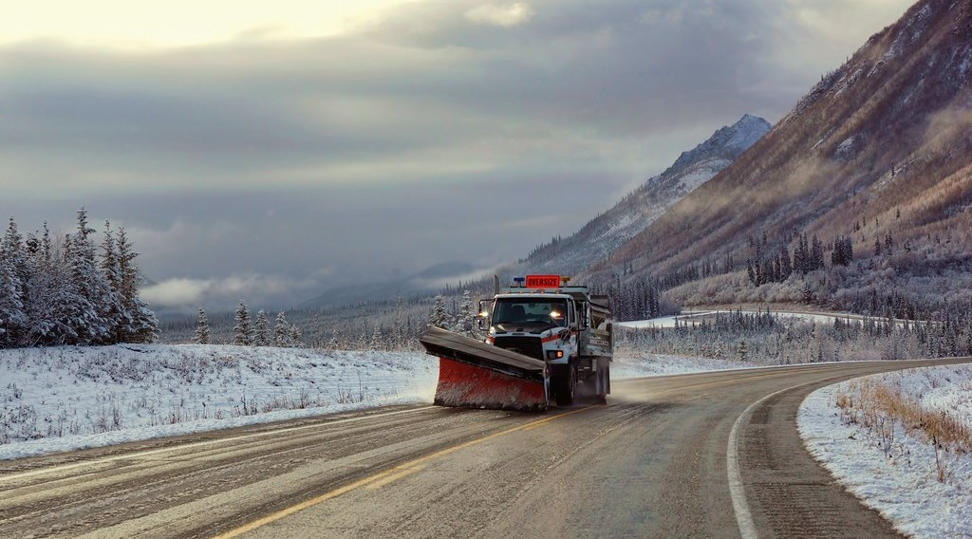
1. PROBLEMS FACED
Activity 1
A machine on a snowy road.
Notes:
Activity 1. Look carefully at this picture: a machine on a snowy road. Observe every detail before I ask the question.

Slide 20
1. PROBLEMS FACED
Activity 1: Question
How do people clear roads blocked by snow?
Notes:
Here is the question for Activity 1: How do people clear roads blocked by snow? Take one minute to think and write your answer in your rough notebook.

Slide 21
1. PROBLEMS FACED
Activity 1: Answer
With machines (snowploughs).
Notes:
Let us check the answer together. With machines (snowploughs).

Slide 22
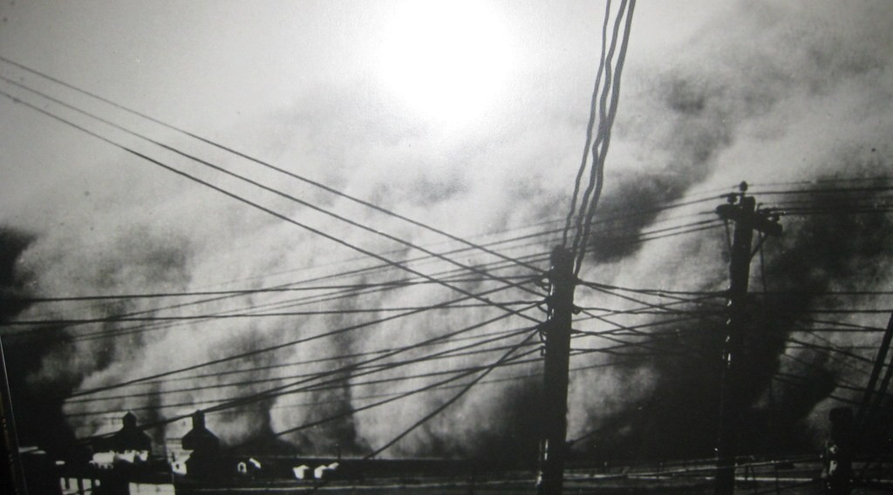
1. PROBLEMS FACED
Activity 2
A dust storm on farms.
Notes:
Activity 2. Look carefully at this picture: a dust storm on farms. Observe every detail before I ask the question.

Slide 23
1. PROBLEMS FACED
Activity 2: Question
What did the wind do to the dry soil of these farms?
Notes:
Here is the question for Activity 2: What did the wind do to the dry soil of these farms? Take one minute to think and write your answer in your rough notebook.

Slide 24
1. PROBLEMS FACED
Activity 2: Answer
It blew it away.
Notes:
Let us check the answer together. It blew it away.

Slide 25
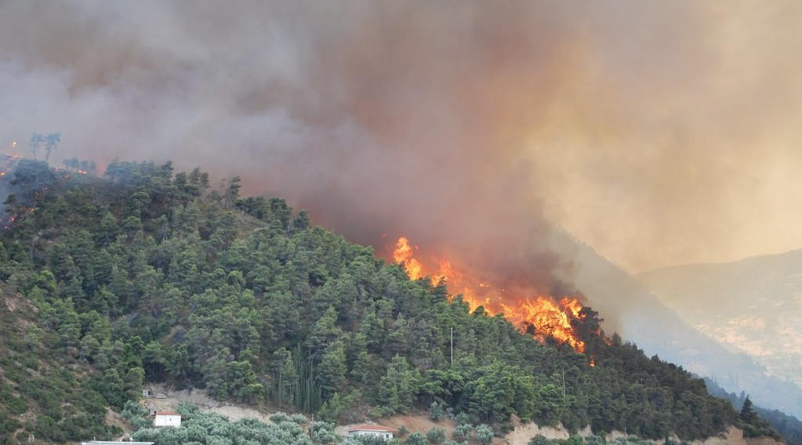
1. PROBLEMS FACED
Activity 3
A forest fire.
Notes:
Activity 3. Look carefully at this picture: a forest fire. Observe every detail before I ask the question.

Slide 26
1. PROBLEMS FACED
Activity 3: Question
Why are there forest fires in Mediterranean summers?
Notes:
Here is the question for Activity 3: Why are there forest fires in Mediterranean summers? Take one minute to think and write your answer in your rough notebook.

Slide 27
1. PROBLEMS FACED
Activity 3: Answer
Summers are hot and dry, so plants burn easily.
Notes:
Let us check the answer together. Summers are hot and dry, so plants burn easily.

Slide 28
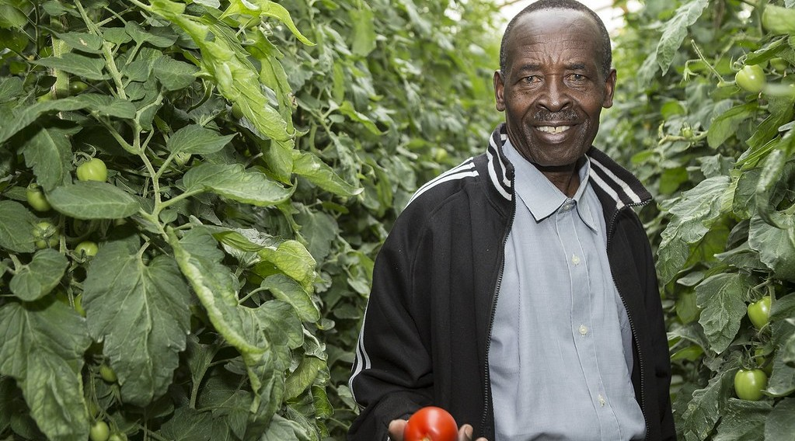
2. ADAPTATIONS
Activity 4
A greenhouse.
Notes:
Activity 4. Look carefully at this picture: a greenhouse. Observe every detail before I ask the question.

Slide 29
2. ADAPTATIONS
Activity 4: Question
How can farmers grow vegetables when it is too cold outside?
Notes:
Here is the question for Activity 4: How can farmers grow vegetables when it is too cold outside? Take one minute to think and write your answer in your rough notebook.

Slide 30
2. ADAPTATIONS
Activity 4: Answer
In greenhouses, where it is warm.
Notes:
Let us check the answer together. In greenhouses, where it is warm.

Slide 31
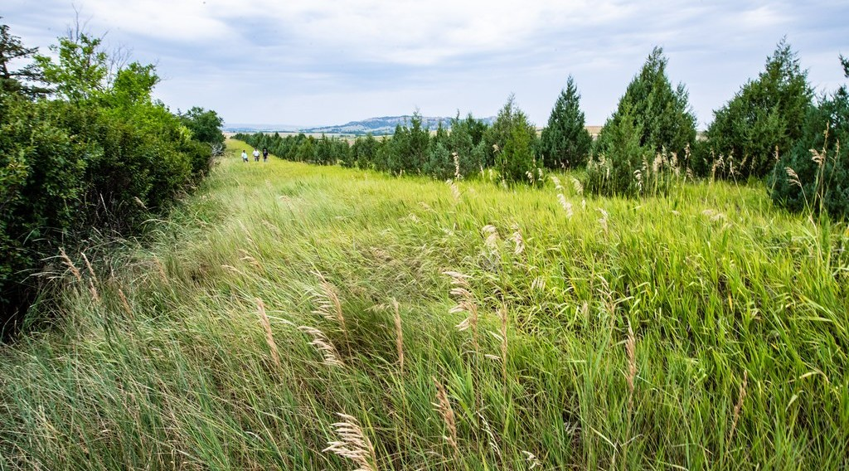
2. ADAPTATIONS
Activity 5
Lines of trees around fields.
Notes:
Activity 5. Look carefully at this picture: lines of trees around fields. Observe every detail before I ask the question.

Slide 32
2. ADAPTATIONS
Activity 5: Question
Why do farmers plant lines of trees around their fields?
Notes:
Here is the question for Activity 5: Why do farmers plant lines of trees around their fields? Take one minute to think and write your answer in your rough notebook.

Slide 33
2. ADAPTATIONS
Activity 5: Answer
To stop the wind from blowing the soil away.
Notes:
Let us check the answer together. To stop the wind from blowing the soil away.

Slide 34
BOARD SUMMARY
Board Summary
Topic: Man in His Environment
Sub-topic: Natural Regions
Lesson 4 (Part 4): The Temperate Region: Problems Faced and Adaptations
Notes:
Now we are going to copy the board summary. Write the title and the headings neatly in your notebooks. I will give you enough time for each slide, so do not rush.

Slide 35
BOARD SUMMARY
DEFINITIONS
The key terms of this lesson are defined as follows:
Greenhouse: It is a glass or plastic house where plants are grown in warm conditions.
Shelter belt: It is a line of trees that protects fields from the wind.
Notes:
Let us copy the definitions. The key terms of this lesson are defined as follows. On this slide we have Greenhouse and Shelter belt. Write each point on a new line, with the key term first, and explain it in your own words when we revise.

Slide 36
BOARD SUMMARY
1. Problems Faced
People in the temperate region face the following problems:
Cold winters: Snow and ice block roads and freeze pipes.
Illustration: clearing snow
Notes:
Let us copy Problems Faced. People in the temperate region face the following problems. Copy the point on Cold winters on the left, then draw the diagram on the right: clearing snow. Give it a title and label it clearly.

Slide 37
BOARD SUMMARY
1. Problems Faced
Short growing season: Crops cannot grow in winter.
Soil erosion by wind: Dry soil is blown away, as in the Dust Bowl.
Notes:
We continue with Problems Faced. On this slide we have Short growing season and Soil erosion by wind. Write each point on a new line, with the key term first, and explain it in your own words when we revise.

Slide 38
BOARD SUMMARY
1. Problems Faced
Summer droughts and fires: Hot, dry summers in Mediterranean lands.
Illustration: a forest fire
Notes:
Copy the point on Summer droughts and fires on the left, then draw the diagram on the right: a forest fire. Give it a title and label it clearly.

Slide 39
BOARD SUMMARY
2. Adaptations
People adapt in the following ways:
Houses: Heated houses with thick walls and double windows.
Clothes: Thick coats, gloves and boots in winter.
Notes:
Let us copy Adaptations. People adapt in the following ways. On this slide we have Houses and Clothes. Write each point on a new line, with the key term first, and explain it in your own words when we revise. When you finish, we go to the next slide.

Slide 40
BOARD SUMMARY
2. Adaptations (continued)
Transport: Snowploughs and salt on the roads.
Notes:
We continue with Adaptations. On this slide we have Transport. Write each point on a new line, with the key term first, and explain it in your own words when we revise.

Slide 41
BOARD SUMMARY
2. Adaptations
Greenhouses: Vegetables grow in warm glasshouses.
Illustration: a greenhouse
Notes:
Copy the point on Greenhouses on the left, then draw the diagram on the right: a greenhouse. Give it a title and label it clearly.

Slide 42
BOARD SUMMARY
2. Adaptations
Shelter belts and irrigation: Trees stop the wind, and irrigation helps in summer.
Illustration: a shelter belt
Notes:
Copy the point on Shelter belts and irrigation on the left, then draw the diagram on the right: a shelter belt. Give it a title and label it clearly.

Slide 43
FORMATIVE EVALUATION
Evaluation 1
Give two problems of the temperate region.
Notes:
Now let us check what you have understood. Question 1: Give two problems of the temperate region. Answer in your exercise book.

Slide 44
FORMATIVE EVALUATION
Expected Answer
Cold winters with snow; soil erosion by wind.
Notes:
The expected answer is: cold winters with snow; soil erosion by wind. If you got it right, well done.

Slide 45
FORMATIVE EVALUATION
Evaluation 2
How can farmers grow vegetables in winter?
Notes:
Now let us check what you have understood. Question 2: How can farmers grow vegetables in winter? Answer in your exercise book.

Slide 46
FORMATIVE EVALUATION
Expected Answer
In greenhouses.
Notes:
The expected answer is: in greenhouses. If you got it right, well done.

Slide 47
REMEDIATION
Remediation
Fill in the blanks:
A glass house for plants is a ______.
A line of trees that stops the wind is a ______.
The 1930s disaster in the USA was the Dust ______.
Notes:
For those who need more practice, fill in the blanks in your exercise book. The answers are: number 1, greenhouse; number 2, shelterbelt; number 3, Bowl.

Slide 48
HOMEWORK
Homework
List five jobs done by people in your family or neighbourhood (for example farmer, trader, teacher, mechanic, tailor).
Notes:
For your homework: List five jobs done by people in your family or neighbourhood (for example farmer, trader, teacher, mechanic, tailor). We shall correct it at the beginning of our next lesson.

Slide 49
NEXT LESSON
Next Lesson
Our next lesson will be on:
Lesson 5 (Part 1): The Sectors of the Economy: Introduction, Definitions and Key Concepts
Notes:
Our next lesson will be on Lesson 5 (Part 1): The Sectors of the Economy: Introduction, Definitions and Key Concepts. Thank you for your attention, and see you next time.

Slide 50
BILINGUAL GAME
Bilingual Game (Jeu Bilingue)
English | Français
Frost | Le gel
Snow | La neige
Greenhouse | La serre
Heating | Le chauffage
Forest fire | L'incendie de forêt
Flood | L'inondation
Shelterbelt | Le brise-vent
Pollution | La pollution
Notes:
Let us play the bilingual game. I say a word in English, and you give me the French word. Then we do the reverse.

Slide 51
LOGBOOK
Official Logbook (1/2)
Module / Topic | Man in His Environment
Lesson Title | Lesson 4 (Part 4): The Temperate Region: Problems Faced and Adaptations
Expected Learning Outcomes | Identify the problems faced by people in the temperate region. Describe how people adapt their houses, clothes and transport. Describe how farmers adapt to the problems of the temperate climate.
Competence | Learners are able to explain how people adapt their houses, clothes and farming to a difficult climate, and apply this idea to their own environment.
Notes:
I record this information in the official logbook of the class after the lesson.

Slide 52
LOGBOOK
Official Logbook (2/2)
Matter Taught | DEFINITIONS; Problems Faced; Adaptations.
Evaluation | Formative evaluation and remediation exercise.
Homework | List five jobs done by people in your family or neighbourhood (for example farmer, trader, teacher, mechanic, tailor).
Enrolment / Present / Absent | ____ / ____ / ____
Achievement | To be completed after the lesson.
Notes:
I complete the second page of the logbook: the matter taught, the evaluation, the homework and the attendance.

Slide 53
TEACHER'S NOTE
Teacher's Note
Timing: Homework correction, plan, objectives 8 min | Recall, situation, action 10 min | 5 activities 30 min | Board summary (copying) 30 min | Evaluation, remediation 10 min | Homework, next lesson 5 min | Logbook 7 min
Without the projector (Activity 1): describe a blocked road.
Without the projector (Activity 2): describe dust in the Harmattan.
Without the projector (Activity 3): compare with bush fires.
Without the projector (Activity 4): describe a closed car in the sun.
Without the projector (Activity 5): describe a hedge.
Notes:
This slide is for me, the teacher: it gives the timing of the lesson and what to do if the projector is not available.

Slide 54
REFERENCES
References
Harmonised Progression Sheet, Economic Geography (5051), Form 2.
Class textbook: The major biomes of the world (temperate regions).
Photo, Activity 1: “First Snowplow of the Season” by JLS Photography - Alaska, CC BY-NC-ND 2.0, via Flickr (https://www.flickr.com/photos/50830796@N04/37613240186)
Photo, Activity 2: “Dust Bowl 1935” by MyEyeSees, CC BY-NC-ND 2.0, via Flickr (https://www.flickr.com/photos/57884042@N00/3182214903)
Photo, Activity 3: “Forest Fires in Greece” by Lotus R, CC BY-SA 2.0, via Flickr (https://www.flickr.com/photos/66012345@N00/964251167)
Photo, Activity 4: “Inside the Greenhouse” by USAID_IMAGES, CC BY-NC-ND 2.0, via Flickr (https://www.flickr.com/photos/46658241@N06/15000160655)
Photo, Activity 5: “20210723-NRCS-LSC-0128” by USDAgov, Public domain 1.0, via Flickr (https://www.flickr.com/photos/41284017@N08/51526578960)
Diagrams and animations: drawn for this lesson (Geography Department).
Notes:
These are the references and picture credits used to prepare this lesson.

