Slide 1
FORM 4
GEOGRAPHY
Lesson 3
Great Circles and the International Date Line
Notes:
Good morning, class, and welcome to our geography lesson. I am your geography teacher, Mr Kamdem. Today we are starting Lesson 3: Great Circles and the International Date Line.

Slide 2
CLASS INFO
Class, Chapter and Duration
Class | Form 4
Chapter | The Earth as a Planet in the Solar System — Location and Time
Duration | 50 minutes
Notes:
This lesson is for Form 4. It belongs to The Earth as a Planet in the Solar System — Location and Time. We shall need 50 minutes to cover it.

Slide 3
IDENTIFICATION
Lesson Identification
Topic | The Earth as a Planet in the Solar System
Sub-topic | Location and Time
Lesson | Lesson 3: Great Circles and the International Date Line
Notions / Concepts | Great circle, small circle, shortest route, date line.
Syllabus focus | Great circles and the International Date Line: meaning, illustrations and importance.
Competence | Learners are able to explain why aeroplanes follow curved routes, and why the date changes when people cross the Pacific Ocean.
Notes:
Our topic is The Earth as a Planet in the Solar System, and the sub-topic is Location and Time. The key notions we shall use today are: great circle, small circle, shortest route, date line. At the end, you should be able to do this: learners are able to explain why aeroplanes follow curved routes, and why the date changes when people cross the Pacific Ocean.

Slide 4

HOMEWORK CORRECTION
Correction of the Homework
Question (Lesson 2: Earth Divisions: Latitudes and Longitudes):
Watch or listen to news about a flight from Douala to Paris or to Dubai. Write the name of the route and ask an adult why aeroplanes do not always fly in a straight line on a flat map.
Notes:
Before we start the new lesson, let us correct the homework I gave you at the end of Lesson 2: Earth Divisions: Latitudes and Longitudes. The question was: Watch or listen to news about a flight from Douala to Paris or to Dubai. Write the name of the route and ask an adult why aeroplanes do not always fly in a straight line on a flat map. Take out your exercise books.

Slide 5
HOMEWORK CORRECTION
Correction: Possible Answer
Example: Douala–Paris flies north over the Sahara and the Mediterranean. Aeroplanes follow the curved Earth: the shortest route is a great circle, which looks curved on a flat map.
Notes:
Here is a good answer. Example: Douala–Paris flies north over the Sahara and the Mediterranean. Aeroplanes follow the curved Earth: the shortest route is a great circle, which looks curved on a flat map. Compare it with your own answer and correct your work in red.

Slide 6
LESSON PLAN
Lesson Plan
Correction of the homework
Objectives and recall
Real-life situation and action to take
Learning activities
Board summary
Evaluation, remediation and homework
Notes:
Here is the plan of our lesson today. First, we shall correct the homework. Then we shall look at the objectives and recall what you already know. After that, we shall study a situation from real life and the action to take, and do the learning activities. Finally, we shall copy the board summary, do the evaluation and the remediation, and I will give you the homework.

Slide 7
OBJECTIVES
Objectives
By the end of this lesson, you should be able to:
Define a great circle and a small circle, with examples.
Give the importance of great circles.
Notes:
Take your time to copy this part; we will continue together.

Slide 8
OBJECTIVES
Objectives (continued)
Describe the International Date Line and explain its importance.
Notes:
By the end of this lesson, you should be able to do three things. Number 1: define a great circle and a small circle, with examples. Number 2: give the importance of great circles. Number 3: describe the International Date Line and explain its importance.

Slide 9
PREVIOUS KNOWLEDGE
Previous Knowledge
Latitudes are parallel lines; the Equator is the longest.
Longitudes meet at the poles.
The 180° meridian is opposite the Prime Meridian.
Notes:
Let us first remember what you already know. Latitudes are parallel lines; the Equator is the longest. Longitudes meet at the poles. The 180° meridian is opposite the Prime Meridian. Keep this in mind, because we shall build on it today.

Slide 10
REAL-LIFE SITUATION
Situation in Real Life
On 31 December, Fatimé watches the news: in the afternoon, people in Australia are already celebrating the New Year, but after midnight in Garoua, people in America are still waiting. She asks: "Why does the New Year not start at the same time everywhere, and where does a new day begin?"
Notes:
Listen carefully to this situation from real life. On 31 December, Fatimé watches the news: in the afternoon, people in Australia are already celebrating the New Year, but after midnight in Garoua, people in America are still waiting. She asks: "Why does the New Year not start at the same time everywhere, and where does a new day begin?" Think about it, because I am going to ask you some questions.

Slide 11
REAL-LIFE SITUATION
Situation: Question 1
What is the problem in the situation?
Notes:
Question 1: What is the problem in the situation? Think for a moment, then raise your hand to answer.

Slide 12
REAL-LIFE SITUATION
Answer
Fatimé does not understand why the New Year comes at different times and where a new day begins.
Notes:
Good. Fatimé does not understand why the New Year comes at different times and where a new day begins.

Slide 13
REAL-LIFE SITUATION
Situation: Question 2
Which country celebrates before Cameroon?
Notes:
Question 2: Which country celebrates before Cameroon? Think for a moment, then raise your hand to answer.

Slide 14
REAL-LIFE SITUATION
Answer
Australia (and New Zealand).
Notes:
Good. Australia (and New Zealand).

Slide 15
REAL-LIFE SITUATION
Situation: Question 3
Which line decides where a new day begins?
Notes:
Question 3: Which line decides where a new day begins? Think for a moment, then raise your hand to answer.

Slide 16
REAL-LIFE SITUATION
Possible Answer
The International Date Line.
Notes:
Good. The International Date Line.

Slide 17
ACTION TO TAKE
Action to Take
Use great circles to understand routes and the Date Line to understand the change of date.
Notes:
From this situation, the action we are working towards in this lesson is the following: use great circles to understand routes and the Date Line to understand the change of date.

Slide 18
JUSTIFICATION
Justification of the Lesson
This lesson helps us to know great circles and the line where each new day begins.
Notes:
Why is this lesson important for you? This lesson helps us to know great circles and the line where each new day begins.

Slide 19
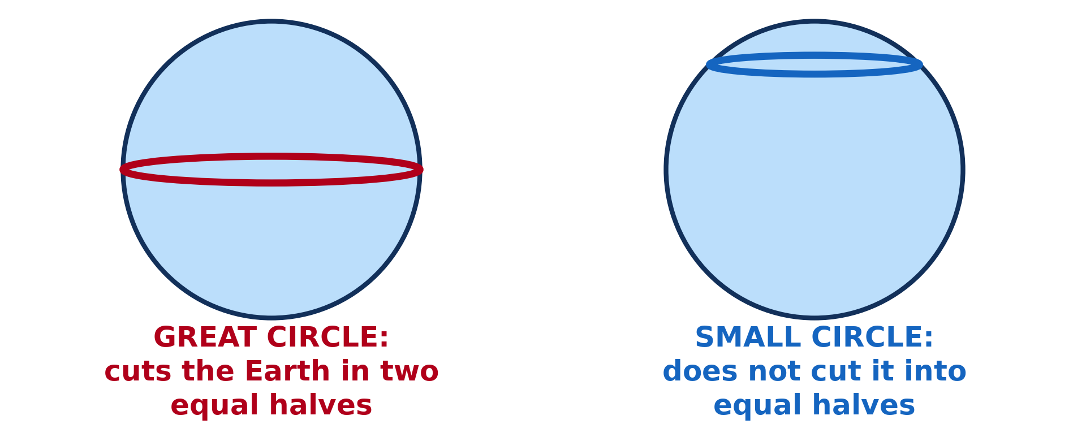
1. GREAT CIRCLES
Activity 1
A great circle and a small circle.
Notes:
Activity 1. Look carefully at this diagram: a great circle and a small circle. Observe every detail before I ask the question.

Slide 20
1. GREAT CIRCLES
Activity 1: Question
Which circle cuts the Earth into two equal halves?
Notes:
Here is the question for Activity 1: Which circle cuts the Earth into two equal halves? Take one minute to think and write your answer in your rough notebook.

Slide 21
1. GREAT CIRCLES
Activity 1: Answer
The great circle, like the Equator.
Notes:
Let us check the answer together. The great circle, like the Equator.

Slide 22
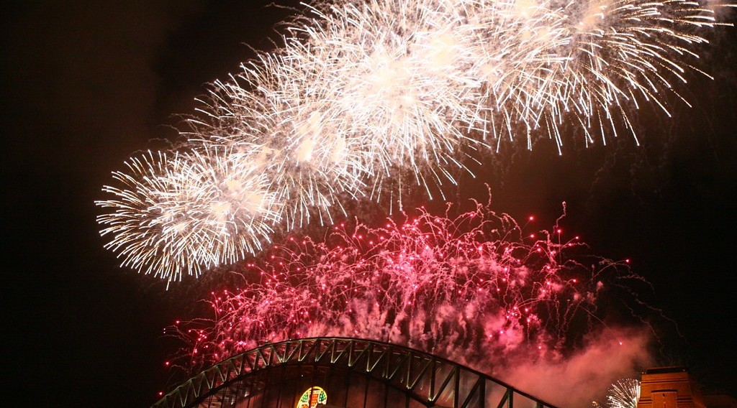
2. THE INTERNATIONAL DATE LINE
Activity 2
New Year fireworks in Sydney, Australia.
Notes:
Activity 2. Look carefully at this picture: new Year fireworks in Sydney, Australia. Observe every detail before I ask the question.

Slide 23
2. THE INTERNATIONAL DATE LINE
Activity 2: Question
Why does Australia see the New Year before Cameroon?
Notes:
Here is the question for Activity 2: Why does Australia see the New Year before Cameroon? Take one minute to think and write your answer in your rough notebook.

Slide 24
2. THE INTERNATIONAL DATE LINE
Activity 2: Answer
It is far to the east, near the Date Line where each new day begins.
Notes:
Let us check the answer together. It is far to the east, near the Date Line where each new day begins.

Slide 25

2. THE INTERNATIONAL DATE LINE
Activity 3
The International Date Line in the Pacific Ocean.
Notes:
Activity 3. Look carefully at this diagram: the International Date Line in the Pacific Ocean. Observe every detail before I ask the question.

Slide 26
2. THE INTERNATIONAL DATE LINE
Activity 3: Question
West of the line it is Monday. What day is it east of the line?
Notes:
Here is the question for Activity 3: West of the line it is Monday. What day is it east of the line? Take one minute to think and write your answer in your rough notebook.

Slide 27
2. THE INTERNATIONAL DATE LINE
Activity 3: Answer
Sunday: one day behind.
Notes:
Let us check the answer together. Sunday: one day behind.

Slide 28
BOARD SUMMARY
Board Summary
Topic: The Earth as a Planet in the Solar System
Sub-topic: Location and Time
Lesson 3: Great Circles and the International Date Line
Notes:
Now we are going to copy the board summary. Write the title and the headings neatly in your notebooks. I will give you enough time for each slide, so do not rush.

Slide 29
BOARD SUMMARY
DEFINITIONS
The key terms of this lesson are defined as follows:
Great circle: It is a circle on the surface of the Earth whose plane passes through the centre, cutting the Earth into two equal halves.
Notes:
Let us copy the definitions. The key terms of this lesson are defined as follows. On this slide we have Great circle. Write each point on a new line, with the key term first, and explain it in your own words when we revise. When you finish, we go to the next slide.

Slide 30
BOARD SUMMARY
DEFINITIONS (continued)
Small circle: It is a circle whose plane does not pass through the centre of the Earth.
International Date Line: It is the imaginary line, near the 180° meridian, where each new calendar day begins.
Notes:
We continue with the definitions. On this slide we have Small circle and International Date Line. Write each point on a new line, with the key term first, and explain it in your own words when we revise.

Slide 31
BOARD SUMMARY
1. Great Circles
A) Illustrations
Great and small circles are illustrated by the following examples:
The Equator: It is the only line of latitude that is a great circle.
Illustration: great and small circles
Notes:
Let us copy Illustrations. Great and small circles are illustrated by the following examples. Copy the point on The Equator on the left, then draw the diagram on the right: great and small circles. Give it a title and label it clearly.

Slide 32
BOARD SUMMARY
1. Great Circles
A) Illustrations
Meridians: Every meridian joined to its opposite meridian forms a great circle.
Small circles: The tropics, the polar circles and all other parallels are small circles.
Notes:
We continue with Illustrations. On this slide we have Meridians and Small circles. Write each point on a new line, with the key term first, and explain it in your own words when we revise.

Slide 33
BOARD SUMMARY
1. Great Circles
B) Importance
Great circles are important for the following reasons:
Shortest route: A great circle gives the shortest distance between two places on the Earth.
Notes:
Let us copy Importance. Great circles are important for the following reasons. On this slide we have Shortest route. Write each point on a new line, with the key term first, and explain it in your own words when we revise. When you finish, we go to the next slide.

Slide 34
BOARD SUMMARY
1. Great Circles
B) Importance (continued)
Air transport: Aeroplanes follow great circle routes to save time and fuel.
Sea transport: Ships follow great circle routes on long ocean journeys.
Day and night: The line between day and night on the Earth is a great circle.
Notes:
We continue with Importance. On this slide we have Air transport, Sea transport and Day and night. Write each point on a new line, with the key term first, and explain it in your own words when we revise.

Slide 35
BOARD SUMMARY
2. The International Date Line
A) Illustration
The International Date Line is placed as follows:
Position: It follows the 180° meridian in the Pacific Ocean.
Illustration: the International Date Line
Notes:
Let us copy Illustration. The International Date Line is placed as follows. Copy the point on Position on the left, then draw the diagram on the right: the International Date Line. Give it a title and label it clearly.

Slide 36
BOARD SUMMARY
2. The International Date Line
A) Illustration
Bends: It bends around islands and countries so that each country keeps one date.
Two dates: West of the line the date is one day ahead of the date east of the line.
Notes:
We continue with Illustration. On this slide we have Bends and Two dates. Write each point on a new line, with the key term first, and explain it in your own words when we revise.

Slide 37
BOARD SUMMARY
2. The International Date Line
B) Importance
The International Date Line is important for the following reasons:
Start of the day: It shows where each new calendar day begins on the Earth.
Crossing westwards: A traveller who crosses it going west adds one day.
Notes:
Let us copy Importance. The International Date Line is important for the following reasons. On this slide we have Start of the day and Crossing westwards. Write each point on a new line, with the key term first, and explain it in your own words when we revise. When you finish, we go to the next slide.

Slide 38
BOARD SUMMARY
2. The International Date Line
B) Importance (continued)
Crossing eastwards: A traveller who crosses it going east removes one day.
Correct dates: It allows travellers, ships and aeroplanes to keep the correct date.
Notes:
We continue with Importance. On this slide we have Crossing eastwards and Correct dates. Write each point on a new line, with the key term first, and explain it in your own words when we revise.

Slide 39
FORMATIVE EVALUATION
Evaluation 1
Is the Equator a great circle? Why?
Notes:
Now let us check what you have understood. Question 1: Is the Equator a great circle? Why? Answer in your exercise book.

Slide 40
FORMATIVE EVALUATION
Expected Answer
Yes. It cuts the Earth into two equal halves.
Notes:
The expected answer is: yes. It cuts the Earth into two equal halves. If you got it right, well done.

Slide 41
FORMATIVE EVALUATION
Evaluation 2
What happens to the date when we cross the Date Line going west?
Notes:
Now let us check what you have understood. Question 2: What happens to the date when we cross the Date Line going west? Answer in your exercise book.

Slide 42
FORMATIVE EVALUATION
Expected Answer
We add one day.
Notes:
The expected answer is: we add one day. If you got it right, well done.

Slide 43
REMEDIATION
Remediation
Fill in the blanks:
A circle that cuts the Earth into two equal halves is a ______ circle.
The International Date Line follows the ______ degree line.
Notes:
Take your time to copy this part; we will continue together.

Slide 44
REMEDIATION
Remediation (continued)
Crossing the line going west, we ______ one day.
Notes:
For those who need more practice, fill in the blanks in your exercise book. The answers are: number 1, great; number 2, 180th; number 3, add.

Slide 45
HOMEWORK
Homework
Bring an atlas, a ruler and a pencil to the next lesson. Find the map of Cameroon in your atlas.
Notes:
For your homework: Bring an atlas, a ruler and a pencil to the next lesson. Find the map of Cameroon in your atlas. We shall correct it at the beginning of our next lesson.

Slide 46
NEXT LESSON
Next Lesson
Our next lesson will be on:
Practical Work 1: Locate a Place on a Map
Notes:
Our next lesson will be on Practical Work 1: Locate a Place on a Map. Thank you for your attention, and see you next time.

Slide 47
BILINGUAL GAME
Bilingual Game (Jeu Bilingue)
English | Français
Great circle | Le grand cercle
Small circle | Le petit cercle
Shortest route | Le chemin le plus court
Date Line | La ligne de changement de date
Pacific Ocean | L'océan Pacifique
Date | La date
Day | Le jour
Traveller | Le voyageur
Notes:
Let us play the bilingual game. I say a word in English, and you give me the French word. Then we do the reverse.

Slide 48
LOGBOOK
Official Logbook (1/2)
Module / Topic | The Earth as a Planet in the Solar System
Lesson Title | Lesson 3: Great Circles and the International Date Line
Expected Learning Outcomes | Define a great circle and a small circle, with examples. Give the importance of great circles. Describe the International Date Line and explain its importance.
Competence | Learners are able to explain why aeroplanes follow curved routes, and why the date changes when people cross the Pacific Ocean.
Notes:
I record this information in the official logbook of the class after the lesson.

Slide 49
LOGBOOK
Official Logbook (2/2)
Matter Taught | DEFINITIONS; Illustrations; Importance; Illustration.
Evaluation | Formative evaluation and remediation exercise.
Homework | Bring an atlas, a ruler and a pencil to the next lesson. Find the map of Cameroon in your atlas.
Enrolment / Present / Absent | ____ / ____ / ____
Achievement | To be completed after the lesson.
Notes:
I complete the second page of the logbook: the matter taught, the evaluation, the homework and the attendance.

Slide 50
TEACHER'S NOTE
Teacher's Note
Timing: Homework correction, plan, objectives 4 min | Recall, situation, action 6 min | 3 activities 12 min | Board summary (copying) 15 min | Evaluation, remediation 5 min | Homework, next lesson 3 min | Logbook 5 min
Without the projector (Activity 1): cut an orange into two equal halves, then cut a small piece from the top.
Without the projector (Activity 2): ask learners who has seen the New Year on television.
Without the projector (Activity 3): draw a line and write MONDAY on the left and SUNDAY on the right.
Notes:
This slide is for me, the teacher: it gives the timing of the lesson and what to do if the projector is not available.

Slide 51
REFERENCES
References
National Geography Syllabus (MINESEC), Form 4 — The Earth as a Planet in the Solar System.
Teacher's lesson notes (Form 4), checked and corrected where necessary.
Photo, Activity 2: “New Year's Fireworks - Sydney Harbour” by Charlie Brewer, CC BY-NC-SA 2.0, via Flickr (https://www.flickr.com/photos/11827916@N00/2157381693)
Diagrams and animations: drawn for this lesson (Geography Department).
Notes:
These are the references and picture credits used to prepare this lesson.

