Slide 1
FORM 4
GEOGRAPHY
Lesson 33
Weather Elements: Humidity, Wind, Pressure and Sunshine
Notes:
Good morning, class, and welcome to our geography lesson. I am your geography teacher, Mr Kamdem. Today we are starting Lesson 33: Weather Elements: Humidity, Wind, Pressure and Sunshine.

Slide 2
CLASS INFO
Class, Chapter and Duration
Class | Form 4
Chapter | Module 3: Weather and Climate — Adaptation to Climatic Excesses
Duration | 50 minutes
Notes:
This lesson is for Form 4. It belongs to Module 3: Weather and Climate — Adaptation to Climatic Excesses. We shall need 50 minutes to cover it.

Slide 3
IDENTIFICATION
Lesson Identification
Topic | The Earth-Atmosphere System
Sub-topic | Measurement of Weather Elements
Lesson | Lesson 33: Weather Elements: Humidity, Wind, Pressure and Sunshine
Notions / Concepts | Humidity, wind direction, wind speed, atmospheric pressure, sunshine.
Syllabus focus | Atmospheric humidity; wind direction; wind speed; atmospheric pressure; amount of sunshine.
Competence | Learners are able to observe the humidity, wind and sky and predict simple changes in the weather around them.
Notes:
Our topic is The Earth-Atmosphere System, and the sub-topic is Measurement of Weather Elements. The key notions we shall use today are: humidity, wind direction, wind speed, atmospheric pressure, sunshine. At the end, you should be able to do this: learners are able to observe the humidity, wind and sky and predict simple changes in the weather around them.

Slide 4

HOMEWORK CORRECTION
Correction of the Homework
Question (Lesson 32: Weather Elements: Atmospheric Temperatures):
Wet a piece of cloth and hang it outside in the morning and in the afternoon. Note how long it takes to dry each time.
Notes:
Before we start the new lesson, let us correct the homework I gave you at the end of Lesson 32: Weather Elements: Atmospheric Temperatures. The question was: Wet a piece of cloth and hang it outside in the morning and in the afternoon. Note how long it takes to dry each time. Take out your exercise books.

Slide 5
HOMEWORK CORRECTION
Correction: Possible Answer
The cloth dries faster in the afternoon because the air is hotter and drier (lower humidity), so water evaporates faster.
Notes:
Here is a good answer. The cloth dries faster in the afternoon because the air is hotter and drier (lower humidity), so water evaporates faster. Compare it with your own answer and correct your work in red.

Slide 6
LESSON PLAN
Lesson Plan
Correction of the homework
Objectives and recall
Real-life situation and action to take
Learning activities
Board summary
Evaluation, remediation and homework
Notes:
Here is the plan of our lesson today. First, we shall correct the homework. Then we shall look at the objectives and recall what you already know. After that, we shall study a situation from real life and the action to take, and do the learning activities. Finally, we shall copy the board summary, do the evaluation and the remediation, and I will give you the homework.

Slide 7
OBJECTIVES
Objectives
By the end of this lesson, you should be able to:
Define humidity and relative humidity, and name their instrument.
Describe how wind direction and wind speed are measured.
Notes:
Take your time to copy this part; we will continue together.

Slide 8
OBJECTIVES
Objectives (continued)
Define atmospheric pressure and sunshine and name their instruments.
Notes:
By the end of this lesson, you should be able to do three things. Number 1: define humidity and relative humidity, and name their instrument. Number 2: describe how wind direction and wind speed are measured. Number 3: define atmospheric pressure and sunshine and name their instruments.

Slide 9
PREVIOUS KNOWLEDGE
Previous Knowledge
Temperature is measured with a thermometer inside a Stevenson screen.
Mean daily temperature = (maximum + minimum) ÷ 2.
Temperature data is shown with isotherms.
Notes:
Let us first remember what you already know. Temperature is measured with a thermometer inside a Stevenson screen. Mean daily temperature = (maximum + minimum) ÷ 2. Temperature data is shown with isotherms. Keep this in mind, because we shall build on it today.

Slide 10
REAL-LIFE SITUATION
Situation in Real Life
In August, Hadja's washing takes a whole day to dry and the air feels heavy. In January, during the Harmattan, the same clothes dry in less than one hour, and the wind comes from another direction. She asks: "What changes in the air between August and January, and how can we measure it?"
Notes:
Listen carefully to this situation from real life. In August, Hadja's washing takes a whole day to dry and the air feels heavy. In January, during the Harmattan, the same clothes dry in less than one hour, and the wind comes from another direction. She asks: "What changes in the air between August and January, and how can we measure it?" Think about it, because I am going to ask you some questions.

Slide 11
REAL-LIFE SITUATION
Situation: Question 1
What is the problem in the situation?
Notes:
Question 1: What is the problem in the situation? Think for a moment, then raise your hand to answer.

Slide 12
REAL-LIFE SITUATION
Answer
Hadja does not know which weather elements change and how they are measured.
Notes:
Good. Hadja does not know which weather elements change and how they are measured.

Slide 13
REAL-LIFE SITUATION
Situation: Question 2
When do clothes dry slowly?
Notes:
Question 2: When do clothes dry slowly? Think for a moment, then raise your hand to answer.

Slide 14
REAL-LIFE SITUATION
Answer
In August, in the rainy season.
Notes:
Good. In August, in the rainy season.

Slide 15
REAL-LIFE SITUATION
Situation: Question 3
Why do they dry fast in January?
Notes:
Question 3: Why do they dry fast in January? Think for a moment, then raise your hand to answer.

Slide 16
REAL-LIFE SITUATION
Possible Answer
The Harmattan air is dry.
Notes:
Good. The Harmattan air is dry.

Slide 17
ACTION TO TAKE
Action to Take
Use weather instruments carefully and record the readings every day.
Notes:
From this situation, the action we are working towards in this lesson is the following: use weather instruments carefully and record the readings every day.

Slide 18
JUSTIFICATION
Justification of the Lesson
This lesson helps us to know humidity, wind, pressure and sunshine.
Notes:
Why is this lesson important for you? This lesson helps us to know humidity, wind, pressure and sunshine.

Slide 19
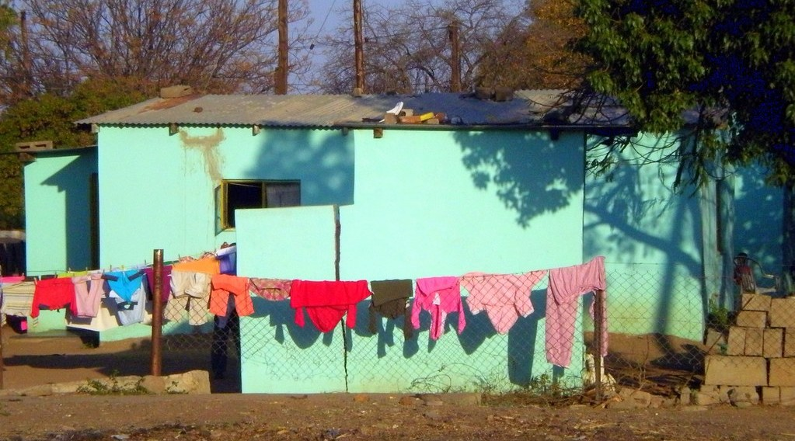
1. ATMOSPHERIC HUMIDITY
Activity 1
Washing hung out to dry.
Notes:
Activity 1. Look carefully at this picture: washing hung out to dry. Observe every detail before I ask the question.

Slide 20
1. ATMOSPHERIC HUMIDITY
Activity 1: Question
Why do clothes dry slowly when the air is wet?
Notes:
Here is the question for Activity 1: Why do clothes dry slowly when the air is wet? Take one minute to think and write your answer in your rough notebook.

Slide 21
1. ATMOSPHERIC HUMIDITY
Activity 1: Answer
The air already holds a lot of water vapour (high humidity).
Notes:
Let us check the answer together. The air already holds a lot of water vapour (high humidity).

Slide 22

2. WIND DIRECTION
Activity 2
A windsock at an airfield.
Notes:
Activity 2. Look carefully at this picture: a windsock at an airfield. Observe every detail before I ask the question.

Slide 23
2. WIND DIRECTION
Activity 2: Question
What does the windsock show?
Notes:
Here is the question for Activity 2: What does the windsock show? Take one minute to think and write your answer in your rough notebook.

Slide 24
2. WIND DIRECTION
Activity 2: Answer
The direction (and the force) of the wind.
Notes:
Let us check the answer together. The direction (and the force) of the wind.

Slide 25

4. ATMOSPHERIC PRESSURE
Activity 3
A barometer.
Notes:
Activity 3. Look carefully at this picture: a barometer. Observe every detail before I ask the question.

Slide 26
4. ATMOSPHERIC PRESSURE
Activity 3: Question
The barometer falls quickly. What weather can we expect?
Notes:
Here is the question for Activity 3: The barometer falls quickly. What weather can we expect? Take one minute to think and write your answer in your rough notebook.

Slide 27
4. ATMOSPHERIC PRESSURE
Activity 3: Answer
Rain or a storm.
Notes:
Let us check the answer together. Rain or a storm.

Slide 28
BOARD SUMMARY
Board Summary
Topic: The Earth-Atmosphere System
Sub-topic: Measurement of Weather Elements
Lesson 33: Weather Elements: Humidity, Wind, Pressure and Sunshine
Notes:
Now we are going to copy the board summary. Write the title and the headings neatly in your notebooks. I will give you enough time for each slide, so do not rush.

Slide 29
BOARD SUMMARY
DEFINITIONS
The key terms of this lesson are defined as follows:
Humidity: It is the amount of water vapour in the air.
Notes:
Let us copy the definitions. The key terms of this lesson are defined as follows. On this slide we have Humidity. Write each point on a new line, with the key term first, and explain it in your own words when we revise. When you finish, we go to the next slide.

Slide 30
BOARD SUMMARY
DEFINITIONS (continued)
Relative humidity: It is the amount of water vapour in the air compared with the maximum it can hold at that temperature, in per cent.
Wind: It is air moving from an area of high pressure to an area of low pressure.
Notes:
We continue with the definitions. On this slide we have Relative humidity and Wind. Write each point on a new line, with the key term first, and explain it in your own words when we revise. When you finish, we go to the next slide.

Slide 31
BOARD SUMMARY
DEFINITIONS (continued)
Atmospheric pressure: It is the weight of the air on the surface of the Earth.
Notes:
We continue with the definitions. On this slide we have Atmospheric pressure. Write each point on a new line, with the key term first, and explain it in your own words when we revise.

Slide 32
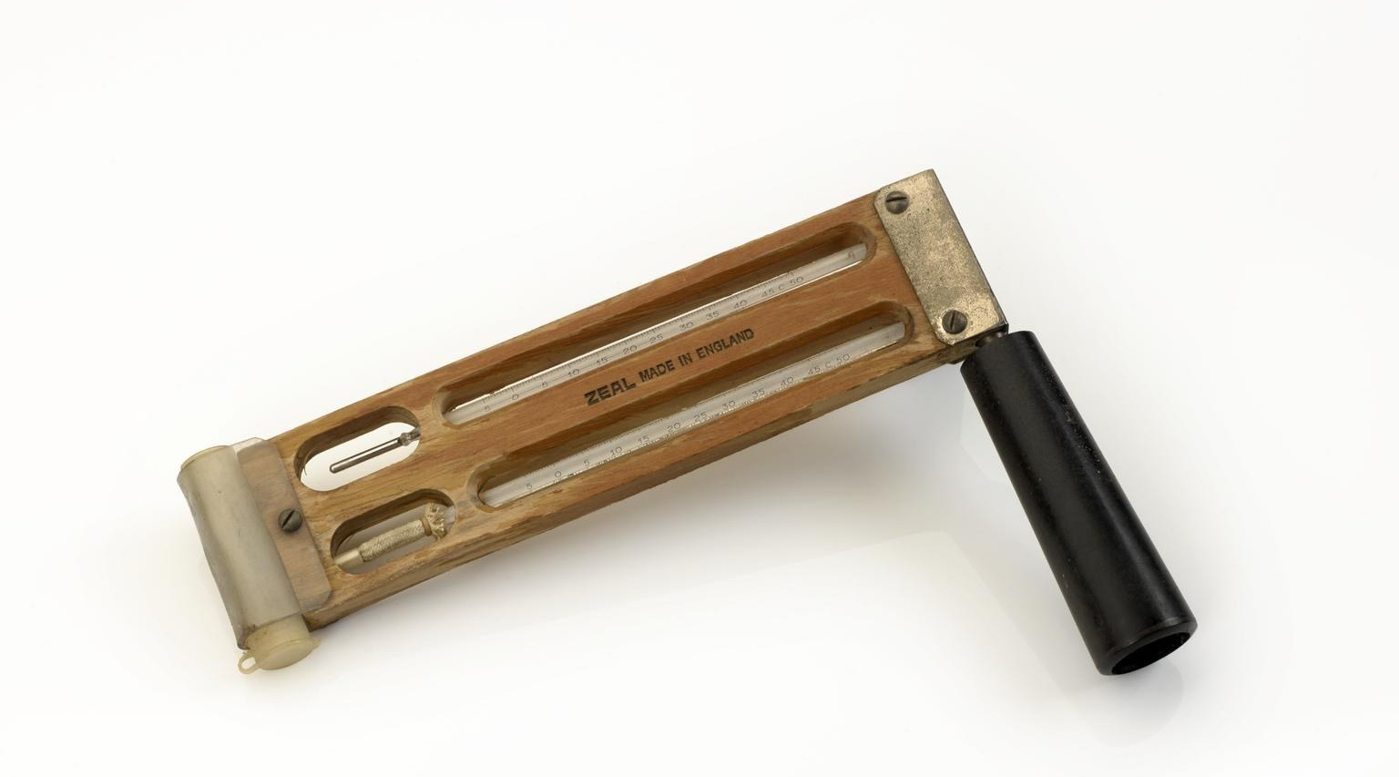
BOARD SUMMARY
1. Atmospheric Humidity
Humidity is measured and varies as follows:
Instrument: Humidity is measured with a hygrometer made of a wet-bulb and a dry-bulb thermometer.
Illustration: a hygrometer
Notes:
Let us copy Atmospheric Humidity. Humidity is measured and varies as follows. Copy the point on Instrument on the left, then draw the diagram on the right: a hygrometer. Give it a title and label it clearly.

Slide 33
BOARD SUMMARY
1. Atmospheric Humidity
Reading: The bigger the difference between the two thermometers, the drier the air.
Notes:
We continue with Atmospheric Humidity. On this slide we have Reading. Write each point on a new line, with the key term first, and explain it in your own words when we revise.

Slide 34
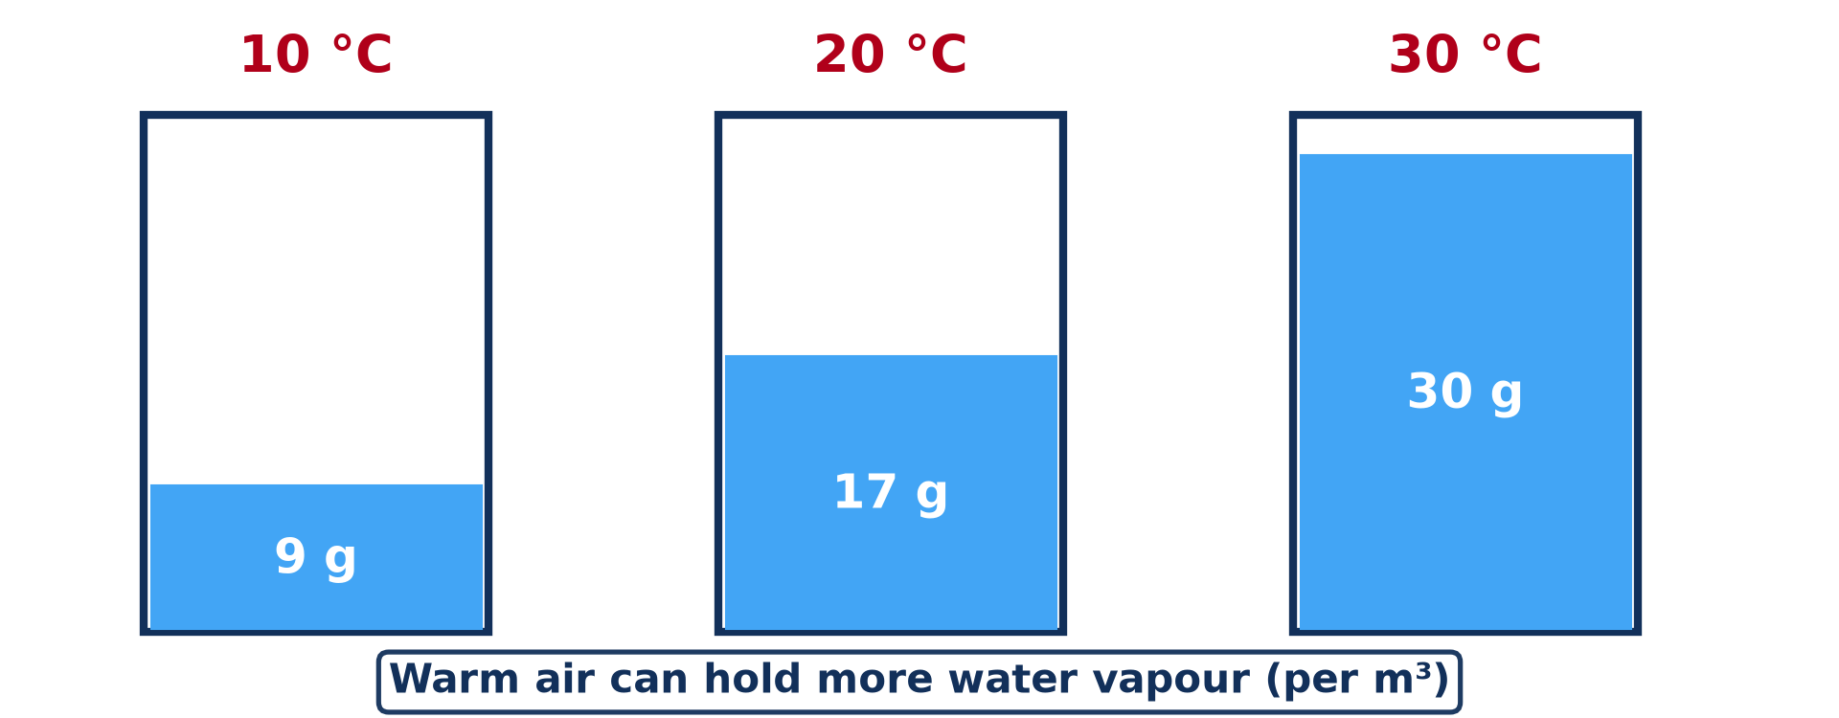
BOARD SUMMARY
1. Atmospheric Humidity
Temperature and humidity: Warm air can hold more water vapour than cold air.
Illustration: warm air holds more water vapour
Notes:
Copy the point on Temperature and humidity on the left, then draw the diagram on the right: warm air holds more water vapour. Give it a title and label it clearly.

Slide 35
BOARD SUMMARY
1. Atmospheric Humidity
Example: In Garoua, relative humidity is high in August and very low in January.
Notes:
We continue with Atmospheric Humidity. On this slide we have Example. Write each point on a new line, with the key term first, and explain it in your own words when we revise.

Slide 36
BOARD SUMMARY
2. Wind Direction
Wind direction is observed as follows:
Wind vane: Its arrow points to the direction from which the wind comes.
Notes:
Let us copy Wind Direction. Wind direction is observed as follows. On this slide we have Wind vane. Write each point on a new line, with the key term first, and explain it in your own words when we revise.

Slide 37
BOARD SUMMARY
2. Wind Direction
Windsock: It shows the direction and the force of the wind at airports.
Illustration: a windsock
Notes:
Copy the point on Windsock on the left, then draw the diagram on the right: a windsock. Give it a title and label it clearly.

Slide 38
BOARD SUMMARY
2. Wind Direction
Naming winds: A wind is named after the direction it comes from, for example the north-east Harmattan.
Wind rose: It is a diagram that shows how often the wind blows from each direction.
Notes:
We continue with Wind Direction. On this slide we have Naming winds and Wind rose. Write each point on a new line, with the key term first, and explain it in your own words when we revise.

Slide 39
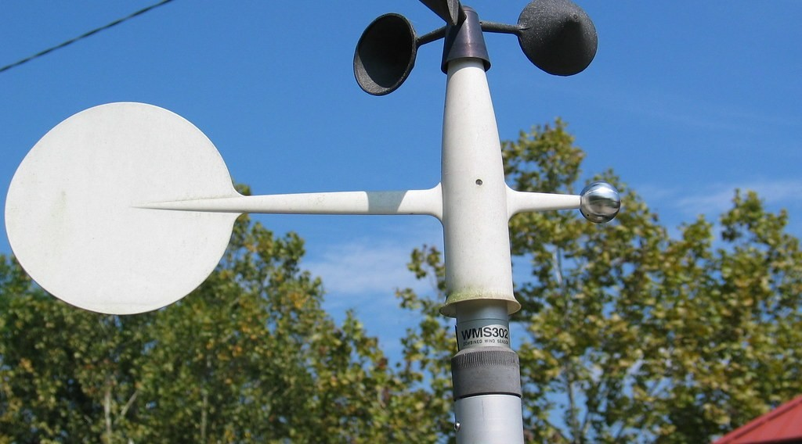
BOARD SUMMARY
3. Wind Speed
Wind speed is measured as follows:
Anemometer: Its cups turn faster when the wind is stronger.
Illustration: an anemometer
Notes:
Let us copy Wind Speed. Wind speed is measured as follows. Copy the point on Anemometer on the left, then draw the diagram on the right: an anemometer. Give it a title and label it clearly.

Slide 40
BOARD SUMMARY
3. Wind Speed
Units: Wind speed is given in km/h, m/s or knots.
Beaufort scale: It estimates wind force from 0 (calm) to 12 (hurricane) by observing smoke, trees and waves.
Notes:
We continue with Wind Speed. On this slide we have Units and Beaufort scale. Write each point on a new line, with the key term first, and explain it in your own words when we revise.

Slide 41
BOARD SUMMARY
4. Atmospheric Pressure
Air pressure is measured as follows:
Barometer: It measures air pressure in millibars; the mercury barometer and the aneroid barometer are the main types.
Illustration: a barometer
Notes:
Let us copy Atmospheric Pressure. Air pressure is measured as follows. Copy the point on Barometer on the left, then draw the diagram on the right: a barometer. Give it a title and label it clearly.

Slide 42
BOARD SUMMARY
4. Atmospheric Pressure
Average value: Normal pressure at sea level is about 1,013 mb.
Meaning of changes: Falling pressure brings clouds and rain, while rising pressure brings dry, fine weather.
Notes:
We continue with Atmospheric Pressure. On this slide we have Average value and Meaning of changes. Write each point on a new line, with the key term first, and explain it in your own words when we revise.

Slide 43
BOARD SUMMARY
5. Amount of Sunshine
Sunshine is measured as follows:
Sunshine recorder: A glass ball focuses the rays of the Sun and burns a line on a paper card.
Unit: Sunshine is given in hours per day.
Notes:
Let us copy Amount of Sunshine. Sunshine is measured as follows. On this slide we have Sunshine recorder and Unit. Write each point on a new line, with the key term first, and explain it in your own words when we revise. When you finish, we go to the next slide.

Slide 44
BOARD SUMMARY
5. Amount of Sunshine (continued)
Example: Garoua has many hours of sunshine in the dry season and fewer in the cloudy rainy season.
Notes:
We continue with Amount of Sunshine. On this slide we have Example. Write each point on a new line, with the key term first, and explain it in your own words when we revise.

Slide 45
FORMATIVE EVALUATION
Evaluation 1
What is humidity?
Notes:
Now let us check what you have understood. Question 1: What is humidity? Answer in your exercise book.

Slide 46
FORMATIVE EVALUATION
Expected Answer
The amount of water vapour in the air.
Notes:
The expected answer is: the amount of water vapour in the air. If you got it right, well done.

Slide 47
FORMATIVE EVALUATION
Evaluation 2
The Harmattan blows from the north-east. What is its name as a wind direction?
Notes:
Now let us check what you have understood. Question 2: The Harmattan blows from the north-east. What is its name as a wind direction? Answer in your exercise book.

Slide 48
FORMATIVE EVALUATION
Expected Answer
A north-easterly wind.
Notes:
The expected answer is: a north-easterly wind. If you got it right, well done.

Slide 49
REMEDIATION
Remediation
Fill in the blanks:
Humidity is measured with a ______.
Air pressure is measured with a ______.
A wind is named after the direction it comes ______.
Notes:
For those who need more practice, fill in the blanks in your exercise book. The answers are: number 1, hygrometer; number 2, barometer; number 3, from.

Slide 50
HOMEWORK
Homework
Early tomorrow morning, look at the grass, leaves or cars near your house. Write down whether you see drops of water on them, and where you think the water came from.
Notes:
For your homework: Early tomorrow morning, look at the grass, leaves or cars near your house. Write down whether you see drops of water on them, and where you think the water came from. We shall correct it at the beginning of our next lesson.

Slide 51
NEXT LESSON
Next Lesson
Our next lesson will be on:
Lesson 34: Condensation
Notes:
Our next lesson will be on Lesson 34: Condensation. Thank you for your attention, and see you next time.

Slide 52
BILINGUAL GAME
Bilingual Game (Jeu Bilingue)
English | Français
Humidity | L'humidité
Hygrometer | L'hygromètre
Wind direction | La direction du vent
Wind speed | La vitesse du vent
Pressure | La pression
Barometer | Le baromètre
Sunshine | L'ensoleillement
Isobar | L'isobare
Notes:
Let us play the bilingual game. I say a word in English, and you give me the French word. Then we do the reverse.

Slide 53
LOGBOOK
Official Logbook (1/2)
Module / Topic | The Earth-Atmosphere System
Lesson Title | Lesson 33: Weather Elements: Humidity, Wind, Pressure and Sunshine
Expected Learning Outcomes | Define humidity and relative humidity, and name their instrument. Describe how wind direction and wind speed are measured. Define atmospheric pressure and sunshine and name their instruments.
Competence | Learners are able to observe the humidity, wind and sky and predict simple changes in the weather around them.
Notes:
I record this information in the official logbook of the class after the lesson.

Slide 54
LOGBOOK
Official Logbook (2/2)
Matter Taught | DEFINITIONS; Atmospheric Humidity; Wind Direction; Wind Speed; Atmospheric Pressure; Amount of Sunshine.
Evaluation | Formative evaluation and remediation exercise.
Homework | Early tomorrow morning, look at the grass, leaves or cars near your house. Write down whether you see drops of water on them, and where you think the water came from.
Enrolment / Present / Absent | ____ / ____ / ____
Achievement | To be completed after the lesson.
Notes:
I complete the second page of the logbook: the matter taught, the evaluation, the homework and the attendance.

Slide 55
TEACHER'S NOTE
Teacher's Note
Timing: Homework correction, plan, objectives 4 min | Recall, situation, action 6 min | 3 activities 12 min | Board summary (copying) 15 min | Evaluation, remediation 5 min | Homework, next lesson 3 min | Logbook 5 min
Without the projector (Activity 1): compare drying in August and January.
Without the projector (Activity 2): hang a piece of cloth on a stick.
Without the projector (Activity 3): explain that low pressure brings rain.
Notes:
This slide is for me, the teacher: it gives the timing of the lesson and what to do if the projector is not available.

Slide 56
REFERENCES
References
National Geography Syllabus (MINESEC), Form 4 — Module 3: Weather and Climate.
Teacher's lesson notes (f4.docx), checked and corrected where necessary.
Photo, Activity 1: “Bright Blue Home” by Clav, CC BY-NC-SA 2.0, via Flickr (https://www.flickr.com/photos/37005711@N00/2797194021)
Photo, Activity 2: “Windsock” by Wajahat Mahmood, CC BY-SA 2.0, via Flickr (https://www.flickr.com/photos/26116471@N03/6613272897)
Photo, Activity 3: “Aneroid Barometer, with dial designed by Sir Napier Shaw, 1914” by Negretti & Zambra; Shaw, Sir Napier, CC BY-NC-SA 4.0, via sciencemuseum (https://collection.sciencemuseumgroup.org.uk/objects/co54459/aneroid-barometer-with-dial-designed-by-sir-napier-shaw-1914)
Photo, board summary (Instrument): “Sling hydrometer used on 1953 Mount Everest expedition” by G H Zeal Limited, CC BY-NC-SA 4.0, via sciencemuseum (https://collection.sciencemuseumgroup.org.uk/objects/co8593941/sling-hydrometer-used-on-1953-mount-everest-expedition)
Notes:
Take your time to copy this part; we will continue together.

Slide 57
REFERENCES
References (continued)
Photo, board summary (Anemometer): “3-cup anemometer installed at Thomas More College measures horizontal ” by FondriestEnv, CC BY-NC 2.0, via Flickr (https://www.flickr.com/photos/67593579@N07/6334536635)
Diagrams and animations: drawn for this lesson (Geography Department).
Notes:
These are the references and picture credits used to prepare this lesson.

