Slide 1
FORM 4
GEOGRAPHY
Lesson 36
Pressure Belts and Planetary Winds
Notes:
Good morning, class, and welcome to our geography lesson. I am your geography teacher, Mr Kamdem. Today we are starting Lesson 36: Pressure Belts and Planetary Winds.

Slide 2
CLASS INFO
Class, Chapter and Duration
Class | Form 4
Chapter | Module 3: Weather and Climate — Adaptation to Climatic Excesses
Duration | 50 minutes
Notes:
This lesson is for Form 4. It belongs to Module 3: Weather and Climate — Adaptation to Climatic Excesses. We shall need 50 minutes to cover it.

Slide 3
IDENTIFICATION
Lesson Identification
Topic | The Earth-Atmosphere System
Sub-topic | Pressure and Winds
Lesson | Lesson 36: Pressure Belts and Planetary Winds
Notions / Concepts | Pressure, wind.
Syllabus focus | Meaning of pressure belts (definition and major types); illustration of pressure belts and planetary winds.
Competence | Learners are able to explain why Garoua has a moist south-west wind in the rainy season and the dry Harmattan in the dry season.
Notes:
Our topic is The Earth-Atmosphere System, and the sub-topic is Pressure and Winds. The key notions we shall use today are: pressure, wind. At the end, you should be able to do this: learners are able to explain why Garoua has a moist south-west wind in the rainy season and the dry Harmattan in the dry season.

Slide 4

HOMEWORK CORRECTION
Correction of the Homework
Question (Lesson 35: Precipitation):
Observe the wind in Garoua for three days: from which direction does it blow? Is it dry or moist? Write your observations.
Notes:
Before we start the new lesson, let us correct the homework I gave you at the end of Lesson 35: Precipitation. The question was: Observe the wind in Garoua for three days: from which direction does it blow? Is it dry or moist? Write your observations. Take out your exercise books.

Slide 5
HOMEWORK CORRECTION
Correction: Possible Answer
Answers vary. In the dry season the wind blows from the north-east (Harmattan): it is dry and dusty. In the rainy season it blows from the south-west: it is moist.
Notes:
Here is a good answer. Answers vary. In the dry season the wind blows from the north-east (Harmattan): it is dry and dusty. In the rainy season it blows from the south-west: it is moist. Compare it with your own answer and correct your work in red.

Slide 6
LESSON PLAN
Lesson Plan
Correction of the homework
Objectives and recall
Real-life situation and action to take
Learning activities
Board summary
Evaluation, remediation and homework
Notes:
Here is the plan of our lesson today. First, we shall correct the homework. Then we shall look at the objectives and recall what you already know. After that, we shall study a situation from real life and the action to take, and do the learning activities. Finally, we shall copy the board summary, do the evaluation and the remediation, and I will give you the homework.

Slide 7
OBJECTIVES
Objectives
By the end of this lesson, you should be able to:
Define atmospheric pressure, pressure belt and planetary wind.
Distinguish between high-pressure and low-pressure belts.
Notes:
Take your time to copy this part; we will continue together.

Slide 8
OBJECTIVES
Objectives (continued)
Identify the pressure belts and planetary winds on a diagram.
Notes:
By the end of this lesson, you should be able to do three things. Number 1: define atmospheric pressure, pressure belt and planetary wind. Number 2: distinguish between high-pressure and low-pressure belts. Number 3: identify the pressure belts and planetary winds on a diagram.

Slide 9
PREVIOUS KNOWLEDGE
Previous Knowledge
Precipitation is water falling from clouds; it is measured with a rain gauge.
There are three types of rainfall: convectional, relief and frontal.
Wind is air moving from high pressure to low pressure.
Notes:
Let us first remember what you already know. Precipitation is water falling from clouds; it is measured with a rain gauge. There are three types of rainfall: convectional, relief and frontal. Wind is air moving from high pressure to low pressure. Keep this in mind, because we shall build on it today.

Slide 10
REAL-LIFE SITUATION
Situation in Real Life
From June to September, the wind in Garoua comes from the south-west and brings rain. From December to February, the dry, dusty Harmattan comes from the north-east. Hamidou asks: "Why do the winds change direction, and where do they come from?"
Notes:
Listen carefully to this situation from real life. From June to September, the wind in Garoua comes from the south-west and brings rain. From December to February, the dry, dusty Harmattan comes from the north-east. Hamidou asks: "Why do the winds change direction, and where do they come from?" Think about it, because I am going to ask you some questions.

Slide 11
REAL-LIFE SITUATION
Situation: Question 1
What is the problem in the situation?
Notes:
Question 1: What is the problem in the situation? Think for a moment, then raise your hand to answer.

Slide 12
REAL-LIFE SITUATION
Answer
Hamidou does not know why the winds of Garoua change direction during the year.
Notes:
Good. Hamidou does not know why the winds of Garoua change direction during the year.

Slide 13
REAL-LIFE SITUATION
Situation: Question 2
From where does the rainy wind come?
Notes:
Question 2: From where does the rainy wind come? Think for a moment, then raise your hand to answer.

Slide 14
REAL-LIFE SITUATION
Answer
From the south-west.
Notes:
Good. From the south-west.

Slide 15
REAL-LIFE SITUATION
Situation: Question 3
From where does the Harmattan come?
Notes:
Question 3: From where does the Harmattan come? Think for a moment, then raise your hand to answer.

Slide 16
REAL-LIFE SITUATION
Possible Answer
From the north-east (the Sahara).
Notes:
Good. From the north-east (the Sahara).

Slide 17
ACTION TO TAKE
Action to Take
Use knowledge of winds to understand the seasons of Garoua.
Notes:
From this situation, the action we are working towards in this lesson is the following: use knowledge of winds to understand the seasons of Garoua.

Slide 18
JUSTIFICATION
Justification of the Lesson
This lesson helps us to understand the big winds of the Earth.
Notes:
Why is this lesson important for you? This lesson helps us to understand the big winds of the Earth.

Slide 19

1. PRESSURE BELTS
Activity 1
Pressure belts of the Earth.
Notes:
Activity 1. Look carefully at this diagram: pressure belts of the Earth. Observe every detail before I ask the question.

Slide 20
1. PRESSURE BELTS
Activity 1: Question 1
Is the pressure high or low at the Equator?
Notes:
Here is the question for Activity 1: Is the pressure high or low at the Equator? Take one minute to think and write your answer in your rough notebook.

Slide 21
1. PRESSURE BELTS
Activity 1: Answer 1
Low.
Notes:
Let us check the answer together. Low.

Slide 22
1. PRESSURE BELTS
Activity 1: Question 2
Why?
Notes:
Here is the next question: Why? Take one minute to think and write your answer in your rough notebook.

Slide 23
1. PRESSURE BELTS
Activity 1: Answer 2
Hot air rises there.
Notes:
Let us check the answer together. Hot air rises there.

Slide 24

2. PLANETARY WINDS
Activity 2
Dusty Harmattan air.
Notes:
Activity 2. Look carefully at this picture: dusty Harmattan air. Observe every detail before I ask the question.

Slide 25
2. PLANETARY WINDS
Activity 2: Question
The Harmattan blows from the Sahara towards the Equator. Which planetary wind is it?
Notes:
Here is the question for Activity 2: The Harmattan blows from the Sahara towards the Equator. Which planetary wind is it? Take one minute to think and write your answer in your rough notebook.

Slide 26
2. PLANETARY WINDS
Activity 2: Answer
The north-east Trade Wind.
Notes:
Let us check the answer together. The north-east Trade Wind.

Slide 27

2. PLANETARY WINDS
Activity 3
Animation: the rain belt moves north in July.
Notes:
Activity 3. Look carefully at this animation: animation: the rain belt moves north in July. Watch the animation to the end; it will play again.

Slide 28
2. PLANETARY WINDS
Activity 3: Question
Why does Garoua have rain in July and not in January?
Notes:
Here is the question for Activity 3: Why does Garoua have rain in July and not in January? Take one minute to think and write your answer in your rough notebook.

Slide 29
2. PLANETARY WINDS
Activity 3: Answer
In July, the rain belt and the moist south-west wind reach Garoua.
Notes:
Let us check the answer together. In July, the rain belt and the moist south-west wind reach Garoua.

Slide 30
BOARD SUMMARY
Board Summary
Topic: The Earth-Atmosphere System
Sub-topic: Pressure and Winds
Lesson 36: Pressure Belts and Planetary Winds
Notes:
Now we are going to copy the board summary. Write the title and the headings neatly in your notebooks. I will give you enough time for each slide, so do not rush.

Slide 31
BOARD SUMMARY
DEFINITIONS
The key terms of this lesson are defined as follows:
Pressure belt: It is a zone of high or low pressure that goes around the Earth.
Planetary winds: They are the large, permanent winds that blow from high-pressure belts to low-pressure belts.
Notes:
Let us copy the definitions. The key terms of this lesson are defined as follows. On this slide we have Pressure belt and Planetary winds. Write each point on a new line, with the key term first, and explain it in your own words when we revise.

Slide 32
BOARD SUMMARY
1. Meaning of Pressure Belts: Major Types
The major pressure belts are the following:
Equatorial Low (0°): Hot air rises at the Equator, giving low pressure, calm winds (the doldrums) and heavy rain.
Illustration: pressure belts
Notes:
Let us copy Meaning of Pressure Belts: Major Types. The major pressure belts are the following. Copy the point on Equatorial Low (0°) on the left, then draw the diagram on the right: pressure belts. Give it a title and label it clearly.

Slide 33
BOARD SUMMARY
1. Meaning of Pressure Belts: Major Types
Sub-tropical Highs (about 30° N and S): Air sinks, giving high pressure, dry weather and hot deserts.
Temperate Lows (about 60° N and S): Warm and cold air meet and rise, giving low pressure and rain.
Notes:
We continue with Meaning of Pressure Belts: Major Types. On this slide we have Sub-tropical Highs (about 30° N and S) and Temperate Lows (about 60° N and S). Write each point on a new line, with the key term first, and explain it in your own words when we revise. When you finish, we go to the next slide.

Slide 34
BOARD SUMMARY
1. Meaning of Pressure Belts: Major Types (continued)
Polar Highs (90° N and S): Very cold, heavy air sinks at the poles, giving high pressure.
Notes:
We continue with Meaning of Pressure Belts: Major Types. On this slide we have Polar Highs (90° N and S). Write each point on a new line, with the key term first, and explain it in your own words when we revise.

Slide 35
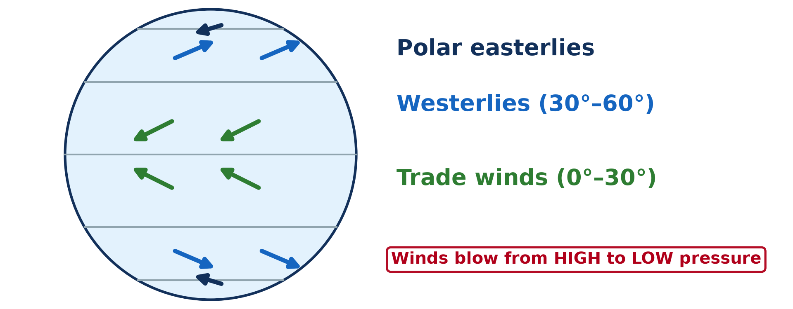
BOARD SUMMARY
2. Illustration of Pressure Belts and Planetary Winds
The planetary winds blow between the pressure belts as follows:
Trade winds: They blow from the sub-tropical highs towards the Equator: north-east trades in the north and south-east trades in the south.
Illustration: planetary winds
Notes:
Let us copy Illustration of Pressure Belts and Planetary Winds. The planetary winds blow between the pressure belts as follows. Copy the point on Trade winds on the left, then draw the diagram on the right: planetary winds. Give it a title and label it clearly.

Slide 36
BOARD SUMMARY
2. Illustration of Pressure Belts and Planetary Winds
Westerlies: They blow from the sub-tropical highs towards the temperate lows.
Polar easterlies: They blow from the polar highs towards the temperate lows.
Deflection: The rotation of the Earth bends the winds to the right in the north and to the left in the south.
Notes:
We continue with Illustration of Pressure Belts and Planetary Winds. On this slide we have Westerlies, Polar easterlies and Deflection. Write each point on a new line, with the key term first, and explain it in your own words when we revise.

Slide 37
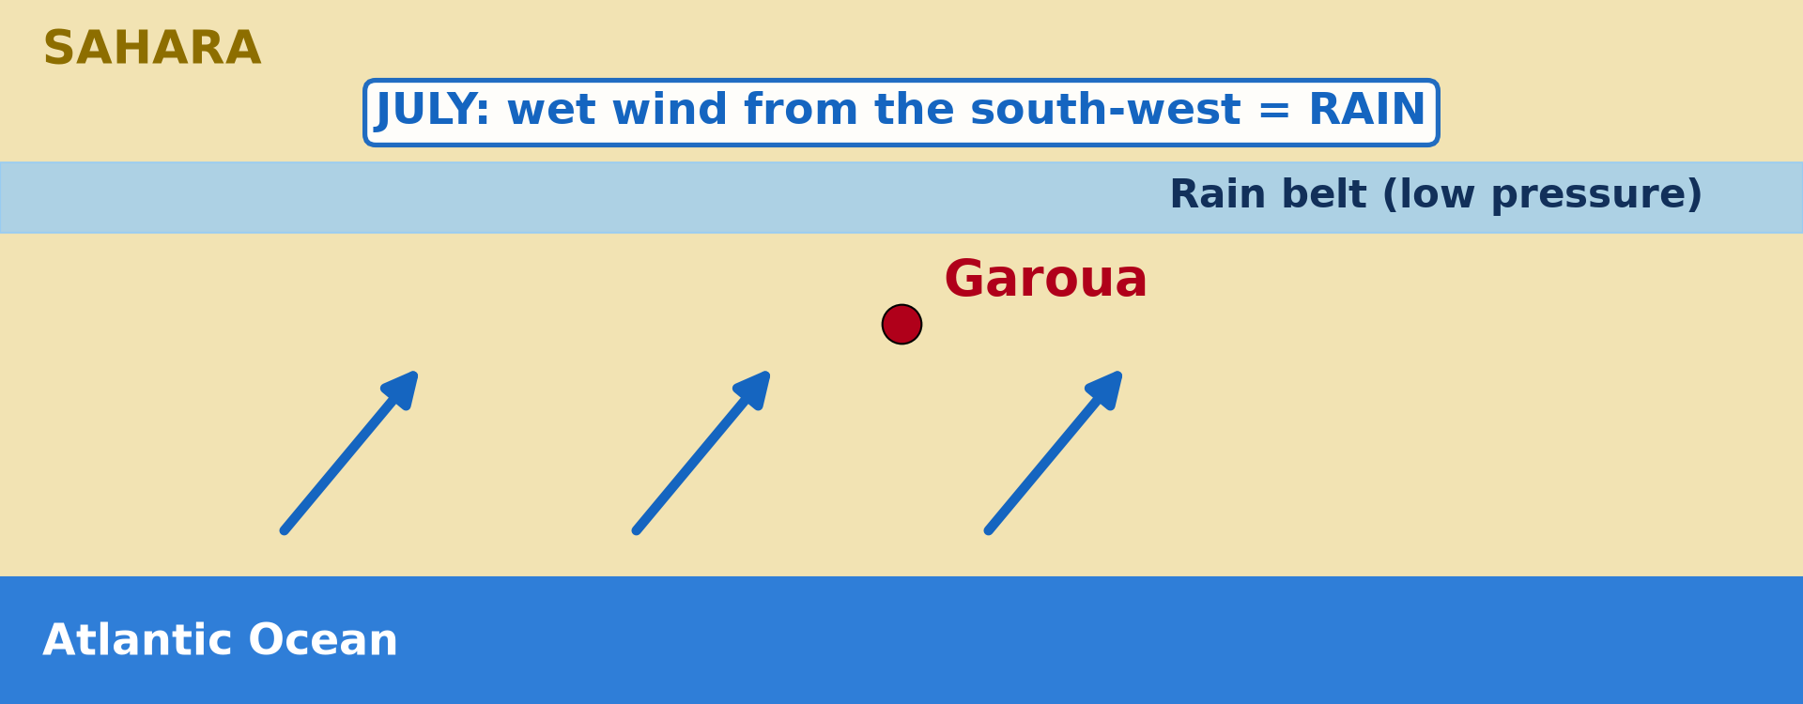
BOARD SUMMARY
2. Illustration of Pressure Belts and Planetary Winds
Seasonal shift: The belts move north in July and south in January, bringing the south-west monsoon, then the Harmattan, to Garoua.
Illustration: the rain belt in July
Notes:
Copy the point on Seasonal shift on the left, then draw the diagram on the right: the rain belt in July. Give it a title and label it clearly.

Slide 38
FORMATIVE EVALUATION
Evaluation 1
Where is the Equatorial Low?
Notes:
Now let us check what you have understood. Question 1: Where is the Equatorial Low? Answer in your exercise book.

Slide 39
FORMATIVE EVALUATION
Expected Answer
At the Equator (0°).
Notes:
The expected answer is: at the Equator (0°). If you got it right, well done.

Slide 40
FORMATIVE EVALUATION
Evaluation 2
Which wind brings rain to Garoua?
Notes:
Now let us check what you have understood. Question 2: Which wind brings rain to Garoua? Answer in your exercise book.

Slide 41
FORMATIVE EVALUATION
Expected Answer
The south-west wind (monsoon) in the wet season.
Notes:
The expected answer is: the south-west wind (monsoon) in the wet season. If you got it right, well done.

Slide 42
REMEDIATION
Remediation
Fill in the blanks:
At the Equator, the pressure is ______.
The winds that blow to the Equator are the ______ Winds.
The dry wind of January in Garoua is the ______.
Notes:
For those who need more practice, fill in the blanks in your exercise book. The answers are: number 1, low; number 2, Trade; number 3, Harmattan.

Slide 43
HOMEWORK
Homework
Ask someone who has lived by the sea (Douala, Kribi or Limbe) or in the mountains (Buea, Mokolo) whether the wind changes between day and night. Write down what they say.
Notes:
For your homework: Ask someone who has lived by the sea (Douala, Kribi or Limbe) or in the mountains (Buea, Mokolo) whether the wind changes between day and night. Write down what they say. We shall correct it at the beginning of our next lesson.

Slide 44
NEXT LESSON
Next Lesson
Our next lesson will be on:
Lesson 37: Local Winds
Notes:
Our next lesson will be on Lesson 37: Local Winds. Thank you for your attention, and see you next time.

Slide 45
BILINGUAL GAME
Bilingual Game (Jeu Bilingue)
English | Français
Pressure | La pression
High pressure | Les hautes pressions
Low pressure | Les basses pressions
Pressure belt | La ceinture de pression
Trade winds | Les alizés
Westerlies | Les vents d'ouest
Doldrums | Le pot au noir
Planetary wind | Le vent planétaire
Notes:
Let us play the bilingual game. I say a word in English, and you give me the French word. Then we do the reverse.

Slide 46
LOGBOOK
Official Logbook (1/2)
Module / Topic | The Earth-Atmosphere System
Lesson Title | Lesson 36: Pressure Belts and Planetary Winds
Expected Learning Outcomes | Define atmospheric pressure, pressure belt and planetary wind. Distinguish between high-pressure and low-pressure belts. Identify the pressure belts and planetary winds on a diagram.
Competence | Learners are able to explain why Garoua has a moist south-west wind in the rainy season and the dry Harmattan in the dry season.
Notes:
I record this information in the official logbook of the class after the lesson.

Slide 47
LOGBOOK
Official Logbook (2/2)
Matter Taught | DEFINITIONS; Meaning of Pressure Belts: Major Types; Illustration of Pressure Belts and Planetary Winds.
Evaluation | Formative evaluation and remediation exercise.
Homework | Ask someone who has lived by the sea (Douala, Kribi or Limbe) or in the mountains (Buea, Mokolo) whether the wind changes between day and night. Write down what they say.
Enrolment / Present / Absent | ____ / ____ / ____
Achievement | To be completed after the lesson.
Notes:
I complete the second page of the logbook: the matter taught, the evaluation, the homework and the attendance.

Slide 48
TEACHER'S NOTE
Teacher's Note
Timing: Homework correction, plan, objectives 4 min | Recall, situation, action 6 min | 3 activities 12 min | Board summary (copying) 15 min | Evaluation, remediation 5 min | Homework, next lesson 3 min | Logbook 5 min
Activity 3 is an animation (GIF): it plays automatically in slide-show mode.
Without the projector (Activity 1): draw a globe with bands.
Without the projector (Activity 2): describe a Harmattan morning.
Without the projector (Activity 3): draw the rain belt in July and in January.
Notes:
This slide is for me, the teacher: it gives the timing of the lesson and what to do if the projector is not available.

Slide 49
REFERENCES
References
National Geography Syllabus (MINESEC), Form 4 — Module 3: Weather and Climate.
Teacher's lesson notes (f4.docx), checked and corrected where necessary.
Photo, Activity 2: “Bamenda sob a poeira do Harmattan” by carlosoliveirareis, CC BY-NC-SA 2.0, via Flickr (https://www.flickr.com/photos/54218923@N00/387054136)
Diagrams and animations: drawn for this lesson (Geography Department).
Notes:
These are the references and picture credits used to prepare this lesson.

