Slide 1
FORM 4
GEOGRAPHY
Lesson 41
Floods, Droughts and Desertification
Notes:
Good morning, class, and welcome to our geography lesson. I am your geography teacher, Mr Kamdem. Today we are starting Lesson 41: Floods, Droughts and Desertification.

Slide 2
CLASS INFO
Class, Chapter and Duration
Class | Form 4
Chapter | Module 3: Weather and Climate — Adaptation to Climatic Excesses
Duration | 50 minutes
Notes:
This lesson is for Form 4. It belongs to Module 3: Weather and Climate — Adaptation to Climatic Excesses. We shall need 50 minutes to cover it.

Slide 3
IDENTIFICATION
Lesson Identification
Topic | Management of Climate and Hydrological Related Hazards
Sub-topic | Hydro-climatic Hazards
Lesson | Lesson 41: Floods, Droughts and Desertification
Notions / Concepts | Floods, droughts, desertification.
Syllabus focus | Meaning (definition and area of occurrence); causes; effects; adaptations and mitigations.
Competence | Learners are able to recognise the risks of floods and drought in their area and to take actions to protect their families, crops and land.
Notes:
Our topic is Management of Climate and Hydrological Related Hazards, and the sub-topic is Hydro-climatic Hazards. The key notions we shall use today are: floods, droughts, desertification. At the end, you should be able to do this: learners are able to recognise the risks of floods and drought in their area and to take actions to protect their families, crops and land.

Slide 4

HOMEWORK CORRECTION
Correction of the Homework
Question (Lesson 40: Global Warming):
Ask an adult in your family whether your area has ever been flooded or has suffered a very dry year. Write down when it happened and what damage it caused.
Notes:
Before we start the new lesson, let us correct the homework I gave you at the end of Lesson 40: Global Warming. The question was: Ask an adult in your family whether your area has ever been flooded or has suffered a very dry year. Write down when it happened and what damage it caused. Take out your exercise books.

Slide 5
HOMEWORK CORRECTION
Correction: Possible Answer
Answers vary. Example: in 2012 the Benue flooded after the Lagdo Dam released water; houses, rice and onion fields were destroyed and many people were displaced.
Notes:
Here is a good answer. Answers vary. Example: in 2012 the Benue flooded after the Lagdo Dam released water; houses, rice and onion fields were destroyed and many people were displaced. Compare it with your own answer and correct your work in red.

Slide 6
LESSON PLAN
Lesson Plan
Correction of the homework
Objectives and recall
Real-life situation and action to take
Learning activities
Board summary
Evaluation, remediation and homework
Notes:
Here is the plan of our lesson today. First, we shall correct the homework. Then we shall look at the objectives and recall what you already know. After that, we shall study a situation from real life and the action to take, and do the learning activities. Finally, we shall copy the board summary, do the evaluation and the remediation, and I will give you the homework.

Slide 7
OBJECTIVES
Objectives
By the end of this lesson, you should be able to:
Define floods, droughts and desertification and give their areas of occurrence.
Explain their causes.
Notes:
Take your time to copy this part; we will continue together.

Slide 8
OBJECTIVES
Objectives (continued)
Describe their effects.
Propose adaptation and mitigation measures.
Notes:
By the end of this lesson, you should be able to do four things. Number 1: define floods, droughts and desertification and give their areas of occurrence. Number 2: explain their causes. Number 3: describe their effects. Number 4: propose adaptation and mitigation measures.

Slide 9
PREVIOUS KNOWLEDGE
Previous Knowledge
Global warming is the long-term rise of the Earth's temperature.
It makes droughts and floods more frequent.
Mitigation reduces its causes; adaptation helps people to live with its effects.
Notes:
Let us first remember what you already know. Global warming is the long-term rise of the Earth's temperature. It makes droughts and floods more frequent. Mitigation reduces its causes; adaptation helps people to live with its effects. Keep this in mind, because we shall build on it today.

Slide 10
REAL-LIFE SITUATION
Situation in Real Life
In September 2012, floods destroyed villages along the Benue near Garoua. Six months later, in the Far North, the rains stopped early, the crops dried up and sand covered some fields. A pupil asks: "How can the same region suffer from too much water and too little water, and what can people do?"
Notes:
Listen carefully to this situation from real life. In September 2012, floods destroyed villages along the Benue near Garoua. Six months later, in the Far North, the rains stopped early, the crops dried up and sand covered some fields. A pupil asks: "How can the same region suffer from too much water and too little water, and what can people do?" Think about it, because I am going to ask you some questions.

Slide 11
REAL-LIFE SITUATION
Situation: Question 1
What is the problem in the situation?
Notes:
Question 1: What is the problem in the situation? Think for a moment, then raise your hand to answer.

Slide 12
REAL-LIFE SITUATION
Answer
The pupil does not understand how the region suffers both floods and droughts, and what can be done.
Notes:
Good. The pupil does not understand how the region suffers both floods and droughts, and what can be done.

Slide 13
REAL-LIFE SITUATION
Situation: Question 2
What happened along the Benue in 2012?
Notes:
Question 2: What happened along the Benue in 2012? Think for a moment, then raise your hand to answer.

Slide 14
REAL-LIFE SITUATION
Answer
Floods destroyed villages.
Notes:
Good. Floods destroyed villages.

Slide 15
REAL-LIFE SITUATION
Situation: Question 3
What happened in the Far North?
Notes:
Question 3: What happened in the Far North? Think for a moment, then raise your hand to answer.

Slide 16
REAL-LIFE SITUATION
Possible Answer
The rains stopped early and the crops dried up.
Notes:
Good. The rains stopped early and the crops dried up.

Slide 17
ACTION TO TAKE
Action to Take
Plant trees, avoid bush fires and prepare for floods and droughts.
Notes:
From this situation, the action we are working towards in this lesson is the following: plant trees, avoid bush fires and prepare for floods and droughts.

Slide 18
JUSTIFICATION
Justification of the Lesson
This lesson helps us to know floods, droughts and desertification.
Notes:
Why is this lesson important for you? This lesson helps us to know floods, droughts and desertification.

Slide 19

1. FLOODS
Activity 1
A flooded village.
Notes:
Activity 1. Look carefully at this picture: a flooded village. Observe every detail before I ask the question.

Slide 20
1. FLOODS
Activity 1: Question
Give one cause of the floods along the Benue.
Notes:
Here is the question for Activity 1: Give one cause of the floods along the Benue. Take one minute to think and write your answer in your rough notebook.

Slide 21
1. FLOODS
Activity 1: Answer
Heavy rain (or water released from the Lagdo Dam).
Notes:
Let us check the answer together. Heavy rain (or water released from the Lagdo Dam).

Slide 22

2. DROUGHTS
Activity 2
Dry, cracked land.
Notes:
Activity 2. Look carefully at this picture: dry, cracked land. Observe every detail before I ask the question.

Slide 23
2. DROUGHTS
Activity 2: Question
What is the difference between a drought and desertification?
Notes:
Here is the question for Activity 2: What is the difference between a drought and desertification? Take one minute to think and write your answer in your rough notebook.

Slide 24
2. DROUGHTS
Activity 2: Answer
A drought is a period without enough rain; desertification is the lasting spread of desert conditions.
Notes:
Let us check the answer together. A drought is a period without enough rain; desertification is the lasting spread of desert conditions.

Slide 25

3. DESERTIFICATION
Activity 3
Planting pits in dry land.
Notes:
Activity 3. Look carefully at this picture: planting pits in dry land. Observe every detail before I ask the question.

Slide 26
3. DESERTIFICATION
Activity 3: Question
How do these pits help farmers in dry areas?
Notes:
Here is the question for Activity 3: How do these pits help farmers in dry areas? Take one minute to think and write your answer in your rough notebook.

Slide 27
3. DESERTIFICATION
Activity 3: Answer
They keep water and manure near the plants.
Notes:
Let us check the answer together. They keep water and manure near the plants.

Slide 28
BOARD SUMMARY
Board Summary
Topic: Management of Climate and Hydrological Related Hazards
Sub-topic: Hydro-climatic Hazards
Lesson 41: Floods, Droughts and Desertification
Notes:
Now we are going to copy the board summary. Write the title and the headings neatly in your notebooks. I will give you enough time for each slide, so do not rush.

Slide 29
BOARD SUMMARY
DEFINITIONS
The key terms of this lesson are defined as follows:
Flood: It is the covering by water of land that is usually dry.
Drought: It is a long period with much less rain than normal.
Notes:
Let us copy the definitions. The key terms of this lesson are defined as follows. On this slide we have Flood and Drought. Write each point on a new line, with the key term first, and explain it in your own words when we revise. When you finish, we go to the next slide.

Slide 30
BOARD SUMMARY
DEFINITIONS (continued)
Desertification: It is the lasting spread of desert conditions into dry lands.
Notes:
We continue with the definitions. On this slide we have Desertification. Write each point on a new line, with the key term first, and explain it in your own words when we revise.

Slide 31
BOARD SUMMARY
1. Floods
Floods are explained as follows:
Areas of occurrence: Floods occur along the Benue, the Logone and the Chari, and in towns such as Douala and Yaoundé.
Illustration: a flooded village
Notes:
Let us copy Floods. Floods are explained as follows. Copy the point on Areas of occurrence on the left, then draw the diagram on the right: a flooded village. Give it a title and label it clearly.

Slide 32
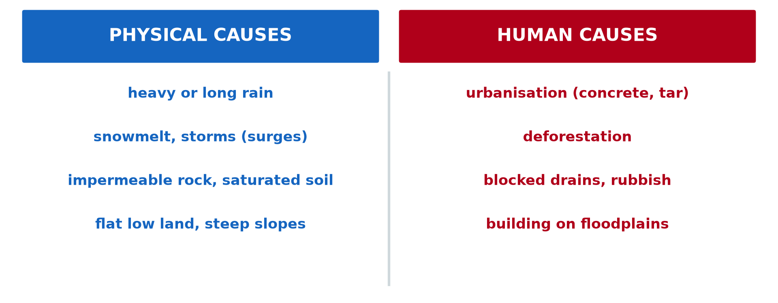
BOARD SUMMARY
1. Floods
Causes: Heavy rain, water released from dams, blocked drains and building on floodplains cause floods.
Illustration: causes of floods
Notes:
Copy the point on Causes on the left, then draw the diagram on the right: causes of floods. Give it a title and label it clearly.

Slide 33
BOARD SUMMARY
1. Floods
Effects: Floods destroy houses, crops and roads, drown people and spread cholera and malaria.
Adaptation and mitigation: Dykes, clean drains, early warnings and building on high ground reduce flood damage.
Notes:
We continue with Floods. On this slide we have Effects and Adaptation and mitigation. Write each point on a new line, with the key term first, and explain it in your own words when we revise.

Slide 34
BOARD SUMMARY
2. Droughts
Droughts are explained as follows:
Areas of occurrence: Droughts occur in the Sahel, including the North and the Far North of Cameroon.
Illustration: dry land
Notes:
Let us copy Droughts. Droughts are explained as follows. Copy the point on Areas of occurrence on the left, then draw the diagram on the right: dry land. Give it a title and label it clearly.

Slide 35
BOARD SUMMARY
2. Droughts
Causes: Low and irregular rainfall, very high temperatures and a long dry season cause droughts.
Effects: Crops fail, animals die, wells dry up, and people suffer hunger and migrate.
Notes:
We continue with Droughts. On this slide we have Causes and Effects. Write each point on a new line, with the key term first, and explain it in your own words when we revise. When you finish, we go to the next slide.

Slide 36
BOARD SUMMARY
2. Droughts (continued)
Adaptation and mitigation: Irrigation, water storage, drought-resistant crops and food reserves reduce the effects.
Notes:
We continue with Droughts. On this slide we have Adaptation and mitigation. Write each point on a new line, with the key term first, and explain it in your own words when we revise.

Slide 37
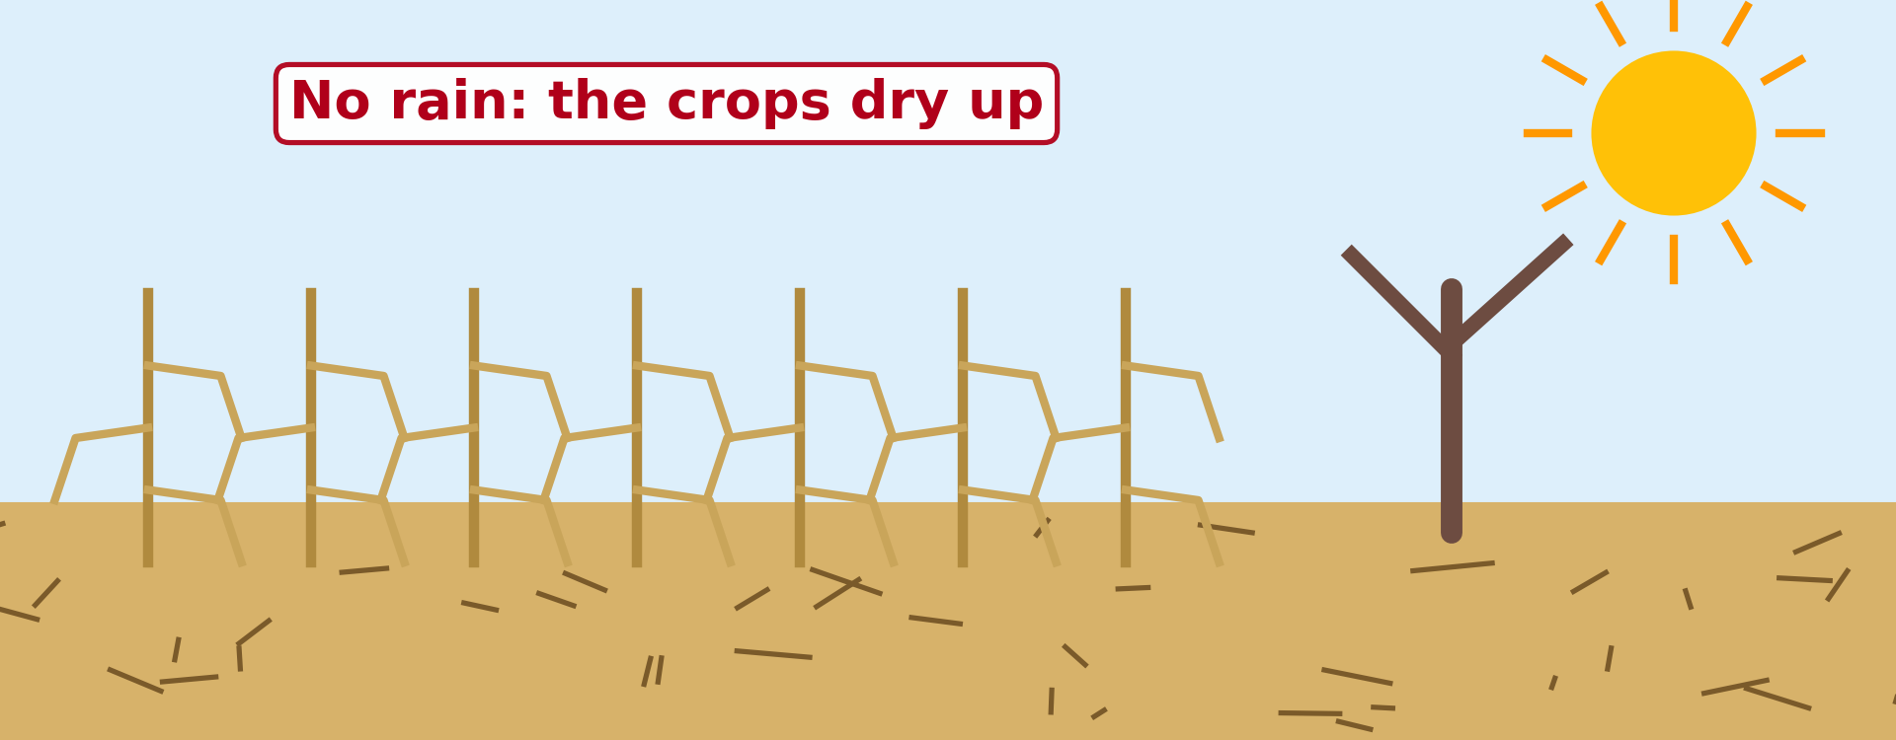
BOARD SUMMARY
3. Desertification
Desertification is explained as follows:
Areas of occurrence: Desertification affects the Sahel, including the Far North of Cameroon around Lake Chad.
Illustration: crops dried by drought
Notes:
Let us copy Desertification. Desertification is explained as follows. Copy the point on Areas of occurrence on the left, then draw the diagram on the right: crops dried by drought. Give it a title and label it clearly.

Slide 38
BOARD SUMMARY
3. Desertification
Causes: Overgrazing, cutting trees for firewood, bush fires, poor farming and repeated droughts cause desertification.
Effects: Soils become poor, sand covers fields, water becomes scarce and people migrate.
Notes:
We continue with Desertification. On this slide we have Causes and Effects. Write each point on a new line, with the key term first, and explain it in your own words when we revise.

Slide 39
BOARD SUMMARY
3. Desertification
Adaptation and mitigation: Tree planting (Sahel Vert, Great Green Wall), zaï pits, stone lines and control of grazing stop the desert.
Illustration: zaï planting pits
Notes:
Copy the point on Adaptation and mitigation on the left, then draw the diagram on the right: zaï planting pits. Give it a title and label it clearly.

Slide 40
FORMATIVE EVALUATION
Evaluation 1
What is desertification?
Notes:
Now let us check what you have understood. Question 1: What is desertification? Answer in your exercise book.

Slide 41
FORMATIVE EVALUATION
Expected Answer
The spread of the desert.
Notes:
The expected answer is: the spread of the desert. If you got it right, well done.

Slide 42
FORMATIVE EVALUATION
Evaluation 2
Give one way to fight desertification.
Notes:
Now let us check what you have understood. Question 2: Give one way to fight desertification. Answer in your exercise book.

Slide 43
FORMATIVE EVALUATION
Expected Answer
Plant trees (or stop overgrazing).
Notes:
The expected answer is: plant trees (or stop overgrazing). If you got it right, well done.

Slide 44
REMEDIATION
Remediation
Fill in the blanks:
A long period without enough rain is a ______.
The spread of the desert is ______.
In 2012, water from the ______ Dam flooded villages.
Notes:
For those who need more practice, fill in the blanks in your exercise book. The answers are: number 1, drought; number 2, desertification; number 3, Lagdo.

Slide 45
HOMEWORK
Homework
Count how many buckets (or litres) of water your family uses in one day, and list the main uses (drinking, cooking, washing).
Notes:
For your homework: Count how many buckets (or litres) of water your family uses in one day, and list the main uses (drinking, cooking, washing). We shall correct it at the beginning of our next lesson.

Slide 46
NEXT LESSON
Next Lesson
Our next lesson will be on:
Lesson 42: Water Scarcity
Notes:
Our next lesson will be on Lesson 42: Water Scarcity. Thank you for your attention, and see you next time.

Slide 47
BILINGUAL GAME
Bilingual Game (Jeu Bilingue)
English | Français
Flood | L'inondation
Drought | La sécheresse
Desertification | La désertification
Floodplain | La plaine d'inondation
Dyke | La digue
Famine | La famine
Overgrazing | Le surpâturage
Early warning | L'alerte précoce
Notes:
Let us play the bilingual game. I say a word in English, and you give me the French word. Then we do the reverse.

Slide 48
LOGBOOK
Official Logbook (1/2)
Module / Topic | Management of Climate and Hydrological Related Hazards
Lesson Title | Lesson 41: Floods, Droughts and Desertification
Expected Learning Outcomes | Define floods, droughts and desertification and give their areas of occurrence. Explain their causes. Describe their effects. Propose adaptation and mitigation measures.
Competence | Learners are able to recognise the risks of floods and drought in their area and to take actions to protect their families, crops and land.
Notes:
I record this information in the official logbook of the class after the lesson.

Slide 49
LOGBOOK
Official Logbook (2/2)
Matter Taught | DEFINITIONS; Floods; Droughts; Desertification.
Evaluation | Formative evaluation and remediation exercise.
Homework | Count how many buckets (or litres) of water your family uses in one day, and list the main uses (drinking, cooking, washing).
Enrolment / Present / Absent | ____ / ____ / ____
Achievement | To be completed after the lesson.
Notes:
I complete the second page of the logbook: the matter taught, the evaluation, the homework and the attendance.

Slide 50
TEACHER'S NOTE
Teacher's Note
Timing: Homework correction, plan, objectives 4 min | Recall, situation, action 6 min | 3 activities 12 min | Board summary (copying) 15 min | Evaluation, remediation 5 min | Homework, next lesson 3 min | Logbook 5 min
Without the projector (Activity 1): describe the flood of 2012.
Without the projector (Activity 2): compare a dry year and a spreading desert.
Without the projector (Activity 3): describe the zaï method.
Notes:
This slide is for me, the teacher: it gives the timing of the lesson and what to do if the projector is not available.

Slide 51
REFERENCES
References
National Geography Syllabus (MINESEC), Form 4 — Module 3: Weather and Climate.
Teacher's lesson notes (f4.docx), checked and corrected where necessary.
MINEPDED: Opération Sahel Vert; African Union: Great Green Wall.
Photo, Activity 1: “Flood in Accra” by Stig Nygaard, CC BY 2.0, via Flickr (https://www.flickr.com/photos/10259776@N00/181742000)
Photo, Activity 2: “Imagine a world without trees” by aloshbennett, CC BY 2.0, via Flickr (https://www.flickr.com/photos/13203757@N00/3480223314)
Photo, Activity 3: “Women sowing okra in zai holes” by abossuet, CC BY-NC 2.0, via Flickr (https://www.flickr.com/photos/30450178@N07/7175750825)
Diagrams and animations: drawn for this lesson (Geography Department).
Notes:
These are the references and picture credits used to prepare this lesson.

