Slide 1
FORM 4
GEOGRAPHY
Lesson 4
Soil Conservation
Notes:
Good morning, class, and welcome to our geography lesson. I am your geography teacher, Mr Kamdem. Today we are starting Lesson 4: Soil Conservation.

Slide 2
CLASS INFO
Class, Chapter and Duration
Class | Form 4
Chapter | Module I: Ecological Systems and their Resources
Duration | 2 periods (2 × 50 minutes)
Notes:
This lesson is for Form 4. It belongs to Module I: Ecological Systems and their Resources. We shall need 2 periods to cover it.

Slide 3
IDENTIFICATION
Lesson Identification
Topic | Conservation of World's Biomes and Resources
Sub-topic | The Soil
Lesson | Lesson 4: Soil Conservation
Notions / Concepts | Soil conservation, checks to soil erosion, conservation measures, terraces, contour ploughing.
Syllabus focus | Meaning; measures and methods of soil conservation.
Competence | Learners are able to propose and apply methods to conserve the soil.
Notes:
Our topic is Conservation of World's Biomes and Resources, and the sub-topic is The Soil. The key notions we shall use today are: soil conservation, checks to soil erosion, conservation measures, terraces, contour ploughing. At the end, you should be able to do this: learners are able to propose and apply methods to conserve the soil.

Slide 4

HOMEWORK CORRECTION
Correction of the Homework
Question (Lesson 3: Soil Erosion):
Find a place with soil erosion near your home. Describe it and give its cause.
Notes:
Before we start the new lesson, let us correct the homework I gave you at the end of Lesson 3: Soil Erosion. The question was: Find a place with soil erosion near your home. Describe it and give its cause. Take out your exercise books.

Slide 5
HOMEWORK CORRECTION
Correction: Possible Answer
Example: a path with deep rills on a slope; caused by running rain water on bare, trampled soil.
Notes:
Here is a good answer. Example: a path with deep rills on a slope; caused by running rain water on bare, trampled soil. Compare it with your own answer and correct your work in red.

Slide 6
LESSON PLAN
Lesson Plan
Correction of the homework
Objectives and recall
Real-life situation and action to take
Learning activities
Board summary
Evaluation, remediation and homework
Notes:
Here is the plan of our lesson today. First, we shall correct the homework. Then we shall look at the objectives and recall what you already know. After that, we shall study a situation from real life and the action to take, and do the learning activities. Finally, we shall copy the board summary, do the evaluation and the remediation, and I will give you the homework.

Slide 7
OBJECTIVES
Objectives
By the end of this lesson, you should be able to:
Define soil conservation.
Describe mechanical methods of soil conservation.
Notes:
Take your time to copy this part; we will continue together.

Slide 8
OBJECTIVES
Objectives (continued)
Describe biological methods of soil conservation.
Notes:
By the end of this lesson, you should be able to do three things. Number 1: define soil conservation. Number 2: describe mechanical methods of soil conservation. Number 3: describe biological methods of soil conservation.

Slide 9
PREVIOUS KNOWLEDGE
Previous Knowledge
Soil erosion removes the topsoil.
Bare soil is eroded quickly.
Plants protect the soil.
Notes:
Let us first remember what you already know. Soil erosion removes the topsoil. Bare soil is eroded quickly. Plants protect the soil. Keep this in mind, because we shall build on it today.

Slide 10
REAL-LIFE SITUATION
Situation in Real Life
On the Mandara Mountains, farmers grow millet on steep slopes. They build stone walls across the slopes, and their soil is not washed away by the heavy rains.
Notes:
Listen carefully to this situation from real life. On the Mandara Mountains, farmers grow millet on steep slopes. They build stone walls across the slopes, and their soil is not washed away by the heavy rains. Think about it, because I am going to ask you some questions.

Slide 11
REAL-LIFE SITUATION
Situation: Question 1
What is the problem in the situation?
Notes:
Question 1: What is the problem in the situation? Think for a moment, then raise your hand to answer.

Slide 12
REAL-LIFE SITUATION
Answer
Farmers must protect the soil on steep slopes.
Notes:
Good. Farmers must protect the soil on steep slopes.

Slide 13
REAL-LIFE SITUATION
Situation: Question 2
What do the farmers build?
Notes:
Question 2: What do the farmers build? Think for a moment, then raise your hand to answer.

Slide 14
REAL-LIFE SITUATION
Answer
Stone walls (terraces) across the slopes.
Notes:
Good. Stone walls (terraces) across the slopes.

Slide 15
REAL-LIFE SITUATION
Situation: Question 3
Why does it work?
Notes:
Question 3: Why does it work? Think for a moment, then raise your hand to answer.

Slide 16
REAL-LIFE SITUATION
Possible Answer
The walls slow down the running water.
Notes:
Good. The walls slow down the running water.

Slide 17
ACTION TO TAKE
Action to Take
Plant trees, grass and cover crops, and farm along the contours.
Notes:
From this situation, the action we are working towards in this lesson is the following: plant trees, grass and cover crops, and farm along the contours.

Slide 18
JUSTIFICATION
Justification of the Lesson
This lesson helps us to protect the soil that feeds us.
Notes:
Why is this lesson important for you? This lesson helps us to protect the soil that feeds us.

Slide 19
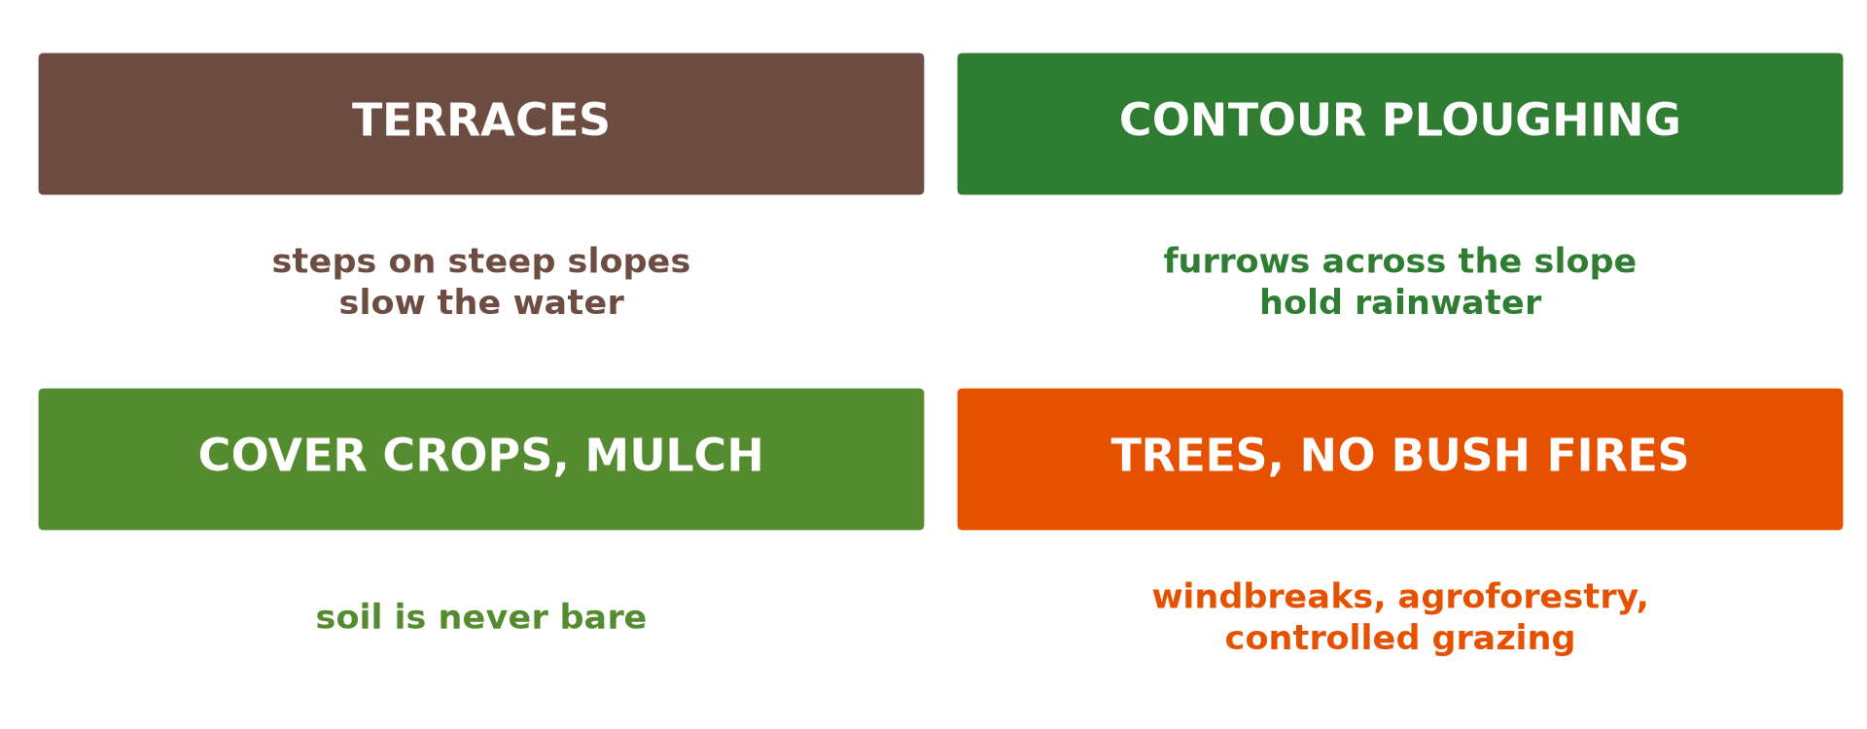
1. MEANING
Activity 1
Soil conservation methods.
Notes:
Activity 1. Look carefully at this diagram: soil conservation methods. Observe every detail before I ask the question.

Slide 20
1. MEANING
Activity 1: Question
What is soil conservation?
Notes:
Here is the question for Activity 1: What is soil conservation? Take one minute to think and write your answer in your rough notebook.

Slide 21
1. MEANING
Activity 1: Answer
All the methods used to protect the soil from erosion and keep it fertile.
Notes:
Let us check the answer together. All the methods used to protect the soil from erosion and keep it fertile.

Slide 22

2. MECHANICAL METHODS
Activity 2
Terraces on a hillside.
Notes:
Activity 2. Look carefully at this picture: terraces on a hillside. Observe every detail before I ask the question.

Slide 23
2. MECHANICAL METHODS
Activity 2: Question
How do terraces reduce soil erosion?
Notes:
Here is the question for Activity 2: How do terraces reduce soil erosion? Take one minute to think and write your answer in your rough notebook.

Slide 24
2. MECHANICAL METHODS
Activity 2: Answer
They make flat steps that slow down running water.
Notes:
Let us check the answer together. They make flat steps that slow down running water.

Slide 25

2. MECHANICAL METHODS
Activity 3
Zaï pits in a dry area.
Notes:
Activity 3. Look carefully at this picture: zaï pits in a dry area. Observe every detail before I ask the question.

Slide 26
2. MECHANICAL METHODS
Activity 3: Question
How do zaï pits and contour ridges help the soil?
Notes:
Here is the question for Activity 3: How do zaï pits and contour ridges help the soil? Take one minute to think and write your answer in your rough notebook.

Slide 27
2. MECHANICAL METHODS
Activity 3: Answer
They catch water and soil and stop them from running down the slope.
Notes:
Let us check the answer together. They catch water and soil and stop them from running down the slope.

Slide 28
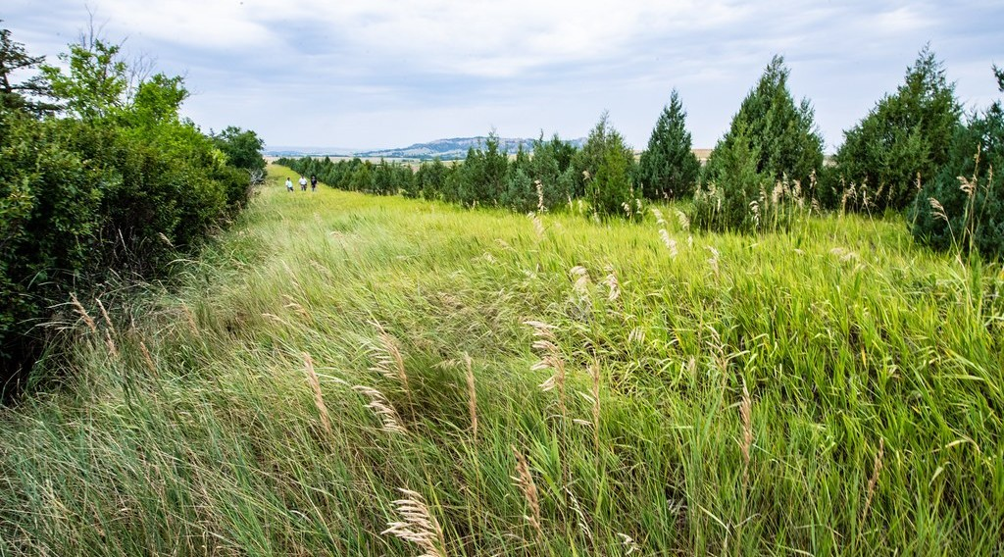
3. BIOLOGICAL METHODS
Activity 4
A line of trees against the wind.
Notes:
Activity 4. Look carefully at this picture: a line of trees against the wind. Observe every detail before I ask the question.

Slide 29
3. BIOLOGICAL METHODS
Activity 4: Question
How do trees protect the soil?
Notes:
Here is the question for Activity 4: How do trees protect the soil? Take one minute to think and write your answer in your rough notebook.

Slide 30
3. BIOLOGICAL METHODS
Activity 4: Answer
Their roots hold the soil and they slow down wind and rain.
Notes:
Let us check the answer together. Their roots hold the soil and they slow down wind and rain.

Slide 31

3. BIOLOGICAL METHODS
Activity 5
Dead leaves covering the soil (mulch).
Notes:
Activity 5. Look carefully at this picture: dead leaves covering the soil (mulch). Observe every detail before I ask the question.

Slide 32
3. BIOLOGICAL METHODS
Activity 5: Question
Give two other biological methods.
Notes:
Here is the question for Activity 5: Give two other biological methods. Take one minute to think and write your answer in your rough notebook.

Slide 33
3. BIOLOGICAL METHODS
Activity 5: Answer
Mulching and cover crops (also crop rotation, manure).
Notes:
Let us check the answer together. Mulching and cover crops (also crop rotation, manure).

Slide 34
BOARD SUMMARY
Board Summary
Topic: Conservation of World's Biomes and Resources
Sub-topic: The Soil
Lesson 4: Soil Conservation
Notes:
Now we are going to copy the board summary. Write the title and the headings neatly in your notebooks. I will give you enough time for each slide, so do not rush.

Slide 35
BOARD SUMMARY
DEFINITIONS
The key terms of this lesson are defined as follows:
Soil conservation: It is the protection of the soil against erosion and loss of fertility.
Notes:
Let us copy the definitions. The key terms of this lesson are defined as follows. On this slide we have Soil conservation. Write each point on a new line, with the key term first, and explain it in your own words when we revise.

Slide 36
BOARD SUMMARY
1. Mechanical Methods
Soil is protected by the following mechanical methods:
Terracing: Flat steps are built across steep slopes, as on the Mandara Mountains.
Contour ploughing and ridges: Ploughing along the contours stops water from running down.
Notes:
Let us copy Mechanical Methods. Soil is protected by the following mechanical methods. On this slide we have Terracing and Contour ploughing and ridges. Write each point on a new line, with the key term first, and explain it in your own words when we revise. When you finish, we go to the next slide.

Slide 37
BOARD SUMMARY
1. Mechanical Methods (continued)
Stone lines and check dams: Lines of stones and small dams slow water and fill gullies.
Notes:
We continue with Mechanical Methods. On this slide we have Stone lines and check dams. Write each point on a new line, with the key term first, and explain it in your own words when we revise.

Slide 38
BOARD SUMMARY
1. Mechanical Methods
Illustration: soil conservation methods
Notes:
Now draw this illustration in your notebook: soil conservation methods. Give it a title and label it clearly.

Slide 39
BOARD SUMMARY
2. Biological Methods
Soil is protected by the following biological methods:
Tree planting: Trees and windbreaks hold the soil and reduce wind.
Cover crops and mulching: Plants and dead leaves cover the soil against rain.
Notes:
Let us copy Biological Methods. Soil is protected by the following biological methods. On this slide we have Tree planting and Cover crops and mulching. Write each point on a new line, with the key term first, and explain it in your own words when we revise. When you finish, we go to the next slide.

Slide 40
BOARD SUMMARY
2. Biological Methods (continued)
Crop rotation and manure: Changing crops and adding manure keep the soil fertile.
Notes:
We continue with Biological Methods. On this slide we have Crop rotation and manure. Write each point on a new line, with the key term first, and explain it in your own words when we revise.

Slide 41
BOARD SUMMARY
3. Other Measures
Other measures also conserve the soil:
Controlled grazing: Limiting the number of animals protects the grass.
Stopping bush fires: Avoiding fires keeps the plant cover.
Notes:
Let us copy Other Measures. Other measures also conserve the soil. On this slide we have Controlled grazing and Stopping bush fires. Write each point on a new line, with the key term first, and explain it in your own words when we revise.

Slide 42
FORMATIVE EVALUATION
Evaluation 1
Give two mechanical methods of soil conservation.
Notes:
Now let us check what you have understood. Question 1: Give two mechanical methods of soil conservation. Answer in your exercise book.

Slide 43
FORMATIVE EVALUATION
Expected Answer
Terracing and contour ploughing.
Notes:
The expected answer is: terracing and contour ploughing. If you got it right, well done.

Slide 44
FORMATIVE EVALUATION
Evaluation 2
Give two biological methods.
Notes:
Now let us check what you have understood. Question 2: Give two biological methods. Answer in your exercise book.

Slide 45
FORMATIVE EVALUATION
Expected Answer
Tree planting and mulching.
Notes:
The expected answer is: tree planting and mulching. If you got it right, well done.

Slide 46
REMEDIATION
Remediation
Fill in the blanks:
Flat steps on slopes are ______.
Covering the soil with dead leaves is ______.
Ploughing across the slope is ______ ploughing.
Notes:
For those who need more practice, fill in the blanks in your exercise book. The answers are: number 1, terraces; number 2, mulching; number 3, contour.

Slide 47
HOMEWORK
Homework
Propose three ways to protect the soil of your school compound.
Notes:
For your homework: Propose three ways to protect the soil of your school compound. We shall correct it at the beginning of our next lesson.

Slide 48
NEXT LESSON
Next Lesson
Our next lesson will be on:
Lesson 5: The Ecosystem
Notes:
Our next lesson will be on Lesson 5: The Ecosystem. Thank you for your attention, and see you next time.

Slide 49
BILINGUAL GAME
Bilingual Game (Jeu Bilingue)
English | Français
Conservation | La conservation
Terrace | La terrasse
Mulching | Le paillage
Windbreak | Le brise-vent
Manure | Le fumier
Contour | La courbe de niveau
Notes:
Let us play the bilingual game. I say a word in English, and you give me the French word. Then we do the reverse.

Slide 50
LOGBOOK
Official Logbook (1/2)
Module / Topic | Conservation of World's Biomes and Resources
Lesson Title | Lesson 4: Soil Conservation
Expected Learning Outcomes | Define soil conservation. Describe mechanical methods of soil conservation. Describe biological methods of soil conservation.
Competence | Learners are able to propose and apply methods to conserve the soil.
Notes:
I record this information in the official logbook of the class after the lesson.

Slide 51
LOGBOOK
Official Logbook (2/2)
Matter Taught | DEFINITIONS; Mechanical Methods; Biological Methods; Other Measures.
Evaluation | Formative evaluation and remediation exercise.
Homework | Propose three ways to protect the soil of your school compound.
Enrolment / Present / Absent | ____ / ____ / ____
Achievement | To be completed after the lesson.
Notes:
I complete the second page of the logbook: the matter taught, the evaluation, the homework and the attendance.

Slide 52
TEACHER'S NOTE
Teacher's Note
Timing: Homework correction, plan, objectives 8 min | Recall, situation, action 10 min | 5 activities 30 min | Board summary (copying) 30 min | Evaluation, remediation 10 min | Homework, next lesson 5 min | Logbook 7 min
Without the projector (Activity 1): list methods known.
Without the projector (Activity 2): describe Mandara terraces.
Without the projector (Activity 3): draw contour ridges.
Without the projector (Activity 4): plan trees for the school.
Without the projector (Activity 5): mulch a school garden.
Notes:
This slide is for me, the teacher: it gives the timing of the lesson and what to do if the projector is not available.

Slide 53
REFERENCES
References
Geography Syllabus, Forms I–V, MINESEC (2023) — Form 4, Module I: Ecological Systems and their Resources.
Photo, Activity 2: “Terraced Hillside” by AdamCohn, CC BY-NC-ND 2.0, via Flickr (https://www.flickr.com/photos/96142515@N00/6311042523)
Photo, Activity 3: “Women sowing okra in zai holes” by abossuet, CC BY-NC 2.0, via Flickr (https://www.flickr.com/photos/30450178@N07/7175750825)
Photo, Activity 4: “20210723-NRCS-LSC-0128” by USDAgov, Public domain 1.0, via Flickr (https://www.flickr.com/photos/41284017@N08/51526578960)
Photo, Activity 5: “Heavily earthworm-infested soil” by esagor, CC BY-NC 2.0, via Flickr (https://www.flickr.com/photos/7357861@N03/1993224477)
Diagrams and animations: drawn for this lesson (Geography Department).
Notes:
These are the references and picture credits used to prepare this lesson.

