Slide 1
FORM 4
GEOGRAPHY
Lesson 8
The Tropical Wet and Dry (Savanna) Biome
Notes:
Good morning, class, and welcome to our geography lesson. I am your geography teacher, Mr Kamdem. Today we are starting Lesson 8: The Tropical Wet and Dry (Savanna) Biome.

Slide 2
CLASS INFO
Class, Chapter and Duration
Class | Form 4
Chapter | Module I: Ecological Systems and their Resources
Duration | 2 periods (2 × 50 minutes)
Notes:
This lesson is for Form 4. It belongs to Module I: Ecological Systems and their Resources. We shall need 2 periods to cover it.

Slide 3
IDENTIFICATION
Lesson Identification
Topic | Conservation of World's Biomes and Resources
Sub-topic | Tropical Biomes and their Significance
Lesson | Lesson 8: The Tropical Wet and Dry (Savanna) Biome
Notions / Concepts | Savanna, ferruginous soils, cereal farming, pastoral farming, handicrafts.
Syllabus focus | Location; characteristics (climate, vegetation, soils, animal life); human activities.
Competence | Learners are able to describe the savanna biome and its human activities.
Notes:
Our topic is Conservation of World's Biomes and Resources, and the sub-topic is Tropical Biomes and their Significance. The key notions we shall use today are: savanna, ferruginous soils, cereal farming, pastoral farming, handicrafts. At the end, you should be able to do this: learners are able to describe the savanna biome and its human activities.

Slide 4

HOMEWORK CORRECTION
Correction of the Homework
Question (Lesson 7: The Tropical Rainforest Biome):
Draw a sketch map of the world showing the three main rainforest areas.
Notes:
Before we start the new lesson, let us correct the homework I gave you at the end of Lesson 7: The Tropical Rainforest Biome. The question was: Draw a sketch map of the world showing the three main rainforest areas. Take out your exercise books.

Slide 5
HOMEWORK CORRECTION
Correction: Possible Answer
The map shows the Amazon Basin (South America), the Congo Basin (Central Africa, including southern Cameroon) and South-East Asia (Indonesia, Malaysia).
Notes:
Here is a good answer. The map shows the Amazon Basin (South America), the Congo Basin (Central Africa, including southern Cameroon) and South-East Asia (Indonesia, Malaysia). Compare it with your own answer and correct your work in red.

Slide 6
LESSON PLAN
Lesson Plan
Correction of the homework
Objectives and recall
Real-life situation and action to take
Learning activities
Board summary
Evaluation, remediation and homework
Notes:
Here is the plan of our lesson today. First, we shall correct the homework. Then we shall look at the objectives and recall what you already know. After that, we shall study a situation from real life and the action to take, and do the learning activities. Finally, we shall copy the board summary, do the evaluation and the remediation, and I will give you the homework.

Slide 7
OBJECTIVES
Objectives
By the end of this lesson, you should be able to:
Locate the savanna biome.
Describe its climate, vegetation, soils and animal life.
Describe its human activities.
Notes:
By the end of this lesson, you should be able to do three things. Number 1: locate the savanna biome. Number 2: describe its climate, vegetation, soils and animal life. Number 3: describe its human activities.

Slide 8
PREVIOUS KNOWLEDGE
Previous Knowledge
Garoua has a rainy and a dry season.
The savanna has grass and scattered trees.
Many cattle are reared in the North.
Notes:
Let us first remember what you already know. Garoua has a rainy and a dry season. The savanna has grass and scattered trees. Many cattle are reared in the North. Keep this in mind, because we shall build on it today.

Slide 9
REAL-LIFE SITUATION
Situation in Real Life
In the dry season, the grass around Garoua is yellow and many trees lose their leaves. In the rainy season, everything becomes green and farmers sow sorghum and cotton.
Notes:
Listen carefully to this situation from real life. In the dry season, the grass around Garoua is yellow and many trees lose their leaves. In the rainy season, everything becomes green and farmers sow sorghum and cotton. Think about it, because I am going to ask you some questions.

Slide 10
REAL-LIFE SITUATION
Situation: Question 1
What is the problem in the situation?
Notes:
Question 1: What is the problem in the situation? Think for a moment, then raise your hand to answer.

Slide 11
REAL-LIFE SITUATION
Answer
We want to understand the changes of the savanna during the year.
Notes:
Good. We want to understand the changes of the savanna during the year.

Slide 12
REAL-LIFE SITUATION
Situation: Question 2
What happens in the dry season?
Notes:
Question 2: What happens in the dry season? Think for a moment, then raise your hand to answer.

Slide 13
REAL-LIFE SITUATION
Answer
The grass dries and trees lose their leaves.
Notes:
Good. The grass dries and trees lose their leaves.

Slide 14
REAL-LIFE SITUATION
Situation: Question 3
What do farmers grow?
Notes:
Question 3: What do farmers grow? Think for a moment, then raise your hand to answer.

Slide 15
REAL-LIFE SITUATION
Possible Answer
Sorghum and cotton.
Notes:
Good. Sorghum and cotton.

Slide 16
ACTION TO TAKE
Action to Take
Avoid bush fires and protect the savanna.
Notes:
From this situation, the action we are working towards in this lesson is the following: avoid bush fires and protect the savanna.

Slide 17
JUSTIFICATION
Justification of the Lesson
This lesson helps us to understand the biome in which we live.
Notes:
Why is this lesson important for you? This lesson helps us to understand the biome in which we live.

Slide 18
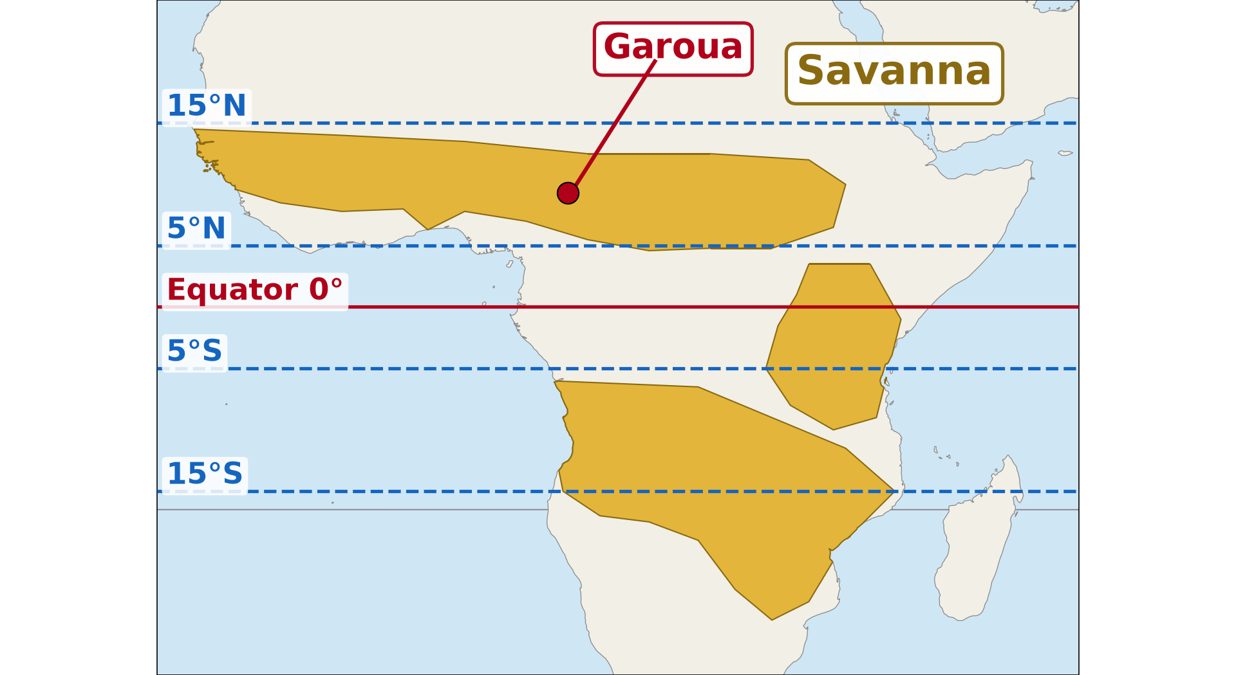
1. LOCATION
Activity 1
The savanna in Africa.
Notes:
Activity 1. Look carefully at this diagram: the savanna in Africa. Observe every detail before I ask the question.

Slide 19
1. LOCATION
Activity 1: Question
Between which latitudes is the savanna found?
Notes:
Here is the question for Activity 1: Between which latitudes is the savanna found? Take one minute to think and write your answer in your rough notebook.

Slide 20
1. LOCATION
Activity 1: Answer
Between about 5° and 15° north and south of the Equator.
Notes:
Let us check the answer together. Between about 5° and 15° north and south of the Equator.

Slide 21

2. CLIMATE
Activity 2
The climate of Garoua.
Notes:
Activity 2. Look carefully at this diagram: the climate of Garoua. Observe every detail before I ask the question.

Slide 22
2. CLIMATE
Activity 2: Question
Describe the savanna climate.
Notes:
Here is the question for Activity 2: Describe the savanna climate. Take one minute to think and write your answer in your rough notebook.

Slide 23
2. CLIMATE
Activity 2: Answer
Hot all year with a wet season and a dry season.
Notes:
Let us check the answer together. Hot all year with a wet season and a dry season.

Slide 24

2. VEGETATION
Activity 3
Savanna with scattered trees.
Notes:
Activity 3. Look carefully at this picture: savanna with scattered trees. Observe every detail before I ask the question.

Slide 25
2. VEGETATION
Activity 3: Question
Describe the vegetation of the savanna.
Notes:
Here is the question for Activity 3: Describe the vegetation of the savanna. Take one minute to think and write your answer in your rough notebook.

Slide 26
2. VEGETATION
Activity 3: Answer
Tall grass with scattered trees such as the baobab and the acacia.
Notes:
Let us check the answer together. Tall grass with scattered trees such as the baobab and the acacia.

Slide 27

2. ANIMAL LIFE
Activity 4
Elephants in the savanna.
Notes:
Activity 4. Look carefully at this picture: elephants in the savanna. Observe every detail before I ask the question.

Slide 28
2. ANIMAL LIFE
Activity 4: Question
Name three animals of the savanna.
Notes:
Here is the question for Activity 4: Name three animals of the savanna. Take one minute to think and write your answer in your rough notebook.

Slide 29
2. ANIMAL LIFE
Activity 4: Answer
Elephants, lions and antelopes (also giraffes, zebras).
Notes:
Let us check the answer together. Elephants, lions and antelopes (also giraffes, zebras).

Slide 30

3. HUMAN ACTIVITIES
Activity 5
Cattle of the savanna.
Notes:
Activity 5. Look carefully at this picture: cattle of the savanna. Observe every detail before I ask the question.

Slide 31
3. HUMAN ACTIVITIES
Activity 5: Question
Give three human activities of the savanna.
Notes:
Here is the question for Activity 5: Give three human activities of the savanna. Take one minute to think and write your answer in your rough notebook.

Slide 32
3. HUMAN ACTIVITIES
Activity 5: Answer
Cereal farming, cattle rearing and handicrafts (also cotton farming, tourism).
Notes:
Let us check the answer together. Cereal farming, cattle rearing and handicrafts (also cotton farming, tourism).

Slide 33
BOARD SUMMARY
Board Summary
Topic: Conservation of World's Biomes and Resources
Sub-topic: Tropical Biomes and their Significance
Lesson 8: The Tropical Wet and Dry (Savanna) Biome
Notes:
Now we are going to copy the board summary. Write the title and the headings neatly in your notebooks. I will give you enough time for each slide, so do not rush.

Slide 34
BOARD SUMMARY
1. Location
The savanna is located as follows:
Location: It lies between the rainforest and the desert, from about 5° to 15° north and south, including northern Cameroon.
Notes:
Let us copy Location. The savanna is located as follows. On this slide we have Location. Write each point on a new line, with the key term first, and explain it in your own words when we revise.

Slide 35
BOARD SUMMARY
1. Location
Illustration: the savanna in Africa
Notes:
Now draw this illustration in your notebook: the savanna in Africa. Give it a title and label it clearly.

Slide 36
BOARD SUMMARY
2. Characteristics
The savanna has the following characteristics:
Climate: It is hot all year with a wet season and a dry season.
Vegetation: It is tall grass with scattered trees that lose their leaves in the dry season.
Notes:
Let us copy Characteristics. The savanna has the following characteristics. On this slide we have Climate and Vegetation. Write each point on a new line, with the key term first, and explain it in your own words when we revise. When you finish, we go to the next slide.

Slide 37
BOARD SUMMARY
2. Characteristics (continued)
Soils: The soils are mainly red ferruginous soils.
Animal life: Large herbivores and carnivores live there, such as elephants, antelopes and lions.
Notes:
We continue with Characteristics. On this slide we have Soils and Animal life. Write each point on a new line, with the key term first, and explain it in your own words when we revise.

Slide 38
BOARD SUMMARY
3. Human Activities
People carry out the following activities:
Farming: Farmers grow cereals such as sorghum, millet and maize, and cotton.
Pastoral farming: Herders rear cattle, sheep and goats.
Notes:
Let us copy Human Activities. People carry out the following activities. On this slide we have Farming and Pastoral farming. Write each point on a new line, with the key term first, and explain it in your own words when we revise. When you finish, we go to the next slide.

Slide 39
BOARD SUMMARY
3. Human Activities (continued)
Handicrafts and tourism: People make crafts and tourists visit parks such as Waza and Bénoué.
Notes:
We continue with Human Activities. On this slide we have Handicrafts and tourism. Write each point on a new line, with the key term first, and explain it in your own words when we revise.

Slide 40
FORMATIVE EVALUATION
Evaluation 1
Give two characteristics of the savanna climate.
Notes:
Now let us check what you have understood. Question 1: Give two characteristics of the savanna climate. Answer in your exercise book.

Slide 41
FORMATIVE EVALUATION
Expected Answer
Hot all year with a wet and a dry season.
Notes:
The expected answer is: hot all year with a wet and a dry season. If you got it right, well done.

Slide 42
FORMATIVE EVALUATION
Evaluation 2
Give two human activities.
Notes:
Now let us check what you have understood. Question 2: Give two human activities. Answer in your exercise book.

Slide 43
FORMATIVE EVALUATION
Expected Answer
Cereal farming and cattle rearing.
Notes:
The expected answer is: cereal farming and cattle rearing. If you got it right, well done.

Slide 44
REMEDIATION
Remediation
Fill in the blanks:
The soils of the savanna are ______ soils.
Sorghum and millet are ______.
A big tree of the savanna is the ______.
Notes:
For those who need more practice, fill in the blanks in your exercise book. The answers are: number 1, ferruginous; number 2, cereals; number 3, baobab.

Slide 45
HOMEWORK
Homework
List five activities of people in the savanna around your home.
Notes:
For your homework: List five activities of people in the savanna around your home. We shall correct it at the beginning of our next lesson.

Slide 46
NEXT LESSON
Next Lesson
Our next lesson will be on:
Lesson 9: The Tropical Monsoon Biome
Notes:
Our next lesson will be on Lesson 9: The Tropical Monsoon Biome. Thank you for your attention, and see you next time.

Slide 47
BILINGUAL GAME
Bilingual Game (Jeu Bilingue)
English | Français
Savanna | La savane
Grass | L'herbe
Cereal | La céréale
Herder | L'éleveur
Craft | L'artisanat
Dry season | La saison sèche
Notes:
Let us play the bilingual game. I say a word in English, and you give me the French word. Then we do the reverse.

Slide 48
LOGBOOK
Official Logbook (1/2)
Module / Topic | Conservation of World's Biomes and Resources
Lesson Title | Lesson 8: The Tropical Wet and Dry (Savanna) Biome
Expected Learning Outcomes | Locate the savanna biome. Describe its climate, vegetation, soils and animal life. Describe its human activities.
Competence | Learners are able to describe the savanna biome and its human activities.
Notes:
I record this information in the official logbook of the class after the lesson.

Slide 49
LOGBOOK
Official Logbook (2/2)
Matter Taught | Location; Characteristics; Human Activities.
Evaluation | Formative evaluation and remediation exercise.
Homework | List five activities of people in the savanna around your home.
Enrolment / Present / Absent | ____ / ____ / ____
Achievement | To be completed after the lesson.
Notes:
I complete the second page of the logbook: the matter taught, the evaluation, the homework and the attendance.

Slide 50
TEACHER'S NOTE
Teacher's Note
Timing: Homework correction, plan, objectives 8 min | Recall, situation, action 10 min | 5 activities 30 min | Board summary (copying) 30 min | Evaluation, remediation 10 min | Homework, next lesson 5 min | Logbook 7 min
Without the projector (Activity 1): use the atlas.
Without the projector (Activity 2): read the data.
Without the projector (Activity 3): describe plants around Garoua.
Without the projector (Activity 4): name animals of Bénoué park.
Without the projector (Activity 5): list activities of the North.
Notes:
This slide is for me, the teacher: it gives the timing of the lesson and what to do if the projector is not available.

Slide 51
REFERENCES
References
Geography Syllabus, Forms I–V, MINESEC (2023) — Form 4, Module I: Ecological Systems and their Resources.
Photo, Activity 3: “Blue Wildebeest in the Lowveld” by Martin_Heigan, CC BY-NC-ND 2.0, via Flickr (https://www.flickr.com/photos/97303475@N00/2089079933)
Photo, Activity 4: “African Bush Elephants, Maasai Mara” by Ray in Manila, CC BY 2.0, via Flickr (https://www.flickr.com/photos/21186555@N07/50627864261)
Photo, Activity 5: “Fulani cattle breed of West Africa” by International Livestock Research Institute, CC BY-NC-SA 2.0, via Flickr (https://www.flickr.com/photos/7155605@N03/48125675226)
Diagrams and animations: drawn for this lesson (Geography Department).
Notes:
These are the references and picture credits used to prepare this lesson.

