Slide 1
FORM 4
GEOGRAPHY
Lesson 12
The Situation of Cameroon
Notes:
Good morning, class, and welcome to our geography lesson. I am your geography teacher, Mr Kamdem. Today we are starting Lesson 12: The Situation of Cameroon.

Slide 2
CLASS INFO
Class, Chapter and Duration
Class | Form 4
Chapter | Module I: Ecological Systems and their Resources
Duration | 2 periods (2 × 50 minutes)
Notes:
This lesson is for Form 4. It belongs to Module I: Ecological Systems and their Resources. We shall need 2 periods to cover it.

Slide 3
IDENTIFICATION
Lesson Identification
Topic | The Physical Geography of Cameroon
Sub-topic | Background of Cameroon
Lesson | Lesson 12: The Situation of Cameroon
Notions / Concepts | Latitudinal location, relative location, size, neighbours.
Syllabus focus | Location; size.
Competence | Learners are able to locate Cameroon and describe its size and neighbours.
Notes:
Our topic is The Physical Geography of Cameroon, and the sub-topic is Background of Cameroon. The key notions we shall use today are: latitudinal location, relative location, size, neighbours. At the end, you should be able to do this: learners are able to locate Cameroon and describe its size and neighbours.

Slide 4

HOMEWORK CORRECTION
Correction of the Homework
Question (Lesson 11: The Mediterranean Biome):
List three products from Mediterranean lands sold in Cameroon.
Notes:
Before we start the new lesson, let us correct the homework I gave you at the end of Lesson 11: The Mediterranean Biome. The question was: List three products from Mediterranean lands sold in Cameroon. Take out your exercise books.

Slide 5
HOMEWORK CORRECTION
Correction: Possible Answer
Olive oil, oranges or apples, wine or grape juice (also dates, pasta).
Notes:
Here is a good answer. Olive oil, oranges or apples, wine or grape juice (also dates, pasta). Compare it with your own answer and correct your work in red.

Slide 6
LESSON PLAN
Lesson Plan
Correction of the homework
Objectives and recall
Real-life situation and action to take
Learning activities
Board summary
Evaluation, remediation and homework
Notes:
Here is the plan of our lesson today. First, we shall correct the homework. Then we shall look at the objectives and recall what you already know. After that, we shall study a situation from real life and the action to take, and do the learning activities. Finally, we shall copy the board summary, do the evaluation and the remediation, and I will give you the homework.

Slide 7
OBJECTIVES
Objectives
By the end of this lesson, you should be able to:
Give the latitudinal and longitudinal location of Cameroon.
Name its neighbours and water bodies.
State the size and shape of Cameroon.
Notes:
By the end of this lesson, you should be able to do three things. Number 1: give the latitudinal and longitudinal location of Cameroon. Number 2: name its neighbours and water bodies. Number 3: state the size and shape of Cameroon.

Slide 8
PREVIOUS KNOWLEDGE
Previous Knowledge
Latitudes and longitudes locate places.
Cameroon is in Africa.
Cameroon has ten regions.
Notes:
Let us first remember what you already know. Latitudes and longitudes locate places. Cameroon is in Africa. Cameroon has ten regions. Keep this in mind, because we shall build on it today.

Slide 9
REAL-LIFE SITUATION
Situation in Real Life
A foreign visitor asks Hamidou where Cameroon is in Africa, how big it is and which countries are its neighbours. Hamidou is not sure how to answer.
Notes:
Listen carefully to this situation from real life. A foreign visitor asks Hamidou where Cameroon is in Africa, how big it is and which countries are its neighbours. Hamidou is not sure how to answer. Think about it, because I am going to ask you some questions.

Slide 10
REAL-LIFE SITUATION
Situation: Question 1
What is the problem in the situation?
Notes:
Question 1: What is the problem in the situation? Think for a moment, then raise your hand to answer.

Slide 11
REAL-LIFE SITUATION
Answer
Hamidou cannot describe the situation of Cameroon.
Notes:
Good. Hamidou cannot describe the situation of Cameroon.

Slide 12
REAL-LIFE SITUATION
Situation: Question 2
On which continent is Cameroon?
Notes:
Question 2: On which continent is Cameroon? Think for a moment, then raise your hand to answer.

Slide 13
REAL-LIFE SITUATION
Answer
Africa.
Notes:
Good. Africa.

Slide 14
REAL-LIFE SITUATION
Situation: Question 3
Name one neighbour of Cameroon.
Notes:
Question 3: Name one neighbour of Cameroon. Think for a moment, then raise your hand to answer.

Slide 15
REAL-LIFE SITUATION
Possible Answer
Nigeria (also Chad, CAR, Congo, Gabon, Equatorial Guinea).
Notes:
Good. Nigeria (also Chad, CAR, Congo, Gabon, Equatorial Guinea).

Slide 16
ACTION TO TAKE
Action to Take
Locate Cameroon and its neighbours on a map of Africa.
Notes:
From this situation, the action we are working towards in this lesson is the following: locate Cameroon and its neighbours on a map of Africa.

Slide 17
JUSTIFICATION
Justification of the Lesson
This lesson helps us to know where our country is and how large it is.
Notes:
Why is this lesson important for you? This lesson helps us to know where our country is and how large it is.

Slide 18
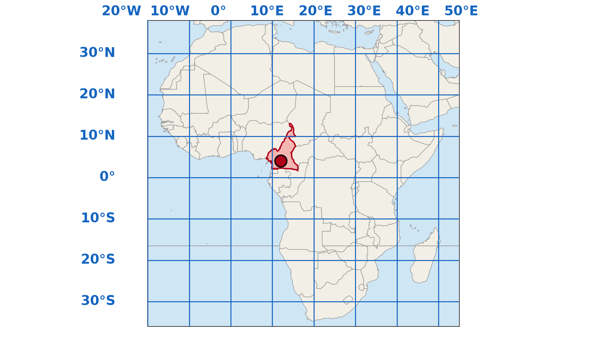
1. LATITUDINAL LOCATION
Activity 1
Africa with latitudes and longitudes.
Notes:
Activity 1. Look carefully at this diagram: africa with latitudes and longitudes. Observe every detail before I ask the question.

Slide 19
1. LATITUDINAL LOCATION
Activity 1: Question
Between which latitudes and longitudes is Cameroon found?
Notes:
Here is the question for Activity 1: Between which latitudes and longitudes is Cameroon found? Take one minute to think and write your answer in your rough notebook.

Slide 20
1. LATITUDINAL LOCATION
Activity 1: Answer
Between about 2° N and 13° N, and between about 8° E and 16° E.
Notes:
Let us check the answer together. Between about 2° N and 13° N, and between about 8° E and 16° E.

Slide 21

1. RELATIVE LOCATION
Activity 2
Cameroon in Africa.
Notes:
Activity 2. Look carefully at this diagram: cameroon in Africa. Observe every detail before I ask the question.

Slide 22
1. RELATIVE LOCATION
Activity 2: Question
In which part of Africa is Cameroon found?
Notes:
Here is the question for Activity 2: In which part of Africa is Cameroon found? Take one minute to think and write your answer in your rough notebook.

Slide 23
1. RELATIVE LOCATION
Activity 2: Answer
In Central Africa, at the hinge between West and Central Africa, on the Gulf of Guinea.
Notes:
Let us check the answer together. In Central Africa, at the hinge between West and Central Africa, on the Gulf of Guinea.

Slide 24
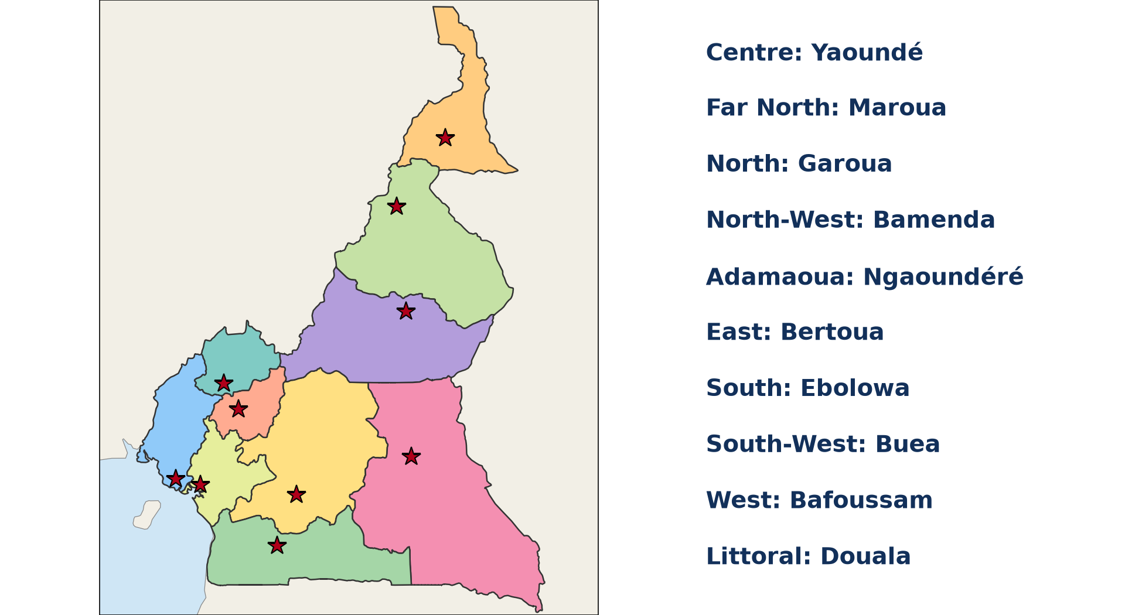
1. NEIGHBOURS
Activity 3
Cameroon and its regions.
Notes:
Activity 3. Look carefully at this diagram: cameroon and its regions. Observe every detail before I ask the question.

Slide 25
1. NEIGHBOURS
Activity 3: Question
Name the six neighbours of Cameroon.
Notes:
Here is the question for Activity 3: Name the six neighbours of Cameroon. Take one minute to think and write your answer in your rough notebook.

Slide 26
1. NEIGHBOURS
Activity 3: Answer
Nigeria, Chad, the Central African Republic, Congo, Gabon and Equatorial Guinea.
Notes:
Let us check the answer together. Nigeria, Chad, the Central African Republic, Congo, Gabon and Equatorial Guinea.

Slide 27

2. SIZE
Activity 4
The shape of Cameroon.
Notes:
Activity 4. Look carefully at this diagram: the shape of Cameroon. Observe every detail before I ask the question.

Slide 28
2. SIZE
Activity 4: Question
What is the area of Cameroon?
Notes:
Here is the question for Activity 4: What is the area of Cameroon? Take one minute to think and write your answer in your rough notebook.

Slide 29
2. SIZE
Activity 4: Answer
About 475,000 km².
Notes:
Let us check the answer together. About 475,000 km².

Slide 30

2. SHAPE
Activity 5
The shape of Cameroon.
Notes:
Activity 5. Look carefully at this diagram: the shape of Cameroon. Observe every detail before I ask the question.

Slide 31
2. SHAPE
Activity 5: Question
Describe the shape of Cameroon.
Notes:
Here is the question for Activity 5: Describe the shape of Cameroon. Take one minute to think and write your answer in your rough notebook.

Slide 32
2. SHAPE
Activity 5: Answer
It is a triangle, long from south to north (about 1,200 km), narrow in the north.
Notes:
Let us check the answer together. It is a triangle, long from south to north (about 1,200 km), narrow in the north.

Slide 33
BOARD SUMMARY
Board Summary
Topic: The Physical Geography of Cameroon
Sub-topic: Background of Cameroon
Lesson 12: The Situation of Cameroon
Notes:
Now we are going to copy the board summary. Write the title and the headings neatly in your notebooks. I will give you enough time for each slide, so do not rush.

Slide 34
BOARD SUMMARY
1. Location
Cameroon is located as follows:
Latitudinal location: It lies between about 2° N and 13° N and between about 8° E and 16° E.
Relative location: It is in Central Africa, on the Gulf of Guinea, at the hinge of West and Central Africa.
Notes:
Let us copy Location. Cameroon is located as follows. On this slide we have Latitudinal location and Relative location. Write each point on a new line, with the key term first, and explain it in your own words when we revise. When you finish, we go to the next slide.

Slide 35
BOARD SUMMARY
1. Location (continued)
Neighbours: Its neighbours are Nigeria, Chad, the CAR, Congo, Gabon and Equatorial Guinea.
Notes:
We continue with Location. On this slide we have Neighbours. Write each point on a new line, with the key term first, and explain it in your own words when we revise.

Slide 36
BOARD SUMMARY
1. Location
Illustration: Cameroon in Africa
Notes:
Now draw this illustration in your notebook: cameroon in Africa. Give it a title and label it clearly.

Slide 37
BOARD SUMMARY
2. Size and Shape
Cameroon has the following size and shape:
Size: It covers about 475,000 km².
Shape: It is triangular, about 1,200 km long from the south to Lake Chad.
Coast: It has about 400 km of coast on the Atlantic Ocean.
Notes:
Let us copy Size and Shape. Cameroon has the following size and shape. On this slide we have Size, Shape and Coast. Write each point on a new line, with the key term first, and explain it in your own words when we revise.

Slide 38
FORMATIVE EVALUATION
Evaluation 1
Between which latitudes is Cameroon found?
Notes:
Now let us check what you have understood. Question 1: Between which latitudes is Cameroon found? Answer in your exercise book.

Slide 39
FORMATIVE EVALUATION
Expected Answer
About 2° N and 13° N.
Notes:
The expected answer is: about 2° N and 13° N. If you got it right, well done.

Slide 40
FORMATIVE EVALUATION
Evaluation 2
Name four neighbours of Cameroon.
Notes:
Now let us check what you have understood. Question 2: Name four neighbours of Cameroon. Answer in your exercise book.

Slide 41
FORMATIVE EVALUATION
Expected Answer
Nigeria, Chad, CAR and Gabon.
Notes:
The expected answer is: nigeria, Chad, CAR and Gabon. If you got it right, well done.

Slide 42
REMEDIATION
Remediation
Fill in the blanks:
Cameroon covers about ______ km².
The neighbour to the west is ______.
The lake in the far north is Lake ______.
Notes:
For those who need more practice, fill in the blanks in your exercise book. The answers are: number 1, 475,000; number 2, Nigeria; number 3, Chad.

Slide 43
HOMEWORK
Homework
Draw a sketch map of Cameroon and name its neighbours.
Notes:
For your homework: Draw a sketch map of Cameroon and name its neighbours. We shall correct it at the beginning of our next lesson.

Slide 44
NEXT LESSON
Next Lesson
Our next lesson will be on:
Lesson 13: The Relief of Cameroon
Notes:
Our next lesson will be on Lesson 13: The Relief of Cameroon. Thank you for your attention, and see you next time.

Slide 45
BILINGUAL GAME
Bilingual Game (Jeu Bilingue)
English | Français
Location | La localisation
Neighbour | Le voisin
Border | La frontière
Size | La superficie
Coast | La côte
Shape | La forme
Notes:
Let us play the bilingual game. I say a word in English, and you give me the French word. Then we do the reverse.

Slide 46
LOGBOOK
Official Logbook (1/2)
Module / Topic | The Physical Geography of Cameroon
Lesson Title | Lesson 12: The Situation of Cameroon
Expected Learning Outcomes | Give the latitudinal and longitudinal location of Cameroon. Name its neighbours and water bodies. State the size and shape of Cameroon.
Competence | Learners are able to locate Cameroon and describe its size and neighbours.
Notes:
I record this information in the official logbook of the class after the lesson.

Slide 47
LOGBOOK
Official Logbook (2/2)
Matter Taught | Location; Size and Shape.
Evaluation | Formative evaluation and remediation exercise.
Homework | Draw a sketch map of Cameroon and name its neighbours.
Enrolment / Present / Absent | ____ / ____ / ____
Achievement | To be completed after the lesson.
Notes:
I complete the second page of the logbook: the matter taught, the evaluation, the homework and the attendance.

Slide 48
TEACHER'S NOTE
Teacher's Note
Timing: Homework correction, plan, objectives 8 min | Recall, situation, action 10 min | 5 activities 30 min | Board summary (copying) 30 min | Evaluation, remediation 10 min | Homework, next lesson 5 min | Logbook 7 min
Without the projector (Activity 1): use the atlas.
Without the projector (Activity 2): point to Cameroon on a map.
Without the projector (Activity 3): draw the borders.
Without the projector (Activity 4): compare with Chad and Nigeria.
Without the projector (Activity 5): draw the outline.
Notes:
This slide is for me, the teacher: it gives the timing of the lesson and what to do if the projector is not available.

Slide 49
REFERENCES
References
Geography Syllabus, Forms I–V, MINESEC (2023) — Form 4, Module I: Ecological Systems and their Resources.
Diagrams and animations: drawn for this lesson (Geography Department).
Notes:
These are the references and picture credits used to prepare this lesson.

