Slide 1
FORM 4
GEOGRAPHY
Lesson 17
The Soils of Cameroon
Notes:
Good morning, class, and welcome to our geography lesson. I am your geography teacher, Mr Kamdem. Today we are starting Lesson 17: The Soils of Cameroon.

Slide 2
CLASS INFO
Class, Chapter and Duration
Class | Form 4
Chapter | Module I: Ecological Systems and their Resources
Duration | 2 periods (2 × 50 minutes)
Notes:
This lesson is for Form 4. It belongs to Module I: Ecological Systems and their Resources. We shall need 2 periods to cover it.

Slide 3
IDENTIFICATION
Lesson Identification
Topic | The Physical Geography of Cameroon
Sub-topic | The Bio-geographical Characteristics of Cameroon
Lesson | Lesson 17: The Soils of Cameroon
Notions / Concepts | Ferruginous, ferrallitic, alluvial, volcanic, hydromorphic soils.
Syllabus focus | Identification and location of main soil types; main characteristics of each type.
Competence | Learners are able to locate and describe the soils of Cameroon and their uses.
Notes:
Our topic is The Physical Geography of Cameroon, and the sub-topic is The Bio-geographical Characteristics of Cameroon. The key notions we shall use today are: ferruginous, ferrallitic, alluvial, volcanic, hydromorphic soils. At the end, you should be able to do this: learners are able to locate and describe the soils of Cameroon and their uses.

Slide 4

HOMEWORK CORRECTION
Correction of the Homework
Question (Lesson 16: The Vegetation of Cameroon):
Draw a sketch map of the vegetation of Cameroon with a key.
Notes:
Before we start the new lesson, let us correct the homework I gave you at the end of Lesson 16: The Vegetation of Cameroon. The question was: Draw a sketch map of the vegetation of Cameroon with a key. Take out your exercise books.

Slide 5
HOMEWORK CORRECTION
Correction: Possible Answer
The map shows mangrove (coast), dense forest (south and east), montane vegetation (west), savanna (Adamawa and North) and steppe (Far North).
Notes:
Here is a good answer. The map shows mangrove (coast), dense forest (south and east), montane vegetation (west), savanna (Adamawa and North) and steppe (Far North). Compare it with your own answer and correct your work in red.

Slide 6
LESSON PLAN
Lesson Plan
Correction of the homework
Objectives and recall
Real-life situation and action to take
Learning activities
Board summary
Evaluation, remediation and homework
Notes:
Here is the plan of our lesson today. First, we shall correct the homework. Then we shall look at the objectives and recall what you already know. After that, we shall study a situation from real life and the action to take, and do the learning activities. Finally, we shall copy the board summary, do the evaluation and the remediation, and I will give you the homework.

Slide 7
OBJECTIVES
Objectives
By the end of this lesson, you should be able to:
Identify and locate the main soil types of Cameroon.
Describe the characteristics of each type.
Relate soils to farming.
Notes:
By the end of this lesson, you should be able to do three things. Number 1: identify and locate the main soil types of Cameroon. Number 2: describe the characteristics of each type. Number 3: relate soils to farming.

Slide 8
PREVIOUS KNOWLEDGE
Previous Knowledge
Soils form from weathered rock and humus.
The south is wet and the north is dry.
Mount Cameroon is a volcano.
Notes:
Let us first remember what you already know. Soils form from weathered rock and humus. The south is wet and the north is dry. Mount Cameroon is a volcano. Keep this in mind, because we shall build on it today.

Slide 9
REAL-LIFE SITUATION
Situation in Real Life
Farmers in Buea grow tea and bananas on very fertile black soil, while farmers near Garoua use fertiliser on red soils. Near the Logone, farmers grow rice on heavy wet soils.
Notes:
Listen carefully to this situation from real life. Farmers in Buea grow tea and bananas on very fertile black soil, while farmers near Garoua use fertiliser on red soils. Near the Logone, farmers grow rice on heavy wet soils. Think about it, because I am going to ask you some questions.

Slide 10
REAL-LIFE SITUATION
Situation: Question 1
What is the problem in the situation?
Notes:
Question 1: What is the problem in the situation? Think for a moment, then raise your hand to answer.

Slide 11
REAL-LIFE SITUATION
Answer
We want to know why soils differ in Cameroon.
Notes:
Good. We want to know why soils differ in Cameroon.

Slide 12
REAL-LIFE SITUATION
Situation: Question 2
Why is the soil of Buea fertile?
Notes:
Question 2: Why is the soil of Buea fertile? Think for a moment, then raise your hand to answer.

Slide 13
REAL-LIFE SITUATION
Answer
It is volcanic soil.
Notes:
Good. It is volcanic soil.

Slide 14
REAL-LIFE SITUATION
Situation: Question 3
Which soil is found near the Logone?
Notes:
Question 3: Which soil is found near the Logone? Think for a moment, then raise your hand to answer.

Slide 15
REAL-LIFE SITUATION
Possible Answer
Hydromorphic (waterlogged) soil.
Notes:
Good. Hydromorphic (waterlogged) soil.

Slide 16
ACTION TO TAKE
Action to Take
Use each soil for the crops that suit it and protect it from erosion.
Notes:
From this situation, the action we are working towards in this lesson is the following: use each soil for the crops that suit it and protect it from erosion.

Slide 17
JUSTIFICATION
Justification of the Lesson
This lesson helps us to know the soils that feed our country.
Notes:
Why is this lesson important for you? This lesson helps us to know the soils that feed our country.

Slide 18
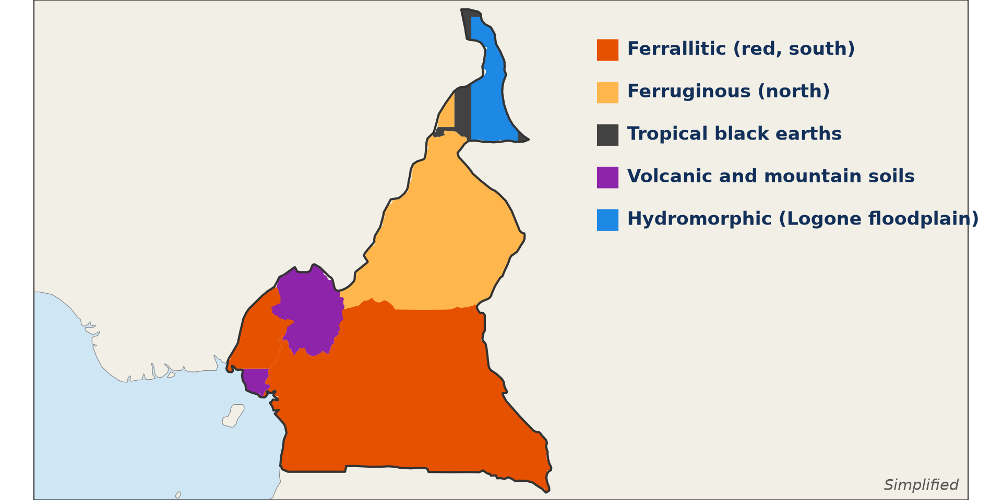
1. TYPES
Activity 1
The soils of Cameroon.
Notes:
Activity 1. Look carefully at this diagram: the soils of Cameroon. Observe every detail before I ask the question.

Slide 19
1. TYPES
Activity 1: Question
Name four soil types of Cameroon.
Notes:
Here is the question for Activity 1: Name four soil types of Cameroon. Take one minute to think and write your answer in your rough notebook.

Slide 20
1. TYPES
Activity 1: Answer
Ferrallitic, ferruginous, volcanic and hydromorphic soils (also alluvial).
Notes:
Let us check the answer together. Ferrallitic, ferruginous, volcanic and hydromorphic soils (also alluvial).

Slide 21

2. FERRALLITIC SOILS
Activity 2
A red soil.
Notes:
Activity 2. Look carefully at this picture: a red soil. Observe every detail before I ask the question.

Slide 22
2. FERRALLITIC SOILS
Activity 2: Question
Where are ferrallitic soils found and what are they like?
Notes:
Here is the question for Activity 2: Where are ferrallitic soils found and what are they like? Take one minute to think and write your answer in your rough notebook.

Slide 23
2. FERRALLITIC SOILS
Activity 2: Answer
In the forest south; red, deep and leached by heavy rain.
Notes:
Let us check the answer together. In the forest south; red, deep and leached by heavy rain.

Slide 24
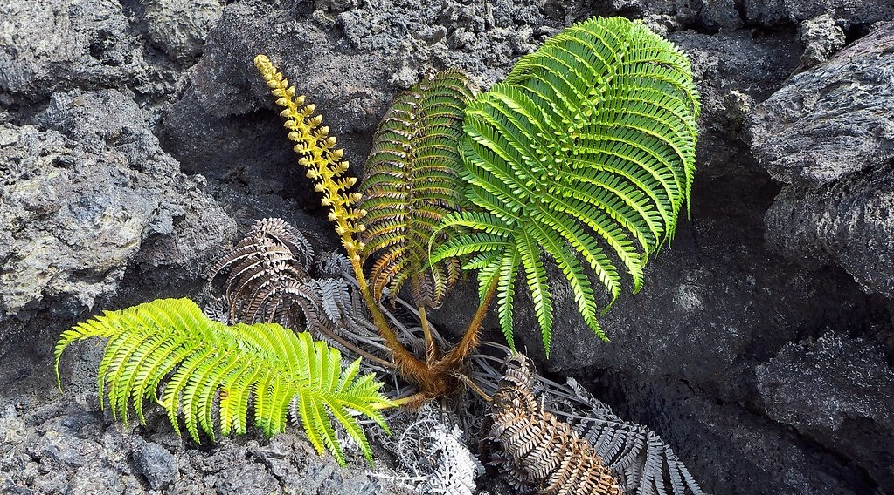
2. VOLCANIC SOILS
Activity 3
Plants growing on volcanic rock.
Notes:
Activity 3. Look carefully at this picture: plants growing on volcanic rock. Observe every detail before I ask the question.

Slide 25
2. VOLCANIC SOILS
Activity 3: Question
Why are volcanic soils fertile?
Notes:
Here is the question for Activity 3: Why are volcanic soils fertile? Take one minute to think and write your answer in your rough notebook.

Slide 26
2. VOLCANIC SOILS
Activity 3: Answer
They are rich in minerals from volcanic rock.
Notes:
Let us check the answer together. They are rich in minerals from volcanic rock.

Slide 27

2. FERRUGINOUS SOILS
Activity 4
A ferruginous soil with laterite.
Notes:
Activity 4. Look carefully at this picture: a ferruginous soil with laterite. Observe every detail before I ask the question.

Slide 28
2. FERRUGINOUS SOILS
Activity 4: Question
Where are ferruginous soils found?
Notes:
Here is the question for Activity 4: Where are ferruginous soils found? Take one minute to think and write your answer in your rough notebook.

Slide 29
2. FERRUGINOUS SOILS
Activity 4: Answer
In the savanna of the north and Adamawa.
Notes:
Let us check the answer together. In the savanna of the north and Adamawa.

Slide 30

2. HYDROMORPHIC AND ALLUVIAL SOILS
Activity 5
Rice on wet soils.
Notes:
Activity 5. Look carefully at this picture: rice on wet soils. Observe every detail before I ask the question.

Slide 31
2. HYDROMORPHIC AND ALLUVIAL SOILS
Activity 5: Question
Where are hydromorphic and alluvial soils found and what are they used for?
Notes:
Here is the question for Activity 5: Where are hydromorphic and alluvial soils found and what are they used for? Take one minute to think and write your answer in your rough notebook.

Slide 32
2. HYDROMORPHIC AND ALLUVIAL SOILS
Activity 5: Answer
On floodplains of the Logone and the Benue; used for rice and vegetables.
Notes:
Let us check the answer together. On floodplains of the Logone and the Benue; used for rice and vegetables.

Slide 33
BOARD SUMMARY
Board Summary
Topic: The Physical Geography of Cameroon
Sub-topic: The Bio-geographical Characteristics of Cameroon
Lesson 17: The Soils of Cameroon
Notes:
Now we are going to copy the board summary. Write the title and the headings neatly in your notebooks. I will give you enough time for each slide, so do not rush.

Slide 34
BOARD SUMMARY
1. Main Soil Types
Cameroon has the following soil types:
Ferrallitic soils: They are red, deep, leached soils of the forest south.
Ferruginous soils: They are red or brown soils of the savanna north, sometimes with laterite.
Notes:
Let us copy Main Soil Types. Cameroon has the following soil types. On this slide we have Ferrallitic soils and Ferruginous soils. Write each point on a new line, with the key term first, and explain it in your own words when we revise. When you finish, we go to the next slide.

Slide 35
BOARD SUMMARY
1. Main Soil Types (continued)
Volcanic soils: They are dark, very fertile soils of the Western Highlands and Mount Cameroon.
Hydromorphic soils: They are waterlogged soils of the Logone floodplain and swamps.
Alluvial soils: They are fertile soils deposited by rivers such as the Benue.
Notes:
We continue with Main Soil Types. On this slide we have Volcanic soils, Hydromorphic soils and Alluvial soils. Write each point on a new line, with the key term first, and explain it in your own words when we revise.

Slide 36
BOARD SUMMARY
1. Main Soil Types
Illustration: the soils of Cameroon
Notes:
Now draw this illustration in your notebook: the soils of Cameroon. Give it a title and label it clearly.

Slide 37
FORMATIVE EVALUATION
Evaluation 1
Name three soil types of Cameroon.
Notes:
Now let us check what you have understood. Question 1: Name three soil types of Cameroon. Answer in your exercise book.

Slide 38
FORMATIVE EVALUATION
Expected Answer
Ferrallitic, ferruginous and volcanic.
Notes:
The expected answer is: ferrallitic, ferruginous and volcanic. If you got it right, well done.

Slide 39
FORMATIVE EVALUATION
Evaluation 2
Which soil is the most fertile?
Notes:
Now let us check what you have understood. Question 2: Which soil is the most fertile? Answer in your exercise book.

Slide 40
FORMATIVE EVALUATION
Expected Answer
Volcanic soil.
Notes:
The expected answer is: volcanic soil. If you got it right, well done.

Slide 41
REMEDIATION
Remediation
Fill in the blanks:
The soils of the forest are ______.
The soils of the savanna are ______.
Waterlogged soils are ______.
Notes:
For those who need more practice, fill in the blanks in your exercise book. The answers are: number 1, ferrallitic; number 2, ferruginous; number 3, hydromorphic.

Slide 42
HOMEWORK
Homework
Name the soil type of your area and two crops grown on it.
Notes:
For your homework: Name the soil type of your area and two crops grown on it. We shall correct it at the beginning of our next lesson.

Slide 43
NEXT LESSON
Next Lesson
Our next lesson will be on:
Further Study 1: The Bio-geographical Regions of Cameroon
Notes:
Our next lesson will be on Further Study 1: The Bio-geographical Regions of Cameroon. Thank you for your attention, and see you next time.

Slide 44
BILINGUAL GAME
Bilingual Game (Jeu Bilingue)
English | Français
Soil | Le sol
Volcanic | Volcanique
Alluvial | Alluvial
Fertile | Fertile
Floodplain | La plaine d'inondation
Crop | La culture
Notes:
Let us play the bilingual game. I say a word in English, and you give me the French word. Then we do the reverse.

Slide 45
LOGBOOK
Official Logbook (1/2)
Module / Topic | The Physical Geography of Cameroon
Lesson Title | Lesson 17: The Soils of Cameroon
Expected Learning Outcomes | Identify and locate the main soil types of Cameroon. Describe the characteristics of each type. Relate soils to farming.
Competence | Learners are able to locate and describe the soils of Cameroon and their uses.
Notes:
I record this information in the official logbook of the class after the lesson.

Slide 46
LOGBOOK
Official Logbook (2/2)
Matter Taught | Main Soil Types.
Evaluation | Formative evaluation and remediation exercise.
Homework | Name the soil type of your area and two crops grown on it.
Enrolment / Present / Absent | ____ / ____ / ____
Achievement | To be completed after the lesson.
Notes:
I complete the second page of the logbook: the matter taught, the evaluation, the homework and the attendance.

Slide 47
TEACHER'S NOTE
Teacher's Note
Timing: Homework correction, plan, objectives 8 min | Recall, situation, action 10 min | 5 activities 30 min | Board summary (copying) 30 min | Evaluation, remediation 10 min | Homework, next lesson 5 min | Logbook 7 min
Without the projector (Activity 1): draw the map.
Without the projector (Activity 2): show red soil.
Without the projector (Activity 3): name crops of Buea.
Without the projector (Activity 4): describe soils of Garoua.
Without the projector (Activity 5): name floodplain crops.
Notes:
This slide is for me, the teacher: it gives the timing of the lesson and what to do if the projector is not available.

Slide 48
REFERENCES
References
Geography Syllabus, Forms I–V, MINESEC (2023) — Form 4, Module I: Ecological Systems and their Resources.
Photo, Activity 2: “in the middle of nowhere, morocco” by mariusz kluzniak, CC BY-NC-ND 2.0, via Flickr (https://www.flickr.com/photos/39997856@N03/8398997251)
Photo, Activity 3: “Fern Growing in Lava” by Ed Suominen, CC BY-NC 2.0, via Flickr (https://www.flickr.com/photos/37960170@N07/9688955410)
Photo, Activity 4: “Laterite soil bricks in Richard Rebello's farm” by India Water Portal, CC BY-NC-SA 2.0, via Flickr (https://www.flickr.com/photos/21623815@N03/10720461943)
Photo, Activity 5: “Irrigated rice fields in Sefula, Zambia. Photo by Kate Longley, 2013.” by WorldFish, CC BY-NC-ND 2.0, via Flickr (https://www.flickr.com/photos/61545321@N06/8608804590)
Diagrams and animations: drawn for this lesson (Geography Department).
Notes:
These are the references and picture credits used to prepare this lesson.

