Slide 1
FORM 4
GEOGRAPHY
Practical Work 1
Basic Principles of Map Analysis
Notes:
Good morning, class, and welcome to our geography lesson. I am your geography teacher, Mr Kamdem. Today we are starting Practical Work 1: Basic Principles of Map Analysis.

Slide 2
CLASS INFO
Class, Chapter and Duration
Class | Form 4
Chapter | Module I: Ecological Systems and their Resources
Duration | 2 periods (2 × 50 minutes)
Notes:
This lesson is for Form 4. It belongs to Module I: Ecological Systems and their Resources. We shall need 2 periods to cover it.

Slide 3
IDENTIFICATION
Lesson Identification
Topic | Initiation to Map Analysis
Sub-topic | Map Reading
Lesson | Practical Work 1: Basic Principles of Map Analysis
Notions / Concepts | Map, map reading, map interpretation, marginal information.
Syllabus focus | Definition of a map and of map reading and interpretation; marginal information and its importance (title, key, scale, orientation).
Competence | Learners are able to use the marginal information of a map to read it correctly.
Notes:
Our topic is Initiation to Map Analysis, and the sub-topic is Map Reading. The key notions we shall use today are: map, map reading, map interpretation, marginal information. At the end, you should be able to do this: learners are able to use the marginal information of a map to read it correctly.

Slide 4

HOMEWORK CORRECTION
Correction of the Homework
Question (Further Study 1: The Bio-geographical Regions of Cameroon):
Write a paragraph describing the bio-geographical region where you live.
Notes:
Before we start the new lesson, let us correct the homework I gave you at the end of Further Study 1: The Bio-geographical Regions of Cameroon. The question was: Write a paragraph describing the bio-geographical region where you live. Take out your exercise books.

Slide 5
HOMEWORK CORRECTION
Correction: Possible Answer
Example: Garoua is in the savanna region; it is hot with one rainy season; the vegetation is savanna on ferruginous soils; people grow cotton and cereals and rear cattle.
Notes:
Here is a good answer. Example: Garoua is in the savanna region; it is hot with one rainy season; the vegetation is savanna on ferruginous soils; people grow cotton and cereals and rear cattle. Compare it with your own answer and correct your work in red.

Slide 6
LESSON PLAN
Lesson Plan
Correction of the homework
Objectives and recall
Real-life situation and action to take
Learning activities
Board summary
Evaluation, remediation and homework
Notes:
Here is the plan of our lesson today. First, we shall correct the homework. Then we shall look at the objectives and recall what you already know. After that, we shall study a situation from real life and the action to take, and do the learning activities. Finally, we shall copy the board summary, do the evaluation and the remediation, and I will give you the homework.

Slide 7
OBJECTIVES
Objectives
By the end of this lesson, you should be able to:
Define a map, map reading and map interpretation.
Identify the marginal information of a map.
Notes:
Take your time to copy this part; we will continue together.

Slide 8
OBJECTIVES
Objectives (continued)
Explain the importance of each element.
Notes:
By the end of this lesson, you should be able to do three things. Number 1: define a map, map reading and map interpretation. Number 2: identify the marginal information of a map. Number 3: explain the importance of each element.

Slide 9
PREVIOUS KNOWLEDGE
Previous Knowledge
A map is a drawing of the Earth on a flat surface.
Maps have a title and a key.
The scale helps to calculate distances.
Notes:
Let us first remember what you already know. A map is a drawing of the Earth on a flat surface. Maps have a title and a key. The scale helps to calculate distances. Keep this in mind, because we shall build on it today.

Slide 10
REAL-LIFE SITUATION
Situation in Real Life
The class receives a topographic map of an area of Cameroon. Before answering questions, the teacher asks them to read everything written around the map.
Notes:
Listen carefully to this situation from real life. The class receives a topographic map of an area of Cameroon. Before answering questions, the teacher asks them to read everything written around the map. Think about it, because I am going to ask you some questions.

Slide 11
REAL-LIFE SITUATION
Situation: Question 1
What is the problem in the situation?
Notes:
Question 1: What is the problem in the situation? Think for a moment, then raise your hand to answer.

Slide 12
REAL-LIFE SITUATION
Answer
Learners must read the marginal information of the map.
Notes:
Good. Learners must read the marginal information of the map.

Slide 13
REAL-LIFE SITUATION
Situation: Question 2
What is written around a map?
Notes:
Question 2: What is written around a map? Think for a moment, then raise your hand to answer.

Slide 14
REAL-LIFE SITUATION
Answer
The title, the key, the scale and the north arrow.
Notes:
Good. The title, the key, the scale and the north arrow.

Slide 15
REAL-LIFE SITUATION
Situation: Question 3
Why read them first?
Notes:
Question 3: Why read them first? Think for a moment, then raise your hand to answer.

Slide 16
REAL-LIFE SITUATION
Possible Answer
To understand what the map shows and how to measure it.
Notes:
Good. To understand what the map shows and how to measure it.

Slide 17
ACTION TO TAKE
Action to Take
Always read the title, key, scale and orientation before studying a map.
Notes:
From this situation, the action we are working towards in this lesson is the following: always read the title, key, scale and orientation before studying a map.

Slide 18
JUSTIFICATION
Justification of the Lesson
This practical work helps us to begin every map study correctly.
Notes:
Why is this lesson important for you? This practical work helps us to begin every map study correctly.

Slide 19
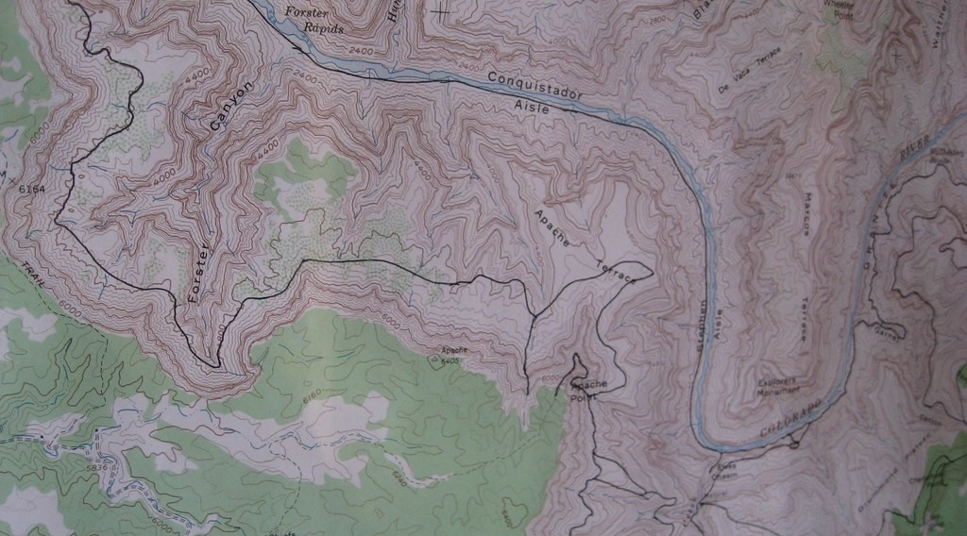
1. MEANING
Activity 1
A topographic map.
Notes:
Activity 1. Look carefully at this picture: a topographic map. Observe every detail before I ask the question.

Slide 20
1. MEANING
Activity 1: Question
What is a topographic map?
Notes:
Here is the question for Activity 1: What is a topographic map? Take one minute to think and write your answer in your rough notebook.

Slide 21
1. MEANING
Activity 1: Answer
A detailed map that shows relief, rivers, vegetation, settlements and roads of an area.
Notes:
Let us check the answer together. A detailed map that shows relief, rivers, vegetation, settlements and roads of an area.

Slide 22
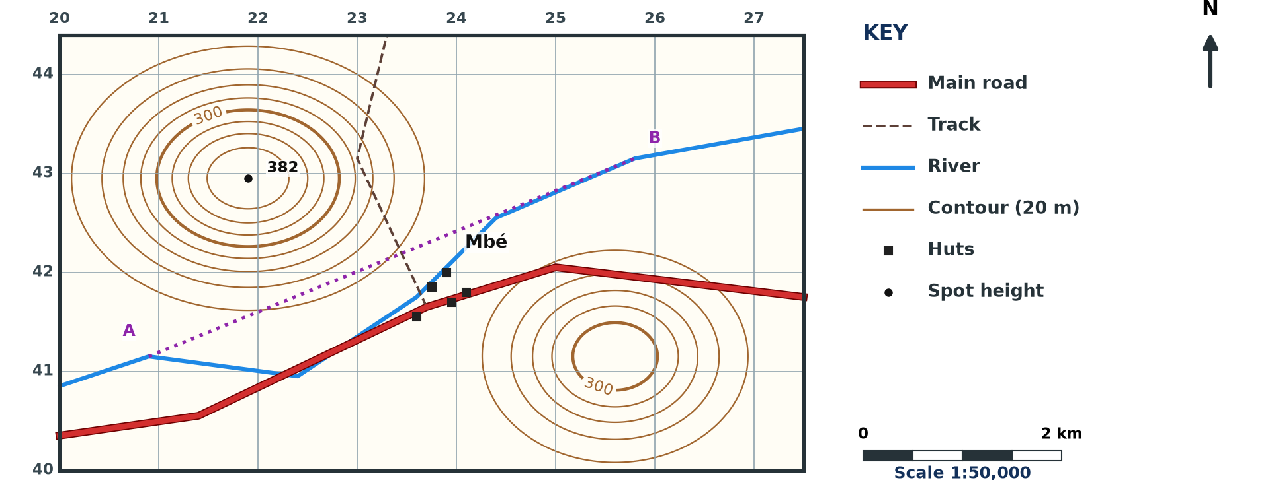
1. READING AND INTERPRETATION
Activity 2
A map extract (invented).
Notes:
Activity 2. Look carefully at this diagram: a map extract (invented). Observe every detail before I ask the question.

Slide 23
1. READING AND INTERPRETATION
Activity 2: Question
Distinguish map reading from map interpretation.
Notes:
Here is the question for Activity 2: Distinguish map reading from map interpretation. Take one minute to think and write your answer in your rough notebook.

Slide 24
1. READING AND INTERPRETATION
Activity 2: Answer
Reading is identifying what is on the map; interpretation is explaining why it is there.
Notes:
Let us check the answer together. Reading is identifying what is on the map; interpretation is explaining why it is there.

Slide 25

2. MARGINAL INFORMATION
Activity 3
The marginal information of a map.
Notes:
Activity 3. Look carefully at this diagram: the marginal information of a map. Observe every detail before I ask the question.

Slide 26
2. MARGINAL INFORMATION
Activity 3: Question
Name four elements of the marginal information.
Notes:
Here is the question for Activity 3: Name four elements of the marginal information. Take one minute to think and write your answer in your rough notebook.

Slide 27
2. MARGINAL INFORMATION
Activity 3: Answer
Title, key, scale and north arrow (also grid lines, date, publisher).
Notes:
Let us check the answer together. Title, key, scale and north arrow (also grid lines, date, publisher).

Slide 28

2. THE KEY
Activity 4
Signs of a key.
Notes:
Activity 4. Look carefully at this diagram: signs of a key. Observe every detail before I ask the question.

Slide 29
2. THE KEY
Activity 4: Question
What is the importance of the key?
Notes:
Here is the question for Activity 4: What is the importance of the key? Take one minute to think and write your answer in your rough notebook.

Slide 30
2. THE KEY
Activity 4: Answer
It explains the signs and colours used on the map.
Notes:
Let us check the answer together. It explains the signs and colours used on the map.

Slide 31
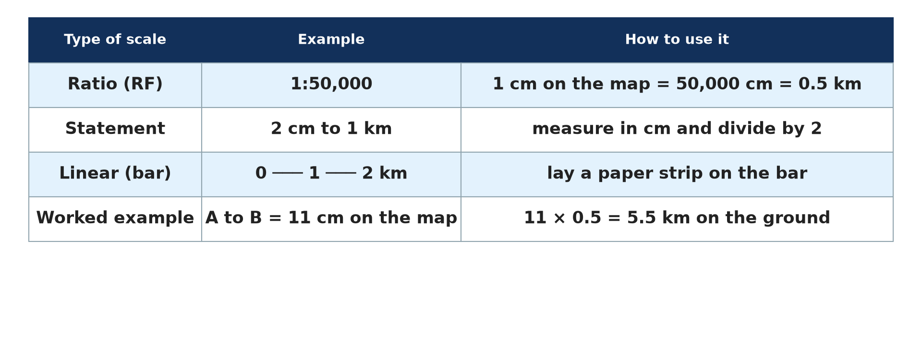
2. SCALE AND ORIENTATION
Activity 5
Types of scale.
Notes:
Activity 5. Look carefully at this diagram: types of scale. Observe every detail before I ask the question.

Slide 32
2. SCALE AND ORIENTATION
Activity 5: Question
What are the scale and the north arrow used for?
Notes:
Here is the question for Activity 5: What are the scale and the north arrow used for? Take one minute to think and write your answer in your rough notebook.

Slide 33
2. SCALE AND ORIENTATION
Activity 5: Answer
The scale helps to measure distances; the north arrow gives directions.
Notes:
Let us check the answer together. The scale helps to measure distances; the north arrow gives directions.

Slide 34
BOARD SUMMARY
Board Summary
Topic: Initiation to Map Analysis
Sub-topic: Map Reading
Practical Work 1: Basic Principles of Map Analysis
Notes:
Now we are going to copy the board summary. Write the title and the headings neatly in your notebooks. I will give you enough time for each slide, so do not rush.

Slide 35
BOARD SUMMARY
DEFINITIONS
The key terms of this lesson are defined as follows:
Map: It is a representation of the Earth or part of it on a flat surface, drawn to scale.
Map reading: It is identifying the features shown on a map.
Notes:
Let us copy the definitions. The key terms of this lesson are defined as follows. On this slide we have Map and Map reading. Write each point on a new line, with the key term first, and explain it in your own words when we revise. When you finish, we go to the next slide.

Slide 36
BOARD SUMMARY
DEFINITIONS (continued)
Map interpretation: It is explaining the features and their relationships.
Notes:
We continue with the definitions. On this slide we have Map interpretation. Write each point on a new line, with the key term first, and explain it in your own words when we revise.

Slide 37
BOARD SUMMARY
1. Marginal Information and its Importance
A map has the following marginal information:
Title: It tells what area or subject the map shows.
Key (legend): It explains the signs, symbols and colours used.
Notes:
Let us copy Marginal Information and its Importance. A map has the following marginal information. On this slide we have Title and Key (legend). Write each point on a new line, with the key term first, and explain it in your own words when we revise. When you finish, we go to the next slide.

Slide 38
BOARD SUMMARY
1. Marginal Information and its Importance (continued)
Scale: It gives the relation between map distance and ground distance.
Orientation: The north arrow shows the direction of north.
Notes:
We continue with Marginal Information and its Importance. On this slide we have Scale and Orientation. Write each point on a new line, with the key term first, and explain it in your own words when we revise.

Slide 39
BOARD SUMMARY
1. Marginal Information and its Importance
Illustration: marginal information of a map
Notes:
Now draw this illustration in your notebook: marginal information of a map. Give it a title and label it clearly.

Slide 40
FORMATIVE EVALUATION
Evaluation 1
Distinguish map reading and map interpretation.
Notes:
Now let us check what you have understood. Question 1: Distinguish map reading and map interpretation. Answer in your exercise book.

Slide 41
FORMATIVE EVALUATION
Expected Answer
Reading identifies features; interpretation explains them.
Notes:
The expected answer is: reading identifies features; interpretation explains them. If you got it right, well done.

Slide 42
FORMATIVE EVALUATION
Evaluation 2
Why is the key important?
Notes:
Now let us check what you have understood. Question 2: Why is the key important? Answer in your exercise book.

Slide 43
FORMATIVE EVALUATION
Expected Answer
It explains the signs used on the map.
Notes:
The expected answer is: it explains the signs used on the map. If you got it right, well done.

Slide 44
REMEDIATION
Remediation
Fill in the blanks:
The key is also called the ______.
The ______ shows the direction of north.
Distances are measured with the ______.
Notes:
For those who need more practice, fill in the blanks in your exercise book. The answers are: number 1, legend; number 2, north arrow; number 3, scale.

Slide 45
HOMEWORK
Homework
List the marginal information found on a map in your atlas.
Notes:
For your homework: List the marginal information found on a map in your atlas. We shall correct it at the beginning of our next lesson.

Slide 46
NEXT LESSON
Next Lesson
Our next lesson will be on:
Practical Work 2: Conventional Signs and Symbols on Ordnance Survey Maps
Notes:
Our next lesson will be on Practical Work 2: Conventional Signs and Symbols on Ordnance Survey Maps. Thank you for your attention, and see you next time.

Slide 47
BILINGUAL GAME
Bilingual Game (Jeu Bilingue)
English | Français
Map | La carte
Legend | La légende
Scale | L'échelle
Title | Le titre
North | Le nord
Interpretation | L'interprétation
Notes:
Let us play the bilingual game. I say a word in English, and you give me the French word. Then we do the reverse.

Slide 48
LOGBOOK
Official Logbook (1/2)
Module / Topic | Initiation to Map Analysis
Lesson Title | Practical Work 1: Basic Principles of Map Analysis
Expected Learning Outcomes | Define a map, map reading and map interpretation. Identify the marginal information of a map. Explain the importance of each element.
Competence | Learners are able to use the marginal information of a map to read it correctly.
Notes:
I record this information in the official logbook of the class after the lesson.

Slide 49
LOGBOOK
Official Logbook (2/2)
Matter Taught | DEFINITIONS; Marginal Information and its Importance.
Evaluation | Formative evaluation and remediation exercise.
Homework | List the marginal information found on a map in your atlas.
Enrolment / Present / Absent | ____ / ____ / ____
Achievement | To be completed after the lesson.
Notes:
I complete the second page of the logbook: the matter taught, the evaluation, the homework and the attendance.

Slide 50
TEACHER'S NOTE
Teacher's Note
Timing: Homework correction, plan, objectives 8 min | Recall, situation, action 10 min | 5 activities 30 min | Board summary (copying) 30 min | Evaluation, remediation 10 min | Homework, next lesson 5 min | Logbook 7 min
Without the projector (Activity 1): show a topographic map.
Without the projector (Activity 2): give examples.
Without the projector (Activity 3): draw a framed map.
Without the projector (Activity 4): draw five signs.
Without the projector (Activity 5): point to north.
Notes:
This slide is for me, the teacher: it gives the timing of the lesson and what to do if the projector is not available.

Slide 51
REFERENCES
References
Geography Syllabus, Forms I–V, MINESEC (2023) — Form 4, Module I: Ecological Systems and their Resources.
Photo, Activity 1: “Harvey Butchart's hiking map” by brewbooks, CC BY-SA 2.0, via Flickr (https://www.flickr.com/photos/93452909@N00/5289678354)
Diagrams and animations: drawn for this lesson (Geography Department).
Notes:
These are the references and picture credits used to prepare this lesson.

