Slide 1
FORM 4
GEOGRAPHY
Practical Work 3
Gridlines and Locational References on Maps
Notes:
Good morning, class, and welcome to our geography lesson. I am your geography teacher, Mr Kamdem. Today we are starting Practical Work 3: Gridlines and Locational References on Maps.

Slide 2
CLASS INFO
Class, Chapter and Duration
Class | Form 4
Chapter | Module I: Ecological Systems and their Resources
Duration | 2 periods (2 × 50 minutes)
Notes:
This lesson is for Form 4. It belongs to Module I: Ecological Systems and their Resources. We shall need 2 periods to cover it.

Slide 3
IDENTIFICATION
Lesson Identification
Topic | Initiation to Map Analysis
Sub-topic | Map Reading
Lesson | Practical Work 3: Gridlines and Locational References on Maps
Notions / Concepts | Grid line, easting, northing, four-figure reference, six-figure reference.
Syllabus focus | Meaning and presentation of gridlines (eastings and northings); four-figure (areas) and six-figure (points) grid references.
Competence | Learners are able to give four- and six-figure grid references.
Notes:
Our topic is Initiation to Map Analysis, and the sub-topic is Map Reading. The key notions we shall use today are: grid line, easting, northing, four-figure reference, six-figure reference. At the end, you should be able to do this: learners are able to give four- and six-figure grid references.

Slide 4

HOMEWORK CORRECTION
Correction of the Homework
Question (Practical Work 2: Conventional Signs and Symbols on Ordnance Survey Maps):
Draw ten conventional signs and write what each represents.
Notes:
Before we start the new lesson, let us correct the homework I gave you at the end of Practical Work 2: Conventional Signs and Symbols on Ordnance Survey Maps. The question was: Draw ten conventional signs and write what each represents. Take out your exercise books.

Slide 5
HOMEWORK CORRECTION
Correction: Possible Answer
Examples: road (red line), railway (line with bars), river (blue line), bridge, hut (black square), church (cross), school, forest (tree symbols), swamp (blue tufts), spot height (dot with number).
Notes:
Here is a good answer. Examples: road (red line), railway (line with bars), river (blue line), bridge, hut (black square), church (cross), school, forest (tree symbols), swamp (blue tufts), spot height (dot with number). Compare it with your own answer and correct your work in red.

Slide 6
LESSON PLAN
Lesson Plan
Correction of the homework
Objectives and recall
Real-life situation and action to take
Learning activities
Board summary
Evaluation, remediation and homework
Notes:
Here is the plan of our lesson today. First, we shall correct the homework. Then we shall look at the objectives and recall what you already know. After that, we shall study a situation from real life and the action to take, and do the learning activities. Finally, we shall copy the board summary, do the evaluation and the remediation, and I will give you the homework.

Slide 7
OBJECTIVES
Objectives
By the end of this lesson, you should be able to:
Define eastings and northings.
Give four-figure grid references for areas.
Notes:
Take your time to copy this part; we will continue together.

Slide 8
OBJECTIVES
Objectives (continued)
Give six-figure grid references for points.
Notes:
By the end of this lesson, you should be able to do three things. Number 1: define eastings and northings. Number 2: give four-figure grid references for areas. Number 3: give six-figure grid references for points.

Slide 9
PREVIOUS KNOWLEDGE
Previous Knowledge
Maps have grid lines.
Latitude and longitude locate places.
Numbers are written along map edges.
Notes:
Let us first remember what you already know. Maps have grid lines. Latitude and longitude locate places. Numbers are written along map edges. Keep this in mind, because we shall build on it today.

Slide 10
REAL-LIFE SITUATION
Situation in Real Life
During a map exercise, the teacher asks the class to locate a church using the numbers along the edges of the map. Many learners write the numbers in the wrong order.
Notes:
Listen carefully to this situation from real life. During a map exercise, the teacher asks the class to locate a church using the numbers along the edges of the map. Many learners write the numbers in the wrong order. Think about it, because I am going to ask you some questions.

Slide 11
REAL-LIFE SITUATION
Situation: Question 1
What is the problem in the situation?
Notes:
Question 1: What is the problem in the situation? Think for a moment, then raise your hand to answer.

Slide 12
REAL-LIFE SITUATION
Answer
Learners cannot give grid references correctly.
Notes:
Good. Learners cannot give grid references correctly.

Slide 13
REAL-LIFE SITUATION
Situation: Question 2
What are the vertical lines called?
Notes:
Question 2: What are the vertical lines called? Think for a moment, then raise your hand to answer.

Slide 14
REAL-LIFE SITUATION
Answer
Eastings.
Notes:
Good. Eastings.

Slide 15
REAL-LIFE SITUATION
Situation: Question 3
Which is written first?
Notes:
Question 3: Which is written first? Think for a moment, then raise your hand to answer.

Slide 16
REAL-LIFE SITUATION
Possible Answer
Eastings, then northings.
Notes:
Good. Eastings, then northings.

Slide 17
ACTION TO TAKE
Action to Take
Remember: "along the corridor, then up the stairs" — eastings first.
Notes:
From this situation, the action we are working towards in this lesson is the following: remember: "along the corridor, then up the stairs" — eastings first.

Slide 18
JUSTIFICATION
Justification of the Lesson
This practical work helps us to locate features precisely on maps.
Notes:
Why is this lesson important for you? This practical work helps us to locate features precisely on maps.

Slide 19
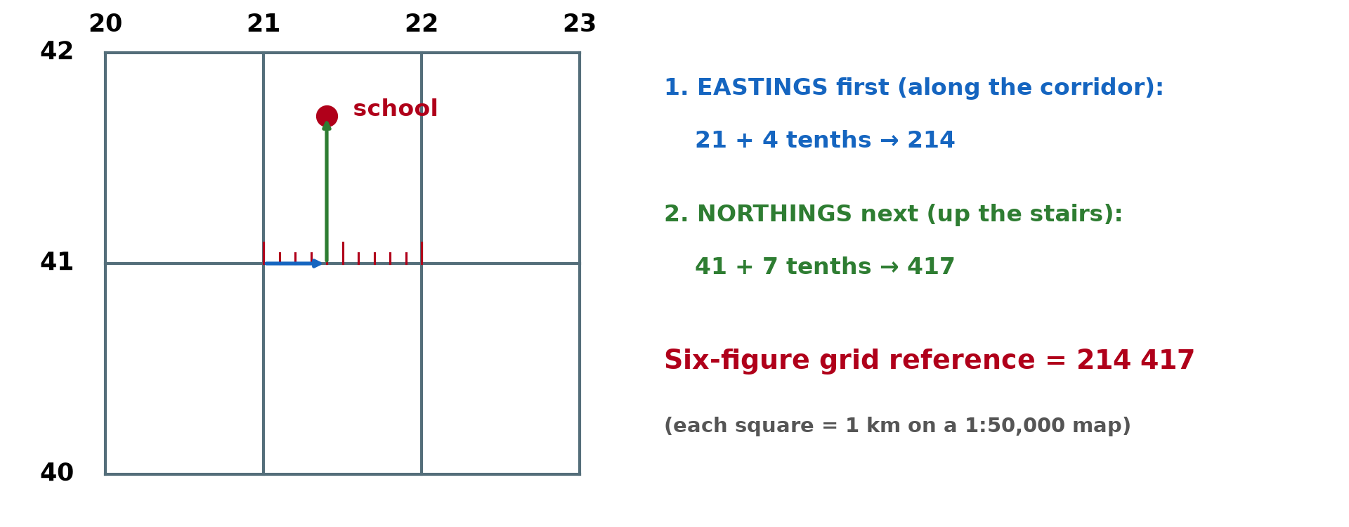
1. GRIDLINES
Activity 1
Eastings and northings.
Notes:
Activity 1. Look carefully at this diagram: eastings and northings. Observe every detail before I ask the question.

Slide 20
1. GRIDLINES
Activity 1: Question
Distinguish eastings and northings.
Notes:
Here is the question for Activity 1: Distinguish eastings and northings. Take one minute to think and write your answer in your rough notebook.

Slide 21
1. GRIDLINES
Activity 1: Answer
Eastings are vertical lines numbered from west to east; northings are horizontal lines numbered from south to north.
Notes:
Let us check the answer together. Eastings are vertical lines numbered from west to east; northings are horizontal lines numbered from south to north.

Slide 22
2. FOUR-FIGURE REFERENCE
Activity 2
A four-figure reference.
Notes:
Activity 2. Look carefully at this diagram: a four-figure reference. Observe every detail before I ask the question.

Slide 23
2. FOUR-FIGURE REFERENCE
Activity 2: Question
How is a four-figure reference given?
Notes:
Here is the question for Activity 2: How is a four-figure reference given? Take one minute to think and write your answer in your rough notebook.

Slide 24
2. FOUR-FIGURE REFERENCE
Activity 2: Answer
Easting of the left side of the square, then northing of the bottom side, e.g. 2345.
Notes:
Let us check the answer together. Easting of the left side of the square, then northing of the bottom side, e.g. 2345.

Slide 25
3. SIX-FIGURE REFERENCE
Activity 3
A six-figure reference.
Notes:
Activity 3. Look carefully at this diagram: a six-figure reference. Observe every detail before I ask the question.

Slide 26
3. SIX-FIGURE REFERENCE
Activity 3: Question
How is a six-figure reference given?
Notes:
Here is the question for Activity 3: How is a six-figure reference given? Take one minute to think and write your answer in your rough notebook.

Slide 27
3. SIX-FIGURE REFERENCE
Activity 3: Answer
Easting + tenths of the square, then northing + tenths, e.g. 234 456.
Notes:
Let us check the answer together. Easting + tenths of the square, then northing + tenths, e.g. 234 456.

Slide 28
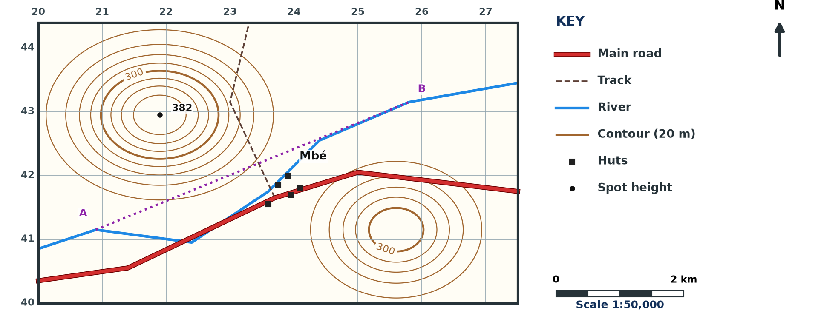
3. EXERCISE
Activity 4
A map extract (invented).
Notes:
Activity 4. Look carefully at this diagram: a map extract (invented). Observe every detail before I ask the question.

Slide 29
3. EXERCISE
Activity 4: Question
Why is a six-figure reference more precise than a four-figure one?
Notes:
Here is the question for Activity 4: Why is a six-figure reference more precise than a four-figure one? Take one minute to think and write your answer in your rough notebook.

Slide 30
3. EXERCISE
Activity 4: Answer
It locates a point within one-tenth of a square, not a whole square.
Notes:
Let us check the answer together. It locates a point within one-tenth of a square, not a whole square.

Slide 31
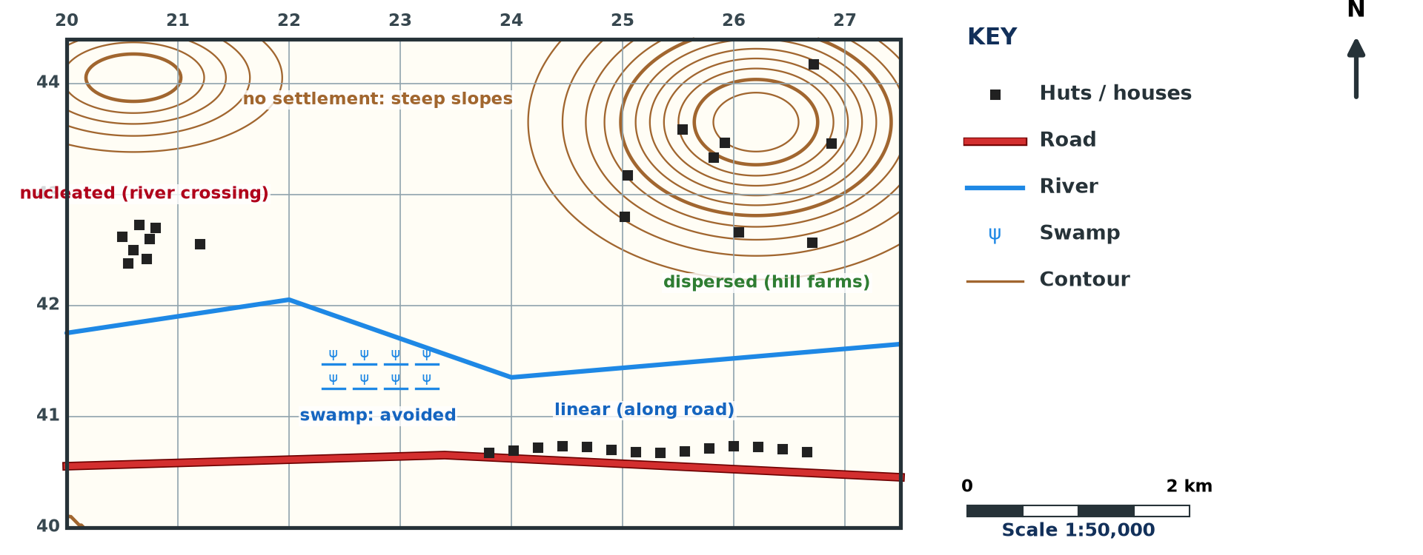
3. EXERCISE
Activity 5
Settlements on a map.
Notes:
Activity 5. Look carefully at this diagram: settlements on a map. Observe every detail before I ask the question.

Slide 32
3. EXERCISE
Activity 5: Question
Which reference is used for a village and which for a church?
Notes:
Here is the question for Activity 5: Which reference is used for a village and which for a church? Take one minute to think and write your answer in your rough notebook.

Slide 33
3. EXERCISE
Activity 5: Answer
Four-figure for an area such as a village; six-figure for a point such as a church.
Notes:
Let us check the answer together. Four-figure for an area such as a village; six-figure for a point such as a church.

Slide 34
BOARD SUMMARY
Board Summary
Topic: Initiation to Map Analysis
Sub-topic: Map Reading
Practical Work 3: Gridlines and Locational References on Maps
Notes:
Now we are going to copy the board summary. Write the title and the headings neatly in your notebooks. I will give you enough time for each slide, so do not rush.

Slide 35
BOARD SUMMARY
DEFINITIONS
The key terms of this lesson are defined as follows:
Eastings: They are vertical grid lines numbered from west to east.
Northings: They are horizontal grid lines numbered from south to north.
Notes:
Let us copy the definitions. The key terms of this lesson are defined as follows. On this slide we have Eastings and Northings. Write each point on a new line, with the key term first, and explain it in your own words when we revise.

Slide 36
BOARD SUMMARY
1. Four-figure Grid References
Four-figure references locate areas as follows:
Method: We write the easting of the left side of the square, then the northing of its bottom side.
Use: They locate areas such as villages, forests and lakes.
Notes:
Let us copy Four-figure Grid References. Four-figure references locate areas as follows. On this slide we have Method and Use. Write each point on a new line, with the key term first, and explain it in your own words when we revise.

Slide 37
BOARD SUMMARY
2. Six-figure Grid References
Six-figure references locate points as follows:
Method: We add the tenths of the square to the easting and then to the northing.
Use: They locate points such as churches, bridges and spot heights.
Notes:
Let us copy Six-figure Grid References. Six-figure references locate points as follows. On this slide we have Method and Use. Write each point on a new line, with the key term first, and explain it in your own words when we revise. When you finish, we go to the next slide.

Slide 38
BOARD SUMMARY
2. Six-figure Grid References (continued)
Rule: Eastings are always written before northings.
Notes:
We continue with Six-figure Grid References. On this slide we have Rule. Write each point on a new line, with the key term first, and explain it in your own words when we revise.

Slide 39
BOARD SUMMARY
2. Six-figure Grid References
Illustration: grid references
Notes:
Now draw this illustration in your notebook: grid references. Give it a title and label it clearly.

Slide 40
FORMATIVE EVALUATION
Evaluation 1
Which comes first in a grid reference?
Notes:
Now let us check what you have understood. Question 1: Which comes first in a grid reference? Answer in your exercise book.

Slide 41
FORMATIVE EVALUATION
Expected Answer
The easting.
Notes:
The expected answer is: the easting. If you got it right, well done.

Slide 42
FORMATIVE EVALUATION
Evaluation 2
What is a six-figure reference used for?
Notes:
Now let us check what you have understood. Question 2: What is a six-figure reference used for? Answer in your exercise book.

Slide 43
FORMATIVE EVALUATION
Expected Answer
To locate a point.
Notes:
The expected answer is: to locate a point. If you got it right, well done.

Slide 44
REMEDIATION
Remediation
Fill in the blanks:
Vertical grid lines are ______.
Horizontal grid lines are ______.
A point is located with a ______-figure reference.
Notes:
For those who need more practice, fill in the blanks in your exercise book. The answers are: number 1, eastings; number 2, northings; number 3, six.

Slide 45
HOMEWORK
Homework
On a map extract, give the four-figure reference of a village and the six-figure reference of a church.
Notes:
For your homework: On a map extract, give the four-figure reference of a village and the six-figure reference of a church. We shall correct it at the beginning of our next lesson.

Slide 46
NEXT LESSON
Next Lesson
Our next lesson will be on:
Practical Work 4: Directions on Maps
Notes:
Our next lesson will be on Practical Work 4: Directions on Maps. Thank you for your attention, and see you next time.

Slide 47
BILINGUAL GAME
Bilingual Game (Jeu Bilingue)
English | Français
Grid | Le quadrillage
Reference | La référence
Square | Le carré
Easting | L'abscisse
Northing | L'ordonnée
Point | Le point
Notes:
Let us play the bilingual game. I say a word in English, and you give me the French word. Then we do the reverse.

Slide 48
LOGBOOK
Official Logbook (1/2)
Module / Topic | Initiation to Map Analysis
Lesson Title | Practical Work 3: Gridlines and Locational References on Maps
Expected Learning Outcomes | Define eastings and northings. Give four-figure grid references for areas. Give six-figure grid references for points.
Competence | Learners are able to give four- and six-figure grid references.
Notes:
I record this information in the official logbook of the class after the lesson.

Slide 49
LOGBOOK
Official Logbook (2/2)
Matter Taught | DEFINITIONS; Four-figure Grid References; Six-figure Grid References.
Evaluation | Formative evaluation and remediation exercise.
Homework | On a map extract, give the four-figure reference of a village and the six-figure reference of a church.
Enrolment / Present / Absent | ____ / ____ / ____
Achievement | To be completed after the lesson.
Notes:
I complete the second page of the logbook: the matter taught, the evaluation, the homework and the attendance.

Slide 50
TEACHER'S NOTE
Teacher's Note
Timing: Homework correction, plan, objectives 8 min | Recall, situation, action 10 min | 5 activities 30 min | Board summary (copying) 30 min | Evaluation, remediation 10 min | Homework, next lesson 5 min | Logbook 7 min
Without the projector (Activity 1): draw a grid.
Without the projector (Activity 2): give examples on the grid.
Without the projector (Activity 3): divide a square into tenths.
Without the projector (Activity 4): practise on a map.
Without the projector (Activity 5): practise on a map.
Notes:
This slide is for me, the teacher: it gives the timing of the lesson and what to do if the projector is not available.

Slide 51
REFERENCES
References
Geography Syllabus, Forms I–V, MINESEC (2023) — Form 4, Module I: Ecological Systems and their Resources.
Diagrams and animations: drawn for this lesson (Geography Department).
Notes:
These are the references and picture credits used to prepare this lesson.

