Slide 1
FORM 4
GEOGRAPHY
Practical Work 4
Directions on Maps
Notes:
Good morning, class, and welcome to our geography lesson. I am your geography teacher, Mr Kamdem. Today we are starting Practical Work 4: Directions on Maps.

Slide 2
CLASS INFO
Class, Chapter and Duration
Class | Form 4
Chapter | Module I: Ecological Systems and their Resources
Duration | 2 periods (2 × 50 minutes)
Notes:
This lesson is for Form 4. It belongs to Module I: Ecological Systems and their Resources. We shall need 2 periods to cover it.

Slide 3
IDENTIFICATION
Lesson Identification
Topic | Initiation to Map Analysis
Sub-topic | Map Reading
Lesson | Practical Work 4: Directions on Maps
Notions / Concepts | Compass direction, cardinal points, bearing.
Syllabus focus | Compass directions; bearings.
Competence | Learners are able to give compass directions and bearings between places on a map.
Notes:
Our topic is Initiation to Map Analysis, and the sub-topic is Map Reading. The key notions we shall use today are: compass direction, cardinal points, bearing. At the end, you should be able to do this: learners are able to give compass directions and bearings between places on a map.

Slide 4

HOMEWORK CORRECTION
Correction of the Homework
Question (Practical Work 3: Gridlines and Locational References on Maps):
On a map extract, give the four-figure reference of a village and the six-figure reference of a church.
Notes:
Before we start the new lesson, let us correct the homework I gave you at the end of Practical Work 3: Gridlines and Locational References on Maps. The question was: On a map extract, give the four-figure reference of a village and the six-figure reference of a church. Take out your exercise books.

Slide 5
HOMEWORK CORRECTION
Correction: Possible Answer
Answers depend on the map. A correct answer writes the easting first: e.g. village 3452; church 347 523.
Notes:
Here is a good answer. Answers depend on the map. A correct answer writes the easting first: e.g. village 3452; church 347 523. Compare it with your own answer and correct your work in red.

Slide 6
LESSON PLAN
Lesson Plan
Correction of the homework
Objectives and recall
Real-life situation and action to take
Learning activities
Board summary
Evaluation, remediation and homework
Notes:
Here is the plan of our lesson today. First, we shall correct the homework. Then we shall look at the objectives and recall what you already know. After that, we shall study a situation from real life and the action to take, and do the learning activities. Finally, we shall copy the board summary, do the evaluation and the remediation, and I will give you the homework.

Slide 7
OBJECTIVES
Objectives
By the end of this lesson, you should be able to:
Name the 16 compass directions.
Define a bearing.
Measure bearings on a map.
Notes:
By the end of this lesson, you should be able to do three things. Number 1: name the 16 compass directions. Number 2: define a bearing. Number 3: measure bearings on a map.

Slide 8
PREVIOUS KNOWLEDGE
Previous Knowledge
The north arrow shows north.
The Sun rises in the east.
A circle has 360°.
Notes:
Let us first remember what you already know. The north arrow shows north. The Sun rises in the east. A circle has 360°. Keep this in mind, because we shall build on it today.

Slide 9
REAL-LIFE SITUATION
Situation in Real Life
A hunter lost in the bush has a map and a compass. He knows the village is to the north-east, but he needs a more precise direction.
Notes:
Listen carefully to this situation from real life. A hunter lost in the bush has a map and a compass. He knows the village is to the north-east, but he needs a more precise direction. Think about it, because I am going to ask you some questions.

Slide 10
REAL-LIFE SITUATION
Situation: Question 1
What is the problem in the situation?
Notes:
Question 1: What is the problem in the situation? Think for a moment, then raise your hand to answer.

Slide 11
REAL-LIFE SITUATION
Answer
The hunter needs a precise direction.
Notes:
Good. The hunter needs a precise direction.

Slide 12
REAL-LIFE SITUATION
Situation: Question 2
What does he know?
Notes:
Question 2: What does he know? Think for a moment, then raise your hand to answer.

Slide 13
REAL-LIFE SITUATION
Answer
The village is to the north-east.
Notes:
Good. The village is to the north-east.

Slide 14
REAL-LIFE SITUATION
Situation: Question 3
What gives a more precise direction?
Notes:
Question 3: What gives a more precise direction? Think for a moment, then raise your hand to answer.

Slide 15
REAL-LIFE SITUATION
Possible Answer
A bearing in degrees.
Notes:
Good. A bearing in degrees.

Slide 16
ACTION TO TAKE
Action to Take
Measure bearings clockwise from north with a protractor.
Notes:
From this situation, the action we are working towards in this lesson is the following: measure bearings clockwise from north with a protractor.

Slide 17
JUSTIFICATION
Justification of the Lesson
This practical work helps us to find directions on maps and in the field.
Notes:
Why is this lesson important for you? This practical work helps us to find directions on maps and in the field.

Slide 18
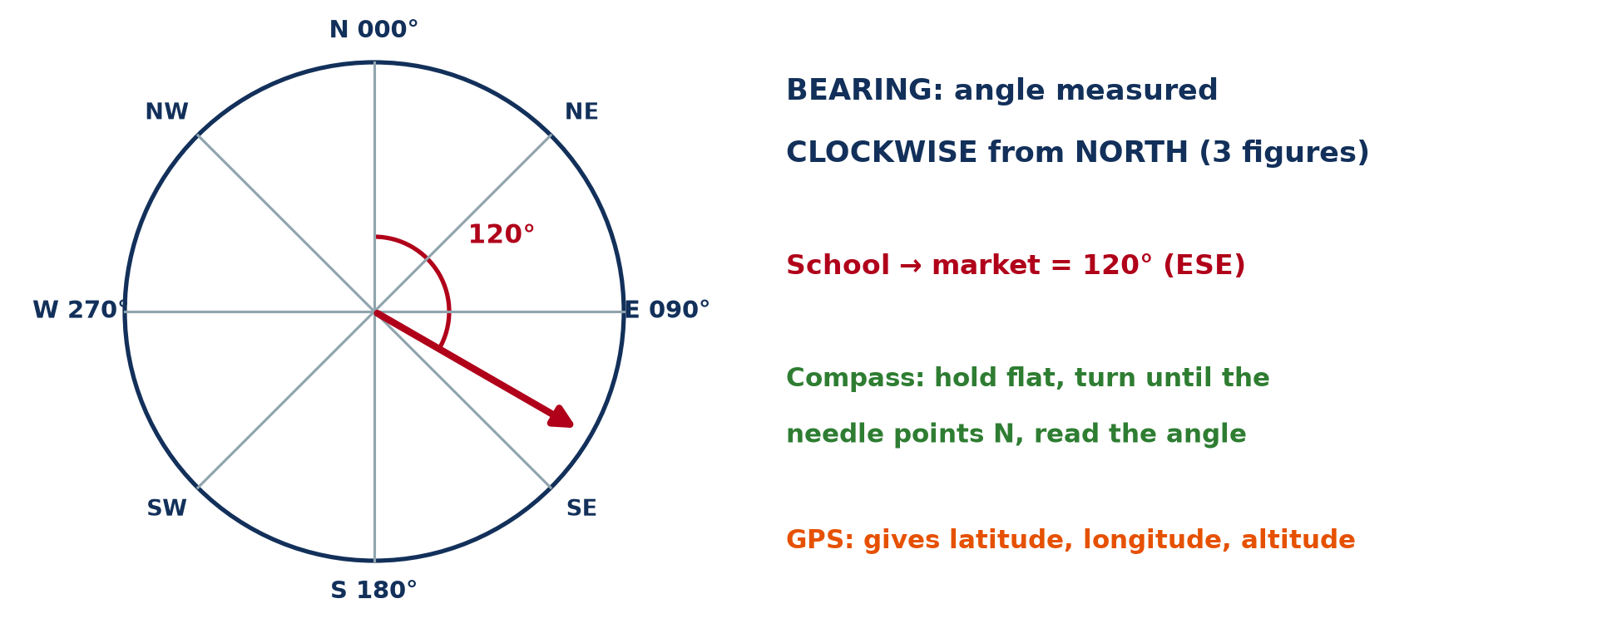
1. COMPASS DIRECTIONS
Activity 1
The compass rose.
Notes:
Activity 1. Look carefully at this diagram: the compass rose. Observe every detail before I ask the question.

Slide 19
1. COMPASS DIRECTIONS
Activity 1: Question
Name the four cardinal points and four intermediate points.
Notes:
Here is the question for Activity 1: Name the four cardinal points and four intermediate points. Take one minute to think and write your answer in your rough notebook.

Slide 20
1. COMPASS DIRECTIONS
Activity 1: Answer
N, E, S, W; NE, SE, SW, NW.
Notes:
Let us check the answer together. N, E, S, W; NE, SE, SW, NW.

Slide 21
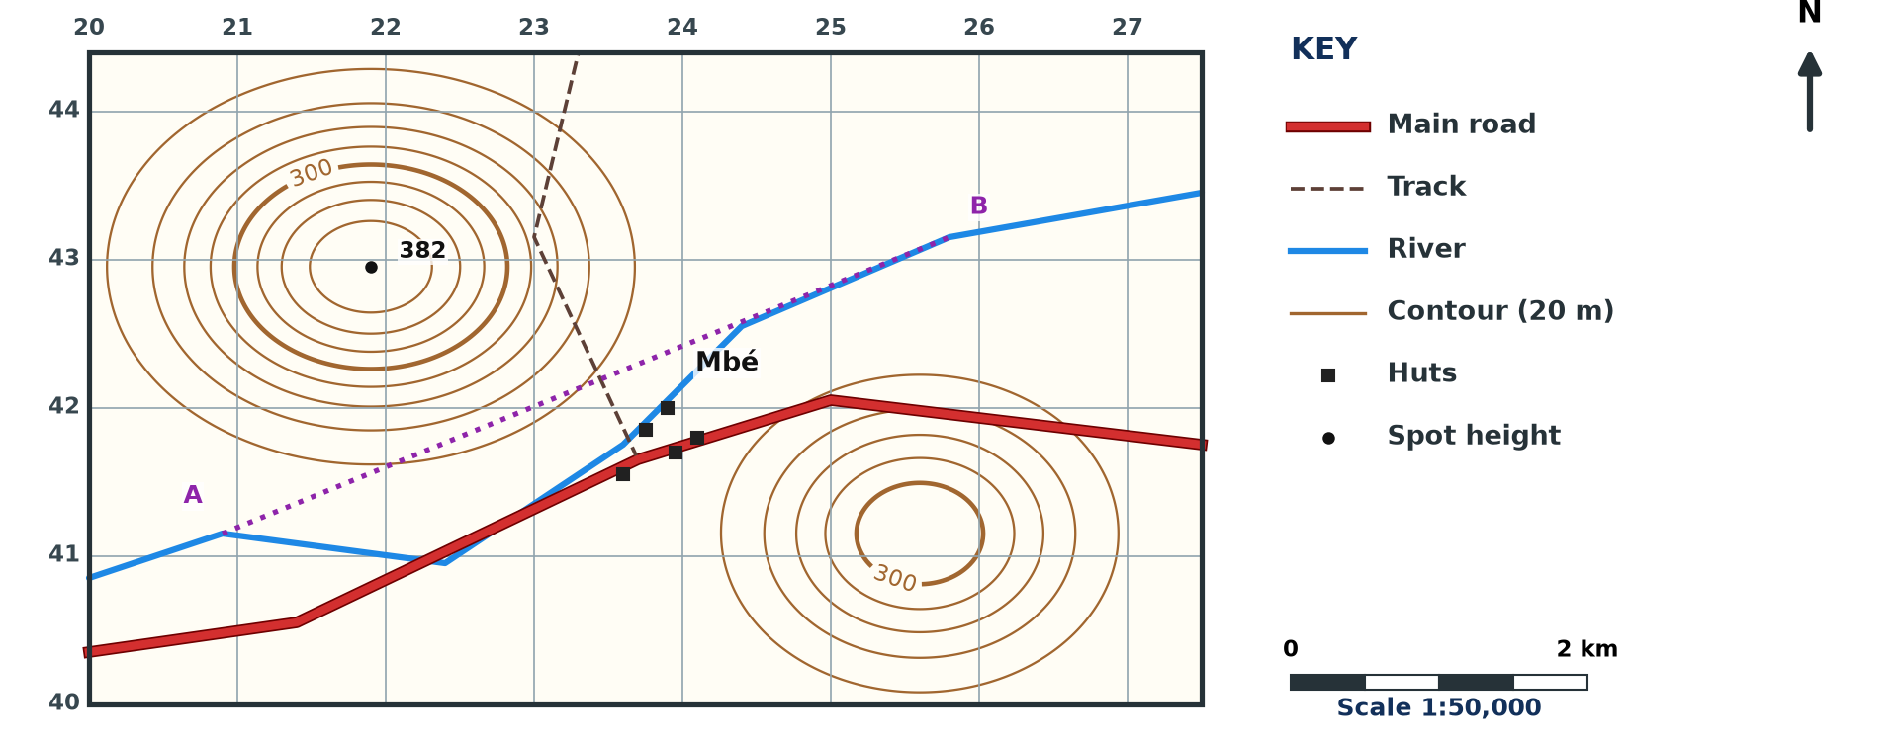
1. COMPASS DIRECTIONS
Activity 2
A map extract.
Notes:
Activity 2. Look carefully at this diagram: a map extract. Observe every detail before I ask the question.

Slide 22
1. COMPASS DIRECTIONS
Activity 2: Question
How do we find the direction of B from A?
Notes:
Here is the question for Activity 2: How do we find the direction of B from A? Take one minute to think and write your answer in your rough notebook.

Slide 23
1. COMPASS DIRECTIONS
Activity 2: Answer
We stand at A, draw a north line and see where B lies.
Notes:
Let us check the answer together. We stand at A, draw a north line and see where B lies.

Slide 24
2. BEARINGS
Activity 3
Bearings.
Notes:
Activity 3. Look carefully at this diagram: bearings. Observe every detail before I ask the question.

Slide 25
2. BEARINGS
Activity 3: Question
What is a bearing?
Notes:
Here is the question for Activity 3: What is a bearing? Take one minute to think and write your answer in your rough notebook.

Slide 26
2. BEARINGS
Activity 3: Answer
An angle measured clockwise from north, from 0° to 360°.
Notes:
Let us check the answer together. An angle measured clockwise from north, from 0° to 360°.

Slide 27
2. MEASURING
Activity 4
Measuring a bearing.
Notes:
Activity 4. Look carefully at this diagram: measuring a bearing. Observe every detail before I ask the question.

Slide 28
2. MEASURING
Activity 4: Question
Give the bearings of east, south and west.
Notes:
Here is the question for Activity 4: Give the bearings of east, south and west. Take one minute to think and write your answer in your rough notebook.

Slide 29
2. MEASURING
Activity 4: Answer
East 090°, south 180°, west 270°.
Notes:
Let us check the answer together. East 090°, south 180°, west 270°.

Slide 30
2. BACK BEARING
Activity 5
Back bearings.
Notes:
Activity 5. Look carefully at this diagram: back bearings. Observe every detail before I ask the question.

Slide 31
2. BACK BEARING
Activity 5: Question
The bearing from A to B is 060°. What is the bearing from B to A?
Notes:
Here is the question for Activity 5: The bearing from A to B is 060°. What is the bearing from B to A? Take one minute to think and write your answer in your rough notebook.

Slide 32
2. BACK BEARING
Activity 5: Answer
060° + 180° = 240°.
Notes:
Let us check the answer together. 060° + 180° = 240°.

Slide 33
BOARD SUMMARY
Board Summary
Topic: Initiation to Map Analysis
Sub-topic: Map Reading
Practical Work 4: Directions on Maps
Notes:
Now we are going to copy the board summary. Write the title and the headings neatly in your notebooks. I will give you enough time for each slide, so do not rush.

Slide 34
BOARD SUMMARY
DEFINITIONS
The key terms of this lesson are defined as follows:
Compass direction: It is the direction of a place given by the points of the compass.
Bearing: It is the angle measured clockwise from north to a place, in degrees.
Notes:
Let us copy the definitions. The key terms of this lesson are defined as follows. On this slide we have Compass direction and Bearing. Write each point on a new line, with the key term first, and explain it in your own words when we revise.

Slide 35
BOARD SUMMARY
1. Compass Directions
Directions are given as follows:
Cardinal points: They are north, east, south and west.
Intermediate points: They are north-east, south-east, south-west and north-west, with 16 points in all.
Notes:
Let us copy Compass Directions. Directions are given as follows. On this slide we have Cardinal points and Intermediate points. Write each point on a new line, with the key term first, and explain it in your own words when we revise.

Slide 36
BOARD SUMMARY
1. Compass Directions
Illustration: the compass rose and bearings
Notes:
Now draw this illustration in your notebook: the compass rose and bearings. Give it a title and label it clearly.

Slide 37
BOARD SUMMARY
2. Bearings
Bearings are measured as follows:
Method: We draw a north line at the starting point and measure the angle clockwise with a protractor.
Values: North is 000°, east 090°, south 180° and west 270°.
Notes:
Let us copy Bearings. Bearings are measured as follows. On this slide we have Method and Values. Write each point on a new line, with the key term first, and explain it in your own words when we revise. When you finish, we go to the next slide.

Slide 38
BOARD SUMMARY
2. Bearings (continued)
Back bearing: It is the bearing ± 180°.
Notes:
We continue with Bearings. On this slide we have Back bearing. Write each point on a new line, with the key term first, and explain it in your own words when we revise.

Slide 39
FORMATIVE EVALUATION
Evaluation 1
What is the bearing of south-east?
Notes:
Now let us check what you have understood. Question 1: What is the bearing of south-east? Answer in your exercise book.

Slide 40
FORMATIVE EVALUATION
Expected Answer
135°.
Notes:
The expected answer is: 135°. If you got it right, well done.

Slide 41
FORMATIVE EVALUATION
Evaluation 2
The bearing from X to Y is 300°. Find the back bearing.
Notes:
Now let us check what you have understood. Question 2: The bearing from X to Y is 300°. Find the back bearing. Answer in your exercise book.

Slide 42
FORMATIVE EVALUATION
Expected Answer
300° − 180° = 120°.
Notes:
The expected answer is: 300° − 180° = 120°. If you got it right, well done.

Slide 43
REMEDIATION
Remediation
Fill in the blanks:
Bearings are measured ______ from north.
The bearing of west is ______.
A back bearing is the bearing ± ______.
Notes:
For those who need more practice, fill in the blanks in your exercise book. The answers are: number 1, clockwise; number 2, 270°; number 3, 180°.

Slide 44
HOMEWORK
Homework
On a map extract, give the direction and the bearing of a bridge from a church.
Notes:
For your homework: On a map extract, give the direction and the bearing of a bridge from a church. We shall correct it at the beginning of our next lesson.

Slide 45
NEXT LESSON
Next Lesson
Our next lesson will be on:
Practical Work 5: Scales and Map Measurements
Notes:
Our next lesson will be on Practical Work 5: Scales and Map Measurements. Thank you for your attention, and see you next time.

Slide 46
BILINGUAL GAME
Bilingual Game (Jeu Bilingue)
English | Français
Direction | La direction
Bearing | L'azimut
Compass | La boussole
Clockwise | Dans le sens des aiguilles d'une montre
Angle | L'angle
Degree | Le degré
Notes:
Let us play the bilingual game. I say a word in English, and you give me the French word. Then we do the reverse.

Slide 47
LOGBOOK
Official Logbook (1/2)
Module / Topic | Initiation to Map Analysis
Lesson Title | Practical Work 4: Directions on Maps
Expected Learning Outcomes | Name the 16 compass directions. Define a bearing. Measure bearings on a map.
Competence | Learners are able to give compass directions and bearings between places on a map.
Notes:
I record this information in the official logbook of the class after the lesson.

Slide 48
LOGBOOK
Official Logbook (2/2)
Matter Taught | DEFINITIONS; Compass Directions; Bearings.
Evaluation | Formative evaluation and remediation exercise.
Homework | On a map extract, give the direction and the bearing of a bridge from a church.
Enrolment / Present / Absent | ____ / ____ / ____
Achievement | To be completed after the lesson.
Notes:
I complete the second page of the logbook: the matter taught, the evaluation, the homework and the attendance.

Slide 49
TEACHER'S NOTE
Teacher's Note
Timing: Homework correction, plan, objectives 8 min | Recall, situation, action 10 min | 5 activities 30 min | Board summary (copying) 30 min | Evaluation, remediation 10 min | Homework, next lesson 5 min | Logbook 7 min
Without the projector (Activity 1): draw a compass rose.
Without the projector (Activity 2): practise with two points.
Without the projector (Activity 3): show a protractor.
Without the projector (Activity 4): write them on the rose.
Without the projector (Activity 5): work it out.
Notes:
This slide is for me, the teacher: it gives the timing of the lesson and what to do if the projector is not available.

Slide 50
REFERENCES
References
Geography Syllabus, Forms I–V, MINESEC (2023) — Form 4, Module I: Ecological Systems and their Resources.
Diagrams and animations: drawn for this lesson (Geography Department).
Notes:
These are the references and picture credits used to prepare this lesson.

