Slide 1
FORM 4
GEOGRAPHY
Practical Work 5
Scales and Map Measurements
Notes:
Good morning, class, and welcome to our geography lesson. I am your geography teacher, Mr Kamdem. Today we are starting Practical Work 5: Scales and Map Measurements.

Slide 2
CLASS INFO
Class, Chapter and Duration
Class | Form 4
Chapter | Module I: Ecological Systems and their Resources
Duration | 2 periods (2 × 50 minutes)
Notes:
This lesson is for Form 4. It belongs to Module I: Ecological Systems and their Resources. We shall need 2 periods to cover it.

Slide 3
IDENTIFICATION
Lesson Identification
Topic | Initiation to Map Analysis
Sub-topic | Map Reading
Lesson | Practical Work 5: Scales and Map Measurements
Notions / Concepts | Scale, representative fraction, linear scale, statement scale, distance, area.
Syllabus focus | Meaning of scale; ways of expressing scale; linear measurements (straight and curved distances); areal measurements (regular and irregular surfaces).
Competence | Learners are able to use the scale to measure distances and areas on maps.
Notes:
Our topic is Initiation to Map Analysis, and the sub-topic is Map Reading. The key notions we shall use today are: scale, representative fraction, linear scale, statement scale, distance, area. At the end, you should be able to do this: learners are able to use the scale to measure distances and areas on maps.

Slide 4

HOMEWORK CORRECTION
Correction of the Homework
Question (Practical Work 4: Directions on Maps):
On a map extract, give the direction and the bearing of a bridge from a church.
Notes:
Before we start the new lesson, let us correct the homework I gave you at the end of Practical Work 4: Directions on Maps. The question was: On a map extract, give the direction and the bearing of a bridge from a church. Take out your exercise books.

Slide 5
HOMEWORK CORRECTION
Correction: Possible Answer
Answers depend on the map: e.g. the bridge is north-east of the church at a bearing of about 045°.
Notes:
Here is a good answer. Answers depend on the map: e.g. the bridge is north-east of the church at a bearing of about 045°. Compare it with your own answer and correct your work in red.

Slide 6
LESSON PLAN
Lesson Plan
Correction of the homework
Objectives and recall
Real-life situation and action to take
Learning activities
Board summary
Evaluation, remediation and homework
Notes:
Here is the plan of our lesson today. First, we shall correct the homework. Then we shall look at the objectives and recall what you already know. After that, we shall study a situation from real life and the action to take, and do the learning activities. Finally, we shall copy the board summary, do the evaluation and the remediation, and I will give you the homework.

Slide 7
OBJECTIVES
Objectives
By the end of this lesson, you should be able to:
Define scale and its forms.
Measure straight and curved distances.
Measure regular and irregular areas.
Notes:
By the end of this lesson, you should be able to do three things. Number 1: define scale and its forms. Number 2: measure straight and curved distances. Number 3: measure regular and irregular areas.

Slide 8
PREVIOUS KNOWLEDGE
Previous Knowledge
A map is drawn to scale.
1 km = 1,000 m = 100,000 cm.
Area = length × width.
Notes:
Let us first remember what you already know. A map is drawn to scale. 1 km = 1,000 m = 100,000 cm. Area = length × width. Keep this in mind, because we shall build on it today.

Slide 9
REAL-LIFE SITUATION
Situation in Real Life
The council wants to know the length of a winding road between two villages and the area of a forest on a map of scale 1:50,000.
Notes:
Listen carefully to this situation from real life. The council wants to know the length of a winding road between two villages and the area of a forest on a map of scale 1:50,000. Think about it, because I am going to ask you some questions.

Slide 10
REAL-LIFE SITUATION
Situation: Question 1
What is the problem in the situation?
Notes:
Question 1: What is the problem in the situation? Think for a moment, then raise your hand to answer.

Slide 11
REAL-LIFE SITUATION
Answer
We must measure a curved distance and an area on a map.
Notes:
Good. We must measure a curved distance and an area on a map.

Slide 12
REAL-LIFE SITUATION
Situation: Question 2
What is the scale?
Notes:
Question 2: What is the scale? Think for a moment, then raise your hand to answer.

Slide 13
REAL-LIFE SITUATION
Answer
1:50,000.
Notes:
Good. 1:50,000.

Slide 14
REAL-LIFE SITUATION
Situation: Question 3
How can we measure a winding road?
Notes:
Question 3: How can we measure a winding road? Think for a moment, then raise your hand to answer.

Slide 15
REAL-LIFE SITUATION
Possible Answer
With a thread or the edge of a paper strip.
Notes:
Good. With a thread or the edge of a paper strip.

Slide 16
ACTION TO TAKE
Action to Take
Show every step and unit when converting map measurements.
Notes:
From this situation, the action we are working towards in this lesson is the following: show every step and unit when converting map measurements.

Slide 17
JUSTIFICATION
Justification of the Lesson
This practical work helps us to measure real distances and areas from maps.
Notes:
Why is this lesson important for you? This practical work helps us to measure real distances and areas from maps.

Slide 18
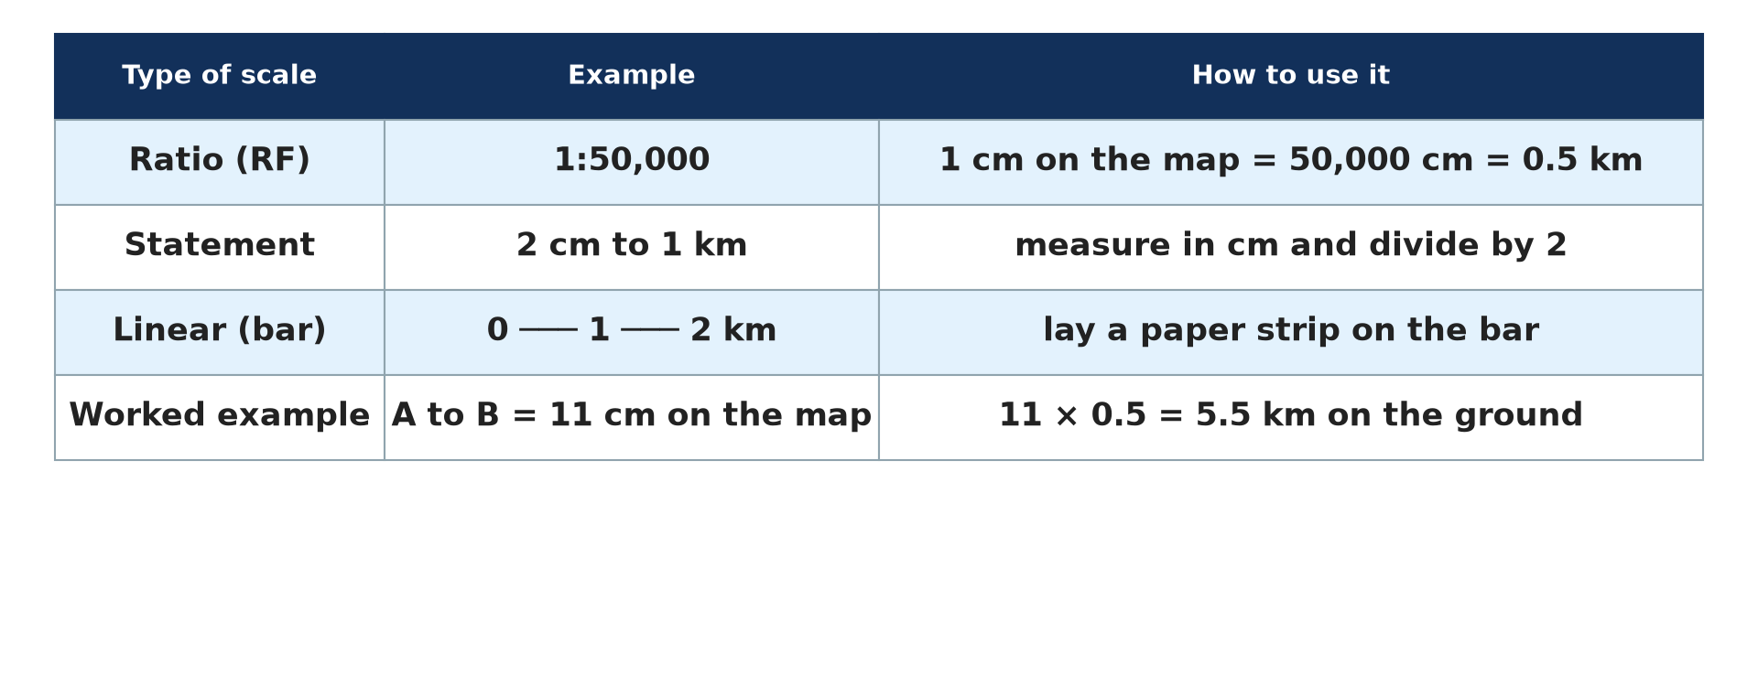
1. MEANING AND FORMS
Activity 1
Types of scale.
Notes:
Activity 1. Look carefully at this diagram: types of scale. Observe every detail before I ask the question.

Slide 19
1. MEANING AND FORMS
Activity 1: Question
Name three ways of expressing scale.
Notes:
Here is the question for Activity 1: Name three ways of expressing scale. Take one minute to think and write your answer in your rough notebook.

Slide 20
1. MEANING AND FORMS
Activity 1: Answer
Representative fraction (1:50,000), statement (2 cm to 1 km) and linear scale.
Notes:
Let us check the answer together. Representative fraction (1:50,000), statement (2 cm to 1 km) and linear scale.

Slide 21
2. STRAIGHT DISTANCES
Activity 2
A worked example.
Notes:
Activity 2. Look carefully at this diagram: a worked example. Observe every detail before I ask the question.

Slide 22
2. STRAIGHT DISTANCES
Activity 2: Question
On a 1:50,000 map, A to B measures 7 cm. Find the real distance.
Notes:
Here is the question for Activity 2: On a 1:50,000 map, A to B measures 7 cm. Find the real distance. Take one minute to think and write your answer in your rough notebook.

Slide 23
2. STRAIGHT DISTANCES
Activity 2: Answer
7 × 50,000 = 350,000 cm = 3.5 km.
Notes:
Let us check the answer together. 7 × 50,000 = 350,000 cm = 3.5 km.

Slide 24
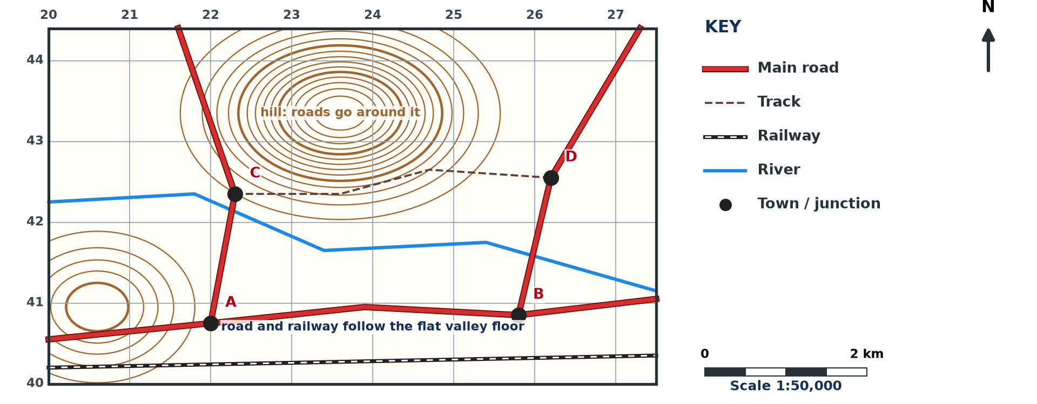
2. CURVED DISTANCES
Activity 3
A winding road.
Notes:
Activity 3. Look carefully at this diagram: a winding road. Observe every detail before I ask the question.

Slide 25
2. CURVED DISTANCES
Activity 3: Question
How do we measure a winding road?
Notes:
Here is the question for Activity 3: How do we measure a winding road? Take one minute to think and write your answer in your rough notebook.

Slide 26
2. CURVED DISTANCES
Activity 3: Answer
We follow it with a thread or a paper strip, mark each bend, then measure the total length against the scale.
Notes:
Let us check the answer together. We follow it with a thread or a paper strip, mark each bend, then measure the total length against the scale.

Slide 27
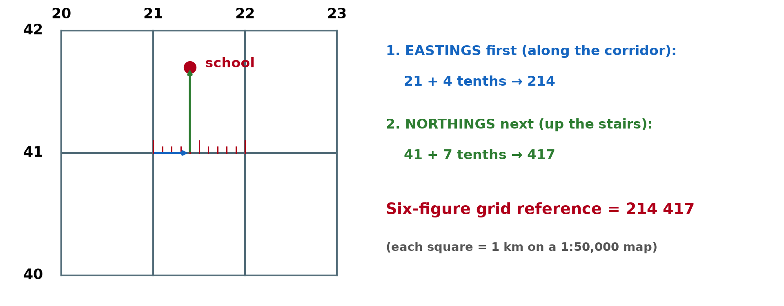
3. REGULAR AREAS
Activity 4
Grid squares.
Notes:
Activity 4. Look carefully at this diagram: grid squares. Observe every detail before I ask the question.

Slide 28
3. REGULAR AREAS
Activity 4: Question
On a 1:50,000 map, a grid square is 2 cm × 2 cm. What is its area?
Notes:
Here is the question for Activity 4: On a 1:50,000 map, a grid square is 2 cm × 2 cm. What is its area? Take one minute to think and write your answer in your rough notebook.

Slide 29
3. REGULAR AREAS
Activity 4: Answer
1 km × 1 km = 1 km².
Notes:
Let us check the answer together. 1 km × 1 km = 1 km².

Slide 30
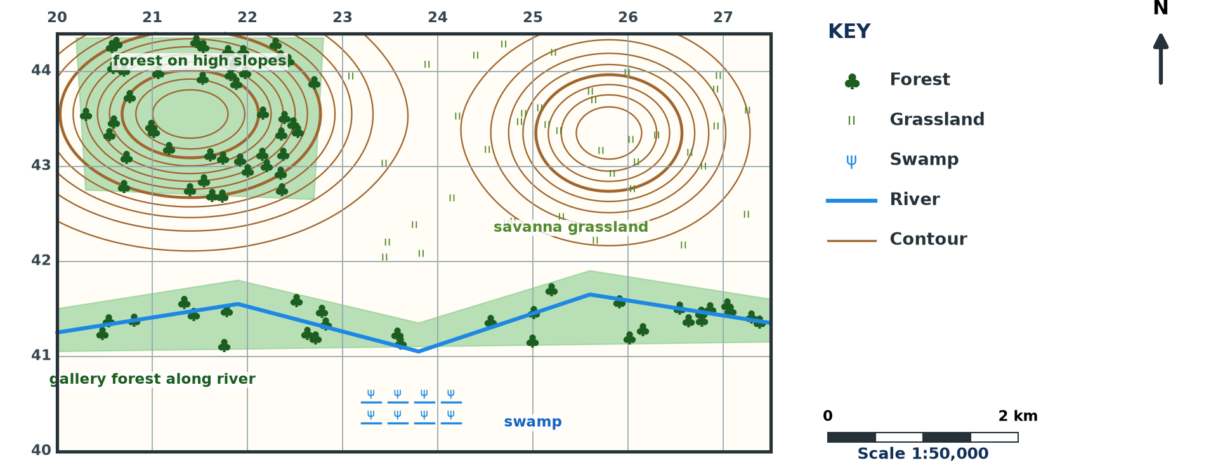
3. IRREGULAR AREAS
Activity 5
A forest on a map.
Notes:
Activity 5. Look carefully at this diagram: a forest on a map. Observe every detail before I ask the question.

Slide 31
3. IRREGULAR AREAS
Activity 5: Question
How do we measure an irregular area such as a forest?
Notes:
Here is the question for Activity 5: How do we measure an irregular area such as a forest? Take one minute to think and write your answer in your rough notebook.

Slide 32
3. IRREGULAR AREAS
Activity 5: Answer
We count the full squares and add half the part squares.
Notes:
Let us check the answer together. We count the full squares and add half the part squares.

Slide 33
BOARD SUMMARY
Board Summary
Topic: Initiation to Map Analysis
Sub-topic: Map Reading
Practical Work 5: Scales and Map Measurements
Notes:
Now we are going to copy the board summary. Write the title and the headings neatly in your notebooks. I will give you enough time for each slide, so do not rush.

Slide 34
BOARD SUMMARY
DEFINITIONS
The key terms of this lesson are defined as follows:
Scale: It is the ratio between a distance on the map and the real distance on the ground.
Notes:
Let us copy the definitions. The key terms of this lesson are defined as follows. On this slide we have Scale. Write each point on a new line, with the key term first, and explain it in your own words when we revise.

Slide 35
BOARD SUMMARY
1. Ways of Expressing Scale
Scale is expressed in the following ways:
Representative fraction: It is written as a ratio, such as 1:50,000.
Statement scale: It is written in words, such as 2 cm to 1 km.
Notes:
Let us copy Ways of Expressing Scale. Scale is expressed in the following ways. On this slide we have Representative fraction and Statement scale. Write each point on a new line, with the key term first, and explain it in your own words when we revise. When you finish, we go to the next slide.

Slide 36
BOARD SUMMARY
1. Ways of Expressing Scale (continued)
Linear scale: It is a line divided into units of distance.
Notes:
We continue with Ways of Expressing Scale. On this slide we have Linear scale. Write each point on a new line, with the key term first, and explain it in your own words when we revise.

Slide 37
BOARD SUMMARY
1. Ways of Expressing Scale
Illustration: types of scale
Notes:
Now draw this illustration in your notebook: types of scale. Give it a title and label it clearly.

Slide 38
BOARD SUMMARY
2. Linear Measurements
Distances are measured as follows:
Straight distances: We measure with a ruler and multiply by the scale, so 7 cm on a 1:50,000 map equals 3.5 km.
Curved distances: We follow the route with a thread or paper strip and convert with the scale.
Notes:
Let us copy Linear Measurements. Distances are measured as follows. On this slide we have Straight distances and Curved distances. Write each point on a new line, with the key term first, and explain it in your own words when we revise.

Slide 39
BOARD SUMMARY
3. Areal Measurements
Areas are measured as follows:
Regular surfaces: Area = length × width, or number of grid squares × area of one square.
Irregular surfaces: We count full squares and add half the number of part squares.
Notes:
Let us copy Areal Measurements. Areas are measured as follows. On this slide we have Regular surfaces and Irregular surfaces. Write each point on a new line, with the key term first, and explain it in your own words when we revise.

Slide 40
FORMATIVE EVALUATION
Evaluation 1
On a 1:50,000 map, a road is 12 cm long. Find the real length.
Notes:
Now let us check what you have understood. Question 1: On a 1:50,000 map, a road is 12 cm long. Find the real length. Answer in your exercise book.

Slide 41
FORMATIVE EVALUATION
Expected Answer
12 × 0.5 = 6 km.
Notes:
The expected answer is: 12 × 0.5 = 6 km. If you got it right, well done.

Slide 42
FORMATIVE EVALUATION
Evaluation 2
A lake covers 6 full and 8 part squares of 1 km². Find its area.
Notes:
Now let us check what you have understood. Question 2: A lake covers 6 full and 8 part squares of 1 km². Find its area. Answer in your exercise book.

Slide 43
FORMATIVE EVALUATION
Expected Answer
6 + (8 ÷ 2) = 10 km².
Notes:
The expected answer is: 6 + (8 ÷ 2) = 10 km². If you got it right, well done.

Slide 44
REMEDIATION
Remediation
Fill in the blanks:
1:50,000 means 1 cm on the map = ______ km.
Curved distances are measured with a ______.
Part squares are counted as ______.
Notes:
For those who need more practice, fill in the blanks in your exercise book. The answers are: number 1, ; number 0, 5; number 2, thread (or paper strip); number 3, halves.

Slide 45
HOMEWORK
Homework
On a 1:50,000 map extract, measure the length of a river and the area of a forest.
Notes:
For your homework: On a 1:50,000 map extract, measure the length of a river and the area of a forest. We shall correct it at the beginning of our next lesson.

Slide 46
NEXT LESSON
Next Lesson
Our next lesson will be on:
Practical Work 6: Map Copying, Reduction and Enlargement
Notes:
Our next lesson will be on Practical Work 6: Map Copying, Reduction and Enlargement. Thank you for your attention, and see you next time.

Slide 47
BILINGUAL GAME
Bilingual Game (Jeu Bilingue)
English | Français
Scale | L'échelle
Distance | La distance
Area | La superficie
Ruler | La règle
Thread | Le fil
Square | Le carré
Notes:
Let us play the bilingual game. I say a word in English, and you give me the French word. Then we do the reverse.

Slide 48
LOGBOOK
Official Logbook (1/2)
Module / Topic | Initiation to Map Analysis
Lesson Title | Practical Work 5: Scales and Map Measurements
Expected Learning Outcomes | Define scale and its forms. Measure straight and curved distances. Measure regular and irregular areas.
Competence | Learners are able to use the scale to measure distances and areas on maps.
Notes:
I record this information in the official logbook of the class after the lesson.

Slide 49
LOGBOOK
Official Logbook (2/2)
Matter Taught | DEFINITIONS; Ways of Expressing Scale; Linear Measurements; Areal Measurements.
Evaluation | Formative evaluation and remediation exercise.
Homework | On a 1:50,000 map extract, measure the length of a river and the area of a forest.
Enrolment / Present / Absent | ____ / ____ / ____
Achievement | To be completed after the lesson.
Notes:
I complete the second page of the logbook: the matter taught, the evaluation, the homework and the attendance.

Slide 50
TEACHER'S NOTE
Teacher's Note
Timing: Homework correction, plan, objectives 8 min | Recall, situation, action 10 min | 5 activities 30 min | Board summary (copying) 30 min | Evaluation, remediation 10 min | Homework, next lesson 5 min | Logbook 7 min
Without the projector (Activity 1): write them.
Without the projector (Activity 2): work it out.
Without the projector (Activity 3): use a thread.
Without the projector (Activity 4): work it out.
Without the projector (Activity 5): count squares.
Notes:
This slide is for me, the teacher: it gives the timing of the lesson and what to do if the projector is not available.

Slide 51
REFERENCES
References
Geography Syllabus, Forms I–V, MINESEC (2023) — Form 4, Module I: Ecological Systems and their Resources.
Diagrams and animations: drawn for this lesson (Geography Department).
Notes:
These are the references and picture credits used to prepare this lesson.

