Slide 1
FORM 4
GEOGRAPHY
Lesson 18
The Notion of Development
Notes:
Good morning, class, and welcome to our geography lesson. I am your geography teacher, Mr Kamdem. Today we are starting Lesson 18: The Notion of Development.

Slide 2
CLASS INFO
Class, Chapter and Duration
Class | Form 4
Chapter | Module II: Development and the Management of Primary Resources
Duration | 2 periods (2 × 50 minutes)
Notes:
This lesson is for Form 4. It belongs to Module II: Development and the Management of Primary Resources. We shall need 2 periods to cover it.

Slide 3
IDENTIFICATION
Lesson Identification
Topic | The Process of Development
Sub-topic | The Concept of Development
Lesson | Lesson 18: The Notion of Development
Notions / Concepts | Development, underdevelopment, poverty, sustainable development.
Syllabus focus | Definition of development, underdevelopment and sustainable development; main principles of sustainable development.
Competence | Learners are able to explain development and underdevelopment and act for sustainable development.
Notes:
Our topic is The Process of Development, and the sub-topic is The Concept of Development. The key notions we shall use today are: development, underdevelopment, poverty, sustainable development. At the end, you should be able to do this: learners are able to explain development and underdevelopment and act for sustainable development.

Slide 4

HOMEWORK CORRECTION
Correction of the Homework
Question (Practical Work 9: Description of Drainage on Maps):
Describe the drainage of a map extract in five sentences.
Notes:
Before we start the new lesson, let us correct the homework I gave you at the end of Practical Work 9: Description of Drainage on Maps. The question was: Describe the drainage of a map extract in five sentences. Take out your exercise books.

Slide 5
HOMEWORK CORRECTION
Correction: Possible Answer
A good answer names the main river and its direction of flow with evidence, counts its tributaries, names the pattern (e.g. dendritic), mentions lakes or swamps and gives the density.
Notes:
Here is a good answer. A good answer names the main river and its direction of flow with evidence, counts its tributaries, names the pattern (e.g. dendritic), mentions lakes or swamps and gives the density. Compare it with your own answer and correct your work in red.

Slide 6
LESSON PLAN
Lesson Plan
Correction of the homework
Objectives and recall
Real-life situation and action to take
Learning activities
Board summary
Evaluation, remediation and homework
Notes:
Here is the plan of our lesson today. First, we shall correct the homework. Then we shall look at the objectives and recall what you already know. After that, we shall study a situation from real life and the action to take, and do the learning activities. Finally, we shall copy the board summary, do the evaluation and the remediation, and I will give you the homework.

Slide 7
OBJECTIVES
Objectives
By the end of this lesson, you should be able to:
Define development and underdevelopment.
Define sustainable development.
State the main principles of sustainable development.
Notes:
By the end of this lesson, you should be able to do three things. Number 1: define development and underdevelopment. Number 2: define sustainable development. Number 3: state the main principles of sustainable development.

Slide 8
PREVIOUS KNOWLEDGE
Previous Knowledge
Some countries are rich and others are poor.
People need food, health and education.
Resources must be protected for the future.
Notes:
Let us first remember what you already know. Some countries are rich and others are poor. People need food, health and education. Resources must be protected for the future. Keep this in mind, because we shall build on it today.

Slide 9
REAL-LIFE SITUATION
Situation in Real Life
Two brothers compare their lives: one lives in Garoua with no electricity and few jobs; the other lives in Paris with good hospitals, schools and roads. They ask why their countries are so different.
Notes:
Listen carefully to this situation from real life. Two brothers compare their lives: one lives in Garoua with no electricity and few jobs; the other lives in Paris with good hospitals, schools and roads. They ask why their countries are so different. Think about it, because I am going to ask you some questions.

Slide 10
REAL-LIFE SITUATION
Situation: Question 1
What is the problem in the situation?
Notes:
Question 1: What is the problem in the situation? Think for a moment, then raise your hand to answer.

Slide 11
REAL-LIFE SITUATION
Answer
The brothers want to understand differences in development.
Notes:
Good. The brothers want to understand differences in development.

Slide 12
REAL-LIFE SITUATION
Situation: Question 2
Give two signs of development in Paris.
Notes:
Question 2: Give two signs of development in Paris. Think for a moment, then raise your hand to answer.

Slide 13
REAL-LIFE SITUATION
Answer
Good hospitals and schools (also roads).
Notes:
Good. Good hospitals and schools (also roads).

Slide 14
REAL-LIFE SITUATION
Situation: Question 3
Give one sign of underdevelopment in the situation.
Notes:
Question 3: Give one sign of underdevelopment in the situation. Think for a moment, then raise your hand to answer.

Slide 15
REAL-LIFE SITUATION
Possible Answer
No electricity (also few jobs).
Notes:
Good. No electricity (also few jobs).

Slide 16
ACTION TO TAKE
Action to Take
Use resources wisely today so that future generations can also meet their needs.
Notes:
From this situation, the action we are working towards in this lesson is the following: use resources wisely today so that future generations can also meet their needs.

Slide 17
JUSTIFICATION
Justification of the Lesson
This lesson helps us to understand what development means and how to achieve it sustainably.
Notes:
Why is this lesson important for you? This lesson helps us to understand what development means and how to achieve it sustainably.

Slide 18
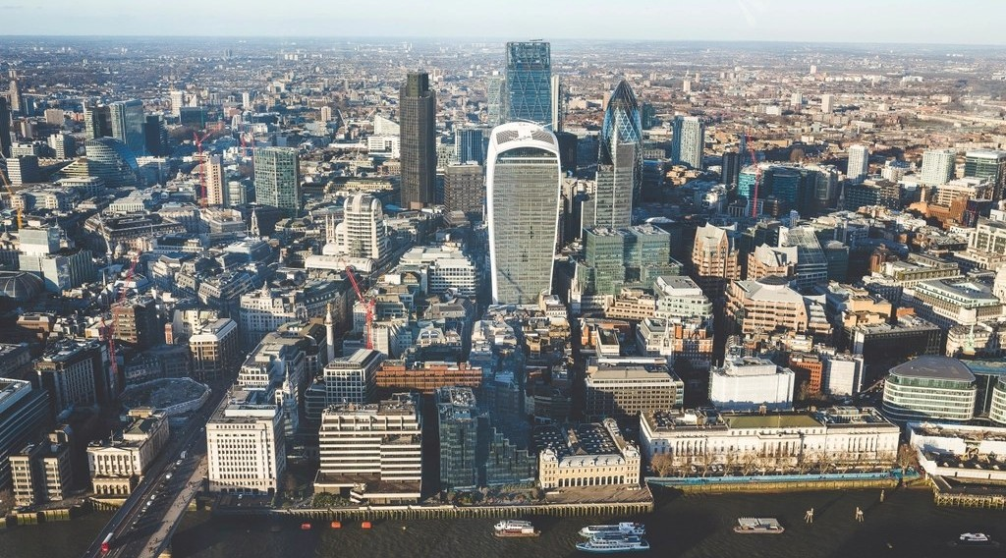
1. DEVELOPMENT
Activity 1
A city in a rich country.
Notes:
Activity 1. Look carefully at this picture: a city in a rich country. Observe every detail before I ask the question.

Slide 19
1. DEVELOPMENT
Activity 1: Question
What is development?
Notes:
Here is the question for Activity 1: What is development? Take one minute to think and write your answer in your rough notebook.

Slide 20
1. DEVELOPMENT
Activity 1: Answer
The improvement of people's living conditions: income, health, education and freedom.
Notes:
Let us check the answer together. The improvement of people's living conditions: income, health, education and freedom.

Slide 21

1. UNDERDEVELOPMENT
Activity 2
A poor neighbourhood.
Notes:
Activity 2. Look carefully at this picture: a poor neighbourhood. Observe every detail before I ask the question.

Slide 22
1. UNDERDEVELOPMENT
Activity 2: Question
What is underdevelopment?
Notes:
Here is the question for Activity 2: What is underdevelopment? Take one minute to think and write your answer in your rough notebook.

Slide 23
1. UNDERDEVELOPMENT
Activity 2: Answer
A situation where most people live in poverty, with poor services and low incomes.
Notes:
Let us check the answer together. A situation where most people live in poverty, with poor services and low incomes.

Slide 24
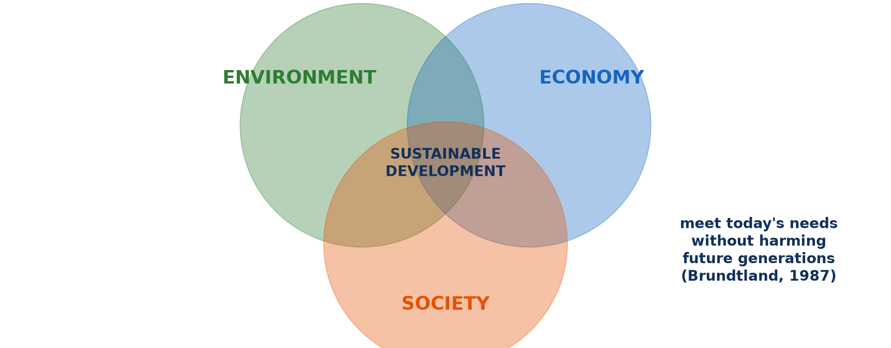
2. SUSTAINABLE DEVELOPMENT
Activity 3
The three pillars.
Notes:
Activity 3. Look carefully at this diagram: the three pillars. Observe every detail before I ask the question.

Slide 25
2. SUSTAINABLE DEVELOPMENT
Activity 3: Question
What is sustainable development?
Notes:
Here is the question for Activity 3: What is sustainable development? Take one minute to think and write your answer in your rough notebook.

Slide 26
2. SUSTAINABLE DEVELOPMENT
Activity 3: Answer
Development that meets present needs without harming the ability of future generations to meet theirs.
Notes:
Let us check the answer together. Development that meets present needs without harming the ability of future generations to meet theirs.

Slide 27

2. PRINCIPLES
Activity 4
Planting trees.
Notes:
Activity 4. Look carefully at this picture: planting trees. Observe every detail before I ask the question.

Slide 28
2. PRINCIPLES
Activity 4: Question
Give two principles of sustainable development.
Notes:
Here is the question for Activity 4: Give two principles of sustainable development. Take one minute to think and write your answer in your rough notebook.

Slide 29
2. PRINCIPLES
Activity 4: Answer
Protect the environment and share wealth fairly (also involve people, think of the future).
Notes:
Let us check the answer together. Protect the environment and share wealth fairly (also involve people, think of the future).

Slide 30

2. PRINCIPLES
Activity 5
A classroom.
Notes:
Activity 5. Look carefully at this picture: a classroom. Observe every detail before I ask the question.

Slide 31
2. PRINCIPLES
Activity 5: Question
Why is education a principle of sustainable development?
Notes:
Here is the question for Activity 5: Why is education a principle of sustainable development? Take one minute to think and write your answer in your rough notebook.

Slide 32
2. PRINCIPLES
Activity 5: Answer
It gives people skills to improve their lives and protect their environment.
Notes:
Let us check the answer together. It gives people skills to improve their lives and protect their environment.

Slide 33
BOARD SUMMARY
Board Summary
Topic: The Process of Development
Sub-topic: The Concept of Development
Lesson 18: The Notion of Development
Notes:
Now we are going to copy the board summary. Write the title and the headings neatly in your notebooks. I will give you enough time for each slide, so do not rush.

Slide 34
BOARD SUMMARY
DEFINITIONS
The key terms of this lesson are defined as follows:
Development: It is the improvement of people's living conditions and well-being.
Underdevelopment: It is a situation of poverty, low income and poor services for most people.
Notes:
Let us copy the definitions. The key terms of this lesson are defined as follows. On this slide we have Development and Underdevelopment. Write each point on a new line, with the key term first, and explain it in your own words when we revise. When you finish, we go to the next slide.

Slide 35
BOARD SUMMARY
DEFINITIONS (continued)
Sustainable development: It is development that meets present needs without harming future generations.
Notes:
We continue with the definitions. On this slide we have Sustainable development. Write each point on a new line, with the key term first, and explain it in your own words when we revise.

Slide 36
BOARD SUMMARY
1. Main Principles of Sustainable Development
Sustainable development follows these principles:
Economic principle: Economic growth must create jobs and income.
Social principle: Wealth, health and education must be shared fairly.
Notes:
Let us copy Main Principles of Sustainable Development. Sustainable development follows these principles. On this slide we have Economic principle and Social principle. Write each point on a new line, with the key term first, and explain it in your own words when we revise. When you finish, we go to the next slide.

Slide 37
BOARD SUMMARY
1. Main Principles of Sustainable Development (continued)
Environmental principle: Resources must be used without destroying the environment.
Participation: People must take part in decisions that affect them.
Notes:
We continue with Main Principles of Sustainable Development. On this slide we have Environmental principle and Participation. Write each point on a new line, with the key term first, and explain it in your own words when we revise.

Slide 38
BOARD SUMMARY
1. Main Principles of Sustainable Development
Illustration: the pillars of sustainable development
Notes:
Now draw this illustration in your notebook: the pillars of sustainable development. Give it a title and label it clearly.

Slide 39
FORMATIVE EVALUATION
Evaluation 1
Define sustainable development.
Notes:
Now let us check what you have understood. Question 1: Define sustainable development. Answer in your exercise book.

Slide 40
FORMATIVE EVALUATION
Expected Answer
Development that meets present needs without harming future generations.
Notes:
The expected answer is: development that meets present needs without harming future generations. If you got it right, well done.

Slide 41
FORMATIVE EVALUATION
Evaluation 2
Give two principles.
Notes:
Now let us check what you have understood. Question 2: Give two principles. Answer in your exercise book.

Slide 42
FORMATIVE EVALUATION
Expected Answer
Protect the environment and share wealth fairly.
Notes:
The expected answer is: protect the environment and share wealth fairly. If you got it right, well done.

Slide 43
REMEDIATION
Remediation
Fill in the blanks:
A situation of widespread poverty is ______.
Development that protects the future is ______ development.
Notes:
Take your time to copy this part; we will continue together.

Slide 44
REMEDIATION
Remediation (continued)
The three pillars are economic, social and ______.
Notes:
For those who need more practice, fill in the blanks in your exercise book. The answers are: number 1, underdevelopment; number 2, sustainable; number 3, environmental.

Slide 45
HOMEWORK
Homework
Give three examples of sustainable actions in your community.
Notes:
For your homework: Give three examples of sustainable actions in your community. We shall correct it at the beginning of our next lesson.

Slide 46
NEXT LESSON
Next Lesson
Our next lesson will be on:
Lesson 19: Indicators of Development
Notes:
Our next lesson will be on Lesson 19: Indicators of Development. Thank you for your attention, and see you next time.

Slide 47
BILINGUAL GAME
Bilingual Game (Jeu Bilingue)
English | Français
Development | Le développement
Poverty | La pauvreté
Sustainable | Durable
Well-being | Le bien-être
Future | L'avenir
Wealth | La richesse
Notes:
Let us play the bilingual game. I say a word in English, and you give me the French word. Then we do the reverse.

Slide 48
LOGBOOK
Official Logbook (1/2)
Module / Topic | The Process of Development
Lesson Title | Lesson 18: The Notion of Development
Expected Learning Outcomes | Define development and underdevelopment. Define sustainable development. State the main principles of sustainable development.
Competence | Learners are able to explain development and underdevelopment and act for sustainable development.
Notes:
I record this information in the official logbook of the class after the lesson.

Slide 49
LOGBOOK
Official Logbook (2/2)
Matter Taught | DEFINITIONS; Main Principles of Sustainable Development.
Evaluation | Formative evaluation and remediation exercise.
Homework | Give three examples of sustainable actions in your community.
Enrolment / Present / Absent | ____ / ____ / ____
Achievement | To be completed after the lesson.
Notes:
I complete the second page of the logbook: the matter taught, the evaluation, the homework and the attendance.

Slide 50
TEACHER'S NOTE
Teacher's Note
Timing: Homework correction, plan, objectives 8 min | Recall, situation, action 10 min | 5 activities 30 min | Board summary (copying) 30 min | Evaluation, remediation 10 min | Homework, next lesson 5 min | Logbook 7 min
Without the projector (Activity 1): list signs of development.
Without the projector (Activity 2): list signs of poverty.
Without the projector (Activity 3): draw three circles.
Without the projector (Activity 4): discuss examples.
Without the projector (Activity 5): discuss the role of school.
Notes:
This slide is for me, the teacher: it gives the timing of the lesson and what to do if the projector is not available.

Slide 51
REFERENCES
References
Geography Syllabus, Forms I–V, MINESEC (2023) — Form 4, Module II: Development and the Management of Primary Resources.
Photo, Activity 1: “Aerial View City Skyline Skyscraper” by unknown, CC0 1.0, via rawpixel (https://www.rawpixel.com/image/5967710/aerial-view-city-skyline-skyscraper)
Photo, Activity 2: “Mathare” by Book Aid International, CC BY-NC-ND 2.0, via Flickr (https://www.flickr.com/photos/45024905@N07/4135561707)
Photo, Activity 4: “Haitian Students Breathe New Life into Depleted Pine Forest” by United Nations Photo, CC BY-NC-ND 2.0, via Flickr (https://www.flickr.com/photos/35483578@N03/5860275159)
Photo, Activity 5: “Students in Primary Seven at Zanaki Primary School” by World Bank Photo Collection, CC BY-NC-ND 2.0, via Flickr (https://www.flickr.com/photos/10816734@N03/33423887921)
Diagrams and animations: drawn for this lesson (Geography Department).
Notes:
These are the references and picture credits used to prepare this lesson.

