Slide 1
FORM 4
GEOGRAPHY
Lesson 27
Agricultural Systems
Notes:
Good morning, class, and welcome to our geography lesson. I am your geography teacher, Mr Kamdem. Today we are starting Lesson 27: Agricultural Systems.

Slide 2
CLASS INFO
Class, Chapter and Duration
Class | Form 4
Chapter | Module II: Development and the Management of Primary Resources
Duration | 2 periods (2 × 50 minutes)
Notes:
This lesson is for Form 4. It belongs to Module II: Development and the Management of Primary Resources. We shall need 2 periods to cover it.

Slide 3
IDENTIFICATION
Lesson Identification
Topic | Managing Resources for Development through Economic Activities
Sub-topic | Agriculture as an Economic Activity of the Primary Sector
Lesson | Lesson 27: Agricultural Systems
Notions / Concepts | Arable farming, pastoral farming, intensive, extensive, subsistence, commercial.
Syllabus focus | Meaning; classification (intensive and extensive); general characteristics of each system.
Competence | Learners are able to classify agricultural systems and describe their characteristics.
Notes:
Our topic is Managing Resources for Development through Economic Activities, and the sub-topic is Agriculture as an Economic Activity of the Primary Sector. The key notions we shall use today are: arable farming, pastoral farming, intensive, extensive, subsistence, commercial. At the end, you should be able to do this: learners are able to classify agricultural systems and describe their characteristics.

Slide 4

HOMEWORK CORRECTION
Correction of the Homework
Question (Lesson 26: Agriculture):
Draw the system of a farm you know with its inputs, processes and outputs.
Notes:
Before we start the new lesson, let us correct the homework I gave you at the end of Lesson 26: Agriculture. The question was: Draw the system of a farm you know with its inputs, processes and outputs. Take out your exercise books.

Slide 5
HOMEWORK CORRECTION
Correction: Possible Answer
Example: inputs – land, seeds, family labour, fertiliser; processes – ploughing with oxen, sowing, weeding, harvesting; outputs – maize, cotton, income.
Notes:
Here is a good answer. Example: inputs – land, seeds, family labour, fertiliser; processes – ploughing with oxen, sowing, weeding, harvesting; outputs – maize, cotton, income. Compare it with your own answer and correct your work in red.

Slide 6
LESSON PLAN
Lesson Plan
Correction of the homework
Objectives and recall
Real-life situation and action to take
Learning activities
Board summary
Evaluation, remediation and homework
Notes:
Here is the plan of our lesson today. First, we shall correct the homework. Then we shall look at the objectives and recall what you already know. After that, we shall study a situation from real life and the action to take, and do the learning activities. Finally, we shall copy the board summary, do the evaluation and the remediation, and I will give you the homework.

Slide 7
OBJECTIVES
Objectives
By the end of this lesson, you should be able to:
Define an agricultural system.
Classify systems into intensive and extensive.
Notes:
Take your time to copy this part; we will continue together.

Slide 8
OBJECTIVES
Objectives (continued)
Describe the characteristics of each system.
Notes:
By the end of this lesson, you should be able to do three things. Number 1: define an agricultural system. Number 2: classify systems into intensive and extensive. Number 3: describe the characteristics of each system.

Slide 9
PREVIOUS KNOWLEDGE
Previous Knowledge
Agriculture has inputs, processes and outputs.
Some farms are small, others very large.
Some farmers sell, others eat their harvest.
Notes:
Let us first remember what you already know. Agriculture has inputs, processes and outputs. Some farms are small, others very large. Some farmers sell, others eat their harvest. Keep this in mind, because we shall build on it today.

Slide 10
REAL-LIFE SITUATION
Situation in Real Life
In the Netherlands, a small farm produces a lot using machines, fertiliser and greenhouses. In the Sahel, herders move over very large areas with few inputs.
Notes:
Listen carefully to this situation from real life. In the Netherlands, a small farm produces a lot using machines, fertiliser and greenhouses. In the Sahel, herders move over very large areas with few inputs. Think about it, because I am going to ask you some questions.

Slide 11
REAL-LIFE SITUATION
Situation: Question 1
What is the problem in the situation?
Notes:
Question 1: What is the problem in the situation? Think for a moment, then raise your hand to answer.

Slide 12
REAL-LIFE SITUATION
Answer
We want to compare different farming systems.
Notes:
Good. We want to compare different farming systems.

Slide 13
REAL-LIFE SITUATION
Situation: Question 2
Which farm uses many inputs on a small area?
Notes:
Question 2: Which farm uses many inputs on a small area? Think for a moment, then raise your hand to answer.

Slide 14
REAL-LIFE SITUATION
Answer
The Dutch farm (intensive).
Notes:
Good. The Dutch farm (intensive).

Slide 15
REAL-LIFE SITUATION
Situation: Question 3
Which uses few inputs on a large area?
Notes:
Question 3: Which uses few inputs on a large area? Think for a moment, then raise your hand to answer.

Slide 16
REAL-LIFE SITUATION
Possible Answer
Sahel herding (extensive).
Notes:
Good. Sahel herding (extensive).

Slide 17
ACTION TO TAKE
Action to Take
Choose farming methods that suit the land and the capital available.
Notes:
From this situation, the action we are working towards in this lesson is the following: choose farming methods that suit the land and the capital available.

Slide 18
JUSTIFICATION
Justification of the Lesson
This lesson helps us to classify the ways people farm.
Notes:
Why is this lesson important for you? This lesson helps us to classify the ways people farm.

Slide 19
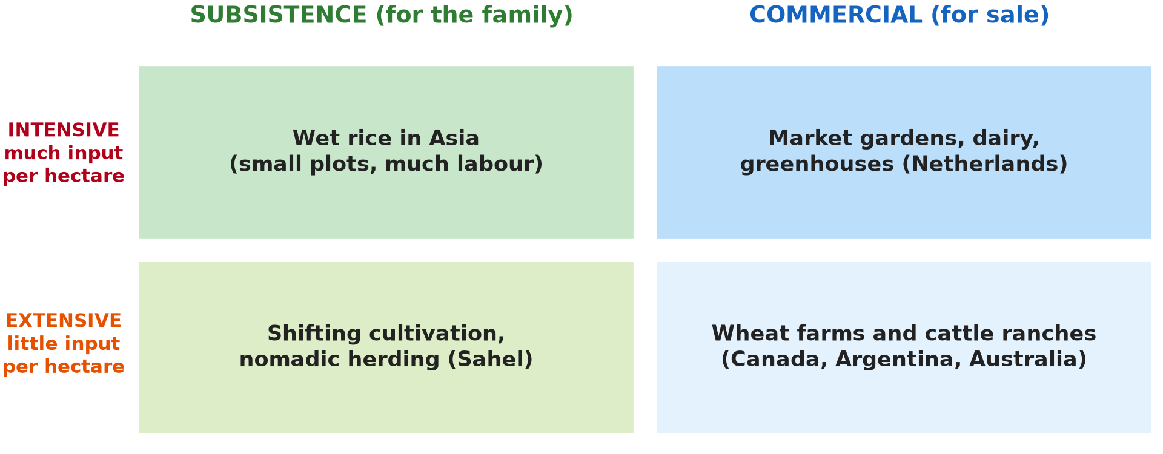
1. MEANING
Activity 1
Types of agriculture.
Notes:
Activity 1. Look carefully at this diagram: types of agriculture. Observe every detail before I ask the question.

Slide 20
1. MEANING
Activity 1: Question
What is an agricultural system?
Notes:
Here is the question for Activity 1: What is an agricultural system? Take one minute to think and write your answer in your rough notebook.

Slide 21
1. MEANING
Activity 1: Answer
A way of farming defined by its inputs, methods and purpose.
Notes:
Let us check the answer together. A way of farming defined by its inputs, methods and purpose.

Slide 22

2. ARABLE AND PASTORAL
Activity 2
Cattle.
Notes:
Activity 2. Look carefully at this picture: cattle. Observe every detail before I ask the question.

Slide 23
2. ARABLE AND PASTORAL
Activity 2: Question
Distinguish arable farming and pastoral farming.
Notes:
Here is the question for Activity 2: Distinguish arable farming and pastoral farming. Take one minute to think and write your answer in your rough notebook.

Slide 24
2. ARABLE AND PASTORAL
Activity 2: Answer
Arable farming grows crops; pastoral farming rears animals.
Notes:
Let us check the answer together. Arable farming grows crops; pastoral farming rears animals.

Slide 25
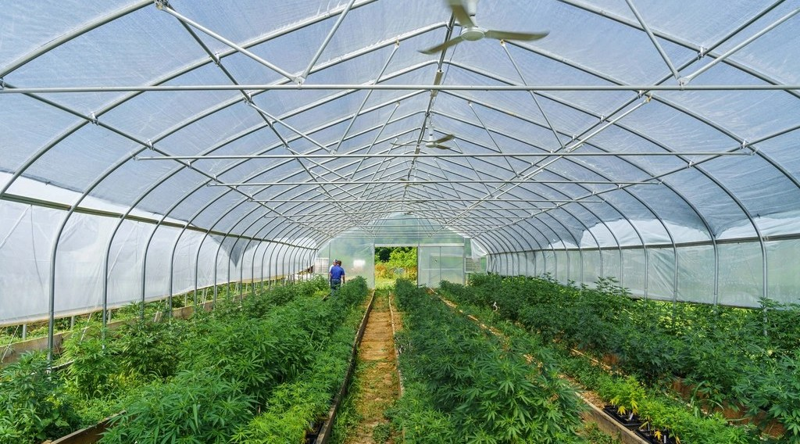
2. INTENSIVE
Activity 3
A greenhouse.
Notes:
Activity 3. Look carefully at this picture: a greenhouse. Observe every detail before I ask the question.

Slide 26
2. INTENSIVE
Activity 3: Question
What is intensive farming?
Notes:
Here is the question for Activity 3: What is intensive farming? Take one minute to think and write your answer in your rough notebook.

Slide 27
2. INTENSIVE
Activity 3: Answer
Using many inputs of labour or capital on a small area to get high yields.
Notes:
Let us check the answer together. Using many inputs of labour or capital on a small area to get high yields.

Slide 28

2. EXTENSIVE
Activity 4
Herders in the Sahel.
Notes:
Activity 4. Look carefully at this picture: herders in the Sahel. Observe every detail before I ask the question.

Slide 29
2. EXTENSIVE
Activity 4: Question
What is extensive farming?
Notes:
Here is the question for Activity 4: What is extensive farming? Take one minute to think and write your answer in your rough notebook.

Slide 30
2. EXTENSIVE
Activity 4: Answer
Using few inputs on a large area, with low yields per hectare.
Notes:
Let us check the answer together. Using few inputs on a large area, with low yields per hectare.

Slide 31
3. CHARACTERISTICS
Activity 5
Subsistence and commercial farming.
Notes:
Activity 5. Look carefully at this diagram: subsistence and commercial farming. Observe every detail before I ask the question.

Slide 32
3. CHARACTERISTICS
Activity 5: Question
Distinguish subsistence and commercial farming.
Notes:
Here is the question for Activity 5: Distinguish subsistence and commercial farming. Take one minute to think and write your answer in your rough notebook.

Slide 33
3. CHARACTERISTICS
Activity 5: Answer
Subsistence farming feeds the family; commercial farming produces for sale.
Notes:
Let us check the answer together. Subsistence farming feeds the family; commercial farming produces for sale.

Slide 34
BOARD SUMMARY
Board Summary
Topic: Managing Resources for Development through Economic Activities
Sub-topic: Agriculture as an Economic Activity of the Primary Sector
Lesson 27: Agricultural Systems
Notes:
Now we are going to copy the board summary. Write the title and the headings neatly in your notebooks. I will give you enough time for each slide, so do not rush.

Slide 35
BOARD SUMMARY
DEFINITIONS
The key terms of this lesson are defined as follows:
Agricultural system: It is a way of farming defined by its inputs, methods and purpose.
Notes:
Let us copy the definitions. The key terms of this lesson are defined as follows. On this slide we have Agricultural system. Write each point on a new line, with the key term first, and explain it in your own words when we revise.

Slide 36
BOARD SUMMARY
1. Classification
Agricultural systems are classified as follows:
Arable and pastoral farming: Arable farming grows crops, while pastoral farming rears animals.
Notes:
Let us copy Classification. Agricultural systems are classified as follows. On this slide we have Arable and pastoral farming. Write each point on a new line, with the key term first, and explain it in your own words when we revise. When you finish, we go to the next slide.

Slide 37
BOARD SUMMARY
1. Classification (continued)
Intensive farming: It uses many inputs on a small area and gives high yields per hectare.
Extensive farming: It uses few inputs on a large area and gives low yields per hectare.
Notes:
We continue with Classification. On this slide we have Intensive farming and Extensive farming. Write each point on a new line, with the key term first, and explain it in your own words when we revise. When you finish, we go to the next slide.

Slide 38
BOARD SUMMARY
1. Classification (continued)
Subsistence and commercial farming: Subsistence farming feeds the family, while commercial farming sells its products.
Notes:
We continue with Classification. On this slide we have Subsistence and commercial farming. Write each point on a new line, with the key term first, and explain it in your own words when we revise.

Slide 39
BOARD SUMMARY
1. Classification
Illustration: types of agriculture
Notes:
Now draw this illustration in your notebook: types of agriculture. Give it a title and label it clearly.

Slide 40
BOARD SUMMARY
2. General Characteristics
The systems have the following characteristics:
Intensive systems: Small farms, much labour or capital, fertilisers and irrigation, as in market gardening.
Notes:
Let us copy General Characteristics. The systems have the following characteristics. On this slide we have Intensive systems. Write each point on a new line, with the key term first, and explain it in your own words when we revise. When you finish, we go to the next slide.

Slide 41
BOARD SUMMARY
2. General Characteristics (continued)
Extensive systems: Large areas, few workers, little capital, as in nomadic herding and wheat farming.
Notes:
We continue with General Characteristics. On this slide we have Extensive systems. Write each point on a new line, with the key term first, and explain it in your own words when we revise.

Slide 42
FORMATIVE EVALUATION
Evaluation 1
Distinguish intensive and extensive farming.
Notes:
Now let us check what you have understood. Question 1: Distinguish intensive and extensive farming. Answer in your exercise book.

Slide 43
FORMATIVE EVALUATION
Expected Answer
Intensive: many inputs on a small area. Extensive: few inputs on a large area.
Notes:
The expected answer is: intensive: many inputs on a small area. Extensive: few inputs on a large area. If you got it right, well done.

Slide 44
FORMATIVE EVALUATION
Evaluation 2
Give one example of each.
Notes:
Now let us check what you have understood. Question 2: Give one example of each. Answer in your exercise book.

Slide 45
FORMATIVE EVALUATION
Expected Answer
Intensive: market gardening. Extensive: nomadic herding.
Notes:
The expected answer is: intensive: market gardening. Extensive: nomadic herding. If you got it right, well done.

Slide 46
REMEDIATION
Remediation
Fill in the blanks:
Growing crops is ______ farming.
Rearing animals is ______ farming.
Farming for sale is ______ farming.
Notes:
For those who need more practice, fill in the blanks in your exercise book. The answers are: number 1, arable; number 2, pastoral; number 3, commercial.

Slide 47
HOMEWORK
Homework
Classify three farms of your area as intensive or extensive and justify.
Notes:
For your homework: Classify three farms of your area as intensive or extensive and justify. We shall correct it at the beginning of our next lesson.

Slide 48
NEXT LESSON
Next Lesson
Our next lesson will be on:
Lesson 28: Intensive and Extensive Agriculture
Notes:
Our next lesson will be on Lesson 28: Intensive and Extensive Agriculture. Thank you for your attention, and see you next time.

Slide 49
BILINGUAL GAME
Bilingual Game (Jeu Bilingue)
English | Français
Arable | Agricole (cultures)
Pastoral | Pastoral
Intensive | Intensif
Extensive | Extensif
Subsistence | La subsistance
Commercial | Commercial
Notes:
Let us play the bilingual game. I say a word in English, and you give me the French word. Then we do the reverse.

Slide 50
LOGBOOK
Official Logbook (1/2)
Module / Topic | Managing Resources for Development through Economic Activities
Lesson Title | Lesson 27: Agricultural Systems
Expected Learning Outcomes | Define an agricultural system. Classify systems into intensive and extensive. Describe the characteristics of each system.
Competence | Learners are able to classify agricultural systems and describe their characteristics.
Notes:
I record this information in the official logbook of the class after the lesson.

Slide 51
LOGBOOK
Official Logbook (2/2)
Matter Taught | DEFINITIONS; Classification; General Characteristics.
Evaluation | Formative evaluation and remediation exercise.
Homework | Classify three farms of your area as intensive or extensive and justify.
Enrolment / Present / Absent | ____ / ____ / ____
Achievement | To be completed after the lesson.
Notes:
I complete the second page of the logbook: the matter taught, the evaluation, the homework and the attendance.

Slide 52
TEACHER'S NOTE
Teacher's Note
Timing: Homework correction, plan, objectives 8 min | Recall, situation, action 10 min | 5 activities 30 min | Board summary (copying) 30 min | Evaluation, remediation 10 min | Homework, next lesson 5 min | Logbook 7 min
Without the projector (Activity 1): list farming types.
Without the projector (Activity 2): give examples.
Without the projector (Activity 3): describe a market garden.
Without the projector (Activity 4): describe herding in the north.
Without the projector (Activity 5): classify local farms.
Notes:
This slide is for me, the teacher: it gives the timing of the lesson and what to do if the projector is not available.

Slide 53
REFERENCES
References
Geography Syllabus, Forms I–V, MINESEC (2023) — Form 4, Module II: Development and the Management of Primary Resources.
Photo, Activity 2: “Fulani cattle breed of West Africa” by International Livestock Research Institute, CC BY-NC-SA 2.0, via Flickr (https://www.flickr.com/photos/7155605@N03/48125675226)
Photo, Activity 3: “Organic farming, vegetable patch” by U.S. Department of Agriculture, CC0 1.0, via rawpixel (https://www.rawpixel.com/image/10995692/organic-farming-vegetable-patch)
Photo, Activity 4: “Young cattle herders in Sénégal (West Africa)” by gbaku, CC BY-SA 2.0, via Flickr (https://www.flickr.com/photos/72105154@N00/525185172)
Diagrams and animations: drawn for this lesson (Geography Department).
Notes:
These are the references and picture credits used to prepare this lesson.

