Slide 1
FORM 4
GEOGRAPHY
Lesson 38
Problems of Tropical Agriculture with Reference to Cameroon
Notes:
Good morning, class, and welcome to our geography lesson. I am your geography teacher, Mr Kamdem. Today we are starting Lesson 38: Problems of Tropical Agriculture with Reference to Cameroon.

Slide 2
CLASS INFO
Class, Chapter and Duration
Class | Form 4
Chapter | Module II: Development and the Management of Primary Resources
Duration | 2 periods (2 × 50 minutes)
Notes:
This lesson is for Form 4. It belongs to Module II: Development and the Management of Primary Resources. We shall need 2 periods to cover it.

Slide 3
IDENTIFICATION
Lesson Identification
Topic | Managing Resources for Development through Economic Activities
Sub-topic | The Economic Development Potentials of Cameroon in the Primary Sector: Agriculture
Lesson | Lesson 38: Problems of Tropical Agriculture with Reference to Cameroon
Notions / Concepts | Physical problems, human problems, solutions.
Syllabus focus | Physical problems and solutions; human problems and solutions.
Competence | Learners are able to explain the problems of agriculture in Cameroon and propose solutions.
Notes:
Our topic is Managing Resources for Development through Economic Activities, and the sub-topic is The Economic Development Potentials of Cameroon in the Primary Sector: Agriculture. The key notions we shall use today are: physical problems, human problems, solutions. At the end, you should be able to do this: learners are able to explain the problems of agriculture in Cameroon and propose solutions.

Slide 4

HOMEWORK CORRECTION
Correction of the Homework
Question (Lesson 37: Food Loss and Food Waste):
Observe food waste at home for three days and suggest how to reduce it.
Notes:
Before we start the new lesson, let us correct the homework I gave you at the end of Lesson 37: Food Loss and Food Waste. The question was: Observe food waste at home for three days and suggest how to reduce it. Take out your exercise books.

Slide 5
HOMEWORK CORRECTION
Correction: Possible Answer
Answers vary. Example: leftover rice and rotten tomatoes were thrown away; solutions: cook smaller amounts, reheat leftovers, and dry or preserve tomatoes.
Notes:
Here is a good answer. Answers vary. Example: leftover rice and rotten tomatoes were thrown away; solutions: cook smaller amounts, reheat leftovers, and dry or preserve tomatoes. Compare it with your own answer and correct your work in red.

Slide 6
LESSON PLAN
Lesson Plan
Correction of the homework
Objectives and recall
Real-life situation and action to take
Learning activities
Board summary
Evaluation, remediation and homework
Notes:
Here is the plan of our lesson today. First, we shall correct the homework. Then we shall look at the objectives and recall what you already know. After that, we shall study a situation from real life and the action to take, and do the learning activities. Finally, we shall copy the board summary, do the evaluation and the remediation, and I will give you the homework.

Slide 7
OBJECTIVES
Objectives
By the end of this lesson, you should be able to:
Explain the physical problems of tropical agriculture.
Explain the human problems.
Propose solutions to each.
Notes:
By the end of this lesson, you should be able to do three things. Number 1: explain the physical problems of tropical agriculture. Number 2: explain the human problems. Number 3: propose solutions to each.

Slide 8
PREVIOUS KNOWLEDGE
Previous Knowledge
Rains are irregular in the north.
Soils can be poor.
Farmers lack money for inputs.
Notes:
Let us first remember what you already know. Rains are irregular in the north. Soils can be poor. Farmers lack money for inputs. Keep this in mind, because we shall build on it today.

Slide 9
REAL-LIFE SITUATION
Situation in Real Life
A farmer near Maroua lost his crops to drought and locusts. He also cannot get a loan to buy fertiliser, and the road to the market is impassable in the rainy season.
Notes:
Listen carefully to this situation from real life. A farmer near Maroua lost his crops to drought and locusts. He also cannot get a loan to buy fertiliser, and the road to the market is impassable in the rainy season. Think about it, because I am going to ask you some questions.

Slide 10
REAL-LIFE SITUATION
Situation: Question 1
What is the problem in the situation?
Notes:
Question 1: What is the problem in the situation? Think for a moment, then raise your hand to answer.

Slide 11
REAL-LIFE SITUATION
Answer
The farmer faces many problems.
Notes:
Good. The farmer faces many problems.

Slide 12
REAL-LIFE SITUATION
Situation: Question 2
Give two physical problems.
Notes:
Question 2: Give two physical problems. Think for a moment, then raise your hand to answer.

Slide 13
REAL-LIFE SITUATION
Answer
Drought and locusts.
Notes:
Good. Drought and locusts.

Slide 14
REAL-LIFE SITUATION
Situation: Question 3
Give two human problems.
Notes:
Question 3: Give two human problems. Think for a moment, then raise your hand to answer.

Slide 15
REAL-LIFE SITUATION
Possible Answer
No loan and a bad road.
Notes:
Good. No loan and a bad road.

Slide 16
ACTION TO TAKE
Action to Take
Support farmers' cooperatives and good farming techniques.
Notes:
From this situation, the action we are working towards in this lesson is the following: support farmers' cooperatives and good farming techniques.

Slide 17
JUSTIFICATION
Justification of the Lesson
This lesson helps us to understand why farmers struggle and how to help them.
Notes:
Why is this lesson important for you? This lesson helps us to understand why farmers struggle and how to help them.

Slide 18

1. PHYSICAL PROBLEMS
Activity 1
Dry, cracked soil.
Notes:
Activity 1. Look carefully at this picture: dry, cracked soil. Observe every detail before I ask the question.

Slide 19
1. PHYSICAL PROBLEMS
Activity 1: Question
Give three physical problems of tropical agriculture.
Notes:
Here is the question for Activity 1: Give three physical problems of tropical agriculture. Take one minute to think and write your answer in your rough notebook.

Slide 20
1. PHYSICAL PROBLEMS
Activity 1: Answer
Drought or irregular rain, poor leached soils and pests (also floods, erosion).
Notes:
Let us check the answer together. Drought or irregular rain, poor leached soils and pests (also floods, erosion).

Slide 21
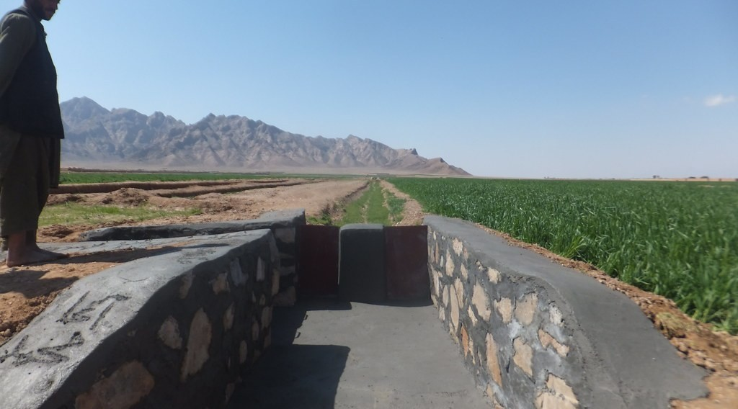
1. PHYSICAL SOLUTIONS
Activity 2
An irrigation canal.
Notes:
Activity 2. Look carefully at this picture: an irrigation canal. Observe every detail before I ask the question.

Slide 22
1. PHYSICAL SOLUTIONS
Activity 2: Question
Give two solutions to physical problems.
Notes:
Here is the question for Activity 2: Give two solutions to physical problems. Take one minute to think and write your answer in your rough notebook.

Slide 23
1. PHYSICAL SOLUTIONS
Activity 2: Answer
Irrigation and fertilisers (also pest control, soil conservation).
Notes:
Let us check the answer together. Irrigation and fertilisers (also pest control, soil conservation).

Slide 24

2. HUMAN PROBLEMS
Activity 3
A bad rural road.
Notes:
Activity 3. Look carefully at this picture: a bad rural road. Observe every detail before I ask the question.

Slide 25
2. HUMAN PROBLEMS
Activity 3: Question
Give three human problems.
Notes:
Here is the question for Activity 3: Give three human problems. Take one minute to think and write your answer in your rough notebook.

Slide 26
2. HUMAN PROBLEMS
Activity 3: Answer
Lack of capital and credit, bad roads and poor storage (also land disputes, low prices).
Notes:
Let us check the answer together. Lack of capital and credit, bad roads and poor storage (also land disputes, low prices).

Slide 27

2. HUMAN PROBLEMS
Activity 4
Cattle near farms.
Notes:
Activity 4. Look carefully at this picture: cattle near farms. Observe every detail before I ask the question.

Slide 28
2. HUMAN PROBLEMS
Activity 4: Question
How do farmer–herder conflicts affect agriculture?
Notes:
Here is the question for Activity 4: How do farmer–herder conflicts affect agriculture? Take one minute to think and write your answer in your rough notebook.

Slide 29
2. HUMAN PROBLEMS
Activity 4: Answer
Crops are destroyed and people are hurt or displaced.
Notes:
Let us check the answer together. Crops are destroyed and people are hurt or displaced.

Slide 30

2. HUMAN SOLUTIONS
Activity 5
A farmer using a phone.
Notes:
Activity 5. Look carefully at this picture: a farmer using a phone. Observe every detail before I ask the question.

Slide 31
2. HUMAN SOLUTIONS
Activity 5: Question
Give three solutions to human problems.
Notes:
Here is the question for Activity 5: Give three solutions to human problems. Take one minute to think and write your answer in your rough notebook.

Slide 32
2. HUMAN SOLUTIONS
Activity 5: Answer
Credit and cooperatives, better roads and storage, and training by extension workers.
Notes:
Let us check the answer together. Credit and cooperatives, better roads and storage, and training by extension workers.

Slide 33
BOARD SUMMARY
Board Summary
Topic: Managing Resources for Development through Economic Activities
Sub-topic: The Economic Development Potentials of Cameroon in the Primary Sector: Agriculture
Lesson 38: Problems of Tropical Agriculture with Reference to Cameroon
Notes:
Now we are going to copy the board summary. Write the title and the headings neatly in your notebooks. I will give you enough time for each slide, so do not rush.

Slide 34
BOARD SUMMARY
1. Physical Problems and Solutions
Tropical agriculture faces the following physical problems and solutions:
Climate: Drought, irregular rain and floods destroy crops, so irrigation and resistant seeds are needed.
Notes:
Let us copy Physical Problems and Solutions. Tropical agriculture faces the following physical problems and solutions. On this slide we have Climate. Write each point on a new line, with the key term first, and explain it in your own words when we revise. When you finish, we go to the next slide.

Slide 35
BOARD SUMMARY
1. Physical Problems and Solutions (continued)
Soils: Leached and eroded soils are poor, so fertilisers and soil conservation are needed.
Pests and diseases: Locusts, birds and diseases attack crops and animals, so pest control and vaccination are needed.
Notes:
We continue with Physical Problems and Solutions. On this slide we have Soils and Pests and diseases. Write each point on a new line, with the key term first, and explain it in your own words when we revise.

Slide 36
BOARD SUMMARY
2. Human Problems and Solutions
Tropical agriculture faces the following human problems and solutions:
Capital: Farmers lack money and credit, so banks and cooperatives must give loans.
Infrastructure: Bad roads and poor storage cause losses, so roads and granaries must be built.
Notes:
Let us copy Human Problems and Solutions. Tropical agriculture faces the following human problems and solutions. On this slide we have Capital and Infrastructure. Write each point on a new line, with the key term first, and explain it in your own words when we revise. When you finish, we go to the next slide.

Slide 37
BOARD SUMMARY
2. Human Problems and Solutions (continued)
Techniques and training: Simple tools and low training limit yields, so extension services must train farmers.
Conflicts and land: Farmer–herder conflicts and land disputes must be solved by clear rules.
Notes:
We continue with Human Problems and Solutions. On this slide we have Techniques and training and Conflicts and land. Write each point on a new line, with the key term first, and explain it in your own words when we revise.

Slide 38
FORMATIVE EVALUATION
Evaluation 1
Give two physical problems and their solutions.
Notes:
Now let us check what you have understood. Question 1: Give two physical problems and their solutions. Answer in your exercise book.

Slide 39
FORMATIVE EVALUATION
Expected Answer
Drought – irrigation; poor soils – fertilisers.
Notes:
The expected answer is: drought – irrigation; poor soils – fertilisers. If you got it right, well done.

Slide 40
FORMATIVE EVALUATION
Evaluation 2
Give two human problems and their solutions.
Notes:
Now let us check what you have understood. Question 2: Give two human problems and their solutions. Answer in your exercise book.

Slide 41
FORMATIVE EVALUATION
Expected Answer
Lack of credit – cooperatives; bad roads – road building.
Notes:
The expected answer is: lack of credit – cooperatives; bad roads – road building. If you got it right, well done.

Slide 42
REMEDIATION
Remediation
Fill in the blanks:
Insects that destroy crops in swarms are ______.
Groups of farmers working together form a ______.
Bringing water to crops is ______.
Notes:
For those who need more practice, fill in the blanks in your exercise book. The answers are: number 1, locusts; number 2, cooperative; number 3, irrigation.

Slide 43
HOMEWORK
Homework
Interview a farmer about his two main problems and propose solutions.
Notes:
For your homework: Interview a farmer about his two main problems and propose solutions. We shall correct it at the beginning of our next lesson.

Slide 44
NEXT LESSON
Next Lesson
Our next lesson will be on:
Lesson 39: Forest Resources and their Management
Notes:
Our next lesson will be on Lesson 39: Forest Resources and their Management. Thank you for your attention, and see you next time.

Slide 45
BILINGUAL GAME
Bilingual Game (Jeu Bilingue)
English | Français
Problem | Le problème
Drought | La sécheresse
Pest | Le ravageur
Credit | Le crédit
Cooperative | La coopérative
Extension worker | Le vulgarisateur agricole
Notes:
Let us play the bilingual game. I say a word in English, and you give me the French word. Then we do the reverse.

Slide 46
LOGBOOK
Official Logbook (1/2)
Module / Topic | Managing Resources for Development through Economic Activities
Lesson Title | Lesson 38: Problems of Tropical Agriculture with Reference to Cameroon
Expected Learning Outcomes | Explain the physical problems of tropical agriculture. Explain the human problems. Propose solutions to each.
Competence | Learners are able to explain the problems of agriculture in Cameroon and propose solutions.
Notes:
I record this information in the official logbook of the class after the lesson.

Slide 47
LOGBOOK
Official Logbook (2/2)
Matter Taught | Physical Problems and Solutions; Human Problems and Solutions.
Evaluation | Formative evaluation and remediation exercise.
Homework | Interview a farmer about his two main problems and propose solutions.
Enrolment / Present / Absent | ____ / ____ / ____
Achievement | To be completed after the lesson.
Notes:
I complete the second page of the logbook: the matter taught, the evaluation, the homework and the attendance.

Slide 48
TEACHER'S NOTE
Teacher's Note
Timing: Homework correction, plan, objectives 8 min | Recall, situation, action 10 min | 5 activities 30 min | Board summary (copying) 30 min | Evaluation, remediation 10 min | Homework, next lesson 5 min | Logbook 7 min
Without the projector (Activity 1): list problems.
Without the projector (Activity 2): discuss.
Without the projector (Activity 3): list problems.
Without the projector (Activity 4): discuss.
Without the projector (Activity 5): list solutions.
Notes:
This slide is for me, the teacher: it gives the timing of the lesson and what to do if the projector is not available.

Slide 49
REFERENCES
References
Geography Syllabus, Forms I–V, MINESEC (2023) — Form 4, Module II: Development and the Management of Primary Resources.
Photo, Activity 1: “Imagine a world without trees” by aloshbennett, CC BY 2.0, via Flickr (https://www.flickr.com/photos/13203757@N00/3480223314)
Photo, Activity 2: “Irrigation Canals in Farah Province Afgahnistan” by USAID_IMAGES, CC BY-NC-ND 2.0, via Flickr (https://www.flickr.com/photos/46658241@N06/14784748647)
Photo, Activity 3: “Cameroon - UN Women's Gender Road Project” by UN Women Gallery, CC BY-NC-ND 2.0, via Flickr (https://www.flickr.com/photos/51431730@N04/40672356003)
Photo, Activity 4: “Acacia Tree” by D-Stanley, CC BY 2.0, via Flickr (https://www.flickr.com/photos/79721788@N00/11527335486)
Photo, Activity 5: “Using mobile technology to give feedback about the crop trials” by Bioversity International, CC BY-NC-ND 2.0, via Flickr (https://www.flickr.com/photos/50383637@N07/15019002626)
Diagrams and animations: drawn for this lesson (Geography Department).
Notes:
These are the references and picture credits used to prepare this lesson.

