Slide 1
FORM 4
GEOGRAPHY
Lesson 44
The Management of Mineral Resources in Cameroon
Notes:
Good morning, class, and welcome to our geography lesson. I am your geography teacher, Mr Kamdem. Today we are starting Lesson 44: The Management of Mineral Resources in Cameroon.

Slide 2
CLASS INFO
Class, Chapter and Duration
Class | Form 4
Chapter | Module II: Development and the Management of Primary Resources
Duration | 2 periods (2 × 50 minutes)
Notes:
This lesson is for Form 4. It belongs to Module II: Development and the Management of Primary Resources. We shall need 2 periods to cover it.

Slide 3
IDENTIFICATION
Lesson Identification
Topic | Management of Primary Resources
Sub-topic | The Economic Development Potentials of Cameroon in the Primary Sector: Mining
Lesson | Lesson 44: The Management of Mineral Resources in Cameroon
Notions / Concepts | Mineral resource, conservation, artisanal mining.
Syllabus focus | Types; distribution; efforts to develop mineral resources; importance to the economy; government efforts to conserve mineral resources.
Competence | Learners are able to describe the mineral resources of Cameroon and their management.
Notes:
Our topic is Management of Primary Resources, and the sub-topic is The Economic Development Potentials of Cameroon in the Primary Sector: Mining. The key notions we shall use today are: mineral resource, conservation, artisanal mining. At the end, you should be able to do this: learners are able to describe the mineral resources of Cameroon and their management.

Slide 4

HOMEWORK CORRECTION
Correction of the Homework
Question (Lesson 43: Mineral Resources and their Management):
List five objects at home made from minerals and name the mineral.
Notes:
Before we start the new lesson, let us correct the homework I gave you at the end of Lesson 43: Mineral Resources and their Management. The question was: List five objects at home made from minerals and name the mineral. Take out your exercise books.

Slide 5
HOMEWORK CORRECTION
Correction: Possible Answer
Cooking pot (aluminium from bauxite), nails (iron), electric wire (copper), cement walls (limestone), salt.
Notes:
Here is a good answer. Cooking pot (aluminium from bauxite), nails (iron), electric wire (copper), cement walls (limestone), salt. Compare it with your own answer and correct your work in red.

Slide 6
LESSON PLAN
Lesson Plan
Correction of the homework
Objectives and recall
Real-life situation and action to take
Learning activities
Board summary
Evaluation, remediation and homework
Notes:
Here is the plan of our lesson today. First, we shall correct the homework. Then we shall look at the objectives and recall what you already know. After that, we shall study a situation from real life and the action to take, and do the learning activities. Finally, we shall copy the board summary, do the evaluation and the remediation, and I will give you the homework.

Slide 7
OBJECTIVES
Objectives
By the end of this lesson, you should be able to:
Identify the mineral resources of Cameroon and their distribution.
Explain their importance and the efforts to develop them.
Notes:
Take your time to copy this part; we will continue together.

Slide 8
OBJECTIVES
Objectives (continued)
Explain government efforts to conserve them.
Notes:
By the end of this lesson, you should be able to do three things. Number 1: identify the mineral resources of Cameroon and their distribution. Number 2: explain their importance and the efforts to develop them. Number 3: explain government efforts to conserve them.

Slide 9
PREVIOUS KNOWLEDGE
Previous Knowledge
Minerals are non-renewable.
Cameroon has bauxite and gold.
Oil is produced near the coast.
Notes:
Let us first remember what you already know. Minerals are non-renewable. Cameroon has bauxite and gold. Oil is produced near the coast. Keep this in mind, because we shall build on it today.

Slide 10
REAL-LIFE SITUATION
Situation in Real Life
In the East Region, artisanal miners dig for gold with simple tools. In Adamawa, the large bauxite deposit of Minim-Martap is still waiting to be exploited.
Notes:
Listen carefully to this situation from real life. In the East Region, artisanal miners dig for gold with simple tools. In Adamawa, the large bauxite deposit of Minim-Martap is still waiting to be exploited. Think about it, because I am going to ask you some questions.

Slide 11
REAL-LIFE SITUATION
Situation: Question 1
What is the problem in the situation?
Notes:
Question 1: What is the problem in the situation? Think for a moment, then raise your hand to answer.

Slide 12
REAL-LIFE SITUATION
Answer
We want to know the minerals of Cameroon and how they are managed.
Notes:
Good. We want to know the minerals of Cameroon and how they are managed.

Slide 13
REAL-LIFE SITUATION
Situation: Question 2
Where is gold mined?
Notes:
Question 2: Where is gold mined? Think for a moment, then raise your hand to answer.

Slide 14
REAL-LIFE SITUATION
Answer
In the East Region.
Notes:
Good. In the East Region.

Slide 15
REAL-LIFE SITUATION
Situation: Question 3
Where is a large bauxite deposit?
Notes:
Question 3: Where is a large bauxite deposit? Think for a moment, then raise your hand to answer.

Slide 16
REAL-LIFE SITUATION
Possible Answer
Minim-Martap in Adamawa.
Notes:
Good. Minim-Martap in Adamawa.

Slide 17
ACTION TO TAKE
Action to Take
Denounce illegal mining and support safe, responsible mining.
Notes:
From this situation, the action we are working towards in this lesson is the following: denounce illegal mining and support safe, responsible mining.

Slide 18
JUSTIFICATION
Justification of the Lesson
This lesson helps us to know the mineral wealth of Cameroon.
Notes:
Why is this lesson important for you? This lesson helps us to know the mineral wealth of Cameroon.

Slide 19
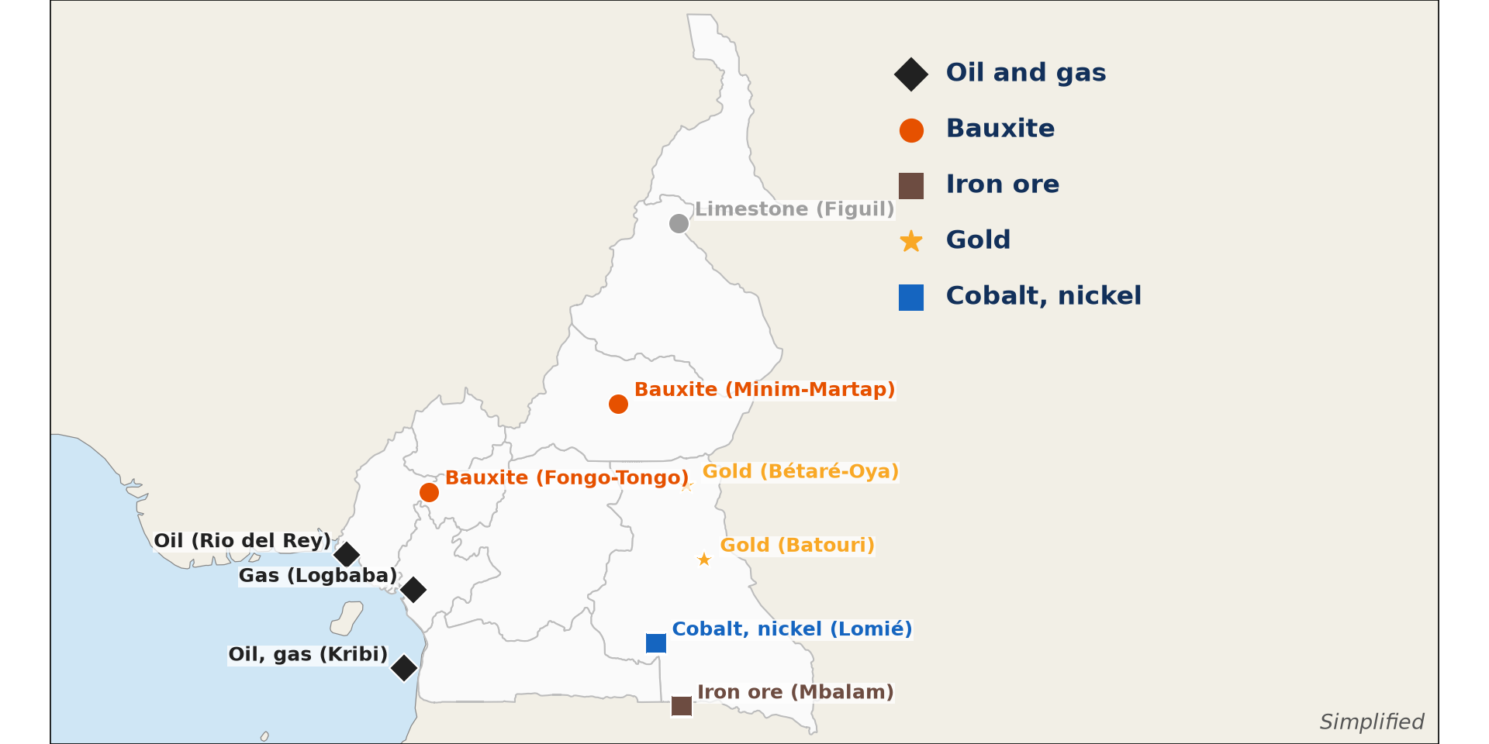
1. TYPES AND DISTRIBUTION
Activity 1
Minerals of Cameroon.
Notes:
Activity 1. Look carefully at this diagram: minerals of Cameroon. Observe every detail before I ask the question.

Slide 20
1. TYPES AND DISTRIBUTION
Activity 1: Question
Name four minerals of Cameroon and where they are found.
Notes:
Here is the question for Activity 1: Name four minerals of Cameroon and where they are found. Take one minute to think and write your answer in your rough notebook.

Slide 21
1. TYPES AND DISTRIBUTION
Activity 1: Answer
Oil (coast), bauxite (Minim-Martap), iron ore (Mbalam, Kribi) and gold (East) (also limestone at Figuil).
Notes:
Let us check the answer together. Oil (coast), bauxite (Minim-Martap), iron ore (Mbalam, Kribi) and gold (East) (also limestone at Figuil).

Slide 22

2. EXPLOITATION
Activity 2
Artisanal gold miners.
Notes:
Activity 2. Look carefully at this picture: artisanal gold miners. Observe every detail before I ask the question.

Slide 23
2. EXPLOITATION
Activity 2: Question
Describe artisanal gold mining.
Notes:
Here is the question for Activity 2: Describe artisanal gold mining. Take one minute to think and write your answer in your rough notebook.

Slide 24
2. EXPLOITATION
Activity 2: Answer
Small-scale mining by hand, digging and washing river sand.
Notes:
Let us check the answer together. Small-scale mining by hand, digging and washing river sand.

Slide 25

2. EFFORTS TO DEVELOP
Activity 3
A bauxite mine.
Notes:
Activity 3. Look carefully at this picture: a bauxite mine. Observe every detail before I ask the question.

Slide 26
2. EFFORTS TO DEVELOP
Activity 3: Question
Give two efforts to develop mineral resources.
Notes:
Here is the question for Activity 3: Give two efforts to develop mineral resources. Take one minute to think and write your answer in your rough notebook.

Slide 27
2. EFFORTS TO DEVELOP
Activity 3: Answer
Mining codes and agreements with investors, and new infrastructure such as the Kribi port.
Notes:
Let us check the answer together. Mining codes and agreements with investors, and new infrastructure such as the Kribi port.

Slide 28
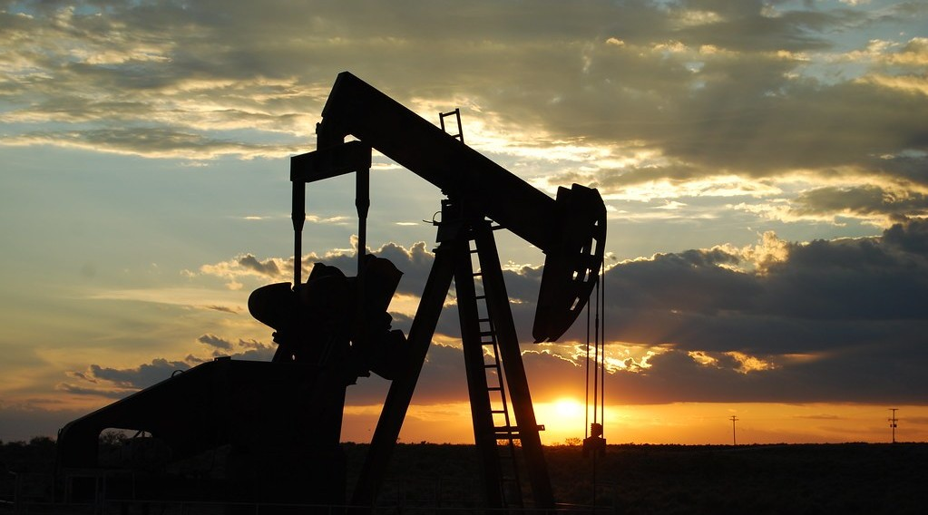
3. IMPORTANCE
Activity 4
An oil well.
Notes:
Activity 4. Look carefully at this picture: an oil well. Observe every detail before I ask the question.

Slide 29
3. IMPORTANCE
Activity 4: Question
Give two importance of minerals for Cameroon.
Notes:
Here is the question for Activity 4: Give two importance of minerals for Cameroon. Take one minute to think and write your answer in your rough notebook.

Slide 30
3. IMPORTANCE
Activity 4: Answer
Export income (especially oil) and jobs (also raw materials for cement).
Notes:
Let us check the answer together. Export income (especially oil) and jobs (also raw materials for cement).

Slide 31
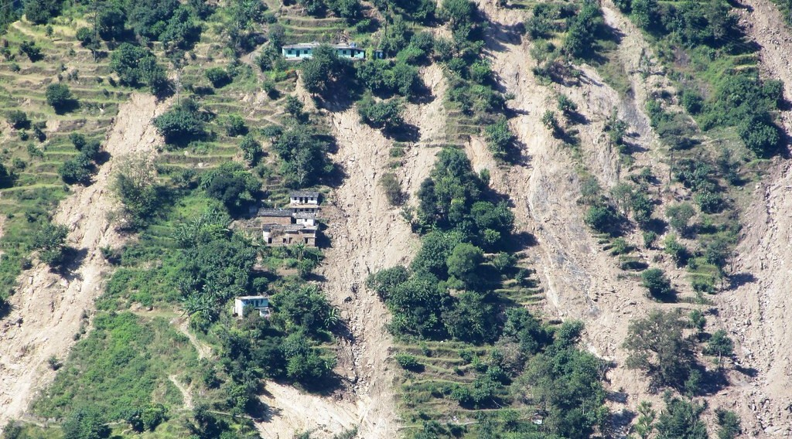
4. CONSERVATION
Activity 5
Land damaged by mining.
Notes:
Activity 5. Look carefully at this picture: land damaged by mining. Observe every detail before I ask the question.

Slide 32
4. CONSERVATION
Activity 5: Question
Give two government efforts to conserve minerals and the environment.
Notes:
Here is the question for Activity 5: Give two government efforts to conserve minerals and the environment. Take one minute to think and write your answer in your rough notebook.

Slide 33
4. CONSERVATION
Activity 5: Answer
The Mining Code and control of illegal mining (also land rehabilitation).
Notes:
Let us check the answer together. The Mining Code and control of illegal mining (also land rehabilitation).

Slide 34
BOARD SUMMARY
Board Summary
Topic: Management of Primary Resources
Sub-topic: The Economic Development Potentials of Cameroon in the Primary Sector: Mining
Lesson 44: The Management of Mineral Resources in Cameroon
Notes:
Now we are going to copy the board summary. Write the title and the headings neatly in your notebooks. I will give you enough time for each slide, so do not rush.

Slide 35
BOARD SUMMARY
1. Types and Distribution
Cameroon has the following mineral resources:
Energy minerals: Oil and gas are produced offshore near Limbe and Kribi.
Metallic minerals: Bauxite (Minim-Martap), iron ore (Mbalam, Kribi), gold (East) and cobalt (Lomié).
Notes:
Let us copy Types and Distribution. Cameroon has the following mineral resources. On this slide we have Energy minerals and Metallic minerals. Write each point on a new line, with the key term first, and explain it in your own words when we revise. When you finish, we go to the next slide.

Slide 36
BOARD SUMMARY
1. Types and Distribution (continued)
Non-metallic minerals: Limestone at Figuil is used to make cement.
Notes:
We continue with Types and Distribution. On this slide we have Non-metallic minerals. Write each point on a new line, with the key term first, and explain it in your own words when we revise.

Slide 37
BOARD SUMMARY
1. Types and Distribution
Illustration: minerals of Cameroon
Notes:
Now draw this illustration in your notebook: minerals of Cameroon. Give it a title and label it clearly.

Slide 38
BOARD SUMMARY
2. Development and Importance
Minerals are developed and are important as follows:
Efforts to develop: The state signs agreements with investors and builds ports and railways.
Importance: Minerals bring export income, jobs and raw materials for industry.
Notes:
Let us copy Development and Importance. Minerals are developed and are important as follows. On this slide we have Efforts to develop and Importance. Write each point on a new line, with the key term first, and explain it in your own words when we revise.

Slide 39
BOARD SUMMARY
3. Government Efforts to Conserve
The government conserves minerals as follows:
Laws: The Mining Code controls exploitation and requires permits.
Control and rehabilitation: Illegal mining is fought and damaged land must be restored.
Notes:
Let us copy Government Efforts to Conserve. The government conserves minerals as follows. On this slide we have Laws and Control and rehabilitation. Write each point on a new line, with the key term first, and explain it in your own words when we revise.

Slide 40
FORMATIVE EVALUATION
Evaluation 1
Name three minerals of Cameroon and their location.
Notes:
Now let us check what you have understood. Question 1: Name three minerals of Cameroon and their location. Answer in your exercise book.

Slide 41
FORMATIVE EVALUATION
Expected Answer
Oil (coast), bauxite (Minim-Martap), gold (East).
Notes:
The expected answer is: oil (coast), bauxite (Minim-Martap), gold (East). If you got it right, well done.

Slide 42
FORMATIVE EVALUATION
Evaluation 2
Give two government efforts.
Notes:
Now let us check what you have understood. Question 2: Give two government efforts. Answer in your exercise book.

Slide 43
FORMATIVE EVALUATION
Expected Answer
Mining Code and fight against illegal mining.
Notes:
The expected answer is: mining Code and fight against illegal mining. If you got it right, well done.

Slide 44
REMEDIATION
Remediation
Fill in the blanks:
The bauxite deposit of Adamawa is at ______.
Limestone for cement is found at ______.
Small-scale mining by hand is ______ mining.
Notes:
For those who need more practice, fill in the blanks in your exercise book. The answers are: number 1, Minim-Martap; number 2, Figuil; number 3, artisanal.

Slide 45
HOMEWORK
Homework
Give two advantages and two dangers of artisanal gold mining.
Notes:
For your homework: Give two advantages and two dangers of artisanal gold mining. We shall correct it at the beginning of our next lesson.

Slide 46
NEXT LESSON
Next Lesson
Our next lesson will be on:
Lesson 45: Energy Resources
Notes:
Our next lesson will be on Lesson 45: Energy Resources. Thank you for your attention, and see you next time.

Slide 47
BILINGUAL GAME
Bilingual Game (Jeu Bilingue)
English | Français
Mining | L'exploitation minière
Bauxite | La bauxite
Iron ore | Le minerai de fer
Oil | Le pétrole
Permit | Le permis
Pit | La fosse
Notes:
Let us play the bilingual game. I say a word in English, and you give me the French word. Then we do the reverse.

Slide 48
LOGBOOK
Official Logbook (1/2)
Module / Topic | Management of Primary Resources
Lesson Title | Lesson 44: The Management of Mineral Resources in Cameroon
Expected Learning Outcomes | Identify the mineral resources of Cameroon and their distribution. Explain their importance and the efforts to develop them. Explain government efforts to conserve them.
Competence | Learners are able to describe the mineral resources of Cameroon and their management.
Notes:
I record this information in the official logbook of the class after the lesson.

Slide 49
LOGBOOK
Official Logbook (2/2)
Matter Taught | Types and Distribution; Development and Importance; Government Efforts to Conserve.
Evaluation | Formative evaluation and remediation exercise.
Homework | Give two advantages and two dangers of artisanal gold mining.
Enrolment / Present / Absent | ____ / ____ / ____
Achievement | To be completed after the lesson.
Notes:
I complete the second page of the logbook: the matter taught, the evaluation, the homework and the attendance.

Slide 50
TEACHER'S NOTE
Teacher's Note
Timing: Homework correction, plan, objectives 8 min | Recall, situation, action 10 min | 5 activities 30 min | Board summary (copying) 30 min | Evaluation, remediation 10 min | Homework, next lesson 5 min | Logbook 7 min
Without the projector (Activity 1): use the map.
Without the projector (Activity 2): discuss.
Without the projector (Activity 3): discuss.
Without the projector (Activity 4): discuss.
Without the projector (Activity 5): discuss.
Notes:
This slide is for me, the teacher: it gives the timing of the lesson and what to do if the projector is not available.

Slide 51
REFERENCES
References
Geography Syllabus, Forms I–V, MINESEC (2023) — Form 4, Module II: Development and the Management of Primary Resources.
Photo, Activity 2: “Mining in Kailo” by Julien Harneis, CC BY-SA 2.0, via Flickr (https://www.flickr.com/photos/16935515@N00/1873057946)
Photo, Activity 3: “Bauxite mine near Itea, Greece” by Jason-Morrison, CC BY-NC 2.0, via Flickr (https://www.flickr.com/photos/8998833@N07/929316608)
Photo, Activity 4: “Oil Pump Jack” by Paul Lowry, CC BY 2.0, via Flickr (https://www.flickr.com/photos/10039026@N03/2770193028)
Photo, Activity 5: “Hillsides scarred by landslides caused by cloudbursts, Rudraprayag, Ut” by ICIMOD.Gallery, CC BY-NC 2.0, via Flickr (https://www.flickr.com/photos/127267759@N06/16051008426)
Diagrams and animations: drawn for this lesson (Geography Department).
Notes:
These are the references and picture credits used to prepare this lesson.

