Slide 1
FORM 5
GEOGRAPHY
Lesson 4
Industrialisation in the Advanced Industrialised Countries
Notes:
Good morning, class, and welcome to our geography lesson. I am your geography teacher, Mr Kamdem. Today we are starting Lesson 4: Industrialisation in the Advanced Industrialised Countries.

Slide 2
CLASS INFO
Class, Chapter and Duration
Class | Form 5
Chapter | Module I: Management of Manufacturing and Tertiary Activities
Duration | 2 periods (2 × 50 minutes)
Notes:
This lesson is for Form 5. It belongs to Module I: Management of Manufacturing and Tertiary Activities. We shall need 2 periods to cover it.

Slide 3
IDENTIFICATION
Lesson Identification
Topic | Managing Resources for Development through Economic Activities
Sub-topic | Manufacturing as an Economic Activity of the Secondary Sector
Lesson | Lesson 4: Industrialisation in the Advanced Industrialised Countries
Notions / Concepts | Agglomeration, high-tech industries.
Syllabus focus | Characteristics; reasons for the high level of industrialisation.
Competence | Learners are able to describe industry in AICs and explain its high level.
Notes:
Our topic is Managing Resources for Development through Economic Activities, and the sub-topic is Manufacturing as an Economic Activity of the Secondary Sector. The key notions we shall use today are: agglomeration, high-tech industries. At the end, you should be able to do this: learners are able to describe industry in AICs and explain its high level.

Slide 4

HOMEWORK CORRECTION
Correction of the Homework
Question (Lesson 3: Industrialisation in the Least Industrialised Countries):
Give three reasons why cotton from the North of Cameroon is not all made into cloth locally.
Notes:
Before we start the new lesson, let us correct the homework I gave you at the end of Lesson 3: Industrialisation in the Least Industrialised Countries. The question was: Give three reasons why cotton from the North of Cameroon is not all made into cloth locally. Take out your exercise books.

Slide 5
HOMEWORK CORRECTION
Correction: Possible Answer
CICAM has limited capacity; energy and machines are costly; imported cheap clothes compete; so much cotton is exported raw.
Notes:
Here is a good answer. CICAM has limited capacity; energy and machines are costly; imported cheap clothes compete; so much cotton is exported raw. Compare it with your own answer and correct your work in red.

Slide 6
LESSON PLAN
Lesson Plan
Correction of the homework
Objectives and recall
Real-life situation and action to take
Learning activities
Board summary
Evaluation, remediation and homework
Notes:
Here is the plan of our lesson today. First, we shall correct the homework. Then we shall look at the objectives and recall what you already know. After that, we shall study a situation from real life and the action to take, and do the learning activities. Finally, we shall copy the board summary, do the evaluation and the remediation, and I will give you the homework.

Slide 7
OBJECTIVES
Objectives
By the end of this lesson, you should be able to:
Describe the characteristics of industry in AICs.
Explain the reasons for the high level of industrialisation.
Notes:
Take your time to copy this part; we will continue together.

Slide 8
OBJECTIVES
Objectives (continued)
Compare AICs and LICs.
Notes:
By the end of this lesson, you should be able to do three things. Number 1: describe the characteristics of industry in AICs. Number 2: explain the reasons for the high level of industrialisation. Number 3: compare AICs and LICs.

Slide 9
PREVIOUS KNOWLEDGE
Previous Knowledge
AICs are rich countries.
The Industrial Revolution began in Britain.
Japan exports cars and electronics.
Notes:
Let us first remember what you already know. AICs are rich countries. The Industrial Revolution began in Britain. Japan exports cars and electronics. Keep this in mind, because we shall build on it today.

Slide 10
REAL-LIFE SITUATION
Situation in Real Life
Germany produces cars, machines and medicines sold all over the world. It has few raw materials but very skilled workers and advanced technology.
Notes:
Listen carefully to this situation from real life. Germany produces cars, machines and medicines sold all over the world. It has few raw materials but very skilled workers and advanced technology. Think about it, because I am going to ask you some questions.

Slide 11
REAL-LIFE SITUATION
Situation: Question 1
What is the problem in the situation?
Notes:
Question 1: What is the problem in the situation? Think for a moment, then raise your hand to answer.

Slide 12
REAL-LIFE SITUATION
Answer
We want to understand why Germany is so industrialised.
Notes:
Good. We want to understand why Germany is so industrialised.

Slide 13
REAL-LIFE SITUATION
Situation: Question 2
Name two products of Germany.
Notes:
Question 2: Name two products of Germany. Think for a moment, then raise your hand to answer.

Slide 14
REAL-LIFE SITUATION
Answer
Cars and machines (also medicines).
Notes:
Good. Cars and machines (also medicines).

Slide 15
REAL-LIFE SITUATION
Situation: Question 3
What does Germany have in abundance?
Notes:
Question 3: What does Germany have in abundance? Think for a moment, then raise your hand to answer.

Slide 16
REAL-LIFE SITUATION
Possible Answer
Skilled workers and technology.
Notes:
Good. Skilled workers and technology.

Slide 17
ACTION TO TAKE
Action to Take
Value science, technology and skills.
Notes:
From this situation, the action we are working towards in this lesson is the following: value science, technology and skills.

Slide 18
JUSTIFICATION
Justification of the Lesson
This lesson helps us to understand the success of industrial countries.
Notes:
Why is this lesson important for you? This lesson helps us to understand the success of industrial countries.

Slide 19

1. CHARACTERISTICS
Activity 1
Robots in a car factory.
Notes:
Activity 1. Look carefully at this picture: robots in a car factory. Observe every detail before I ask the question.

Slide 20
1. CHARACTERISTICS
Activity 1: Question
Give two characteristics of industry in AICs.
Notes:
Here is the question for Activity 1: Give two characteristics of industry in AICs. Take one minute to think and write your answer in your rough notebook.

Slide 21
1. CHARACTERISTICS
Activity 1: Answer
Heavy and high-tech industries, with many machines and robots.
Notes:
Let us check the answer together. Heavy and high-tech industries, with many machines and robots.

Slide 22

1. HIGH-TECH INDUSTRIES
Activity 2
A technology park.
Notes:
Activity 2. Look carefully at this picture: a technology park. Observe every detail before I ask the question.

Slide 23
1. HIGH-TECH INDUSTRIES
Activity 2: Question
What are high-tech industries?
Notes:
Here is the question for Activity 2: What are high-tech industries? Take one minute to think and write your answer in your rough notebook.

Slide 24
1. HIGH-TECH INDUSTRIES
Activity 2: Answer
Industries using advanced technology, such as computers, electronics and medicines.
Notes:
Let us check the answer together. Industries using advanced technology, such as computers, electronics and medicines.

Slide 25
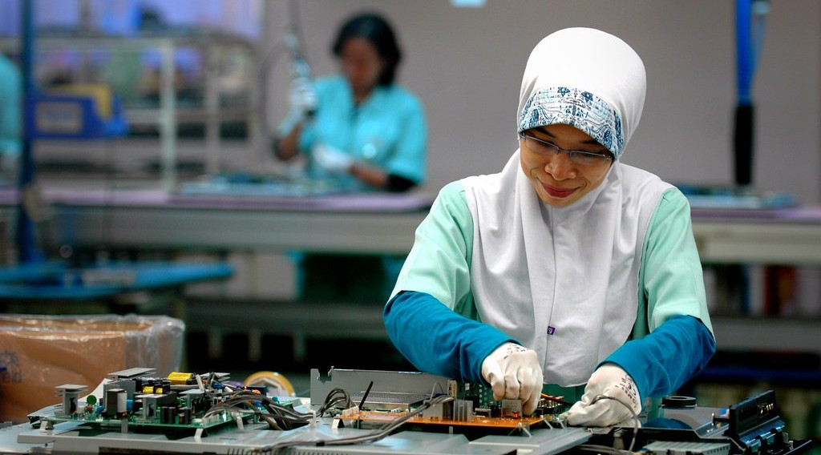
2. REASONS: CAPITAL AND TECHNOLOGY
Activity 3
Electronics workers.
Notes:
Activity 3. Look carefully at this picture: electronics workers. Observe every detail before I ask the question.

Slide 26
2. REASONS: CAPITAL AND TECHNOLOGY
Activity 3: Question
Give two reasons for high industrialisation in AICs.
Notes:
Here is the question for Activity 3: Give two reasons for high industrialisation in AICs. Take one minute to think and write your answer in your rough notebook.

Slide 27
2. REASONS: CAPITAL AND TECHNOLOGY
Activity 3: Answer
Plenty of capital and advanced technology and research.
Notes:
Let us check the answer together. Plenty of capital and advanced technology and research.

Slide 28
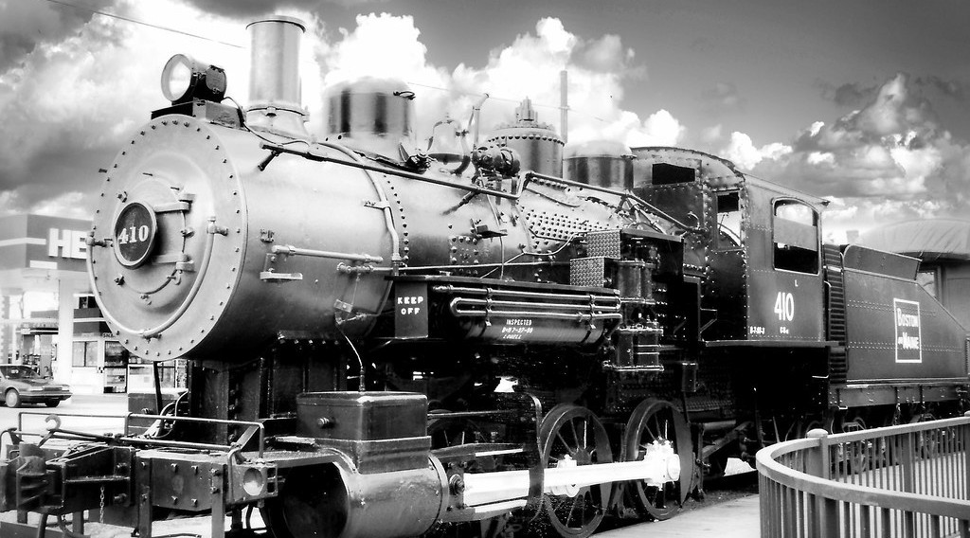
2. REASONS: HISTORY AND MARKETS
Activity 4
An old steam engine.
Notes:
Activity 4. Look carefully at this picture: an old steam engine. Observe every detail before I ask the question.

Slide 29
2. REASONS: HISTORY AND MARKETS
Activity 4: Question
How did history help AICs?
Notes:
Here is the question for Activity 4: How did history help AICs? Take one minute to think and write your answer in your rough notebook.

Slide 30
2. REASONS: HISTORY AND MARKETS
Activity 4: Answer
They started the Industrial Revolution early (Britain, 18th century) and built strong markets.
Notes:
Let us check the answer together. They started the Industrial Revolution early (Britain, 18th century) and built strong markets.

Slide 31

2. REASONS: INFRASTRUCTURE
Activity 5
A modern port.
Notes:
Activity 5. Look carefully at this picture: a modern port. Observe every detail before I ask the question.

Slide 32
2. REASONS: INFRASTRUCTURE
Activity 5: Question
How does infrastructure help industry in AICs?
Notes:
Here is the question for Activity 5: How does infrastructure help industry in AICs? Take one minute to think and write your answer in your rough notebook.

Slide 33
2. REASONS: INFRASTRUCTURE
Activity 5: Answer
Good energy, transport and communication reduce costs.
Notes:
Let us check the answer together. Good energy, transport and communication reduce costs.

Slide 34
BOARD SUMMARY
Board Summary
Topic: Managing Resources for Development through Economic Activities
Sub-topic: Manufacturing as an Economic Activity of the Secondary Sector
Lesson 4: Industrialisation in the Advanced Industrialised Countries
Notes:
Now we are going to copy the board summary. Write the title and the headings neatly in your notebooks. I will give you enough time for each slide, so do not rush.

Slide 35
BOARD SUMMARY
1. Characteristics of Industry in AICs
Industry in AICs has the following characteristics:
Variety: There are heavy, light and high-tech industries.
Technology: Factories use machines, robots and computers.
Notes:
Let us copy Characteristics of Industry in AICs. Industry in AICs has the following characteristics. On this slide we have Variety and Technology. Write each point on a new line, with the key term first, and explain it in your own words when we revise. When you finish, we go to the next slide.

Slide 36
BOARD SUMMARY
1. Characteristics of Industry in AICs (continued)
Agglomerations: Industries are grouped in large regions such as the Ruhr and the Great Lakes.
Notes:
We continue with Characteristics of Industry in AICs. On this slide we have Agglomerations. Write each point on a new line, with the key term first, and explain it in your own words when we revise.

Slide 37
BOARD SUMMARY
2. Reasons for the High Level of Industrialisation
Industry is strong in AICs for the following reasons:
Capital and technology: Banks and research provide money and new inventions.
Skilled labour: Good education produces skilled workers.
Notes:
Let us copy Reasons for the High Level of Industrialisation. Industry is strong in AICs for the following reasons. On this slide we have Capital and technology and Skilled labour. Write each point on a new line, with the key term first, and explain it in your own words when we revise. When you finish, we go to the next slide.

Slide 38
BOARD SUMMARY
2. Reasons for the High Level of Industrialisation (continued)
History: The Industrial Revolution started early in Europe.
Infrastructure and markets: Good energy, transport and rich markets support industry.
Notes:
We continue with Reasons for the High Level of Industrialisation. On this slide we have History and Infrastructure and markets. Write each point on a new line, with the key term first, and explain it in your own words when we revise.

Slide 39

BOARD SUMMARY
2. Reasons for the High Level of Industrialisation
Illustration: industrial regions of the world
Notes:
Now draw this illustration in your notebook: industrial regions of the world. Give it a title and label it clearly.

Slide 40
FORMATIVE EVALUATION
Evaluation 1
Give two characteristics of industry in AICs.
Notes:
Now let us check what you have understood. Question 1: Give two characteristics of industry in AICs. Answer in your exercise book.

Slide 41
FORMATIVE EVALUATION
Expected Answer
High-tech industries and use of robots.
Notes:
The expected answer is: high-tech industries and use of robots. If you got it right, well done.

Slide 42
FORMATIVE EVALUATION
Evaluation 2
Give three reasons for high industrialisation.
Notes:
Now let us check what you have understood. Question 2: Give three reasons for high industrialisation. Answer in your exercise book.

Slide 43
FORMATIVE EVALUATION
Expected Answer
Capital, skilled labour and technology.
Notes:
The expected answer is: capital, skilled labour and technology. If you got it right, well done.

Slide 44
REMEDIATION
Remediation
Fill in the blanks:
Industries using advanced technology are ______ industries.
The Industrial Revolution began in ______.
Germany is an ______.
Notes:
For those who need more practice, fill in the blanks in your exercise book. The answers are: number 1, high-tech; number 2, Britain; number 3, AIC.

Slide 45
HOMEWORK
Homework
Compare industry in Cameroon and in Germany in three points.
Notes:
For your homework: Compare industry in Cameroon and in Germany in three points. We shall correct it at the beginning of our next lesson.

Slide 46
NEXT LESSON
Next Lesson
Our next lesson will be on:
Lesson 5: Weber's Industrial Location Model
Notes:
Our next lesson will be on Lesson 5: Weber's Industrial Location Model. Thank you for your attention, and see you next time.

Slide 47
BILINGUAL GAME
Bilingual Game (Jeu Bilingue)
English | Français
Technology | La technologie
Robot | Le robot
Research | La recherche
Skilled | Qualifié
Revolution | La révolution
Infrastructure | L'infrastructure
Notes:
Let us play the bilingual game. I say a word in English, and you give me the French word. Then we do the reverse.

Slide 48
LOGBOOK
Official Logbook (1/2)
Module / Topic | Managing Resources for Development through Economic Activities
Lesson Title | Lesson 4: Industrialisation in the Advanced Industrialised Countries
Expected Learning Outcomes | Describe the characteristics of industry in AICs. Explain the reasons for the high level of industrialisation. Compare AICs and LICs.
Competence | Learners are able to describe industry in AICs and explain its high level.
Notes:
I record this information in the official logbook of the class after the lesson.

Slide 49
LOGBOOK
Official Logbook (2/2)
Matter Taught | Characteristics of Industry in AICs; Reasons for the High Level of Industrialisation.
Evaluation | Formative evaluation and remediation exercise.
Homework | Compare industry in Cameroon and in Germany in three points.
Enrolment / Present / Absent | ____ / ____ / ____
Achievement | To be completed after the lesson.
Notes:
I complete the second page of the logbook: the matter taught, the evaluation, the homework and the attendance.

Slide 50
TEACHER'S NOTE
Teacher's Note
Timing: Homework correction, plan, objectives 8 min | Recall, situation, action 10 min | 5 activities 30 min | Board summary (copying) 30 min | Evaluation, remediation 10 min | Homework, next lesson 5 min | Logbook 7 min
Without the projector (Activity 1): list products of AICs.
Without the projector (Activity 2): name high-tech products.
Without the projector (Activity 3): discuss.
Without the projector (Activity 4): discuss.
Without the projector (Activity 5): compare with Cameroon.
Notes:
This slide is for me, the teacher: it gives the timing of the lesson and what to do if the projector is not available.

Slide 51
REFERENCES
References
Geography Syllabus, Forms I–V, MINESEC (2023) — Form 5, Module I: Management of Manufacturing and Tertiary Activities.
Photo, Activity 1: “rover 200 framing line” by spencer_cooper, CC BY-ND 2.0, via Flickr (https://www.flickr.com/photos/80889122@N06/7481166880)
Photo, Activity 2: “Knight-Crane Convergence Lab” by Knight Foundation, CC BY-SA 2.0, via Flickr (https://www.flickr.com/photos/9133668@N08/6242015734)
Photo, Activity 3: “electronics factory” by ILO in Asia and the Pacific, CC BY-NC-ND 2.0, via Flickr (https://www.flickr.com/photos/77173826@N08/8096445212)
Photo, Activity 4: “Lowell Massachusetts - Boston & Maine Railroad - Steam Engine - Monoch” by Onasill - Bill Badzo - 149 Million Views - Thank Y, CC BY-NC-SA 2.0, via Flickr (https://www.flickr.com/photos/7156765@N05/51797580418)
Photo, Activity 5: “Container Ships @ Port of Oakland” by jdnx, CC BY 2.0, via Flickr (https://www.flickr.com/photos/21442511@N08/3464243881)
Diagrams and animations: drawn for this lesson (Geography Department).
Notes:
These are the references and picture credits used to prepare this lesson.

