Slide 1
FORM 5
GEOGRAPHY
Lesson 5
Weber's Industrial Location Model
Notes:
Good morning, class, and welcome to our geography lesson. I am your geography teacher, Mr Kamdem. Today we are starting Lesson 5: Weber's Industrial Location Model.

Slide 2
CLASS INFO
Class, Chapter and Duration
Class | Form 5
Chapter | Module I: Management of Manufacturing and Tertiary Activities
Duration | 2 periods (2 × 50 minutes)
Notes:
This lesson is for Form 5. It belongs to Module I: Management of Manufacturing and Tertiary Activities. We shall need 2 periods to cover it.

Slide 3
IDENTIFICATION
Lesson Identification
Topic | Managing Resources for Development through Economic Activities
Sub-topic | Manufacturing as an Economic Activity of the Secondary Sector
Lesson | Lesson 5: Weber's Industrial Location Model
Notions / Concepts | Weight-gaining industries, weight-losing industries, foot-loose industries, material index.
Syllabus focus | Aims; main assumptions; major conclusions; some examples or areas where applicable.
Competence | Learners are able to explain Weber's model and apply it to industries.
Notes:
Our topic is Managing Resources for Development through Economic Activities, and the sub-topic is Manufacturing as an Economic Activity of the Secondary Sector. The key notions we shall use today are: weight-gaining industries, weight-losing industries, foot-loose industries, material index. At the end, you should be able to do this: learners are able to explain Weber's model and apply it to industries.

Slide 4

HOMEWORK CORRECTION
Correction of the Homework
Question (Lesson 4: Industrialisation in the Advanced Industrialised Countries):
Compare industry in Cameroon and in Germany in three points.
Notes:
Before we start the new lesson, let us correct the homework I gave you at the end of Lesson 4: Industrialisation in the Advanced Industrialised Countries. The question was: Compare industry in Cameroon and in Germany in three points. Take out your exercise books.

Slide 5
HOMEWORK CORRECTION
Correction: Possible Answer
Cameroon: light industries, little capital, raw material exports. Germany: heavy and high-tech industries, much capital and research, exports of cars and machines.
Notes:
Here is a good answer. Cameroon: light industries, little capital, raw material exports. Germany: heavy and high-tech industries, much capital and research, exports of cars and machines. Compare it with your own answer and correct your work in red.

Slide 6
LESSON PLAN
Lesson Plan
Correction of the homework
Objectives and recall
Real-life situation and action to take
Learning activities
Board summary
Evaluation, remediation and homework
Notes:
Here is the plan of our lesson today. First, we shall correct the homework. Then we shall look at the objectives and recall what you already know. After that, we shall study a situation from real life and the action to take, and do the learning activities. Finally, we shall copy the board summary, do the evaluation and the remediation, and I will give you the homework.

Slide 7
OBJECTIVES
Objectives
By the end of this lesson, you should be able to:
State the aim and assumptions of Weber's model.
Explain its major conclusions.
Give examples where it applies.
Notes:
By the end of this lesson, you should be able to do three things. Number 1: state the aim and assumptions of Weber's model. Number 2: explain its major conclusions. Number 3: give examples where it applies.

Slide 8
PREVIOUS KNOWLEDGE
Previous Knowledge
Industries need raw materials and markets.
Transport costs money.
Some raw materials lose weight in processing.
Notes:
Let us first remember what you already know. Industries need raw materials and markets. Transport costs money. Some raw materials lose weight in processing. Keep this in mind, because we shall build on it today.

Slide 9
REAL-LIFE SITUATION
Situation in Real Life
A sugar factory is built next to the sugar-cane fields at Mbandjock, but a brewery is built in the town near its customers.
Notes:
Listen carefully to this situation from real life. A sugar factory is built next to the sugar-cane fields at Mbandjock, but a brewery is built in the town near its customers. Think about it, because I am going to ask you some questions.

Slide 10
REAL-LIFE SITUATION
Situation: Question 1
What is the problem in the situation?
Notes:
Question 1: What is the problem in the situation? Think for a moment, then raise your hand to answer.

Slide 11
REAL-LIFE SITUATION
Answer
We want to explain why factories choose different locations.
Notes:
Good. We want to explain why factories choose different locations.

Slide 12
REAL-LIFE SITUATION
Situation: Question 2
Where is the sugar factory?
Notes:
Question 2: Where is the sugar factory? Think for a moment, then raise your hand to answer.

Slide 13
REAL-LIFE SITUATION
Answer
Near the sugar-cane fields.
Notes:
Good. Near the sugar-cane fields.

Slide 14
REAL-LIFE SITUATION
Situation: Question 3
Where is the brewery?
Notes:
Question 3: Where is the brewery? Think for a moment, then raise your hand to answer.

Slide 15
REAL-LIFE SITUATION
Possible Answer
In town near the market.
Notes:
Good. In town near the market.

Slide 16
ACTION TO TAKE
Action to Take
Apply transport costs to explain the location of local factories.
Notes:
From this situation, the action we are working towards in this lesson is the following: apply transport costs to explain the location of local factories.

Slide 17
JUSTIFICATION
Justification of the Lesson
This lesson helps us to understand where factories are built.
Notes:
Why is this lesson important for you? This lesson helps us to understand where factories are built.

Slide 18

1. AIM
Activity 1
Weber's location triangle.
Notes:
Activity 1. Look carefully at this diagram: weber's location triangle. Observe every detail before I ask the question.

Slide 19
1. AIM
Activity 1: Question
What was the aim of Weber's model?
Notes:
Here is the question for Activity 1: What was the aim of Weber's model? Take one minute to think and write your answer in your rough notebook.

Slide 20
1. AIM
Activity 1: Answer
To find the least-cost location for a factory, mainly by reducing transport costs.
Notes:
Let us check the answer together. To find the least-cost location for a factory, mainly by reducing transport costs.

Slide 21
2. ASSUMPTIONS
Activity 2
Raw materials and market.
Notes:
Activity 2. Look carefully at this diagram: raw materials and market. Observe every detail before I ask the question.

Slide 22
2. ASSUMPTIONS
Activity 2: Question
Give two assumptions of the model.
Notes:
Here is the question for Activity 2: Give two assumptions of the model. Take one minute to think and write your answer in your rough notebook.

Slide 23
2. ASSUMPTIONS
Activity 2: Answer
Flat land with equal transport in all directions, and fixed locations of raw materials and market (also labour at fixed places).
Notes:
Let us check the answer together. Flat land with equal transport in all directions, and fixed locations of raw materials and market (also labour at fixed places).

Slide 24

3. WEIGHT-LOSING INDUSTRIES
Activity 3
Bauxite.
Notes:
Activity 3. Look carefully at this picture: bauxite. Observe every detail before I ask the question.

Slide 25
3. WEIGHT-LOSING INDUSTRIES
Activity 3: Question
Where are weight-losing industries located? Give an example.
Notes:
Here is the question for Activity 3: Where are weight-losing industries located? Give an example. Take one minute to think and write your answer in your rough notebook.

Slide 26
3. WEIGHT-LOSING INDUSTRIES
Activity 3: Answer
Near raw materials, because the product is lighter; e.g. sugar mills and ore smelters.
Notes:
Let us check the answer together. Near raw materials, because the product is lighter; e.g. sugar mills and ore smelters.

Slide 27

3. WEIGHT-GAINING INDUSTRIES
Activity 4
A brewery.
Notes:
Activity 4. Look carefully at this picture: a brewery. Observe every detail before I ask the question.

Slide 28
3. WEIGHT-GAINING INDUSTRIES
Activity 4: Question
Where are weight-gaining industries located?
Notes:
Here is the question for Activity 4: Where are weight-gaining industries located? Take one minute to think and write your answer in your rough notebook.

Slide 29
3. WEIGHT-GAINING INDUSTRIES
Activity 4: Answer
Near the market, because water is added and the product is heavier; e.g. breweries.
Notes:
Let us check the answer together. Near the market, because water is added and the product is heavier; e.g. breweries.

Slide 30
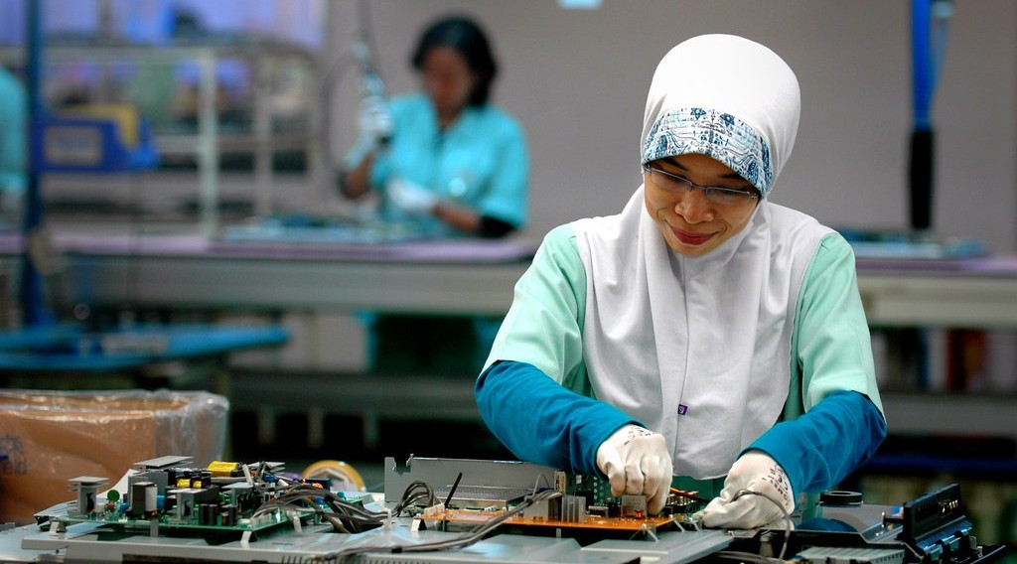
3. FOOT-LOOSE INDUSTRIES
Activity 5
Electronics.
Notes:
Activity 5. Look carefully at this picture: electronics. Observe every detail before I ask the question.

Slide 31
3. FOOT-LOOSE INDUSTRIES
Activity 5: Question
What are foot-loose industries?
Notes:
Here is the question for Activity 5: What are foot-loose industries? Take one minute to think and write your answer in your rough notebook.

Slide 32
3. FOOT-LOOSE INDUSTRIES
Activity 5: Answer
Industries not tied to raw materials or markets, such as electronics.
Notes:
Let us check the answer together. Industries not tied to raw materials or markets, such as electronics.

Slide 33
BOARD SUMMARY
Board Summary
Topic: Managing Resources for Development through Economic Activities
Sub-topic: Manufacturing as an Economic Activity of the Secondary Sector
Lesson 5: Weber's Industrial Location Model
Notes:
Now we are going to copy the board summary. Write the title and the headings neatly in your notebooks. I will give you enough time for each slide, so do not rush.

Slide 34
BOARD SUMMARY
DEFINITIONS
The key terms of this lesson are defined as follows:
Material index: It is the weight of raw materials divided by the weight of the product.
Notes:
Let us copy the definitions. The key terms of this lesson are defined as follows. On this slide we have Material index. Write each point on a new line, with the key term first, and explain it in your own words when we revise.

Slide 35
BOARD SUMMARY
1. Aim and Assumptions
Weber (1909) built his model as follows:
Aim: Industry locates where total transport costs are lowest.
Assumptions: The land is flat, transport costs depend on weight and distance, and raw materials and market are at fixed places.
Notes:
Let us copy Aim and Assumptions. Weber (1909) built his model as follows. On this slide we have Aim and Assumptions. Write each point on a new line, with the key term first, and explain it in your own words when we revise.

Slide 36
BOARD SUMMARY
1. Aim and Assumptions
Illustration: Weber's location triangle
Notes:
Now draw this illustration in your notebook: weber's location triangle. Give it a title and label it clearly.

Slide 37
BOARD SUMMARY
2. Major Conclusions
Weber reached the following conclusions:
Weight-losing industries: With a material index above 1, they locate near raw materials, like sugar mills and smelters.
Weight-gaining industries: With a material index below 1, they locate near the market, like breweries.
Notes:
Let us copy Major Conclusions. Weber reached the following conclusions. On this slide we have Weight-losing industries and Weight-gaining industries. Write each point on a new line, with the key term first, and explain it in your own words when we revise. When you finish, we go to the next slide.

Slide 38
BOARD SUMMARY
2. Major Conclusions (continued)
Foot-loose industries: They can locate almost anywhere, like electronics.
Notes:
We continue with Major Conclusions. On this slide we have Foot-loose industries. Write each point on a new line, with the key term first, and explain it in your own words when we revise.

Slide 39
BOARD SUMMARY
3. Examples
The model applies in the following cases:
Cameroon: The Mbandjock sugar mill is near cane fields and breweries are in big towns.
World: Iron and steel works were first built near coalfields such as the Ruhr.
Notes:
Let us copy Examples. The model applies in the following cases. On this slide we have Cameroon and World. Write each point on a new line, with the key term first, and explain it in your own words when we revise.

Slide 40
FORMATIVE EVALUATION
Evaluation 1
Where do weight-losing industries locate?
Notes:
Now let us check what you have understood. Question 1: Where do weight-losing industries locate? Answer in your exercise book.

Slide 41
FORMATIVE EVALUATION
Expected Answer
Near raw materials.
Notes:
The expected answer is: near raw materials. If you got it right, well done.

Slide 42
FORMATIVE EVALUATION
Evaluation 2
Give an example of a weight-gaining industry.
Notes:
Now let us check what you have understood. Question 2: Give an example of a weight-gaining industry. Answer in your exercise book.

Slide 43
FORMATIVE EVALUATION
Expected Answer
A brewery.
Notes:
The expected answer is: a brewery. If you got it right, well done.

Slide 44
REMEDIATION
Remediation
Fill in the blanks:
Weber's model looks for the least-______ location.
A brewery is a weight-______ industry.
Industries that can locate anywhere are ______.
Notes:
For those who need more practice, fill in the blanks in your exercise book. The answers are: number 1, cost; number 2, gaining; number 3, foot-loose.

Slide 45
HOMEWORK
Homework
Explain the location of one factory in Cameroon using Weber's model.
Notes:
For your homework: Explain the location of one factory in Cameroon using Weber's model. We shall correct it at the beginning of our next lesson.

Slide 46
NEXT LESSON
Next Lesson
Our next lesson will be on:
Lesson 6: Secondary (Manufacturing) Industries in Cameroon
Notes:
Our next lesson will be on Lesson 6: Secondary (Manufacturing) Industries in Cameroon. Thank you for your attention, and see you next time.

Slide 47
BILINGUAL GAME
Bilingual Game (Jeu Bilingue)
English | Français
Location | La localisation
Transport cost | Le coût de transport
Weight | Le poids
Market | Le marché
Model | Le modèle
Sugar | Le sucre
Notes:
Let us play the bilingual game. I say a word in English, and you give me the French word. Then we do the reverse.

Slide 48
LOGBOOK
Official Logbook (1/2)
Module / Topic | Managing Resources for Development through Economic Activities
Lesson Title | Lesson 5: Weber's Industrial Location Model
Expected Learning Outcomes | State the aim and assumptions of Weber's model. Explain its major conclusions. Give examples where it applies.
Competence | Learners are able to explain Weber's model and apply it to industries.
Notes:
I record this information in the official logbook of the class after the lesson.

Slide 49
LOGBOOK
Official Logbook (2/2)
Matter Taught | DEFINITIONS; Aim and Assumptions; Major Conclusions; Examples.
Evaluation | Formative evaluation and remediation exercise.
Homework | Explain the location of one factory in Cameroon using Weber's model.
Enrolment / Present / Absent | ____ / ____ / ____
Achievement | To be completed after the lesson.
Notes:
I complete the second page of the logbook: the matter taught, the evaluation, the homework and the attendance.

Slide 50
TEACHER'S NOTE
Teacher's Note
Timing: Homework correction, plan, objectives 8 min | Recall, situation, action 10 min | 5 activities 30 min | Board summary (copying) 30 min | Evaluation, remediation 10 min | Homework, next lesson 5 min | Logbook 7 min
Without the projector (Activity 1): draw the triangle.
Without the projector (Activity 2): list assumptions.
Without the projector (Activity 3): discuss sugar at Mbandjock.
Without the projector (Activity 4): discuss SABC.
Without the projector (Activity 5): discuss.
Notes:
This slide is for me, the teacher: it gives the timing of the lesson and what to do if the projector is not available.

Slide 51
REFERENCES
References
Geography Syllabus, Forms I–V, MINESEC (2023) — Form 5, Module I: Management of Manufacturing and Tertiary Activities.
Photo, Activity 3: “Bauxite mine near Itea, Greece” by Jason-Morrison, CC BY-NC 2.0, via Flickr (https://www.flickr.com/photos/8998833@N07/929316608)
Photo, Activity 4: “Interior of Winston-Salem Chero-Cola Bottling Company, Winston-Salem, ” by unclibraries_commons, Public domain 1.0, via Flickr (https://www.flickr.com/photos/122654055@N06/22680169228)
Photo, Activity 5: “electronics factory” by ILO in Asia and the Pacific, CC BY-NC-ND 2.0, via Flickr (https://www.flickr.com/photos/77173826@N08/8096445212)
Diagrams and animations: drawn for this lesson (Geography Department).
Notes:
These are the references and picture credits used to prepare this lesson.

