Slide 1
FORM 5
GEOGRAPHY
Lesson 11
Air and Water Transport
Notes:
Good morning, class, and welcome to our geography lesson. I am your geography teacher, Mr Kamdem. Today we are starting Lesson 11: Air and Water Transport.

Slide 2
CLASS INFO
Class, Chapter and Duration
Class | Form 5
Chapter | Module I: Management of Manufacturing and Tertiary Activities
Duration | 2 periods (2 × 50 minutes)
Notes:
This lesson is for Form 5. It belongs to Module I: Management of Manufacturing and Tertiary Activities. We shall need 2 periods to cover it.

Slide 3
IDENTIFICATION
Lesson Identification
Topic | Managing Resources for Development through Economic Activities
Sub-topic | World Communication
Lesson | Lesson 11: Air and Water Transport
Notions / Concepts | Container ships, tankers, liners, lakers, drones.
Syllabus focus | Types; factors influencing the development of air and water transport; advantages and disadvantages; impact on the economy; recent developments.
Competence | Learners are able to describe air and water transport and explain their development and importance.
Notes:
Our topic is Managing Resources for Development through Economic Activities, and the sub-topic is World Communication. The key notions we shall use today are: container ships, tankers, liners, lakers, drones. At the end, you should be able to do this: learners are able to describe air and water transport and explain their development and importance.

Slide 4

HOMEWORK CORRECTION
Correction of the Homework
Question (Lesson 10: Impact of Road and Railway Transport on the Economy):
Explain how the tarring of a road in your region changed the life of the people.
Notes:
Before we start the new lesson, let us correct the homework I gave you at the end of Lesson 10: Impact of Road and Railway Transport on the Economy. The question was: Explain how the tarring of a road in your region changed the life of the people. Take out your exercise books.

Slide 5
HOMEWORK CORRECTION
Correction: Possible Answer
Faster and cheaper travel, more trade and lower prices, new shops and jobs along the road, but more accidents and speeding.
Notes:
Here is a good answer. Faster and cheaper travel, more trade and lower prices, new shops and jobs along the road, but more accidents and speeding. Compare it with your own answer and correct your work in red.

Slide 6
LESSON PLAN
Lesson Plan
Correction of the homework
Objectives and recall
Real-life situation and action to take
Learning activities
Board summary
Evaluation, remediation and homework
Notes:
Here is the plan of our lesson today. First, we shall correct the homework. Then we shall look at the objectives and recall what you already know. After that, we shall study a situation from real life and the action to take, and do the learning activities. Finally, we shall copy the board summary, do the evaluation and the remediation, and I will give you the homework.

Slide 7
OBJECTIVES
Objectives
By the end of this lesson, you should be able to:
Identify the types of air and water transport.
Explain the factors of their development.
Notes:
Take your time to copy this part; we will continue together.

Slide 8
OBJECTIVES
Objectives (continued)
Assess their advantages, disadvantages and impact.
Notes:
By the end of this lesson, you should be able to do three things. Number 1: identify the types of air and water transport. Number 2: explain the factors of their development. Number 3: assess their advantages, disadvantages and impact.

Slide 9
PREVIOUS KNOWLEDGE
Previous Knowledge
Douala and Kribi have seaports.
Aeroplanes are the fastest means of transport.
Ships carry most world trade.
Notes:
Let us first remember what you already know. Douala and Kribi have seaports. Aeroplanes are the fastest means of transport. Ships carry most world trade. Keep this in mind, because we shall build on it today.

Slide 10
REAL-LIFE SITUATION
Situation in Real Life
Cameroon exports timber and cocoa by ship from Kribi and Douala, while fresh flowers from Kenya reach Europe by aeroplane in one night.
Notes:
Listen carefully to this situation from real life. Cameroon exports timber and cocoa by ship from Kribi and Douala, while fresh flowers from Kenya reach Europe by aeroplane in one night. Think about it, because I am going to ask you some questions.

Slide 11
REAL-LIFE SITUATION
Situation: Question 1
What is the problem in the situation?
Notes:
Question 1: What is the problem in the situation? Think for a moment, then raise your hand to answer.

Slide 12
REAL-LIFE SITUATION
Answer
We want to know why ships and aeroplanes carry different goods.
Notes:
Good. We want to know why ships and aeroplanes carry different goods.

Slide 13
REAL-LIFE SITUATION
Situation: Question 2
What do ships carry?
Notes:
Question 2: What do ships carry? Think for a moment, then raise your hand to answer.

Slide 14
REAL-LIFE SITUATION
Answer
Heavy goods such as timber and cocoa.
Notes:
Good. Heavy goods such as timber and cocoa.

Slide 15
REAL-LIFE SITUATION
Situation: Question 3
What do aeroplanes carry?
Notes:
Question 3: What do aeroplanes carry? Think for a moment, then raise your hand to answer.

Slide 16
REAL-LIFE SITUATION
Possible Answer
Light, valuable and perishable goods such as flowers.
Notes:
Good. Light, valuable and perishable goods such as flowers.

Slide 17
ACTION TO TAKE
Action to Take
Respect safety rules on boats and wear a life jacket.
Notes:
From this situation, the action we are working towards in this lesson is the following: respect safety rules on boats and wear a life jacket.

Slide 18
JUSTIFICATION
Justification of the Lesson
This lesson helps us to understand world trade and travel.
Notes:
Why is this lesson important for you? This lesson helps us to understand world trade and travel.

Slide 19

1. TYPES: WATER
Activity 1
A container ship.
Notes:
Activity 1. Look carefully at this picture: a container ship. Observe every detail before I ask the question.

Slide 20
1. TYPES: WATER
Activity 1: Question
Name three types of ships.
Notes:
Here is the question for Activity 1: Name three types of ships. Take one minute to think and write your answer in your rough notebook.

Slide 21
1. TYPES: WATER
Activity 1: Answer
Container ships, tankers and liners (also lakers and bulk carriers).
Notes:
Let us check the answer together. Container ships, tankers and liners (also lakers and bulk carriers).

Slide 22
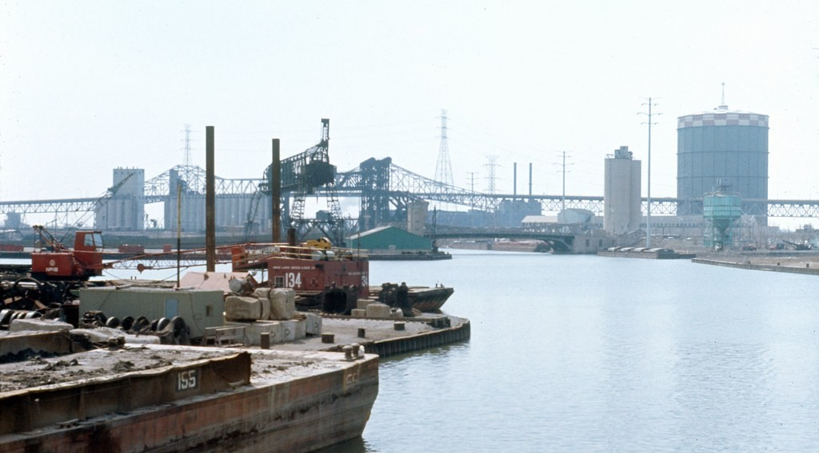
1. TYPES: INLAND WATERWAYS
Activity 2
Barges on a river.
Notes:
Activity 2. Look carefully at this picture: barges on a river. Observe every detail before I ask the question.

Slide 23
1. TYPES: INLAND WATERWAYS
Activity 2: Question
What is inland water transport?
Notes:
Here is the question for Activity 2: What is inland water transport? Take one minute to think and write your answer in your rough notebook.

Slide 24
1. TYPES: INLAND WATERWAYS
Activity 2: Answer
Transport on rivers, lakes and canals by barges and boats.
Notes:
Let us check the answer together. Transport on rivers, lakes and canals by barges and boats.

Slide 25
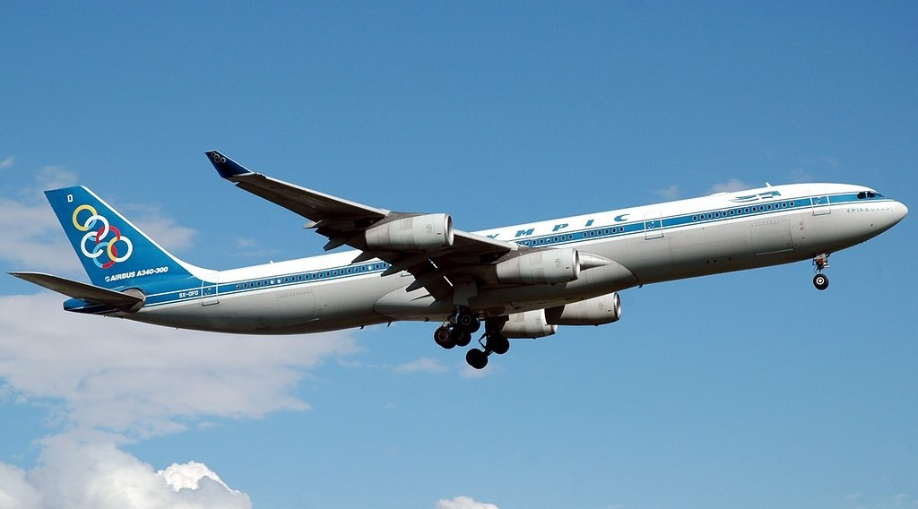
1. TYPES: AIR
Activity 3
A passenger aeroplane.
Notes:
Activity 3. Look carefully at this picture: a passenger aeroplane. Observe every detail before I ask the question.

Slide 26
1. TYPES: AIR
Activity 3: Question
Name two types of air transport.
Notes:
Here is the question for Activity 3: Name two types of air transport. Take one minute to think and write your answer in your rough notebook.

Slide 27
1. TYPES: AIR
Activity 3: Answer
Passenger flights and cargo flights (also drones and helicopters).
Notes:
Let us check the answer together. Passenger flights and cargo flights (also drones and helicopters).

Slide 28

2. FACTORS
Activity 4
An airport.
Notes:
Activity 4. Look carefully at this picture: an airport. Observe every detail before I ask the question.

Slide 29
2. FACTORS
Activity 4: Question
Give two factors for the development of air and water transport.
Notes:
Here is the question for Activity 4: Give two factors for the development of air and water transport. Take one minute to think and write your answer in your rough notebook.

Slide 30
2. FACTORS
Activity 4: Answer
Deep, sheltered harbours for ports and flat land with capital for airports.
Notes:
Let us check the answer together. Deep, sheltered harbours for ports and flat land with capital for airports.

Slide 31

3. ADVANTAGES AND IMPACT
Activity 5
Transport costs.
Notes:
Activity 5. Look carefully at this diagram: transport costs. Observe every detail before I ask the question.

Slide 32
3. ADVANTAGES AND IMPACT
Activity 5: Question
Compare the advantages of sea and air transport.
Notes:
Here is the question for Activity 5: Compare the advantages of sea and air transport. Take one minute to think and write your answer in your rough notebook.

Slide 33
3. ADVANTAGES AND IMPACT
Activity 5: Answer
Sea transport is cheap for heavy goods; air transport is fast for people and valuable goods.
Notes:
Let us check the answer together. Sea transport is cheap for heavy goods; air transport is fast for people and valuable goods.

Slide 34
BOARD SUMMARY
Board Summary
Topic: Managing Resources for Development through Economic Activities
Sub-topic: World Communication
Lesson 11: Air and Water Transport
Notes:
Now we are going to copy the board summary. Write the title and the headings neatly in your notebooks. I will give you enough time for each slide, so do not rush.

Slide 35
BOARD SUMMARY
1. Types of Air and Water Transport
The types of air and water transport are the following:
Ocean transport: Container ships, tankers, bulk carriers and liners cross the seas.
Inland waterways: Barges and lakers use rivers, lakes and canals.
Notes:
Let us copy Types of Air and Water Transport. The types of air and water transport are the following. On this slide we have Ocean transport and Inland waterways. Write each point on a new line, with the key term first, and explain it in your own words when we revise. When you finish, we go to the next slide.

Slide 36
BOARD SUMMARY
1. Types of Air and Water Transport (continued)
Air transport: Passenger and cargo aeroplanes, helicopters and drones fly goods and people.
Notes:
We continue with Types of Air and Water Transport. On this slide we have Air transport. Write each point on a new line, with the key term first, and explain it in your own words when we revise.

Slide 37
BOARD SUMMARY
2. Factors of Development
Air and water transport develop because of the following factors:
Physical factors: Deep sheltered harbours, navigable rivers and flat land for airports are needed.
Economic factors: Trade, tourism and large capital support ports and airports.
Notes:
Let us copy Factors of Development. Air and water transport develop because of the following factors. On this slide we have Physical factors and Economic factors. Write each point on a new line, with the key term first, and explain it in your own words when we revise. When you finish, we go to the next slide.

Slide 38
BOARD SUMMARY
2. Factors of Development (continued)
Technology: Big ships, jet aircraft and radar make transport safe and fast.
Notes:
We continue with Factors of Development. On this slide we have Technology. Write each point on a new line, with the key term first, and explain it in your own words when we revise.

Slide 39
BOARD SUMMARY
3. Advantages, Disadvantages and Impact
Air and water transport have the following effects:
Water transport: It is cheap for bulky goods but slow.
Air transport: It is fast but very costly and carries small loads.
Notes:
Let us copy Advantages, Disadvantages and Impact. Air and water transport have the following effects. On this slide we have Water transport and Air transport. Write each point on a new line, with the key term first, and explain it in your own words when we revise. When you finish, we go to the next slide.

Slide 40
BOARD SUMMARY
3. Advantages, Disadvantages and Impact (continued)
Impact on the economy: Ports and airports create jobs, trade and tourism.
Recent developments: Giant container ships, cargo drones and larger aircraft are new trends.
Notes:
We continue with Advantages, Disadvantages and Impact. On this slide we have Impact on the economy and Recent developments. Write each point on a new line, with the key term first, and explain it in your own words when we revise.

Slide 41
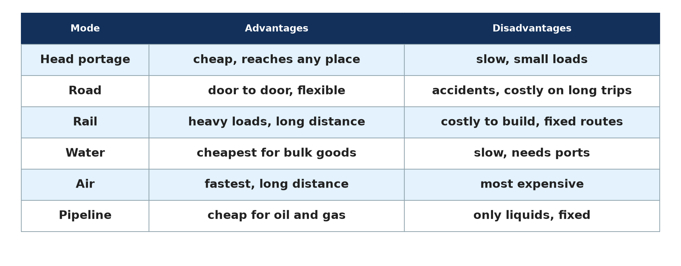
BOARD SUMMARY
3. Advantages, Disadvantages and Impact
Illustration: modes of transport
Notes:
Now draw this illustration in your notebook: modes of transport. Give it a title and label it clearly.

Slide 42
FORMATIVE EVALUATION
Evaluation 1
Give two types of ships.
Notes:
Now let us check what you have understood. Question 1: Give two types of ships. Answer in your exercise book.

Slide 43
FORMATIVE EVALUATION
Expected Answer
Tankers and container ships.
Notes:
The expected answer is: tankers and container ships. If you got it right, well done.

Slide 44
FORMATIVE EVALUATION
Evaluation 2
Give one advantage and one disadvantage of air transport.
Notes:
Now let us check what you have understood. Question 2: Give one advantage and one disadvantage of air transport. Answer in your exercise book.

Slide 45
FORMATIVE EVALUATION
Expected Answer
Fast; very costly.
Notes:
The expected answer is: fast; very costly. If you got it right, well done.

Slide 46
REMEDIATION
Remediation
Fill in the blanks:
A ship that carries oil is a ______.
A ship that carries passengers is a ______.
The fastest mode of transport is ______ transport.
Notes:
For those who need more practice, fill in the blanks in your exercise book. The answers are: number 1, tanker; number 2, liner; number 3, air.

Slide 47
HOMEWORK
Homework
Name the seaports and international airports of Cameroon.
Notes:
For your homework: Name the seaports and international airports of Cameroon. We shall correct it at the beginning of our next lesson.

Slide 48
NEXT LESSON
Next Lesson
Our next lesson will be on:
Further Study 2: Containerisation
Notes:
Our next lesson will be on Further Study 2: Containerisation. Thank you for your attention, and see you next time.

Slide 49
BILINGUAL GAME
Bilingual Game (Jeu Bilingue)
English | Français
Ship | Le navire
Tanker | Le pétrolier
Harbour | Le port
Airport | L'aéroport
Cargo | La cargaison
Drone | Le drone
Notes:
Let us play the bilingual game. I say a word in English, and you give me the French word. Then we do the reverse.

Slide 50
LOGBOOK
Official Logbook (1/2)
Module / Topic | Managing Resources for Development through Economic Activities
Lesson Title | Lesson 11: Air and Water Transport
Expected Learning Outcomes | Identify the types of air and water transport. Explain the factors of their development. Assess their advantages, disadvantages and impact.
Competence | Learners are able to describe air and water transport and explain their development and importance.
Notes:
I record this information in the official logbook of the class after the lesson.

Slide 51
LOGBOOK
Official Logbook (2/2)
Matter Taught | Types of Air and Water Transport; Factors of Development; Advantages, Disadvantages and Impact.
Evaluation | Formative evaluation and remediation exercise.
Homework | Name the seaports and international airports of Cameroon.
Enrolment / Present / Absent | ____ / ____ / ____
Achievement | To be completed after the lesson.
Notes:
I complete the second page of the logbook: the matter taught, the evaluation, the homework and the attendance.

Slide 52
TEACHER'S NOTE
Teacher's Note
Timing: Homework correction, plan, objectives 8 min | Recall, situation, action 10 min | 5 activities 30 min | Board summary (copying) 30 min | Evaluation, remediation 10 min | Homework, next lesson 5 min | Logbook 7 min
Without the projector (Activity 1): name ships.
Without the projector (Activity 2): name navigable rivers.
Without the projector (Activity 3): name airports.
Without the projector (Activity 4): discuss.
Without the projector (Activity 5): compare.
Notes:
This slide is for me, the teacher: it gives the timing of the lesson and what to do if the projector is not available.

Slide 53
REFERENCES
References
Geography Syllabus, Forms I–V, MINESEC (2023) — Form 5, Module I: Management of Manufacturing and Tertiary Activities.
Photo, Activity 1: “JAXPORT Welcomes Largest Container Ship To Date” by JAXPORT, CC BY-NC 2.0, via Flickr (https://www.flickr.com/photos/24847875@N05/17069054628)
Photo, Activity 2: “Cargo handling facilities, Calumet River” by UIC Library Digital Collections, CC BY-NC-SA 2.0, via Flickr (https://www.flickr.com/photos/34893859@N05/7979987843)
Photo, Activity 3: “Olympic Airlines A340-313X 'Epidauros'” by caribb, CC BY-NC-ND 2.0, via Flickr (https://www.flickr.com/photos/87857621@N00/194965684)
Photo, Activity 4: “Airplane” by jeffk, CC BY 2.0, via Flickr (https://www.flickr.com/photos/44124372247@N01/59597563)
Diagrams and animations: drawn for this lesson (Geography Department).
Notes:
These are the references and picture credits used to prepare this lesson.

