Slide 1
FORM 5
GEOGRAPHY
Further Study 2
Containerisation
Notes:
Good morning, class, and welcome to our geography lesson. I am your geography teacher, Mr Kamdem. Today we are starting Further Study 2: Containerisation.

Slide 2
CLASS INFO
Class, Chapter and Duration
Class | Form 5
Chapter | Module I: Management of Manufacturing and Tertiary Activities
Duration | 2 periods (2 × 50 minutes)
Notes:
This lesson is for Form 5. It belongs to Module I: Management of Manufacturing and Tertiary Activities. We shall need 2 periods to cover it.

Slide 3
IDENTIFICATION
Lesson Identification
Topic | Managing Resources for Development through Economic Activities
Sub-topic | World Communication
Lesson | Further Study 2: Containerisation
Notions / Concepts | Container, container ship, container terminal, intermodal transport.
Syllabus focus | Meaning; reasons for development; advantages and disadvantages.
Competence | Learners are able to explain containerisation and assess it.
Notes:
Our topic is Managing Resources for Development through Economic Activities, and the sub-topic is World Communication. The key notions we shall use today are: container, container ship, container terminal, intermodal transport. At the end, you should be able to do this: learners are able to explain containerisation and assess it.

Slide 4

HOMEWORK CORRECTION
Correction of the Homework
Question (Lesson 11: Air and Water Transport):
Name the seaports and international airports of Cameroon.
Notes:
Before we start the new lesson, let us correct the homework I gave you at the end of Lesson 11: Air and Water Transport. The question was: Name the seaports and international airports of Cameroon. Take out your exercise books.

Slide 5
HOMEWORK CORRECTION
Correction: Possible Answer
Seaports: Douala, Kribi, Limbe (Tiko) and Garoua river port; airports: Douala, Yaoundé-Nsimalen and Garoua.
Notes:
Here is a good answer. Seaports: Douala, Kribi, Limbe (Tiko) and Garoua river port; airports: Douala, Yaoundé-Nsimalen and Garoua. Compare it with your own answer and correct your work in red.

Slide 6
LESSON PLAN
Lesson Plan
Correction of the homework
Objectives and recall
Real-life situation and action to take
Learning activities
Board summary
Evaluation, remediation and homework
Notes:
Here is the plan of our lesson today. First, we shall correct the homework. Then we shall look at the objectives and recall what you already know. After that, we shall study a situation from real life and the action to take, and do the learning activities. Finally, we shall copy the board summary, do the evaluation and the remediation, and I will give you the homework.

Slide 7
OBJECTIVES
Objectives
By the end of this lesson, you should be able to:
Define containerisation.
Explain the reasons for its development.
Give its advantages and disadvantages.
Notes:
By the end of this lesson, you should be able to do three things. Number 1: define containerisation. Number 2: explain the reasons for its development. Number 3: give its advantages and disadvantages.

Slide 8
PREVIOUS KNOWLEDGE
Previous Knowledge
Ships carry most world trade.
Kribi has a deep-water port.
Goods are moved by ship, rail and road.
Notes:
Let us first remember what you already know. Ships carry most world trade. Kribi has a deep-water port. Goods are moved by ship, rail and road. Keep this in mind, because we shall build on it today.

Slide 9
REAL-LIFE SITUATION
Situation in Real Life
At Kribi port, giant cranes lift steel boxes from a ship directly onto lorries and trains. The dockers say that fewer workers are now needed.
Notes:
Listen carefully to this situation from real life. At Kribi port, giant cranes lift steel boxes from a ship directly onto lorries and trains. The dockers say that fewer workers are now needed. Think about it, because I am going to ask you some questions.

Slide 10
REAL-LIFE SITUATION
Situation: Question 1
What is the problem in the situation?
Notes:
Question 1: What is the problem in the situation? Think for a moment, then raise your hand to answer.

Slide 11
REAL-LIFE SITUATION
Answer
We want to understand the use of containers.
Notes:
Good. We want to understand the use of containers.

Slide 12
REAL-LIFE SITUATION
Situation: Question 2
What are the steel boxes?
Notes:
Question 2: What are the steel boxes? Think for a moment, then raise your hand to answer.

Slide 13
REAL-LIFE SITUATION
Answer
Containers.
Notes:
Good. Containers.

Slide 14
REAL-LIFE SITUATION
Situation: Question 3
What is one effect on dockers?
Notes:
Question 3: What is one effect on dockers? Think for a moment, then raise your hand to answer.

Slide 15
REAL-LIFE SITUATION
Possible Answer
Fewer workers are needed.
Notes:
Good. Fewer workers are needed.

Slide 16
ACTION TO TAKE
Action to Take
Learn technical skills needed in modern ports.
Notes:
From this situation, the action we are working towards in this lesson is the following: learn technical skills needed in modern ports.

Slide 17
JUSTIFICATION
Justification of the Lesson
This further study helps us to understand modern world trade.
Notes:
Why is this lesson important for you? This further study helps us to understand modern world trade.

Slide 18

1. MEANING
Activity 1
Containers in a port.
Notes:
Activity 1. Look carefully at this picture: containers in a port. Observe every detail before I ask the question.

Slide 19
1. MEANING
Activity 1: Question
What is containerisation?
Notes:
Here is the question for Activity 1: What is containerisation? Take one minute to think and write your answer in your rough notebook.

Slide 20
1. MEANING
Activity 1: Answer
The transport of goods in standard steel boxes called containers.
Notes:
Let us check the answer together. The transport of goods in standard steel boxes called containers.

Slide 21

1. MEANING
Activity 2
A container ship.
Notes:
Activity 2. Look carefully at this picture: a container ship. Observe every detail before I ask the question.

Slide 22
1. MEANING
Activity 2: Question
What is a container ship?
Notes:
Here is the question for Activity 2: What is a container ship? Take one minute to think and write your answer in your rough notebook.

Slide 23
1. MEANING
Activity 2: Answer
A ship built to carry many standard containers.
Notes:
Let us check the answer together. A ship built to carry many standard containers.

Slide 24

2. REASONS FOR DEVELOPMENT
Activity 3
A container lorry.
Notes:
Activity 3. Look carefully at this picture: a container lorry. Observe every detail before I ask the question.

Slide 25
2. REASONS FOR DEVELOPMENT
Activity 3: Question
Give two reasons for the development of containerisation.
Notes:
Here is the question for Activity 3: Give two reasons for the development of containerisation. Take one minute to think and write your answer in your rough notebook.

Slide 26
2. REASONS FOR DEVELOPMENT
Activity 3: Answer
Faster loading and easy transfer between ship, rail and road.
Notes:
Let us check the answer together. Faster loading and easy transfer between ship, rail and road.

Slide 27

3. ADVANTAGES
Activity 4
Transport costs.
Notes:
Activity 4. Look carefully at this diagram: transport costs. Observe every detail before I ask the question.

Slide 28
3. ADVANTAGES
Activity 4: Question
Give two advantages of containerisation.
Notes:
Here is the question for Activity 4: Give two advantages of containerisation. Take one minute to think and write your answer in your rough notebook.

Slide 29
3. ADVANTAGES
Activity 4: Answer
It reduces costs and theft and protects goods.
Notes:
Let us check the answer together. It reduces costs and theft and protects goods.

Slide 30
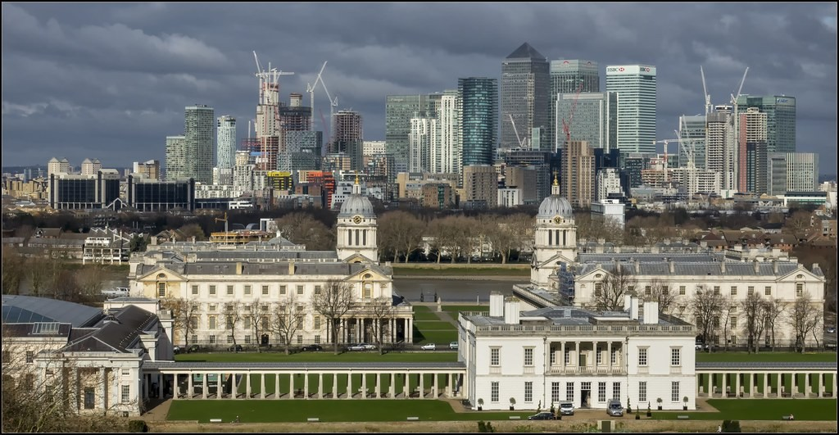
3. DISADVANTAGES
Activity 5
Old docks.
Notes:
Activity 5. Look carefully at this picture: old docks. Observe every detail before I ask the question.

Slide 31
3. DISADVANTAGES
Activity 5: Question
Give two disadvantages of containerisation.
Notes:
Here is the question for Activity 5: Give two disadvantages of containerisation. Take one minute to think and write your answer in your rough notebook.

Slide 32
3. DISADVANTAGES
Activity 5: Answer
Loss of dock jobs and very costly ports and cranes.
Notes:
Let us check the answer together. Loss of dock jobs and very costly ports and cranes.

Slide 33
BOARD SUMMARY
Board Summary
Topic: Managing Resources for Development through Economic Activities
Sub-topic: World Communication
Further Study 2: Containerisation
Notes:
Now we are going to copy the board summary. Write the title and the headings neatly in your notebooks. I will give you enough time for each slide, so do not rush.

Slide 34
BOARD SUMMARY
DEFINITIONS
The key terms of this lesson are defined as follows:
Containerisation: It is the transport of goods in large standard steel boxes called containers.
Notes:
Let us copy the definitions. The key terms of this lesson are defined as follows. On this slide we have Containerisation. Write each point on a new line, with the key term first, and explain it in your own words when we revise.

Slide 35
BOARD SUMMARY
1. Reasons for Development
Containerisation developed for the following reasons:
Speed: Cranes load and unload containers in a few hours.
Intermodal transport: The same container moves easily from ship to train to lorry.
Notes:
Let us copy Reasons for Development. Containerisation developed for the following reasons. On this slide we have Speed and Intermodal transport. Write each point on a new line, with the key term first, and explain it in your own words when we revise. When you finish, we go to the next slide.

Slide 36
BOARD SUMMARY
1. Reasons for Development (continued)
Growth of trade: World trade grew and needed cheaper and safer transport.
Notes:
We continue with Reasons for Development. On this slide we have Growth of trade. Write each point on a new line, with the key term first, and explain it in your own words when we revise.

Slide 37
BOARD SUMMARY
2. Advantages and Disadvantages
Containerisation has the following advantages and disadvantages:
Advantages: It lowers costs, reduces theft and damage, and saves time.
Disadvantages: It needs costly deep ports and cranes and reduces dock jobs.
Notes:
Let us copy Advantages and Disadvantages. Containerisation has the following advantages and disadvantages. On this slide we have Advantages and Disadvantages. Write each point on a new line, with the key term first, and explain it in your own words when we revise. When you finish, we go to the next slide.

Slide 38
BOARD SUMMARY
2. Advantages and Disadvantages (continued)
Cameroon: Douala and Kribi have container terminals.
Notes:
We continue with Advantages and Disadvantages. On this slide we have Cameroon. Write each point on a new line, with the key term first, and explain it in your own words when we revise.

Slide 39
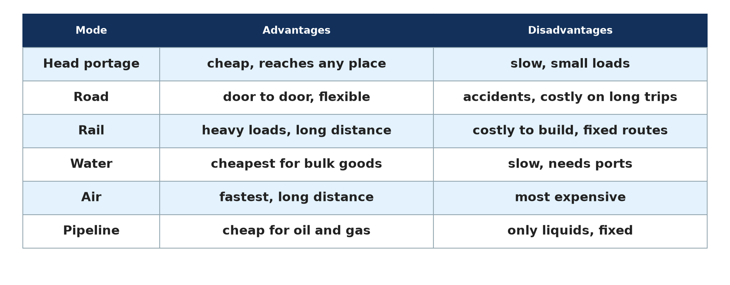
BOARD SUMMARY
2. Advantages and Disadvantages
Illustration: modes of transport
Notes:
Now draw this illustration in your notebook: modes of transport. Give it a title and label it clearly.

Slide 40
FORMATIVE EVALUATION
Evaluation 1
What is containerisation?
Notes:
Now let us check what you have understood. Question 1: What is containerisation? Answer in your exercise book.

Slide 41
FORMATIVE EVALUATION
Expected Answer
The transport of goods in standard steel boxes.
Notes:
The expected answer is: the transport of goods in standard steel boxes. If you got it right, well done.

Slide 42
FORMATIVE EVALUATION
Evaluation 2
Give one advantage and one disadvantage.
Notes:
Now let us check what you have understood. Question 2: Give one advantage and one disadvantage. Answer in your exercise book.

Slide 43
FORMATIVE EVALUATION
Expected Answer
Lower costs; loss of dock jobs.
Notes:
The expected answer is: lower costs; loss of dock jobs. If you got it right, well done.

Slide 44
REMEDIATION
Remediation
Fill in the blanks:
Standard steel boxes for goods are ______.
Moving a container from ship to train is ______ transport.
Cameroon has a deep-water port at ______.
Notes:
For those who need more practice, fill in the blanks in your exercise book. The answers are: number 1, containers; number 2, intermodal; number 3, Kribi.

Slide 45
HOMEWORK
Homework
Explain why Kribi port was built for container ships.
Notes:
For your homework: Explain why Kribi port was built for container ships. We shall correct it at the beginning of our next lesson.

Slide 46
NEXT LESSON
Next Lesson
Our next lesson will be on:
Lesson 12: Specialised Forms of Transport: Motorways and Cableways
Notes:
Our next lesson will be on Lesson 12: Specialised Forms of Transport: Motorways and Cableways. Thank you for your attention, and see you next time.

Slide 47
BILINGUAL GAME
Bilingual Game (Jeu Bilingue)
English | Français
Container | Le conteneur
Crane | La grue
Docker | Le docker
Terminal | Le terminal
Deep-water port | Le port en eau profonde
Theft | Le vol
Notes:
Let us play the bilingual game. I say a word in English, and you give me the French word. Then we do the reverse.

Slide 48
LOGBOOK
Official Logbook (1/2)
Module / Topic | Managing Resources for Development through Economic Activities
Lesson Title | Further Study 2: Containerisation
Expected Learning Outcomes | Define containerisation. Explain the reasons for its development. Give its advantages and disadvantages.
Competence | Learners are able to explain containerisation and assess it.
Notes:
I record this information in the official logbook of the class after the lesson.

Slide 49
LOGBOOK
Official Logbook (2/2)
Matter Taught | DEFINITIONS; Reasons for Development; Advantages and Disadvantages.
Evaluation | Formative evaluation and remediation exercise.
Homework | Explain why Kribi port was built for container ships.
Enrolment / Present / Absent | ____ / ____ / ____
Achievement | To be completed after the lesson.
Notes:
I complete the second page of the logbook: the matter taught, the evaluation, the homework and the attendance.

Slide 50
TEACHER'S NOTE
Teacher's Note
Timing: Homework correction, plan, objectives 8 min | Recall, situation, action 10 min | 5 activities 30 min | Board summary (copying) 30 min | Evaluation, remediation 10 min | Homework, next lesson 5 min | Logbook 7 min
Without the projector (Activity 1): describe a container.
Without the projector (Activity 2): describe.
Without the projector (Activity 3): discuss.
Without the projector (Activity 4): list.
Without the projector (Activity 5): list.
Notes:
This slide is for me, the teacher: it gives the timing of the lesson and what to do if the projector is not available.

Slide 51
REFERENCES
References
Geography Syllabus, Forms I–V, MINESEC (2023) — Form 5, Module I: Management of Manufacturing and Tertiary Activities.
Photo, Activity 1: “Container Ships @ Port of Oakland” by jdnx, CC BY 2.0, via Flickr (https://www.flickr.com/photos/21442511@N08/3464243881)
Photo, Activity 2: “JAXPORT Welcomes Largest Container Ship To Date” by JAXPORT, CC BY-NC 2.0, via Flickr (https://www.flickr.com/photos/24847875@N05/17069054628)
Photo, Activity 3: “Traveling by truck” by World Bank Photo Collection, CC BY-NC-ND 2.0, via Flickr (https://www.flickr.com/photos/10816734@N03/2628517227)
Photo, Activity 5: “Old & new: University Greenwich, The Queen's House & London Docklands” by Bert Kaufmann, CC BY-NC 2.0, via Flickr (https://www.flickr.com/photos/22746515@N02/26742366958)
Diagrams and animations: drawn for this lesson (Geography Department).
Notes:
These are the references and picture credits used to prepare this lesson.

