Slide 1
FORM 5
GEOGRAPHY
Lesson 13
Pipelines
Notes:
Good morning, class, and welcome to our geography lesson. I am your geography teacher, Mr Kamdem. Today we are starting Lesson 13: Pipelines.

Slide 2
CLASS INFO
Class, Chapter and Duration
Class | Form 5
Chapter | Module I: Management of Manufacturing and Tertiary Activities
Duration | 2 periods (2 × 50 minutes)
Notes:
This lesson is for Form 5. It belongs to Module I: Management of Manufacturing and Tertiary Activities. We shall need 2 periods to cover it.

Slide 3
IDENTIFICATION
Lesson Identification
Topic | Managing Resources for Development through Economic Activities
Sub-topic | World Communication
Lesson | Lesson 13: Pipelines
Notions / Concepts | Pipeline, oil, gas, water supply.
Syllabus focus | Definition; advantages and disadvantages; impact on the economy and on the environment.
Competence | Learners are able to explain the use of pipelines and assess their impact.
Notes:
Our topic is Managing Resources for Development through Economic Activities, and the sub-topic is World Communication. The key notions we shall use today are: pipeline, oil, gas, water supply. At the end, you should be able to do this: learners are able to explain the use of pipelines and assess their impact.

Slide 4

HOMEWORK CORRECTION
Correction of the Homework
Question (Lesson 12: Specialised Forms of Transport: Motorways and Cableways):
Suggest where a motorway and a cableway could be useful in Cameroon.
Notes:
Before we start the new lesson, let us correct the homework I gave you at the end of Lesson 12: Specialised Forms of Transport: Motorways and Cableways. The question was: Suggest where a motorway and a cableway could be useful in Cameroon. Take out your exercise books.

Slide 5
HOMEWORK CORRECTION
Correction: Possible Answer
Motorway: Douala–Yaoundé (heavy traffic, under construction); cableway: Mount Cameroon or the Mandara Mountains for tourism.
Notes:
Here is a good answer. Motorway: Douala–Yaoundé (heavy traffic, under construction); cableway: Mount Cameroon or the Mandara Mountains for tourism. Compare it with your own answer and correct your work in red.

Slide 6
LESSON PLAN
Lesson Plan
Correction of the homework
Objectives and recall
Real-life situation and action to take
Learning activities
Board summary
Evaluation, remediation and homework
Notes:
Here is the plan of our lesson today. First, we shall correct the homework. Then we shall look at the objectives and recall what you already know. After that, we shall study a situation from real life and the action to take, and do the learning activities. Finally, we shall copy the board summary, do the evaluation and the remediation, and I will give you the homework.

Slide 7
OBJECTIVES
Objectives
By the end of this lesson, you should be able to:
Define a pipeline.
Give the advantages and disadvantages of pipelines.
Notes:
Take your time to copy this part; we will continue together.

Slide 8
OBJECTIVES
Objectives (continued)
Explain their impact on the economy and the environment.
Notes:
By the end of this lesson, you should be able to do three things. Number 1: define a pipeline. Number 2: give the advantages and disadvantages of pipelines. Number 3: explain their impact on the economy and the environment.

Slide 9
PREVIOUS KNOWLEDGE
Previous Knowledge
Pipelines are a form of land transport.
Chad produces oil.
Oil spills pollute the environment.
Notes:
Let us first remember what you already know. Pipelines are a form of land transport. Chad produces oil. Oil spills pollute the environment. Keep this in mind, because we shall build on it today.

Slide 10
REAL-LIFE SITUATION
Situation in Real Life
Oil from Doba in Chad travels more than 1,000 km under the ground to Kribi in Cameroon. Villagers along the line receive some jobs, but they fear leaks.
Notes:
Listen carefully to this situation from real life. Oil from Doba in Chad travels more than 1,000 km under the ground to Kribi in Cameroon. Villagers along the line receive some jobs, but they fear leaks. Think about it, because I am going to ask you some questions.

Slide 11
REAL-LIFE SITUATION
Situation: Question 1
What is the problem in the situation?
Notes:
Question 1: What is the problem in the situation? Think for a moment, then raise your hand to answer.

Slide 12
REAL-LIFE SITUATION
Answer
We want to know the role and impact of pipelines.
Notes:
Good. We want to know the role and impact of pipelines.

Slide 13
REAL-LIFE SITUATION
Situation: Question 2
What does the pipeline carry?
Notes:
Question 2: What does the pipeline carry? Think for a moment, then raise your hand to answer.

Slide 14
REAL-LIFE SITUATION
Answer
Crude oil.
Notes:
Good. Crude oil.

Slide 15
REAL-LIFE SITUATION
Situation: Question 3
What do villagers fear?
Notes:
Question 3: What do villagers fear? Think for a moment, then raise your hand to answer.

Slide 16
REAL-LIFE SITUATION
Possible Answer
Leaks and pollution.
Notes:
Good. Leaks and pollution.

Slide 17
ACTION TO TAKE
Action to Take
Report any leak or damage to pipelines to the authorities.
Notes:
From this situation, the action we are working towards in this lesson is the following: report any leak or damage to pipelines to the authorities.

Slide 18
JUSTIFICATION
Justification of the Lesson
This lesson helps us to understand an important way of moving fuels and water.
Notes:
Why is this lesson important for you? This lesson helps us to understand an important way of moving fuels and water.

Slide 19
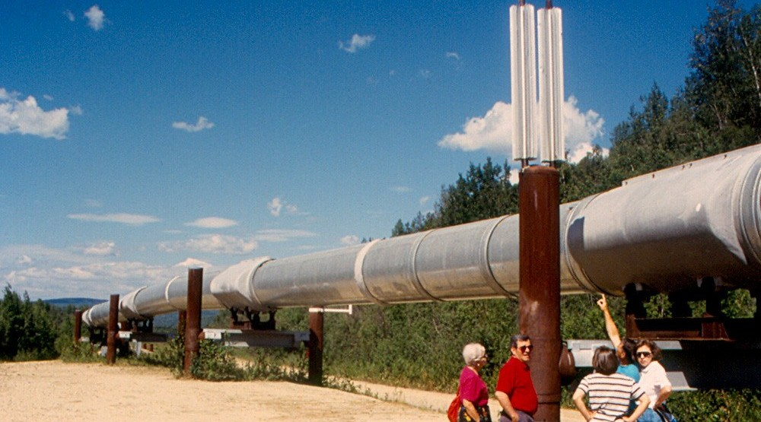
1. DEFINITION
Activity 1
A pipeline.
Notes:
Activity 1. Look carefully at this picture: a pipeline. Observe every detail before I ask the question.

Slide 20
1. DEFINITION
Activity 1: Question
What is a pipeline?
Notes:
Here is the question for Activity 1: What is a pipeline? Take one minute to think and write your answer in your rough notebook.

Slide 21
1. DEFINITION
Activity 1: Answer
A long line of pipes that carries liquids or gases over a distance.
Notes:
Let us check the answer together. A long line of pipes that carries liquids or gases over a distance.

Slide 22
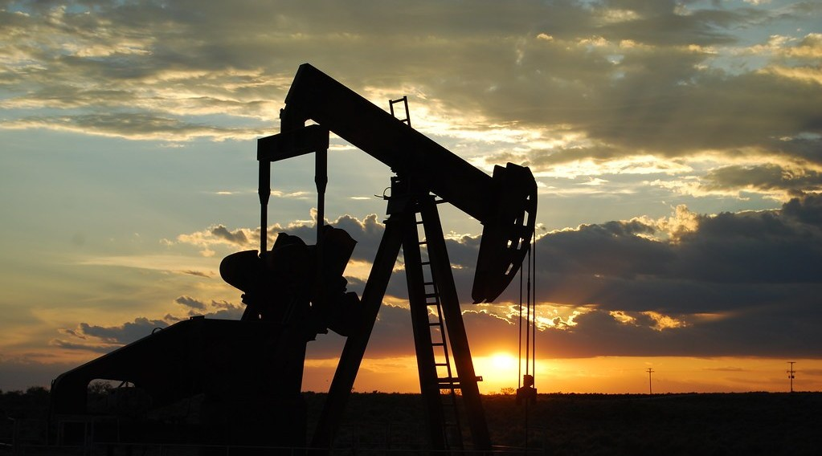
2. ADVANTAGES
Activity 2
An oil well.
Notes:
Activity 2. Look carefully at this picture: an oil well. Observe every detail before I ask the question.

Slide 23
2. ADVANTAGES
Activity 2: Question
Give two advantages of pipelines.
Notes:
Here is the question for Activity 2: Give two advantages of pipelines. Take one minute to think and write your answer in your rough notebook.

Slide 24
2. ADVANTAGES
Activity 2: Answer
They carry large quantities cheaply and continuously.
Notes:
Let us check the answer together. They carry large quantities cheaply and continuously.

Slide 25
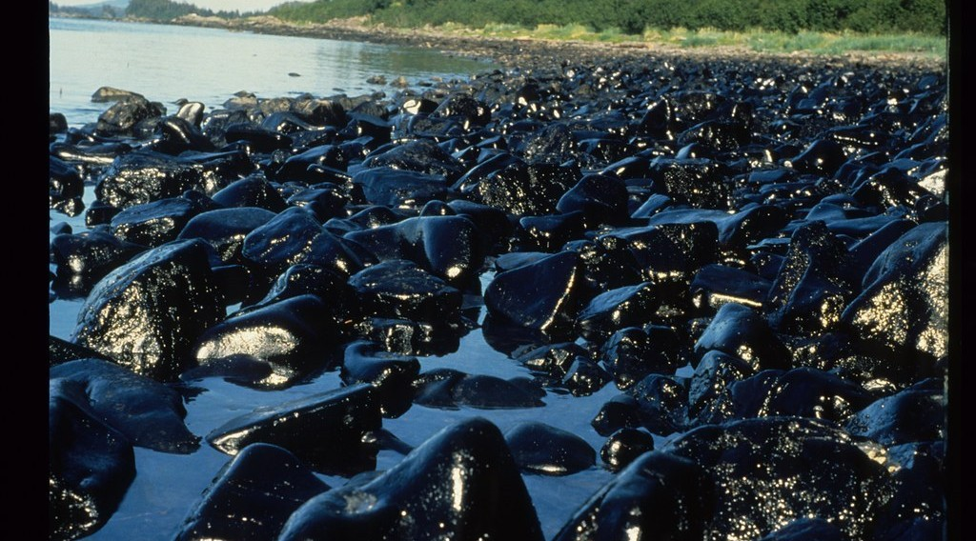
2. DISADVANTAGES
Activity 3
An oil spill.
Notes:
Activity 3. Look carefully at this picture: an oil spill. Observe every detail before I ask the question.

Slide 26
2. DISADVANTAGES
Activity 3: Question
Give two disadvantages of pipelines.
Notes:
Here is the question for Activity 3: Give two disadvantages of pipelines. Take one minute to think and write your answer in your rough notebook.

Slide 27
2. DISADVANTAGES
Activity 3: Answer
They are costly to build and can leak or be sabotaged.
Notes:
Let us check the answer together. They are costly to build and can leak or be sabotaged.

Slide 28
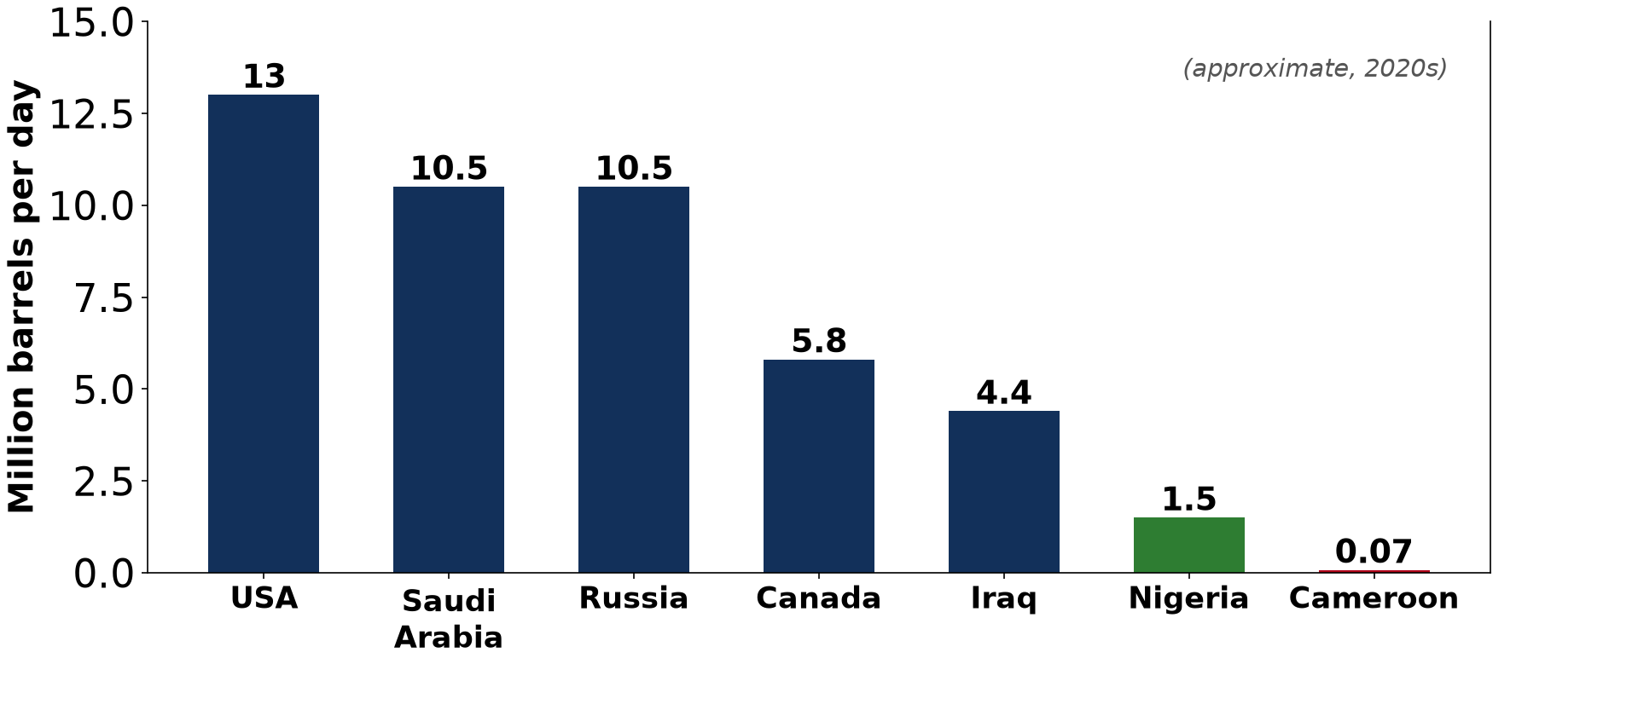
3. IMPACT ON THE ECONOMY
Activity 4
Oil producers.
Notes:
Activity 4. Look carefully at this diagram: oil producers. Observe every detail before I ask the question.

Slide 29
3. IMPACT ON THE ECONOMY
Activity 4: Question
How does the Chad–Cameroon pipeline help the economy?
Notes:
Here is the question for Activity 4: How does the Chad–Cameroon pipeline help the economy? Take one minute to think and write your answer in your rough notebook.

Slide 30
3. IMPACT ON THE ECONOMY
Activity 4: Answer
It brings transit fees and jobs to Cameroon and exports for Chad.
Notes:
Let us check the answer together. It brings transit fees and jobs to Cameroon and exports for Chad.

Slide 31
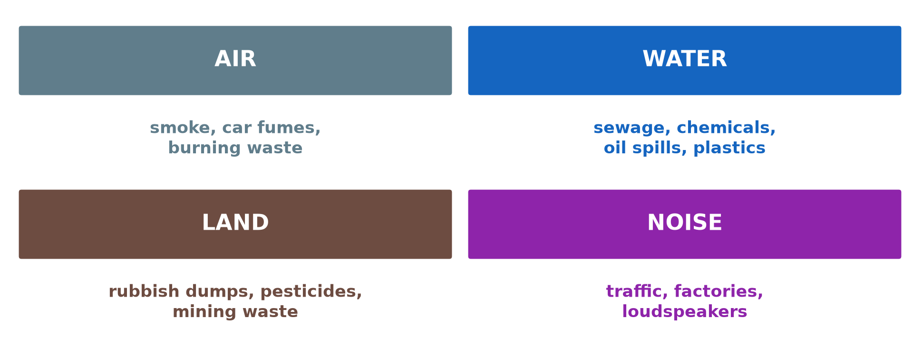
3. IMPACT ON THE ENVIRONMENT
Activity 5
Pollution.
Notes:
Activity 5. Look carefully at this diagram: pollution. Observe every detail before I ask the question.

Slide 32
3. IMPACT ON THE ENVIRONMENT
Activity 5: Question
Give two effects of pipelines on the environment.
Notes:
Here is the question for Activity 5: Give two effects of pipelines on the environment. Take one minute to think and write your answer in your rough notebook.

Slide 33
3. IMPACT ON THE ENVIRONMENT
Activity 5: Answer
Oil leaks pollute soil and water, and building destroys forest.
Notes:
Let us check the answer together. Oil leaks pollute soil and water, and building destroys forest.

Slide 34
BOARD SUMMARY
Board Summary
Topic: Managing Resources for Development through Economic Activities
Sub-topic: World Communication
Lesson 13: Pipelines
Notes:
Now we are going to copy the board summary. Write the title and the headings neatly in your notebooks. I will give you enough time for each slide, so do not rush.

Slide 35
BOARD SUMMARY
DEFINITIONS
The key terms of this lesson are defined as follows:
Pipeline: It is a long line of pipes that carries liquids or gases over a distance.
Notes:
Let us copy the definitions. The key terms of this lesson are defined as follows. On this slide we have Pipeline. Write each point on a new line, with the key term first, and explain it in your own words when we revise.

Slide 36
BOARD SUMMARY
1. Advantages and Disadvantages
Pipelines have the following advantages, disadvantages and risks:
Advantages: They carry large volumes cheaply, continuously and safely.
Disadvantages: They are costly to build and carry only liquids and gases.
Notes:
Let us copy Advantages and Disadvantages. Pipelines have the following advantages, disadvantages and risks. On this slide we have Advantages and Disadvantages. Write each point on a new line, with the key term first, and explain it in your own words when we revise. When you finish, we go to the next slide.

Slide 37
BOARD SUMMARY
1. Advantages and Disadvantages (continued)
Risks: Leaks, theft and sabotage are possible.
Notes:
We continue with Advantages and Disadvantages. On this slide we have Risks. Write each point on a new line, with the key term first, and explain it in your own words when we revise.

Slide 38
BOARD SUMMARY
2. Impact on the Economy and the Environment
Pipelines have the following impacts:
Economy: They bring revenue, jobs and cheap supply of oil, gas and water.
Example: The Chad–Cameroon pipeline carries oil from Doba to Kribi.
Notes:
Let us copy Impact on the Economy and the Environment. Pipelines have the following impacts. On this slide we have Economy and Example. Write each point on a new line, with the key term first, and explain it in your own words when we revise. When you finish, we go to the next slide.

Slide 39
BOARD SUMMARY
2. Impact on the Economy and the Environment (continued)
Environment: Leaks pollute soil and water and building destroys vegetation.
Notes:
We continue with Impact on the Economy and the Environment. On this slide we have Environment. Write each point on a new line, with the key term first, and explain it in your own words when we revise.

Slide 40
BOARD SUMMARY
2. Impact on the Economy and the Environment
Illustration: environmental pollution
Notes:
Now draw this illustration in your notebook: environmental pollution. Give it a title and label it clearly.

Slide 41
FORMATIVE EVALUATION
Evaluation 1
What is a pipeline?
Notes:
Now let us check what you have understood. Question 1: What is a pipeline? Answer in your exercise book.

Slide 42
FORMATIVE EVALUATION
Expected Answer
A line of pipes carrying liquids or gases.
Notes:
The expected answer is: a line of pipes carrying liquids or gases. If you got it right, well done.

Slide 43
FORMATIVE EVALUATION
Evaluation 2
Give one economic and one environmental impact.
Notes:
Now let us check what you have understood. Question 2: Give one economic and one environmental impact. Answer in your exercise book.

Slide 44
FORMATIVE EVALUATION
Expected Answer
Revenue; oil pollution.
Notes:
The expected answer is: revenue; oil pollution. If you got it right, well done.

Slide 45
REMEDIATION
Remediation
Fill in the blanks:
Pipelines carry liquids and ______.
The Chad–Cameroon pipeline ends at ______.
A pipeline leak causes ______.
Notes:
For those who need more practice, fill in the blanks in your exercise book. The answers are: number 1, gases; number 2, Kribi; number 3, pollution.

Slide 46
HOMEWORK
Homework
Draw a sketch map of the Chad–Cameroon pipeline.
Notes:
For your homework: Draw a sketch map of the Chad–Cameroon pipeline. We shall correct it at the beginning of our next lesson.

Slide 47
NEXT LESSON
Next Lesson
Our next lesson will be on:
Lesson 14: Globalisation
Notes:
Our next lesson will be on Lesson 14: Globalisation. Thank you for your attention, and see you next time.

Slide 48
BILINGUAL GAME
Bilingual Game (Jeu Bilingue)
English | Français
Pipeline | L'oléoduc / le pipeline
Gas | Le gaz
Crude oil | Le pétrole brut
Leak | La fuite
Sabotage | Le sabotage
Revenue | Les recettes
Notes:
Let us play the bilingual game. I say a word in English, and you give me the French word. Then we do the reverse.

Slide 49
LOGBOOK
Official Logbook (1/2)
Module / Topic | Managing Resources for Development through Economic Activities
Lesson Title | Lesson 13: Pipelines
Expected Learning Outcomes | Define a pipeline. Give the advantages and disadvantages of pipelines. Explain their impact on the economy and the environment.
Competence | Learners are able to explain the use of pipelines and assess their impact.
Notes:
I record this information in the official logbook of the class after the lesson.

Slide 50
LOGBOOK
Official Logbook (2/2)
Matter Taught | DEFINITIONS; Advantages and Disadvantages; Impact on the Economy and the Environment.
Evaluation | Formative evaluation and remediation exercise.
Homework | Draw a sketch map of the Chad–Cameroon pipeline.
Enrolment / Present / Absent | ____ / ____ / ____
Achievement | To be completed after the lesson.
Notes:
I complete the second page of the logbook: the matter taught, the evaluation, the homework and the attendance.

Slide 51
TEACHER'S NOTE
Teacher's Note
Timing: Homework correction, plan, objectives 8 min | Recall, situation, action 10 min | 5 activities 30 min | Board summary (copying) 30 min | Evaluation, remediation 10 min | Homework, next lesson 5 min | Logbook 7 min
Without the projector (Activity 1): describe.
Without the projector (Activity 2): list.
Without the projector (Activity 3): list.
Without the projector (Activity 4): discuss.
Without the projector (Activity 5): discuss.
Notes:
This slide is for me, the teacher: it gives the timing of the lesson and what to do if the projector is not available.

Slide 52
REFERENCES
References
Geography Syllabus, Forms I–V, MINESEC (2023) — Form 5, Module I: Management of Manufacturing and Tertiary Activities.
Photo, Activity 1: “Fairbanks - Trans-Alaska Pipeline” by roger4336, CC BY-SA 2.0, via Flickr (https://www.flickr.com/photos/24736216@N07/3824994628)
Photo, Activity 2: “Oil Pump Jack” by Paul Lowry, CC BY 2.0, via Flickr (https://www.flickr.com/photos/10039026@N03/2770193028)
Photo, Activity 3: “Exxon Valdez Oil Spill - 0038” by ARLIS Reference, CC BY-SA 2.0, via Flickr (https://www.flickr.com/photos/51606297@N07/4750613516)
Diagrams and animations: drawn for this lesson (Geography Department).
Notes:
These are the references and picture credits used to prepare this lesson.

