Slide 1
FORM 5
GEOGRAPHY
Lesson 19
Tourism
Notes:
Good morning, class, and welcome to our geography lesson. I am your geography teacher, Mr Kamdem. Today we are starting Lesson 19: Tourism.

Slide 2
CLASS INFO
Class, Chapter and Duration
Class | Form 5
Chapter | Module I: Management of Manufacturing and Tertiary Activities
Duration | 2 periods (2 × 50 minutes)
Notes:
This lesson is for Form 5. It belongs to Module I: Management of Manufacturing and Tertiary Activities. We shall need 2 periods to cover it.

Slide 3
IDENTIFICATION
Lesson Identification
Topic | Managing Resources for Development through Economic Activities
Sub-topic | Global Tourism
Lesson | Lesson 19: Tourism
Notions / Concepts | Tourism, mass tourism, ecotourism, tourist attraction.
Syllabus focus | Meaning; types (only definitions); factors for the promotion of mass tourism; tourist destinations; major characteristics; general tourist attractions.
Competence | Learners are able to explain tourism, its types, factors and destinations.
Notes:
Our topic is Managing Resources for Development through Economic Activities, and the sub-topic is Global Tourism. The key notions we shall use today are: tourism, mass tourism, ecotourism, tourist attraction. At the end, you should be able to do this: learners are able to explain tourism, its types, factors and destinations.

Slide 4

HOMEWORK CORRECTION
Correction of the Homework
Question (Lesson 18: Trade Blocs):
Draw a sketch map of the CEMAC member states and name their capitals.
Notes:
Before we start the new lesson, let us correct the homework I gave you at the end of Lesson 18: Trade Blocs. The question was: Draw a sketch map of the CEMAC member states and name their capitals. Take out your exercise books.

Slide 5
HOMEWORK CORRECTION
Correction: Possible Answer
Cameroon (Yaoundé), Chad (N’Djamena), Gabon (Libreville), Congo (Brazzaville), CAR (Bangui), Equatorial Guinea (Malabo).
Notes:
Here is a good answer. Cameroon (Yaoundé), Chad (N’Djamena), Gabon (Libreville), Congo (Brazzaville), CAR (Bangui), Equatorial Guinea (Malabo). Compare it with your own answer and correct your work in red.

Slide 6
LESSON PLAN
Lesson Plan
Correction of the homework
Objectives and recall
Real-life situation and action to take
Learning activities
Board summary
Evaluation, remediation and homework
Notes:
Here is the plan of our lesson today. First, we shall correct the homework. Then we shall look at the objectives and recall what you already know. After that, we shall study a situation from real life and the action to take, and do the learning activities. Finally, we shall copy the board summary, do the evaluation and the remediation, and I will give you the homework.

Slide 7
OBJECTIVES
Objectives
By the end of this lesson, you should be able to:
Define tourism and its types.
Explain the factors for the promotion of mass tourism.
Notes:
Take your time to copy this part; we will continue together.

Slide 8
OBJECTIVES
Objectives (continued)
Identify tourist destinations and attractions.
Notes:
By the end of this lesson, you should be able to do three things. Number 1: define tourism and its types. Number 2: explain the factors for the promotion of mass tourism. Number 3: identify tourist destinations and attractions.

Slide 9
PREVIOUS KNOWLEDGE
Previous Knowledge
Tourism is a tertiary activity.
Waza Park has wild animals.
Many tourists visit Europe.
Notes:
Let us first remember what you already know. Tourism is a tertiary activity. Waza Park has wild animals. Many tourists visit Europe. Keep this in mind, because we shall build on it today.

Slide 10
REAL-LIFE SITUATION
Situation in Real Life
Every year, millions of Europeans travel to the beaches of Spain, while a few tourists visit Waza Park in Cameroon to see elephants and lions.
Notes:
Listen carefully to this situation from real life. Every year, millions of Europeans travel to the beaches of Spain, while a few tourists visit Waza Park in Cameroon to see elephants and lions. Think about it, because I am going to ask you some questions.

Slide 11
REAL-LIFE SITUATION
Situation: Question 1
What is the problem in the situation?
Notes:
Question 1: What is the problem in the situation? Think for a moment, then raise your hand to answer.

Slide 12
REAL-LIFE SITUATION
Answer
We want to understand tourism.
Notes:
Good. We want to understand tourism.

Slide 13
REAL-LIFE SITUATION
Situation: Question 2
Where do many Europeans go?
Notes:
Question 2: Where do many Europeans go? Think for a moment, then raise your hand to answer.

Slide 14
REAL-LIFE SITUATION
Answer
To the beaches of Spain.
Notes:
Good. To the beaches of Spain.

Slide 15
REAL-LIFE SITUATION
Situation: Question 3
What attracts tourists to Waza?
Notes:
Question 3: What attracts tourists to Waza? Think for a moment, then raise your hand to answer.

Slide 16
REAL-LIFE SITUATION
Possible Answer
Wild animals.
Notes:
Good. Wild animals.

Slide 17
ACTION TO TAKE
Action to Take
Welcome visitors and protect tourist sites.
Notes:
From this situation, the action we are working towards in this lesson is the following: welcome visitors and protect tourist sites.

Slide 18
JUSTIFICATION
Justification of the Lesson
This lesson helps us to understand a growing economic activity.
Notes:
Why is this lesson important for you? This lesson helps us to understand a growing economic activity.

Slide 19

1. MEANING
Activity 1
A tourist beach.
Notes:
Activity 1. Look carefully at this picture: a tourist beach. Observe every detail before I ask the question.

Slide 20
1. MEANING
Activity 1: Question
What is tourism?
Notes:
Here is the question for Activity 1: What is tourism? Take one minute to think and write your answer in your rough notebook.

Slide 21
1. MEANING
Activity 1: Answer
Travel for leisure, business or culture away from home for at least one night.
Notes:
Let us check the answer together. Travel for leisure, business or culture away from home for at least one night.

Slide 22
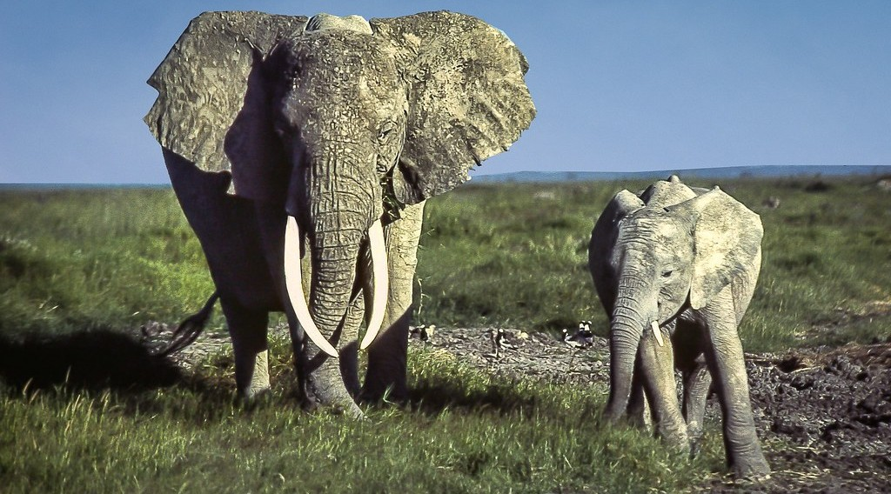
2. TYPES
Activity 2
A safari.
Notes:
Activity 2. Look carefully at this picture: a safari. Observe every detail before I ask the question.

Slide 23
2. TYPES
Activity 2: Question
Define mass tourism and ecotourism.
Notes:
Here is the question for Activity 2: Define mass tourism and ecotourism. Take one minute to think and write your answer in your rough notebook.

Slide 24
2. TYPES
Activity 2: Answer
Mass tourism is travel by very many people to the same places; ecotourism is responsible travel to natural areas.
Notes:
Let us check the answer together. Mass tourism is travel by very many people to the same places; ecotourism is responsible travel to natural areas.

Slide 25
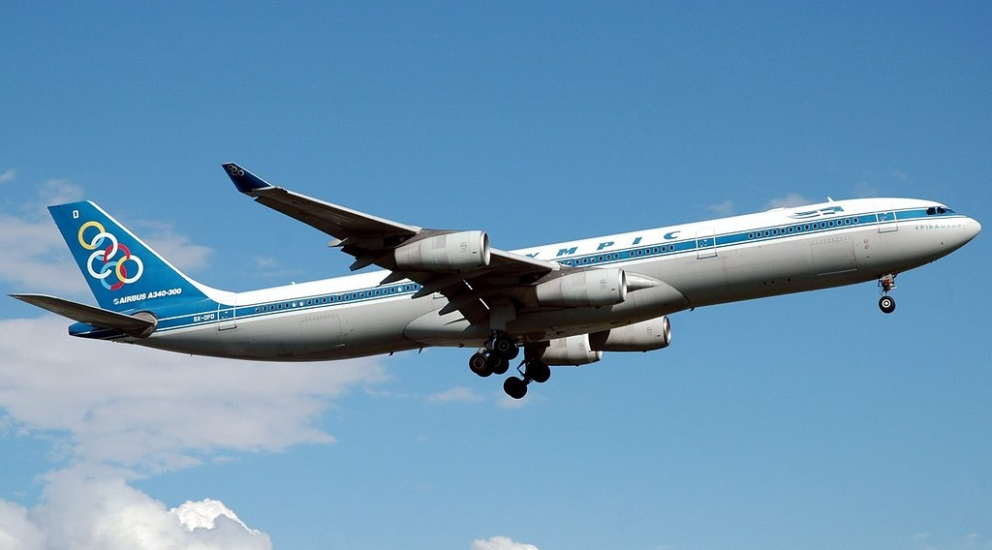
3. FACTORS FOR MASS TOURISM
Activity 3
An aeroplane.
Notes:
Activity 3. Look carefully at this picture: an aeroplane. Observe every detail before I ask the question.

Slide 26
3. FACTORS FOR MASS TOURISM
Activity 3: Question
Give three factors that promote mass tourism.
Notes:
Here is the question for Activity 3: Give three factors that promote mass tourism. Take one minute to think and write your answer in your rough notebook.

Slide 27
3. FACTORS FOR MASS TOURISM
Activity 3: Answer
Cheap air travel, paid holidays and higher incomes (also advertising).
Notes:
Let us check the answer together. Cheap air travel, paid holidays and higher incomes (also advertising).

Slide 28
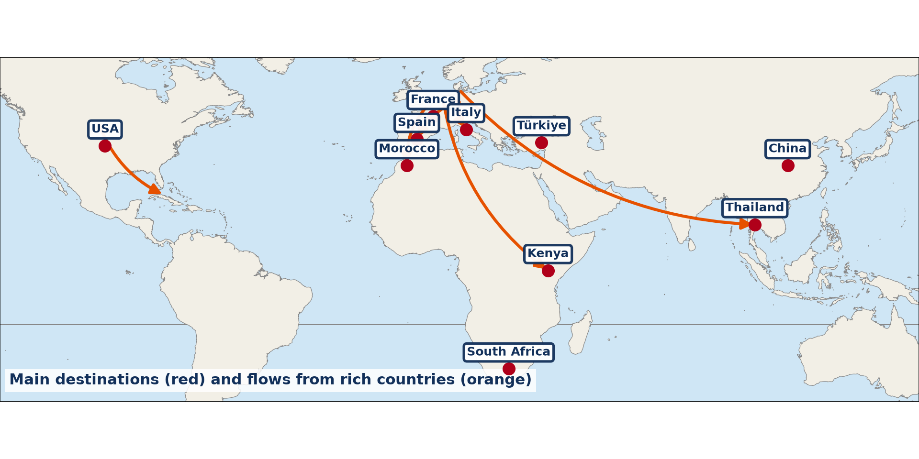
4. DESTINATIONS AND CHARACTERISTICS
Activity 4
World tourist flows.
Notes:
Activity 4. Look carefully at this diagram: world tourist flows. Observe every detail before I ask the question.

Slide 29
4. DESTINATIONS AND CHARACTERISTICS
Activity 4: Question
Name three major tourist destinations.
Notes:
Here is the question for Activity 4: Name three major tourist destinations. Take one minute to think and write your answer in your rough notebook.

Slide 30
4. DESTINATIONS AND CHARACTERISTICS
Activity 4: Answer
France, Spain and the USA (also Italy and China).
Notes:
Let us check the answer together. France, Spain and the USA (also Italy and China).

Slide 31

5. TOURIST ATTRACTIONS
Activity 5
Mount Cameroon.
Notes:
Activity 5. Look carefully at this picture: mount Cameroon. Observe every detail before I ask the question.

Slide 32
5. TOURIST ATTRACTIONS
Activity 5: Question
Give three types of tourist attractions.
Notes:
Here is the question for Activity 5: Give three types of tourist attractions. Take one minute to think and write your answer in your rough notebook.

Slide 33
5. TOURIST ATTRACTIONS
Activity 5: Answer
Natural sites, wildlife and cultural or historical sites.
Notes:
Let us check the answer together. Natural sites, wildlife and cultural or historical sites.

Slide 34
BOARD SUMMARY
Board Summary
Topic: Managing Resources for Development through Economic Activities
Sub-topic: Global Tourism
Lesson 19: Tourism
Notes:
Now we are going to copy the board summary. Write the title and the headings neatly in your notebooks. I will give you enough time for each slide, so do not rush.

Slide 35
BOARD SUMMARY
DEFINITIONS
The key terms of this lesson are defined as follows:
Tourism: It is travel away from home for leisure, business or culture for at least one night.
Mass tourism: It is the travel of very many people to the same destinations.
Notes:
Let us copy the definitions. The key terms of this lesson are defined as follows. On this slide we have Tourism and Mass tourism. Write each point on a new line, with the key term first, and explain it in your own words when we revise. When you finish, we go to the next slide.

Slide 36
BOARD SUMMARY
DEFINITIONS (continued)
Ecotourism: It is responsible travel to natural areas that protects the environment.
Notes:
We continue with the definitions. On this slide we have Ecotourism. Write each point on a new line, with the key term first, and explain it in your own words when we revise.

Slide 37
BOARD SUMMARY
1. Factors for the Promotion of Mass Tourism
Mass tourism is promoted by the following factors:
Transport: Cheap air travel and good roads make travel easy.
Income and leisure: Higher incomes and paid holidays allow people to travel.
Notes:
Let us copy Factors for the Promotion of Mass Tourism. Mass tourism is promoted by the following factors. On this slide we have Transport and Income and leisure. Write each point on a new line, with the key term first, and explain it in your own words when we revise. When you finish, we go to the next slide.

Slide 38
BOARD SUMMARY
1. Factors for the Promotion of Mass Tourism (continued)
Advertising: Travel agencies and the internet promote holiday packages.
Notes:
We continue with Factors for the Promotion of Mass Tourism. On this slide we have Advertising. Write each point on a new line, with the key term first, and explain it in your own words when we revise.

Slide 39
BOARD SUMMARY
2. Destinations, Characteristics and Attractions
Tourism has the following destinations and attractions:
Destinations: France, Spain, the USA, Italy and China receive the most tourists.
Characteristics: Tourism is seasonal and concentrated in coasts, mountains and cities.
Notes:
Let us copy Destinations, Characteristics and Attractions. Tourism has the following destinations and attractions. On this slide we have Destinations and Characteristics. Write each point on a new line, with the key term first, and explain it in your own words when we revise. When you finish, we go to the next slide.

Slide 40
BOARD SUMMARY
2. Destinations, Characteristics and Attractions (continued)
Natural attractions: Beaches, mountains, waterfalls and wildlife attract tourists.
Cultural attractions: Monuments, museums, festivals and crafts attract tourists.
Notes:
We continue with Destinations, Characteristics and Attractions. On this slide we have Natural attractions and Cultural attractions. Write each point on a new line, with the key term first, and explain it in your own words when we revise.

Slide 41
BOARD SUMMARY
2. Destinations, Characteristics and Attractions
Illustration: world tourist flows
Notes:
Now draw this illustration in your notebook: world tourist flows. Give it a title and label it clearly.

Slide 42
FORMATIVE EVALUATION
Evaluation 1
Define mass tourism.
Notes:
Now let us check what you have understood. Question 1: Define mass tourism. Answer in your exercise book.

Slide 43
FORMATIVE EVALUATION
Expected Answer
The travel of very many people to the same destinations.
Notes:
The expected answer is: the travel of very many people to the same destinations. If you got it right, well done.

Slide 44
FORMATIVE EVALUATION
Evaluation 2
Give two factors of mass tourism.
Notes:
Now let us check what you have understood. Question 2: Give two factors of mass tourism. Answer in your exercise book.

Slide 45
FORMATIVE EVALUATION
Expected Answer
Cheap air travel and paid holidays.
Notes:
The expected answer is: cheap air travel and paid holidays. If you got it right, well done.

Slide 46
REMEDIATION
Remediation
Fill in the blanks:
Responsible travel to natural areas is ______.
The most visited country in the world is ______.
Beaches are ______ attractions.
Notes:
For those who need more practice, fill in the blanks in your exercise book. The answers are: number 1, ecotourism; number 2, France; number 3, natural.

Slide 47
HOMEWORK
Homework
List five tourist attractions in Cameroon and classify them as natural or cultural.
Notes:
For your homework: List five tourist attractions in Cameroon and classify them as natural or cultural. We shall correct it at the beginning of our next lesson.

Slide 48
NEXT LESSON
Next Lesson
Our next lesson will be on:
Lesson 20: General Effects of Tourism
Notes:
Our next lesson will be on Lesson 20: General Effects of Tourism. Thank you for your attention, and see you next time.

Slide 49
BILINGUAL GAME
Bilingual Game (Jeu Bilingue)
English | Français
Tourism | Le tourisme
Tourist | Le touriste
Mass tourism | Le tourisme de masse
Ecotourism | L'écotourisme
Attraction | L'attraction
Holiday | Les vacances
Notes:
Let us play the bilingual game. I say a word in English, and you give me the French word. Then we do the reverse.

Slide 50
LOGBOOK
Official Logbook (1/2)
Module / Topic | Managing Resources for Development through Economic Activities
Lesson Title | Lesson 19: Tourism
Expected Learning Outcomes | Define tourism and its types. Explain the factors for the promotion of mass tourism. Identify tourist destinations and attractions.
Competence | Learners are able to explain tourism, its types, factors and destinations.
Notes:
I record this information in the official logbook of the class after the lesson.

Slide 51
LOGBOOK
Official Logbook (2/2)
Matter Taught | DEFINITIONS; Factors for the Promotion of Mass Tourism; Destinations, Characteristics and Attractions.
Evaluation | Formative evaluation and remediation exercise.
Homework | List five tourist attractions in Cameroon and classify them as natural or cultural.
Enrolment / Present / Absent | ____ / ____ / ____
Achievement | To be completed after the lesson.
Notes:
I complete the second page of the logbook: the matter taught, the evaluation, the homework and the attendance.

Slide 52
TEACHER'S NOTE
Teacher's Note
Timing: Homework correction, plan, objectives 8 min | Recall, situation, action 10 min | 5 activities 30 min | Board summary (copying) 30 min | Evaluation, remediation 10 min | Homework, next lesson 5 min | Logbook 7 min
Without the projector (Activity 1): give examples.
Without the projector (Activity 2): define.
Without the projector (Activity 3): discuss.
Without the projector (Activity 4): use the map.
Without the projector (Activity 5): list.
Notes:
This slide is for me, the teacher: it gives the timing of the lesson and what to do if the projector is not available.

Slide 53
REFERENCES
References
Geography Syllabus, Forms I–V, MINESEC (2023) — Form 5, Module I: Management of Manufacturing and Tertiary Activities.
Photo, Activity 1: “Crowded Sunny Beach, Bulgaria” by phototouring, CC BY-NC-SA 2.0, via Flickr (https://www.flickr.com/photos/19054742@N00/1557605901)
Photo, Activity 2: “African Bush Elephant, Amboseli National Park, Kenya” by Ray in Manila, CC BY 2.0, via Flickr (https://www.flickr.com/photos/21186555@N07/37211779966)
Photo, Activity 3: “Olympic Airlines A340-313X 'Epidauros'” by caribb, CC BY-NC-ND 2.0, via Flickr (https://www.flickr.com/photos/87857621@N00/194965684)
Photo, Activity 5: “Mount Cameroon” by John & Mel Kots, CC BY-NC-ND 2.0, via Flickr (https://www.flickr.com/photos/26745817@N00/2347261849)
Diagrams and animations: drawn for this lesson (Geography Department).
Notes:
These are the references and picture credits used to prepare this lesson.

