Slide 1
FORM 5
GEOGRAPHY
Further Study 3
Sources of Population Data
Notes:
Good morning, class, and welcome to our geography lesson. I am your geography teacher, Mr Kamdem. Today we are starting Further Study 3: Sources of Population Data.

Slide 2
CLASS INFO
Class, Chapter and Duration
Class | Form 5
Chapter | Module III: Management of Population Growth and Space Colonisation
Duration | 2 periods (2 × 50 minutes)
Notes:
This lesson is for Form 5. It belongs to Module III: Management of Population Growth and Space Colonisation. We shall need 2 periods to cover it.

Slide 3
IDENTIFICATION
Lesson Identification
Topic | The Dynamics of Population and Implications
Sub-topic | Population and Population Distribution
Lesson | Further Study 3: Sources of Population Data
Notions / Concepts | Census, survey, vital registration, migration records.
Syllabus focus | Census: meaning, methods, advantages and weaknesses; surveys: meaning, types, advantages and weaknesses; vital registrations; migration records.
Competence | Learners are able to explain the sources of population data and assess them.
Notes:
Our topic is The Dynamics of Population and Implications, and the sub-topic is Population and Population Distribution. The key notions we shall use today are: census, survey, vital registration, migration records. At the end, you should be able to do this: learners are able to explain the sources of population data and assess them.

Slide 4

HOMEWORK CORRECTION
Correction of the Homework
Question (Lesson 28: Basic Notions on Population):
Find the population of Cameroon in the censuses of 1976, 1987 and 2005.
Notes:
Before we start the new lesson, let us correct the homework I gave you at the end of Lesson 28: Basic Notions on Population. The question was: Find the population of Cameroon in the censuses of 1976, 1987 and 2005. Take out your exercise books.

Slide 5
HOMEWORK CORRECTION
Correction: Possible Answer
1976: about 7.7 million; 1987: about 10.5 million; 2005: about 17.5 million (about 28 million estimated today).
Notes:
Here is a good answer. 1976: about 7.7 million; 1987: about 10.5 million; 2005: about 17.5 million (about 28 million estimated today). Compare it with your own answer and correct your work in red.

Slide 6
LESSON PLAN
Lesson Plan
Correction of the homework
Objectives and recall
Real-life situation and action to take
Learning activities
Board summary
Evaluation, remediation and homework
Notes:
Here is the plan of our lesson today. First, we shall correct the homework. Then we shall look at the objectives and recall what you already know. After that, we shall study a situation from real life and the action to take, and do the learning activities. Finally, we shall copy the board summary, do the evaluation and the remediation, and I will give you the homework.

Slide 7
OBJECTIVES
Objectives
By the end of this lesson, you should be able to:
Explain the census and its methods.
Explain surveys and vital registrations.
Assess the advantages and weaknesses of each source.
Notes:
By the end of this lesson, you should be able to do three things. Number 1: explain the census and its methods. Number 2: explain surveys and vital registrations. Number 3: assess the advantages and weaknesses of each source.

Slide 8
PREVIOUS KNOWLEDGE
Previous Knowledge
BUCREP organises censuses in Cameroon.
Births must be declared.
Passports record travel.
Notes:
Let us first remember what you already know. BUCREP organises censuses in Cameroon. Births must be declared. Passports record travel. Keep this in mind, because we shall build on it today.

Slide 9
REAL-LIFE SITUATION
Situation in Real Life
Census agents visit every house in Garoua to count the people. At the same time, the council records births and deaths, and the police record travellers at the border.
Notes:
Listen carefully to this situation from real life. Census agents visit every house in Garoua to count the people. At the same time, the council records births and deaths, and the police record travellers at the border. Think about it, because I am going to ask you some questions.

Slide 10
REAL-LIFE SITUATION
Situation: Question 1
What is the problem in the situation?
Notes:
Question 1: What is the problem in the situation? Think for a moment, then raise your hand to answer.

Slide 11
REAL-LIFE SITUATION
Answer
We want to know how population data are collected.
Notes:
Good. We want to know how population data are collected.

Slide 12
REAL-LIFE SITUATION
Situation: Question 2
Who counts people in every house?
Notes:
Question 2: Who counts people in every house? Think for a moment, then raise your hand to answer.

Slide 13
REAL-LIFE SITUATION
Answer
Census agents.
Notes:
Good. Census agents.

Slide 14
REAL-LIFE SITUATION
Situation: Question 3
Who records births and deaths?
Notes:
Question 3: Who records births and deaths? Think for a moment, then raise your hand to answer.

Slide 15
REAL-LIFE SITUATION
Possible Answer
The council (civil status).
Notes:
Good. The council (civil status).

Slide 16
ACTION TO TAKE
Action to Take
Declare births and deaths and cooperate with census agents.
Notes:
From this situation, the action we are working towards in this lesson is the following: declare births and deaths and cooperate with census agents.

Slide 17
JUSTIFICATION
Justification of the Lesson
This further study helps us to understand where population figures come from.
Notes:
Why is this lesson important for you? This further study helps us to understand where population figures come from.

Slide 18
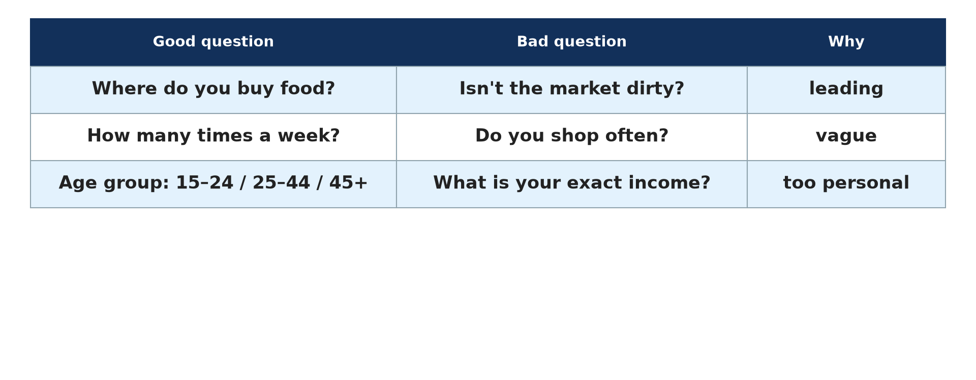
1. CENSUS
Activity 1
A questionnaire.
Notes:
Activity 1. Look carefully at this diagram: a questionnaire. Observe every detail before I ask the question.

Slide 19
1. CENSUS
Activity 1: Question
What is a census?
Notes:
Here is the question for Activity 1: What is a census? Take one minute to think and write your answer in your rough notebook.

Slide 20
1. CENSUS
Activity 1: Answer
The official counting of all the people of a country at a given time.
Notes:
Let us check the answer together. The official counting of all the people of a country at a given time.

Slide 21
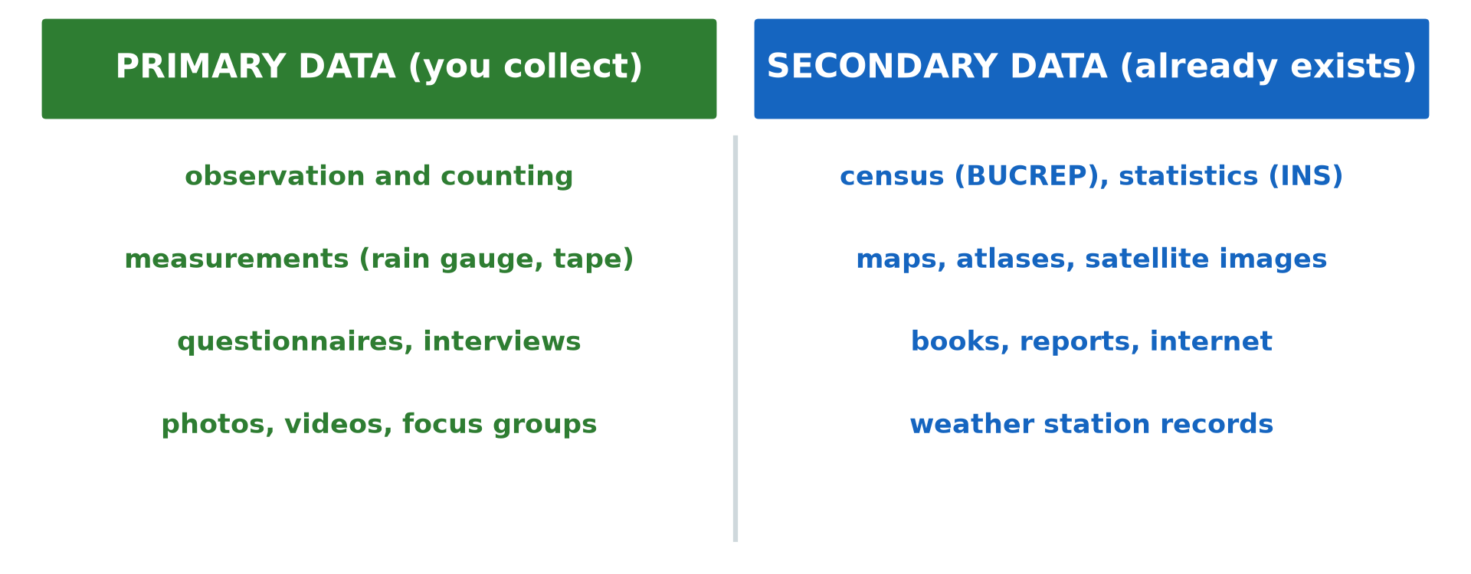
1. CENSUS: METHODS
Activity 2
Sources of data.
Notes:
Activity 2. Look carefully at this diagram: sources of data. Observe every detail before I ask the question.

Slide 22
1. CENSUS: METHODS
Activity 2: Question
Distinguish de facto and de jure census.
Notes:
Here is the question for Activity 2: Distinguish de facto and de jure census. Take one minute to think and write your answer in your rough notebook.

Slide 23
1. CENSUS: METHODS
Activity 2: Answer
De facto counts people where they are on census night; de jure counts them at their usual residence.
Notes:
Let us check the answer together. De facto counts people where they are on census night; de jure counts them at their usual residence.

Slide 24

2. SURVEYS
Activity 3
People interviewed.
Notes:
Activity 3. Look carefully at this picture: people interviewed. Observe every detail before I ask the question.

Slide 25
2. SURVEYS
Activity 3: Question
What is a sample survey?
Notes:
Here is the question for Activity 3: What is a sample survey? Take one minute to think and write your answer in your rough notebook.

Slide 26
2. SURVEYS
Activity 3: Answer
The study of a small part of the population to learn about the whole.
Notes:
Let us check the answer together. The study of a small part of the population to learn about the whole.

Slide 27
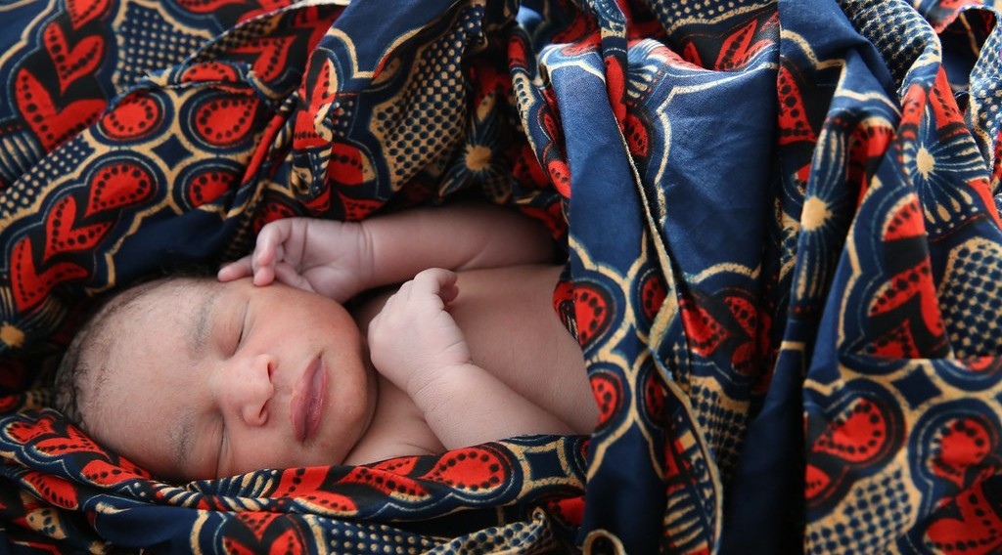
3. VITAL REGISTRATION
Activity 4
A newborn baby.
Notes:
Activity 4. Look carefully at this picture: a newborn baby. Observe every detail before I ask the question.

Slide 28
3. VITAL REGISTRATION
Activity 4: Question
What is vital registration?
Notes:
Here is the question for Activity 4: What is vital registration? Take one minute to think and write your answer in your rough notebook.

Slide 29
3. VITAL REGISTRATION
Activity 4: Answer
The recording of births, deaths and marriages by civil status offices.
Notes:
Let us check the answer together. The recording of births, deaths and marriages by civil status offices.

Slide 30
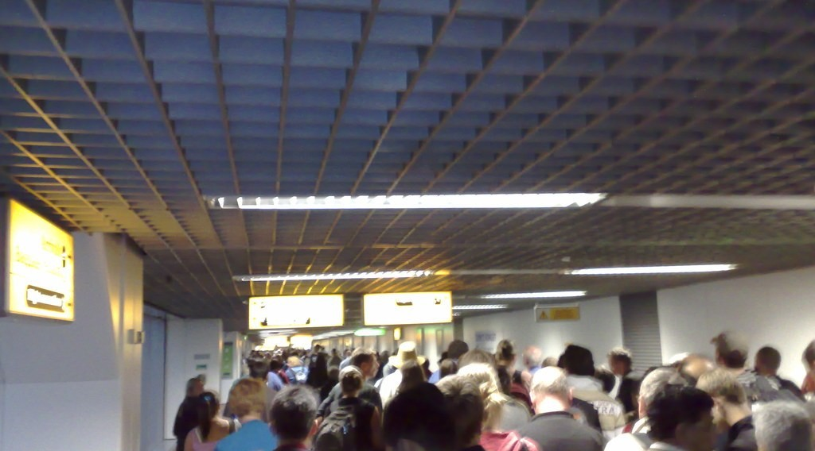
4. MIGRATION RECORDS
Activity 5
A passport.
Notes:
Activity 5. Look carefully at this picture: a passport. Observe every detail before I ask the question.

Slide 31
4. MIGRATION RECORDS
Activity 5: Question
Give one advantage and one weakness of migration records.
Notes:
Here is the question for Activity 5: Give one advantage and one weakness of migration records. Take one minute to think and write your answer in your rough notebook.

Slide 32
4. MIGRATION RECORDS
Activity 5: Answer
They count people crossing borders; clandestine migrants are not recorded.
Notes:
Let us check the answer together. They count people crossing borders; clandestine migrants are not recorded.

Slide 33
BOARD SUMMARY
Board Summary
Topic: The Dynamics of Population and Implications
Sub-topic: Population and Population Distribution
Further Study 3: Sources of Population Data
Notes:
Now we are going to copy the board summary. Write the title and the headings neatly in your notebooks. I will give you enough time for each slide, so do not rush.

Slide 34
BOARD SUMMARY
1. The Census
The census is organised as follows:
Meaning: It is the official counting of all the people of a country at a given time.
Methods: A de facto census counts people where they are, and a de jure census counts them at their usual home.
Notes:
Let us copy The Census. The census is organised as follows. On this slide we have Meaning and Methods. Write each point on a new line, with the key term first, and explain it in your own words when we revise. When you finish, we go to the next slide.

Slide 35
BOARD SUMMARY
1. The Census (continued)
Advantages: It gives complete data on age, sex, education and housing.
Weaknesses: It is costly, rare and some people are not counted.
Notes:
We continue with The Census. On this slide we have Advantages and Weaknesses. Write each point on a new line, with the key term first, and explain it in your own words when we revise.

Slide 36
BOARD SUMMARY
1. The Census
Illustration: sources of population data
Notes:
Now draw this illustration in your notebook: sources of population data. Give it a title and label it clearly.

Slide 37
BOARD SUMMARY
2. Other Sources
Other sources of population data are the following:
Surveys: They study a sample of the population, and they are cheap but less complete.
Notes:
Let us copy Other Sources. Other sources of population data are the following. On this slide we have Surveys. Write each point on a new line, with the key term first, and explain it in your own words when we revise. When you finish, we go to the next slide.

Slide 38
BOARD SUMMARY
2. Other Sources (continued)
Vital registration: It records births, deaths and marriages, but many events are not declared.
Migration records: They record people crossing borders, but clandestine migrants escape them.
Notes:
We continue with Other Sources. On this slide we have Vital registration and Migration records. Write each point on a new line, with the key term first, and explain it in your own words when we revise.

Slide 39
FORMATIVE EVALUATION
Evaluation 1
What is a census?
Notes:
Now let us check what you have understood. Question 1: What is a census? Answer in your exercise book.

Slide 40
FORMATIVE EVALUATION
Expected Answer
The official counting of all the people of a country.
Notes:
The expected answer is: the official counting of all the people of a country. If you got it right, well done.

Slide 41
FORMATIVE EVALUATION
Evaluation 2
Give one weakness of vital registration in Cameroon.
Notes:
Now let us check what you have understood. Question 2: Give one weakness of vital registration in Cameroon. Answer in your exercise book.

Slide 42
FORMATIVE EVALUATION
Expected Answer
Many births and deaths are not declared.
Notes:
The expected answer is: many births and deaths are not declared. If you got it right, well done.

Slide 43
REMEDIATION
Remediation
Fill in the blanks:
The institution in charge of censuses in Cameroon is ______.
Recording births and deaths is ______ registration.
Notes:
Take your time to copy this part; we will continue together.

Slide 44
REMEDIATION
Remediation (continued)
A study of part of the population is a ______.
Notes:
For those who need more practice, fill in the blanks in your exercise book. The answers are: number 1, BUCREP; number 2, vital; number 3, survey (sample survey).

Slide 45
HOMEWORK
Homework
Explain two reasons why census figures in Cameroon may be inaccurate.
Notes:
For your homework: Explain two reasons why census figures in Cameroon may be inaccurate. We shall correct it at the beginning of our next lesson.

Slide 46
NEXT LESSON
Next Lesson
Our next lesson will be on:
Lesson 29: Population Distribution
Notes:
Our next lesson will be on Lesson 29: Population Distribution. Thank you for your attention, and see you next time.

Slide 47
BILINGUAL GAME
Bilingual Game (Jeu Bilingue)
English | Français
Census | Le recensement
Survey | L'enquête
Sample | L'échantillon
Birth certificate | L'acte de naissance
Civil status | L'état civil
Border | La frontière
Notes:
Let us play the bilingual game. I say a word in English, and you give me the French word. Then we do the reverse.

Slide 48
LOGBOOK
Official Logbook (1/2)
Module / Topic | The Dynamics of Population and Implications
Lesson Title | Further Study 3: Sources of Population Data
Expected Learning Outcomes | Explain the census and its methods. Explain surveys and vital registrations. Assess the advantages and weaknesses of each source.
Competence | Learners are able to explain the sources of population data and assess them.
Notes:
I record this information in the official logbook of the class after the lesson.

Slide 49
LOGBOOK
Official Logbook (2/2)
Matter Taught | The Census; Other Sources.
Evaluation | Formative evaluation and remediation exercise.
Homework | Explain two reasons why census figures in Cameroon may be inaccurate.
Enrolment / Present / Absent | ____ / ____ / ____
Achievement | To be completed after the lesson.
Notes:
I complete the second page of the logbook: the matter taught, the evaluation, the homework and the attendance.

Slide 50
TEACHER'S NOTE
Teacher's Note
Timing: Homework correction, plan, objectives 8 min | Recall, situation, action 10 min | 5 activities 30 min | Board summary (copying) 30 min | Evaluation, remediation 10 min | Homework, next lesson 5 min | Logbook 7 min
Without the projector (Activity 1): discuss.
Without the projector (Activity 2): discuss.
Without the projector (Activity 3): discuss.
Without the projector (Activity 4): discuss.
Without the projector (Activity 5): discuss.
Notes:
This slide is for me, the teacher: it gives the timing of the lesson and what to do if the projector is not available.

Slide 51
REFERENCES
References
Geography Syllabus, Forms I–V, MINESEC (2023) — Form 5, Module III: Management of Population Growth and Space Colonisation.
Photo, Activity 3: “Students in Primary Seven at Zanaki Primary School” by World Bank Photo Collection, CC BY-NC-ND 2.0, via Flickr (https://www.flickr.com/photos/10816734@N03/33423887921)
Photo, Activity 4: “Newborn baby rests” by World Bank Photo Collection, CC BY-NC-ND 2.0, via Flickr (https://www.flickr.com/photos/10816734@N03/19845580540)
Photo, Activity 5: “London Heathrow T4 arrivals” by markhillary, CC BY 2.0, via Flickr (https://www.flickr.com/photos/56087830@N00/1568955656)
Diagrams and animations: drawn for this lesson (Geography Department).
Notes:
These are the references and picture credits used to prepare this lesson.

