Slide 1
FORM 5
GEOGRAPHY
Practical Work 3
Population Densities in Cameroon
Notes:
Good morning, class, and welcome to our geography lesson. I am your geography teacher, Mr Kamdem. Today we are starting Practical Work 3: Population Densities in Cameroon.

Slide 2
CLASS INFO
Class, Chapter and Duration
Class | Form 5
Chapter | Module III: Management of Population Growth and Space Colonisation
Duration | 2 periods (2 × 50 minutes)
Notes:
This lesson is for Form 5. It belongs to Module III: Management of Population Growth and Space Colonisation. We shall need 2 periods to cover it.

Slide 3
IDENTIFICATION
Lesson Identification
Topic | The Dynamics of Population and Implications
Sub-topic | Population and Population Distribution
Lesson | Practical Work 3: Population Densities in Cameroon
Notions / Concepts | Population density, choropleth map, interpretation.
Syllabus focus | Calculation of population densities; interpretation of results; draw map of spatial distribution of the population densities in Cameroon.
Competence | Learners are able to calculate densities, interpret them and draw a density map of Cameroon.
Notes:
Our topic is The Dynamics of Population and Implications, and the sub-topic is Population and Population Distribution. The key notions we shall use today are: population density, choropleth map, interpretation. At the end, you should be able to do this: learners are able to calculate densities, interpret them and draw a density map of Cameroon.

Slide 4

HOMEWORK CORRECTION
Correction of the Homework
Question (Lesson 29: Population Distribution):
Calculate the density of Cameroon if it has 28 million people on 475,000 km².
Notes:
Before we start the new lesson, let us correct the homework I gave you at the end of Lesson 29: Population Distribution. The question was: Calculate the density of Cameroon if it has 28 million people on 475,000 km². Take out your exercise books.

Slide 5
HOMEWORK CORRECTION
Correction: Possible Answer
28,000,000 ÷ 475,000 ≈ 59 people per km² (moderate).
Notes:
Here is a good answer. 28,000,000 ÷ 475,000 ≈ 59 people per km² (moderate). Compare it with your own answer and correct your work in red.

Slide 6
LESSON PLAN
Lesson Plan
Correction of the homework
Objectives and recall
Real-life situation and action to take
Learning activities
Board summary
Evaluation, remediation and homework
Notes:
Here is the plan of our lesson today. First, we shall correct the homework. Then we shall look at the objectives and recall what you already know. After that, we shall study a situation from real life and the action to take, and do the learning activities. Finally, we shall copy the board summary, do the evaluation and the remediation, and I will give you the homework.

Slide 7
OBJECTIVES
Objectives
By the end of this lesson, you should be able to:
Calculate the population densities of the regions of Cameroon.
Interpret the results.
Draw a choropleth map of densities.
Notes:
By the end of this lesson, you should be able to do three things. Number 1: calculate the population densities of the regions of Cameroon. Number 2: interpret the results. Number 3: draw a choropleth map of densities.

Slide 8
PREVIOUS KNOWLEDGE
Previous Knowledge
Density = population ÷ area.
Cameroon has ten regions.
A choropleth map uses shades.
Notes:
Let us first remember what you already know. Density = population ÷ area. Cameroon has ten regions. A choropleth map uses shades. Keep this in mind, because we shall build on it today.

Slide 9
REAL-LIFE SITUATION
Situation in Real Life
The teacher gives a table of the population and area of the ten regions of Cameroon. The class must calculate the densities and map them.
Notes:
Listen carefully to this situation from real life. The teacher gives a table of the population and area of the ten regions of Cameroon. The class must calculate the densities and map them. Think about it, because I am going to ask you some questions.

Slide 10
REAL-LIFE SITUATION
Situation: Question 1
What is the problem in the situation?
Notes:
Question 1: What is the problem in the situation? Think for a moment, then raise your hand to answer.

Slide 11
REAL-LIFE SITUATION
Answer
The class must calculate and map densities.
Notes:
Good. The class must calculate and map densities.

Slide 12
REAL-LIFE SITUATION
Situation: Question 2
What formula is used?
Notes:
Question 2: What formula is used? Think for a moment, then raise your hand to answer.

Slide 13
REAL-LIFE SITUATION
Answer
Population ÷ area.
Notes:
Good. Population ÷ area.

Slide 14
REAL-LIFE SITUATION
Situation: Question 3
What map will be drawn?
Notes:
Question 3: What map will be drawn? Think for a moment, then raise your hand to answer.

Slide 15
REAL-LIFE SITUATION
Possible Answer
A choropleth map.
Notes:
Good. A choropleth map.

Slide 16
ACTION TO TAKE
Action to Take
Present calculations clearly and check them.
Notes:
From this situation, the action we are working towards in this lesson is the following: present calculations clearly and check them.

Slide 17
JUSTIFICATION
Justification of the Lesson
This practical work helps us to understand the population of our country with real figures.
Notes:
Why is this lesson important for you? This practical work helps us to understand the population of our country with real figures.

Slide 18
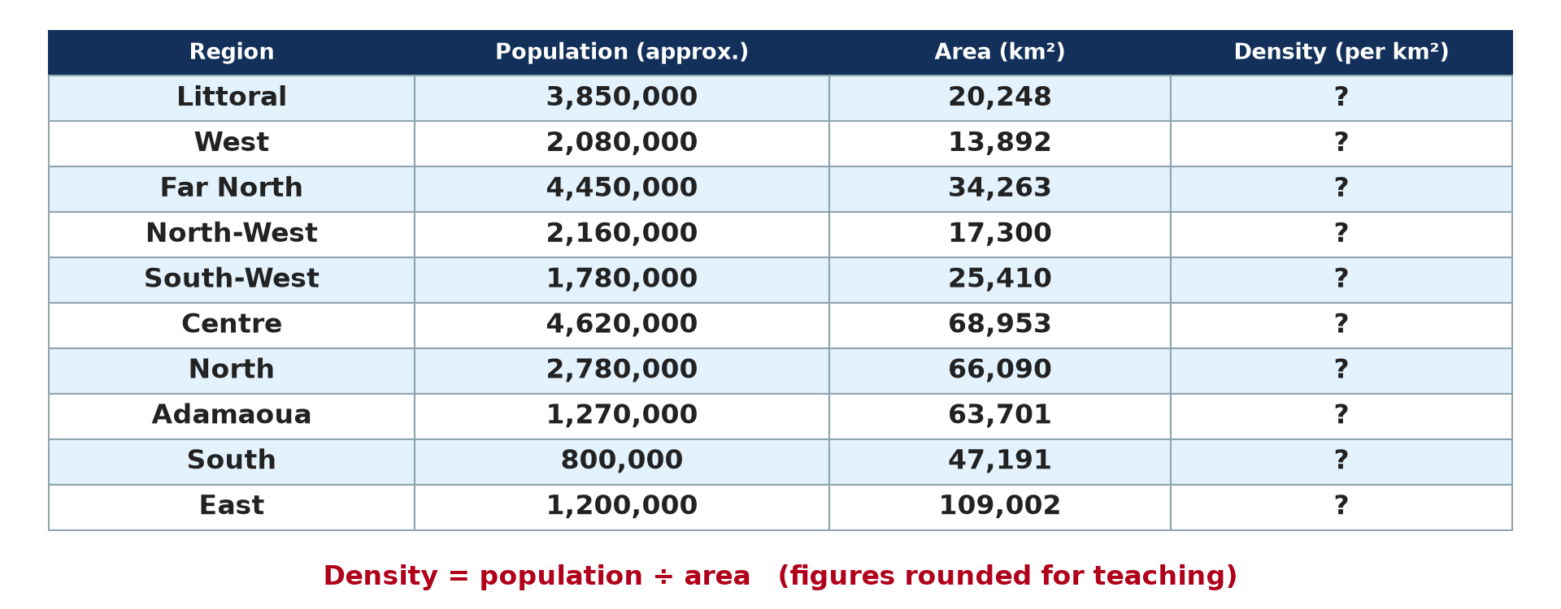
1. CALCULATION
Activity 1
Population and area of the regions (approximate).
Notes:
Activity 1. Look carefully at this diagram: population and area of the regions (approximate). Observe every detail before I ask the question.

Slide 19
1. CALCULATION
Activity 1: Question
Calculate the densities of the Littoral, the West and the Far North.
Notes:
Here is the question for Activity 1: Calculate the densities of the Littoral, the West and the Far North. Take one minute to think and write your answer in your rough notebook.

Slide 20
1. CALCULATION
Activity 1: Answer
Littoral 3,850,000 ÷ 20,248 ≈ 190; West ≈ 150; Far North ≈ 130 people per km².
Notes:
Let us check the answer together. Littoral 3,850,000 ÷ 20,248 ≈ 190; West ≈ 150; Far North ≈ 130 people per km².

Slide 21
1. CALCULATION
Activity 2
Population and area of the regions (approximate).
Notes:
Activity 2. Look carefully at this diagram: population and area of the regions (approximate). Observe every detail before I ask the question.

Slide 22
1. CALCULATION
Activity 2: Question
Calculate the densities of the East, the South and the Adamaoua.
Notes:
Here is the question for Activity 2: Calculate the densities of the East, the South and the Adamaoua. Take one minute to think and write your answer in your rough notebook.

Slide 23
1. CALCULATION
Activity 2: Answer
East ≈ 11; South ≈ 17; Adamaoua ≈ 20 people per km².
Notes:
Let us check the answer together. East ≈ 11; South ≈ 17; Adamaoua ≈ 20 people per km².

Slide 24

2. INTERPRETATION
Activity 3
Density of Cameroon by region.
Notes:
Activity 3. Look carefully at this diagram: density of Cameroon by region. Observe every detail before I ask the question.

Slide 25
2. INTERPRETATION
Activity 3: Question
Which regions are dense and which are sparse?
Notes:
Here is the question for Activity 3: Which regions are dense and which are sparse? Take one minute to think and write your answer in your rough notebook.

Slide 26
2. INTERPRETATION
Activity 3: Answer
Dense: Littoral, West, Far North, North-West; sparse: East, South, Adamaoua.
Notes:
Let us check the answer together. Dense: Littoral, West, Far North, North-West; sparse: East, South, Adamaoua.

Slide 27
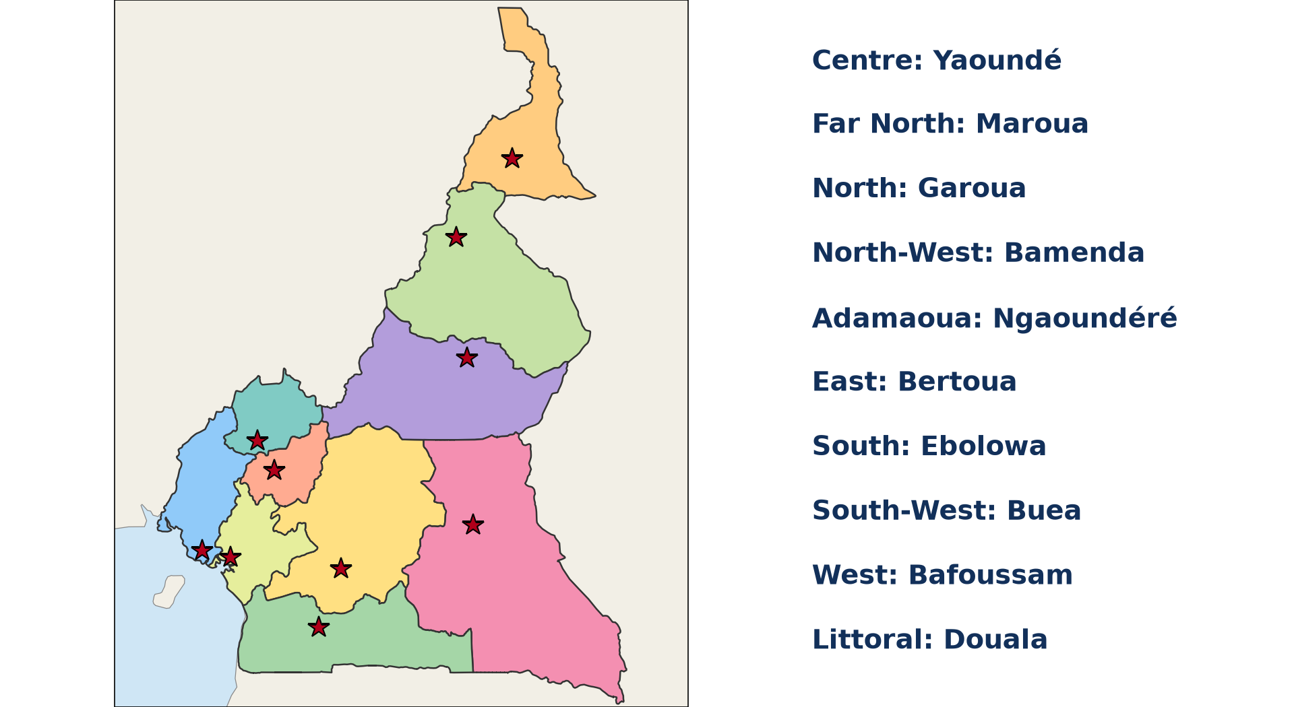
2. INTERPRETATION
Activity 4
Regions of Cameroon.
Notes:
Activity 4. Look carefully at this diagram: regions of Cameroon. Observe every detail before I ask the question.

Slide 28
2. INTERPRETATION
Activity 4: Question
Explain why the West and the East differ.
Notes:
Here is the question for Activity 4: Explain why the West and the East differ. Take one minute to think and write your answer in your rough notebook.

Slide 29
2. INTERPRETATION
Activity 4: Answer
The West has fertile volcanic soils and a mild climate; the East has dense forest and poor roads.
Notes:
Let us check the answer together. The West has fertile volcanic soils and a mild climate; the East has dense forest and poor roads.

Slide 30
3. MAPPING
Activity 5
A choropleth map.
Notes:
Activity 5. Look carefully at this diagram: a choropleth map. Observe every detail before I ask the question.

Slide 31
3. MAPPING
Activity 5: Question
How do we draw the density map?
Notes:
Here is the question for Activity 5: How do we draw the density map? Take one minute to think and write your answer in your rough notebook.

Slide 32
3. MAPPING
Activity 5: Answer
Group densities into classes and shade each region darker for higher density, with a key.
Notes:
Let us check the answer together. Group densities into classes and shade each region darker for higher density, with a key.

Slide 33
BOARD SUMMARY
Board Summary
Topic: The Dynamics of Population and Implications
Sub-topic: Population and Population Distribution
Practical Work 3: Population Densities in Cameroon
Notes:
Now we are going to copy the board summary. Write the title and the headings neatly in your notebooks. I will give you enough time for each slide, so do not rush.

Slide 34
BOARD SUMMARY
1. Calculation of Population Densities
The densities of the regions of Cameroon are calculated as follows:
Formula: Density equals population divided by area in km².
Dense regions: The Littoral has about 190, the West 150, the Far North 130 and the North-West 125 people per km².
Notes:
Let us copy Calculation of Population Densities. The densities of the regions of Cameroon are calculated as follows. On this slide we have Formula and Dense regions. Write each point on a new line, with the key term first, and explain it in your own words when we revise. When you finish, we go to the next slide.

Slide 35
BOARD SUMMARY
1. Calculation of Population Densities (continued)
Moderate regions: The South-West has about 70, the Centre 67 and the North 42 people per km².
Sparse regions: The Adamaoua has about 20, the South 17 and the East 11 people per km².
Notes:
We continue with Calculation of Population Densities. On this slide we have Moderate regions and Sparse regions. Write each point on a new line, with the key term first, and explain it in your own words when we revise.

Slide 36
BOARD SUMMARY
1. Calculation of Population Densities
Illustration: data table
Notes:
Now draw this illustration in your notebook: data table. Give it a title and label it clearly.

Slide 37
BOARD SUMMARY
2. Interpretation and Mapping
The results are interpreted and mapped as follows:
Interpretation: Densities are high in fertile highlands, the coast and cities, and low in the forest and plateau.
Choropleth map: Each region is shaded according to its density class.
Notes:
Let us copy Interpretation and Mapping. The results are interpreted and mapped as follows. On this slide we have Interpretation and Choropleth map. Write each point on a new line, with the key term first, and explain it in your own words when we revise. When you finish, we go to the next slide.

Slide 38
BOARD SUMMARY
2. Interpretation and Mapping (continued)
Map elements: The map needs a title, key, frame, scale and north arrow.
Notes:
We continue with Interpretation and Mapping. On this slide we have Map elements. Write each point on a new line, with the key term first, and explain it in your own words when we revise.

Slide 39
BOARD SUMMARY
2. Interpretation and Mapping
Illustration: density map of Cameroon
Notes:
Now draw this illustration in your notebook: density map of Cameroon. Give it a title and label it clearly.

Slide 40
FORMATIVE EVALUATION
Evaluation 1
Calculate the density of a region with 2,160,000 people on 17,300 km².
Notes:
Now let us check what you have understood. Question 1: Calculate the density of a region with 2,160,000 people on 17,300 km². Answer in your exercise book.

Slide 41
FORMATIVE EVALUATION
Expected Answer
About 125 people per km².
Notes:
The expected answer is: about 125 people per km². If you got it right, well done.

Slide 42
FORMATIVE EVALUATION
Evaluation 2
Name the densest and the least dense regions.
Notes:
Now let us check what you have understood. Question 2: Name the densest and the least dense regions. Answer in your exercise book.

Slide 43
FORMATIVE EVALUATION
Expected Answer
The Littoral and the East.
Notes:
The expected answer is: the Littoral and the East. If you got it right, well done.

Slide 44
REMEDIATION
Remediation
Fill in the blanks:
The densest region of Cameroon is the ______.
The least dense region is the ______.
A map with shades by area is a ______ map.
Notes:
For those who need more practice, fill in the blanks in your exercise book. The answers are: number 1, Littoral; number 2, East; number 3, choropleth.

Slide 45
HOMEWORK
Homework
Draw the choropleth map of population densities of Cameroon using four classes.
Notes:
For your homework: Draw the choropleth map of population densities of Cameroon using four classes. We shall correct it at the beginning of our next lesson.

Slide 46
NEXT LESSON
Next Lesson
Our next lesson will be on:
Lesson 30: Spatial Distribution of the World's Population
Notes:
Our next lesson will be on Lesson 30: Spatial Distribution of the World's Population. Thank you for your attention, and see you next time.

Slide 47
BILINGUAL GAME
Bilingual Game (Jeu Bilingue)
English | Français
Calculation | Le calcul
Table | Le tableau
Class | La classe
Shade | La teinte
Key | La légende
Region | La région
Notes:
Let us play the bilingual game. I say a word in English, and you give me the French word. Then we do the reverse.

Slide 48
LOGBOOK
Official Logbook (1/2)
Module / Topic | The Dynamics of Population and Implications
Lesson Title | Practical Work 3: Population Densities in Cameroon
Expected Learning Outcomes | Calculate the population densities of the regions of Cameroon. Interpret the results. Draw a choropleth map of densities.
Competence | Learners are able to calculate densities, interpret them and draw a density map of Cameroon.
Notes:
I record this information in the official logbook of the class after the lesson.

Slide 49
LOGBOOK
Official Logbook (2/2)
Matter Taught | Calculation of Population Densities; Interpretation and Mapping.
Evaluation | Formative evaluation and remediation exercise.
Homework | Draw the choropleth map of population densities of Cameroon using four classes.
Enrolment / Present / Absent | ____ / ____ / ____
Achievement | To be completed after the lesson.
Notes:
I complete the second page of the logbook: the matter taught, the evaluation, the homework and the attendance.

Slide 50
TEACHER'S NOTE
Teacher's Note
Timing: Homework correction, plan, objectives 8 min | Recall, situation, action 10 min | 5 activities 30 min | Board summary (copying) 30 min | Evaluation, remediation 10 min | Homework, next lesson 5 min | Logbook 7 min
Without the projector (Activity 1): copy the table.
Without the projector (Activity 2): calculate.
Without the projector (Activity 3): classify.
Without the projector (Activity 4): discuss.
Without the projector (Activity 5): draw the map.
Notes:
This slide is for me, the teacher: it gives the timing of the lesson and what to do if the projector is not available.

Slide 51
REFERENCES
References
Geography Syllabus, Forms I–V, MINESEC (2023) — Form 5, Module III: Management of Population Growth and Space Colonisation.
Diagrams and animations: drawn for this lesson (Geography Department).
Notes:
These are the references and picture credits used to prepare this lesson.

