Slide 1
FORM 5
GEOGRAPHY
Lesson 37
Notions on Optimum Population, Over-population and Under-population
Notes:
Good morning, class, and welcome to our geography lesson. I am your geography teacher, Mr Kamdem. Today we are starting Lesson 37: Notions on Optimum Population, Over-population and Under-population.

Slide 2
CLASS INFO
Class, Chapter and Duration
Class | Form 5
Chapter | Module III: Management of Population Growth and Space Colonisation
Duration | 2 periods (2 × 50 minutes)
Notes:
This lesson is for Form 5. It belongs to Module III: Management of Population Growth and Space Colonisation. We shall need 2 periods to cover it.

Slide 3
IDENTIFICATION
Lesson Identification
Topic | The Dynamics of Population and Implications
Sub-topic | Population and Resources
Lesson | Lesson 37: Notions on Optimum Population, Over-population and Under-population
Notions / Concepts | Optimum population, over-population, under-population, standards of living.
Syllabus focus | Meaning; examples of areas; indicators.
Competence | Learners are able to explain the relationship between population and resources.
Notes:
Our topic is The Dynamics of Population and Implications, and the sub-topic is Population and Resources. The key notions we shall use today are: optimum population, over-population, under-population, standards of living. At the end, you should be able to do this: learners are able to explain the relationship between population and resources.

Slide 4

HOMEWORK CORRECTION
Correction of the Homework
Question (Lesson 36: Migration):
Interview a migrant in your area and write the causes of his or her migration.
Notes:
Before we start the new lesson, let us correct the homework I gave you at the end of Lesson 36: Migration. The question was: Interview a migrant in your area and write the causes of his or her migration. Take out your exercise books.

Slide 5
HOMEWORK CORRECTION
Correction: Possible Answer
Example: came from a village to Garoua for work or school (pull), because of poor harvests or insecurity (push).
Notes:
Here is a good answer. Example: came from a village to Garoua for work or school (pull), because of poor harvests or insecurity (push). Compare it with your own answer and correct your work in red.

Slide 6
LESSON PLAN
Lesson Plan
Correction of the homework
Objectives and recall
Real-life situation and action to take
Learning activities
Board summary
Evaluation, remediation and homework
Notes:
Here is the plan of our lesson today. First, we shall correct the homework. Then we shall look at the objectives and recall what you already know. After that, we shall study a situation from real life and the action to take, and do the learning activities. Finally, we shall copy the board summary, do the evaluation and the remediation, and I will give you the homework.

Slide 7
OBJECTIVES
Objectives
By the end of this lesson, you should be able to:
Define optimum, over- and under-population.
Give examples of areas.
Give the indicators of each.
Notes:
By the end of this lesson, you should be able to do three things. Number 1: define optimum, over- and under-population. Number 2: give examples of areas. Number 3: give the indicators of each.

Slide 8
PREVIOUS KNOWLEDGE
Previous Knowledge
Resources feed people.
Some areas are crowded and poor.
Some areas have few people and many resources.
Notes:
Let us first remember what you already know. Resources feed people. Some areas are crowded and poor. Some areas have few people and many resources. Keep this in mind, because we shall build on it today.

Slide 9
REAL-LIFE SITUATION
Situation in Real Life
In a crowded village, farms are tiny and many youths leave, while a neighbouring region has fertile land but few people to farm it.
Notes:
Listen carefully to this situation from real life. In a crowded village, farms are tiny and many youths leave, while a neighbouring region has fertile land but few people to farm it. Think about it, because I am going to ask you some questions.

Slide 10
REAL-LIFE SITUATION
Situation: Question 1
What is the problem in the situation?
Notes:
Question 1: What is the problem in the situation? Think for a moment, then raise your hand to answer.

Slide 11
REAL-LIFE SITUATION
Answer
Population and resources are not balanced.
Notes:
Good. Population and resources are not balanced.

Slide 12
REAL-LIFE SITUATION
Situation: Question 2
What happens in the crowded village?
Notes:
Question 2: What happens in the crowded village? Think for a moment, then raise your hand to answer.

Slide 13
REAL-LIFE SITUATION
Answer
Farms are tiny and youths leave.
Notes:
Good. Farms are tiny and youths leave.

Slide 14
REAL-LIFE SITUATION
Situation: Question 3
What happens in the other region?
Notes:
Question 3: What happens in the other region? Think for a moment, then raise your hand to answer.

Slide 15
REAL-LIFE SITUATION
Possible Answer
Land is not fully used.
Notes:
Good. Land is not fully used.

Slide 16
ACTION TO TAKE
Action to Take
Encourage out-migration from crowded areas and birth control.
Notes:
From this situation, the action we are working towards in this lesson is the following: encourage out-migration from crowded areas and birth control.

Slide 17
JUSTIFICATION
Justification of the Lesson
This lesson helps us to understand the balance between people and resources.
Notes:
Why is this lesson important for you? This lesson helps us to understand the balance between people and resources.

Slide 18
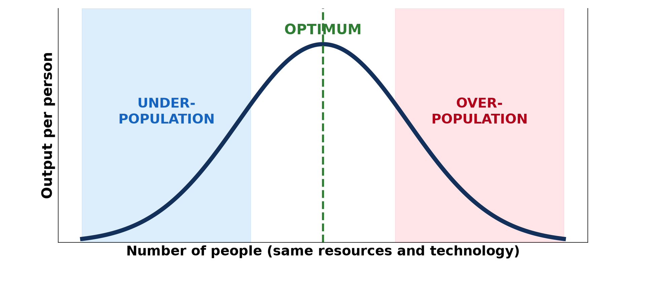
1. MEANING: OPTIMUM
Activity 1
Optimum population.
Notes:
Activity 1. Look carefully at this diagram: optimum population. Observe every detail before I ask the question.

Slide 19
1. MEANING: OPTIMUM
Activity 1: Question
What is optimum population?
Notes:
Here is the question for Activity 1: What is optimum population? Take one minute to think and write your answer in your rough notebook.

Slide 20
1. MEANING: OPTIMUM
Activity 1: Answer
The number of people that gives the highest standard of living with the available resources.
Notes:
Let us check the answer together. The number of people that gives the highest standard of living with the available resources.

Slide 21

1. MEANING: OVER-POPULATION
Activity 2
A crowded area.
Notes:
Activity 2. Look carefully at this picture: a crowded area. Observe every detail before I ask the question.

Slide 22
1. MEANING: OVER-POPULATION
Activity 2: Question
What is over-population?
Notes:
Here is the question for Activity 2: What is over-population? Take one minute to think and write your answer in your rough notebook.

Slide 23
1. MEANING: OVER-POPULATION
Activity 2: Answer
Too many people for the resources available.
Notes:
Let us check the answer together. Too many people for the resources available.

Slide 24

1. MEANING: UNDER-POPULATION
Activity 3
A forest area.
Notes:
Activity 3. Look carefully at this picture: a forest area. Observe every detail before I ask the question.

Slide 25
1. MEANING: UNDER-POPULATION
Activity 3: Question
What is under-population?
Notes:
Here is the question for Activity 3: What is under-population? Take one minute to think and write your answer in your rough notebook.

Slide 26
1. MEANING: UNDER-POPULATION
Activity 3: Answer
Too few people to use the resources fully.
Notes:
Let us check the answer together. Too few people to use the resources fully.

Slide 27
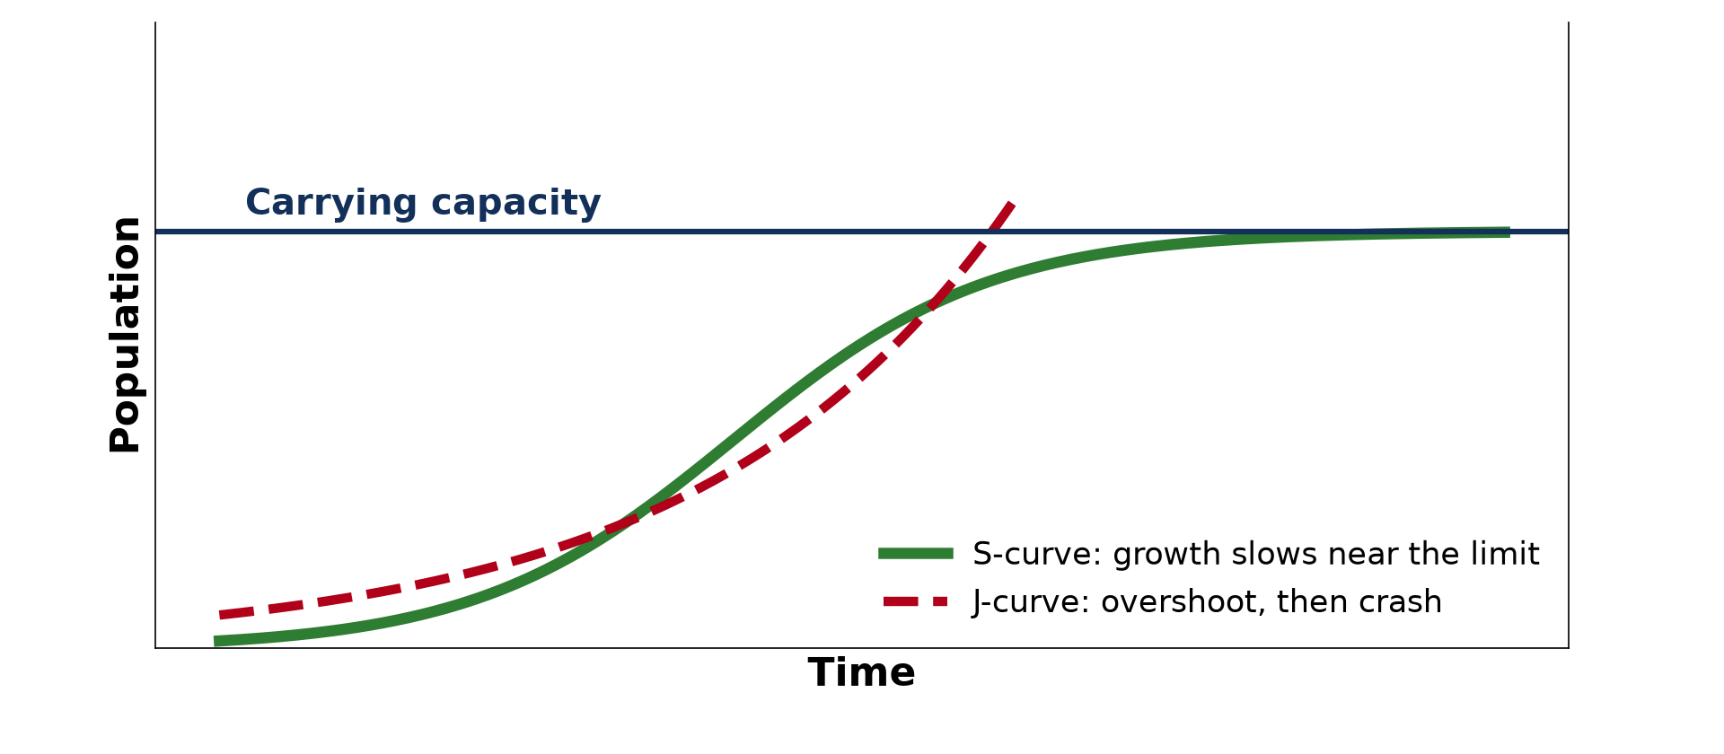
2. EXAMPLES
Activity 4
Carrying capacity.
Notes:
Activity 4. Look carefully at this diagram: carrying capacity. Observe every detail before I ask the question.

Slide 28
2. EXAMPLES
Activity 4: Question
Give one example of an over-populated and an under-populated area.
Notes:
Here is the question for Activity 4: Give one example of an over-populated and an under-populated area. Take one minute to think and write your answer in your rough notebook.

Slide 29
2. EXAMPLES
Activity 4: Answer
Over-populated: Bangladesh or the Mandara Mountains; under-populated: Canada or the East Region of Cameroon.
Notes:
Let us check the answer together. Over-populated: Bangladesh or the Mandara Mountains; under-populated: Canada or the East Region of Cameroon.

Slide 30

3. INDICATORS
Activity 5
Food aid.
Notes:
Activity 5. Look carefully at this picture: food aid. Observe every detail before I ask the question.

Slide 31
3. INDICATORS
Activity 5: Question
Give two indicators of over-population.
Notes:
Here is the question for Activity 5: Give two indicators of over-population. Take one minute to think and write your answer in your rough notebook.

Slide 32
3. INDICATORS
Activity 5: Answer
Unemployment and food shortages (also out-migration and land degradation).
Notes:
Let us check the answer together. Unemployment and food shortages (also out-migration and land degradation).

Slide 33
BOARD SUMMARY
Board Summary
Topic: The Dynamics of Population and Implications
Sub-topic: Population and Resources
Lesson 37: Notions on Optimum Population, Over-population and Under-population
Notes:
Now we are going to copy the board summary. Write the title and the headings neatly in your notebooks. I will give you enough time for each slide, so do not rush.

Slide 34
BOARD SUMMARY
DEFINITIONS
The key terms of this lesson are defined as follows:
Optimum population: It is the number of people that gives the highest standard of living with the available resources.
Over-population: It is a situation where there are too many people for the resources.
Notes:
Let us copy the definitions. The key terms of this lesson are defined as follows. On this slide we have Optimum population and Over-population. Write each point on a new line, with the key term first, and explain it in your own words when we revise. When you finish, we go to the next slide.

Slide 35
BOARD SUMMARY
DEFINITIONS (continued)
Under-population: It is a situation where there are too few people to use the resources fully.
Notes:
We continue with the definitions. On this slide we have Under-population. Write each point on a new line, with the key term first, and explain it in your own words when we revise.

Slide 36
BOARD SUMMARY
1. Examples of Areas
Examples of areas are the following:
Over-populated areas: Bangladesh, parts of the Sahel and the Mandara Mountains are examples.
Under-populated areas: Canada, Australia and the East Region of Cameroon are examples.
Notes:
Let us copy Examples of Areas. Examples of areas are the following. On this slide we have Over-populated areas and Under-populated areas. Write each point on a new line, with the key term first, and explain it in your own words when we revise.

Slide 37
BOARD SUMMARY
1. Examples of Areas
Illustration: optimum population
Notes:
Now draw this illustration in your notebook: optimum population. Give it a title and label it clearly.

Slide 38
BOARD SUMMARY
2. Indicators
Each situation has the following indicators:
Over-population: Unemployment, food shortages, out-migration and land degradation are signs.
Under-population: Unused resources, labour shortages and immigration are signs.
Notes:
Let us copy Indicators. Each situation has the following indicators. On this slide we have Over-population and Under-population. Write each point on a new line, with the key term first, and explain it in your own words when we revise. When you finish, we go to the next slide.

Slide 39
BOARD SUMMARY
2. Indicators (continued)
Optimum: Full employment and a high standard of living are signs.
Notes:
We continue with Indicators. On this slide we have Optimum. Write each point on a new line, with the key term first, and explain it in your own words when we revise.

Slide 40
FORMATIVE EVALUATION
Evaluation 1
Define over-population.
Notes:
Now let us check what you have understood. Question 1: Define over-population. Answer in your exercise book.

Slide 41
FORMATIVE EVALUATION
Expected Answer
Too many people for the resources available.
Notes:
The expected answer is: too many people for the resources available. If you got it right, well done.

Slide 42
FORMATIVE EVALUATION
Evaluation 2
Give one indicator of under-population.
Notes:
Now let us check what you have understood. Question 2: Give one indicator of under-population. Answer in your exercise book.

Slide 43
FORMATIVE EVALUATION
Expected Answer
Unused resources (labour shortage).
Notes:
The expected answer is: unused resources (labour shortage). If you got it right, well done.

Slide 44
REMEDIATION
Remediation
Fill in the blanks:
The best number of people for the resources is the ______ population.
Canada is ______.
Food shortage is a sign of ______.
Notes:
For those who need more practice, fill in the blanks in your exercise book. The answers are: number 1, optimum; number 2, under-populated; number 3, over-population.

Slide 45
HOMEWORK
Homework
Is the East Region of Cameroon over-populated or under-populated? Justify your answer.
Notes:
For your homework: Is the East Region of Cameroon over-populated or under-populated? Justify your answer. We shall correct it at the beginning of our next lesson.

Slide 46
NEXT LESSON
Next Lesson
Our next lesson will be on:
Lesson 38: Population and Resource Model (Malthus)
Notes:
Our next lesson will be on Lesson 38: Population and Resource Model (Malthus). Thank you for your attention, and see you next time.

Slide 47
BILINGUAL GAME
Bilingual Game (Jeu Bilingue)
English | Français
Optimum population | L'optimum de peuplement
Over-population | La surpopulation
Under-population | Le sous-peuplement
Resource | La ressource
Standard of living | Le niveau de vie
Shortage | La pénurie
Notes:
Let us play the bilingual game. I say a word in English, and you give me the French word. Then we do the reverse.

Slide 48
LOGBOOK
Official Logbook (1/2)
Module / Topic | The Dynamics of Population and Implications
Lesson Title | Lesson 37: Notions on Optimum Population, Over-population and Under-population
Expected Learning Outcomes | Define optimum, over- and under-population. Give examples of areas. Give the indicators of each.
Competence | Learners are able to explain the relationship between population and resources.
Notes:
I record this information in the official logbook of the class after the lesson.

Slide 49
LOGBOOK
Official Logbook (2/2)
Matter Taught | DEFINITIONS; Examples of Areas; Indicators.
Evaluation | Formative evaluation and remediation exercise.
Homework | Is the East Region of Cameroon over-populated or under-populated? Justify your answer.
Enrolment / Present / Absent | ____ / ____ / ____
Achievement | To be completed after the lesson.
Notes:
I complete the second page of the logbook: the matter taught, the evaluation, the homework and the attendance.

Slide 50
TEACHER'S NOTE
Teacher's Note
Timing: Homework correction, plan, objectives 8 min | Recall, situation, action 10 min | 5 activities 30 min | Board summary (copying) 30 min | Evaluation, remediation 10 min | Homework, next lesson 5 min | Logbook 7 min
Without the projector (Activity 1): discuss.
Without the projector (Activity 2): define.
Without the projector (Activity 3): define.
Without the projector (Activity 4): discuss.
Without the projector (Activity 5): list.
Notes:
This slide is for me, the teacher: it gives the timing of the lesson and what to do if the projector is not available.

Slide 51
REFERENCES
References
Geography Syllabus, Forms I–V, MINESEC (2023) — Form 5, Module III: Management of Population Growth and Space Colonisation.
Photo, Activity 2: “Mathare” by Book Aid International, CC BY-NC-ND 2.0, via Flickr (https://www.flickr.com/photos/45024905@N07/4135561707)
Photo, Activity 3: “Amazon 11” by CIAT International Center for Tropical Agriculture, CC BY-SA 2.0, via Flickr (https://www.flickr.com/photos/38476503@N08/5641587148)
Photo, Activity 5: “WFP food distribution” by UNAMID Photo, CC BY-NC-ND 2.0, via Flickr (https://www.flickr.com/photos/58538810@N03/12495227734)
Diagrams and animations: drawn for this lesson (Geography Department).
Notes:
These are the references and picture credits used to prepare this lesson.

