Slide 1
FORM 5
GEOGRAPHY
Lesson 47
Urbanisation
Notes:
Good morning, class, and welcome to our geography lesson. I am your geography teacher, Mr Kamdem. Today we are starting Lesson 47: Urbanisation.

Slide 2
CLASS INFO
Class, Chapter and Duration
Class | Form 5
Chapter | Module III: Management of Population Growth and Space Colonisation
Duration | 2 periods (2 × 50 minutes)
Notes:
This lesson is for Form 5. It belongs to Module III: Management of Population Growth and Space Colonisation. We shall need 2 periods to cover it.

Slide 3
IDENTIFICATION
Lesson Identification
Topic | The Development of Settlements and their Implications
Sub-topic | Urban Settlements and their Spheres of Influence
Lesson | Lesson 47: Urbanisation
Notions / Concepts | Urbanisation, urban growth, rural-urban migration.
Syllabus focus | Meaning; factors influencing urbanisation.
Competence | Learners are able to explain urbanisation and its factors.
Notes:
Our topic is The Development of Settlements and their Implications, and the sub-topic is Urban Settlements and their Spheres of Influence. The key notions we shall use today are: urbanisation, urban growth, rural-urban migration. At the end, you should be able to do this: learners are able to explain urbanisation and its factors.

Slide 4

HOMEWORK CORRECTION
Correction of the Homework
Question (Lesson 46: The Concept of Urban Settlement):
Classify five settlements of Cameroon into village, town and city.
Notes:
Before we start the new lesson, let us correct the homework I gave you at the end of Lesson 46: The Concept of Urban Settlement. The question was: Classify five settlements of Cameroon into village, town and city. Take out your exercise books.

Slide 5
HOMEWORK CORRECTION
Correction: Possible Answer
Village: a local village; towns: Garoua, Bertoua, Ebolowa; cities: Douala and Yaoundé.
Notes:
Here is a good answer. Village: a local village; towns: Garoua, Bertoua, Ebolowa; cities: Douala and Yaoundé. Compare it with your own answer and correct your work in red.

Slide 6
LESSON PLAN
Lesson Plan
Correction of the homework
Objectives and recall
Real-life situation and action to take
Learning activities
Board summary
Evaluation, remediation and homework
Notes:
Here is the plan of our lesson today. First, we shall correct the homework. Then we shall look at the objectives and recall what you already know. After that, we shall study a situation from real life and the action to take, and do the learning activities. Finally, we shall copy the board summary, do the evaluation and the remediation, and I will give you the homework.

Slide 7
OBJECTIVES
Objectives
By the end of this lesson, you should be able to:
Define urbanisation.
Describe the trend of urbanisation in the world.
Notes:
Take your time to copy this part; we will continue together.

Slide 8
OBJECTIVES
Objectives (continued)
Explain the factors influencing urbanisation.
Notes:
By the end of this lesson, you should be able to do three things. Number 1: define urbanisation. Number 2: describe the trend of urbanisation in the world. Number 3: explain the factors influencing urbanisation.

Slide 9
PREVIOUS KNOWLEDGE
Previous Knowledge
Many people leave villages for towns.
Towns grow fast in Africa.
Towns offer jobs.
Notes:
Let us first remember what you already know. Many people leave villages for towns. Towns grow fast in Africa. Towns offer jobs. Keep this in mind, because we shall build on it today.

Slide 10
REAL-LIFE SITUATION
Situation in Real Life
In 1960, less than 15 percent of Cameroonians lived in towns, but today more than half do. Douala and Yaoundé have each passed 3 million people.
Notes:
Listen carefully to this situation from real life. In 1960, less than 15 percent of Cameroonians lived in towns, but today more than half do. Douala and Yaoundé have each passed 3 million people. Think about it, because I am going to ask you some questions.

Slide 11
REAL-LIFE SITUATION
Situation: Question 1
What is the problem in the situation?
Notes:
Question 1: What is the problem in the situation? Think for a moment, then raise your hand to answer.

Slide 12
REAL-LIFE SITUATION
Answer
Towns grow very fast.
Notes:
Good. Towns grow very fast.

Slide 13
REAL-LIFE SITUATION
Situation: Question 2
What percentage lived in towns in 1960?
Notes:
Question 2: What percentage lived in towns in 1960? Think for a moment, then raise your hand to answer.

Slide 14
REAL-LIFE SITUATION
Answer
Less than 15 percent.
Notes:
Good. Less than 15 percent.

Slide 15
REAL-LIFE SITUATION
Situation: Question 3
What is this growth called?
Notes:
Question 3: What is this growth called? Think for a moment, then raise your hand to answer.

Slide 16
REAL-LIFE SITUATION
Possible Answer
Urbanisation.
Notes:
Good. Urbanisation.

Slide 17
ACTION TO TAKE
Action to Take
Plan towns and develop rural areas to balance growth.
Notes:
From this situation, the action we are working towards in this lesson is the following: plan towns and develop rural areas to balance growth.

Slide 18
JUSTIFICATION
Justification of the Lesson
This lesson helps us to understand the growth of towns.
Notes:
Why is this lesson important for you? This lesson helps us to understand the growth of towns.

Slide 19
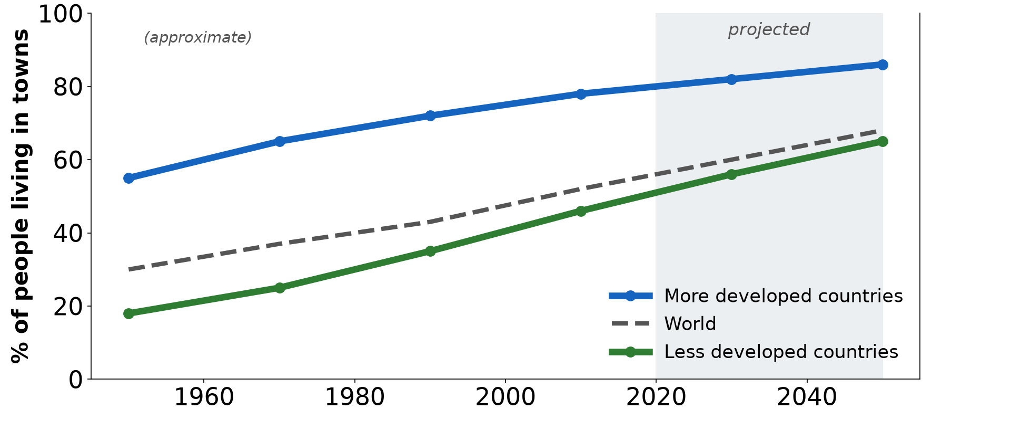
1. MEANING
Activity 1
Urban population percentage.
Notes:
Activity 1. Look carefully at this diagram: urban population percentage. Observe every detail before I ask the question.

Slide 20
1. MEANING
Activity 1: Question
What is urbanisation?
Notes:
Here is the question for Activity 1: What is urbanisation? Take one minute to think and write your answer in your rough notebook.

Slide 21
1. MEANING
Activity 1: Answer
The increase in the proportion of people living in towns.
Notes:
Let us check the answer together. The increase in the proportion of people living in towns.

Slide 22
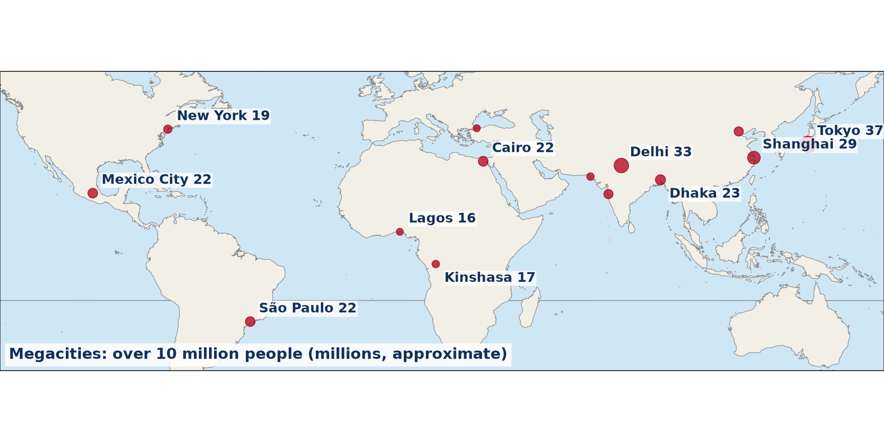
1. WORLD TREND
Activity 2
Megacities.
Notes:
Activity 2. Look carefully at this diagram: megacities. Observe every detail before I ask the question.

Slide 23
1. WORLD TREND
Activity 2: Question
Describe the world trend of urbanisation.
Notes:
Here is the question for Activity 2: Describe the world trend of urbanisation. Take one minute to think and write your answer in your rough notebook.

Slide 24
1. WORLD TREND
Activity 2: Answer
More than half of the world lives in towns, and growth is fastest in LICs.
Notes:
Let us check the answer together. More than half of the world lives in towns, and growth is fastest in LICs.

Slide 25

2. FACTORS: MIGRATION
Activity 3
Arrivals at a bus station.
Notes:
Activity 3. Look carefully at this picture: arrivals at a bus station. Observe every detail before I ask the question.

Slide 26
2. FACTORS: MIGRATION
Activity 3: Question
How does migration cause urbanisation?
Notes:
Here is the question for Activity 3: How does migration cause urbanisation? Take one minute to think and write your answer in your rough notebook.

Slide 27
2. FACTORS: MIGRATION
Activity 3: Answer
Rural people move to towns for jobs and services.
Notes:
Let us check the answer together. Rural people move to towns for jobs and services.

Slide 28

2. FACTORS: NATURAL INCREASE
Activity 4
Children in town.
Notes:
Activity 4. Look carefully at this picture: children in town. Observe every detail before I ask the question.

Slide 29
2. FACTORS: NATURAL INCREASE
Activity 4: Question
How does natural increase cause urbanisation?
Notes:
Here is the question for Activity 4: How does natural increase cause urbanisation? Take one minute to think and write your answer in your rough notebook.

Slide 30
2. FACTORS: NATURAL INCREASE
Activity 4: Answer
Young migrants have many children in towns.
Notes:
Let us check the answer together. Young migrants have many children in towns.

Slide 31

2. FACTORS: ECONOMIC
Activity 5
Yaoundé.
Notes:
Activity 5. Look carefully at this picture: yaoundé. Observe every detail before I ask the question.

Slide 32
2. FACTORS: ECONOMIC
Activity 5: Question
Give two economic factors of urbanisation.
Notes:
Here is the question for Activity 5: Give two economic factors of urbanisation. Take one minute to think and write your answer in your rough notebook.

Slide 33
2. FACTORS: ECONOMIC
Activity 5: Answer
Industrialisation and administrative and commercial jobs in towns.
Notes:
Let us check the answer together. Industrialisation and administrative and commercial jobs in towns.

Slide 34
BOARD SUMMARY
Board Summary
Topic: The Development of Settlements and their Implications
Sub-topic: Urban Settlements and their Spheres of Influence
Lesson 47: Urbanisation
Notes:
Now we are going to copy the board summary. Write the title and the headings neatly in your notebooks. I will give you enough time for each slide, so do not rush.

Slide 35
BOARD SUMMARY
DEFINITIONS
The key terms of this lesson are defined as follows:
Urbanisation: It is the increase in the proportion of people living in towns.
Notes:
Let us copy the definitions. The key terms of this lesson are defined as follows. On this slide we have Urbanisation. Write each point on a new line, with the key term first, and explain it in your own words when we revise.

Slide 36
BOARD SUMMARY
1. Trend of Urbanisation
Urbanisation evolves as follows:
World: More than half of the world population lives in towns.
LICs: Towns grow fastest in Africa and Asia.
Cameroon: More than half of Cameroonians now live in towns.
Notes:
Let us copy Trend of Urbanisation. Urbanisation evolves as follows. On this slide we have World, LICs and Cameroon. Write each point on a new line, with the key term first, and explain it in your own words when we revise.

Slide 37
BOARD SUMMARY
1. Trend of Urbanisation
Illustration: urban population percentage
Notes:
Now draw this illustration in your notebook: urban population percentage. Give it a title and label it clearly.

Slide 38
BOARD SUMMARY
2. Factors Influencing Urbanisation
Urbanisation is caused by the following factors:
Rural-urban migration: People move from villages to towns for jobs and services.
Natural increase: Young urban populations have many births.
Notes:
Let us copy Factors Influencing Urbanisation. Urbanisation is caused by the following factors. On this slide we have Rural-urban migration and Natural increase. Write each point on a new line, with the key term first, and explain it in your own words when we revise. When you finish, we go to the next slide.

Slide 39
BOARD SUMMARY
2. Factors Influencing Urbanisation (continued)
Economic factors: Industries, trade and administration create jobs in towns.
Social factors: Schools, hospitals and modern life attract people.
Notes:
We continue with Factors Influencing Urbanisation. On this slide we have Economic factors and Social factors. Write each point on a new line, with the key term first, and explain it in your own words when we revise.

Slide 40
FORMATIVE EVALUATION
Evaluation 1
Define urbanisation.
Notes:
Now let us check what you have understood. Question 1: Define urbanisation. Answer in your exercise book.

Slide 41
FORMATIVE EVALUATION
Expected Answer
The increase in the proportion of people living in towns.
Notes:
The expected answer is: the increase in the proportion of people living in towns. If you got it right, well done.

Slide 42
FORMATIVE EVALUATION
Evaluation 2
Give two factors of urbanisation.
Notes:
Now let us check what you have understood. Question 2: Give two factors of urbanisation. Answer in your exercise book.

Slide 43
FORMATIVE EVALUATION
Expected Answer
Rural-urban migration and industrialisation.
Notes:
The expected answer is: rural-urban migration and industrialisation. If you got it right, well done.

Slide 44
REMEDIATION
Remediation
Fill in the blanks:
The growth of the urban share of population is ______.
Movement from village to town is rural-urban ______.
The largest city of Cameroon is ______.
Notes:
For those who need more practice, fill in the blanks in your exercise book. The answers are: number 1, urbanisation; number 2, migration; number 3, Douala.

Slide 45
HOMEWORK
Homework
Explain three reasons for the rapid growth of Garoua.
Notes:
For your homework: Explain three reasons for the rapid growth of Garoua. We shall correct it at the beginning of our next lesson.

Slide 46
NEXT LESSON
Next Lesson
Our next lesson will be on:
Lesson 48: Consequences of the Urbanisation Process
Notes:
Our next lesson will be on Lesson 48: Consequences of the Urbanisation Process. Thank you for your attention, and see you next time.

Slide 47
BILINGUAL GAME
Bilingual Game (Jeu Bilingue)
English | Français
Urbanisation | L'urbanisation
Urban growth | La croissance urbaine
Migrant | Le migrant
Job | L'emploi
Proportion | La proportion
Service | Le service
Notes:
Let us play the bilingual game. I say a word in English, and you give me the French word. Then we do the reverse.

Slide 48
LOGBOOK
Official Logbook (1/2)
Module / Topic | The Development of Settlements and their Implications
Lesson Title | Lesson 47: Urbanisation
Expected Learning Outcomes | Define urbanisation. Describe the trend of urbanisation in the world. Explain the factors influencing urbanisation.
Competence | Learners are able to explain urbanisation and its factors.
Notes:
I record this information in the official logbook of the class after the lesson.

Slide 49
LOGBOOK
Official Logbook (2/2)
Matter Taught | DEFINITIONS; Trend of Urbanisation; Factors Influencing Urbanisation.
Evaluation | Formative evaluation and remediation exercise.
Homework | Explain three reasons for the rapid growth of Garoua.
Enrolment / Present / Absent | ____ / ____ / ____
Achievement | To be completed after the lesson.
Notes:
I complete the second page of the logbook: the matter taught, the evaluation, the homework and the attendance.

Slide 50
TEACHER'S NOTE
Teacher's Note
Timing: Homework correction, plan, objectives 8 min | Recall, situation, action 10 min | 5 activities 30 min | Board summary (copying) 30 min | Evaluation, remediation 10 min | Homework, next lesson 5 min | Logbook 7 min
Without the projector (Activity 1): define.
Without the projector (Activity 2): discuss.
Without the projector (Activity 3): discuss.
Without the projector (Activity 4): discuss.
Without the projector (Activity 5): discuss.
Notes:
This slide is for me, the teacher: it gives the timing of the lesson and what to do if the projector is not available.

Slide 51
REFERENCES
References
Geography Syllabus, Forms I–V, MINESEC (2023) — Form 5, Module III: Management of Population Growth and Space Colonisation.
Photo, Activity 3: “Wadi Halfa Bus Station” by D-Stanley, CC BY 2.0, via Flickr (https://www.flickr.com/photos/79721788@N00/8651154444)
Photo, Activity 4: “African school children” by World Resources, CC BY-NC-SA 2.0, via Flickr (https://www.flickr.com/photos/26107309@N05/2658469563)
Photo, Activity 5: “Yaoundé” by wili_hybrid, CC BY-NC 2.0, via Flickr (https://www.flickr.com/photos/62223880@N00/5677034246)
Diagrams and animations: drawn for this lesson (Geography Department).
Notes:
These are the references and picture credits used to prepare this lesson.

